Slide 1
AV343 Communication Systems Lab: 1
Simulation of a Baseband Communication System
NAME – PRAKHAR GUPTA
STUDENT CODE – SC19B114
B-Tech Electronics & Communication Engg. (SEMESTER VI)

Slide 2
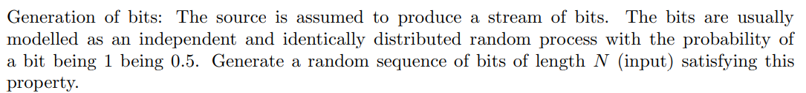
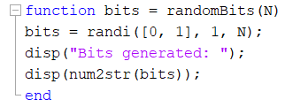


CODE
OUTPUT

Slide 3
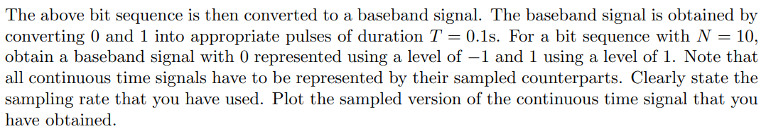
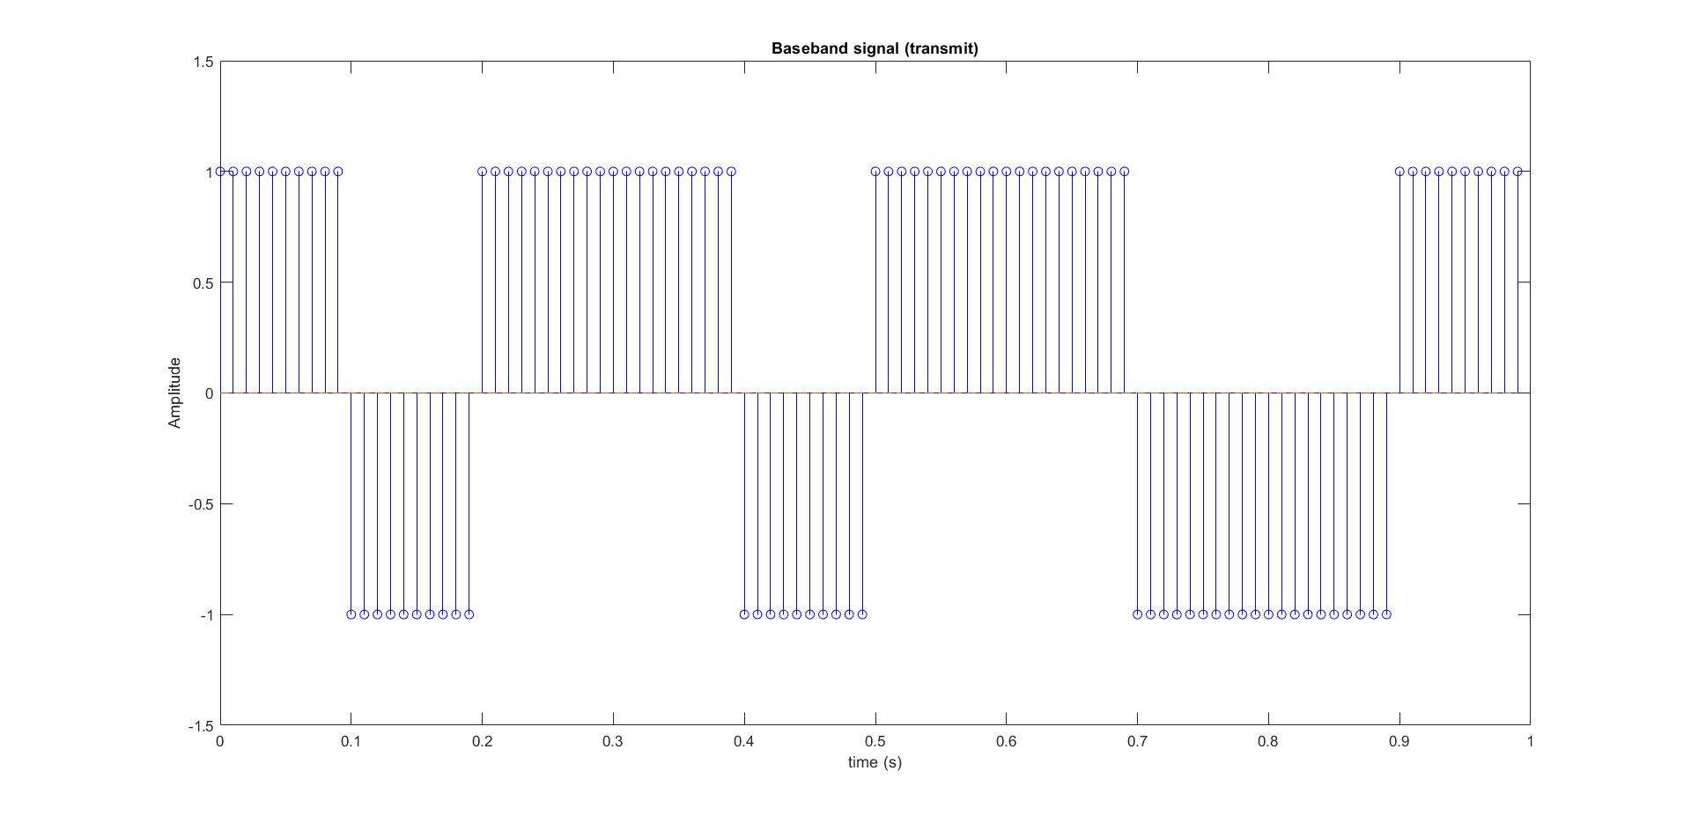

Slide 4
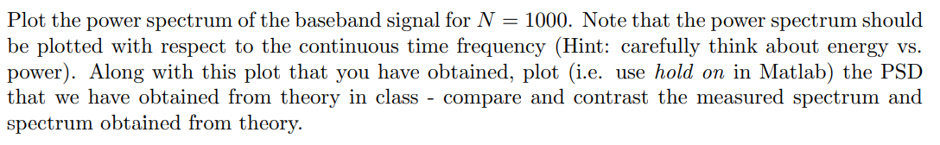
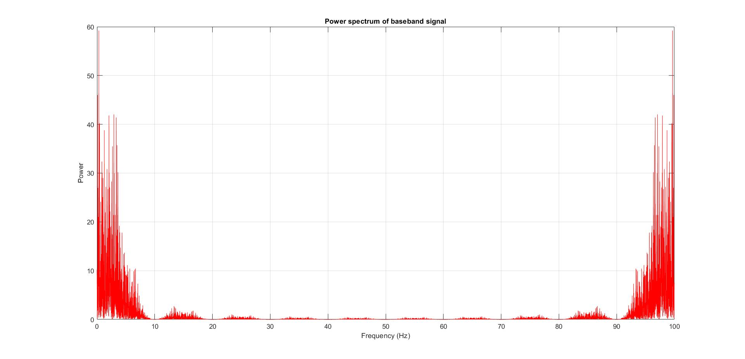

Slide 5
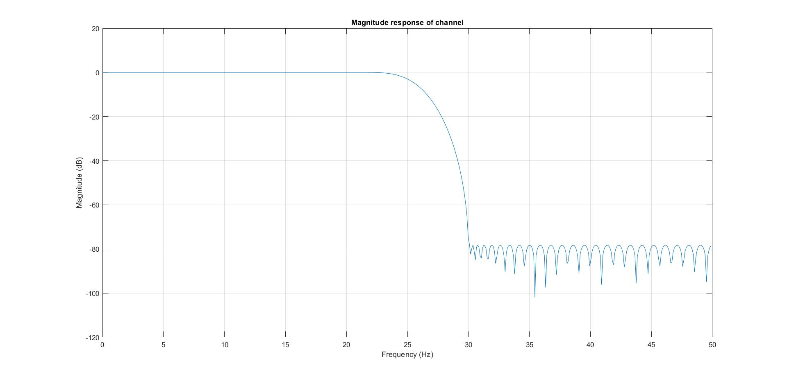

Slide 6
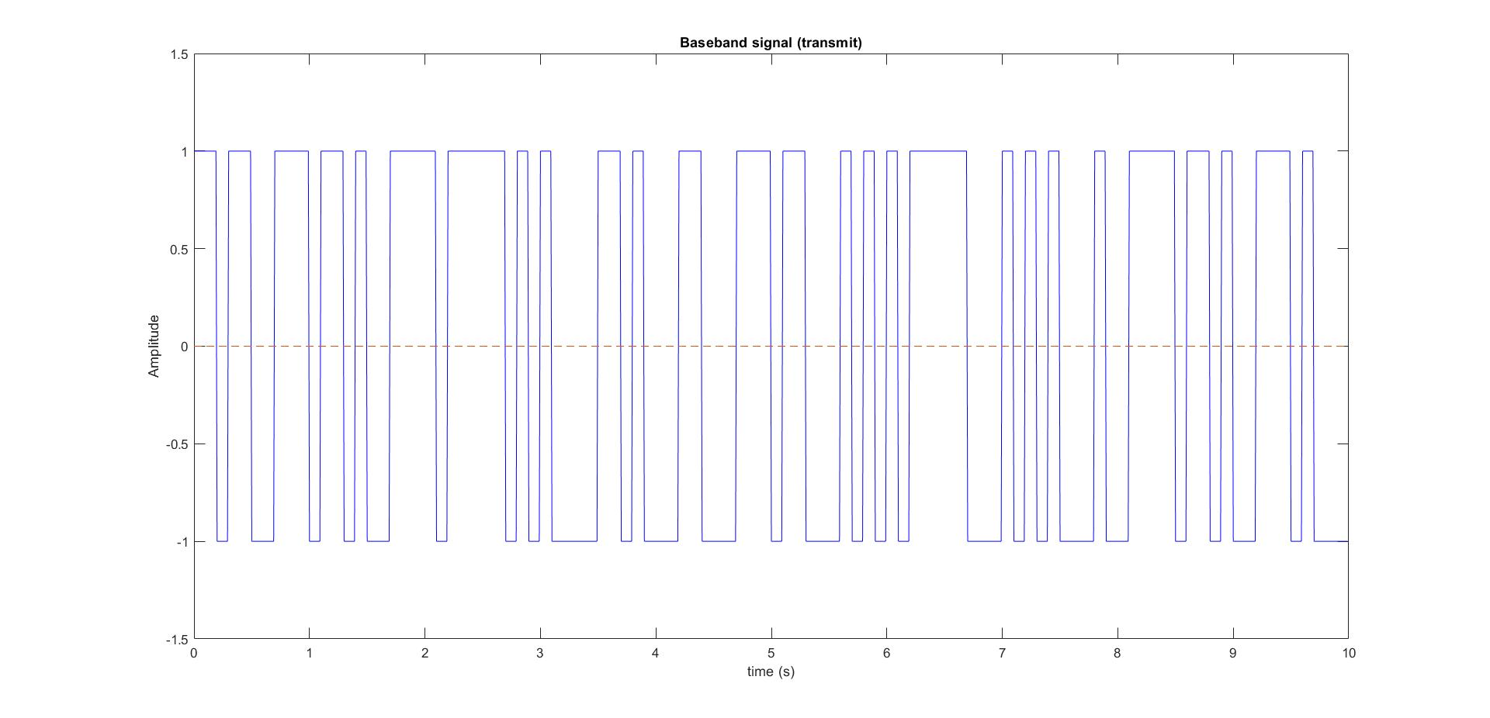
Signal input to channel

Slide 7
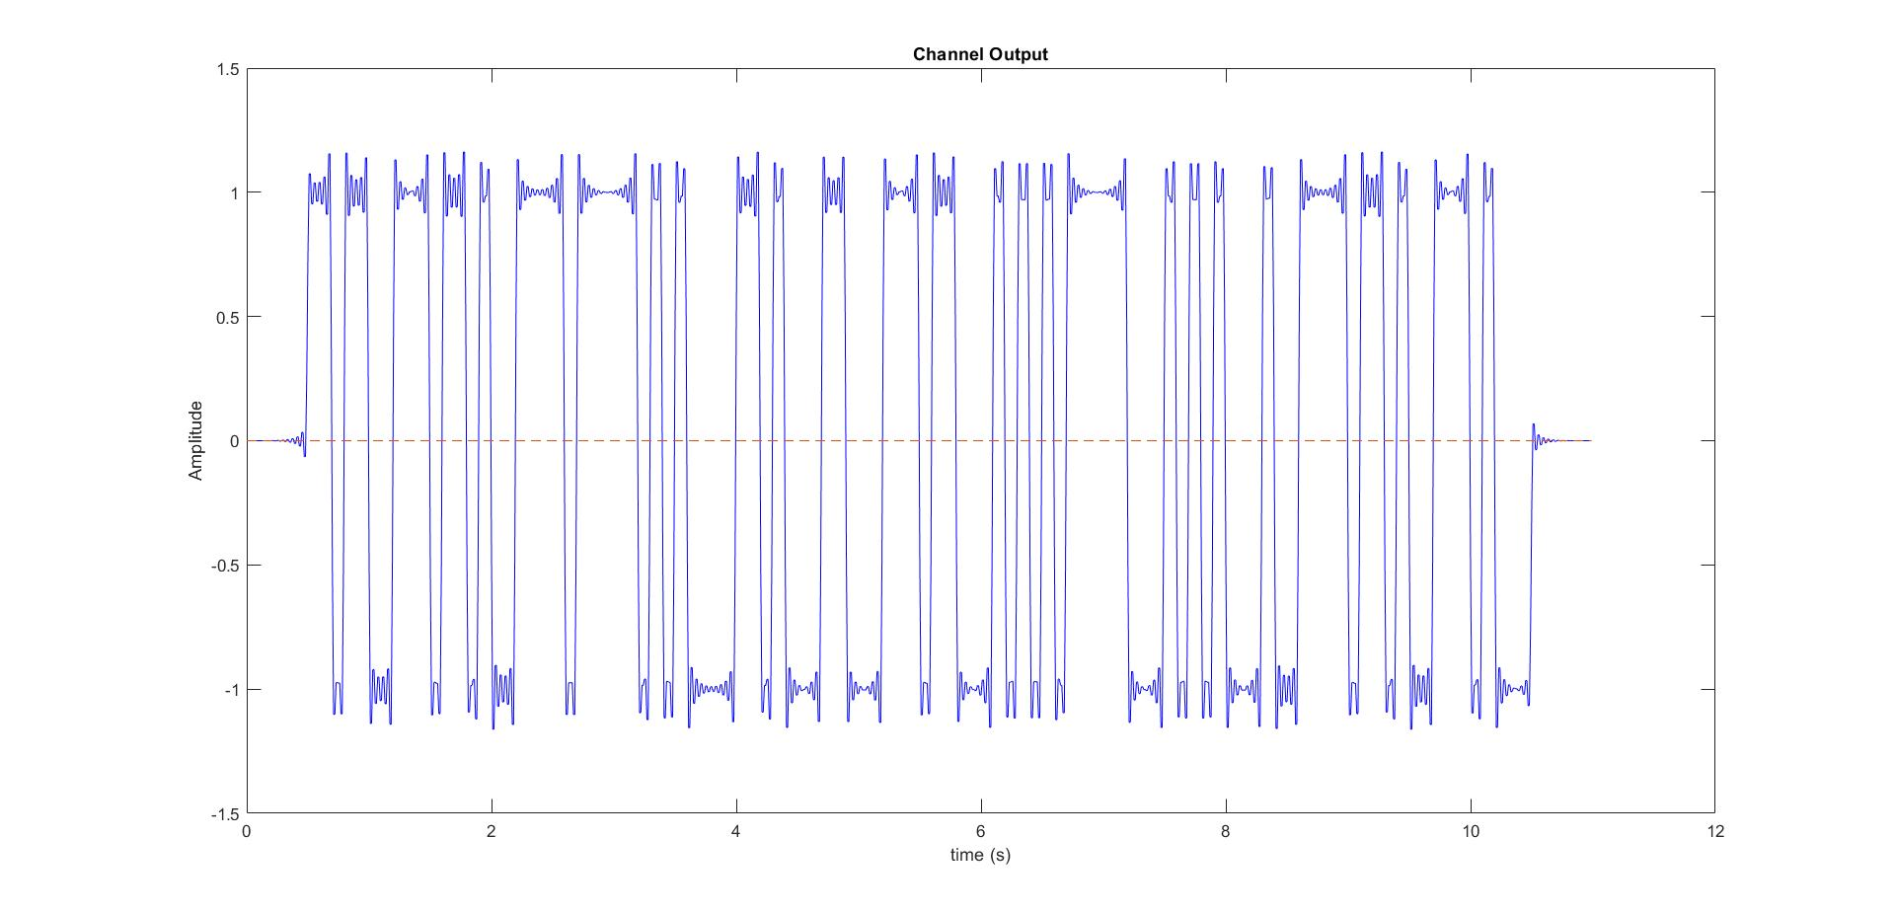
Signal output from channel

Slide 8

Filter specifications:
Passband frequency = 20 Hz
Stopband frequency = 30 Hz
Passband gain = 0 dB
Stopband attenuation ~ 80 dB
Reasons for the specification choice:
Having stopband frequency smaller than the channel cut-off would remove the smaller frequency components of the transmitted signal. Also, keeping passband edge greater than channel cut-off would only invite noise in a practical scenario.

Slide 9
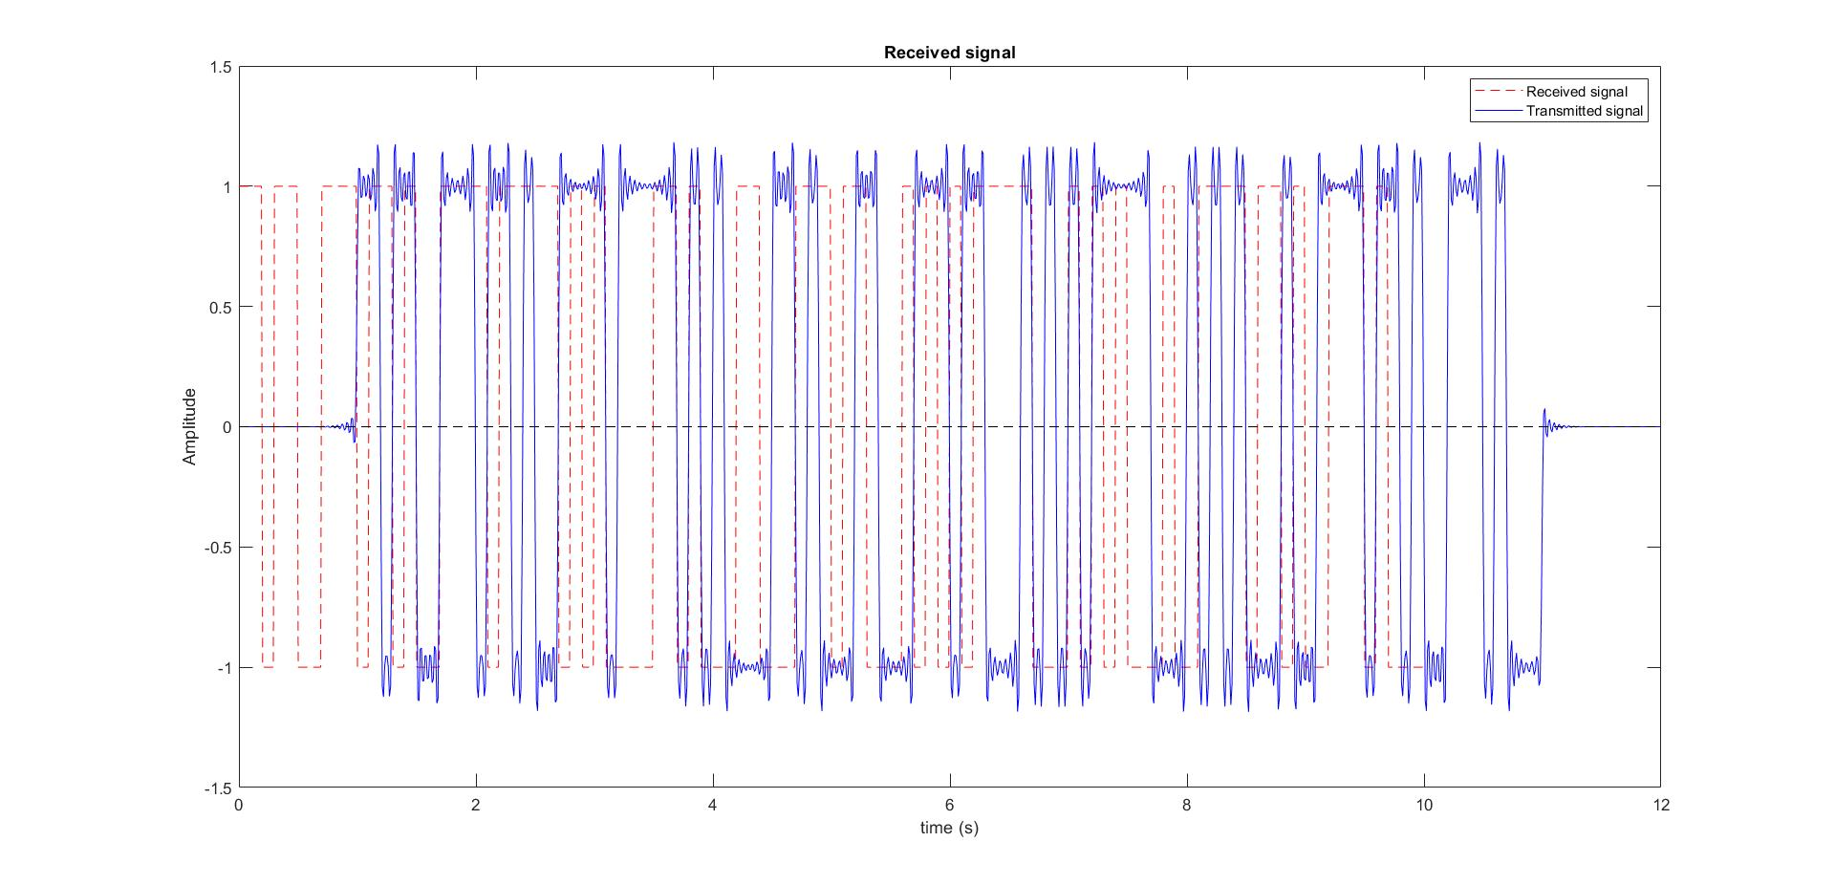

Slide 10
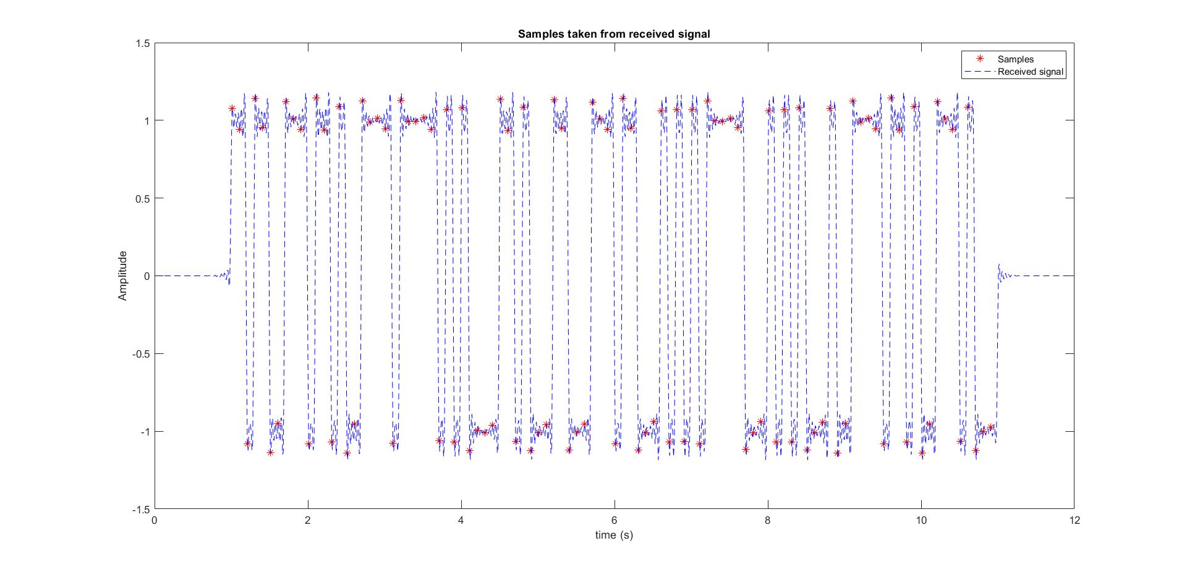

Slide 11


CODE
OUTPUT
Number of error bits = 0

Slide 12
Result
A digital baseband communication system was simulated in MATLAB assuming perfect frame and symbol synchronization.

