Slide 1

AV343 Communication Systems Lab: 2
Indian Institute of Space science and Technology
Bandlimited channels and inter-symbol interference
NAME – PRAKHAR GUPTA
STUDENT CODE – SC19B114
B-Tech Electronics & Communication Engineering (SEMESTER VI)

Slide 2
Baseband channel modelling

Slide 3
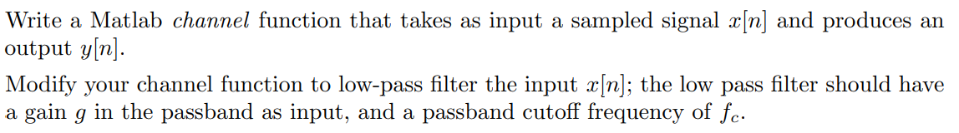
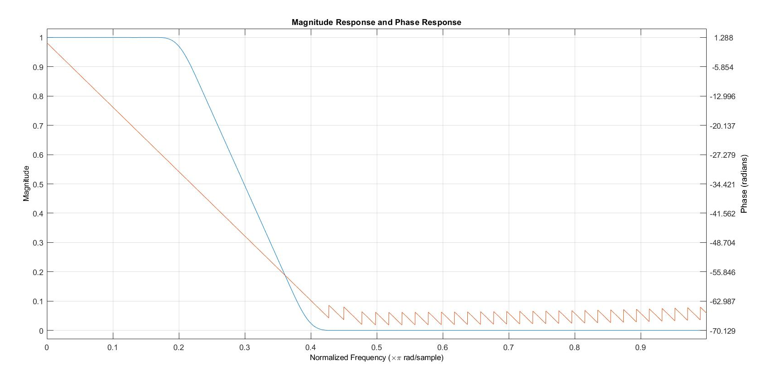
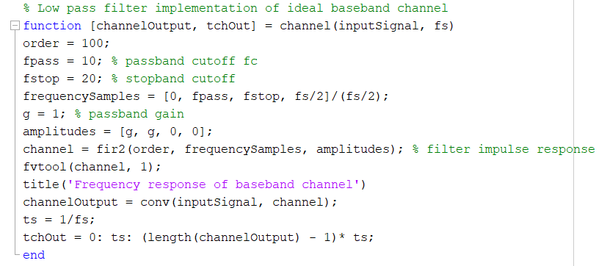
CODE
OUTPUT

Slide 4
Inter-symbol interference baseband channels

Slide 5
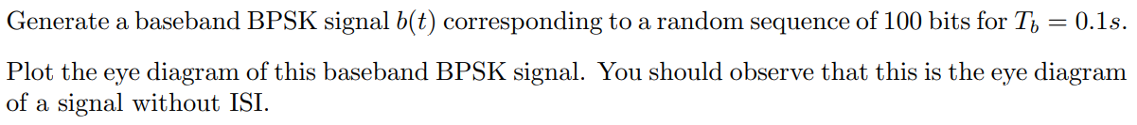
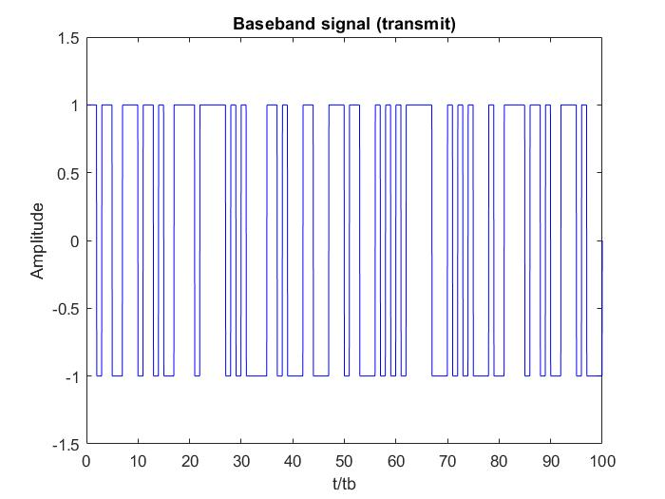
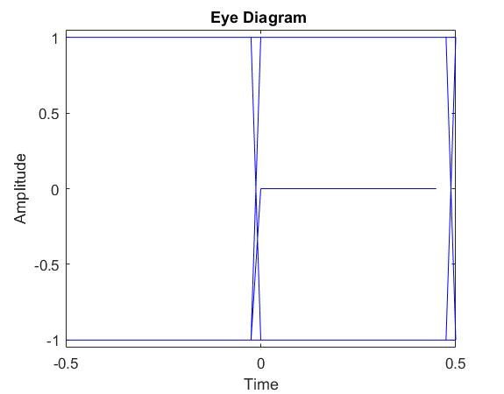
Baseband BPSK signal b(t)
As there is neither amplitude distortion nor jitter in the eye diagram, it is inferred that there is no ISI in the system.

Slide 6
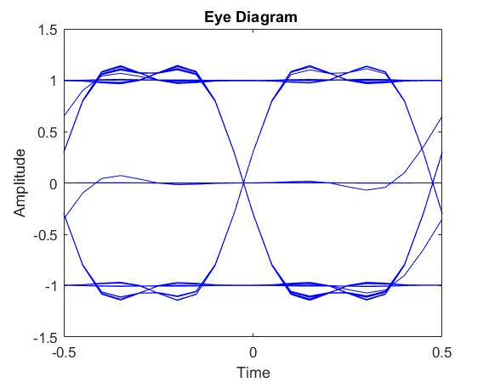
Observations
ISI effects clearly visible due to amplitude distortion at all points of a pulse.
Lower noise margin.
Finite jitter at the middle of a pulse.
High timing sensitivity near the end of a pulse.
Insignificant jitter effects at the end of a pulse.
Reduced effective eye-opening.
Eye diagram of channel output

Slide 7
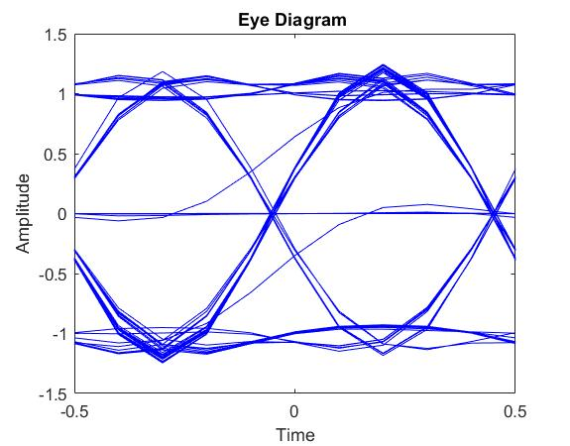
Observations
Increased peak distortion.
Reduced noise margin.
Timing/synchronization jitter at the end of a pulse.
Similar timing sensitivity at the end of a pulse.
Reduced effective eye-opening.
Tb = 0.05 corresponds to double the signal frequency. As channel has cut-off still at 10 Hz, higher frequency components of the signal are cut-off resulting in spreading of the signal and hence greater ISI.
Eye diagram for Tb = 0.05

Slide 8
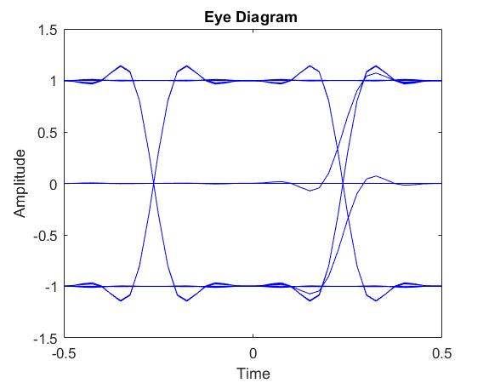
Observations
Lower peak distortion.
Greater noise margin.
Negligible jitter at the end of a pulse.
Larger timing sensitivity at the end of a pulse.
Larger effective eye-opening.
Tb = 0.2 corresponds to half the signal frequency. As channel has cut-off still at 10 Hz, higher frequency components of the signal are not cut-off resulting in lesser spreading of the signal and hence lower ISI.
Eye diagram for Tb = 0.05

Slide 9
Can’t comment. We haven’t studied it yet.

Slide 10
Pulse shaping

Slide 11
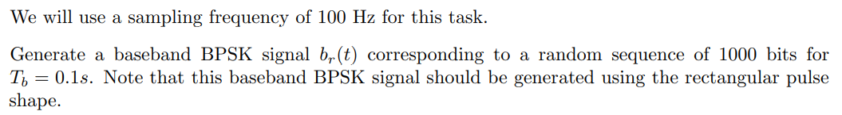
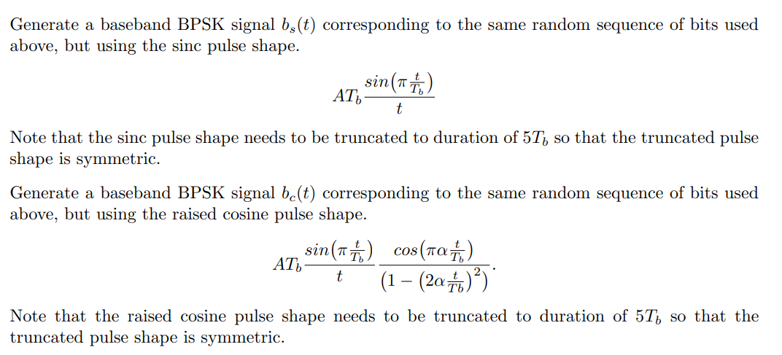
Graphs in the next slide…

Slide 12
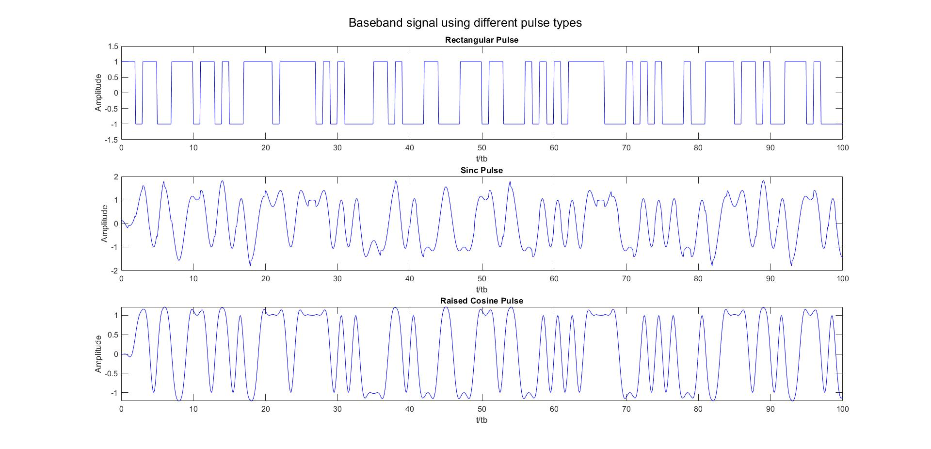
Baseband signals
Baseband signals made from different pulse shapes are shown.
Only first 100 pulses are shown for clarity.

Slide 13
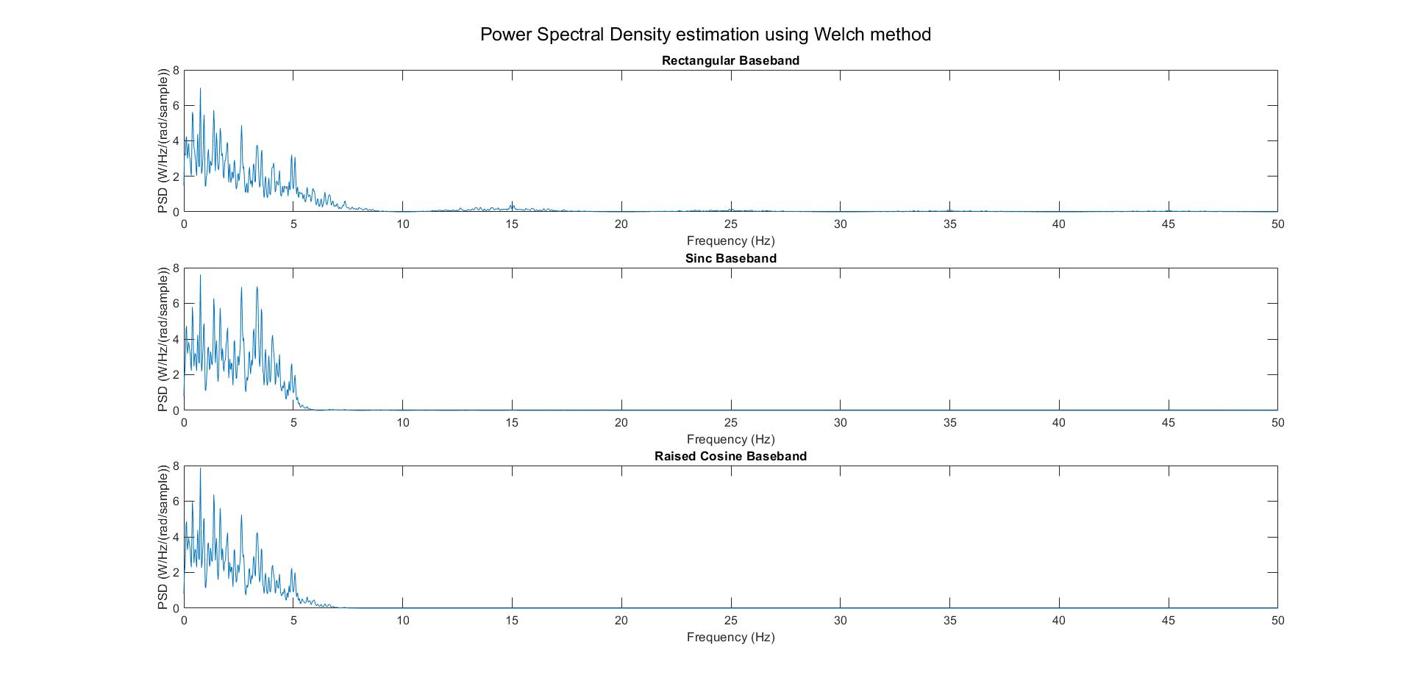
Observations
Rectangular signal occupies greater bandwidth as the graph has non zero points near 15 Hz, which is absent in the other 2 cases.
Sinc signal has greater power at many frequencies as compared to other 2 cases. Also, it occupies the least bandwidth.
Raised cosine signal has lesser bandwidth than that of rectangular but more than that of sinc signal.

Slide 14
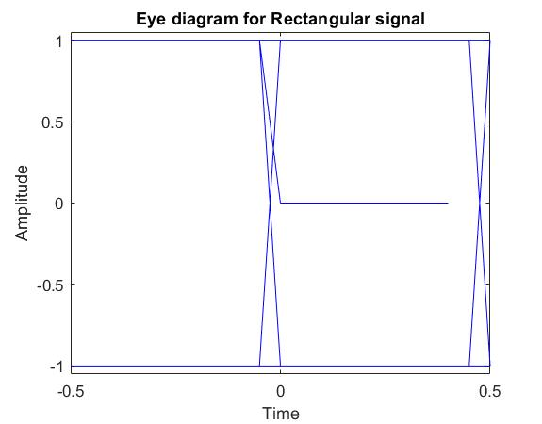
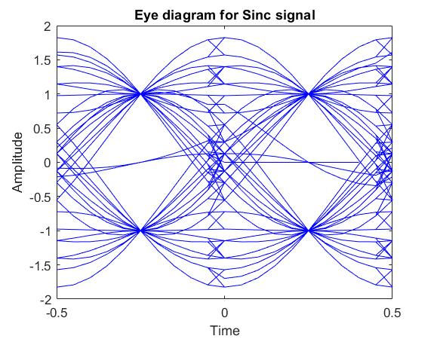
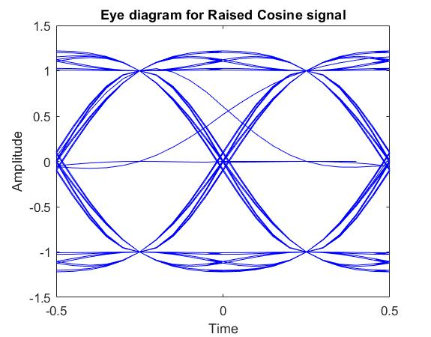
Feature | Rectangular | Sinc | Raised Cosine
Zero-crossing jitter (for extracting clock) | Negligible | Very High | Significant
Amplitude Distortion | Negligible | High | Medium
Common feature: All of them have negligible amplitude distortion at the middle of a pulse, and hence a larger noise margin there. Also, rectangular has the largest eye opening, followed by raised cosine and sinc.

Slide 15
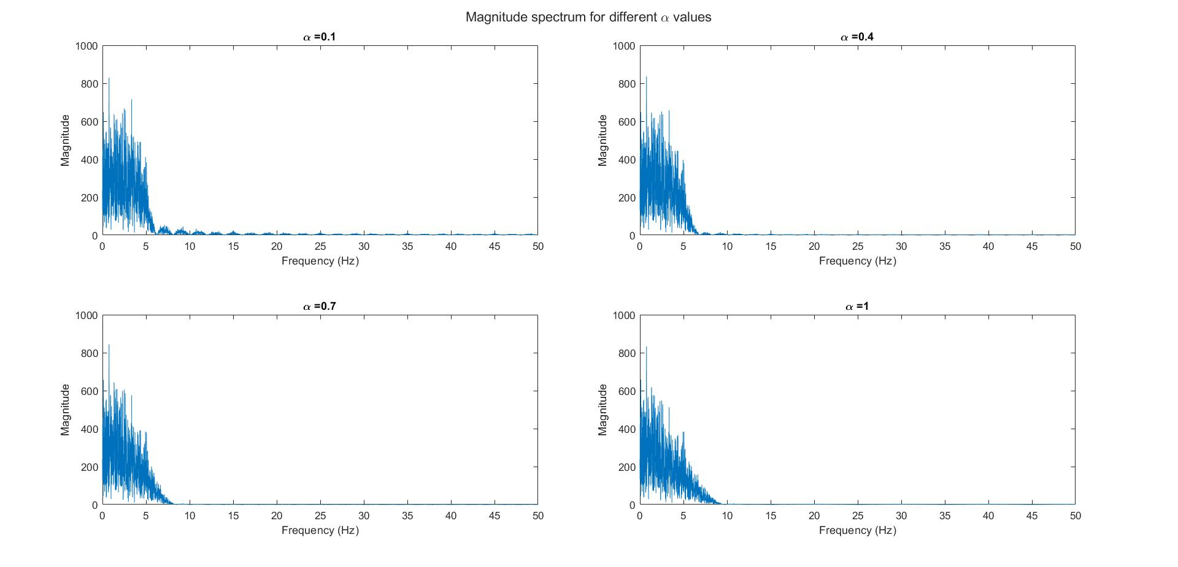
It is observed that as α increases,
The ripples go away
Main lobe width increases e.g., from around 5 Hz in α = 0.1 to around 10 Hz in α = 1.

Slide 16
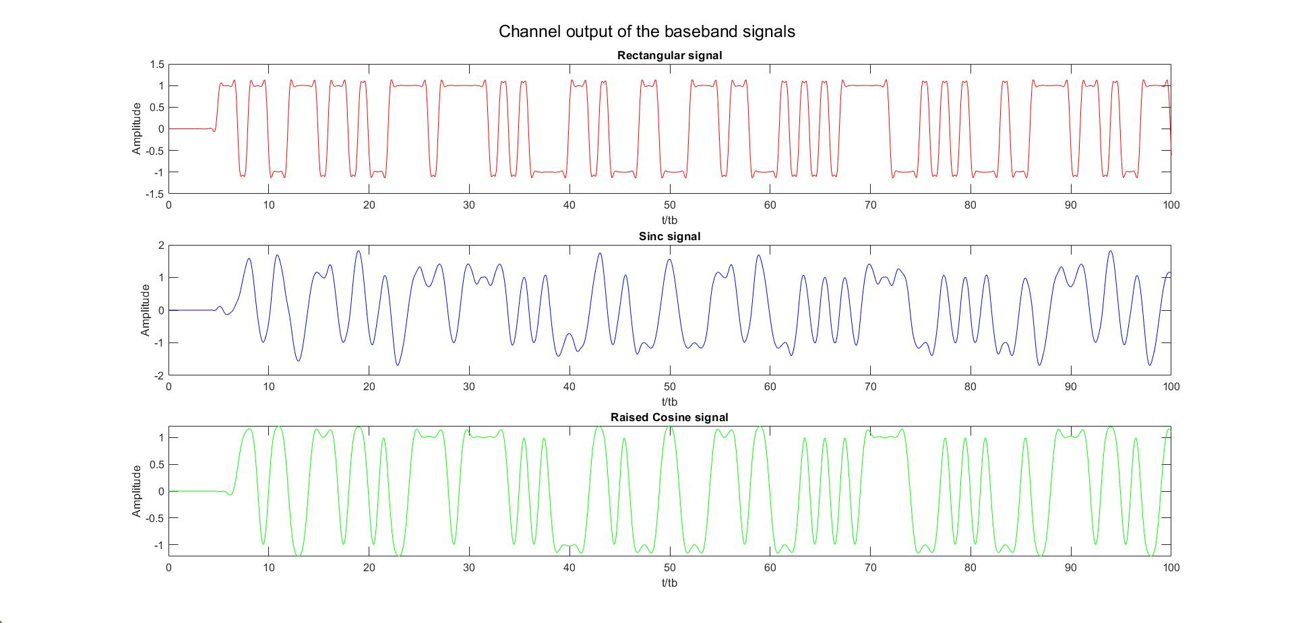

Slide 17
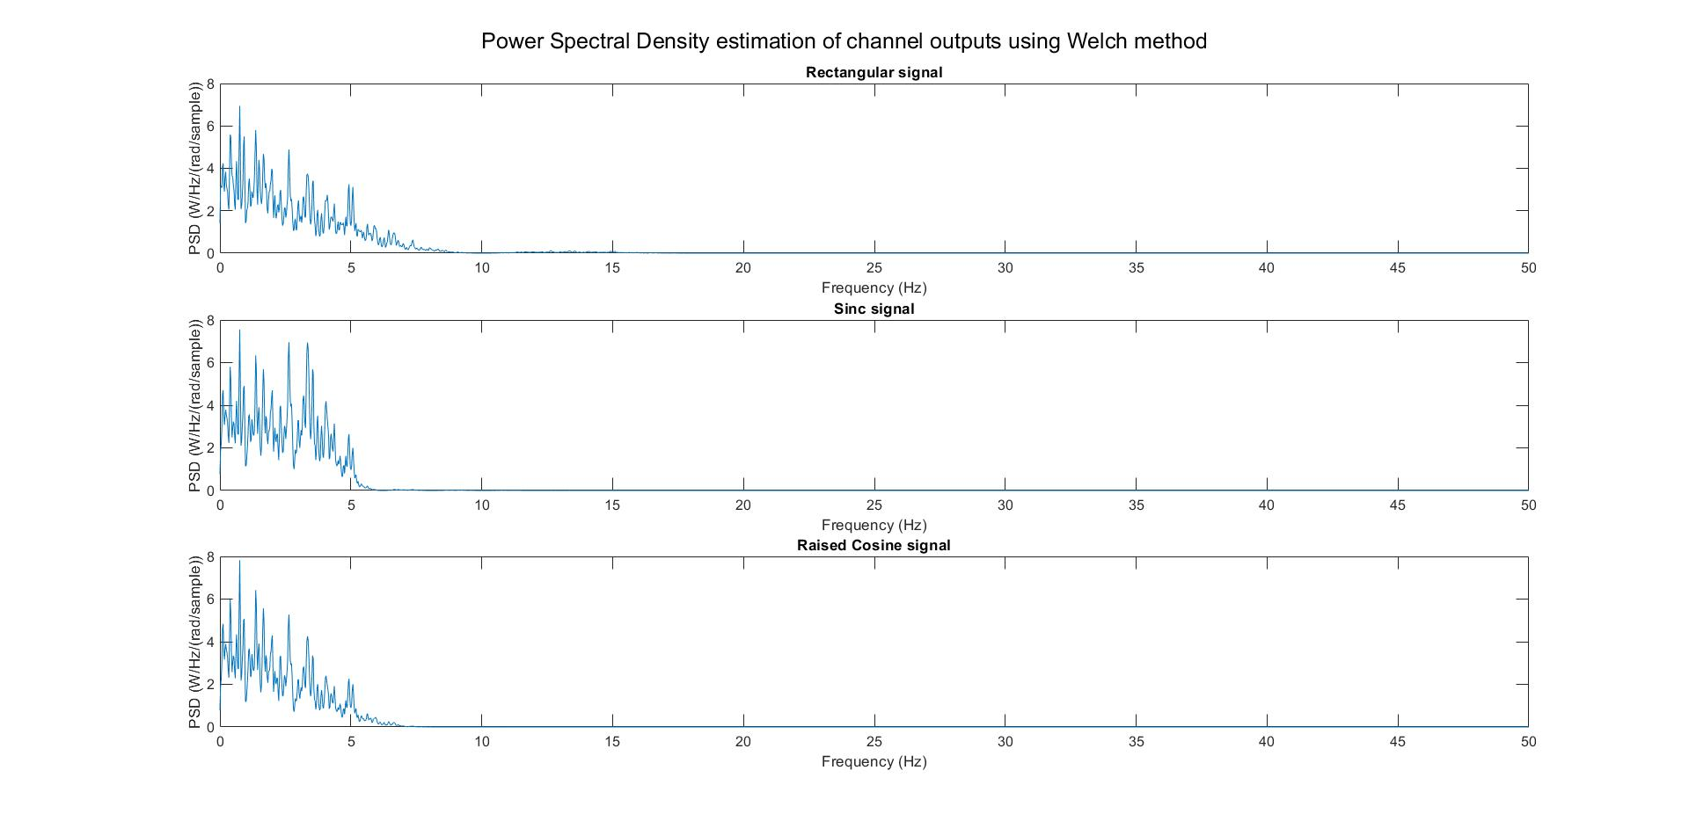
Case 1:
Tb = 0.1
Observations
Rectangular signal has the largest bandwidth followed by raised cosine and sinc finally.
Sinc signal has greater power at many frequencies as compared to other 2 cases.
The bandlimited channel has cut-off the power around 15 Hz which was present in the transmitted rectangular signal.

Slide 18
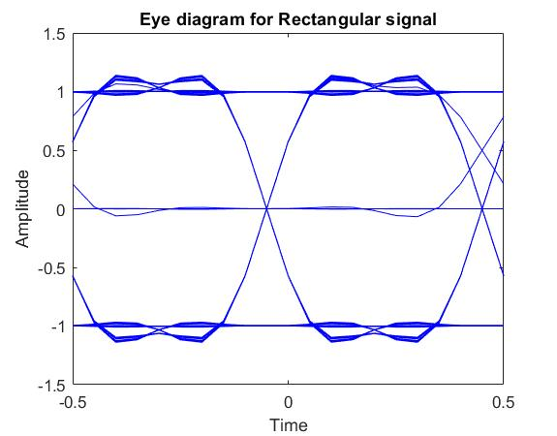
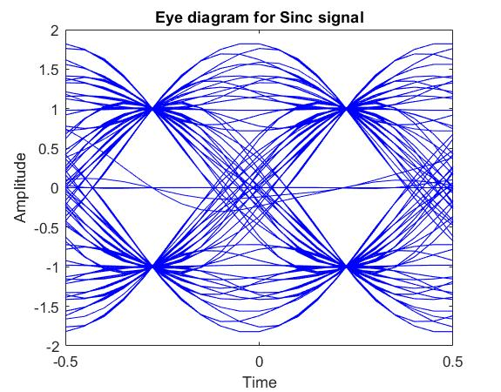
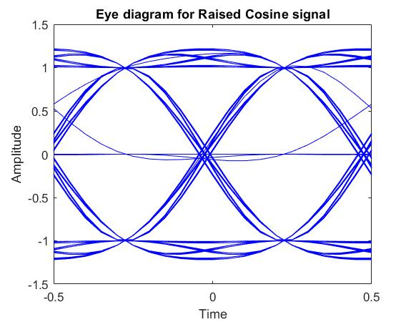
Case 1:
Tb = 0.1

Slide 19
Case 1:
Tb = 0.1
Observations
Bandlimited channel has introduced amplitude distortion in all the baseband signals.
Sinc and Raised cosine signals have negligible ISI at middle of a pulse. Rectangular baseband signal has non-zero ISI.
Timing synchronisation at sampling point (middle of pulse, since eye-opening is maximum there) has huge penalty if not done correctly for all the three signals, with rectangular having the least of it.
Sinc has the least eye-width. Rectangular has the largest eye-width.
Very difficult to do perform zero-crossing synchronization for sinc signal. The situation is much better for raised cosine and ideal for rectangular.

Slide 20
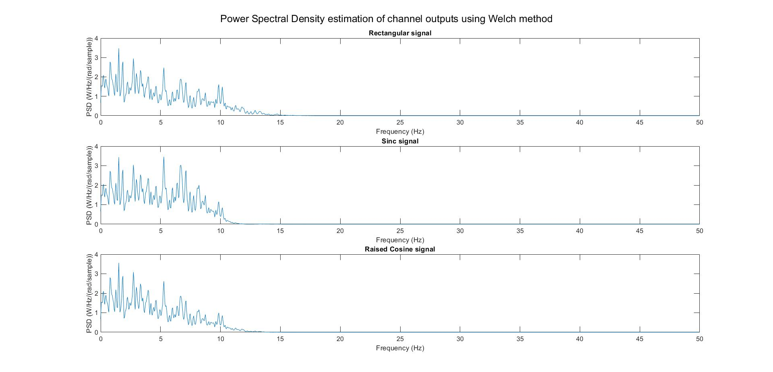
Case 2:
Tb = 0.05
Observations
Rectangular signal has the largest bandwidth followed by raised cosine and sinc finally.
Sinc signal has greater power at many frequencies as compared to other 2 cases.

Slide 21
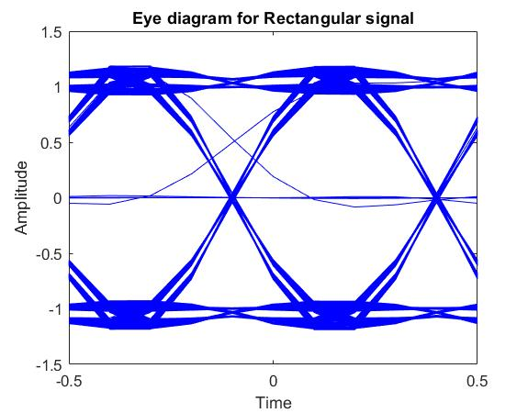
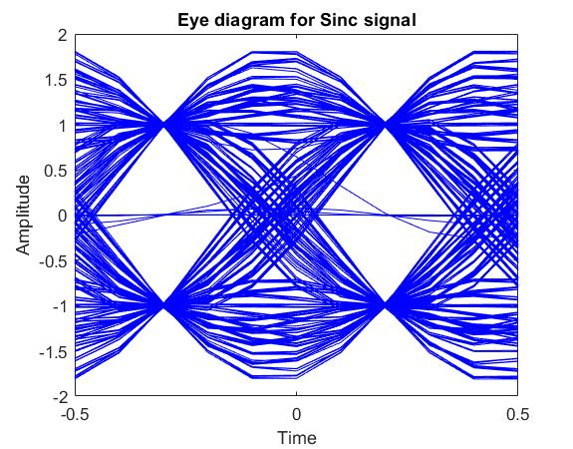
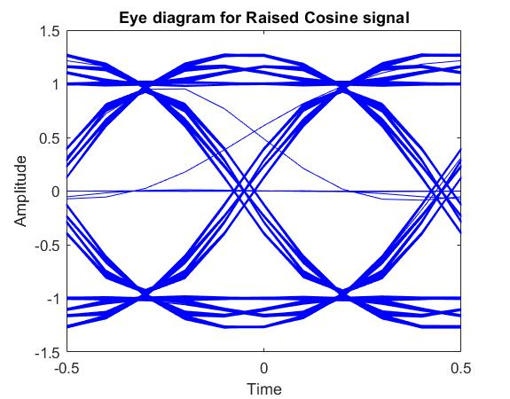
Case 2:
Tb = 0.05

Slide 22
Case 2:
Tb = 0.05
Observations
Increased amplitude distortion.
Sinc and Raised cosine now have non-zero significant ISI at the middle of a pulse.
Timing synchronisation at sampling point (middle of pulse, since eye-opening is maximum there) has huge penalty if not done correctly for all the three signals, with rectangular having the least of it.
Sinc has the least eye-width. Rectangular has the largest eye-width.
Zero-crossing synchronization has become much more difficult for sinc signal. Raised cosine and rectangular, though better, now face this synchronization issue.
The above happened due to higher frequencies in the transmitted signal and hence cut-off from the bandlimited channel having cut-off frequency same as earlier.

Slide 23
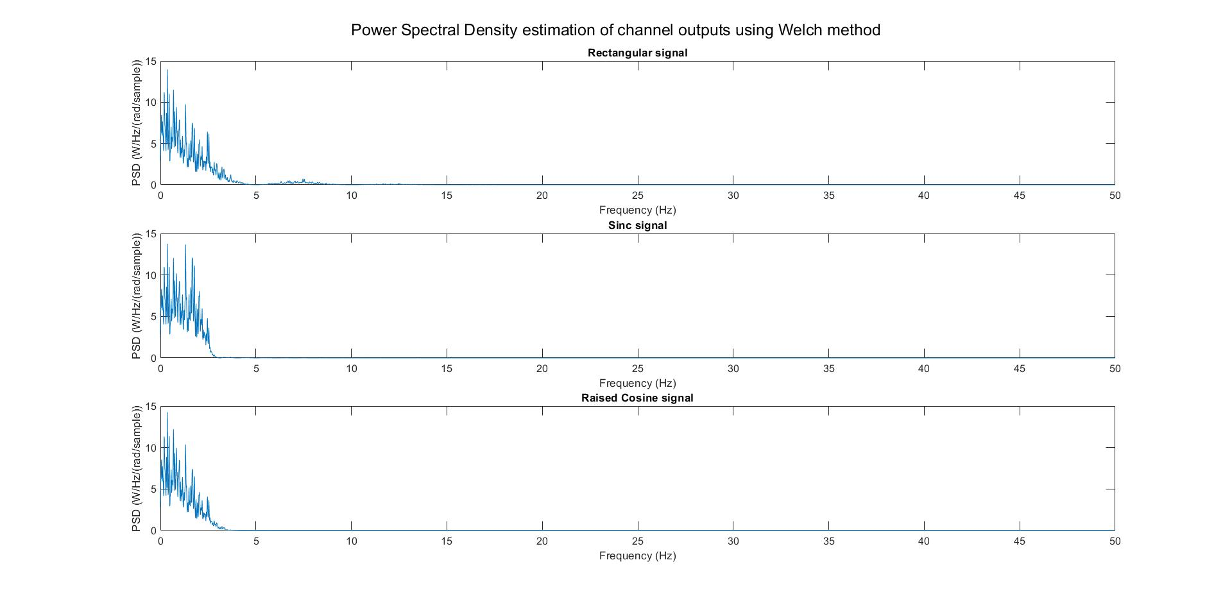
Case 3:
Tb = 0.2
Observations
Rectangular signal has the largest bandwidth followed by raised cosine and sinc finally.
Rectangular signal also has non-zero power at frequencies around 7 Hz, which is not present in the other two cases.
Sinc signal has greater power at many frequencies as compared to other 2 cases.

Slide 24
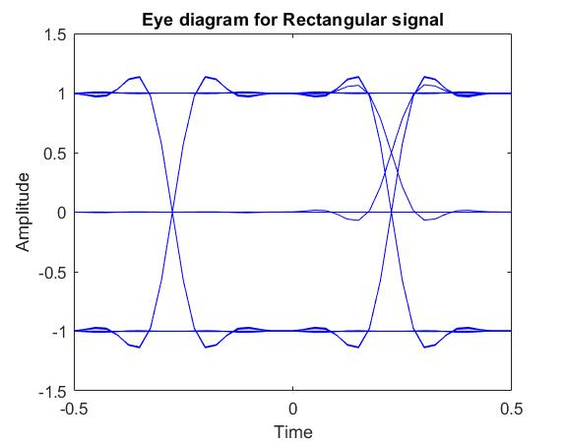
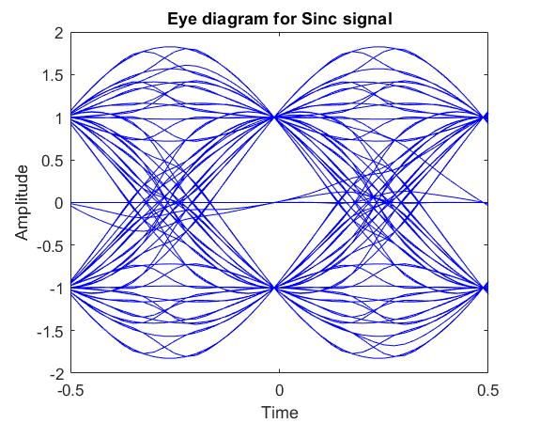
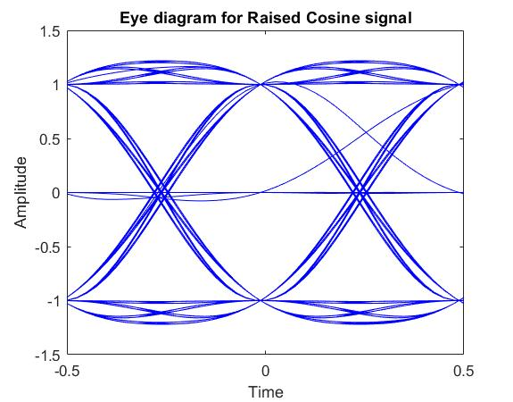
Case 3:
Tb = 0.2

Slide 25
Case 3:
Tb = 0.2
Observations
Decreased amplitude distortion.
All three signals have non-zero significant ISI at the middle of a pulse.
Timing synchronisation at sampling point (middle of pulse, since eye-opening is maximum there) has huge penalty if not done correctly for sinc signal. Raised cosine has lesser penality, with rectangular having the least of it.
Sinc has the least eye-width. Rectangular has the largest eye-width.
Zero-crossing synchronization has become comparatively easier (though still difficult) for sinc signal. The situation is much better for raised cosine and ideal for rectangular.
The above happened due to lower frequencies in the transmitted signal and hence lesser cut-off from the bandlimited channel having cut-off frequency same as earlier.

Slide 26
Result and MATLAB Codes
The effects of bandlimitedness of a baseband channel and resulting ISI were simulated in MATLAB assuming perfect frame and symbol synchronization.
MATLAB codes written for this lab work can be found here.

