Slide 1
WORDLE
PRAKHAR GUPTA - 2021300040
HARSH JAIN - 2021300048
PALAASH JAIN - 2021300050

Slide 2
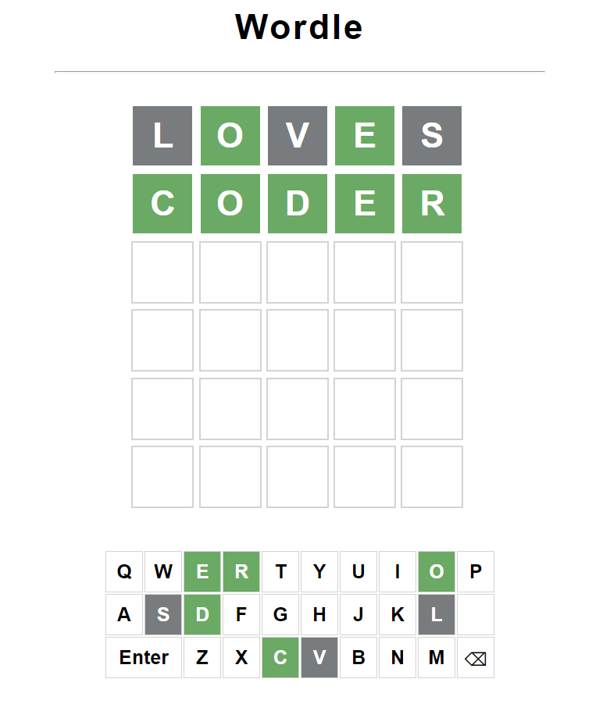
WORDLE
IT IS A MARVELOUS CREATION OF WORDLE USING TWO DATA STRUCTURE
WHERE A RANDOM WORD IS GENRATED BY THE SYSTEM
AND USER GETS 6 TRIES TO GUESS THE WORD
IF THE USER GET THE LETTER PRESENT IN THE SYSTEM GENRATED WORD IN CORRECT PLACE A GREEN COLOR SHOWS UP
IF THE USER GET THE LETTER PRESENT IN THE SYSTEM GENRATED WORD IN INCORRECT PLACE A YELLOW COLOR SHOWS UP
IF THE USER GET THE LETTER NOT PRESENT IN THE SYSTEM GENRATED WORD GREY COLOR SHOWS UP

Slide 3
DATA STRUCTURE USED
MAP
ARRAY

Slide 4
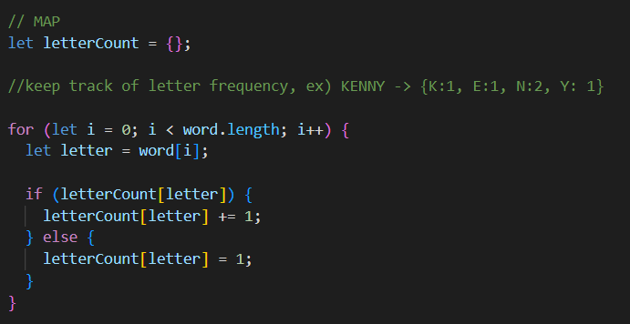
MAP
USED TO STORE THE RAMDOM WORD GENRATED
ANY NUMBER OF SIMILAR CHARECTERS PRESENT IN THE GENRATED WORD
CAN BE EASILY COUNTED

Slide 5
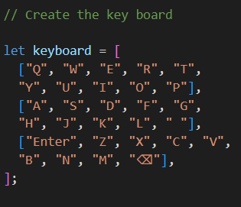
ARRAY
TO STORE THE ALL THE KEYS IN THE KEYBOAR
TO STORE THE WORD GUESSED BY THE USER

Slide 6
IMPLENMENTATION OF ALL THE FUNCTIONS USED

Slide 7
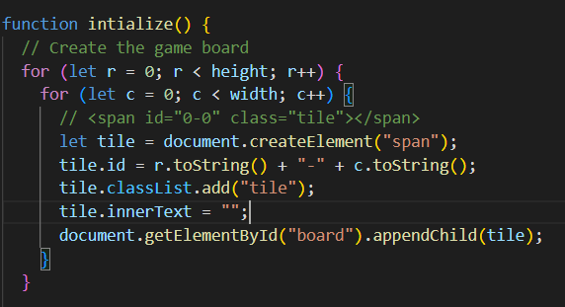
IMPLEMENTATTION
THIS CREATES THE BLANK 5X6 SPACES IN WHICH USER ENTERED WORD IS DISPLYED
AND CALLED WE GAME IS STARTED

Slide 8
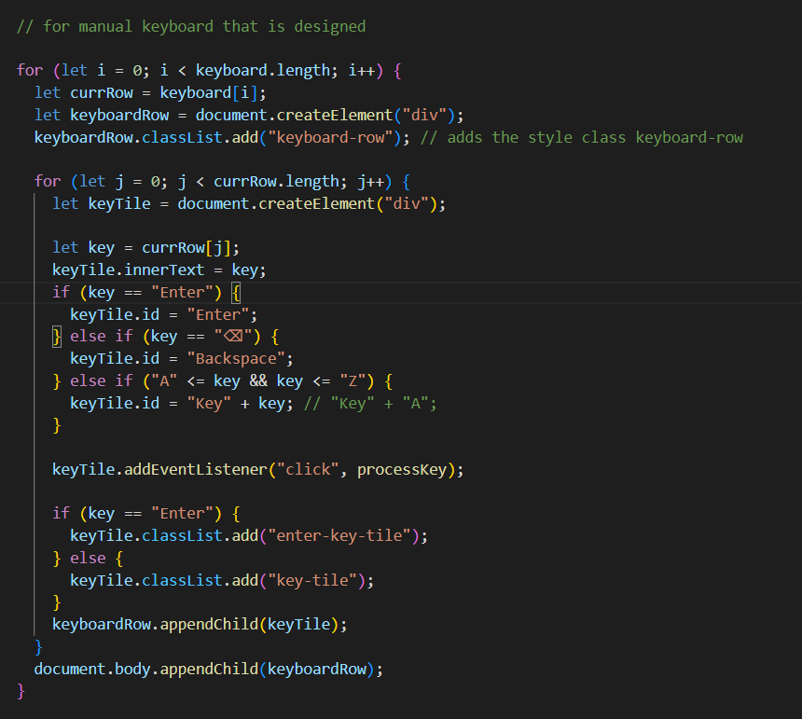
IMPLEMENTATTION
THIS ALLOWES THE USER TO USE THE KEYBOARD PROVIDED ON THE SCREEN AND DISPLAYS THE LETTER THE ARE GUESSED RIGHT OR WORNG
ALLOWES THE USER TO USE BACKSPCE AND ENTER

Slide 9
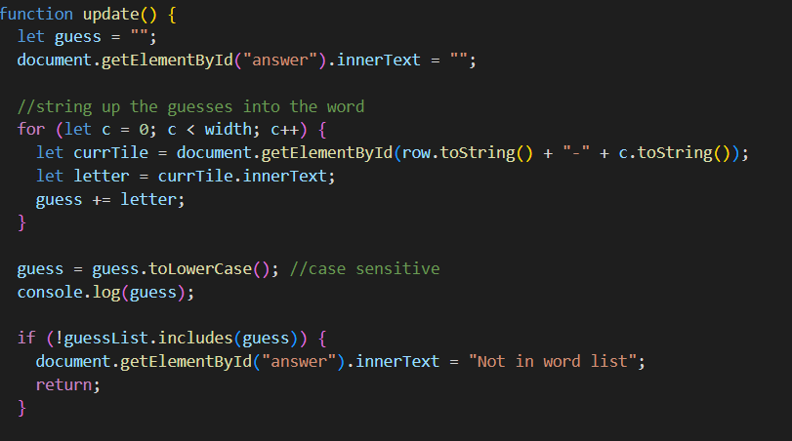
IMPLEMENTATTION
THIS FUNCTION CREATES THE STRING OF LETTER ENTERED BY THE USER AND CHECK IF THAT IS PRESENT IN THE
GUESS LIST WHICH CONTAINS ALL THE POSSIBLE 5 LETTERED WORDS

Slide 10
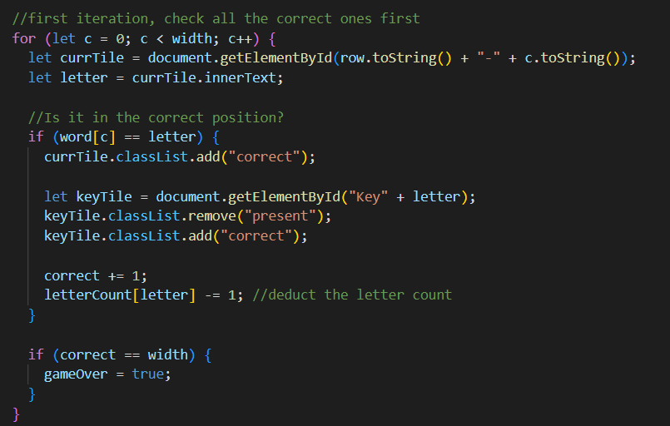
IMPLEMENTATTION
THIS FUNCTION IS USED TO MARK THE LETTERS WHICH ARE PRESENT IN SYSTEM GENRATED WORD GREEN ,YELLOW AND GREY ACCORDINLY
IF THE WIDTH IS FULL THEN GAME IS OVER

Slide 11
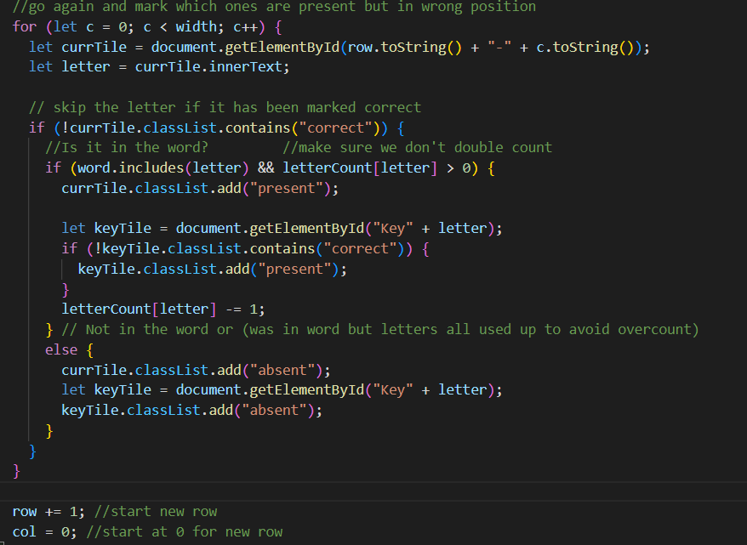
IMPLEMENTATTION
THIS FUNCTION CHECKS IF THERE IS MORE THAN ONE OCCURANCE OF THE LETTER THEN MARK THAT LETTER ACCORDINLY

Slide 12
THANK YOU
SIGNING OFF
PRAKHAR GUPTA
HARSH JAIN
PALAASH JAIN

