Slide 1
CRC TRAINING WEBSITE
MADHAV PANDEY ( 2002900100080/ CSE / B)
PRAKHAR SHARMA (2002900100107 / CSE/ B)

Slide 2
Objective
To create a user-friendly website .
To design a website for CRC department of our college.
To manage the database of all courses .
Here all the courses are provided offered by crc department.

Slide 3

Layout
We have a banner of crc department here.
Key features of crc department are present here .
Information about any new course or internship are present here.

Slide 4
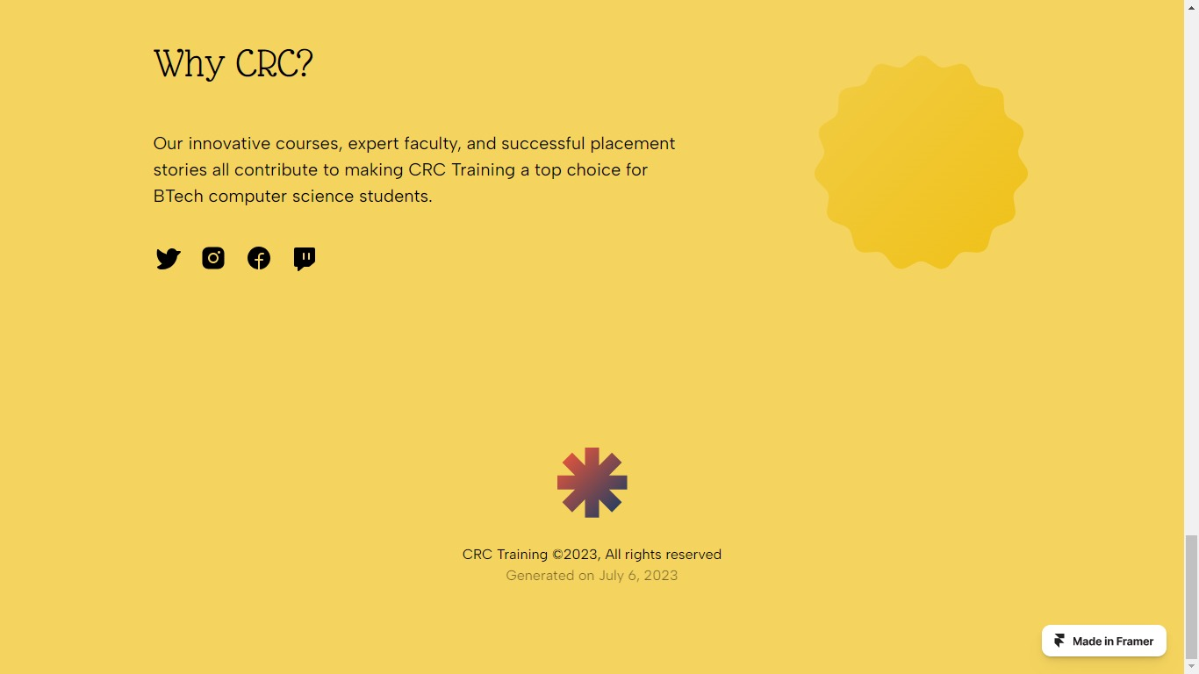
Layout

Slide 5

Layout
Details about courses are present in this part.
You can further deails abou the course by clicking on the particular course.
Each image is redirected to a new page where you can get more details about that course.

Slide 6

Layout
In this section user can explore moe courses.
By clicking on get started user will be redirected to the login page.

Slide 7
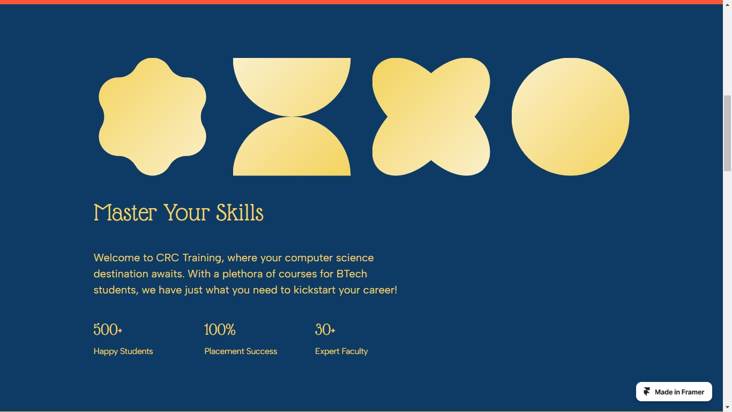
Layout

Slide 8
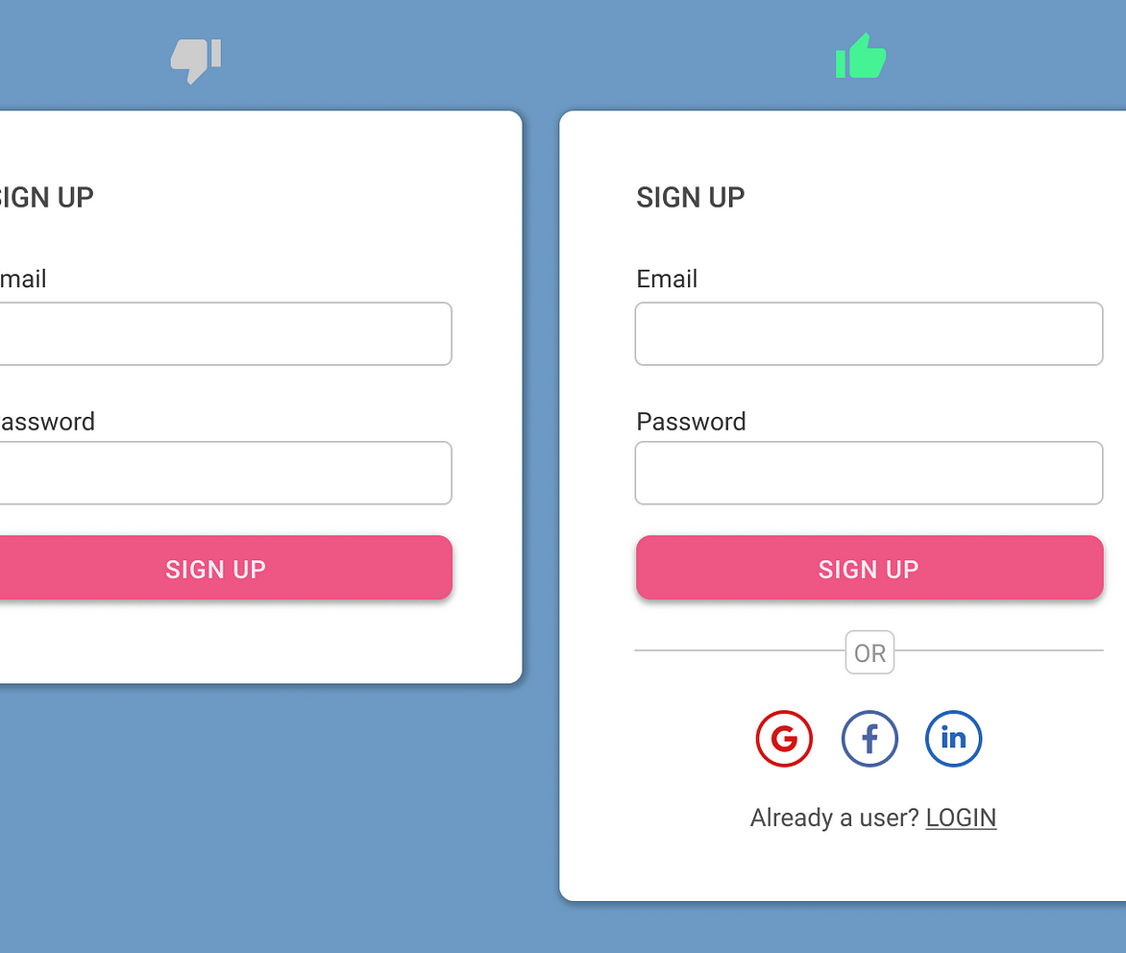
Layout
Here user need to enter the signup page.
By signing in user can check enrolled internships and courses.

Slide 9
Details about component
we used bootstrap5.o , for building responsive, with jsDelivr and a template starter page.
We used NAVBAR in the header section.
we used FOOTER in the bottom section.
We have used CARD design to reoersent popular courses.

Slide 10
Details about component
We use CAROUSEL foe the banner of the website .
Using bootstrap makes the website responsive .
User can jump on connected webpages which is possible with anchor tags .

Slide 11


