Slide 1


SIEMENS
MOBILITY
Project Manager
Job Simulation
A Virtual Job Simulation Experience Report — Powered by Forage
PRAKHAR SINGH
B.Tech — Computer Science & Engineering
Enrollment No: 25SCS1003004134
IILM University, Greater Noida, Uttar Pradesh
COMPLETED · SEPTEMBER 2026

Slide 2


Candidate & Program Overview
Candidate Details
Simulation Profile
Student Name
Programme Name
PRAKHAR SINGH
Siemens Mobility — Project Manager Job Simulation
Enrollment Number
Delivery Platform
25SCS1003004134
Forage Virtual Experience Program
Degree Programme
Sponsoring Organization
B.Tech (Computer Science & Engineering)
Siemens Mobility
University
Format & Duration
IILM University, Greater Noida, U.P.
Self-paced, approx. 1–2 hours
Academic Session
Completion Date
2026 – 2027
September 20, 2026
Siemens Mobility — Project Manager Job Simulation
2

Slide 3




Organization Profile: Siemens Mobility
Siemens Mobility is a leading provider of transport solutions, focused on sustainable and efficient mobility across the entire ecosystem of rail and road transportation.
Forage Partnership
Rail & Road Ecosystem
Delivered through Forage's virtual experience platform, letting students practice authentic workplace tasks risk-free.
Offerings span infrastructure, rolling stock, rail electrification, signaling & control, and intelligent traffic systems.
Global Industry Reach
Core Focus Areas
Partners with transport authorities and industry stakeholders worldwide to modernize mobility infrastructure.
Rail infrastructure project management, KPI strategy design, and data-driven dashboard reporting.
Siemens Mobility — Project Manager Job Simulation
3

Slide 4


Problem Statement & Scenario Context
The Industry Challenge
The Simulation Scope
Rail infrastructure programmes involve many stakeholders and moving parts. Without clear, measurable indicators, it becomes difficult to track progress in safety, efficiency, and sustainability — or to communicate that progress convincingly to decision-makers.
Step into the shoes of a project team member on Siemens Mobility's Metroville rail expansion project — developing KPIs from the ground up, then turning raw project updates into a clear, stakeholder-ready dashboard.
Siemens Mobility — Project Manager Job Simulation
4

Slide 5


Core Simulation Modules
Module 1 — Developing KPIs
Module 2 — Managing Project Dashboards
Design key performance indicators aligned to project objectives in safety, efficiency, and sustainability. Set measurable targets and outline a strategy for ongoing monitoring.
Analyze provided project data, summarize key progress and challenges, and visually present updates for clear, effective stakeholder communication.
Siemens Mobility — Project Manager Job Simulation
5

Slide 6




Skills & Competencies Applied
KPI Strategy
Dashboard Management
Analytical Thinking
Data Integration
Strategic Planning
Dashboard Operations
KPI Design
Critical Thinking
Written Communication
Siemens Mobility — Project Manager Job Simulation
6

Slide 7



Task 1 — Developing Key Performance Indicators
Aligning KPIs to Objectives
Setting Measurable Targets
Framed KPIs around the project's core objectives — safety, efficiency, and sustainability — for the rail expansion programme.
Translated broad goals into specific, quantifiable targets that project teams could track and act on.
Understanding Rail Infrastructure
Monitoring Strategy & Communication
Studied the unique operational challenges of large-scale rail infrastructure projects before defining metrics.
Outlined a clear strategy for ongoing KPI monitoring, written up for stakeholder review.
Siemens Mobility — Project Manager Job Simulation
7

Slide 8


Task 2 — Managing Project Dashboards
Analyzing Project Data
Summarizing Progress & Challenges
Reviewed provided Metroville rail project updates to identify the most relevant progress signals.
Distilled complex updates into concise summaries covering both wins and outstanding risks.
Visual Presentation of Updates
Stakeholder Communication
Presented findings visually so stakeholders could scan progress at a glance.
Ensured the dashboard supported clear, effective communication across the project team.
Siemens Mobility — Project Manager Job Simulation
8

Slide 9

Key Takeaways & Demonstrated Learning
KPI Framework Design: Built measurable indicators spanning safety, efficiency, and sustainability for a rail expansion project.
Stakeholder-Ready Reporting: Converted raw project data into a concise, visual dashboard for clear communication.
Strategic & Critical Thinking: Practiced structured problem-solving under a real-world rail-infrastructure scenario.
Professional Communication: Strengthened written communication by translating technical progress into business insight.
Industry Exposure: Gained first-hand insight into how Siemens Mobility approaches large-scale infrastructure delivery.
Siemens Mobility — Project Manager Job Simulation
9

Slide 10
Certification & Official Verification
Verification Metric
Official Record / Credential Details
Job Simulation Title
Siemens Mobility — Project Manager Job Simulation
Delivery Platform
Forage Virtual Experience Program
Sponsoring Organization
Siemens Mobility
Skills Certified
Developing KPIs · Managing Project Dashboards
Completion Period
September 2026
Certificate Issued
September 20, 2026
Enrolment Verification Code
6aafb3048b93e7892af2b310
User Verification Code
6aafb2748b93e7892af29e08
Certified By
Tom Brunskill, Co-Founder of Forage
Siemens Mobility — Project Manager Job Simulation
10

Slide 11
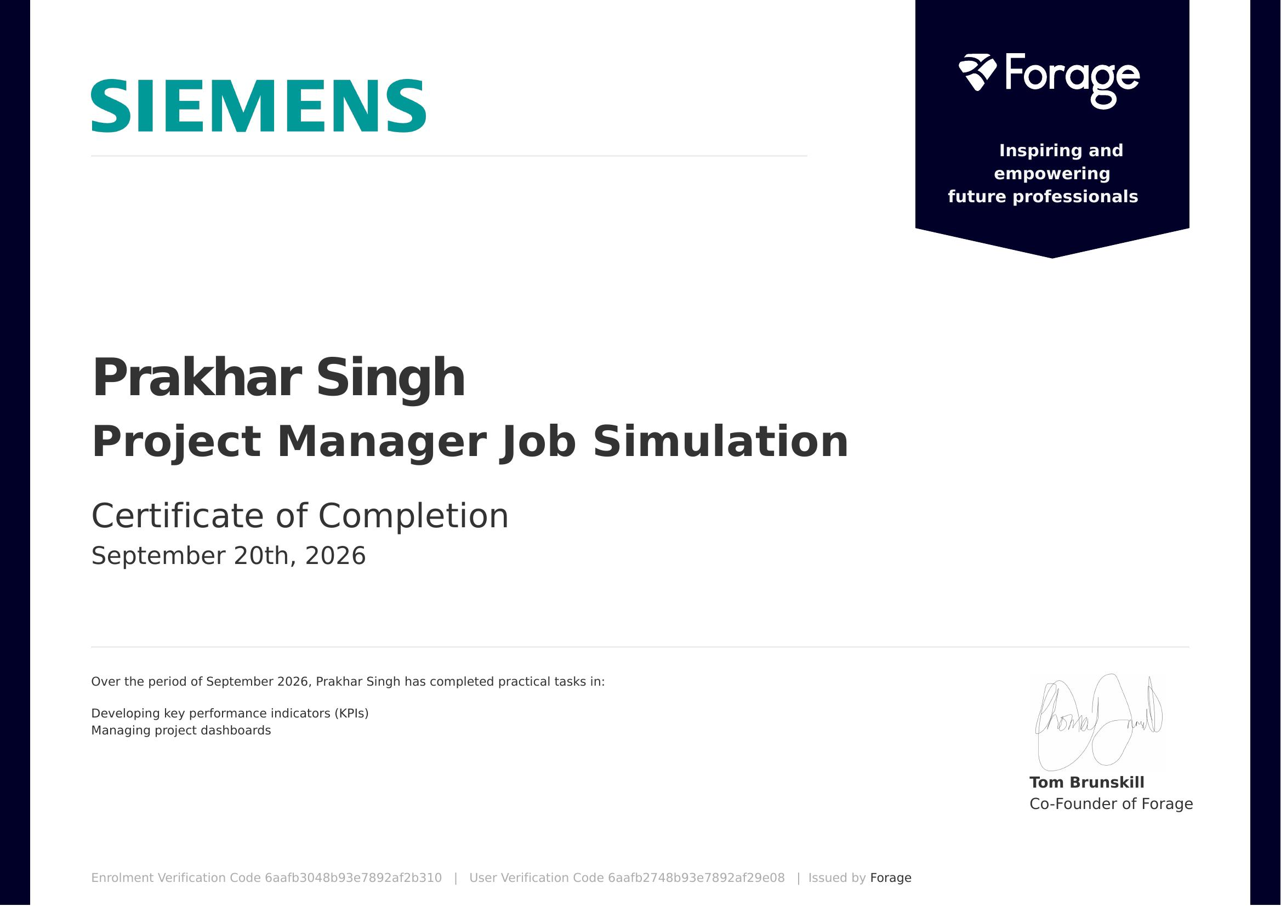
Certificate of Completion

Slide 12
Thank You
Prakhar Singh
IILM University
B.Tech, Computer Science & Engineering
Greater Noida, Uttar Pradesh
Enrollment No: 25SCS1003004134
Siemens Mobility Job Simulation, 2026

