Slide 1
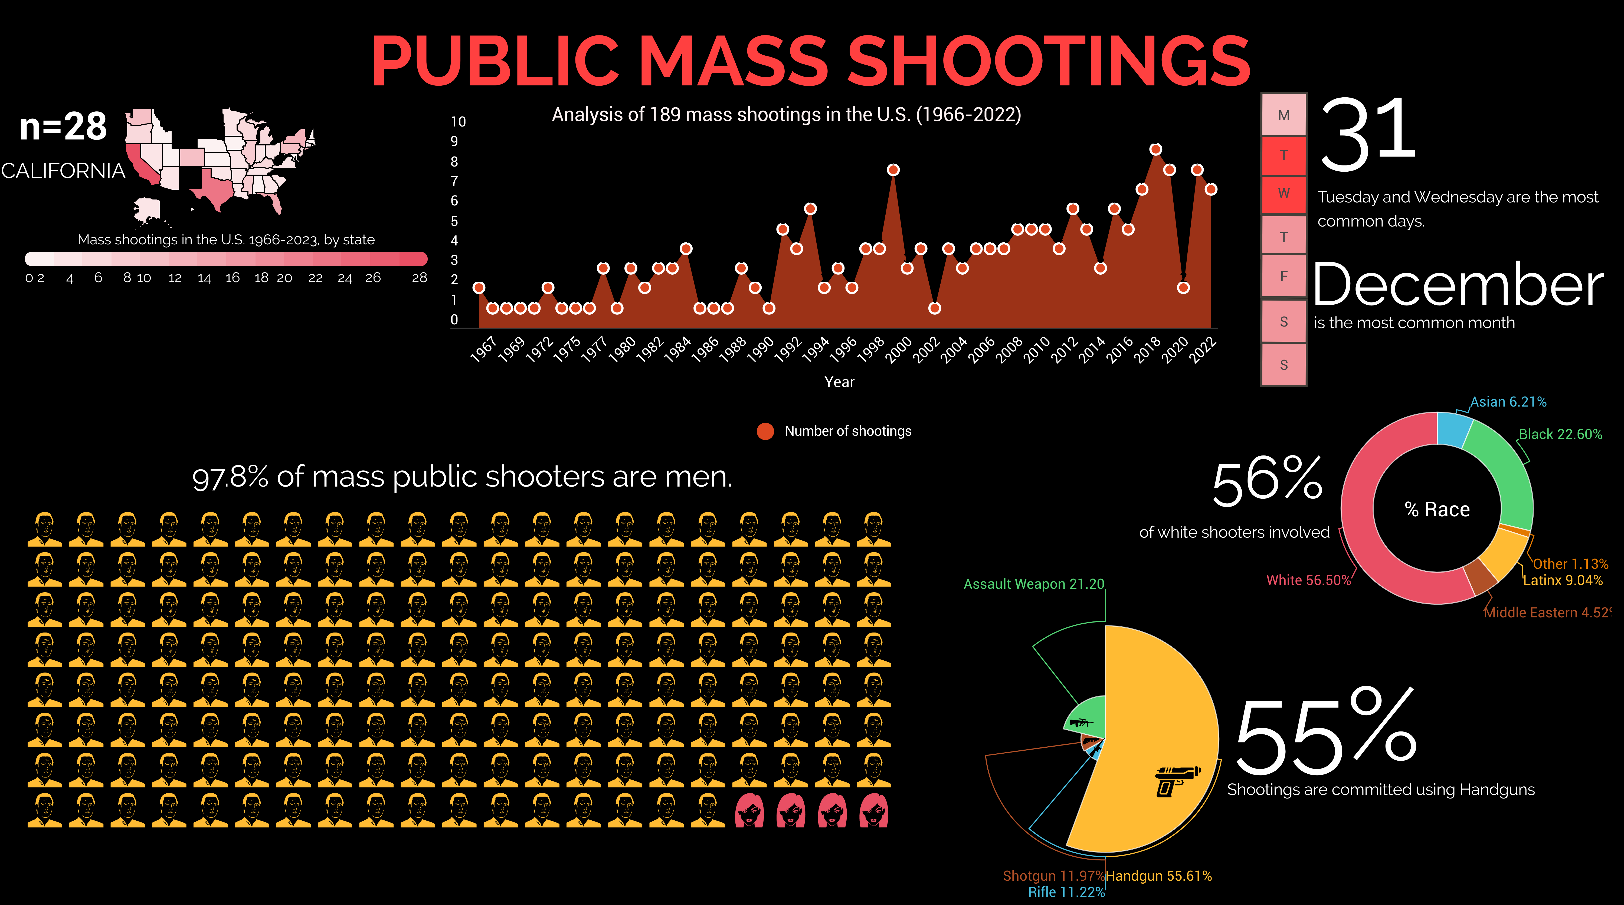

Slide 2
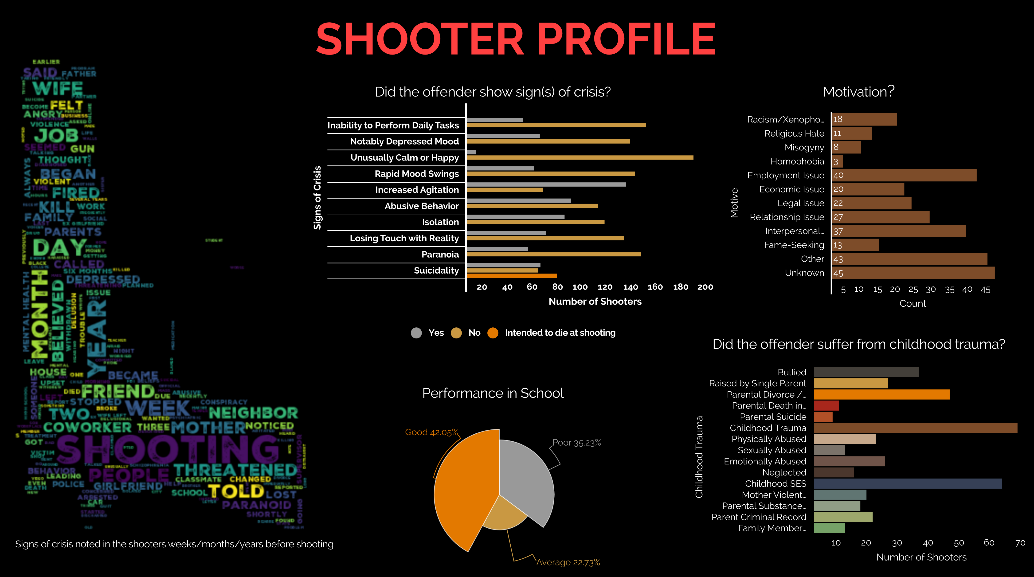

Slide 3
Data Source & References
https://www.theviolenceproject.org/mass-shooter-database/
https://www.fbi.gov/file-repository/active-shooter-incidents-in-the-us-2021-052422.pdf/view
https://www.motherjones.com/politics/2012/12/mass-shootings-mother-jones-full-data/

