Slide 1
SSAD R1 Presentation
PDF Generator
Prepared for
Barna Bhattacharyya
Amit Kripalani
Instructor: Prof. Raghu Reddy

Slide 2
Brief Description
⦿Generate candidate assessment PDF reports for hiring managers.
⦿To make analysis for hiring manager easy and efficient.

Slide 3

Why do we need this project
⦿Companies for hiring employees need to follow a procedure of selection for each and every candidate.
⦿Which is time consuming and
not efficient as it does not
cover all aspects.

Slide 4
Why do we need this project
⦿So need of the hour is to have detailed and correct report of a candidate for which a company is looking.
⦿The report should give the overview of the capabilities of a candidate.
⦿The report should cover all aspects on which the candidate is tested.
⦿Also the report should also give the general overview of performance of all candidates and of the exam.
⦿The report should tell which questions were solved by
maximum number of people, and similar semantics.

Slide 5
Technologies Required
⦿Reportlab(python library)
⦿Django(backend)

Slide 6
Why Reportlab
⦿Create documents directly from database.
⦿Draw images and charts directly into PDF.
⦿Dynamically include tables of content, page numbers and tags into documents.
⦿Deliver dynamic PDFs directly to a web browser.
⦿Reuse pages and image assets from existing
PDFs.

Slide 7
Features Implemented
⦿Generated pdf containing containing name,image,company of the candidate.
⦿Implemented tables containing scores of candidate in various sections and subsections.
⦿All data is fetched from database.
⦿Graphical representation is done by using
pie charts and bar graphs.

Slide 8
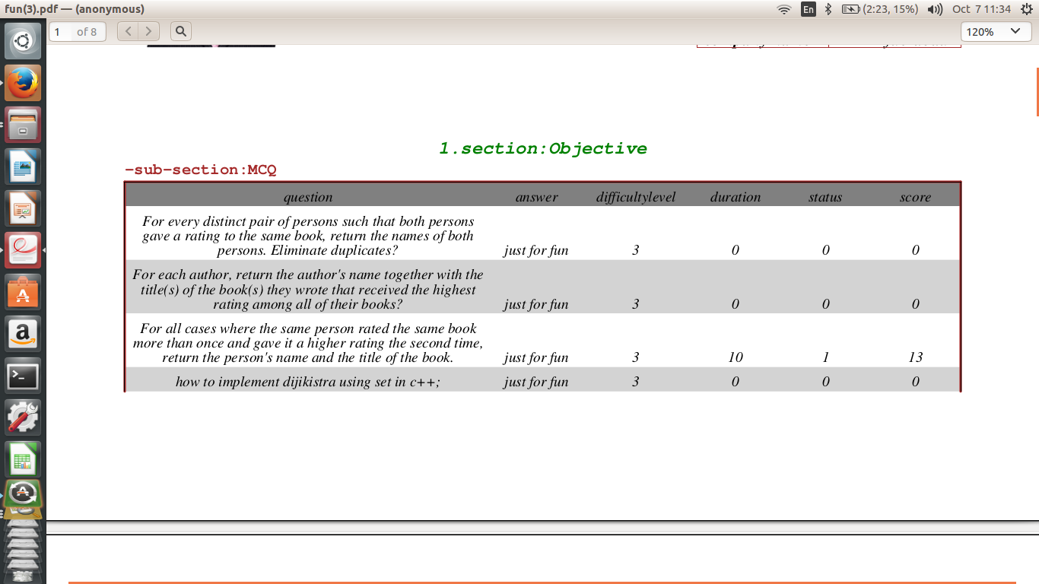
Objective Section : MCQ Questions

Slide 9
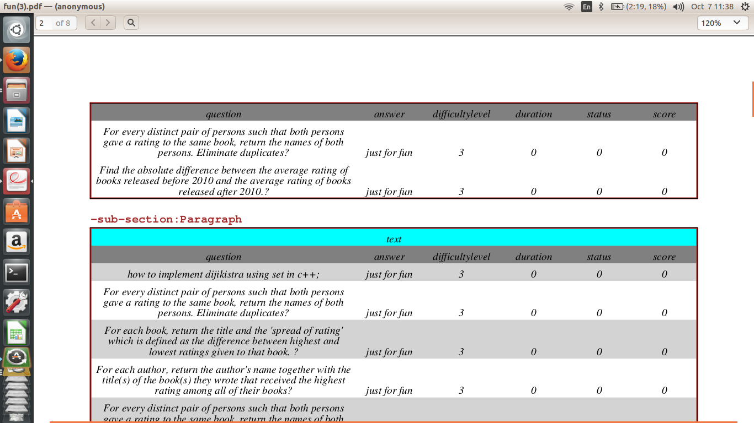
Subjective Section: Paragraph Questions

Slide 10
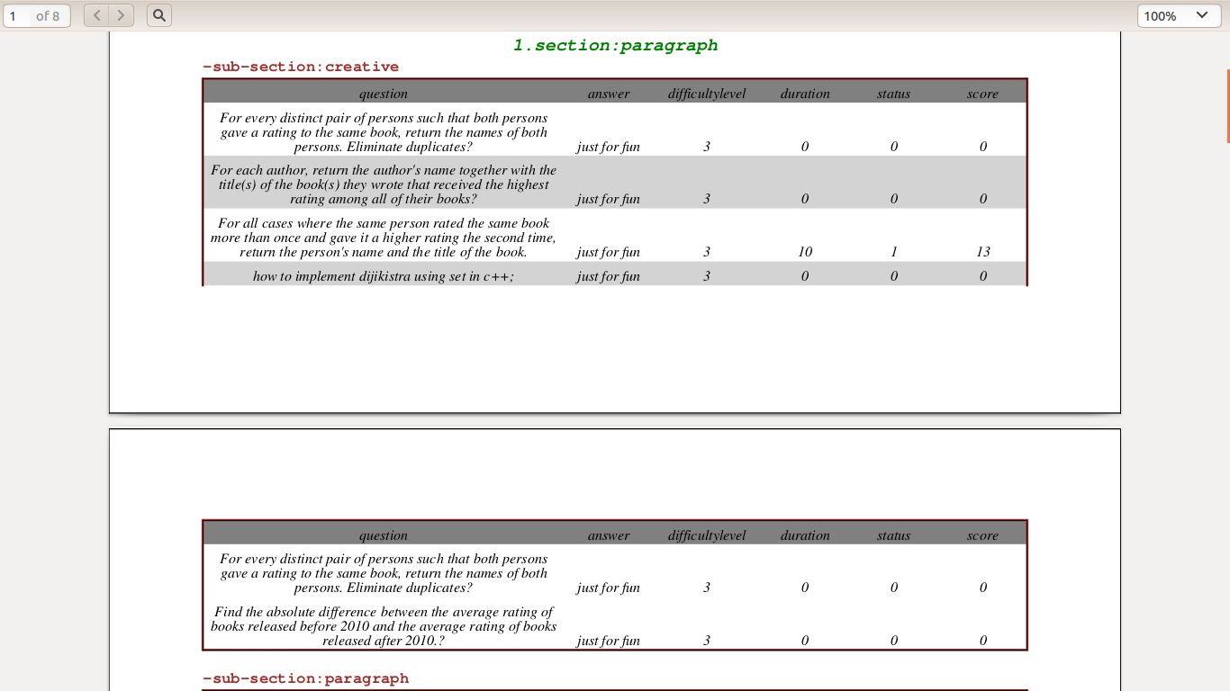
Handling broken tables

Slide 11
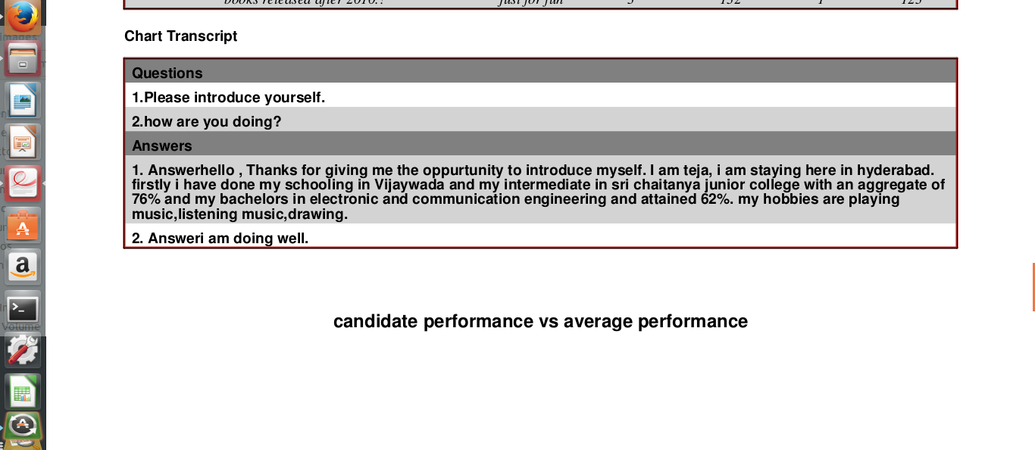
Chat Transcript

Slide 12
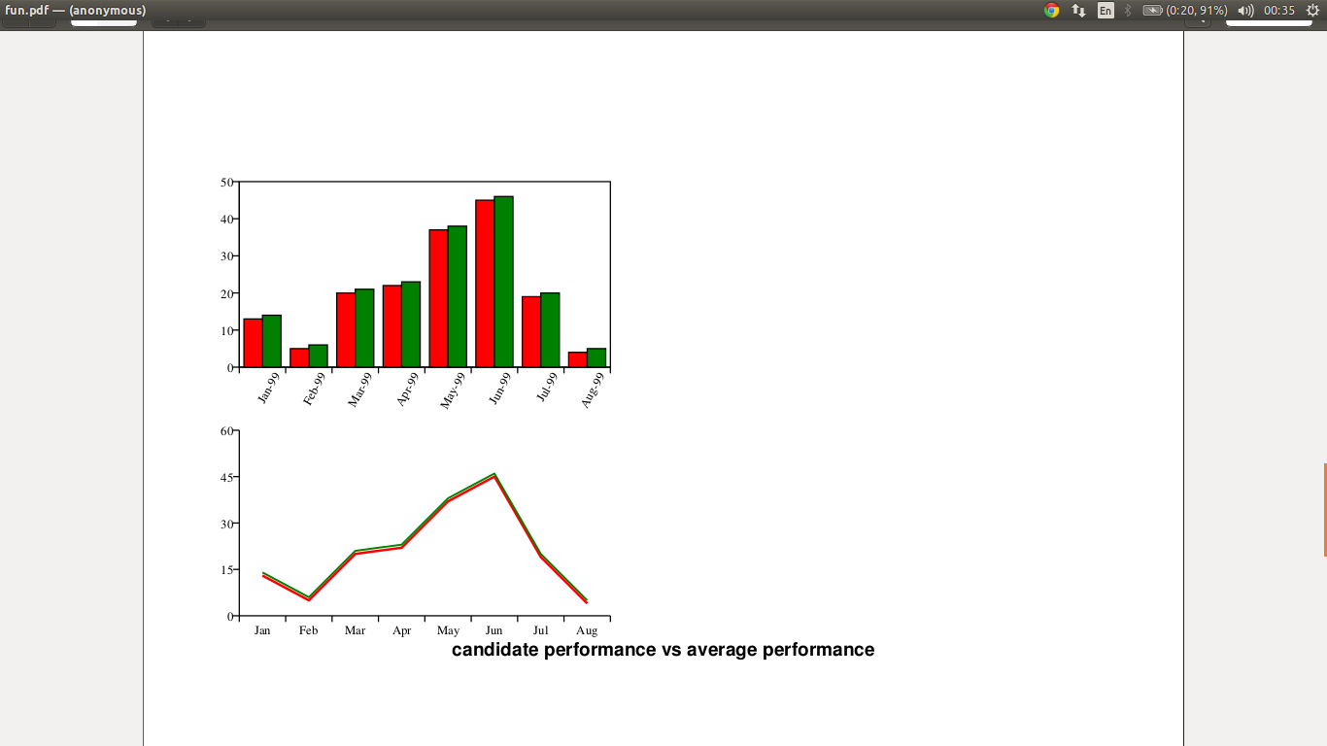
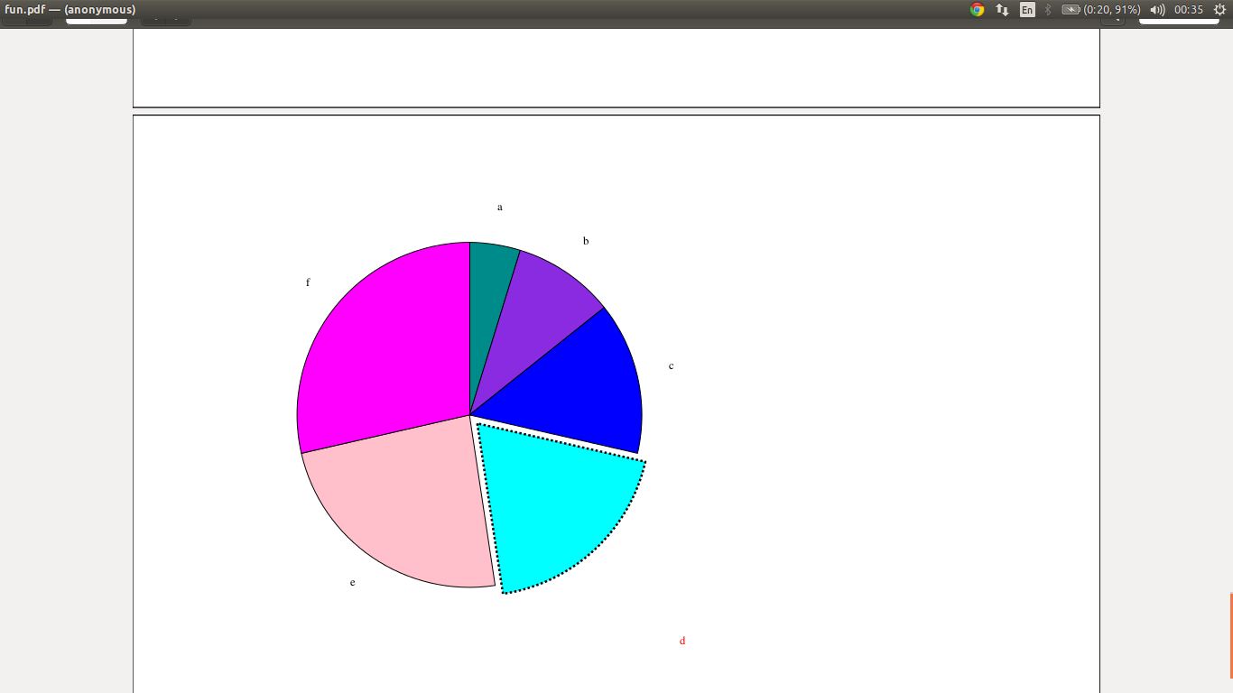
Graphical Representation

Slide 13
Plan for R2
⦿To make user interface better.
⦿To implement features like codeplay and audio files in pdf, keeping the size of pdf small.
⦿To mail the pdf to the hiring manager.

Slide 14
TA Mentor-Sane Sushmitha Reddy
SSAD Team 45
Ayush Joshi
Prakhar Pandey
Veerendra Mandava

