Slide 1
SSAD R2 Presentation
Prepared for
Barna Bhattacharyya
Amit Kripalani
ICS 261—Structured Systems Analysis and Design
Instructor: Prof. Raghu Reddy

Slide 2
Brief Description
⦿Generate candidate assessment PDF reports for hiring managers.
⦿To make analysis for hiring manager easy and efficient.

Slide 3

Why do we need this project
⦿Companies for hiring employees need to follow a procedure of selection for each and every candidate.
⦿Which is time consuming and not
efficient as it does not cover all
aspects.

Slide 4
Technologies Required
⦿Reportlab(python library)
⦿Django(backend)

Slide 5
Why Reportlab
⦿Create documents directly from database.
⦿Draw images and charts directly into PDF.
⦿Dynamically include tables of content, page numbers and tags into documents.
⦿Insert audio,video files.
⦿Deliver dynamic PDFs directly to a web browser.
⦿Reuse pages and image assets from existing
PDFs.

Slide 6
Features Implemented
⦿All data is dynamically fetched from database.
⦿Symbolically representing status of each answer.
⦿Image of candidate(of any size) is adjusted according to aspect ratio.
⦿Snapshots of candidate while answering questions are added inside the table.
⦿Outlook of pdf has been modified.
⦿File compression is also implemented to keep the size of file small.

Slide 7
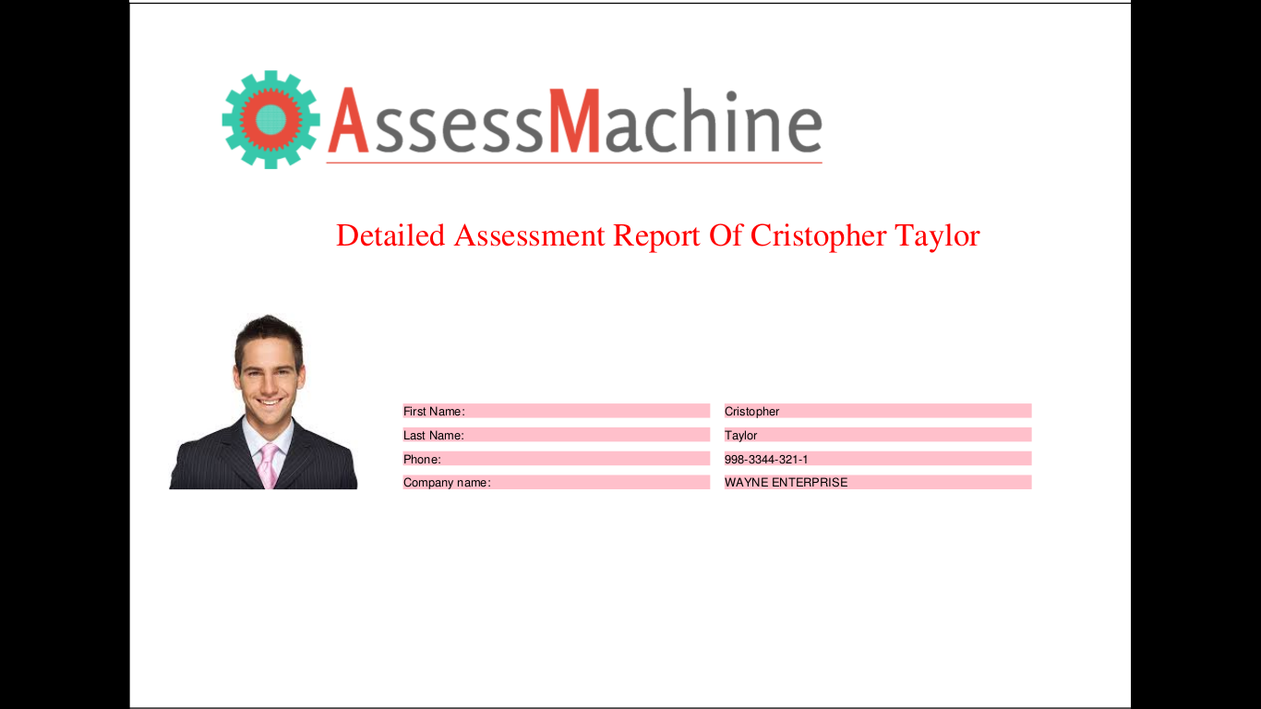
Generated pdf contains basic info of candidate.

Slide 8
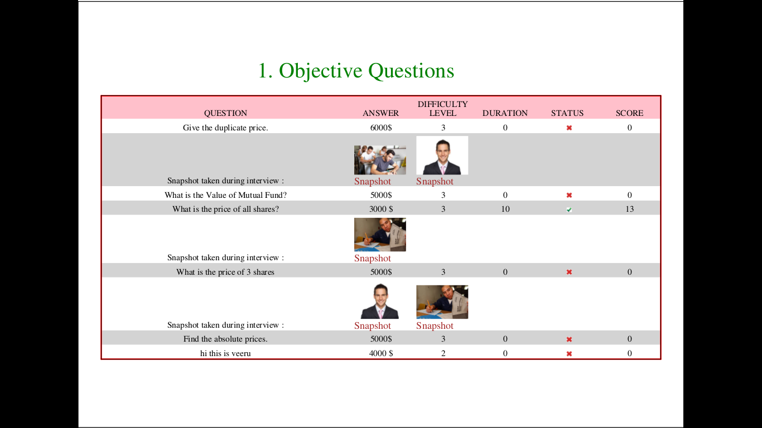
Graphically representing the status of each question.

Slide 9
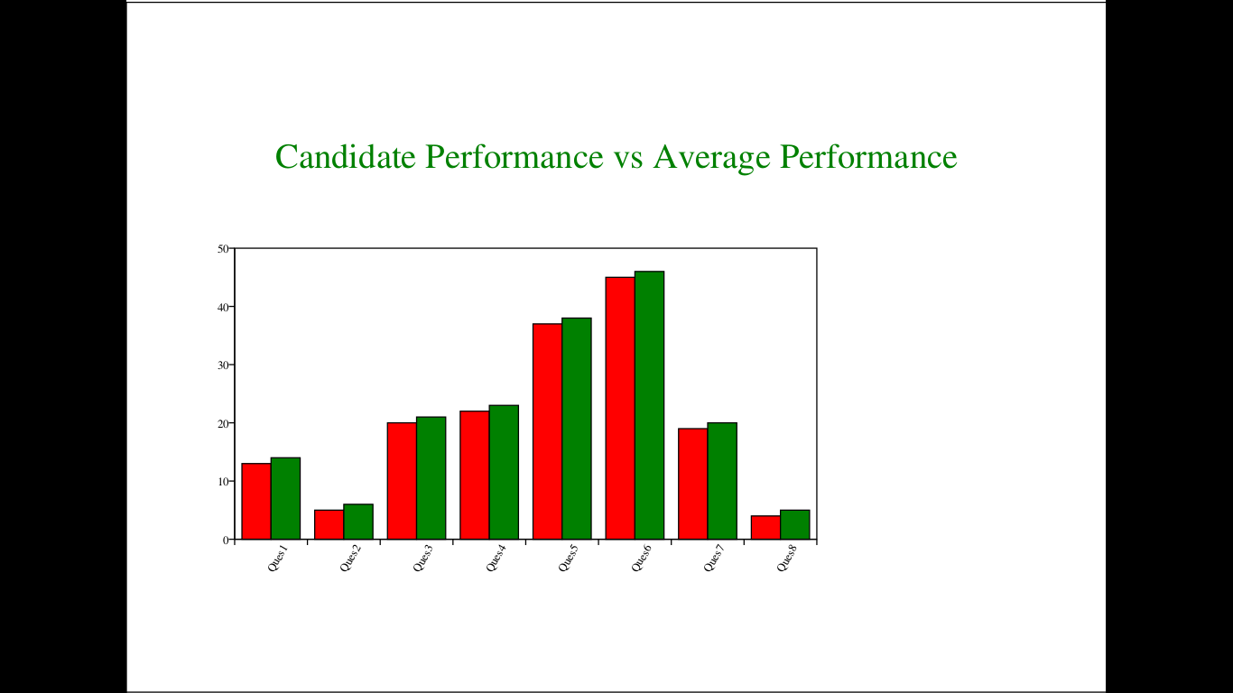
Graphical representation(bar graphs).

Slide 10
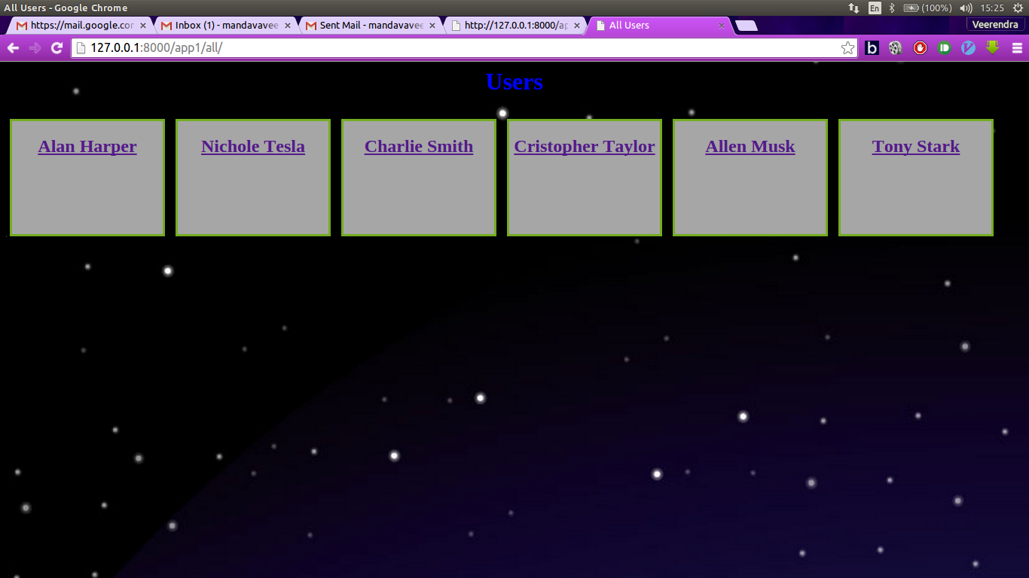
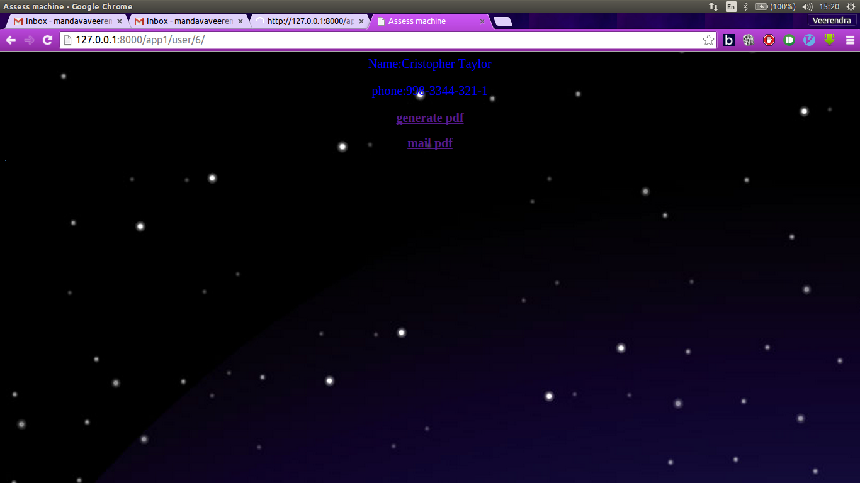
Frontend is made to select any candidate & generate,mail pdf.

Slide 11
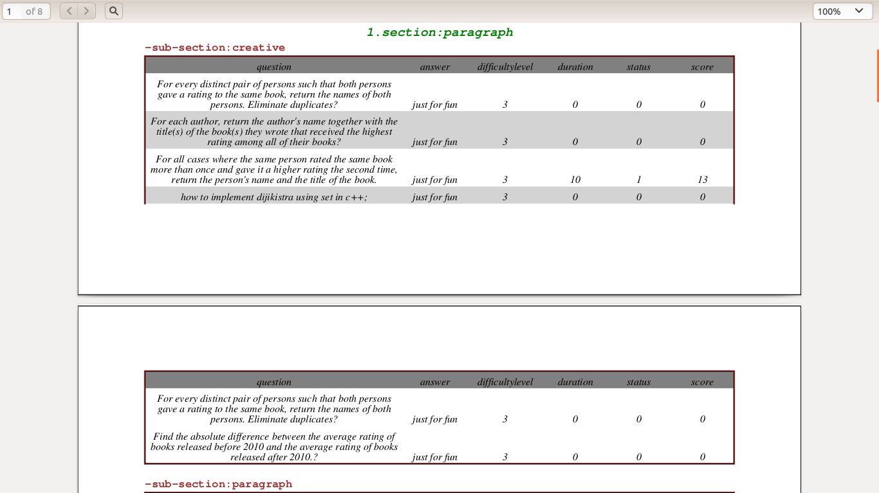
Broken tables have been handled.

Slide 12
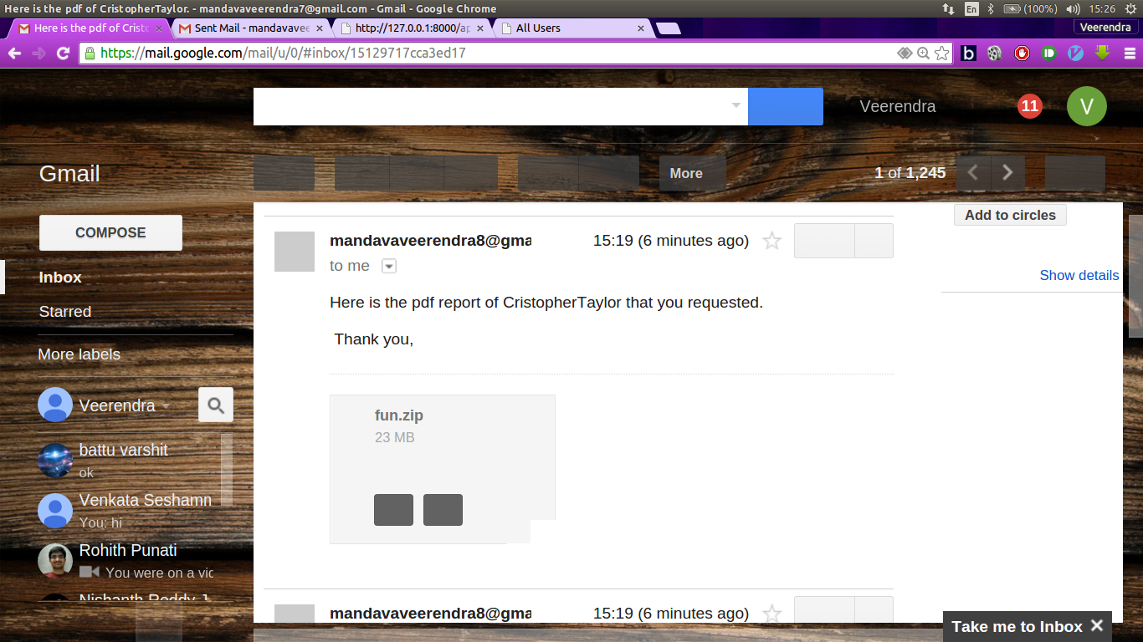
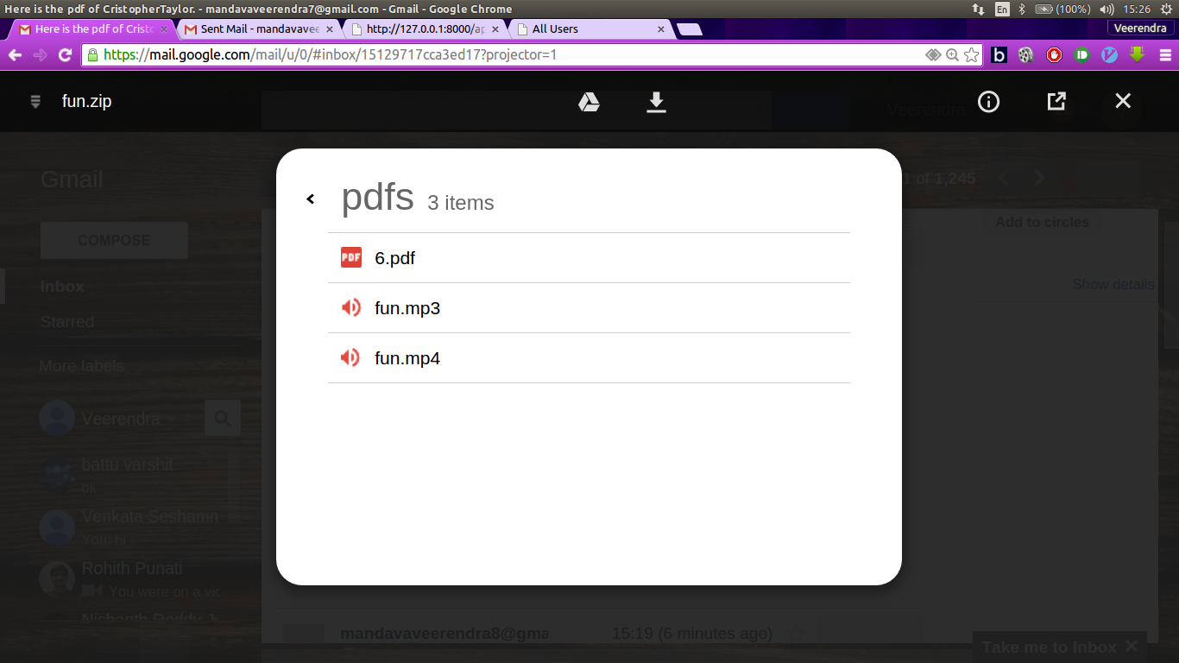
Pdf file can be mailed to hiring manager.

Slide 13
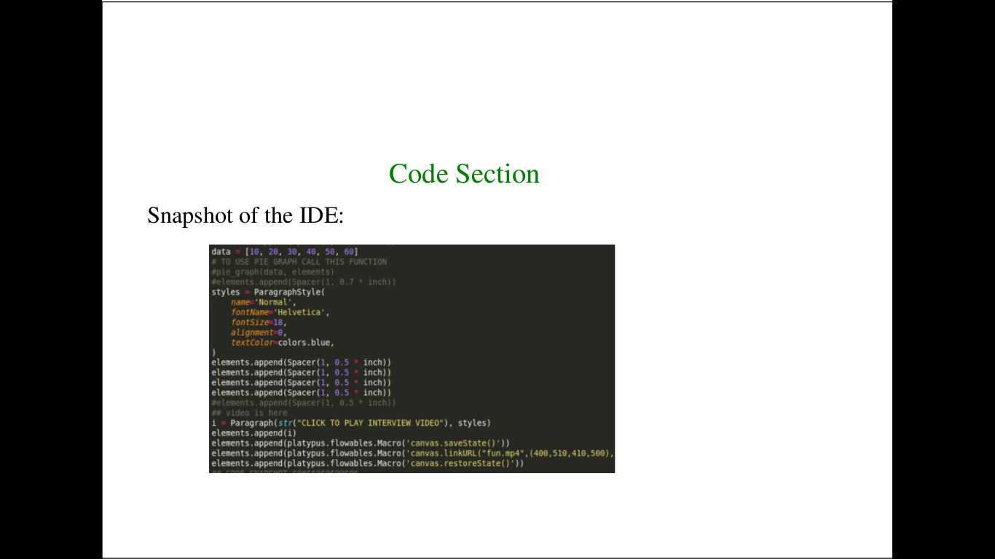
Snapshot of IDE is added.

Slide 14
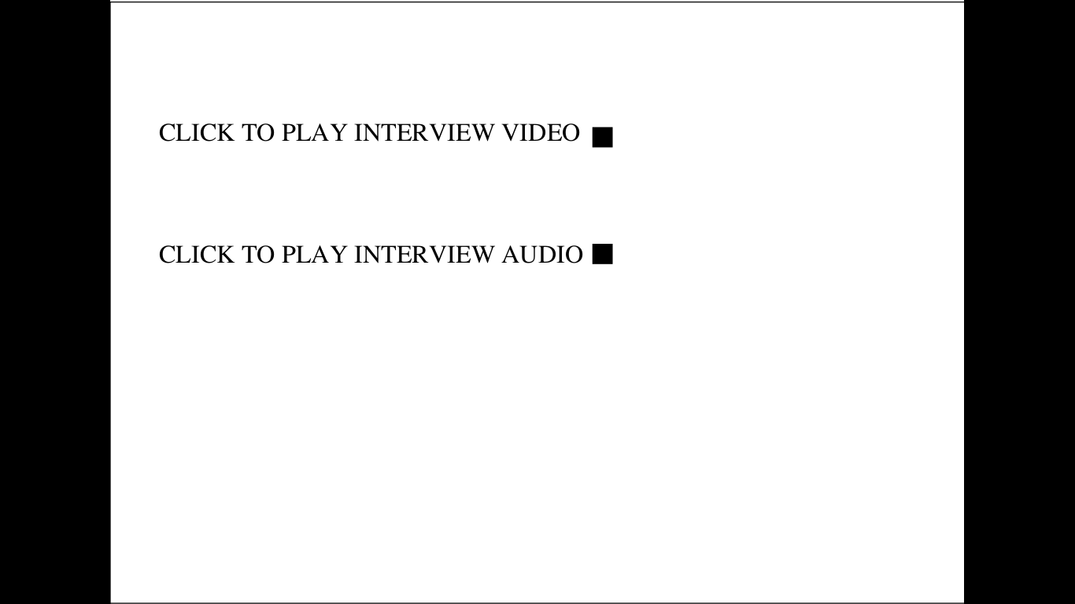
Video and audio files are added to detect plagiarism.

Slide 15
TA Mentor-Sane Sushmita Reddy
SSAD Team 45
Ayush Joshi
Prakhar Pandey
Veerendra Mandava

