Slide 1
Neural networks and
Neuromorphic computing(cognitive computing)

Slide 2
Presented By-

Slide 3
Contents-
Overview
History
Artificial Intelligence
Application
Neuromorphic
IBM
Google TPU

Slide 4
Neural network
A neural network is a network or circuit of neurons or nodes.
a neural network is either a biological neural network, made up of real biological neurons, or an artificial neural network, for solving artificial intelligence (AI) problems.
The connections of the biological neuron are modeled as weights. A positive weight reflects an excitatory connection, while negative values mean inhibitory connections. All inputs are modified by a weight and summed.
Finally, an activation function controls the amplitude of the output.

Slide 5
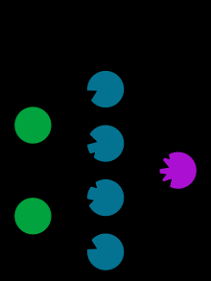

Slide 6
Artificial intelligence, cognitive modeling, and neural networks are information processing paradigms inspired by the way biological neural systems process data.
In the artificial intelligence field, artificial neural networks have been applied successfully to speech recognition, image analysis and adaptive control, in order to construct softwares or autonomous robots.

Slide 7
digital computers evolved from the von Neumann model, and operate via the execution of explicit instructions via access to memory by a number of processors
Unlike the von Neumann model, neural network computing does not separate memory and processing.

Slide 8
Artificial Intelligence
A neural network (NN), in the case of artificial neurons called artificial neural network (ANN) or simulated neural network (SNN), is an interconnected group of natural or artificial neurons that uses a mathematical or computational model for information processing based on a connectionistic approach to computation.
Artificial neurons were first proposed in 1943 by Warren McCulloch, a neurophysiologist, and Walter Pitts, a logician, who first collaborated at the University of Chicago

Slide 9
The concept of a neural network appears to have first been proposed by Alan Turing in his 1948 paper Intelligent Machinery in which called them "B-type unorganised machines"

Slide 10
Applications
Neural networks can be used in different fields.
Function approximation
regression analysis
Time series prediction and modeling.
Classification of sets
pattern and sequence recognition
novelty detection
sequential decision making
Data processing, including filtering, clustering, blind signal separation and compression.

Slide 11
Neuromorphic Engineering
Neuromorphic Engineering is among the top emerging technologies of the year 2018.

Slide 12
Neuromorphic Computing

Slide 14
what is neuromorphic computing?
Neuromorphic engineering, also known as neuromorphic computing started as a concept developed by Carver Mead in the late 1980s, describing the use of very-large-scale integration (VLSI) systems containing electronic analogue circuits to mimic neurobiological architectures present in the nervous system.

Slide 15
A key aspect of neuromorphic engineering is understanding how the morphology of individual neurones, circuits and overall architectures creates desirable computations, affects how information is represented, influences robustness to damage, incorporates learning and development, adapts to local change (plasticity), and facilitates evolutionary change. Neuromorphic Computing is next stage in machine learning.

Slide 16
IBM’s million “neurones” TrueNorth chip, revealed in prototype in August 2014, has a power efficiency for certain tasks that is hundreds of times superior to conventional CPU’s and comparable for the first time to the human cortex. The challenge here remains creating code that can realise the potential of the TrueNorth chip, an area IBM continues investing in today.

Slide 17
Neuromorphic engineering is a new emerging interdisciplinary field which takes inspiration from biology, physics, mathematics, computer science and engineering to design hardware/physical models of neural and sensory systems.

Slide 18
IBM
TrueNorth microchip architecture, which is designed to be closer in structure to the human brain than the von Neumann architecture used in conventional computers
Last year, IBM introduced TrueNorth, a high-powered, low-energy-consumption chip inspired by the human brain.

Slide 19
This network of TrueNorth chips is made of 48 million artificial nerve cells (48 chips housing 1 million artificial cells each), and is designed to run deep learning algorithms with greater efficiency. They call the chips "neuromorphic," meaning they mimic organic brain cells. These algorithms are the backbone of current artificial intelligence platforms—software like Facebook’s image recognition and Google’s Translate app, that visually recognizes and translates text.

Slide 20
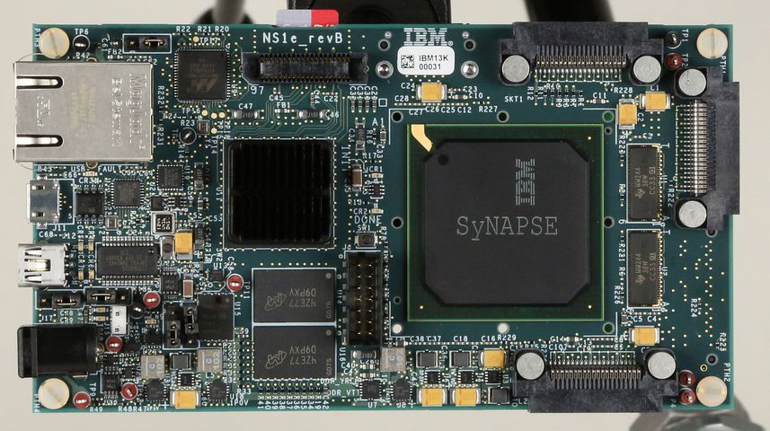

Slide 21
Networks of artificial neurons like the one built with TrueNorth will allow that level of computation in small devices like phones or watches, IBM told Wired. That's because its most attractive feature, aside from computing power, is low energy consumption—just about 70 milliwatts powering 5.4 billion transistors. Modern processors have around 1.4 billion transistors and take far more energy, between 35 and 140 watts

Slide 22
Networks of artificial neurons like the one built with TrueNorth will allow that level of computation in small devices like phones or watches, IBM told Wired. That's because its most attractive feature, aside from computing power, is low energy consumption—just about 70 milliwatts powering 5.4 billion transistors. Modern processors have around 1.4 billion transistors and take far more energy, between 35 and 140 watts

Slide 23
neuromorphic chips
Modeled on biological brains—designed to process sensory data such as images and sound and respond to changes in that data in ways not specifically programmed

Slide 24
Tensor processing unit (Google)
The tensor processing unit was announced in May 2016 at Google I/O, when the company said that the TPU had already been used inside their data centers for over a year
The chip has been specifically designed for Google's TensorFlow framework, a symbolic math library which is used for machine learning applications such as neural networks

Slide 25
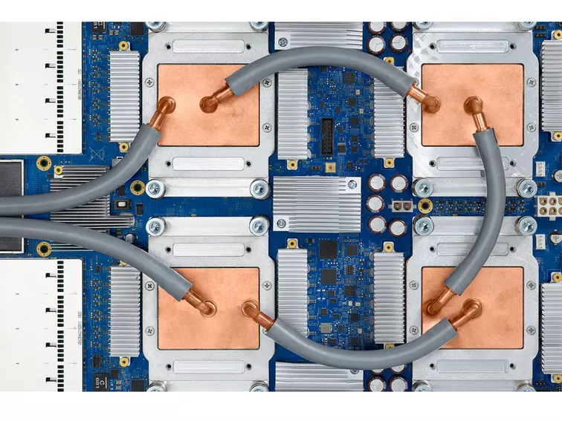

Slide 26
Google has stated that they were used in the AlphaGo versus Lee Sedol series of man-machine Go games,[2] as well as in the AlphaZero system which produced Chess, Shogi and Go playing programs from the game rules alone and went on to beat the leading programs in those games.[5] Google has also used TPUs for Google Street View text processing, and was able to find all the text in the Street View database in less than five days. In Google Photos, an individual TPU can process over 100 million photos a day. It is also used in RankBrain which Google uses to provide search results.[6]

Slide 27
Nature’s own computing device, the brain,
is extremely powerful and the one you’re
using to read this uses only 20 Watts
of power!

Slide 29
Advantages
Can compute in real time, which is similar to how the
brain works
• Might take us a step closer to artificial intelligence
• Different applications in various disciplines
• Advances in neuroscience and chip making

Slide 30
Limitations
High cost
Still a bit far in terms of real-life applications
Needs more research
Further development paves way for AI, causing ethical concerns

Slide 31
Cognitive
A cognitive computer combines artificial intelligence and machine-learning algorithms, in an approach which attempts to reproduce the behaviour of the human brain.It generally adopts a Neuromorphic engineering approach. An example of a cognitive computer implemented by using neural networks and deep learning is provided by the IBM company's Watson machine and TrueNorth microchip architecture, which is designed to be closer in structure to the human brain than the von Neumann architecture used in conventional computers.
In 2017 Intel announced its own version of a cognitive chip in "Loihi", which will be available to university and research labs in 2018. Intel, Qualcomm, and others are improving neuromorphic processors steadily, Intel with its Pohoiki Beach and Springs systems

Slide 32
referances
https://www.popsci.com/ibms-neuromorphic-chip-array-mimics-rodent-brain/
https://www.engadget.com/2015/08/17/ibm-wires-up-neuromorphic-chips-like-a-rodents-brain/
Copeland, B. Jack, ed. (2004). The Essential Turing. Oxford University Press. p. 403. ISBN 978-0-19-825080-7.

