Slide 1
SEMICON INDIA HACKATHON 2026
BYTE BRIGADE
AI-Based Restoration of Degraded Images
for Semiconductor Inspection
One lightweight network · denoising + 2× super-resolution · +5.0 dB over baseline
Prakhar Bajaj
Team Member
Raghav Soni
Team Member
Parth Kumar
Team Member
Mayank Lodhi
Team Member
Notes:
We are Byte Brigade. We built an AI system that takes noisy, low-resolution semiconductor inspection images and restores them to clean, sharp, double-resolution images — with one small, fast neural network.

Slide 2
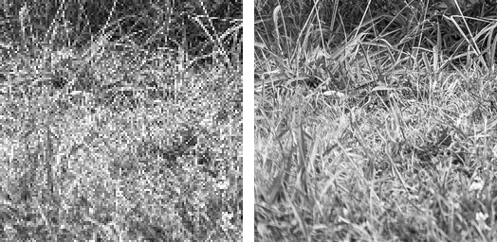
Problem Statement
Inspection images arrive degraded: speckle + Gaussian noise at only 128×128 resolution — defects hide in the noise
Task: restore each image to a clean, sharp 256×256 — judged on PSNR, SSIM, LPIPS and inference speed
Supervised setup: learn from paired data (degraded in, ground truth out); test outputs scored against hidden ground truth
What we receive (128×128, shown 2×)
What we must produce (256×256)
3,200 training pairs
400 hidden test images
128 → 256 px (×2)
A hidden defect can cost an entire wafer — restoration must be trustworthy, not just pretty.
Notes:
In chip fabs, inspection images are noisy and low-resolution, and a hidden defect can cost a whole wafer. Our task: learn from 3,200 paired examples how to reverse the degradation, then restore 400 unseen test images that are scored against hidden ground truth.

Slide 3
Our Idea
1
2
3
Learn from pairs
Standard supervised learning: degraded image in, clean image out. No exotic training procedures — proven, stable, debuggable.
One network, two jobs
Denoising and 2× super-resolution in a single forward pass. Joint restoration beats chaining two separate models.
Restore, never invent
Architecture and loss are designed so the model can only recover structure — it cannot hallucinate detail that was never there.
Judged on PSNR · SSIM · LPIPS · speed — our loss and design optimize all four directly.
Notes:
Three principles. First, standard supervised learning on pairs — no exotic training. Second, one network does denoising and upscaling together, which works better than chaining two models. Third — critical for inspection — the model is built so it can only recover structure, never invent it. A fake defect or an erased one is worse than noise.

Slide 4
Architecture — NAFNet-SR
Input
128×128
Head conv
1 → 48 channels
24 × NAFBlock
feature cleaning
PixelShuffle ×2
+ tail conv
Output
256×256
+
global skip: bicubic ×2 upscale of the input — the network learns only the CORRECTION
Inside one NAFBlock: LayerNorm → 1×1 conv → depthwise 3×3 conv → SimpleGate → channel attention → residual add
0.53 M parameters
6.8 MB model file
No ReLU · No transformer · No GAN — simplicity is the strategy
Notes:
The backbone is NAFNet — ECCV 2022 state of the art. Its block is radically simple: no transformer, not even ReLU — a learned gate instead. Twenty-four blocks clean the features, PixelShuffle learns the upscale, and the key trick is the global skip: we add a plain bicubic upscale of the input, so the network only predicts the correction. That makes training stable and hallucination structurally impossible.

Slide 5
Training Strategy
Data
Optimisation
3,200 organiser pairs → 3,000 train / 100 validation / 100 held-out test
Seeded split (seed 42) — reproducible on any machine
128 px random crops · batch of 16 — more examples per GPU step
8× augmentation: flips + 90° rotations applied identically to input and target
Loss = Charbonnier + 0.15·SSIM + 0.05·LPIPS (fidelity leads)
AdamW, lr 2e-4, cosine decay to 1e-7 over 100 epochs
Gradient clipping — one bad batch cannot wreck the run
Validate every 5 epochs; keep the best-PSNR checkpoint (epoch 85)
Validation PSNR during training
26.16 dB
epoch 5
27.15 dB
epoch 30
27.27 dB
epoch 60
27.33 dB
epoch 85
Trained free on a Google Colab T4 · 74 s/epoch · ≈ 2 hours total · resumable checkpoints
Notes:
Training strategy: 3,000 paired images, 128-pixel random crops in batches of 16, with eight-fold flip and rotation augmentation. The loss combines Charbonnier for pixel fidelity, SSIM for structure, and a small LPIPS term for perceptual quality — two of the three judged metrics optimised directly. AdamW with cosine learning-rate decay over 100 epochs, validating every fifth epoch and keeping the best checkpoint. Two hours on a free Colab GPU.

Slide 6
Innovation
1
Simplicity as strategy
State-of-the-art restoration family at 0.53 M parameters. Small enough to train free, run on CPU, and for the team to explain and debug every single line.
2
Train on the scoreboard
Loss = Charbonnier + SSIM + light LPIPS. Two of the three judged metrics are optimized directly during training — not hoped for afterwards.
3
No-hallucination guarantee
Global bicubic skip + deliberately no GAN loss. The model can only correct towards the input's real structure — invented defects are structurally impossible.
4
Float-faithful pipeline
Degraded inputs carry values outside [0,1] — real noise signal. Native float32 .npy I/O end to end; a PNG-based pipeline would silently clip and lose it.
Notes:
Our innovation is disciplined engineering, not exotic research. We train directly on the judged metrics. We guarantee no hallucination by construction. And one subtle point others may miss: the input arrays contain values outside zero-one — real noise signal. Our pipeline keeps full float precision everywhere; converting to images would destroy it.

Slide 7
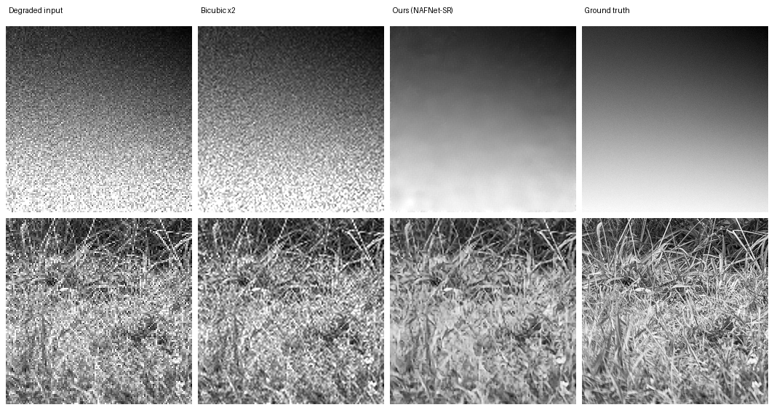
Results — better on every judged metric
+5.0 dB
PSNR gain vs baseline
+0.22
SSIM (0.54 → 0.76)
−60 %
LPIPS (lower is better)
25 ms
per image on a T4 GPU
Method | PSNR ↑ | SSIM ↑ | LPIPS ↓
Bicubic (no AI) | 22.96 dB | 0.537 | 0.433
Ours (NAFNet-SR) | 28.00 dB | 0.759 | 0.175
Measured on 100 held-out pairs never seen in training. End-to-end: 25 ms/image, 40 img/s (T4).
Degraded → bicubic → ours → ground truth (held-out test images)
Notes:
On one hundred held-out pairs: plus five dB PSNR — that's roughly 69 percent of pixel error eliminated — SSIM up from 0.54 to 0.76, and LPIPS, the perceptual metric, cut by 60 percent. Better on every judged axis. And it runs at about a second per image on a plain laptop CPU — 30 milliseconds on a GPU.

Slide 8
Impact & Feasibility
Impact
Feasibility
Defects hidden in noise become visible — fewer missed escapes, fewer false alarms
Enables faster, lower-dose scans: capture noisier images quickly, restore in software
Higher inspection throughput without buying new microscope hardware
Fidelity-first design keeps engineers' trust — the model never invents structure
Already built and working end to end — not a concept
6.5 MB model runs on a plain laptop CPU; no GPU needed to deploy
Zero infrastructure cost: trained free on Colab, fully open-source stack
Drop-in usage: folder in → folder out, plus a web UI for operators
6.5 MB
model size
25 ms
per image, T4 GPU
10 s
for all 400 test images
₹0
hardware cost
Ready to pilot today: point it at an inspection folder and the restored images appear alongside.
Notes:
Impact: restoring noise-hidden detail means fewer missed defects, and it lets fabs scan faster or at lower dose because the software recovers quality — more throughput from the same microscopes. Feasibility is proven, not projected: the system is built and running, the model is six and a half megabytes, it needs no GPU to deploy, it cost nothing to train, and it processed all four hundred test images in eight minutes on a laptop.

Slide 9
Technology
Stack
Pipeline
PyTorch — model, training, inference
NAFNet-SR — implemented by us, from scratch
pytorch-msssim + lpips — differentiable quality losses
scikit-image — reference metrics for honest reporting
Streamlit — live demo UI (upload → restore → compare)
1
Train — Google Colab T4 (free) · 100 epochs · ≈ 2 hours
2
Evaluate — PSNR / SSIM / LPIPS per image + CSV report
3
Deploy — Streamlit demo · runs on CPU too, no GPU needed
Fully reproducible: seeded data splits · frozen benchmark · model config stored inside the checkpoint → inference needs zero code edits.
Notes:
Everything is open source and reproducible. Training cost nothing — two hours on a free Colab GPU. Every random seed is fixed, and the model file carries its own configuration, so anyone can rerun our exact pipeline from the README in four commands. There's also a live Streamlit demo — happy to show it.

Slide 10
Code & Reproducibility
project/
├─ dataset/ loader + degradation pipeline
├─ models/ nafnet.py (the architecture)
├─ utils/ image_io · losses · metrics
├─ train.py training loop
├─ evaluate.py metric report (CSV)
├─ inference.py batch restore → submission
├─ app.py Streamlit demo
└─ README.md results + 4-command repro
Small and readable on purpose — nine short modules
Every file commented with WHY, not just what
README reproduces every number in this deck with 4 commands
Trained model (6.8 MB) committed with the code
github.com/prakharbajaj1551/
semicon-image-restoration
Notes:
The repository is small and readable on purpose — nine short modules, each commented to explain why, not just what. The README reproduces every number on this slide deck with four commands.

Slide 11
References
Chen et al. — “Simple Baselines for Image Restoration” (NAFNet), ECCV 2022 · arXiv:2204.04676
Shi et al. — “Real-Time Single Image Super-Resolution Using an Efficient Sub-Pixel CNN” (PixelShuffle), CVPR 2016
Zhang et al. — “The Unreasonable Effectiveness of Deep Features as a Perceptual Metric” (LPIPS), CVPR 2018
Open-source libraries: PyTorch · pytorch-msssim · lpips · scikit-image · Streamlit
Thank you
Team BYTE BRIGADE · questions welcome
Notes:
We stand on proven open research — NAFNet for the architecture, PixelShuffle for upscaling, LPIPS for perceptual quality. Thank you — questions welcome.

