Slide 1
Scalable Pattern Mining Algorithms for Large Scale Interval Data
PRESENTED BY:
UNDER SUPERVISION OF:
Prakhar Dhama
15535029
Dr. Sateesh K. Peddoju

Slide 2
Outline
What is Pattern Mining?
Frequent Itemset Mining
Sequential Pattern Mining
Structured Pattern Mining
Temporal Pattern Mining
Need for Scalable Pattern Mining
Need for Interval Pattern Mining
Problem Statement
Background and Related Work
Interval Sequence Database
Temporal Relations
Representation Methods
Interval Pattern Mining Algorithms
Apriori-like Algorithms
Projection-based Algorithms
Parallel Frequent Itemset Mining
Parallel FP-growth
FiDoop Algorithm
Research Gap

Slide 3
Outline (Cont.)
Experimental Setup
Proposed Methodology
Complexity Analysis
Proposed PIMiner Algorithm
PIMiner Framework
PISpan Procedure
PostEndPoints Procedure
ProjectDB Procedure
MapReduce Job
Performance Study
Synthetic Data Generation
Synthetic Dataset Performance Evaluation
Execution time, pattern distribution, effects of maximum length of pattern
Real Dataset Analysis
Execution time, pattern distribution, spark jobs, task parallelism
Scalability Tests
Execution time, effects of increasing sequences
Conclusion and Future Scope
References

Slide 4
What is Pattern Mining?
A pattern can be a set of items, ordered subsequences, subgraphs, etc. Different kinds of pattern mining are:
Frequent itemset mining. finding set of items that frequently appear together in a transactional database, such as milk and bread.
Sequential pattern mining. finding frequently occurring subsequence in a sequence database, such as customer buying pattern, first a digital camera, followed by a memory card.
Structured pattern mining. finding frequent substructures in a spatial database such as graphs, trees, or lattices.
Temporal pattern mining. finding relations among events in a temporal database such as time for which iron is on and time for which its steel base is hot.
Need for Scalable Pattern Mining
In 2013, NSA processed 29 petabytes of data in a single day [1]. With huge increase in data size, pattern mining on single machine is infeasible.
The parallel programming models are MapReduce, Bulk Synchronous Parallel, etc [2]. Some of the popular big data tools to implement parallel algorithms are Apache Spark, Hadoop, NoSQL databases like Cassandra, MongoDB, etc.

Slide 5
Need for Interval Pattern Mining
In real world events, instead of being instantaneous, persist for some duration and called interval events.
The data including time related attribute is stored in temporal database. The relation among these interval events is intrinsically complex and point-based algorithms are not applicable.
Application
power meter in house that logs household appliance electricity usage, can be used to identify times each appliance is turned on or off.
it has been observed that in diabetic patients, the presence of hyperglycemia overlaps with the absence of glycosuria.
domains such as medical, multimedia, meteorology and finance where the events durations could play an important role.
Problem Statement
To develop a scalable pattern mining algorithm for large scale interval based data that can run
in distributed means on multiple computing nodes using big data technologies. Also depicting the mechanism to store, maintain and process the data in distributed way. Furthermore incorporating both task and data parallelism techniques in the computation which are yet unaddressed with the traditional computing techniques.

Slide 6
Parallel Itemset Mining
Apriori-like parallel FIM algorithms such as FDM, MapReduce based DPC[2] and others.
Apriori-like solutions suffer potential problems of high I/O, communication, and synchronization overhead, which make it strenuous to scale up these parallel algorithms.
Eclat-like most recent parallel algorithms include Dist-Eclat and BigFIM[3].
FP-growth-like parallel FIM algorithms such as and shared memory based cache conscious FP-growth and most popular MapReduce based PFP[4].
Utrametric-tree based FIUT[5] and FiDoop[6] (2015.).
Others include recent lexicographical tree based Sequence Growth[7] (2015.).

Slide 7
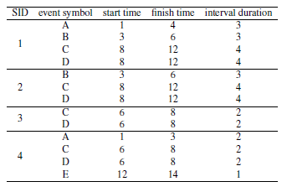
Background and Related Work
Interval Sequence Database
A temporal database can handle data with time. It stores all the interval sequences in which each interval denoting an interval-based event can have starting and finish times.
An interval sequence is a collection of several intervals. Table 1 shows the example database with four interval sequences 1, 2 3 and 4 as sequence id containing subset of four interval events A, B, C and D.
TABLE 1: Database with Interval Sequences

Slide 8
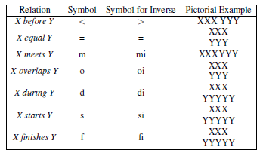
Background and Related Work (cont.)
Temporal Relations
All of the work related to temporal pattern mining is based on the 13 relations among temporal
events given in original James F. Allen’s work [3]. These various relations between two interval
events say X and Y is depicted in Table 2.
TABLE 2. Relation among Temporal Events

Slide 9
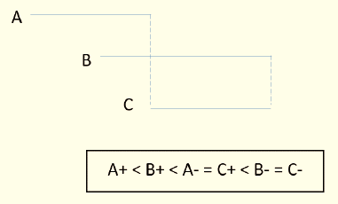
Background and Related Work (cont.)
Hierarchical Representation
One of the earliest representation to express temporal pattern was hierarchical as proposed by Fu and Kam [4]. The temporal pattern was formed by combining frequent temporal pattern to original long pattern. However this relationship was ambiguous. Since same relation can be mapped into different temporal pattern based on the candidate selection.
Relation Matrix
The ambiguity was addressed by Hoppner [5] by using a matrix to list exhaustively all the relations and using graph connectivity to mention a temporal pattern only once if it is connected.
Endpoint Representation
Wu and Chen proposed endpoint representation [6] to unamb-
iguously depict the pattern where starting and finishing points
of each interval event. In Figure 1, the endpoints representation
for three events is shown. The starting point is denoted by ev-
ent symbol followed by the + symbol and ending point as eve-
nt symbol followed by – symbol.
FIGURE 1: Endpoint Representation

Slide 10
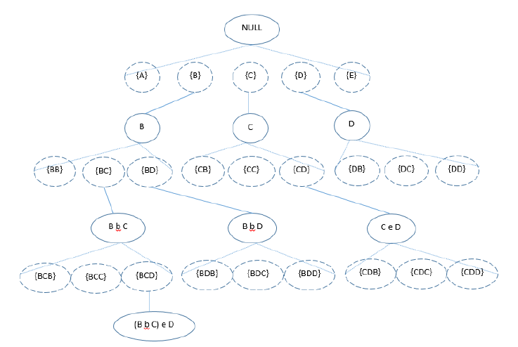
Background and Related Work (cont.)
Apriori-like Algorithms
In early days, most of the algorithms for discovering temporal patterns were Apriori-like. Cooper et al. proposed Recent Temporal Pattern (RTP) [7] mining that mines frequent time-interval patterns backward in time. HDFS [8] converts the temporal database into a list of sequence ids for each event. Then merging the sequence ids using enumeration tree. For the database given in the Table 1 enumeration tree is shown in Figure 2 for minimum support 3.
FIGURE 2. Arrangement of Enumeration Tree

Slide 11
Background and Related Work (cont.)
Projection-based Algorithms
Projection based interval mining uses divide and conquer strategy to find frequent temporal patterns. If α is a sequential pattern, then let DB|α denotes α projected database, which is a collection of sequences’ suffixes with regard to prefix α. Then α+1 pattern is generated using the projected database and extending the α sequential pattern. TPrefixSpan [9] uses projection based method along with the endpoint representation of interval sequence to extend the patterns.
TPMiner Algorithm
The most recent TPMiner [10] extends the concept of aforementioned database projection. Events with same sequence ID are clubbed in single interval sequence. The procedure for TPMiner follows the steps mentioned below.
Temporal database is transformed to endpoint representation. TPMiner counts the frequency of each endpoint i.e. the starting and ending points.
The infrequent endpoints are removed. Then for each of the remaining starting endpoint, the projected database is built and frequent temporal sequence is extended recursively.
Meanwhile, if the sequence is a valid temporal pattern then output.
Julia et al. developed Inc TPMiner (Incremental Temporal Pattern Miner) [11] to incrementally discover temporal patterns from interval-based data.

Slide 12
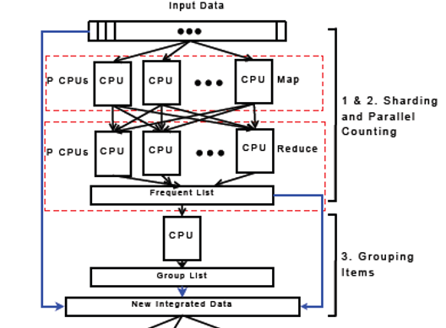
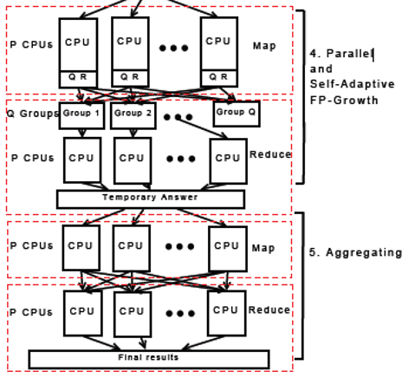
Background and Related Work (cont.)
Parallel FP-growth Algorithm
PFP [12] is a popular parallel frequent itemset mining algorithm that parallelize the classic FP-Growth algorithm. Recent work in parallel Apriori-like algorithm, such as sequence-growth that uses lexicographical tree, has to scan database multiple times and exchange large number of candidate itemset. PFP uses 3 MapReduce phases to parallelize FP-Growth shown in Fig 3.
FIGURE 3. PFP Computing Stages [12]

Slide 13
Background and Related Work (cont.)
FiDoop Model
FiDoop [13] is the most recent technique that incorporated FIU-tree [14] to mine frequent itemset mining. FIU-tree has certain advantages over traditional FP-tree. The following three MapReduce Jobs in FiDoop is explained briefly.
First MapReduce Job. The first MapReduce job creates all the frequent one-itemset. The transaction database is partitioned into multiple local files. Each mapper reads all the transactions from its local files sequentially and generates local one-itemsets. The reducer then combines all the local one-itemset and creates a global frequent.
Second MapReduce Job. The second MapReduce job scans the database second time to prune out the infrequent items from each transaction. The mapper here for each transaction outputs the k-itemset (2 ≤ k ≤ M where M is the maximum pruned value) with pruned out items as key and count one as value. The reducer then outputs the itemset id as key and value contains the itemset and the count as similar pruned out itemset may be generated.
Third MapReduce Job. The final MapReduce job decompose the k-itemset, construct the k-FIU-tree, and mines the frequent itemset. The mapper constructs FIU-tree from local decomposed itemsets of same length. The mapper finally outputs the number of items in itemset and the FIU-tree so itemsets of same length are passed to single reducer. The reducer then creates the h-FIU-tree and mines the frequent itemset by probing the count of leaves in h-FIU-tree.

Slide 14
Background and Related Work (cont.)
Research Gap
It is observed that Apriori-based interval pattern mining algorithms may lead to huge number of candidate patterns because of the complex relation that can exist between two intervals. This is then followed by tedious work of calculating support of those candidate patterns. Only recently, projection-based interval pattern mining algorithms are devised in which complexity only increases with the length of pattern.
The serial projection-based algorithms become infeasible when the dataset size increases too much. Since the pattern mining on interval data is itself an arduous task, to the best of my knowledge no prior work has been done to address the scalability issue on interval pattern mining. Therefore, there is a growing need to address the scalability issue in this area.

Slide 15
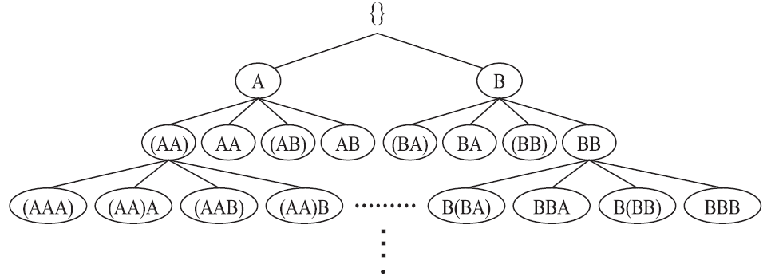
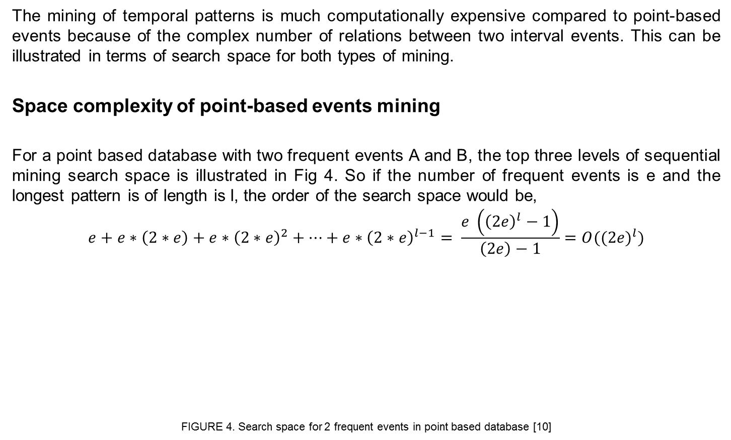
Proposed Methodology
The mining of temporal patterns is much computationally expensive compared to point-based events because of the complex number of relations between two interval events. This can be illustrated in terms of search space for both types of mining.
Space complexity of point-based events mining
For a point based database with two frequent events A and B, the top three levels of sequential mining search space is illustrated in Fig 4. So if the number of frequent events is e and the longest pattern is of length is l, the order of the search space would be,
$$e+e∗\left(2∗e\right)+e∗{\left(2∗e\right)}^{2}+…+e∗{\left(2∗e\right)}^{l−1}= \frac{e \left({\left(2e\right)}^{l}−1\right)}{\left(2e\right)−1}=O({(2e)}^{l})$$
FIGURE 4. Search space for 2 frequent events in point based database [10]

Slide 16
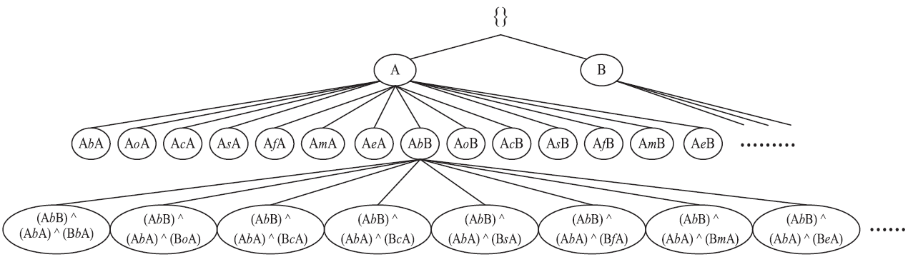
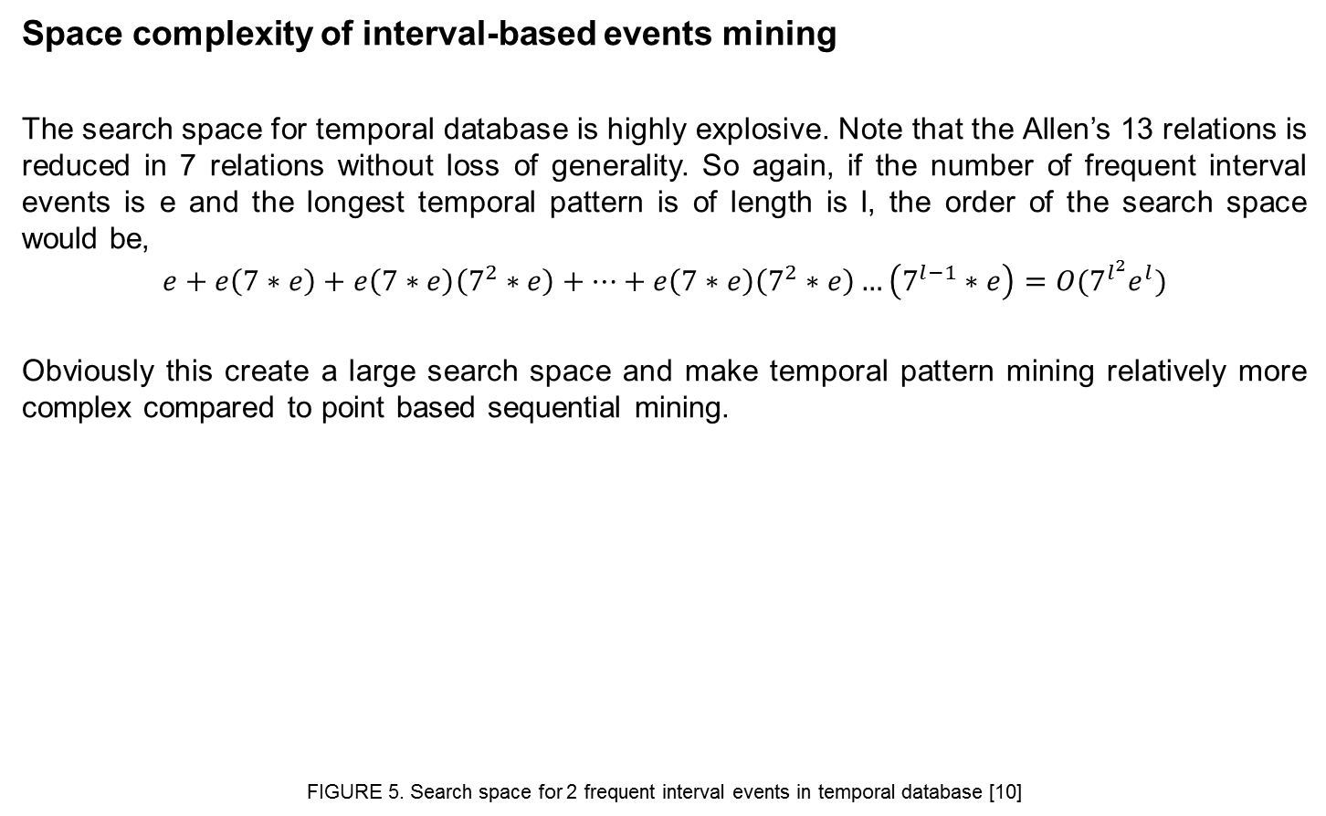
Proposed Methodology (cont.)
Space complexity of interval-based events mining
The search space for temporal database is highly explosive. Note that the Allen’s 13 relations is reduced in 7 relations without loss of generality. So again, if the number of frequent interval events is e and the longest temporal pattern is of length is l, the order of the search space would be,
$$e+e\left(7∗e\right)+e\left(7∗e\right)\left(7^{2}∗e\right)+…+e\left(7∗e\right)\left(7^{2}∗e\right)…\left(7^{l−1}∗e\right)=O({7^{l^{2}}e}^{l})$$
Obviously this create a large search space and make temporal pattern mining relatively more complex compared to point based sequential mining.
FIGURE 5. Search space for 2 frequent interval events in temporal database [10]

Slide 17
Proposed Methodology (cont.)
Representation Scheme
We used endtime representation [10] in implementation which is an extension to the endpoint representation used in previous work [6] for expressing temporal patterns.
TABLE 3. Endtime Representation Scheme

Slide 18
Proposed Methodology (cont.)
PIMiner Algorithm Framework

Slide 19
Proposed Methodology (cont.)
PISpan Procedure

Slide 20
Proposed Methodology (cont.)
PostEndpoints Procedure

Slide 21
Proposed Methodology (cont.)
ProjectDB Procedure

Slide 22
Proposed Methodology (cont.)
MapReduce Flowchart Frequent Starting Endpoints
FIGURE 6. PIMiner MapReduce Job Flowchart

Slide 23
Proposed Methodology (cont.)
KeyValue Example
FIGURE 7. Frequent Endpoints Generation

Slide 24
Experimental Setup
We have used Apache Spark which is a lightning-fast MapReduce based cluster computing framework designed for fast computation. The database used is HDFS with stands for Hadoop Distributed File System.
Standalone deployment is employed in which Spark sits above the HDFS and space for HDFS is though allocated explicitly. In this way both MapReduce and Spark and MapReduce run concurrently to complete all the Spark jobs in the cluster.
The most important feature of Spark is in-memory clustering cluster computing that increases the computation speed of an application as the intermittent time between two MapReduce steps the intermediate result is saved in memory and not on disk.
Spark is installed over the rack server via CDH (Cloudera Distribution of Hadoop) which is an open source Hadoop distribution provided by Cloudera Inc, an American enterprise software company. It is the most complete, robust and widely deployed Apache Hadoop distribution. More enterprises have used CHD than all the other distributions combined together.
The details of the CDH used is mentioned as following.
Version: Cloudera Express 5.6.0
Java VM Name: Java HotSpot(TM) 64-Bit Server VM
Java VM Vendor: Oracle Corporation
Java Version: 1.7.0_67

Slide 25
Experimental Setup (cont.)
The details of rack server installed in UGPC Lab to run the job is illustrated in Table 4. The data is distributed stored across HDFS DataNode and there are 6 standalone Spark Workers for carrying out the computation. All the implementation is done in python on Spark.
TABLE 4. Dell Rack Server UGPC Lab

Slide 26
Experimental Setup (cont.)
Finally, the Cloudera manager system to interact with the rack server has the following specifications.
OS: Ubuntu 12.04 LTS 64-bit
Memory: 11.6 GiB
Processor: Intel® Xeon(R) CPU E5-16500 @3.20GHz X12
Disk: 357.4 GB

Slide 27
Performance Study
The performance study of proposed PIMiner algorithm is carried out on both synthetic as well as real world datasets. We conduct several tests including execution time, distribution of patterns, number of sparks, effects of threads, and scalability tests among others.
Synthetic Data Generation
The synthetic datasets for experiments are generated as proposed by Srikant and Agarwal [10]. This proposed program was meant for time point-based events and hence needed to be modified accordingly. The several parameters that were used for synthetic temporal data generation are shown in Table 5.
TABLE 5. Synthetic Data Generation Parameters

Slide 28
Performance Study (cont.)
S10kC20E1k Dataset
First synthetic dataset used for experimental study has the aspects as shown in Table. The size of the dataset is only 2.2MB so effects of task parallelism is depicted only.
TABLE 6. S10kC20E1k Dataset Aspects
The execution time is compared against serial TPMiner for different values of threads in Fig 8. It is evident that only using task parallelism alone results in execution time improvement.

Slide 29
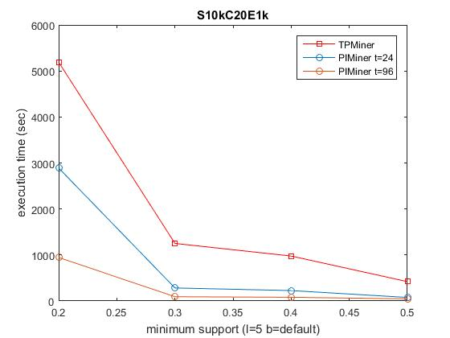
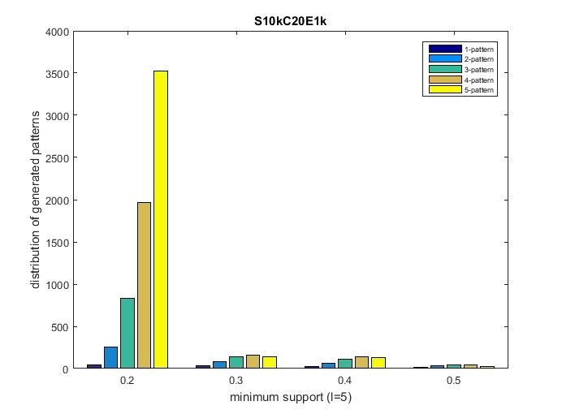
Performance Study (cont.)
FIGURE 8. Execution Time Analysis for S10kC20E1k
FIGURE 9. Distribution of Generated Patterns for S10kC20E1k
In Fig 9 the distribution of number of patterns of different lengths is shown. Notice that as the support decreases the longer patterns are more evident as a k-length pattern can be concatenated with numerous events with one of the several possible relations.

Slide 30
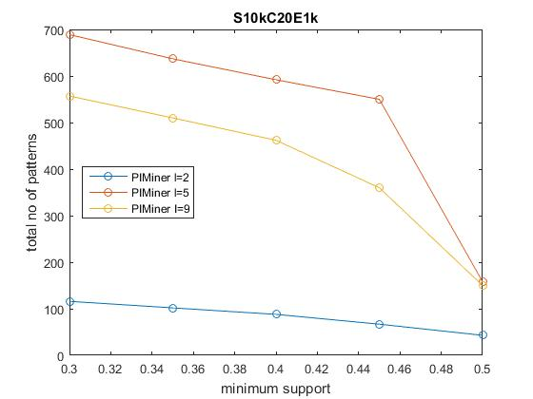
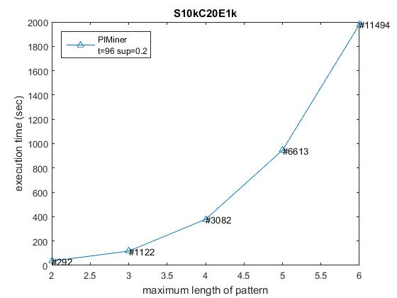
Performance Study (cont.)
FIGURE 10. Number of Patterns on Maximum Length of Patterns for S10kC20E1k
FIGURE 11. Performance Analysis on Maximum Length of Pattern for S10kC20E1k
The number of patterns generated by setting the maximum length of desired patterns is shown in Fig 10 which is not addressed in previous work on interval pattern mining. The execution time is shown in Fig 11 for different pattern length and is exponential as expected as longer patterns are more evident when maximum length is increased.

Slide 31
Performance Study (cont.)
ASL Dataset
In addition to the experiments on synthetic dataset, we have conducted the performance study on a real dataset to show the applicability of the algorithm and efficiency compared to traditional serial algorithms. The dataset we have used is of American Sign Language (ASL) dataset.
In ASL dataset we can determine the relationship between gesture field used and the grammatical structure. The dataset contains total of 730 utterances. Each of the utterance contains the gestural as well as the grammatical field. The complete specification of ASL dataset is shown in Table 7.
The size of the dataset is 213.6KB. So task parallelism is enough to observe the performance of the PIMiner compared to serial TPMiner.
TABLE 7. ASL Dataset Aspects

Slide 32
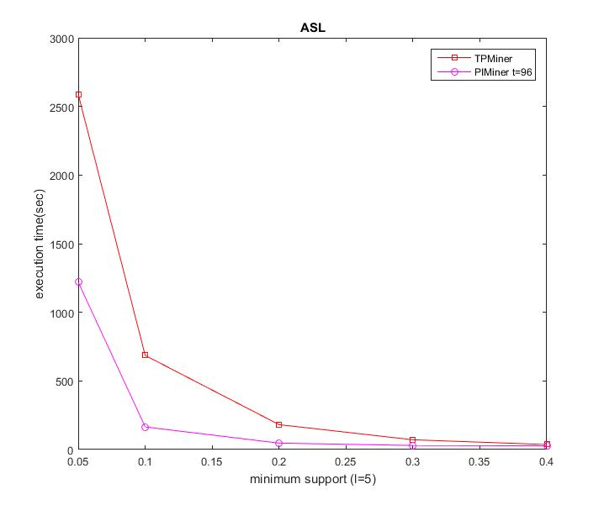
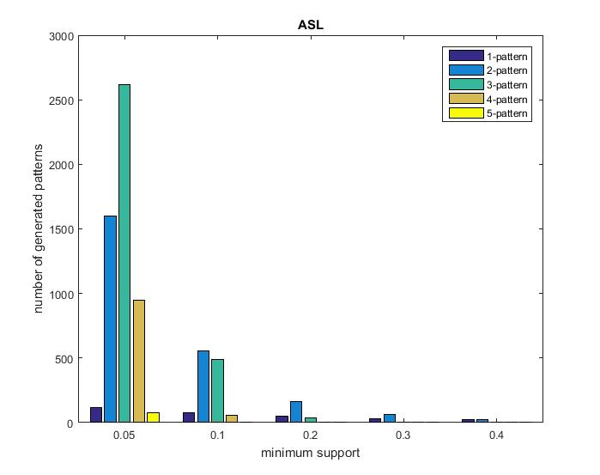
Performance Study (cont.)
FIGURE 12. Execution Time Analysis for ASL Dataset
FIGURE 13. Distribution of Generated Patterns for ASL Dataset
The block size is again default and the whole dataset is in the single block. The execution time is shown in Fig for different values of support. Fig shows distribution of generated patterns in the dataset. It can be inferred from it that the medium size patterns i.e. 3-length are more frequent phrases.

Slide 33
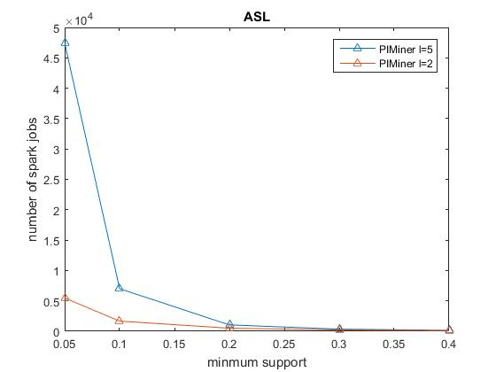
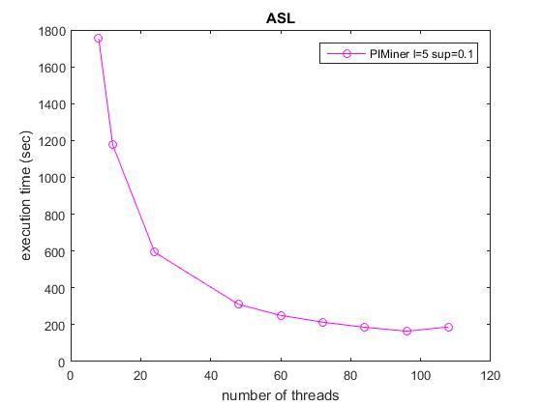
Performance Study (cont.)
FIGURE 14. Spark Jobs Analysis for ASL Dataset
FIGURE 15. Threads Influence on ASL Dataset
From Fig 14 we can observe that the number of spark jobs are increasing exponentially as the support is decreased which are associated with map, collect and reduce jobs. Also observer from the Fig 15 as the number of threads are increased the execution time is reduced but after a certain threshold the execution time starts increasing as scheduling those threads become expensive. This threshold is experimental system dependent mainly.

Slide 34
Performance Study (cont.)
S100kC40E1k Dataset
The synthetic dataset used for scalability test has the aspects as shown in Table 8. The size of the dataset is 45.4MB which is considerable in respect to interval pattern mining.
With this dataset we have mainly depicted the effects of data parallelism alone. The block size is taken as input so the dataset would be divided into blocks of specified size and distributed among the several data nodes using HDFS. The replication factor 3 is used.
TABLE 8. S100kC40E1k Dataset Aspects

Slide 35
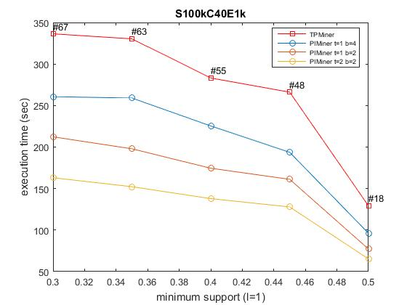
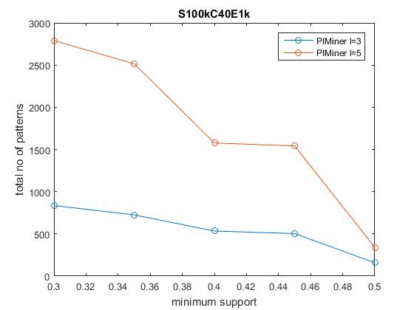
Performance Study (cont.)
FIGURE 16. Execution Time Analysis for S100kC40E1k
FIGURE 17. Patterns Generated on Maximum Length of Pattern on S100kC40E1k
The execution time of the proposed algorithm is plotted for three different configurations as t=1 b=4, t=1 b=2, and t=2 b=2 where t is number of threads and b is block size. Notice that even on using single thread block parallelism is enough improvement. The number of patterns is shown in Fig 17 for different maximum length of patterns.

Slide 36
Performance Study (cont.)
C40E1k set of Datasets
The final scalability test is conducted on the five synthetic datasets. The length of sequence and number of events is kept same for all five datasets. The size of the databases are 45.4MB, 91.0MB, 136.9MB, 185.5MB and 232.4MB respectively. The detailed specification of the datasets is shown in Table 9 mainly illustrating the differences among the datasets.
TABLE 9. C40E1k Dataset Aspects
First we execute serial TPMiner algorithm on the datasets. As serial algorithm takes much time the maximum length of sequence is set to 2 only. The execution time is plotted for different support values in Fig 18 and is roughly linear as the sequences are increased.

Slide 37
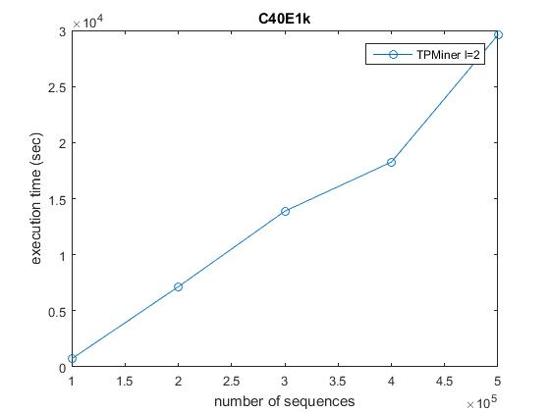
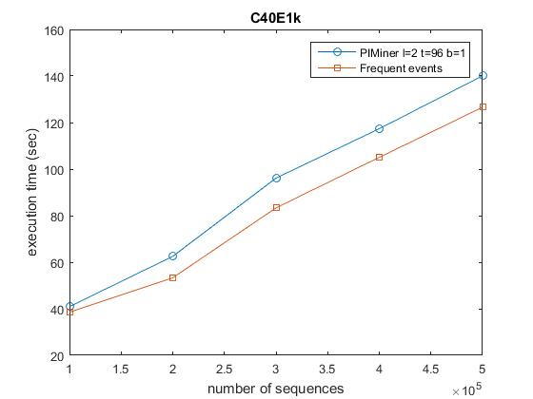
Performance Study (cont.)
FIGURE 18. TPMiner Performance Analysis on C40E1k
FIGURE 19. PIMiner Performance Analysis on C40E1k
The execution time of PIMiner for same I = 2 is plotted in Fig 19. Note that here we have tried to achieve maximum performance by tweaking both the parameters several times by number of threads and block size to t = 96 and b = 1MB respectively. Notice the considerable execution time improvement in two cases where TPMiner is taking time in order of several thousand seconds and PIMiner is taking only in few hundred seconds

Slide 38
Conclusion and Future Scope
Mining of frequent temporal patterns on interval based data is a crucial subfield of data mining. The complex relations among intervals make it inherently arduous to design efficient distributed temporal pattern mining algorithm. All the current pattern mining algorithms on interval-based events are sequential in nature. They cannot scale to large data set which cannot be stored in single memory. The various parallel techniques proposed in mining frequent patterns are carried out on point-based events and not on interval events. In this work, we have developed a new algorithm PIMiner which runs in distributed fashion, which is a first such attempt on interval pattern mining.
PIMiner employs both task and data parallelism techniques and is therefore highly scalable. The performance study of PIMiner indicate that the algorithm is much efficient compared to serial temporal pattern mining algorithms as it is evident when stacked against the state-of-the-art serial algorithm for mining temporal patterns.
Future Scope
There are several possible interesting issues that could be addressed in future. To the best of my knowledge, the main issues that are not addressed anywhere regarding parallel interval pattern mining are as follows:

Slide 39
Conclusion and Future Scope (cont.)
No techniques is developed to utilize GPU computations in finding the frequent patterns in interval data. Although GPU based techniques for instantaneous events are presented which can help in tackling this issue. In order to achieve this an entirely new techniques need to be devised so that there is some portion of algorithm which can run in parallel on GPU cores.

Slide 40
References
[1] Internet Source. Article at theGuardian (2013). How much data the NSA really gets. Source url: www.theguardian.com/commentisfree/2013/aug/13/nsa-internet-traffic- surveillance
[2] Internet Source. Aricle at Wikipedia (2017). Parallel Programming Model. Source url: https://en.wikipedia.org/wiki/Parallel_programming_model
[3] Allen, J. F. (1983). Maintaining knowledge about temporal intervals. Commun. ACM,
26(11):832–843.
[4] Kam, P.-s. and Fu, A. W.-C. (2000). Discovering temporal patterns for interval-based
events. In International Conference on Data Warehousing and Knowledge discovery, pages 317–326. Springer.
[5] H¨oppner, F. and Klawonn, F. (2001). Finding informative rules in interval sequences. In International Symposium on Intelligent Data Analysis, pages 125–134. Springer.
[6] Wu, S. Y. and Chen, Y. L. (2007). Mining non ambiguous temporal patterns for interval based events. IEEE Transactions on Knowledge and Data Engineering, 19(6):742-758.
[7] Batal, I., Cooper, G. F., Fradkin, D., Harrison Jr, J., Moerchen, F., and Hauskrecht, M.
(2016). An efficient pattern mining approach for event detection in multivariate temporal data. Knowledge and information systems, 46(1):115–150.

Slide 41
References (cont.)
[8] Papapetrou, P., Kollios, G., Sclaroff, S., and Gunopulos, D. (2005). Discovering frequent arrangements of temporal intervals. In Data Mining, Fifth IEEE International Conference on, pages 8–pp. IEEE.
[9] Sadasivam, R. and Duraiswamy, K. (2013). Efficient approach to discover interval- based sequential patterns. Journal of Computer Science, 9(2):225.
[10] Chen, Y. C., Peng, W. C., and Lee, S. Y. (2015). Mining temporal patterns in time interval based data. IEEE Transactions on Knowledge and Data Engineering, 27(12):3318–3331.
[11] Yi-Cheng, L. and Chen, Julia Tzu-Ya, S.-Y. (2016). Incremental mining of temporal
patterns in interval-based database. Knowledge and Information Systems, 46(2):423–448.
[12] Li, H., Wang, Y., Zhang, D., Zhang, M., and Chang, E. Y. (2008). Pfp: parallel fp- growth for query recommendation. In Proceedings of the 2008 ACM conference on Recommender systems, pages 107–114. ACM.
[13] Xun, Y., Zhang, J., and Qin, X. (2016). Fidoop: Parallel mining of frequent itemsets using mapreduce. IEEE Transactions on Systems, Man, and Cybernetics: Systems, 46(3):313–325.
[14] Tsay, Y.-J., Hsu, T.-J., and Yu, J.-R. (2009). Fiut: A new method for mining frequent
itemsets. Information Sciences, 179(11):1724–1737.

Slide 42
Thank You!

