Slide 1
Dual Degree Project Stage-I Heterogeneous-ISA Polymorphic Architecture: Exploiting ILP-TLP tradeoffs above ISA affinity
Prakhar Diwan
180100083@iitb.ac.in Guide: Prof. Virendra Singh

Slide 2
Outline
Introduction
Literature Survey
Proposed Architecture
Work Done
Conclusion & Future Work
Notes:
Let’s have a look @ the outline.

Slide 3
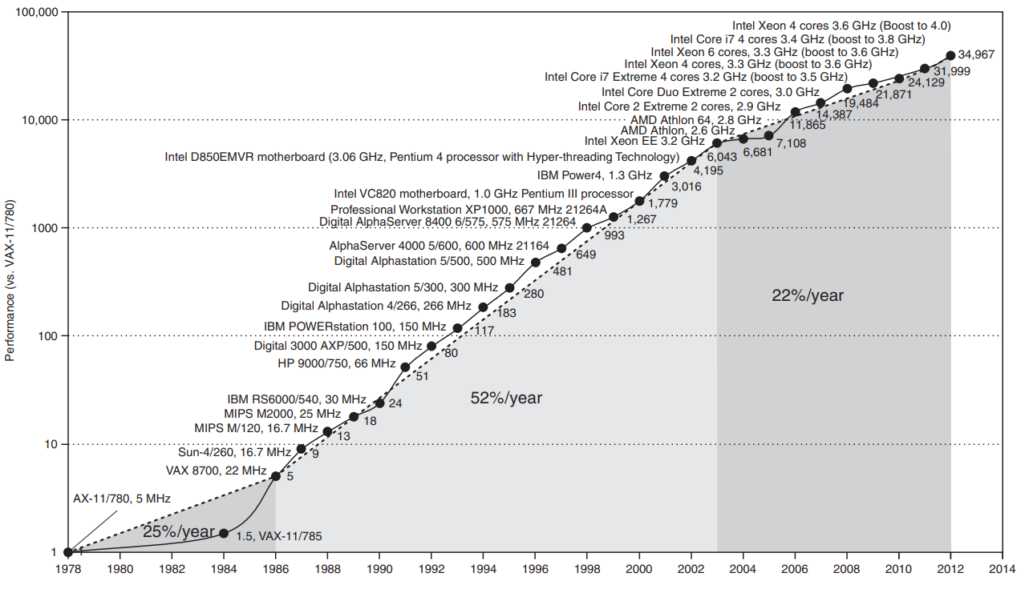
Processor’s Evolution
[1] J. L. Hennessy and D. A. Patterson, Computer Architecture, Fifth Edition: A Quantitative Approach. 5th ed., 2011.
Notes:
In last century, focus of microprocessor technology was to develop faster cores → “The Faster The Better”
After various improvements in performance, system frequency reached its limit “Power Wall”
For advancing microprocessor technology further, multi-core was invented to meet performance demands
Multicore achieved performance gains by exploiting parallelism present in modern apps → increasing throughput

Slide 4
Drawbacks of Multicore
Single-threaded (ST) perf. became a bottleneck as per Amdahl’s Law [2]
Low utilization for low parallelism phases, also low energy efficiency
Due to shared structures b/w cores, it is vulnerable to information leakage
[2] G. M. Amdahl, “Validity of the single processor approach to achieving large scale computing capabilities,” AFIPS ’67 (Spring)
Notes:
Single-threaded (ST) performance became a bottleneck as per Amdahl’s Law [2], and since significant part of program (on avg) remains ST, which is a major issue
Multiple cores lead to low utilization for the ST phases and even coarse multi-threaded (MT) phases. Also leading to increased power consumption
Due to sharing of structures among the cores, multicore is vulnerable to information leakage as well
Example give of timing side-channel attacks via LLC : Flush+Reload, Prime+Probe etc.. TLB: TLBleed, TLP

Slide 5
Single-threaded Performance
Improving ST performance:
Using Heterogeneous ISA Dynamic Core (HIDC) by
Executing phases on ISA affine core
Reduction in migration latency due to shared memory
Drawbacks of HIDC -
Gives suboptimal performance for parallel phases in apps
Unable to dynamically adapt to parallelism in program
Leading to poor performance and power for parallel phases
Notes:
Instruction Level Parallelism & Thread Level Parallelism
Improving ST performance in multicore would lead to improved overall performance
Effective utilization & energy efficiency of multicore systems also remain a concern
Modern-day applications are very diverse across phases of the same run (from sequential to highly parallel) exerting different demands on hardware
Enforcing the need of a dynamic architecture capable of exploiting various phases of program to improve overall performance & energy efficiency

Slide 6
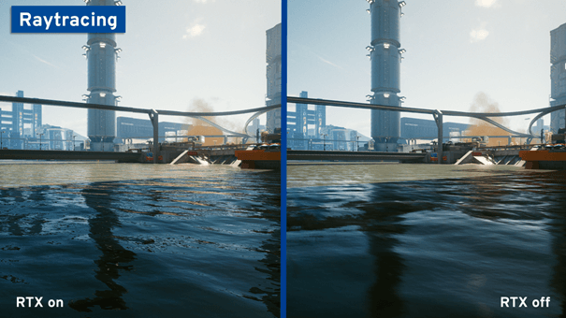



https://www.simplilearn.com/computer-vision-article
https://www.anandtech.com/show/16078/the-2020-browser-battle-surfing-with-speed
https://www.ionos.com/digitalguide/server/know-how/ray-tracing/
https://www.btcc.com/en-US/academy/research-analysis/cryptocurrency-futures-trading-a-complete-guide-for-beginners
Notes:
Computer Vision Applications like body tracking
https://www.simplilearn.com/computer-vision-article
Browsing is another multithreaded application and is most frequently used modern application
https://www.anandtech.com/show/16078/the-2020-browser-battle-surfing-with-speed
Ray tracing is a type of graphics technology that realistically calculates visible and invisible rays of light. It enables lifelike lighting in computer games and animated 3D graphics and is increasingly used as a hardware feature in the form of real-time ray tracing
https://www.ionos.com/digitalguide/server/know-how/ray-tracing/
Options and derivatives pricing, which are used in trading industry.. One such example application is blackscholes option pricing models..

Slide 7
Multithreading is everywhere today
https://www.simplilearn.com/computer-vision-article
https://www.anandtech.com/show/16078/the-2020-browser-battle-surfing-with-speed
https://www.ionos.com/digitalguide/server/know-how/ray-tracing/
https://www.btcc.com/en-US/academy/research-analysis/cryptocurrency-futures-trading-a-complete-guide-for-beginners
Notes:
Computer Vision Applications like body tracking
https://www.simplilearn.com/computer-vision-article
Browsing is another multithreaded application and is most frequently used modern application
https://www.anandtech.com/show/16078/the-2020-browser-battle-surfing-with-speed
Ray tracing is a type of graphics technology that realistically calculates visible and invisible rays of light. It enables lifelike lighting in computer games and animated 3D graphics and is increasingly used as a hardware feature in the form of real-time ray tracing
https://www.ionos.com/digitalguide/server/know-how/ray-tracing/
Options and derivatives pricing, which are used in trading industry.. One such example application is blackscholes option pricing models..

Slide 8
Motivation
Modern workloads are diverse & can be split into phases
Enforcing the need for a dynamic architecture that is capable of exploiting various phases
based on ISA affinity
based on parallelism
To improve energy efficiency and performance
Notes:
Modern workloads are diverse & can be split into phases based on ISA affinity and parallelism
Instruction Level Parallelism & Thread Level Parallelism
Improving ST performance in multicore would lead to improved overall performance
Effective utilization & energy efficiency of multicore systems also remain a concern
Modern-day applications are very diverse across phases of the same run (from sequential to highly parallel) exerting different demands on hardware
Enforcing the need of a dynamic architecture capable of exploiting various phases of program to improve overall performance & energy efficiency

Slide 9
Literature Survey
Notes:
This dimension has been shown to have significant potential by previous researchers, to improve performance and energy consumption. Let’s have a look @ a few architectures proposed in this area.

Slide 10
Exploiting ISA Affinity
Notes:
Heterogeneous architecture research

Slide 11
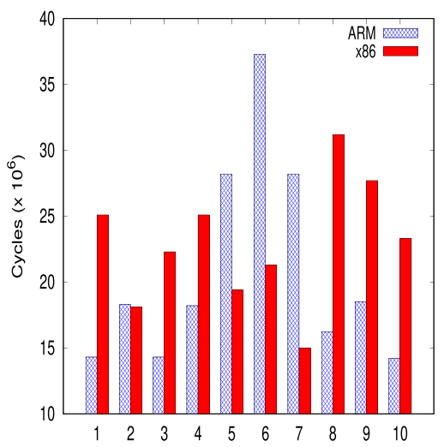
Diverse Workloads: ISA Affinity
An application can be divided into multiple phases
Each phase may have different characteristics
Phases may have affinity towards diff. types of ISA
Reason?
[3] Performance for different phases of sjeng benchmark from SPEC CPU2006[4]
[3] N. K. Boran et. al, “Fine-grained scheduling in heterogeneous-isa architectures,” IEEE Computer Architecture Letters, 2021.
[4] J. L. Henning, “Spec cpu2006 benchmark descriptions,” SIGARCH Comput. Archit. News, vol. 34, p. 1–17, sep 2006.
Notes:
A program is said to have affinity towards an ISA if it performs better on that ISA compared to the chosen reference ISA.

Slide 12
ISA Diversity
Different ISA may have different set of features, like:
Architectural register file size
Types of memory operand support
Format of instructions
Types of operation support
These affect various performance parameters:
Register pressure
Code Density
Dynamic Instruction Count
[5] A. Venkat et. al, “Harnessing isa diversity: Design of a heterogeneous-isa chip multiprocessor,” in ISCA, 2014
Notes:
Register pressure is proportional to number of memory accesses required affected by number of registers in RF.
For eg: higher code density leads to 1. reduced I-cache misses, 2. conserves power due to less fetching
Another factors of diversity:
X86 is CISC type ISA and has variable length encoding, whereas Alpha, ARM are RISC type ISA and have fixed length encoding
Have different operations and addressing modes support

Slide 13
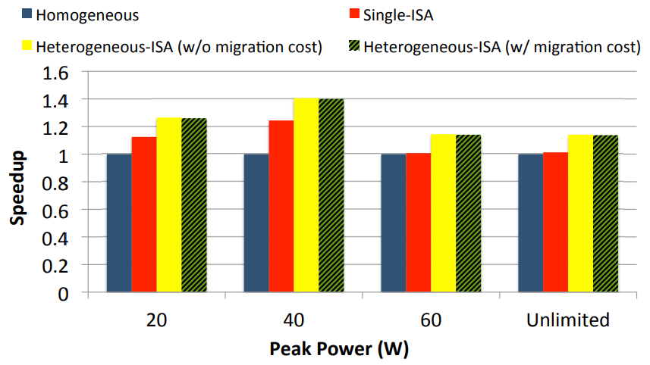
Harnessing ISA Diversity
CMP consisting of different ISA cores
Only one core is active at a time
Process migrates between cores as per its affinity
But used oracle schedule! How to realize this?
[4] Overall speedup on SPEC CPU2006[5]
[4] J. L. Henning, “Spec cpu2006 benchmark descriptions,” SIGARCH Comput. Archit. News, 2006.
[5] A. Venkat et. al, “Harnessing isa diversity: Design of a heterogeneous-isa chip multiprocessor,” in ISCA, 2014
Notes:
Each core shares only L2 cache
Okay so here

Slide 14
ISA Affinity-based Scheduling
Boran et. al [6] proposed coarse-grain scheduling with ~100M instr phases
Estimate perf(inactive-ISA core) using regression models on active-ISA params
Utilize heuristics to decide on next phase’s schedule
Migration overhead ~ 5-150 μs [5]
[5] A. Venkat et. al, “Harnessing isa diversity: Design of a heterogeneous-isa chip multiprocessor,” in ISCA, 2014
[6] N. K. Boran et. al, “Classification based Scheduling on Heterogeneous-ISA Multi-core Architectures”, VDAT 2020
Notes:
Idea was to estimate performance of inactive-ISA core for the current phase using regression models with active-ISA micro-arch params such as branch mispredictions, cache misses, SQ Full events, etc.
such as branch mispredictions, cache misses, SQ Full events, etc.

Slide 15
Exploiting Parallelism
A multithreaded (MT) program in execution
P0,1,2,3,4 → Phases
Thicker → Higher ILP
P0
P1
P2
P3
P4
Notes:
This dimension has been shown to have significant potential by previous researchers, to improve performance and energy consumption. Let’s have a look @ a few architectures proposed in this area.

Slide 16
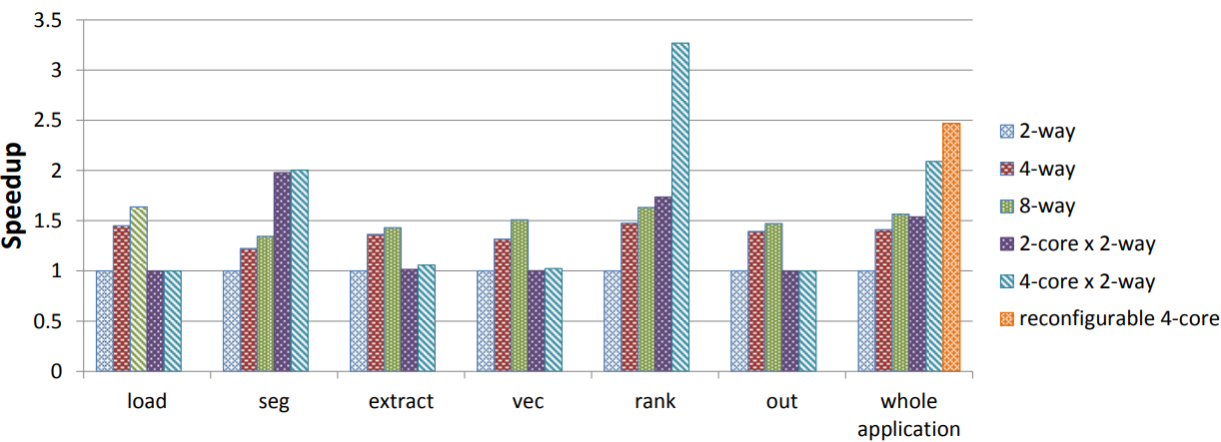
Diverse Workloads: Parallelism
[8] Speedup trends for Ferret kernels [11]
[8] M. Pricopi et. al, “Bahurupi: A polymorphic heterogeneous multi-core architecture,” TACO 2012
[11] C. Bienia et al. , “The parsec benchmark suite: Characterization and architectural implications,” PACT 2008.
Notes:
Ferret →content-based similarity search of feature-rich data such as audio, images. The reason for the inclusion: it represents emerging next-generation desktop and Internet search engines for non-text document data types. Image similarity search.
Ferret is parallelized using the pipeline model with six stages. The first and the last stage are for input and output. The middle four stages are for query image segmentation, feature extraction, indexing of candidate sets with multi-probe Locality Sensitive Hashing (LSH) [60] and ranking. Each stage has its own thread pool and the basic work unit of the pipeline is a query image.

Slide 17
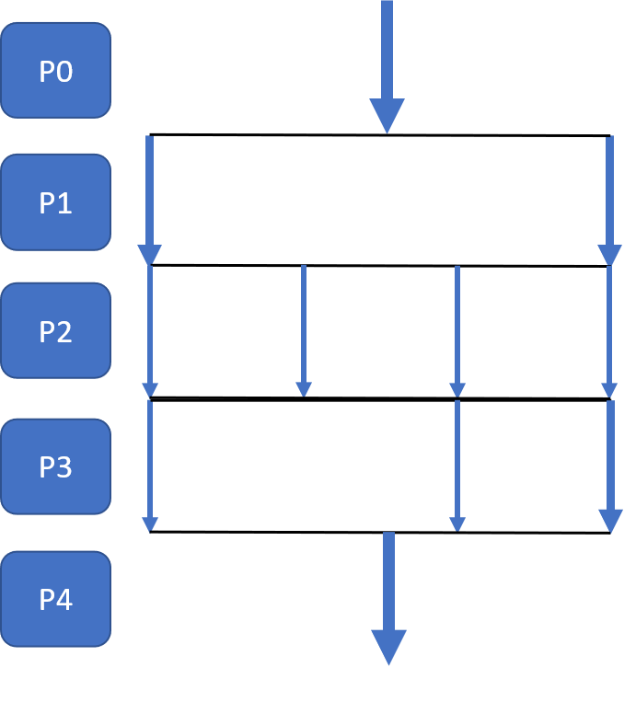
Core Fusion - Idea
Combine multiple simple independent cores dynamically to form a larger core
How this helps?
Fuse cores into a few powerful cores for sequential phases (ILP extraction)
Independent execution for fine-grain parallel phases (TLP extraction)
Intermediate fused configuration for low parallelism phases
[7] E. Ipek et. al, “Core fusion: Accommodating software diversity in chip multiprocessors,” ISCA 2007

Slide 18
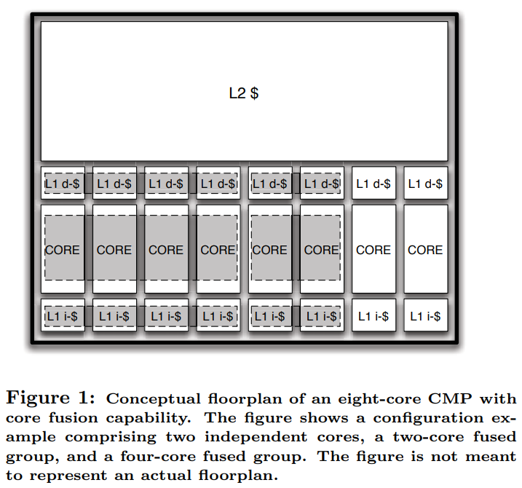
Core Fusion - Overview
[7] E. Ipek et. al, “Core fusion: Accommodating software diversity in chip multiprocessors,” ISCA 2007
Notes:
Core Fusion builds on top of a substrate comprising 8 identical 2-issue O3 cores along with:
A bus connecting their private L1-I and L1-D caches to assure data coherence
On-chip L2 cache and memory controller on the other side of the bus
Additional covering hardware for managing the fusion of cores referred as core fusion fabric

Slide 19

When to reconfigure?
P0
P1
P2
P3
P4
[7] E. Ipek et. al, “Core fusion: Accommodating software diversity in chip multiprocessors,” ISCA 2007
Notes:
Application requests core fusion/split actions via FUSE & SPLIT ISA instructions
These requests can be enveloped inside parallelizing macros or directives (e.g. OpenMP’s fork-join model)
These instructions are executed conditionally by hardware based on the value of an OS-visible control register indicative of eligible cores for fusion

Slide 20
When to reconfigure?
P0
App. requests fusion/split actions via FUSE & SPLIT ISA instructions
Requests enveloped inside macros or directives (e.g. OpenMP’s fork-join model)
These instructions are executed conditionally by HW
P1
P2
P3
P4
[7] E. Ipek et. al, “Core fusion: Accommodating software diversity in chip multiprocessors,” ISCA 2007
Notes:
Application requests core fusion/split actions via FUSE & SPLIT ISA instructions
These requests can be enveloped inside parallelizing macros or directives (e.g. OpenMP’s fork-join model)
These instructions are executed conditionally by hardware based on the value of an OS-visible control register indicative of eligible cores for fusion

Slide 21
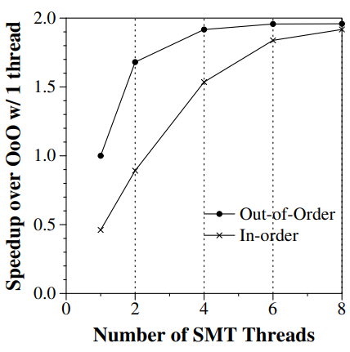
MorphCore
Combine O3 and highly-threaded InO SMT execution in a single core
Built on 2 key insights:
A highly threaded [HT] (6-8 way SMT) InO core can achieve >= performance as an O3
A HT InO SMT core can be built using a subset of HW reqd. to build an aggressive O3 core
[9] Khubaib et. al, “Morphcore: An energy-efficient microarchitecture for high performance ilp and high throughput tlp,” MICRO 2012
Notes:
MorphCore, a new microarchitecture that combines out-of-order and highly-threaded in-order SMT execution within a single core. We comprehensively describe the microarchitecture needed to implement MorphCore, and the policy to switch between modes

Slide 22
Proposed Architecture
Notes:
This dimension has been shown to have significant potential by previous researchers, to improve performance and energy consumption. Let’s have a look @ a few architectures proposed in this area.

Slide 23
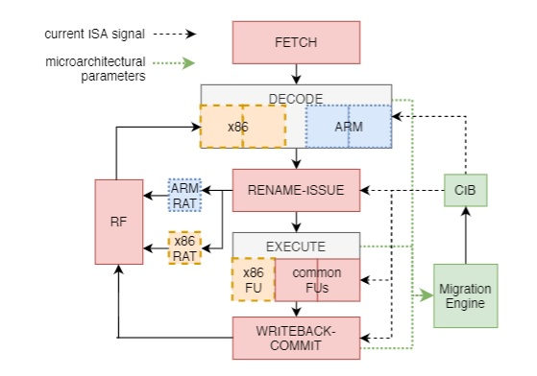
Het-ISA Dynamic Core
Notes:
This is the previous in-house work,
Het-ISA Dynamic Core, is a single-core system which is capable of dynamically migrating & reconfiguring itself b/w ARM and X86 ISA core. The pipeline dynamically adjusts resources such as different functional units, decoders, etc., in the core according to the demand of current executing ISA
This is an in-house work.. Here we see the various stages of the out-of-order engine along with the Migration Engine & CiB which are used for scheduling on the most affine core.,.
The MEC monitors multiple micro-architectural parameters and then dynamically decides the affined ISA based on these parameters for the program. The information of the currently executing ISA is stored in a 1-bit register which can be accessed in a manner similar to model-specific registers. We call this bit as Current-ISA Bit (CIB).
The HIDC architecture contains a superset of the resources that are required by all ISAs. HIDC contains separate decoders for respective ISA, while all of the pipeline stages are shared among all ISAs with appropriate resources as indicated by the CIB. In order to save energy, the resources which are not required by the current ISA are clock-gated.
Each ISA utilizes different number of architecture registers, hence separate register allocation tables (RAT) are used depending upon the value of CIB
Different store buffer are present for each ISA, and the active store buffer would be decided by the CIB. This is done because store policy varies as per the ISA, e.g., x86 has total store order (TSO) and ARM retires in lazy order.

Slide 24
Het-ISA Polymorphic Architecture
Aim: Exploit ILP-TLP & ISA affinity of phases from modern workloads
ARM and X86 ISAs are considered due to popularity & diversity
Capable of aggressive extraction of ILP to moderate TLP extraction
For ISA affinity-based schedule, various models proposed [3, 6]
For parallelism, need #live threads(n) to schedule on optimal config (will be done with OS support)
[3] N. K. Boran et. al, “Fine-grained scheduling in heterogeneous-isa architectures,” IEEE Computer Architecture Letters, 2021.
[6] N. K. Boran et. al, “Classification based Scheduling on Heterogeneous-ISA Multi-core Architectures”, VDAT 2020
Notes:
So the proposal is using the inhouse-HIDC to make multi-core HIDC.. And then exploit the application of ideas such as MorphCore & Core Fusion

Slide 25
Work Done
Notes:
This dimension has been shown to have significant potential by previous researchers, to improve performance and energy consumption. Let’s have a look @ a few architectures proposed in this area.

Slide 26
How to find n?
In MT programs, thread handling is done via libraries such as pthreads
Steps followed:
Declare “n” as a global variable i.e. visible to all threads
Initialize it with #threads to use in a run of workload
Decrement “n” with every thread termination
Notes:
This section is required to be atomic (done using mutex)
for simulation

Slide 27
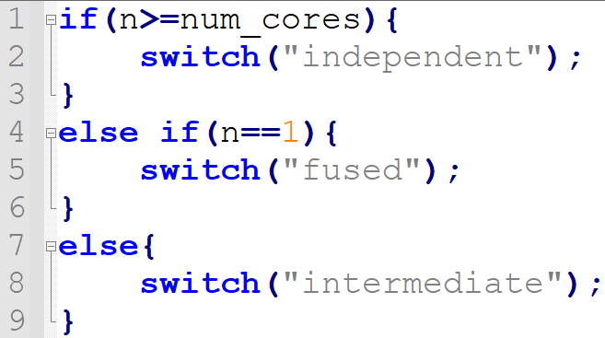
Scheduling based on n?
Based on n, can switch config as follows:

Slide 28
Experimental setup
For modeling, the gem5 [10] simulator is used in Full System mode
PARSEC [11] suite is used for MT benchmarks
SPEC CPU2006 [4] is used for ST benchmarks
[4] J. L. Henning, “Spec cpu2006 benchmark descriptions,” SIGARCH Comput. Archit. News 2006.
[10] N. Binkert et al., “The gem5 simulator,” SIGARCH Comput. Archit. News 2011.
[11] C. Bienia et al. , “The parsec benchmark suite: Characterization and architectural implications,” PACT 2008

Slide 29
C1,C2,C4 Parameters
Core | C1 | C2 | C4
F/D/I/E/W/C/S Width | 2 | 4 | 8
LQ Entries | 8 | 16 | 32
SQ Entries | 8 | 16 | 32
Instr Queue Entries | 16 | 32 | 64
ROB Size | 48 | 96 | 192
Phy Int & FP registers | 64 | 128 | 256
Int ALU | 2 | 4 | 8
Int MULT/Div | 1 | 2 | 4
FP ALU | 1 | 2 | 4
FP MULT/Div | 1 | 2 | 4
RdWr Ports to Mem | 1 | 2 | 4
L1-D $ (in kB) | 16 | 32 | 64
L1-I $ (in kB) | 8 | 16 | 32
L2 $ | 512 kB | 1MB | 2MB
L3 (shared) $ (in MB) | 16 | 16 | 16
Notes:
F-fetch, D-Decode, I-Issue, E-Execute, W-Writeback, C-Commit, S-Squash

Slide 30
Planned Experiments
Running 4-threaded BM on G1, 2-threaded on G2, single-threaded on G3 configuration
G1 - Independent Quad-core configuration (4XC1)
G2 - Intermediate two-core configuration (2XC2)
G3 - Fused single-core configuration (1XC4)
Simulation of Core Fusion[7] on het-ISA CMP
Simulation of MorphCore[9] on het-ISA CMP
[7] E. Ipek et. al, “Core fusion: Accommodating software diversity in chip multiprocessors,” ISCA 2007
[9] Khubaib et. al, “Morphcore: An energy-efficient microarchitecture for high performance ilp and high throughput tlp,” MICRO 2012

Slide 31
Challenges
Gem5 FS is giving errors for some benchmarks due to MSB flipping in 64-bit systems
Said fixed in the latest version but the kernel itself isn’t loading
In FS, the use of matching address of fn to get dyn. inst. count isn’t working
Kernel handling the memory image → VA-PA matching issue
SMT support not included in FS mode

Slide 32
Conclusion & Future Work
Conclusion:
Proposed Architecture has potential of exploiting both parallelism (ILP, TLP) & ISA affinity
Future Work:
Performing planned experiments
Approximation of migration time b/w configs

Slide 33
Thank You

Slide 34
References
[1] J. L. Hennessy and D. A. Patterson, Computer Architecture, Fifth Edition: A Quantitative Approach. San Francisco, CA, USA: Morgan Kaufmann Publishers Inc., 5th ed., 2011.
[2] G. M. Amdahl, “Validity of the single processor approach to achieving large scale computing capabilities,” in Proceedings of the April 18-20, 1967, Spring Joint Computer Conference, AFIPS ’67 (Spring), (New York, NY, USA), p. 483–485, Association for Computing Machinery, 1967
[3] N. K. Boran, S. Rathore, M. Udeshi, and V. Singh, “Fine-grained scheduling in heterogeneous-isa architectures,” IEEE Computer Architecture Letters, vol. 20, no. 1, pp. 9–12, 2021.
[4] J. L. Henning, “Spec cpu2006 benchmark descriptions,” SIGARCH Comput. Archit. News, vol. 34, p. 1–17, sep 2006.

Slide 35
References
[5] A. Venkat and D. M. Tullsen, “Harnessing isa diversity: Design of a heterogeneous-isa chip multiprocessor,” in 2014 ACM/IEEE 41st International Symposium on Computer Architecture (ISCA), pp. 121–132, 2014
[6] N. K. Boran, D. K. Yadav, and R. Iyer, “Classification based scheduling in heterogeneous isa architectures,” in 2020 24th International Symposium on VLSI Design and Test (VDAT), pp. 1–6, 2020.
[7] E. Ipek, M. Kirman, N. Kirman, and J. F. Martinez, “Core fusion: Accommodating software diversity in chip multiprocessors,” ISCA ’07, (New York, NY, USA), p. 186–197, Association for Computing Machinery, 2007.
[8] M. Pricopi and T. Mitra, “Bahurupi: A polymorphic heterogeneous multi-core architecture,” ACM Transactions on Architecture and Code Optimization (TACO), vol. 8, Jan 2012.

Slide 36
References
[9] Khubaib, M. A. Suleman, M. Hashemi, C. Wilkerson, and Y. N. Patt, “Morphcore: An energy-efficient microarchitecture for high performance ilp and high throughput tlp,” in 2012 45th Annual IEEE/ACM International Symposium on Microarchitecture, pp. 305–316, 2012
[10] N. Binkert, B. Beckmann, G. Black, S. K. Reinhardt, A. Saidi, A. Basu, J. Hestness, D. R. Hower, T. Krishna, S. Sardashti, R. Sen, K. Sewell, M. Shoaib, N. Vaish, M. D. Hill, and D. A. Wood, “The gem5 simulator,” SIGARCH Comput. Archit. News, vol. 39, p. 1–7, aug 2011.
[11] C. Bienia, S. Kumar, J. P. Singh, and K. Li, “The parsec benchmark suite: Characterization and architectural implications,” in 2008 International Conference on Parallel Architectures and Compilation Techniques (PACT), pp. 72–81, 2008.

Slide 37
Research Gap
To date, het-ISA reconfigurable CMP architectures remain unexplored
Combining benefits from ISA and microarchitecture heterogeneity:
Single-threaded: Dynamic CMP + ISA Affinity gains
Multi-threaded: Dynamic CMP + ISA Affinity + InO SMT gains

Slide 38
Evaluated Architectures
CMP Configuration | Composition (Cores)
CoreFusion | 8x2-issue
FineGrain-2i | 9x2-issue
CoarseGrain-4i | 4x4-issue
CoarseGrain-6i | 2x6-issue
Asymmetric-4i | 1x4-issue + 6x2-issue
Asymmetric-6i | 1x6-issue + 4x2-issue
[7] E. Ipek et. al, “Core fusion: Accommodating software diversity in chip multiprocessors,” ISCA 2007

Slide 39
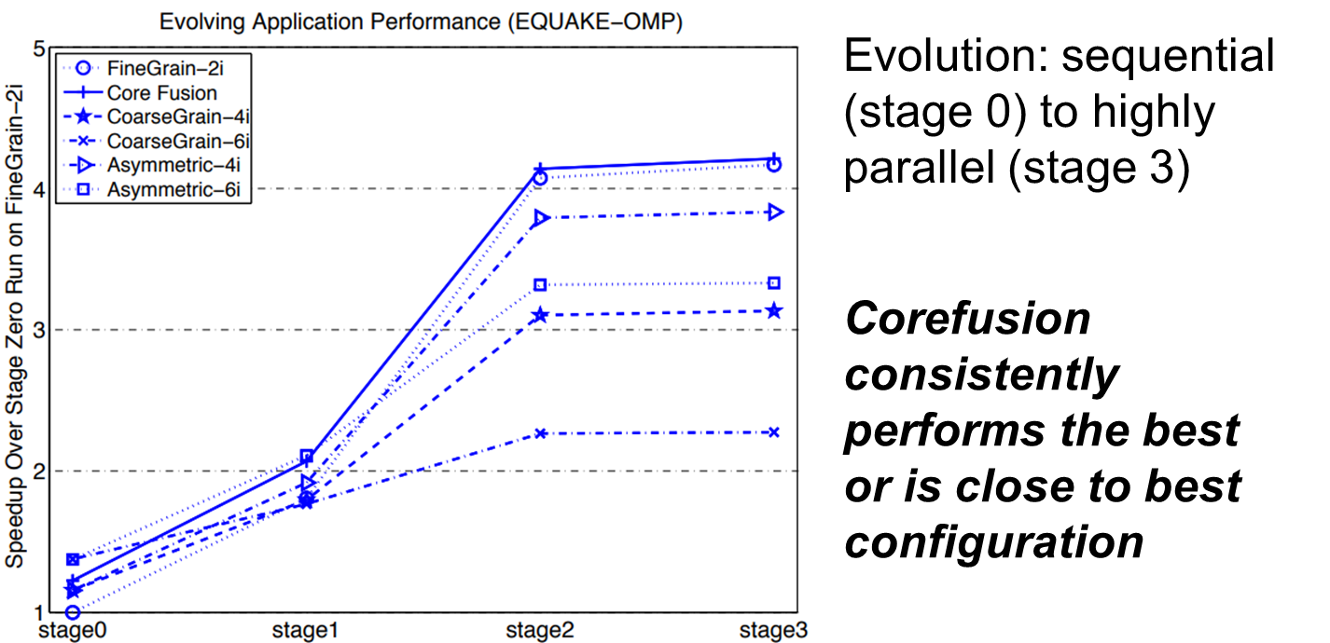
Core Fusion - Results
[7] E. Ipek et. al, “Core fusion: Accommodating software diversity in chip multiprocessors,” ISCA 2007
Notes:
Baseline in single-threaded (sequential) run on fine-grain-2i configuration
Benchmark SPEC-OPENMP- EarthQuake Model

Slide 40
Bahurupi
It is another reconfigurable CMP architecture
However, a hw-sw solution, requires minimal hw resources & compiler changes
In coalition mode, it follows distributed execution model:
Basic blocks as the unit of execution for the cores
Executed in parallel on coalition cores
More instructions in window → more ILP extraction opportunities
[8] M. Pricopi et. al, “Bahurupi: A polymorphic heterogeneous multi-core architecture,” TACO 2012
Notes:
In normal mode, it executes multi-threaded (MT) programs on set of homogeneous cores
The compiler splits the programs into basic blocks & adds a sentinel instruction at their start
LI and LO registers correspond to inter basic block dependencies
LI & LO information is transferred to hardware through the added “sentinel” instruction
As inter-BB dependencies are captured via sentinel instructions, in-order fetching of them meets the needs
For DEM to work efficiently for parallel execution of basic blocks, we need to:
Resolve register and memory dependencies among the basic blocks to maintain correctness [hw-sw co-operative solution proposed]
Ensure that cores fetch, decode, rename and commit the basic blocks in program order
Execution of instructions from diff basic blocks can be performed in O3 fashion parallelly, giving most of the speedup

Slide 41
Bahurupi
It is another reconfigurable CMP architecture
However, a hw-sw solution, requires minimal hw resources & compiler changes
In coalition mode, it follows distributed execution model:
Basic blocks as the unit of execution for the cores
Executed in parallel on coalition cores
More instructions in window → more ILP extraction opportunities
Major breakthrough: Quad-core Bahurupi gives better perf. and energy efficiency than 8-way OoO baseline core
[8] M. Pricopi et. al, “Bahurupi: A polymorphic heterogeneous multi-core architecture,” TACO 2012
Notes:
In normal mode, it executes multi-threaded (MT) programs on set of homogeneous cores
The compiler splits the programs into basic blocks & adds a sentinel instruction at their start
LI and LO registers correspond to inter basic block dependencies
LI & LO information is transferred to hardware through the added “sentinel” instruction
As inter-BB dependencies are captured via sentinel instructions, in-order fetching of them meets the needs
For DEM to work efficiently for parallel execution of basic blocks, we need to:
Resolve register and memory dependencies among the basic blocks to maintain correctness [hw-sw co-operative solution proposed]
Ensure that cores fetch, decode, rename and commit the basic blocks in program order
Execution of instructions from diff basic blocks can be performed in O3 fashion parallelly, giving most of the speedup

