Slide 1
Dual Degree Project Stage-I Heterogeneous-ISA Polymorphic Architecture: Exploiting ILP-TLP tradeoffs above ISA affinity
Prakhar Diwan
180100083@iitb.ac.in Guide: Prof. Virendra Singh

Slide 2
Outline
Introduction
Previous Work
Proposed Architecture
Work Done
Conclusion & Future Work
Notes:
Let’s have a look @ the outline.

Slide 3
Introduction: Multicore’s Inception
In last century, focus of microprocessor technology was to develop faster cores → “The Faster The Better”
After various improvements in performance, system frequency reached its limit “Power Wall”
For advancing microprocessor technology further, multi-core was invented to meet performance demands
Multicore achieved performance gains by exploiting parallelism present in modern apps → increasing throughput

Slide 4
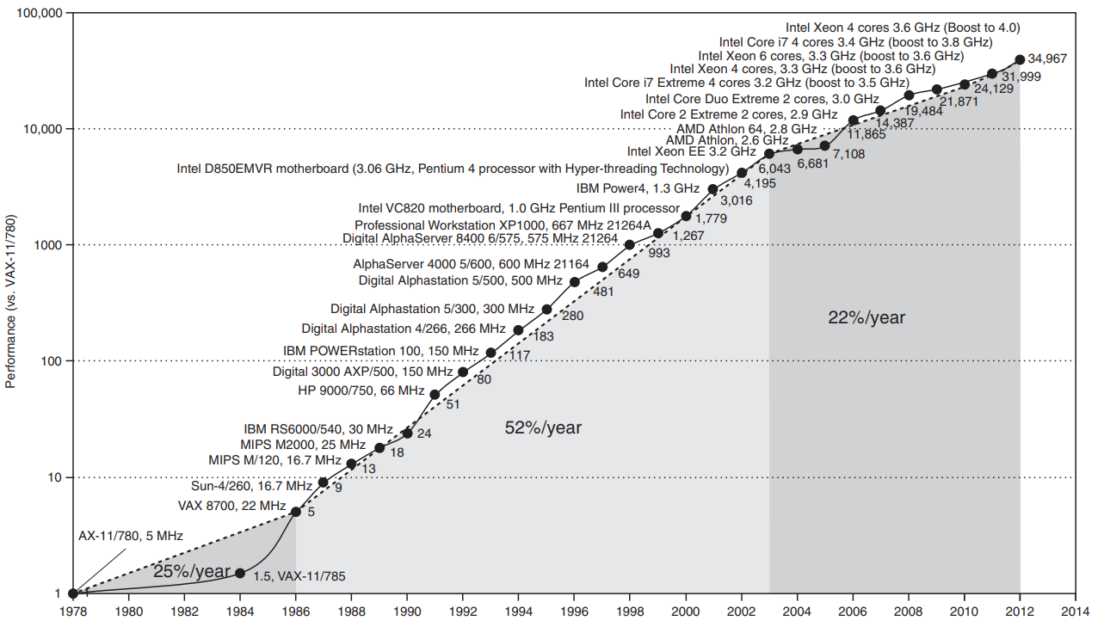
Performance Trends [15]

Slide 5
Introduction: Multicore Issues
Single-threaded (ST) performance became a bottleneck as per Amdahl’s Law [1], and since significant part of program (on avg) remains ST, which is a major issue
Multiple cores lead to low utilization for the ST phases and even coarse multi-threaded (MT) phases. Also leading to increased power consumption
Due to sharing of structures among the cores, multicore is vulnerable to information leakage as well
Notes:
Example give of timing side-channel attacks via LLC : Flush+Reload, Prime+Probe etc.. TLB: TLBleed, TLP

Slide 6
Introduction
Improving single-threaded performance in multicore would lead to improved overall performance
Effective utilization & energy efficiency of multicore systems also remain a concern
Modern-day applications are very diverse across phases of the same run (from sequential to highly parallel) exerting different demands on hardware
Enforcing the need of a dynamic architecture capable of exploiting various phases of program to improve overall performance & energy efficiency
Notes:
Instruction Level Parallelism & Thread Level Parallelism

Slide 7
Previous Work
To date, innovations in many areas like branch prediction, cache replacement policies, value predictions etc. have been performed to improve performance
One direction has been heterogeneous chip multiprocessors which exploit heterogeneity in 2 dimensions:
1. Microarchitectural (μarch) Heterogeneity
2. ISA Heterogeneity
Notes:
Core specialization: accelerate performance of certain workloads… (eg: having special core for performing crypto applications, vector processing (SIMD support))
Microarchitectural heterogeneity: use small power-efficient and large high performance cores together..
ISA heterogeneity: running the program phases on their most affine ISA-core..
Not specialized because it leads to drift away from general purpose and you can’t keep building specialized core for each workload you encounter..
Let’s discuss about μarch and ISA dimensions further

Slide 8
Heterogeneity in Microarchitecture
Notes:
This dimension has been shown to have significant potential by previous researchers, to improve performance and energy consumption. Let’s have a look @ a few architectures proposed in this area.

Slide 9
Core Fusion[4] - Idea
Combine multiple simple independent cores dynamically to form a larger, more powerful core
How this helps?
Fuse cores into a few powerful cores for sequential phases (ILP extraction)
Independent execution for fine-grain parallel phases (TLP extraction)
Intermediate fused configuration for low parallelism phases

Slide 10
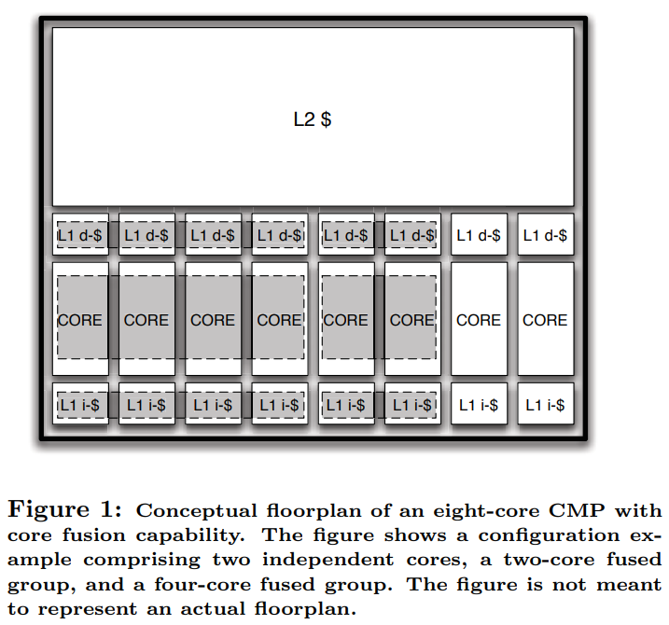
Core Fusion builds on top of a substrate comprising 8 identical 2-issue Out-of-order cores
Notes:
Core Fusion builds on top of a substrate comprising 8 identical 2-issue O3 cores along with:
A bus connecting their private L1-I and L1-D caches to assure data coherence
On-chip L2 cache and memory controller on the other side of the bus
Additional covering hardware for managing the fusion of cores referred as core fusion fabric

Slide 11
Core Fusion Operation
Fused Mode:
Uses a single execution model with appropriate changes in front-end and back-end
Front End: Collective Fetch, Fetch Management Unit, Collective Decode, Steering Management Unit
Back End: Collective Execution, Collective Commit
Independent Mode:
The cores operate as distinct processing elements
Notes:
Collective Fetch
Each core fetches 2 instructions per cycle from its own I-cache with fetch aligned with wrt core 0
In case of misaligned target due to taken branch (or misprediction recovery), lower-order cores skip fetch
In case of I-cache miss, an 8 word block is:
a. delivered to requesting core if operating independently
b. distributed across all 4 cores in fused configuration to permit collective fetch
For collective fetch, I-TLBs are replicated across the cores fused together
Fetch Management Unit
1. FMU updates I-TLBs upon I-TLB miss by a core
2. FMU handles PC redirection: Cores process branches locally, communicate target PC to FMU.
3. FMU selects correct PC & communicates it back
4. For BP to learn the correlation effectively, the GHR is replicated across cores and updated through FMU
5. FMU receives nonspeculative updates from every backend upon branch mispredictions
6. Any fetch stall is communicated to FMU and it synchronizes all the fetch engines by telling to discard over fetched ones
About Branches and Subroutine calls
Each core (in every config) accesses its own branch predictor and BTB, which are indexed to get maximum utility
Core 0 maintains return address stack and provides it via FMU
Collective Decode & Steering Management Unit
Instructions in fetch grp need to be renamed and steered. Cores still retain their individual renaming structures, but these are bypassed when cores are fused
It is achieved via Steering Management Unit (SMU)
SMU consists of:
1. Global steering table to track the mapping of arch reg to any core
2. 4 free lists for register allocation
3. 4 rename maps
4. steering/renaming logic
Collective Execution
[1] Operand Crossbar:
To support operand comm. (2 copy instructions per cycle for each core) a copy-out and a copy-in queue are added to each core.
[2] Wake-up and Selection:
At consumer core, copy instructions are placed in the FIFO copy-in queue
Then after being issued (via scheduler) they wake up their dependent instructions and update registers
Collective Commit
1. For fused in-order retirement the 4 ROBs commit in lockstep up to 8 instructions per cycle
2. In case of one of the ROBs is blocked all cores must also stop committing on time.
3. This is accomplished by exchanging stall/resume signals across ROBs.
4. To accommodate communication delay, each ROB is extended with a pre-commit head pointer in addition to the conventional head and tail point, enabling lockstep in-order commit
Load/Store Queue
1. In fused mode, a banked-by-address LSQ implementation was adopted
2. This allowed to keep data coherent without requiring data cache flushes after dynamic reconfiguration
3. Address banking also facilitates store forwarding and speculative loading

Slide 12
Dynamic Reconfiguration
It is enabled through a simple application interface. Application requests core fusion/split actions via FUSE and SPLIT ISA instructions
These requests can be enveloped inside parallelizing macros or directives (e.g. OpenMP’s fork-join model)
These instructions are executed conditionally by hardware based on the value of an OS-visible control register indicative of eligible cores for fusion

Slide 13
Evaluated Architectures
CMP Configuration | Composition (Cores)
CoreFusion | 8x2-issue
FineGrain-2i | 9x2-issue
CoarseGrain-4i | 4x4-issue
CoarseGrain-6i | 2x6-issue
Asymmetric-4i | 1x4-issue + 6x2-issue
Asymmetric-6i | 1x6-issue + 4x2-issue

Slide 14
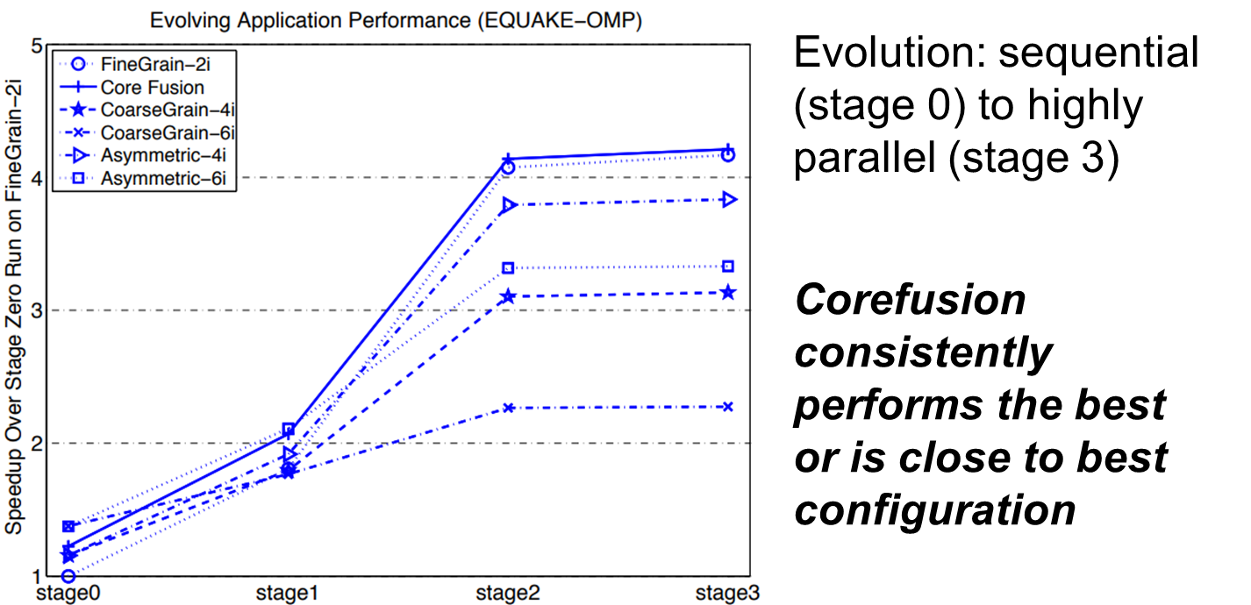
Core Fusion - Results
Notes:
Baseline in single-threaded (sequential) run on fine-grain-2i configuration
Benchmark SPEC-OPENMP- EarthQuake Model

Slide 15
Bahurupi [5]
Bahurupi is another reconfigurable multi-core architecture
However, it is a hardware-software cooperative solution requiring minimal hardware resources & compiler support
In normal mode, Bahurupi executes multi-threaded applications on a set of homogeneous cores
In coalition mode, it follows a distributed execution model:
Basic block as the unit of execution for a core
These basic blocks are executed in parallel on coalition cores, leading to speedup for serial code
Notes:
The compiler splits the programs into basic blocks & adds a sentinel instruction at their start
LI and LO registers correspond to inter basic block dependencies
LI & LO information is transferred to hardware through the added “sentinel” instruction
As inter-BB dependencies are captured via sentinel instructions, in-order fetching of them meets the needs
For DEM to work efficiently for parallel execution of basic blocks, we need to:
Resolve register and memory dependencies among the basic blocks to maintain correctness [hw-sw co-operative solution proposed]
Ensure that cores fetch, decode, rename and commit the basic blocks in program order
Execution of instructions from diff basic blocks can be performed in O3 fashion parallelly, giving most of the speedup

Slide 16
Bahurupi [5]
Bahurupi is another reconfigurable multi-core architecture
However, it is a hardware-software cooperative solution requiring minimal hardware resources & compiler support
In normal mode, Bahurupi executes multi-threaded applications on a set of homogeneous cores
In coalition mode, it follows a distributed execution model:
Basic block as the unit of execution for a core
These basic blocks are executed in parallel on coalition cores, leading to speedup for serial code
Major breakthrough: quad-core Bahurupi is more energy efficient that 8-way OoO baseline core and gives more performance
Notes:
Corefusion was unable to reach performance of an equivalent n-way fetch O3 core in fused mode, But.. Bahurupi is able to surpass that along with decrease in energy consumption due to minimal hardware modifications compared to Core Fusion.
+ Bahurupi model of execution can even outperform true out-of-order execution engines. This is because Bahurupi can look far ahead in the future. As dependencies between the basic blocks are resolved with the help of live-in, live-out information, Bahurupi can exploit ILP across basic blocks much more easily.
+ O3 superscalar cores scale superlinearly with fetch width [Core Fusion]

Slide 17
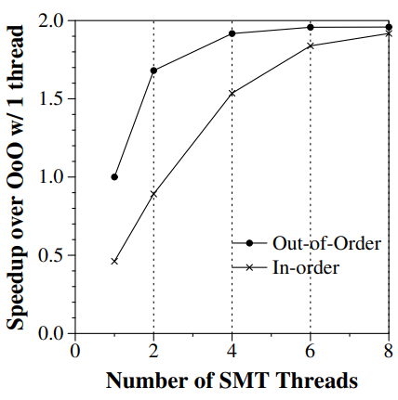
MorphCore [3]
It is a microarchitecture that combines O3 and highly-threaded InO SMT execution in a single core
Built on 2 key insights:
A highly threaded [HT] (6-8 way SMT) InO core can achieve >= performance as an O3
A HT InO SMT core can be built using a subset of HW reqd. to build an aggressive O3 core
Notes:
MorphCore, a new microarchitecture that combines out-of-order and highly-threaded in-order SMT execution within a single core. We comprehensively describe the microarchitecture needed to implement MorphCore, and the policy to switch between modes

Slide 18
Heterogeneity in ISA
Notes:
Heterogeneous architecture research

Slide 19
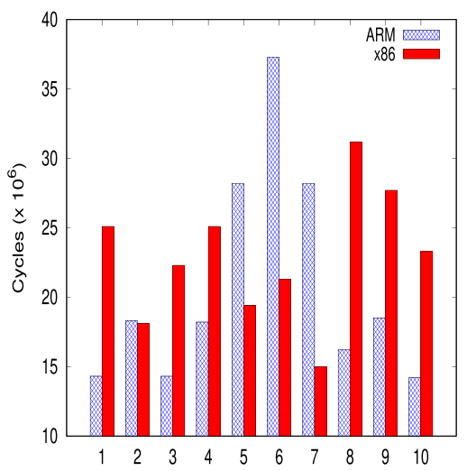
ISA Affinity
An application can be divided into multiple phases
Each phase may have different characteristics
Phases may have affinity towards different types of ISA
[11] Performance for different phases of sjeng benchmark from SPEC CPU 2006
Notes:
A program is said to have affinity towards an ISA if it performs better on that ISA compared to the chosen reference ISA.

Slide 20
ISA Diversity
Different ISA may have different set of features, like:
Architectural register file size
Types of memory operand support
Format of instructions
Types of operation support
These affect various performance parameters:
Register pressure
Code Density
Dynamic Instruction Count
Notes:
Register pressure is proportional to number of memory accesses required affected by number of registers in RF.
For eg: higher code density leads to 1. reduced I-cache misses, 2. conserves power due to less fetching
Another factors of diversity:
X86 is CISC type ISA and has variable length encoding, whereas Alpha, ARM are RISC type ISA and have fixed length encoding
Have different operations and addressing modes support

Slide 21
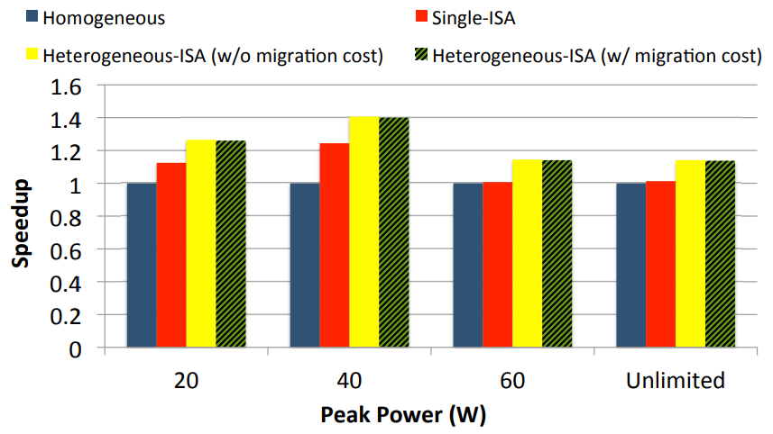
Harnessing ISA Diversity [8]
CMP consisting of different ISA cores
Only one core is active at a time
Process migrates between cores as per its affinity
Achieved about 21% speedup and 23% energy savings
Notes:
Each core shares only L2 cache

Slide 22
How & when to migrate?
DeVuyst et. al [7] described a low-overhead method for migration between het-ISA cores; through compiler modifications & migrations sw addition
For low overheads, migrate at equivalence points:
Memory image is ~consistent (stack, heap, registers)
Function calls are possible choices
Compiler backend modified to keep memory image consistency
Stack transformation needed for modifying program state for target-ISA core

Slide 23
How to switch based on affinity?
Boran et. al [10] proposed coarse-grain scheduling with scheduling intervals (~100M instructions)
Idea was to estimate performance of the inactive-ISA core for the current phase using regression models with active-ISA micro-arch params such as branch mispredictions, cache misses, SQ Full events, etc.
This was then utilized in heuristics to schedule to the affine-ISA core and achieve near oracle schedule

Slide 24
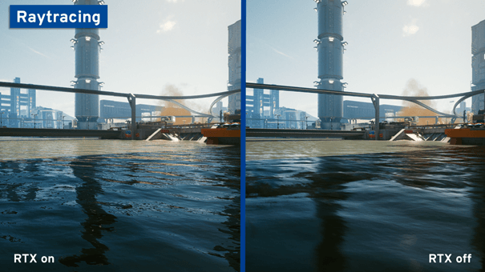



Notes:
Computer Vision Applications like body tracking
https://www.simplilearn.com/computer-vision-article
Browsing is another multithreaded application and is most frequently used modern application
https://www.anandtech.com/show/16078/the-2020-browser-battle-surfing-with-speed
Ray tracing is a type of graphics technology that realistically calculates visible and invisible rays of light. It enables lifelike lighting in computer games and animated 3D graphics and is increasingly used as a hardware feature in the form of real-time ray tracing
https://www.ionos.com/digitalguide/server/know-how/ray-tracing/
Options and derivatives pricing, which are used in trading industry.. One such example application is blackscholes option pricing models..

Slide 25
Multithreading is inevitable today
Notes:
Computer Vision Applications like body tracking
https://www.simplilearn.com/computer-vision-article
Browsing is another multithreaded application and is most frequently used modern application
https://www.anandtech.com/show/16078/the-2020-browser-battle-surfing-with-speed
Ray tracing is a type of graphics technology that realistically calculates visible and invisible rays of light. It enables lifelike lighting in computer games and animated 3D graphics and is increasingly used as a hardware feature in the form of real-time ray tracing
https://www.ionos.com/digitalguide/server/know-how/ray-tracing/
Options and derivatives pricing, which are used in trading industry.. One such example application is blackscholes option pricing models..

Slide 26
Het-ISA Polymorphic Architecture
To date, heterogeneous ISA multicore architectures remain unexplored; but have significant promise as:
Single-threaded: Dynamic CMP + ISA Affinity gains
Multi-threaded: Dynamic CMP + ISA Affinity + InO SMT gains
Heterogeneous-ISA Polymorphic Architecture is proposed for meeting ILP-TLP & ISA affinity demands from various phases of modern workloads
ARM and X86 ISAs are considered due to popularity
Capability from extreme exploitation of ILP (needed for sequential workloads) to coarse TLP exploitation (16 threads)

Slide 27
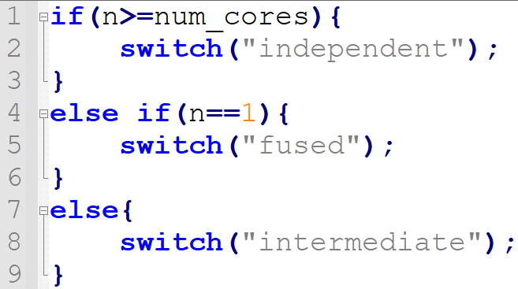
#Live Threads at Runtime (n)
It’s important to obtain “n” for optimal switching between configurations, as follows:

Slide 28
How to find “n”?
In multithreaded programs, thread handling is done via libraries such as pthreads and OpenMP.
Steps followed:
Declare “n” as a global variable i.e. visible to all threads
Initialize it with #threads to use in a run of workload
Decrement “n” with every thread termination. This section is required to be atomic (done using mutex)

Slide 29
Experiments & Simulations
For this work, the simulations have been carried out on the open-source gem5 [12] simulator
We use gem5 full system (FS) mode simulations to model the accurate behavior of systems
PARSEC [13] suite is used for multithreaded benchmarks.
SPEC CPU2006 [14] is used for single-threaded benchmarks.

Slide 30
Experiment: ILP-TLP trade-off
Running 4-threaded BM on G1, 2-threaded on G2, single-threaded on G3 configuration
G1 - Independent Quad-core configuration (4XC1)
G2 - Intermediate two-core configuration (2XC2)
G3 - Fused single-core configuration (1XC4)
All results shown are for ARM-based systems

Slide 31
C1,C2,C4 Parameters
Core | C1 | C2 | C4
F/D/I/E/W/C/S Width | 2 | 4 | 8
LQ Entries | 8 | 16 | 32
SQ Entries | 8 | 16 | 32
Instr Queue Entries | 16 | 32 | 64
ROB Size | 48 | 96 | 192
Phy Int & FP registers | 64 | 128 | 256
Int ALU | 2 | 4 | 8
Int MULT/Div | 1 | 2 | 4
FP ALU | 1 | 2 | 4
FP MULT/Div | 1 | 2 | 4
RdWr Ports to Mem | 1 | 2 | 4
L1-D $ (in kB) | 16 | 32 | 64
L1-I $ (in kB) | 8 | 16 | 32
L2 $ | 512 kB | 1MB | 2MB
L3 (shared) $ (in MB) | 16 | 16 | 16
Notes:
F-fetch, D-Decode, I-Issue, E-Execute, W-Writeback, C-Commit, S-Squash

Slide 32
Simulation Results
Notes:
Draw 1-2 interpretations from the simulation results..

Slide 33
Conclusion & Future Work
Conclusion
…
….
…
Future Work:
Analysis and simulation of Core Fusion on heterogeneous-ISA multicore
Incorporating highly-threaded SMT InO capability in 2-way O3 core; and related simulations

Slide 34
Thank You

Slide 35
References
[1] G. M. Amdahl, “Validity of the single processor approach to achieving large scale computing capabilities,” in Proceedings of the April 18-20, 1967, Spring Joint Computer Conference, AFIPS ’67 (Spring), (New York, NY, USA), p. 483–485, Association for Computing Machinery, 1967
[2] A. Lukefahr, S. Padmanabha, R. Das, F. M. Sleiman, R. Dreslinski, T. F. Wenisch, and S. Mahlke, “Composite cores: Pushing heterogeneity into a core,” in 2012 45th Annual IEEE/ACM International Symposium on Microarchitecture, pp. 317–328, 2012
[3] Khubaib, M. A. Suleman, M. Hashemi, C. Wilkerson, and Y. N. Patt, “Morphcore: An energy-efficient microarchitecture for high performance ilp and high throughput tlp,” in 2012 45th Annual IEEE/ACM International Symposium on Microarchitecture, pp. 305–316, 2012
[4] E. Ipek, M. Kirman, N. Kirman, and J. F. Martinez, “Core fusion: Accommodating software diversity in chip multiprocessors,” ISCA ’07, (New York, NY, USA), p. 186–197, Association for Computing Machinery, 2007.

Slide 36
References
[5] M. Pricopi and T. Mitra, “Bahurupi: A polymorphic heterogeneous multi-core architecture,” ACM Transactions on Architecture and Code Optimization (TACO), vol. 8, Jan 2012.
[6] E. Blem, J. Menon, and K. Sankaralingam, “Power struggles: Revisiting the risc vs. cisc debate on contemporary arm and x86 architectures,” in 2013 IEEE 19th International Symposium on High Performance Computer Architecture (HPCA), pp. 1–12, 2013.
[7] M. DeVuyst, A. Venkat, and D. M. Tullsen, “Execution migration in a heterogeneous isa chip multiprocessor,” in Proceedings of the Seventeenth International Conference on Architectural Support for Programming Languages and Operating Systems, ASPLOS XVII, (New York, NY, USA), p. 261–272, Association for Computing Machinery, 2012.
[8] A. Venkat and D. M. Tullsen, “Harnessing isa diversity: Design of a heterogeneous-isa chip multiprocessor,” in 2014 ACM/IEEE 41st International Symposium on Computer Architecture (ISCA), pp. 121–132, 2014

Slide 37
References
[9] N. K. Boran, R. P. Meghwal, K. Sharma, B. Kumar, and V. Singh, “Performance modelling of heterogeneous isa multicore architectures,” in 2016 IEEE East-West Design Test Symposium (EWDTS), pp. 1–4, 2016.
[10] N. K. Boran, D. K. Yadav, and R. Iyer, “Classification based scheduling in heterogeneous isa architectures,” in 2020 24th International Symposium on VLSI Design and Test (VDAT), pp. 1–6, 2020.
[11] N. K. Boran, S. Rathore, M. Udeshi, and V. Singh, “Fine-grained scheduling in heterogeneous-isa architectures,” IEEE Computer Architecture Letters, vol. 20, no. 1, pp. 9–12, 2021.
[12] N. Binkert, B. Beckmann, G. Black, S. K. Reinhardt, A. Saidi, A. Basu, J. Hestness, D. R. Hower, T. Krishna, S. Sardashti, R. Sen, K. Sewell, M. Shoaib, N. Vaish, M. D. Hill, and D. A. Wood, “The gem5 simulator,” SIGARCH Comput. Archit. News, vol. 39, p. 1–7, aug 2011.
[13] C. Bienia, S. Kumar, J. P. Singh, and K. Li, “The parsec benchmark suite: Characterization and architectural implications,” in 2008 International Conference on Parallel Architectures and Compilation Techniques (PACT), pp. 72–81, 2008.
[14] J. L. Henning, “Spec cpu2006 benchmark descriptions,” SIGARCH Comput. Archit. News, vol. 34, p. 1–17, sep 2006.

Slide 38
References
[15] J. L. Hennessy and D. A. Patterson, Computer Architecture, Fifth Edition: A Quantitative Approach. San Francisco, CA, USA: Morgan Kaufmann Publishers Inc., 5th ed., 2011.

