Slide 1


HPCC 24: Paper 1571072796
HIDC: Heterogeneous-ISA
Dynamic Core
Nirmal Kumar Boran, Prakhar Diwan, Meet Udeshi, Shubhakit Rathore and Virendra Singh

Slide 2
Outline
Introduction
Motivation
Proposal
Experimental Setup
Simulation Results
Conclusion
References

Slide 3
Introduction
Computing is heavily diverging towards:
Mobile space
Data center space
Data center space involves multitude of processors integrated in multiple servers, which cater to large compute demands
Mobile space comprises of devices such as tablets, smartphones etc., which cater to lower-compute applications

Slide 4
Shared aim for mobile & data center compute
Data centers remain major consumers of electrical power^{[a][b]}
Consumption as high as 416 Terawatt-hours in 2017
It follows an increasing trend → need for energy-efficiency
Mobile devices are becoming popular as they support ever-increasing range of applications, but:
they operate on battery → need for energy savings
Hence, both spaces share a common target of energy efficiency
[a] https://www.techtarget.com/searchdatacenter/tip/How-much-energy-do-data-centers-consume
[b]https://cc-techgroup.com/data-center-energy-consumption/#:~:text=Data%20centers%20usually%20use%20a,and%20cool%20down%20their%20components

Slide 5
Achieving Energy Efficiency
Architects analysed the workloads and observed their diverse needs across and within programs, such as:
varying ILP vs TLP requirements
high-ILP vs low-ILP, memory intensive phases
One solution to deal with this diversity→through heterogeneity^{[1][2]}:
using cores with different performance & power characteristics
switching phases/applications between such cores, based on optimal matching
led to significant energy efficiency benefits
[1] R. Kumar et. al, “Single-ISA Heterogeneous Multi-Core Architectures: the potential for processor power reduction”, MICRO 2003
[2] R. Kumar et. al, “Single-ISA Heterogeneous Multi-Core Architectures for Multithreaded Workload Performance”, ISCA 2004

Slide 6
Heterogeneous Computing
Energy efficiency has been extracted by various heterogeneity dimensions such as:
Core sizes (issue-widths)
Execution semantics (in-order/out-of-order)
Number of cores
Later, ISA was added as a dimension, after Devuyst^{[3]} presented cross-ISA migration techniques for a heterogeneous ISA CMP
Why does ISA have significant potential?
[3] M. Devuyst et. al, “Execution migration in a heterogeneous ISA chip multiprocessor”, ASPLOS 2012
Notes:
However it was all restricted to a single ISA

Slide 7
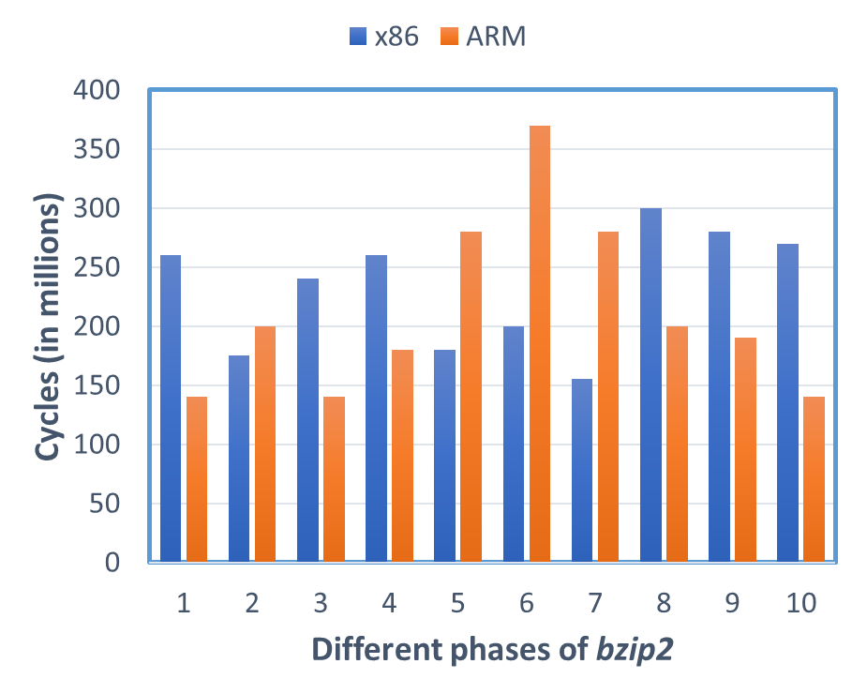
ISA affinity
ARM affine
[4] A. Venkat et. al, “Harnessing ISA diversity: Design of a heterogeneous-ISA chip multiprocessor”. ISCA, 2014.
Notes:
Here I have plotted the execution time of consecutive phases of 100M instructions from bzip2 benchmark.
Dynamic execution of phases on affine ISA led to 24% improvement over best single-ISA execution.

Slide 8
ISA affinity
x86 affine
[4] A. Venkat et. al, “Harnessing ISA diversity: Design of a heterogeneous-ISA chip multiprocessor”. ISCA, 2014.
Notes:
Here I have plotted the execution time of consecutive phases of 100M instructions from bzip2 benchmark.
Dynamic execution of phases on affine ISA led to 24% improvement over best single-ISA execution.

Slide 9
ISA affinity
24% speedup
Reason for speedup?
[4] A. Venkat et. al, “Harnessing ISA diversity: Design of a heterogeneous-ISA chip multiprocessor”. ISCA, 2014.
Notes:
Here I have plotted the execution time of consecutive phases of 100M instructions from bzip2 benchmark.
Dynamic execution of phases on affine ISA led to 24% improvement over best single-ISA execution.

Slide 10
ISA Diversity
Different ISAs may have different sets of features:
Architectural register file size
Types of memory operand support
Instruction format
Types of operand support
These affect various performance parameters:
Register pressure
Code density
Dynamic instruction count
[4] A. Venkat et. al, “Harnessing ISA diversity: Design of a heterogeneous-ISA chip multiprocessor”. ISCA, 2014.
Notes:
How to implement such a different ISA system and migration between the cores..

Slide 11
Heterogeneous ISA CMP (HISACMP)
CMP consisting of different ISA cores with private LLCs
Process migrates between the cores dynamically as per affinity
32% reduction in EDP compared to best single-ISA architecture
ISA-1
ISA-2
L1$
L1$
L2$
L2$
ISA-3
L1$
L2$
[4] A. Venkat et. al, “Harnessing ISA diversity: Design of a heterogeneous-ISA chip multiprocessor”. ISCA, 2014.

Slide 12
Cross-ISA migration techniques
Coarse-grained strategies^{[3][4][5]}:
Can switch at anytime between ISAs
Large migration overhead (~100 μs)
Finer-grained strategies^{[6]}:
Switch at function call & return sites
Lower migration overhead (~100 ns)
[3] M. Devuyst et. al, “Execution migration in a heterogeneous ISA chip multiprocessor”, ASPLOS 2012
[4] A. Venkat et. al, “Harnessing ISA diversity: Design of a heterogeneous-ISA chip multiprocessor”. ISCA, 2014.
[5] A. Barbalace et. al, “Breaking the Boundaries in Heterogeneous-ISA Datacenter”. ASPLOS, 2017.
[6] N. Boran et. al, “Fine-Grained Scheduling in Heterogeneous-ISA Architectures”, CAL 2021
Notes:
– Load balancing – spread workload evenly across available servers
– Consolidation – group workload on minimal number of machines, idle or power down others

Slide 13
Motivation: Heterogeneous-ISA Execution
IDLE
ACTIVE
ISA-1
ISA-2
L1$
L1$
L2$
L2$
Main Memory
Notes:
Single-threaded execution in HISACMP/HISADC

Slide 14
Motivation: Heterogeneous-ISA Execution
ACTIVE
IDLE
ISA-1
ISA-2
L1$
L1$
L2$
L2$
Main Memory
Notes:
Single-threaded execution in HISACMP/HISADC

Slide 15
Motivation: Heterogeneous-ISA Execution
IDLE
ACTIVE
ISA-1
ISA-2
L1$
L1$
L2$
L2$
Can we make heterogeneous ISA execution (single-threaded) more energy-efficient?
Main Memory
Heterogeneous ISA CMP execution involves switching between cores, which leads to:
Static power dissipation by idle cores
Core resources are underutilized
Also, migration overhead (~100μs) is large due to separate LLCs
Notes:
Single-threaded execution in HISACMP/HISADC

Slide 16
Heterogeneous ISA Dynamic Core (HIDC)
HIDC consists of:
a dynamic out-of-order core supporting multiple ISAs
migration engine to facilitate cross-ISA migration
Core consists a superset of resources required by the ISAs
It overcomes static power and resource utilization issues
For cross-ISA switching decisions, HIDC uses a perceptron-based scheduler^{[7]}
We use the two popular ISAs ARM & x86 for the proposal
How to execute multiple ISAs within a core?
[7] N. Boran et. al, “Classification based scheduling in Heterogeneous ISA Architectures”. VDAT, 2020.
Notes:
How

Slide 17
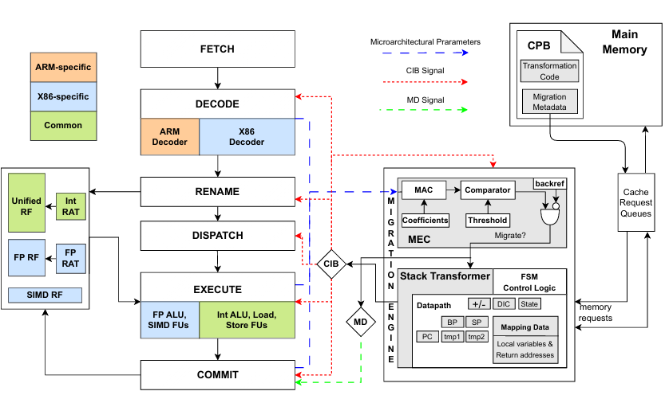
HIDC
Notes:
Simultaneous transformation is done at L2 level so it’s fast as most recent stack frames are present..

Slide 18
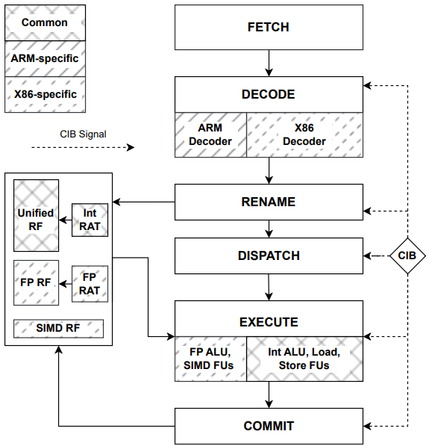
HIDC Pipeline
Remains unaltered across ARM/x86 execution
CIB: Indicates the executing ISA
Notes:
Simultaneous transformation is done at L2 level so it’s fast as most recent stack frames are present..

Slide 19
HIDC Pipeline
ISA-specific decoders are used
Notes:
Instruction blocks are demultiplexed to the appropriate decoder based on the CIB signal

Slide 20
HIDC Pipeline
Common register files & renaming logic are used by both ISAs
Notes:
We append the register bits according to ARM as 5, as it contains 32 architectural registers.

Slide 21
HIDC Pipeline
RS, ROB, SB entries are modified
to incorporate exclusive ISA information
Notes:
SB - store buffer

Slide 22
HIDC Pipeline
Only x86 uses SIMD
and FP Functional Units
Notes:
Simultaneous transformation is done at L2 level so it’s fast as most recent stack frames are present..

Slide 23
HIDC Pipeline
Common ROB & SB is used
Notes:
Simultaneous transformation is done at L2 level so it’s fast as most recent stack frames are present..

Slide 24
Simultaneous Transformation
Time
Equivalence point: call D()
HIDC Execution
x86 execution: C()
Migration
Engine
A
X86 Format
Stack
Memory
ARM Format
B
C
Being transformed
Growth
Notes:
Simultaneous transformation is done at L2 level so it’s fast as most recent stack frames are present..

Slide 25
Simultaneous Transformation
Time
Decide to
migrate
Equivalence point: call D()
HIDC Execution
x86 execution: C()
Migration
Engine
A
X86 Format
Stack
Memory
ARM Format
B
C
Being transformed
Growth
Notes:
Simultaneous transformation is done at L2 level so it’s fast as most recent stack frames are present..

Slide 26
Simultaneous Transformation
Time
Decide to
migrate
Equivalence point: call D()
HIDC Execution
x86 execution: C()
Migration
Engine
Transform(A,B)
A
A
X86 Format
Stack Memory
ARM Format
B
B
C
C
Being transformed
Growth
Notes:
Simultaneous transformation is done at L2 level so it’s fast as most recent stack frames are present..

Slide 27
Simultaneous Transformation
Time
Decide to
migrate
Equivalence point: call D()
Migrate to ARM
HIDC Execution
x86 execution: C()
Idle
Migration
Engine
Transform(A,B)
Transform
(C)
A
A
A
X86 Format
Stack Memory
ARM Format
B
B
B
C
C
C
Being transformed
Growth
Notes:
Simultaneous transformation is done at L2 level so it’s fast as most recent stack frames are present..

Slide 28
Simultaneous Transformation
Time
Decide to
migrate
Equivalence point: call D()
Migrate to ARM
HIDC Execution
x86 execution: C()
Idle
Migration
Engine
Transform(A,B)
Transform (C)
A
A
A
A
X86 Format
Stack Memory
ARM Format
B
B
B
B
C
C
C
C
Being transformed
Growth
Notes:
Simultaneous transformation is done at L2 level so it’s fast as most recent stack frames are present..

Slide 29
Simultaneous Transformation
Time
Decide to
migrate
Equivalence point: call D()
Migrate to ARM
HIDC Execution
x86 execution: C()
Idle
ARM execution: D()
Migration
Engine
Transform(A,B)
Transform (C)
A
A
A
A
X86 Format
Stack
Memory
ARM Format
B
B
B
B
C
C
C
C
Being transformed
Growth
Notes:
Simultaneous transformation is done at L2 level so it’s fast as most recent stack frames are present..

Slide 30
Simultaneous Transformation
Previous Proposal[2]
x86 execution
Transform(A,B)+ Transform(C)
ARM execution
Decide to
migrate
Equivalence point: call D()
Migrate to ARM
HIDC Execution
x86 execution: C()
Idle
ARM execution: D()
Migration
Engine
Transform(A,B)
Transform (C)
A
A
A
A
X86 Format
Stack
Memory
B
B
B
B
ARM Format
C
C
C
C
Being transformed
Growth
[2]: A. Venkat et.al, Design of a heterogeneous-ISA chip multiprocessor. ISCA 2014.
Notes:
Simultaneous transformation is done at L2 level so it’s fast as most recent stack frames are present..

Slide 31
Experimental Setup: Core Configurations
Performance analysis done using gem5 v20.0 simulator
Configuration | HISACMP |  | HIDC (ARM/X86)
 | ARM core | X86 core
4-wide Out-of-Order 3 GHz clock | ROB=108 LQ=16 SQ=16 RS=36 | ROB=192 LQ=36 SQ=48 RS=64 | ROB=192 LQ=36 SQ=48 RS=64
Functional Units | IntALU=4, IntMultDiv=2, FPALU=0/2, FPMultDiv= 0/2, SIMD Units=0/2
HISACMP - Heterogeneous ISA CMP (baseline), HIDC - Heterogeneous ISA Dynamic Core (proposal)
Notes:
Mention HISACMP is a dual core system with ARM and x86 core each with private LLCs.

Slide 32
Experimental Setup: Cache Configuration
Performance analysis done using gem5 v20.0 simulator
L1 I-Cache | 32 KB, 8-way, 2 cycle latency
L1 D-Cache | 32 KB, 8-way, 2 cycle latency
Last Level Cache | 2 MB, 16-way, 15 cycle latency
Private LLCs of 2MB were used with ARM and x86 cores in HISACMP
Notes:
Private LLCs are used by HISACMP.. And explain that it’s used as baseline.

Slide 33
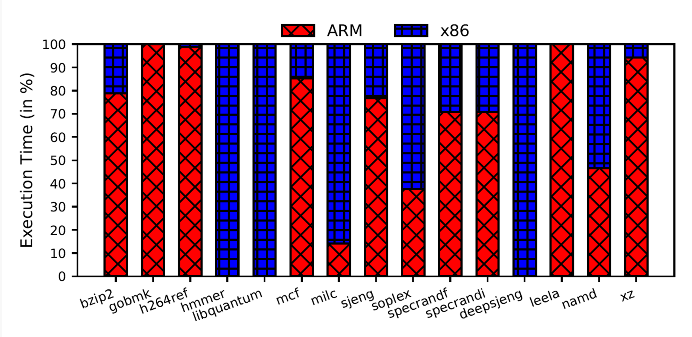
ISA Affinity of HIDC
Applications display different affinities towards ARM & x86
Notes:
Explain a few cases like: milc uses SIMD functionality available in x86 used byt HIDC and soplex uses FP too.. In ARMv7 it performs that by software emulations.
Mcf is a memory intensive benchmark and effectively utilizes the ARM’s lower register pressure to it’s advantage..

Slide 34
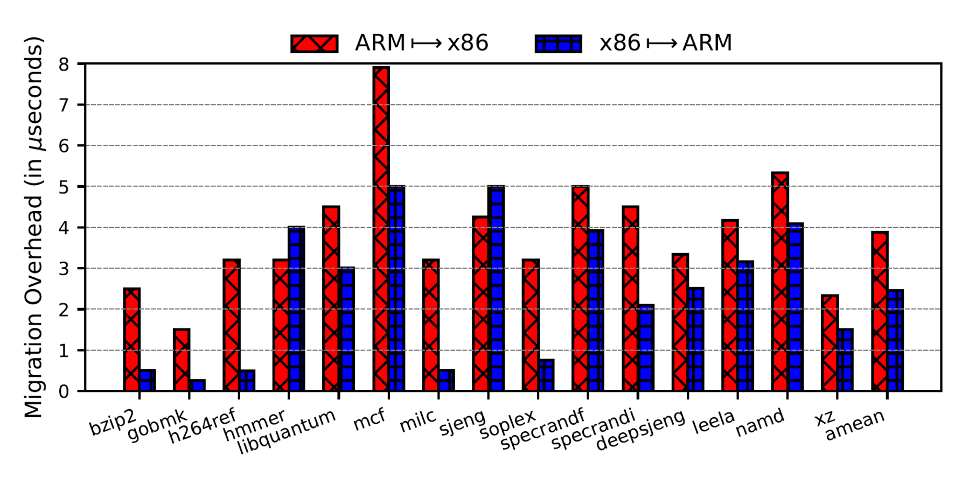
Migration Overhead
Significant reduction due to Simultaneous Transformation and Shared Cache Hierarchy across different ISA executions
Notes:
Reduction due to simultanoues transformation strategy and shared cache across different ISA program execution

Slide 35
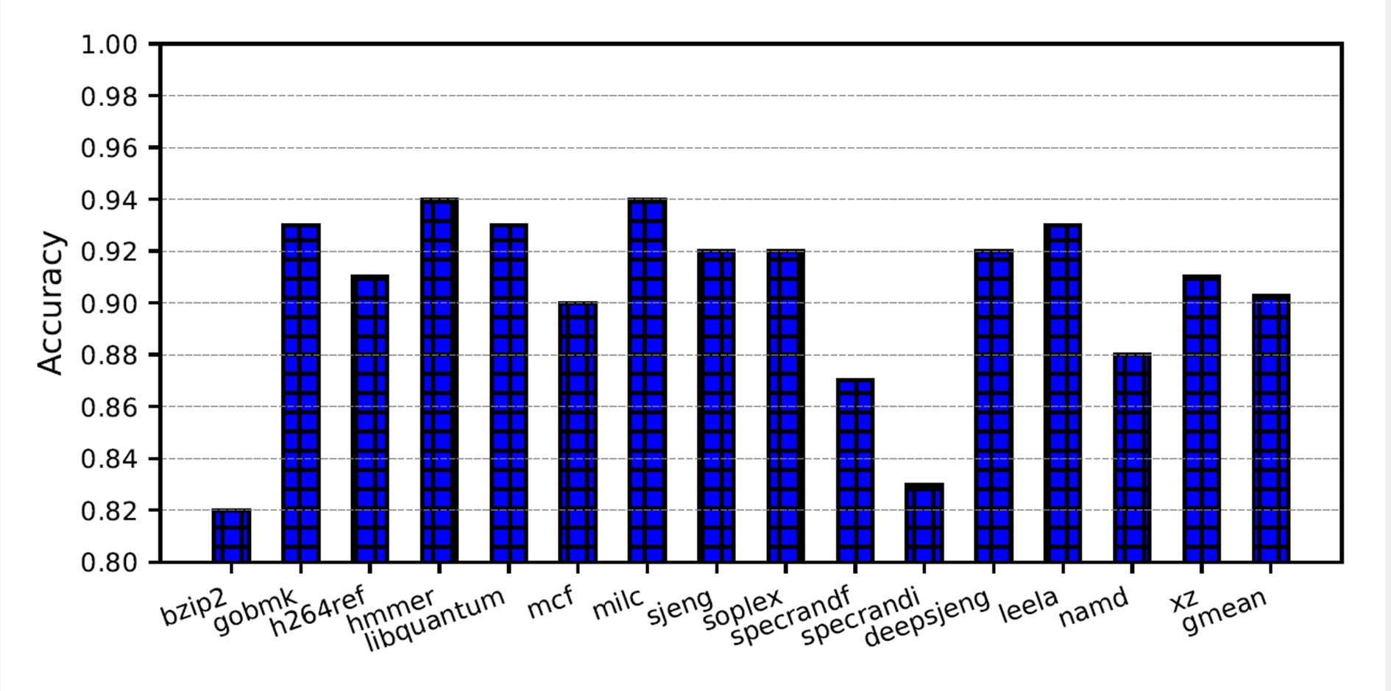
Perceptron based scheduling
On average >90% accuracy was achieved
Notes:
Reduction due to simultanoues transformation strategy and shared cache across different ISA program execution

Slide 36
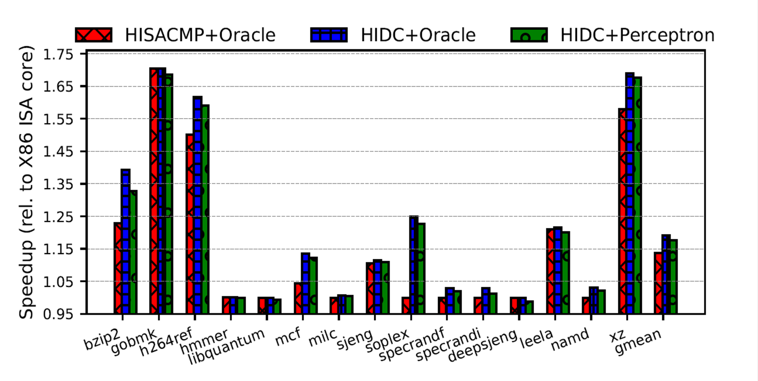
HIDC Performance
4.62% speedup over HISACMP
19.06% speedup over X86 Core

Slide 37
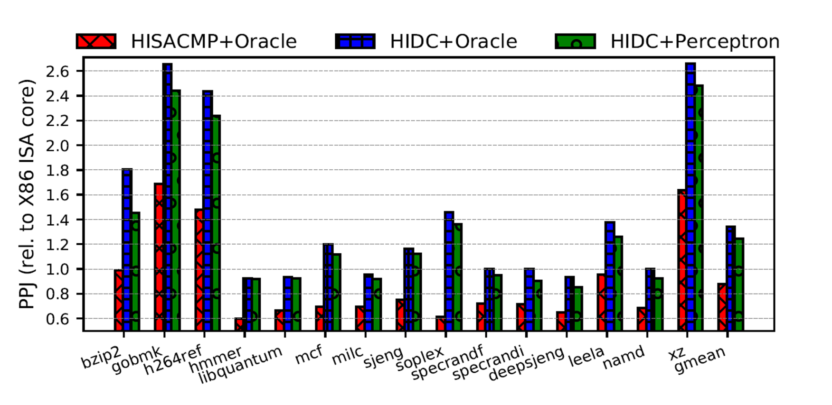
HIDC Performance Per Joule
52.89% and 33.93% gain in PPJ over
HISACMP and X86-ISA Core

Slide 38
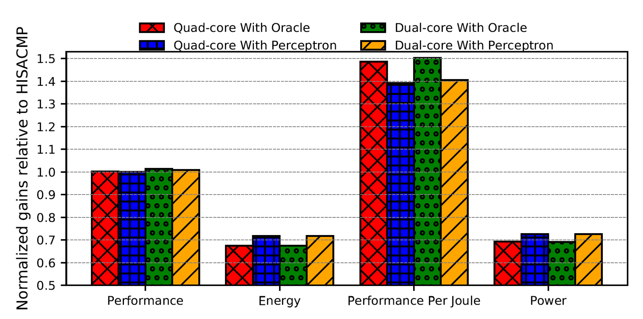
Analysis on Multiprogrammed Workloads
50.36% PPJ increase over HISACMP (with power gating)
Notes:
Explain the baseline configuration in each dual and quad core config.
Executed 330 quad combinations and 55 pairs from SPEC benchmarks were used.
Explain each metric and gains..

Slide 39
Conclusion
HIDC achieves 52.89% performance per joule improvements over Heterogeneous ISA CMP on single-threaded applications
Simultaneous Transformation achieves ~20x reduction in cross-ISA migration overheads compared to prior works
HIDC achieves 4.62% performance gains by exploiting finer phases due to lower switching overheads
On MP* workloads, it obtains ~50% performance per joule benefits for a dual-HIDC system; reducing energy consumption by 32%
[*] MP - multi-programmed

Slide 40
Thank You

