Slide 1
Lichen: Leveraging Coupled Heterogeneity
Paper ID: 215
Prakhar Diwan^{[a]}, Nirmal Kumar Boran^{[b]} and Virendra Singh^{[a]}
^{[a]} Indian Institute of Technology Bombay, India
^{[b]} National Institute of Technology Calicut, India

Slide 2
Introduction
Moore’s law persisted with shrinking transistors, however, V_{th} reduction plateaued, limiting the number of active transistors
Heterogeneous CMPs effectively trade area for energy efficiency^{[1]}
Cores with different perf. and power values to meet diverse demands
Cores vary across dimensions such as InO/OoO, issue-widths etc.
ISA is a recent addition^{[2]} to list of heterogeneity dimensions, due to:
ISAs have different feature sets (instr format, operand support etc.)
These impact performance parameters (register pressure, code density etc.)
Notes:
that can operate within the power budget.

Slide 3
Motivation
Heterogeneous-ISA CMPs outperformed single-ISA counterparts over performance and energy efficiency metrics^{[3]}
However, they utilized oracular scheduling and uniform phases to analyse heterogeneity dimensions in design space exploration
ISA^{[4]} and execution semantics (InO/OoO) ^{[5]} have fared better at finer phases, individually
Do these exhibit synergy, when utilized together?
Let’s analyse program using different ISA cores with different execution modes

Slide 4
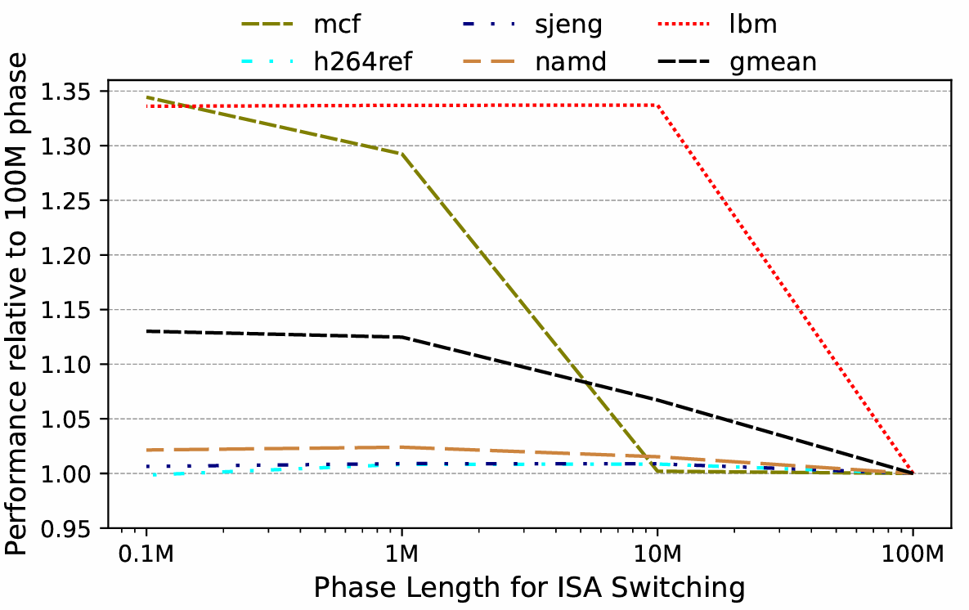
Motivation
Finer switching between ISA cores improves performance

Slide 5
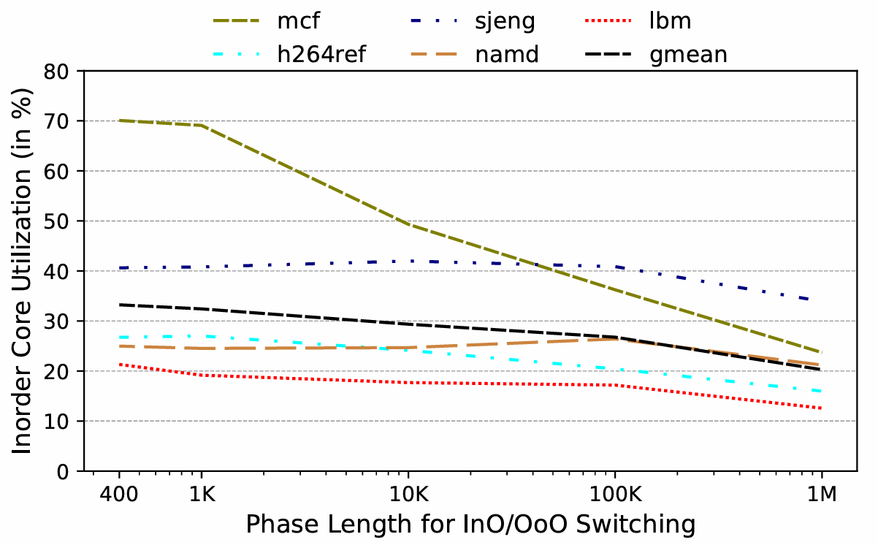
Motivation
In-order mode utilization increases at finer granularities
How to schedule such phases?
Utilize 1M for ISA and 1K for InO/OoO switching

Slide 6
Lichen: Overview
Single-ISA Out-of-order Execution
Heterogenous-ISA Out-of-order Execution (1M phase length)
X86-ISA
ARM-ISA
X86-ISA
ARM-ISA
Heterogenous-ISA InO/OoO Execution (1K phase length)
OoO
InO
OoO
InO
OoO

Slide 7
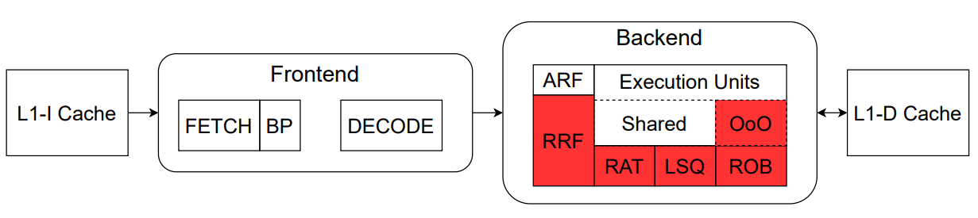
Using InO/OoO Morphing
An existing facility in modern processors for hardware debug^{[6]}
Further reduction in switching overheads for InO/OoO by morphing:
Common architecture register file used, avoiding state transfer
On OoO to InO, ROB flushed & instructions re-fetched in InO mode
InO to OoO, ROB is powered on & starts fresh

Slide 8
Lichen
Heterogeneous CMP with different ISA out-of-order cores morphing into in-order cores based on upcoming program phase
Migration between different-ISA cores^{[3]} and execution modes^{[6]} performed as in prior works
We decouple scheduling problem to 2 levels:
Predicting affine-ISA core at 1M instruction granularity
Deciding efficient execution mode at 1K instructions within same-ISA phase
CART decision tree algorithm was found optimal from decision accuracy and number of parameters required for predicting both

Slide 9
Lichen
Parameter | Purpose
L1-I misses | Stalls due to cache misses
L1-D misses
L2-misses
ROB full events | Execution pipeline stalls
IQ full events
ILP | Parallelism of the executing program
MLP
Branch misprediction | Performance Impact of branch predictor
Float instruction count | ISA-specific parameter

Slide 10
Experimental Setup
Dual Core System with ARM & X86 simulated using gem5
OoO/InO Core (ARM & X86) | Superscalar Width=2, 108-entry ROB, 16-entry LQ, 16-entry SQ, 36-entry IQ, 3 GHz Clock, 256 Int PhyReg, 256 FP PhyReg
Functional Units ARM/X86 | IntALU=2, IntMultDiv=1, FPALU=0/1, FPMultDiv= 0/1, SIMD Units=0/1
L1 I-Cache | 32 KB, 8-way, 2 cycle latency
L1 D-Cache | 32 KB, 8-way, 2 cycle latency
Last Level Cache | 2 MB, 16-way, 15 cycle latency

Slide 11
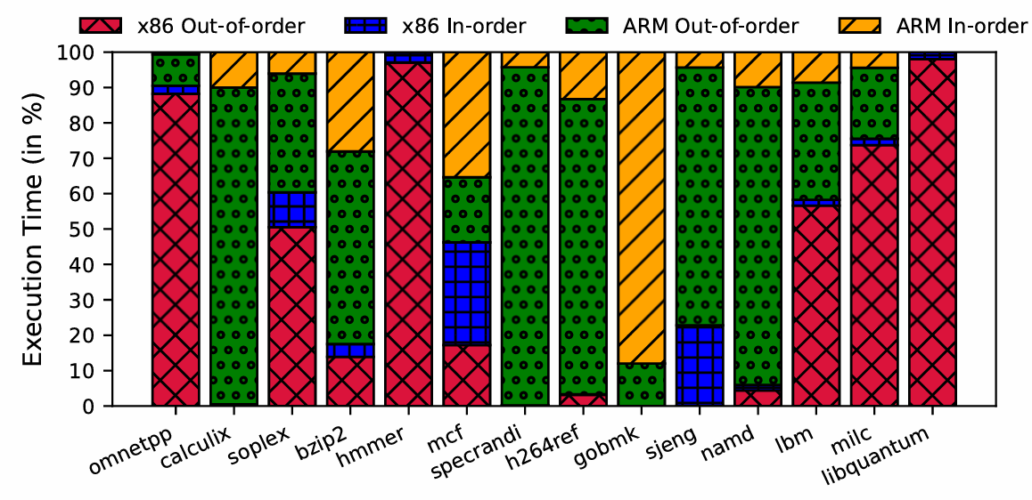
Results: ISA/μarch Affinity

Slide 12
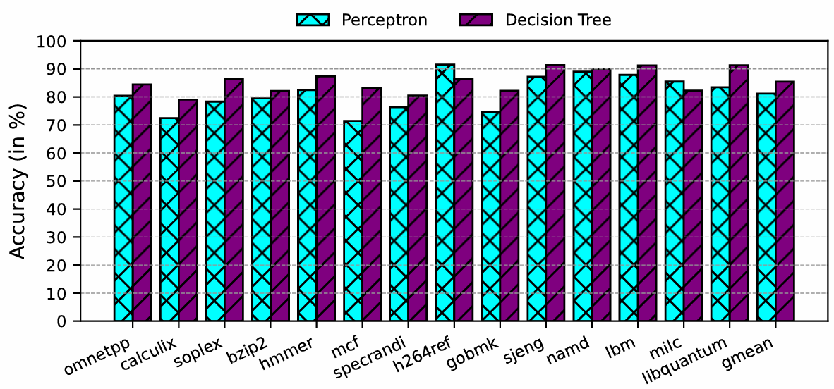
Results: ISA-Scheduling Accuracy

Slide 13
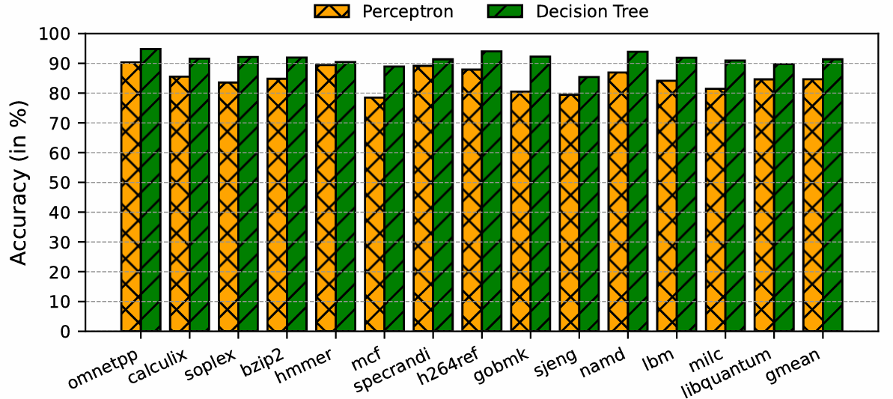
Results: μarch-Scheduling Accuracy

Slide 14
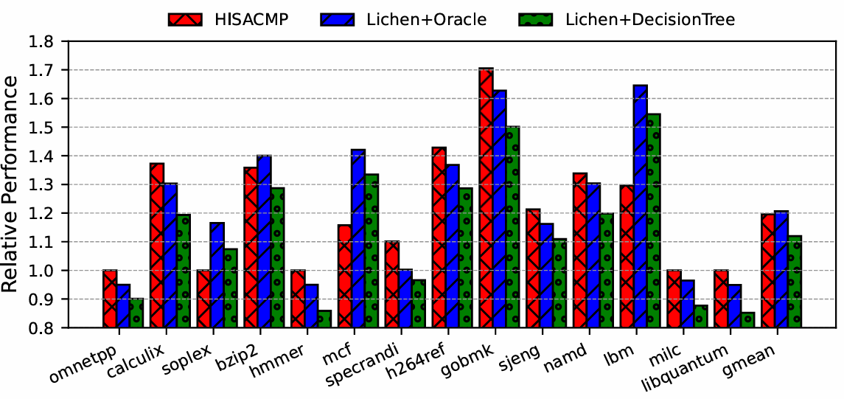
Results: Performance

Slide 15
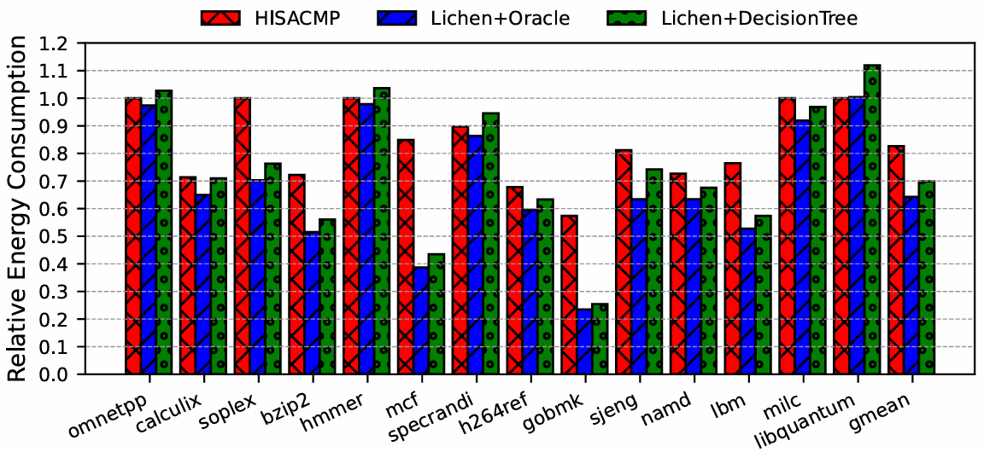
Results: Energy Consumption

Slide 16
Conclusion
Lichen uses finer-grained switching between ISAs and existent OoO to InO morphing feature (at runtime), improving energy efficiency
ISA & microarchitectural heterogeneity, leveraged effectively provides significant energy benefits with synergy in interaction
Lichen achieves 15.36% energy savings with 9.36 % EDP reduction over HISACMP (oracular scheduling), with 6.35% performance loss
CART-based scheduling achieves 85.44% and 91.35% accuracy for predicting optimal ISA and execution scheme (InO/OoO)

Slide 17
Thank You

