Slide 1
Environmental Solution
BY PRAKHAR DUBEY

Slide 2
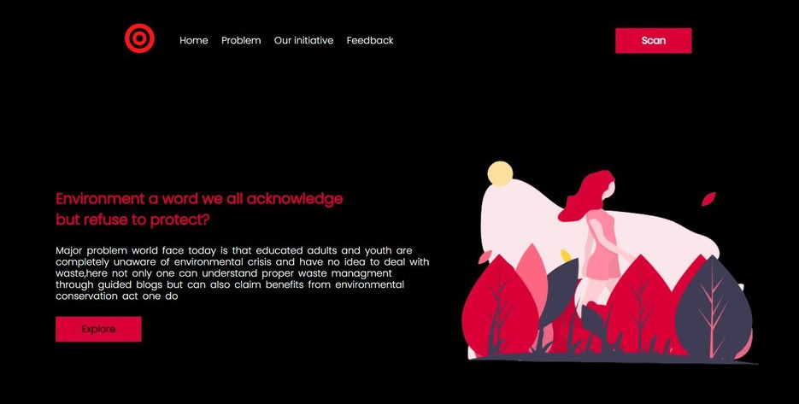

Problem statment and solution
ENCOURAGING ADULTS AND YOUTH
Problem with young population is that it not only they lack awareness but they also lack will and inspiration to do environmental protection
This website main motive is to encourage and motivate oneself for waste managment and Environmental protection
tech stack-Html5,CSS3,Javascript,isotope,jquey,PHP

Slide 3
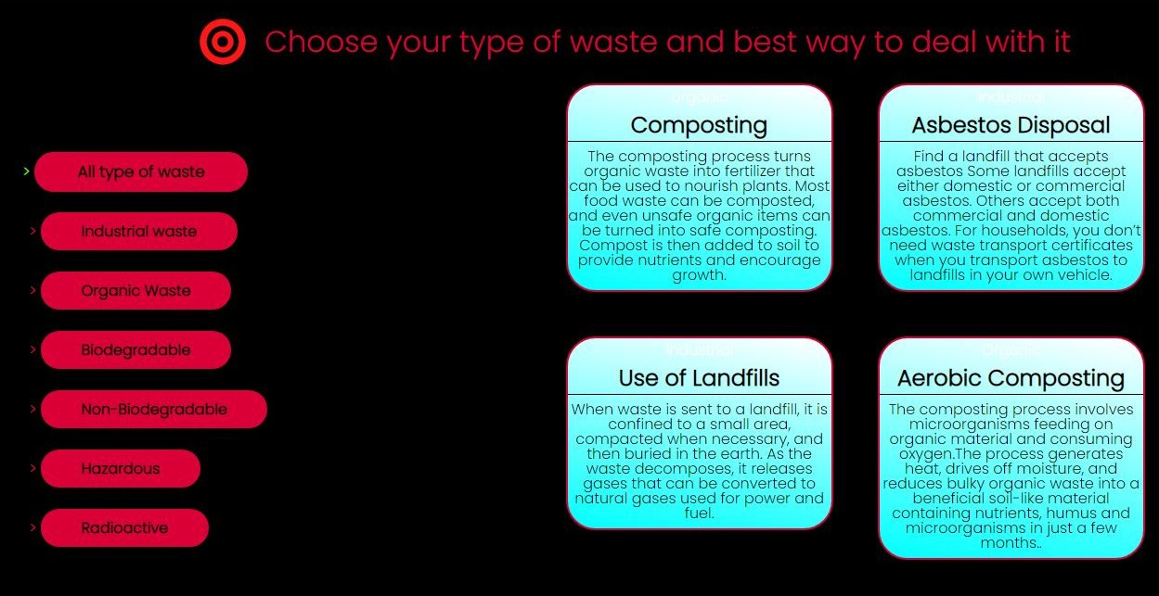
Working
1. Method for awarness
Explore button of website will redirect to page where one can choose there waste type and way to deal with it list of waste type can be easily used toshortlist all possible ways of dealing with waste effciently
(This section utilize isotope and jquery for shortlisting)

Slide 4
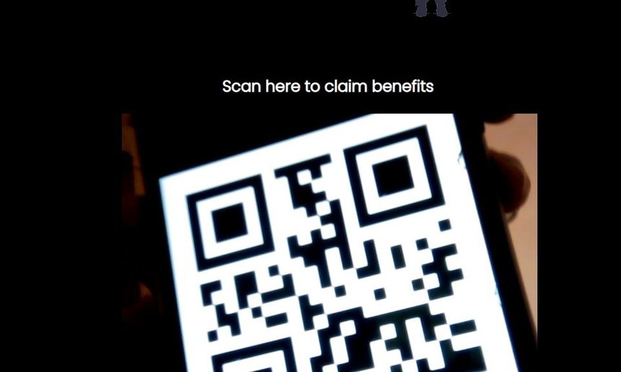
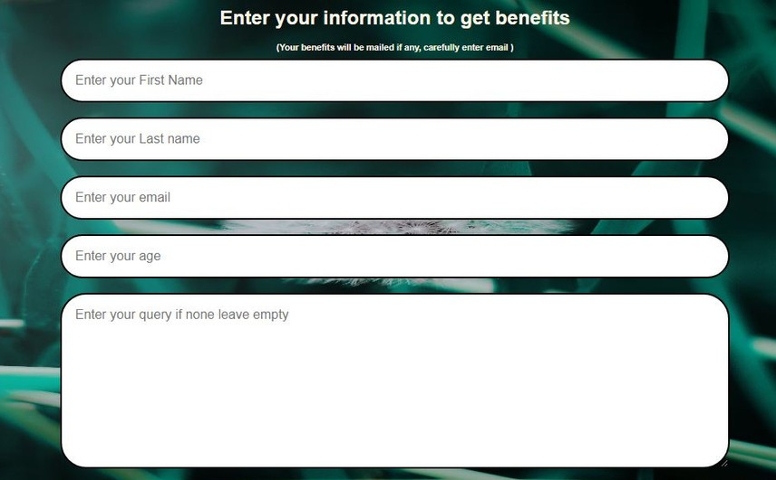
Working
2. Scann for benefit
This section is made for encouragment for waste managment primary idea behind is that one time scan qrcode would be embedded in garbage trucks so that when one throw waste and scan he will be redirected to a form page where he/she can enter information and can get benefits
benefits will be awarded only after completion of certain score and and be mailed by at offered email
(this section utilize instascan plugin and php)

Slide 5

Why wil someone use this website?
Benefits
As after certain score reward will be given one will always proactivily manage waste and have mutually favour garbage truck
Information Offered
Website easily shortlist all possible ways of dealing with waste so it can fuel one curosity if seen once
Simplicity
Website is simple to use and easy to understand there is no complex model for sake of easy use

Slide 6
Thankyou
NAME
Prakhar Dubey
EMAIL
prakhardubey2002@gmail.com
COLLEGE
Gyan Ganga Institute of technolgy and sciences

