Slide 1
KPMG NLP Assessment
Submitted By : Prakhar Gurawa
Aim: To perform a task of Sequence Tagging on a Movie dataset

Slide 2
About problem
We are provided a custom movie dataset in BIO format (Link: https://groups.csail.mit.edu/sls/downloads/movie/) which involves two database eng corpus with simple queries and trivia10k13 with complex.
The task described in the given problem is generally defined as sequence tagging or sequence labelling in the literature.
According to Wikipedia: In machine learning, sequence labeling is a type of pattern recognition task that involves the algorithmic assignment of a categorical label to each member of a sequence of observed values. A common example of a sequence labeling task is part of speech tagging, which seeks to assign a part of speech to each word in an input sentence or document. (Reference : https://en.wikipedia.org/wiki/Sequence_labeling)
Chapter 9 of Book by Dan Jurafsky and James H. Martin, Speech and Language Processing goes in great depth by presenting deep learning models for sequence processing. (Reference: https://web.stanford.edu/~jurafsky/slp3/)

Slide 3
Methodology
We are going to train a custom NER/Sequence Tagging model, using an open- source NLP Python library Flair (Link: https://github.com/flairNLP/flair)
Flair is a powerful framework for Natural language processing build using PyTorch and even provides its own flair embeddings, assistance in number of NLP tasks like POS tagging, NER, text classification.
The training code can be found as Colab ipynb files trained on GPU Tesla P100-PCIE-16GB and Intel(R) Xeon(R) CPU @ 2.20GHz CPU.
Benefits of using flair library: state of art models, different embeddings provided, extensive evaluation with different measures, open source so easy to extend and modify models.

Slide 4
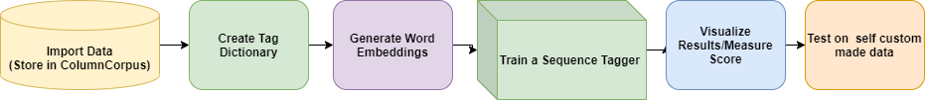
Sequence Tagging Pipeline using Flair
Importing data: The data is stored in ColumnCorpus, a data structure used by Flair for processing of data. Each example in our ColumnCorpus will have two columns, word and tag (which will be predicted).
Create Tag Dictionary: To create a dictionary which will contain classes from which predictions will belong to. Example: B-Actor, I-Actor, B-Plot, I-Plot etc.
Generate Word Embeddings: Flair provides a number of different embeddings, we will be using Glove Embeddings. GloVe embeddings are PyTorch vectors of dimensionality 100.

Slide 5
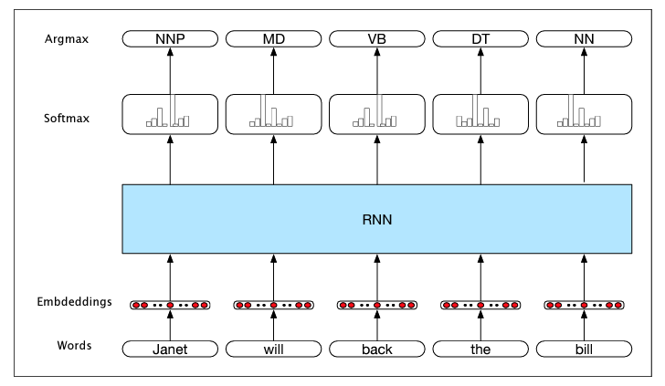
Train a Sequence Model: Sequence Tagger used is a bi-directional LSTM model, for better generalization of relations over time as compared to RNNs and Vanilla Neural Nets. The model somewhat looks like as figure just stacked and with LSTM cells. The image is taken from Chapter 9, of Book by Dan Jurafsky and James H. Martin, Speech and Language Processing
Visualizing Results/Measuring Results: Performed multiple operation to evaluate the learned model like F1-Score (Macro and Micro), per class performance, precision, recall etc.
Test on self custom made data : As the model is already tested on test data, a evaluation on few self made example is performed to sense the real performance of model.

Slide 6
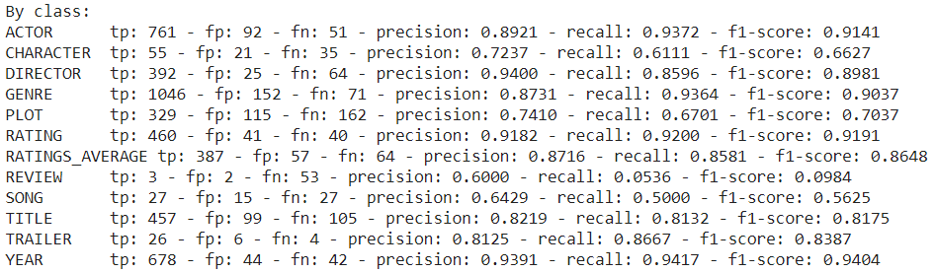
Performance on Eng data
Hidden size 256, learning rate 0.1, mini batch size 32 trained for 68 epochs.
F1 score (micro) : 0.8695
F1 score (macro): 0.7603
Final training loss : 1.645139, Final dev loss : 1.564637
Final dev precision : 0.8780, Final dev recall : 0.8670, Final dev F1 score : 0.8725
Per class performance

Slide 7
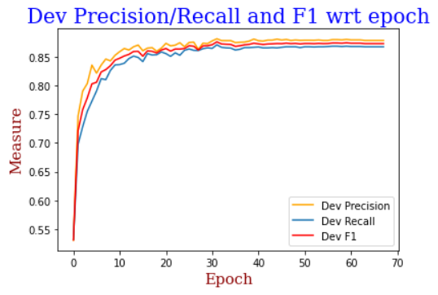
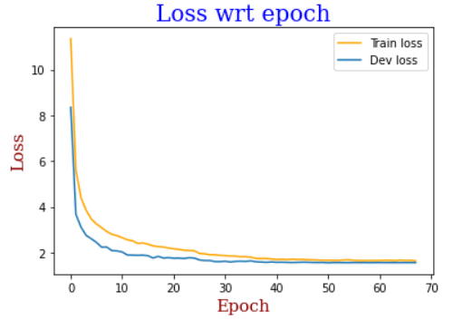
Performance on Eng data
Example predictions on test set. Prediction format : (Word, Actual Tag, Predicted Tag) . These examples can be found in test.tsv
First example of test file. all tags are correctly predicted except the year ones.
Second example of test file, all tags correctly predicted.

Slide 8
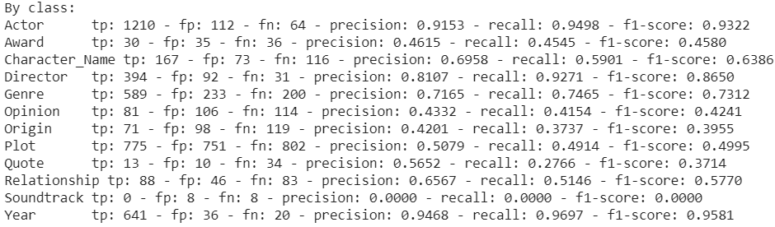
Performance on Trivia10k13 data
Hidden size 256, learning rate 0.1, mini batch size 32 trained for 65 epochs.
F1 score (micro) : 0.7156
F1 score (macro): 0.5709
Final training loss : 3.825191, Final dev loss : 3.307125
Final dev precision : 0.7160, Final dev recall : 0.6999, Final dev F1 score : 0.7079
Per class performance

Slide 9
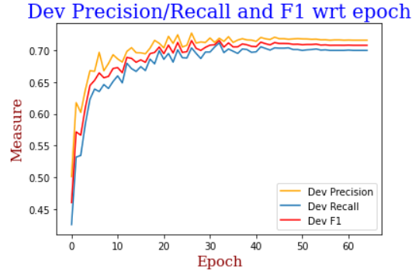
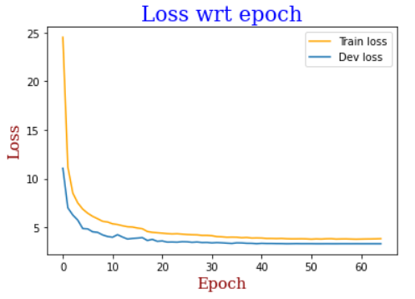
Performance on Trivia10k13 data
Example predictions on test set. Prediction format : (Word, Actual Tag, Predicted Tag) . These examples can be found in test.tsv
First example of test file. all tags are correctly predicted
Second example of test file, excepted the tag for word 'remade' all are correctly predicted.

Slide 10
Potential Improvements
The flair library provides StackedEmbeddings which can be used to combine different embeddings together, for instance if you want to use both traditional embeddings together with contextual string embeddings. It can provide a better performance.
We can perform hyperparameter optimizers, as there are number of hyperparameters like learning rate, regularization, hidden size, dropout, word dropout, loss weight. Varying them can help us learn better model, but will require more time and resources.
The flair model uses bi-directional LSTM model, we can use a transformer based model like BERT to expect a better performance. Huggingface provides BERT implemnation for this task which can be found here : https://huggingface.co/transformers/model_doc/bert.html#bertfortokenclassification
We can create a new model which takes word embeddings and parse trees as input for better understanding of relationship, this will be a new kind of model of its own.

