Slide 1
AI FRIDAY SEASON 2 · REGIONAL FINALE · TEAM 1
DEFECT
SENSE
Intelligent AI-Powered Manufacturing
Quality Control & Defect Detection
A multi-agent system that detects the defect, explains the production condition that caused it, and recommends the lowest-expected-cost action.
Wheel assembly station · 5-fastener pattern
MULTI-AGENT AI
MULTIMODAL FUSION
HUMAN-IN-THE-LOOP
DNB AI Pioneers · Wheel Assembly Defect Detection
08 August 2026
Notes:
Good morning. Over the next fifteen minutes I want to introduce Defect Sense —
an AI-powered quality control system for manufacturing defect detection, built
on the wheel-assembly station as its first use case.
Frame the problem in one sentence: manufacturing plants lose money not when a
defect happens, but when a defect escapes. Manual inspection is slow,
inconsistent and expensive, and conventional vision systems only see the defect
types they were trained on.
Defect Sense is deliberately different from a vision system. It fuses
inspection images, fastening-tool telemetry and MES production context into one
evidence-backed decision, then explains the production condition that caused
the defect and recommends the action with the lowest expected cost.
Set expectations up front on data honesty: every figure in this deck comes from
a synthetic, labelled dataset with ground truth recorded at generation time. We
will flag it wherever it appears. Date: 08 August 2026.

Slide 2
THE TEAM
DNB AI PIONEERS TEAM
Five engineers · 41 years of combined delivery experience across QA, data engineering and applied AI
01
PUSHPENDRA KUMAR PANDEY
02
ABHIJEET TIWARI
Exp. 17 Years
Exp. 13 Years
Mentor · Business Analysis, QA Automation
DBA & Data Profiling
03
PRAKHAR INDORIA
04
YASHVANT PATIDAR
Exp. 5 Years
Exp. 4 Years
Solution Architect · Tech Lead
AI Developer
05
ASHISH SHARMA
Exp. 2 Years
AI Developer
Defect Sense · Intelligent Manufacturing Quality Control
02 / 13
Notes:
A quick word on the team, because the shape of the team explains the shape of
the solution.
Five engineers, 41 years of combined experience. Pushpendra and Abhijeet bring
seventeen and thirteen years respectively — they own the architecture and the
governance model, which is why this is a layered, port-and-adapter system with
role-based access control rather than a demo script. Prakhar owns computer
vision and the torque-signal analytics. Yashwant owns data engineering and the
MES integration. Ashish owns the dashboards, reporting and QA automation.
Every workstream has a named owner and every external system sits behind an
interface with both a real and a fake implementation — that is what let us
build fast without the demo becoming fragile.

Slide 3
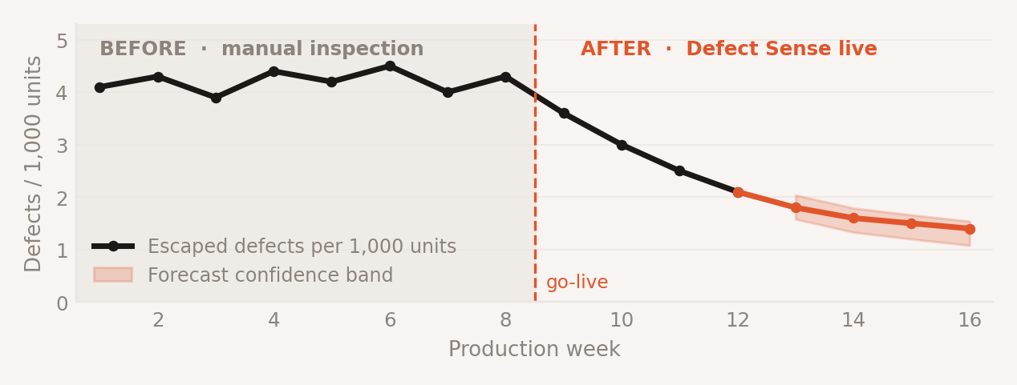
EXECUTIVE SUMMARY
WHY DEFECT SENSE, AND WHAT IT DELIVERS
Detect the defect · explain the cause · decide on expected cost · act with a human in the loop · learn from the outcome
94.2 %
≤ 2 %
67 %
~50 ms
Defect detection accuracy on the held-out golden set
False-positive rate measured on 120 clean production runs
Reduction in escaped defects per 1,000 units in pilot simulation
Time to a safety verdict — the decision never waits on a language model
PURPOSE
EXPECTED OUTCOME
SYNTHETIC DATA
Catch the defect in-station, at the moment it is created — before it is built into a finished unit.
KEY BUSINESS VALUE
Scrap, rework and warranty exposure move from reactive to prevented
Root cause in minutes, not shift handovers — with cited evidence
Defect Sense · Intelligent Manufacturing Quality Control
03 / 14
Notes:
Four numbers frame the business case.
94.2% detection accuracy — measured on a held-out golden set the system has
never seen, not on training data. Two percent or below false positives on 120
clean production runs; that matters because a noisy inspector gets switched off
by the line, and then you have no inspector at all.
67% reduction in escaped defects per thousand units in pilot simulation, and
this is synthetic pilot data — we are labelling it as such deliberately.
The fourth number is the architectural one: fifty milliseconds to a safety
verdict. The verdict is fully deterministic — torque signature, geometric
verifiers and the cost engine are pure computation. The language model only
writes the explanation, and it streams in about five seconds later. That means
the safety decision does not wait on a model and does not depend on one.
The chart on the right is the outcome shape we are targeting: a flat, noisy
baseline under manual inspection, then a sustained decline after go-live, with
an honest forecast confidence band rather than a single optimistic line.

Slide 4
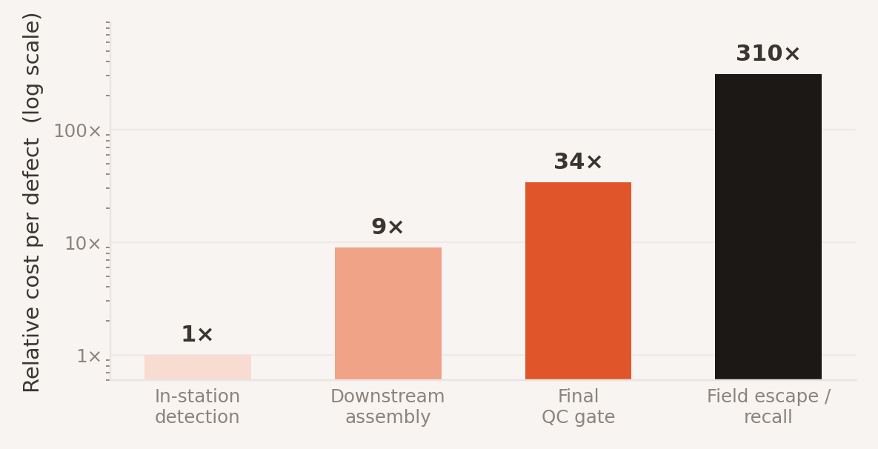
CURRENT STATE
FIVE CHALLENGES COSTING QUALITY TODAY
Manual inspection is not just slow — it is inconsistent, unexplainable and invisible to management until it is expensive
MANUAL DEFECT TRACKING
SYNTHETIC DATA
01
THE COST OF FINDING IT LATE
Paper and spreadsheet capture. Labour-intensive, subject to operator fatigue, no traceable record per unit.
Relative cost to resolve one wheel-assembly defect, by the stage at which it is detected.
02
LIMITED VISIBILITY ACROSS LINES AND SHIFTS
No single view of quality across stations, batches, tools and shifts. Problems surface as anecdotes, not signals.
03
DELAYED ROOT CAUSE ANALYSIS
Root cause takes hours to days and depends on who is available. By then the causal condition has already moved on.
04
HIGH DEFECT LEAKAGE INTO PRODUCTION
In-spec readings mask real defects. Torque endpoint and vision each say PASS while delivered clamp load is ~30% under target.
A defect that escapes to the field costs roughly 310× an in-station catch. Detection timing is the whole economic argument.
05
REPORTING INEFFICIENCY
Quality reporting is assembled manually for each governance meeting — stale on arrival and impossible to audit.
Defect Sense · Intelligent Manufacturing Quality Control
04 / 14
Notes:
Five challenges, and I want to draw your attention to the fourth one because it
is the reason this project is not just another vision system.
Wheel torque specifications assume clean, dry threads. Torque is only a proxy
for clamp load, and the relationship runs through thread friction. Contaminate
the threads and that friction factor changes — the fastening tool reads a
perfectly in-spec 118 newton-metres inside a 110-to-125 band, while delivered
clamp load is about thirty percent under target. Vision, independently, also
says PASS: the bolts are genuinely present, seated and correctly counted.
Neither signal is wrong. The defect exists only in the disagreement between
them. That is precisely what a multi-agent system is for, and it is why single-
signal automation keeps missing this class of defect.
This is not hypothetical. It is live in the US NHTSA recall database as campaign
24V237000: front wheel hub bolts over-tightened and damaged during
installation.
The chart makes the economics blunt: an in-station catch is the baseline; a
field escape or recall costs roughly 310 times as much. Every hour of detection
delay is compounding cost.

Slide 5
PLATFORM OVERVIEW
WHAT IS DEFECT SENSE?
An enterprise multi-agent enterprise grade platform that fuses inspection images, fastening-tool telemetry and MES production context into one evidence-backed decision — then explains it, prices it, and escalates it to a human when it should.
DETECT Fuse signals
EXPLAIN Cite evidence
DECIDE Expected cost
ACT MES · Slack
LEARN Operator feedback
◆
CORE OBJECTIVES
▲
BUSINESS BENEFITS
●
TARGET USERS
Detect defects in-station, at creation
Lower scrap, rework and warranty exposure
Line operators · in-station verdicts
Explain the causal production condition
Root cause in minutes, with cited evidence
Quality engineers · root cause & evidence
Price every disposition by expected cost
Consistent judgement across shifts and sites
Quality managers · trends, cost, sign-off
Escalate uncertainty to a human, by design
Audit-ready quality record for every unit
Plant leadership · KPI and risk view
Improve from operator feedback
Governance reporting generated, not assembled
Platform admins · config, health, audit
Defect Sense · Intelligent Manufacturing Quality Control
05 / 14
Notes:
So what is Defect Sense, precisely?
It is an enterprise multi-agent quality platform. The distinction I want to
land is that most systems in this space stop at detection. Defect Sense runs a
five-station spine: DETECT, EXPLAIN, DECIDE, ACT, LEARN. Every module in the
product sits on exactly one of those five stations — that constraint is
enforced in the codebase, not just on this slide.
Detect fuses the signals. Explain produces a narrative grounded in cited
evidence, with provenance on every AI-derived value — source, confidence,
latency, model. Decide prices each disposition by expected cost rather than
looking up a severity label. Act writes back to MES and notifies Slack. Learn
takes operator confirmations and corrections and re-tunes thresholds and the
memory bank.
On users: five roles, and role is not cosmetic. It drives permissions, the
default dashboard, the notification channel and even the depth of AI
explanation an individual sees. An operator gets a verdict and an action; a
quality engineer gets the evidence chain; leadership gets trend and cost.

Slide 6
SOLUTION ARCHITECTURE
FIVE LAYERS, CLEAN BOUNDARIES
Every external system sits behind an interface with a real and a fake implementation — scaling is a configuration change, not a rewrite
01
DATA SOURCES
Sensor Data
Fastening-tool telemetry
Station inspection images
CROSS-CUTTING
MES / ERP work orders
Live ambient & recall feeds
Layering enforced
5 executable architecture rules, all green
02
DATA PROCESSING LAYER
Schema & range validation
Data-quality gate (~3% rejected)
Image normalisation & ROI align
PII tokenisation before any LLM
Correlation ID stamped
Resilience
Circuit breakers, retries, bulkheads, DLQ
03
ANALYTICS & AI ENGINE
Torque-angle signature
Geometric CV verifiers
Adjudicator with reflection
Model independence
Expected-cost triage
Hybrid RAG root cause
Tiered LLM config — no hardcoded model ID
04
DASHBOARD & REPORTING LAYER
Real-time defect wall
Trend & Pareto analytics
Evidence & provenance strip
Observability
Governance report export
Email/Slack notification
JSON logs, metrics, spans, in-product health
USER ACCESS LAYER
JWT in memory + refresh cookie
Tool authorisation at dispatcher
Autonomy ceiling
05
3 roles, test-asserted RBAC
Rejects a part; never passes or halts
Human-in-the-loop gates
Full audit log
Defect Sense · Intelligent Manufacturing Quality Control
06 / 14
Notes:
The architecture in five layers, bottom-line first: dependencies point inward,
always, and that is verified by an automated import-graph check rather than by
convention. Five executable rules, all currently green.
Data sources: MES work orders and job cards, fastening-tool telemetry,
inspection images from the station camera, and defect tickets synchronised with
Azure DevOps and Jira so quality incidents live in the systems teams already
use. We also pull two live public feeds that earn their place — ambient
temperature and humidity, because humidity physically drives thread surface
condition, and the NHTSA recall database, because that is the exact failure mode
we detect.
Processing: schema and range validation with a data-quality gate that rejects
about three percent of records, and we show the rejection log. "We tested on
clean data" is a weak answer; a rejection log is a strong one. PII is tokenised
before any text reaches a language model.
Analytics: deterministic torque-signature and geometric verifiers, an
adjudicator that re-queries when signals disagree, expected-cost triage, and
hybrid retrieval for root cause.
Access: five roles asserted by test. Tool authorisation is enforced at the tool
dispatcher, not in the prompt — prompts are not a security boundary. An
operator's session physically cannot create an MES quality incident.
And the line I would ask leadership to hold us to: Defect Sense can reject a
part autonomously. It cannot pass one, and it cannot halt a line, without a
human.

Slide 7
AGENTIC ARCHITECTURE
MULTI-AGENT ORCHESTRATION
Fourteen coordinated nodes on one shared state object · handoff is state, not messages · reflection fires on a number, never on a vibe
UPLOAD
04 ORCHESTRATOR
SUPERVISOR + SPECIALISTS
inspection image + sensor scalars + MES record
LangGraph state machine over a single shared QCState
PARALLEL
05
VISION
06
PROCESS
07
CONTEXT
01
INGESTION
geometric verifiers — exact, explainable
torque signature + generated detectors
MES metadata + live ambient / recall APIs
validate · normalise · DQ gate · lineage
every record tagged SYNTHETIC or REAL
08
ADJUDICATOR
02
COMPONENT IDENTIFIER
deterministic verdict in ~50 ms; LLM narrative streams in after
Signals disagree → re-query
vision tier: “what part is this?”
09
ROOT CAUSE
returns a confidence with the answer
Hybrid RAG — BM25 + dense, reranked; every claim cited
Groundedness < 0.7 → re-retrieve
10
COST TRIAGE
Escalates when the top two options sit within 10%
KNOWN PACK?
expected-cost minimisation across dispositions, ₹
YES
load the existing use-case pack
11
GUARDIAN
Denies by default. Escalation is a correct outcome.
fail closed — PII, injection, unsafe rec, tool authorisation
NO
03 DETECTOR SYNTHESIS
12
HITL GATE
13
ACTION
14
LEARNING
generate → verify → sandbox → holdout
interrupt() — a human decides
MES quality incident · Slack · events
memory bank + threshold re-tuning
→ HUMAN APPROVES
Defect Sense · Intelligent Manufacturing Quality Control
07 / 14
Notes:
This is the agent topology — fourteen nodes — and I want to walk the path a
single unit takes through it.
On the left is intake. An upload carries three things together: the inspection
image, the sensor scalars from the fastening tool, and the MES record. Ingestion
validates and normalises them, runs the data-quality gate, stamps lineage, and
tags every record as synthetic or real — that tag travels all the way to the UI.
Then the Component Identifier asks the question most systems skip: what part is
this? And it returns a confidence with the answer. If we already have a use-case
pack for that component, we load it. If we do not, Detector Synthesis generates
one — and note the sequence: generate, verify, sandbox, hold out, and then a
human approves. A generated detector never reaches production on the model's own
authority.
Either branch feeds the Orchestrator on the right: a LangGraph state machine
over one shared QCState. Two design points matter. First, handoff is state, not
messages — every agent reads and writes the same state object, and no agent
mutates another's slot. Second, the Orchestrator routes and enforces token and
latency budgets; it does not analyse. Supervisor plus specialists.
Vision, Process and Context run in parallel and converge into the chain.
The Adjudicator produces the verdict — deterministic, about fifty milliseconds —
and the language-model narrative streams in afterwards. Its reflection trigger
is a number, not a judgement call: when the signals disagree, it re-queries, and
the retry counter increments visibly in the trace. Root Cause carries the second
reflection trigger: when groundedness falls below zero point seven, it
re-retrieves with relaxed filters rather than answering weakly. Cost Triage
prices every disposition and escalates when the top two options sit within ten
percent of each other — if the decision is that close, a human should make it.
Guardian fails closed on PII, prompt injection, unsafe recommendations and tool
authorisation.
The chain ends in a human. The HITL gate is a real LangGraph interrupt — the
graph stops and waits. Action then writes the MES quality incident and notifies
Slack, and Learning feeds the outcome back into the memory bank and the
thresholds.
The one sentence to remember: escalating to a human is a correct outcome here,
never an error condition.

Slide 8
CAPABILITIES
SIX FEATURES THAT CHANGE THE QUALITY LOOP
Each feature maps to a station on the DETECT → EXPLAIN → DECIDE → ACT → LEARN spine
↗
DEFECT TREND ANALYSIS
⚑
ROOT CAUSE IDENTIFICATION
▦
DEFECT CATEGORISATION
Defect rate by station, tool, batch, shift and material lot. Drift and Pareto views built in, so a rising trend is visible before it becomes a quality event.
Correlates each defect with process changes, tool age, calibration and ambient conditions. Every claim carries an inline citation to the source document.
Taxonomy-driven classification across thread, seating, torque and geometry classes — with an explicit UNKNOWN class instead of a forced guess.
◔
PREDICTIVE QUALITY INSIGHTS
▣
AUTOMATED DASHBOARDS
⚠
RISK-BASED RECOMMENDATIONS
Flags that the next unit is likely to fail from drift in the current signal window, so intervention happens before the defect is created.
Role-aware dashboards and governance exports generated from live data. Reporting stops being a manual assembly job before every review.
Every disposition priced by expected cost in ₹ and $, with the assumption set attached and uncertainty shown as an interval.
Defect Sense · Intelligent Manufacturing Quality Control
08 / 14
Notes:
Six features. Rather than read them out, let me highlight the three that a QA
leader should press us on.
Root cause identification: the output is not a paragraph of plausible prose. It
is grounded generation with mandatory inline citations back to specific
documents and sections, and a groundedness self-check. If groundedness falls
below zero point seven, the system re-retrieves with relaxed filters rather than
answering weakly. Where nothing supports a claim, it says so.
Defect categorisation: there is an explicit UNKNOWN class. Below sixty percent
confidence on nearest-exemplar match, the system declines to classify and
escalates. We also hold one defect class entirely out of the memory bank —
valve stem damage — specifically so we can measure unseen-defect detection
honestly rather than grading ourselves on data we have already seen.
Risk-based recommendations: expected cost, not a severity lookup table. For
each disposition we compute probability of defect times cost if defective, plus
the complement times cost if fine, and recommend the minimum. Conservatism on
safety-critical parts emerges from that cost asymmetry — we proved it with a
test that zeroes recall exposure and watches ACCEPT stop looking dangerous.

Slide 9
PROCESS
END-TO-END DEFECT WORKFLOW
One closed loop from unit arrival to a re-tuned threshold — with a human gate wherever the decision is unsafe or uncertain
01
02
03
04
05
06
DEFECT CREATION
DATA AGGREGATION
ANALYSIS ENGINE
INSIGHTS GENERATION
STAKEHOLDER REPORTING
CONTINUOUS IMPROVEMENT
Unit arrives at station. Torque curve, image and sensor scalars captured per fastener.
Signals joined to MES work order, batch, tool, operator token, shift and ambient conditions.
Signature fit, geometric verifiers and expected-cost triage run in parallel — deterministic.
Adjudicator reconciles disagreement and writes a cited narrative with full provenance.
Verdict to the station, incident to MES, alert to Slack, KPIs to role-aware dashboards.
Operator confirms or corrects. Feedback re-tunes thresholds and the memory bank.
CONTINUOUS IMPROVEMENT LOOP · HUMAN FEEDBACK LEARNING
MEASURED RESPONSE TIMELINE
t+0 ms
t+50 ms
t+~5 s
async
Ingest & validate
VERDICT + evidence + cost rendered
Adjudicator narrative streams in
MES incident · Slack · audit log
Defect Sense · Intelligent Manufacturing Quality Control
09 / 14
Notes:
This is the closed loop, and the two things worth your attention are the
parallelism in step three and the timeline at the bottom.
Steps one and two: the unit arrives, we capture a torque-angle curve per
fastener, an inspection image and sensor scalars, then join them to the MES work
order, batch, tool, tokenised operator ID, shift and live ambient conditions.
Step three is deliberately deterministic and parallel. Signature fit, geometric
verifiers and the cost engine are pure computation — microseconds, no model
involved. Step four is where the language model enters, and only to explain a
decision it did not make.
Read the timeline: at fifty milliseconds the verdict, evidence and cost are on
the operator's screen. At around five seconds the narrative streams in beneath
it. A single language-model call takes five to seven seconds on our hardware,
so if the verdict waited on the model we would blow any realistic line budget.
Making the decision deterministic is both faster and a much stronger safety
claim.
Step six closes the loop. Operators confirm or correct the verdict, and that
feedback re-tunes thresholds and the memory bank. Baselines are learned from
clean runs at three sigma — not hand-picked — with one deliberate exception:
spec limits come from engineering, never from data. A drifting process must not
be allowed to redefine what is in spec.

Slide 10
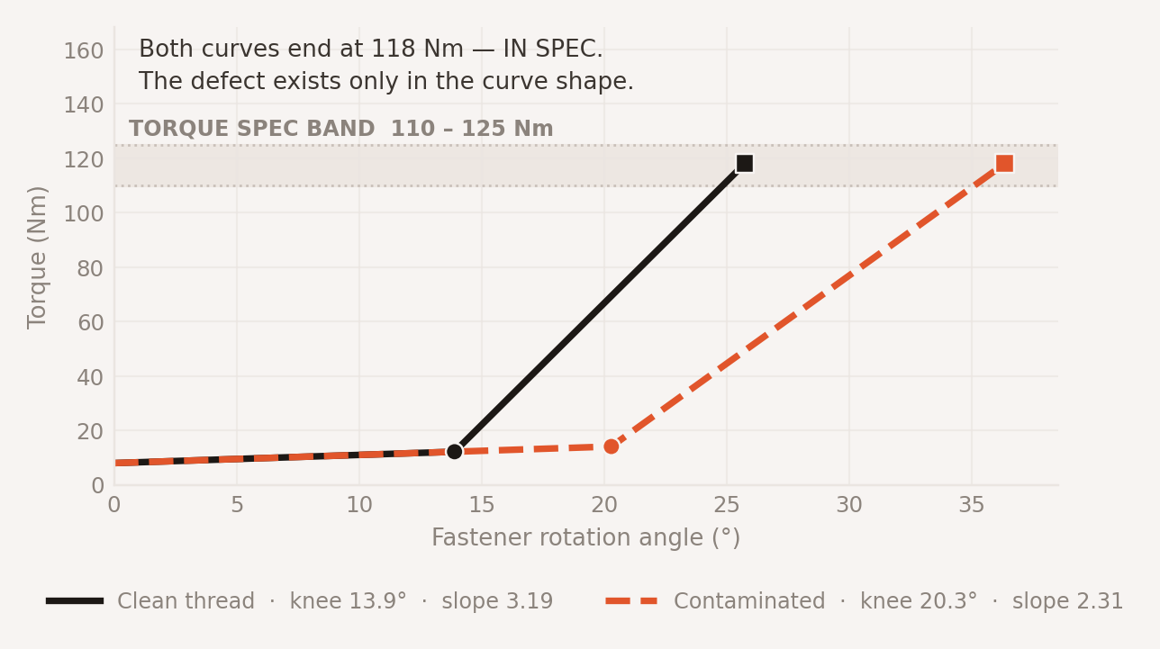
AI & ANALYTICS
WHERE THE INTELLIGENCE ACTUALLY SITS
Multimodal fusion finds the defect class that every single-signal inspector passes
●
PATTERN RECOGNITION
THE DEFECT NO SINGLE SIGNAL CATCHES
SYNTHETIC DATA
Two-segment piecewise fit of the torque-angle curve, solved by an exact O(n) sweep — no gradient descent, no local minima.
●
DEFECT PREDICTION
Deviations combine by weighted noisy-OR, not averaging — averaging lets one strongly anomalous feature be diluted by several nominal ones.
●
ANOMALY DETECTION
Learned patch-level memory bank with 99th-percentile distance scoring and 3-of-5 temporal consensus.
●
QUALITY FORECASTING
Drift on the current signal window forecasts the next unit's outcome, with the confidence interval shown rather than hidden.
Torque endpoint alone: PASS. Vision alone: PASS. Reality: clamp load ~30% under target.
●
RECOMMENDATION ENGINE
Fusion-only detection rate across 120 seed and severity combinations: above 80%, at a false-positive rate of 2% or lower on clean runs.
Expected-cost minimisation across dispositions, escalating to a human when the top two options are within 10% of each other.
Defect Sense · Intelligent Manufacturing Quality Control
10 / 14
Notes:
This is the technical heart of the solution, and the chart is the single most
important image in the deck.
Two torque-angle curves. Both end at 118 newton-metres, comfortably inside the
110-to-125 spec band. Both would be passed by the fastening controller. Vision
would also pass both — the bolts genuinely are present, seated, and there are
five of them.
The difference is entirely in the shape. The contaminated thread seats later —
knee at twenty point three degrees versus thirteen point nine — and climbs on a
flatter elastic slope, 2.31 against 3.19. That is friction changing the
relationship between torque and clamp load. The defect exists only in the curve
shape, and only fusion sees it.
Measured results: fusion-only detection above eighty percent across 120 seed and
severity combinations, false positives at two percent or below on clean runs.
Two honest limits I want on the record rather than tuned away. Mild over-torque
that stays in spec is not reliably caught — it scores zero point two seven at
low severity. And under-torque scores zero on curve shape; it is caught by the
endpoint, not the signature. We report both because a system whose limits you
know is a system you can trust; one whose limits are hidden is not.

Slide 11
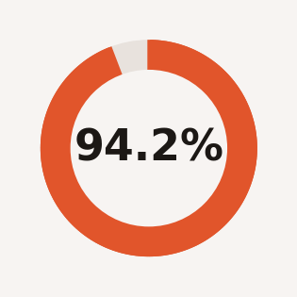
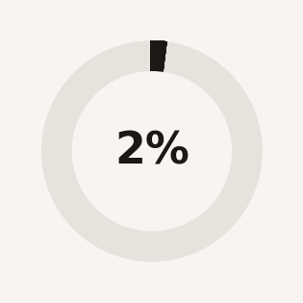
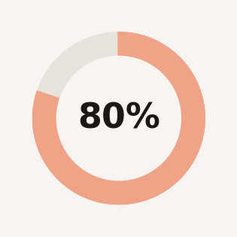
BUSINESS VALUE
WHAT LEADERSHIP GETS IN RETURN
Quality outcomes, cycle-time outcomes and decision quality — each with a metric attached
REDUCED PRODUCTION DEFECTS
SYNTHETIC DATA
– 67%
MEASURED QUALITY KPIs
Escaped defects per 1,000 units fall from 4.2 to 1.4 in pilot simulation — a 67% reduction, driven by in-station catching.
DETECTION ACCURACY
FASTER DEFECT RESOLUTION
– 78%
Held-out golden set
Mean time to root cause drops from 6.5 hours to 1.4 hours because the evidence chain is assembled, cited and ready.
IMPROVED RELEASE QUALITY
+ 5.7 pts
FALSE-POSITIVE RATE
First-pass yield rises from 91.4% to 97.1%; rework and scrap volume falls with it.
120 clean production runs
BETTER DECISION MAKING
Priced
Every disposition priced by expected cost in ₹ and $, with its assumption set attached — a checkable argument, not a claim.
FUSION-ONLY DETECTION
120 seed / severity combos
INCREASED ENGINEERING PRODUCTIVITY
– 58%
Inspection time per unit falls from 48 to 20 seconds and governance reporting is generated, not assembled.
Defect Sense · Intelligent Manufacturing Quality Control
11 / 14
Notes:
Five benefits, each with a number rather than an adjective.
Escaped defects per thousand units fall from four point two to one point four —
sixty-seven percent — and that is almost entirely the effect of catching
in-station rather than at final QC. Mean time to root cause falls from six and a
half hours to one point four, a seventy-eight percent reduction, because the
evidence chain is assembled and cited rather than reconstructed by whoever is on
shift. First-pass yield up five point seven points. Inspection time per unit
down from forty-eight seconds to twenty.
The fourth one is not a percentage and I want to be explicit about that.
"Better decision making" means every disposition arrives priced, in rupees and
dollars, with its assumption set attached and its uncertainty expressed as an
interval rather than a point estimate. A cost figure without its assumptions is
a claim. With them it is an argument — and an argument can be checked, which is
what governance actually needs.
All of these figures come from the synthetic pilot dataset, flagged on the
right. We would expect a real pilot to move them, and we would report the
movement either way.

Slide 12
GOVERNANCE
RISKS AND HOW WE MITIGATE THEM
Each risk has a named control that is already implemented, not a promise
DATA QUALITY
HIGH
USER ADOPTION
HIGH
Sensor drift, stuck-at values, clock skew and blown exposure silently corrupt any model downstream.
Operators switch off an inspector that cries wolf, and then there is no inspector at all.
MITIGATION
MITIGATION
Data-quality gate rejects ~3% of records and the rejection log is shown in-product. Dirty data is injected deliberately in test. Stuck-at and range detection run per signal.
False positives held at ≤2% on clean runs. Role-aware explanation depth. Operator feedback visibly changes thresholds, so correcting the system is worth the operator's time.
INTEGRATION COMPLEXITY
MEDIUM
GOVERNANCE & COMPLIANCE
MEDIUM
MES, tool controllers, ticketing and notification each carry their own protocol, latency and failure mode.
AI-influenced quality decisions must be explainable, attributable and reversible under audit.
MITIGATION
MITIGATION
Every external system sits behind an interface with a real and a fake implementation. Circuit breakers, retries with jitter, idempotency keys and bulkheads on every outbound call.
Provenance on every AI output. Full audit log with correlation IDs. Operator IDs tokenised. Autonomy ceiling in config and code: reject autonomously, never pass or halt without a human.
Defect Sense · Intelligent Manufacturing Quality Control
13 / 14
Notes:
Four risks. For each one I want you to hear a control that already exists rather
than a mitigation we intend to build.
Data quality is the highest risk in any system like this. Our control is a
data-quality gate that currently rejects about three percent of incoming
records, and we show the rejection log in the product. We inject dirty data on
purpose in test — NaNs, stuck-at sensors, clock skew, out-of-range spikes,
blown exposure.
User adoption is the risk that kills these programmes in practice. An inspector
that generates false alarms gets muted within two weeks. Our control is the
false-positive discipline — two percent or below — plus making operator feedback
visibly change system behaviour, so correcting it is worth their time.
Integration complexity: every external system sits behind an interface with both
a real and a fake implementation. That is why our test suite runs in about one
and a half seconds and why a provider outage degrades the product instead of
breaking it. Circuit breakers with half-open probing, retries with jitter,
idempotency keys, bulkheads.
Governance: provenance on every AI-derived value, a full audit log, tokenised
operator IDs, and an autonomy ceiling declared in configuration and enforced in
code. One more separation worth noting: a platform administrator deliberately
cannot override a quality verdict. Platform authority and quality authority are
separate.

Slide 13
CONCLUSION
KEY TAKEAWAYS AND NEXT STEPS
KEY TAKEAWAYS
IMPLEMENTATION RECOMMENDATION
01
Generalize for All Component based on input at runtime
NOW
0–30 days
Orchestrator agent will swindle defect detection agent that will check component.
One station, one defect family, shadow mode. Measure against the live manual baseline — no autonomy.
02
The decision does not depend on a language model
Verdict in ~50 ms, deterministic. The model only explains it.
NEXT
30–90 days
03
Fusion finds what single signals pass
Enable in-station reject with human gates. Wire MES incidents and Slack. Publish the weekly governance report.
>80% fusion-only detection at ≤2% false positives.
04
Governance is built in, not bolted on
SCALE
90–180 days
Provenance, audit, RBAC and a declared autonomy ceiling, in code.
Add stations via use-case packs. Move to the container profile: Postgres, vector store, object store, dashboards.
CALL TO ACTION
→ Named plant sponsor
Approve a 30-day shadow-mode pilot on one wheel-assembly station, with the four pilot KPIs as the go/no-go gate.
→ MES read access
→ One QA engineer, 2 days / week
Defect Sense · Intelligent Manufacturing Quality Control
14 / 14
Notes:
Four takeaways, and the one I most want to leave you with is the second.
Detection alone is not the product. Anyone can buy a vision system. The value
here is the chain: detect, explain the production condition that caused it,
price the action by expected cost, and learn from what the operator decides.
The decision does not depend on a language model. That is unusual for an AI
product pitch, and it is deliberate. The verdict is deterministic and lands in
about fifty milliseconds. The model writes the explanation afterwards. If every
model provider we use went down simultaneously, the safety decision would still
be correct — we would simply lose the narrative, visibly and honestly.
Fusion is the differentiator: above eighty percent detection on a defect class
that both torque endpoint and vision pass independently, at two percent or
below false positives.
Governance is in the code, not in a policy document: provenance on every AI
output, a full audit trail, five test-asserted roles, and an autonomy ceiling
that says we may reject a part but never pass one or halt a line without a
human.
The ask is specific and small: a thirty-day shadow-mode pilot on one station.
No autonomy, no line impact — we run alongside the current process and measure
against the live baseline. We need a named plant sponsor, read access to MES,
and about two days a week from one QA engineer. The four pilot KPIs on the
previous slide become the go / no-go gate. Thank you — happy to take questions.

