Slide 1

Disease Prediction System
Submitted By:
Gaurav Birdi (01918002718)
Md. Omer (03018002718)
Sachin Sharma (04418002718
Prakhar Katiyar (40118002718)
Submitted To:
Ms. Upasna Joshi

Slide 2
Introduction
Disease Prediction helps patients to identify the risk of disease or health problems/disorder. In certain circumstances, people feel unsafe to visit hospitals or individual doctors. Further, sometime people just want to know the type of disease, they have been suffering with.
Therefore, a need for a generic disease prediction system arises using which people can predict the disease on the basis of symptoms that they are facing.
This would also create an awareness of diseases and available medical advice thus avoiding further health complications.
The proposed project aims at developing a web-based system that can predict diseases based on the symptoms reported by the user
In today’s world almost everyone has an access to smartphones, it is going to play a crucial role in improving future of public health care system.
This will further help patients in getting fast and appropriate medical opinion, improve patient care, decrease in resource consumption and further reduce health care costs .

Slide 3
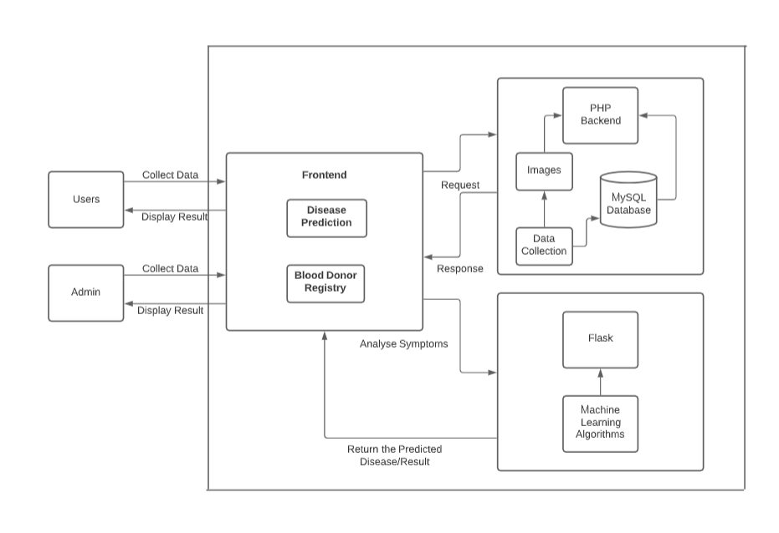
Use Case Diagram

Slide 4
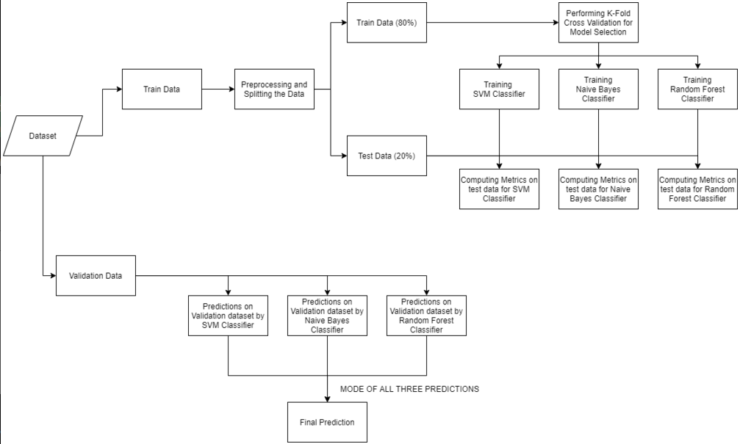
General Disease Prediction Flowchart

Slide 5
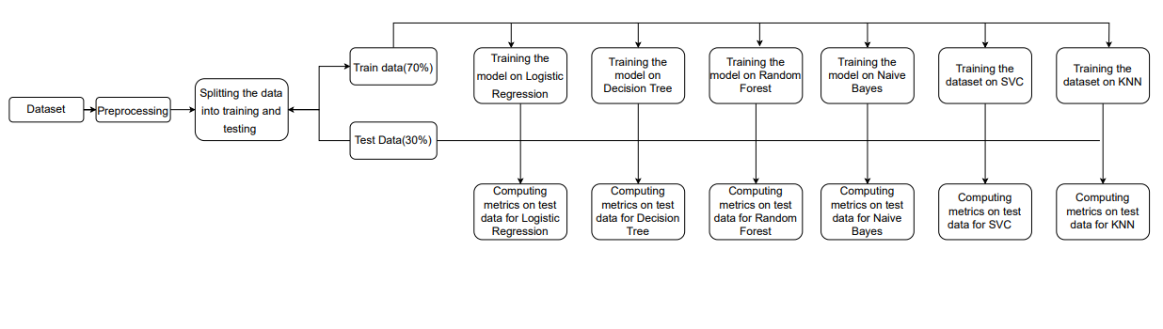
Corona Virus Prediction Flowchart

Slide 6
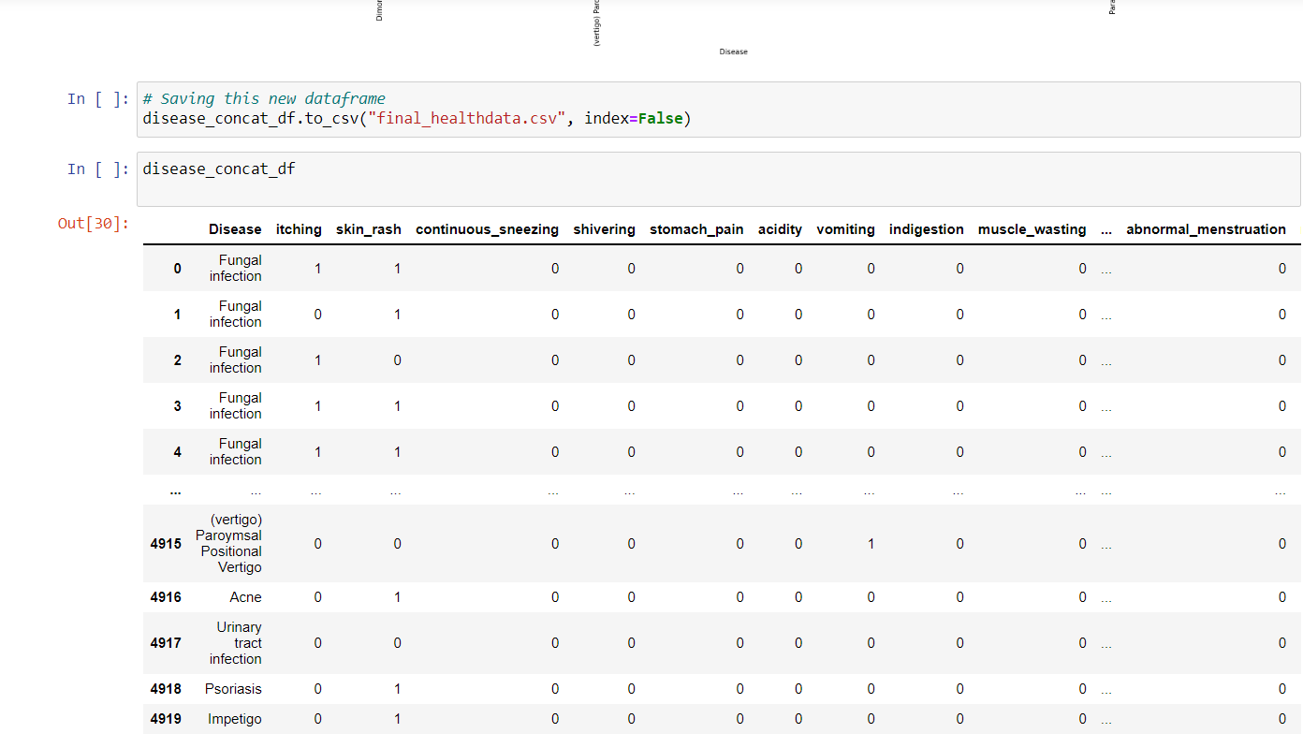
Implementation
DATA PREPROCESSING FOR GENERAL DISEASE PREDICTION DATASET

Slide 7
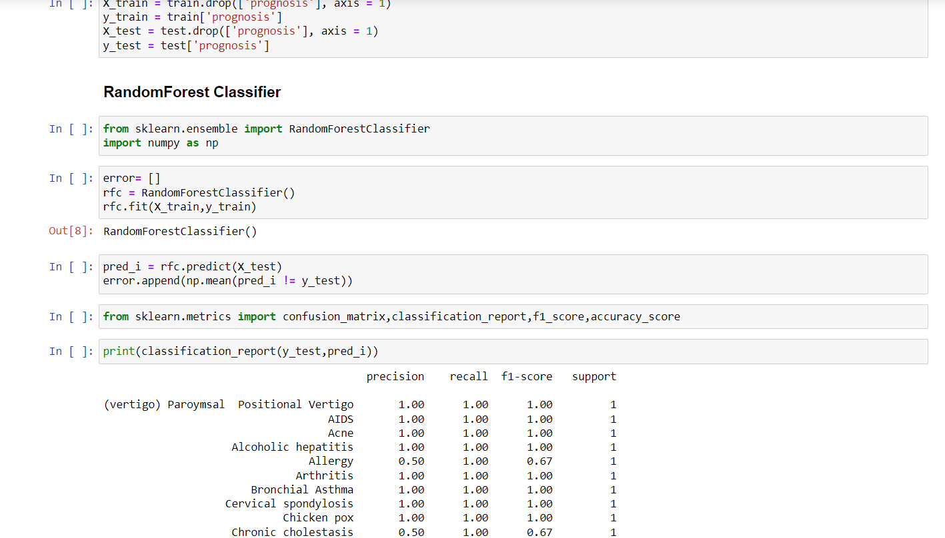
MODEL TRAINING ON GENERAL DISEASE DATASET
Random Forest is the first algorithm used (Accuracy : 95%)

Slide 8
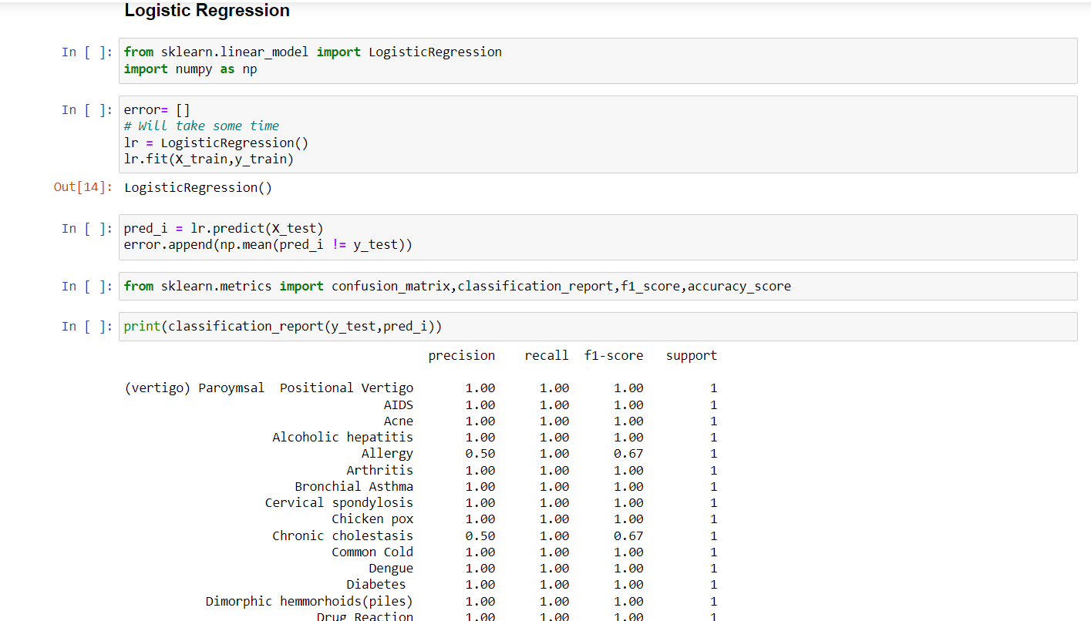
Logistic Regression is the second algorithm used (Accuracy : 95%)

Slide 9
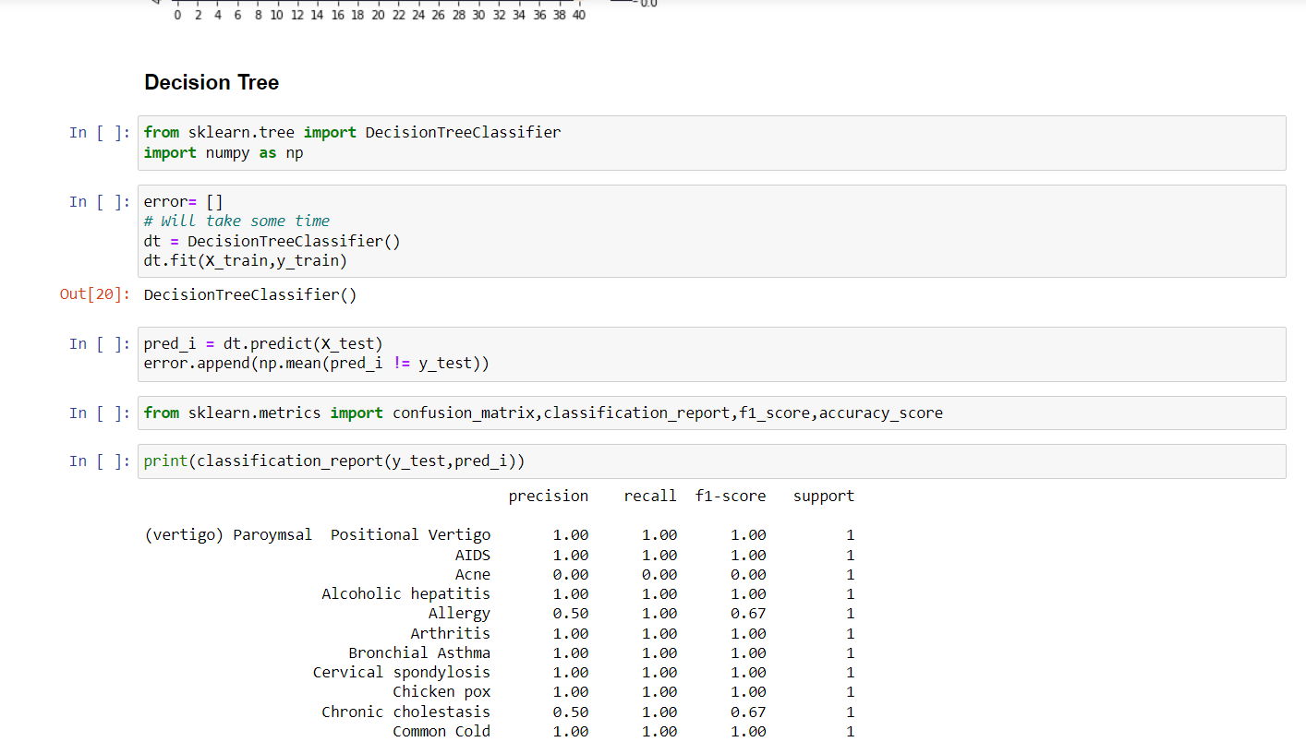
Decision Tree is the third algorithm used (Accuracy : 93%)

Slide 10
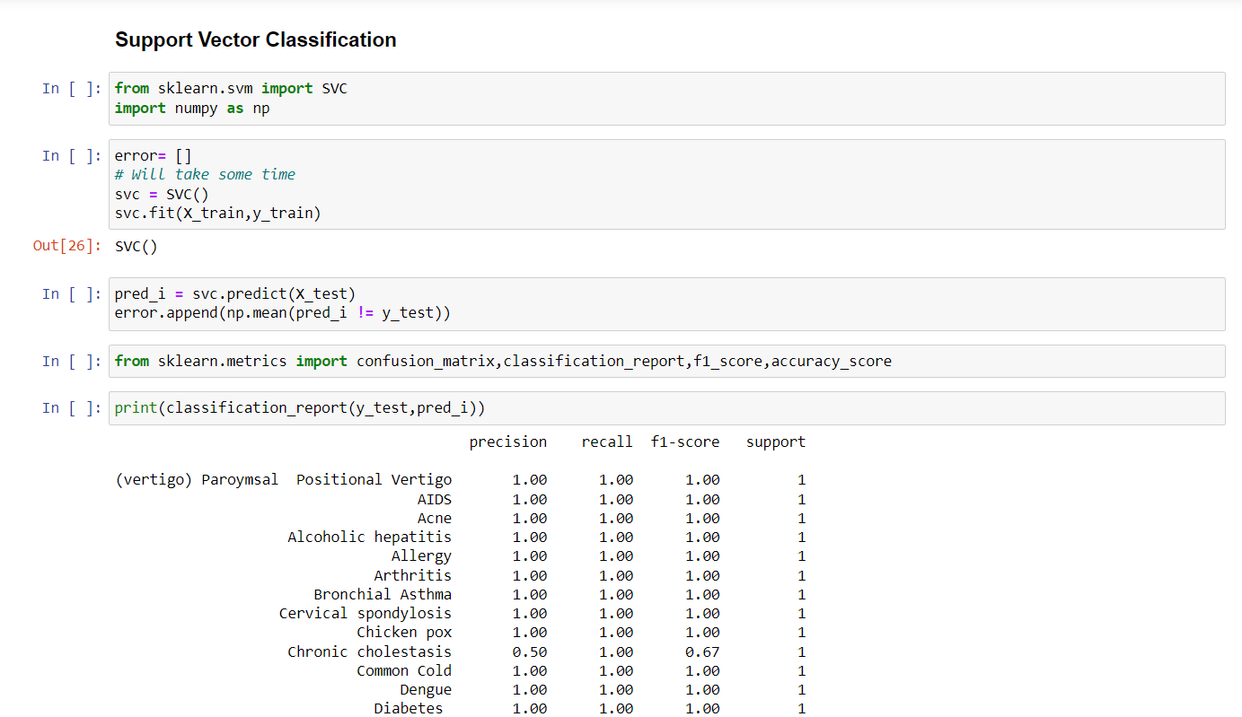
Support Vector Classification is the fourth algorithm used (Accuracy : 95%)

Slide 11
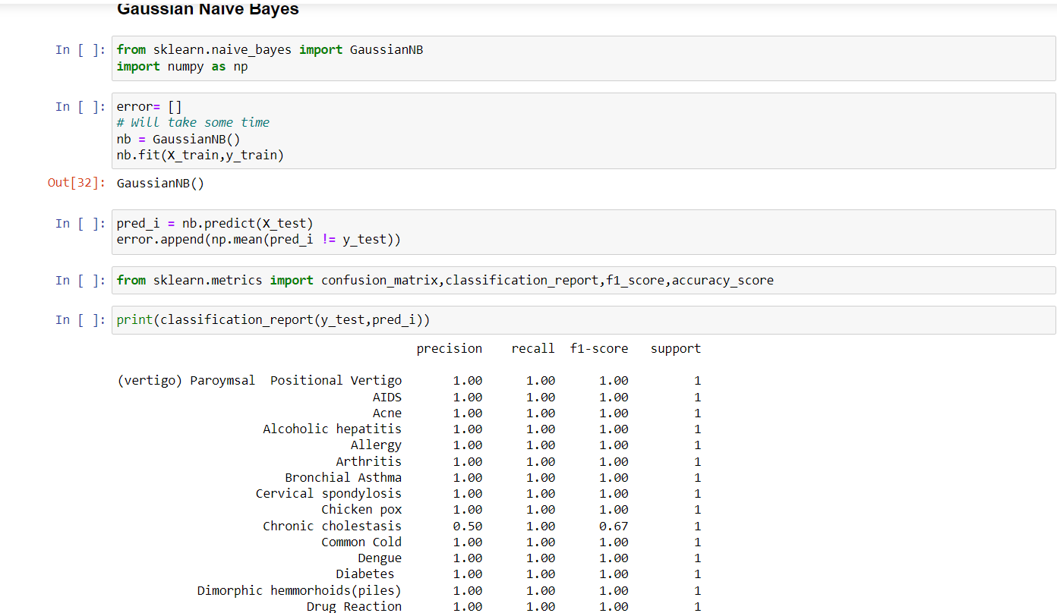
Naïve Bayes is the fifth algorithm used (Accuracy : 95%)

Slide 12
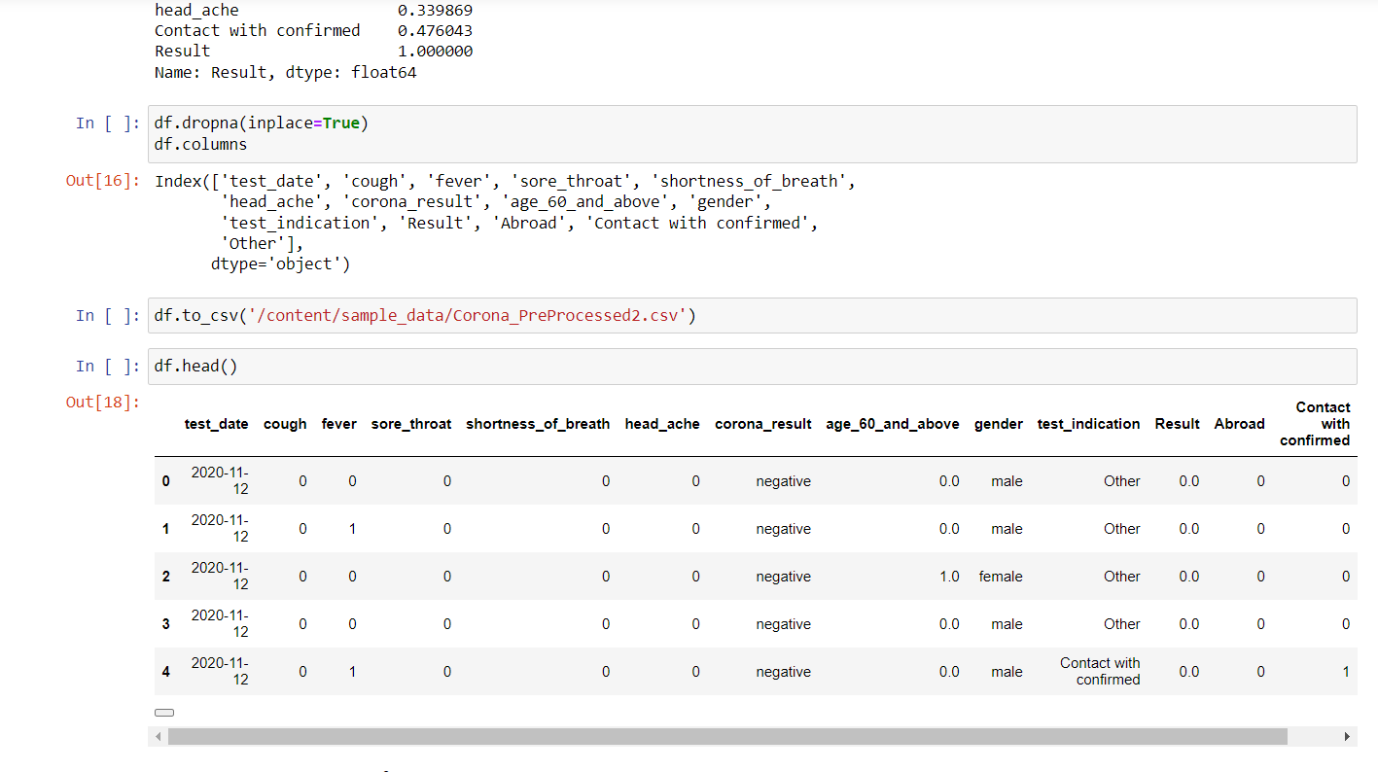
DATA PREPROCESSING FOR GENERAL DISEASE DATASET

Slide 13
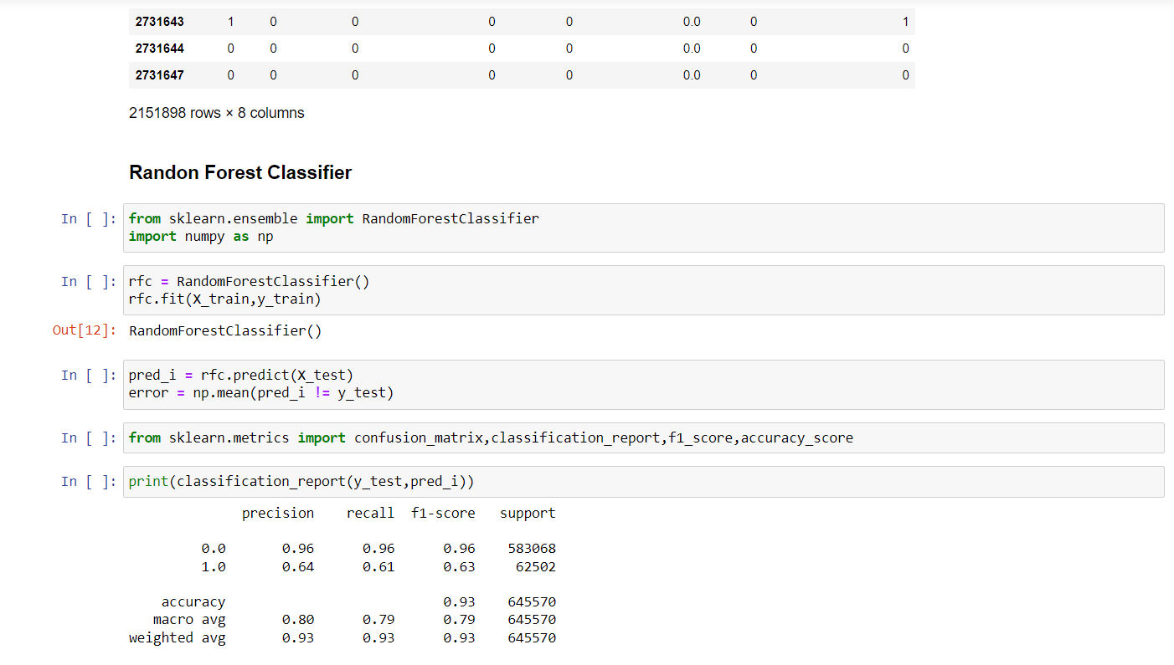
MODEL TRAINING ON CORONAVIRUS DATASET
Random Forest is the first algorithm used (Accuracy : 93%)

Slide 14
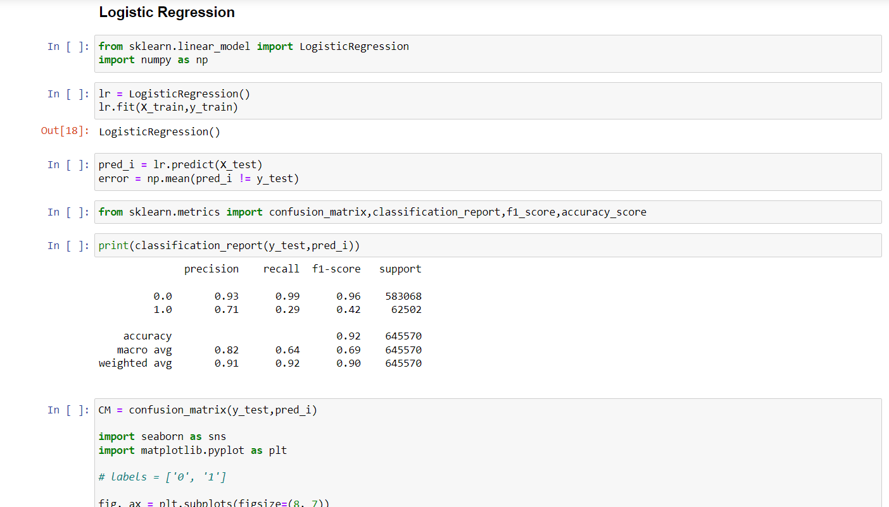
Logistic Regression is the second algorithm used (Accuracy : 92%)

Slide 15
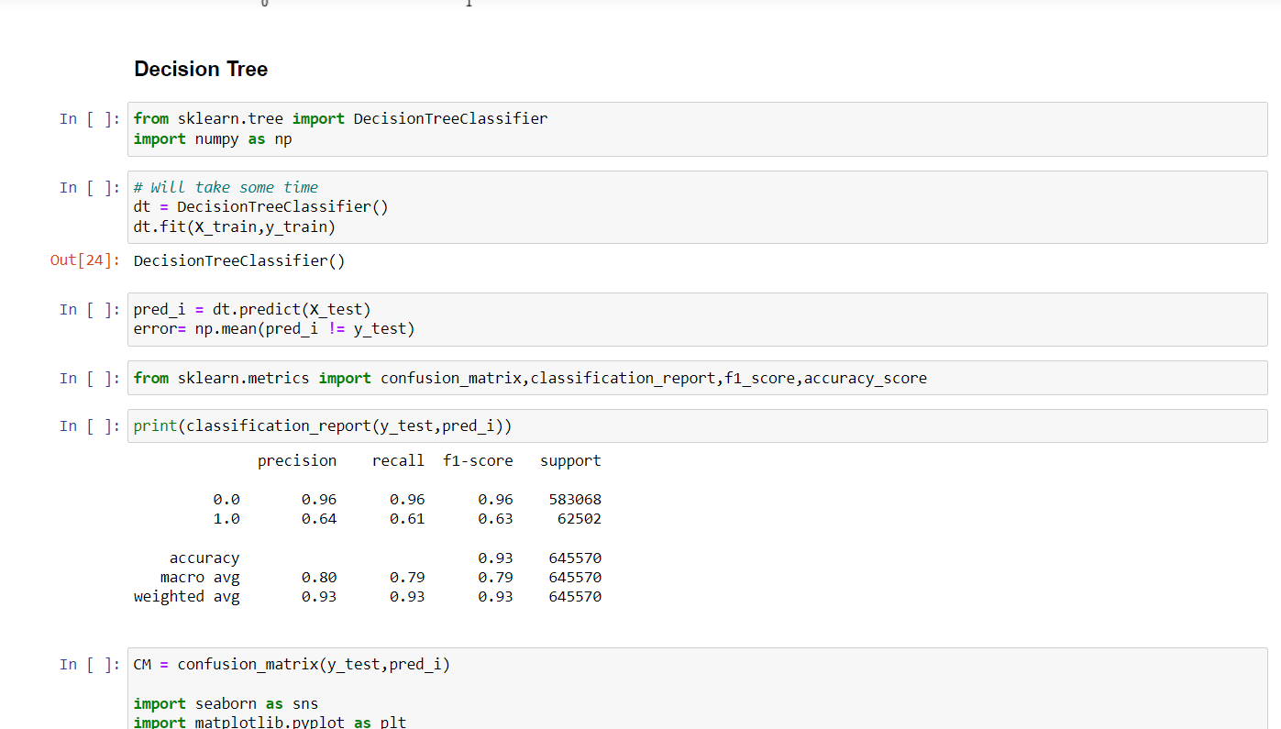
Decision Tree Algorithm is the third algorithm used (Accuracy: 93%)

Slide 16
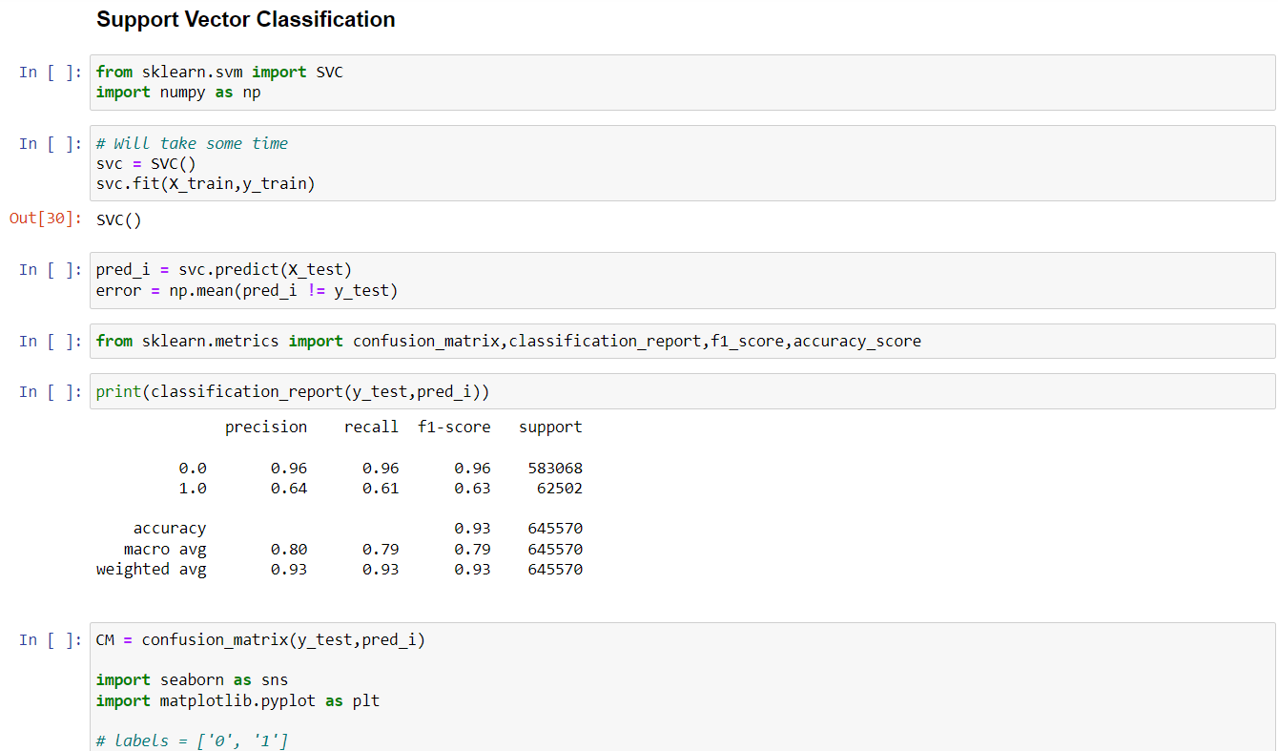
Support Vector Classification is the fourth algorithm used (Accuracy: 93%)

Slide 17
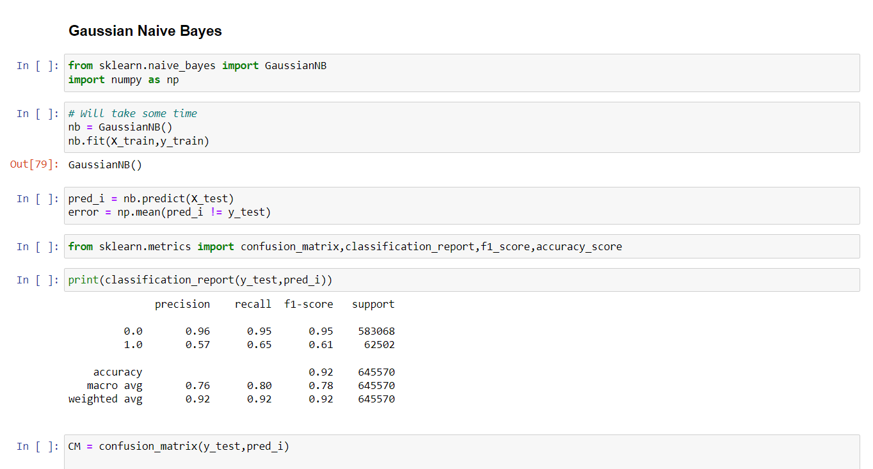
Gaussian Naïve Bayes is the fifth algorithm used (Accuracy: 92%)

Slide 18
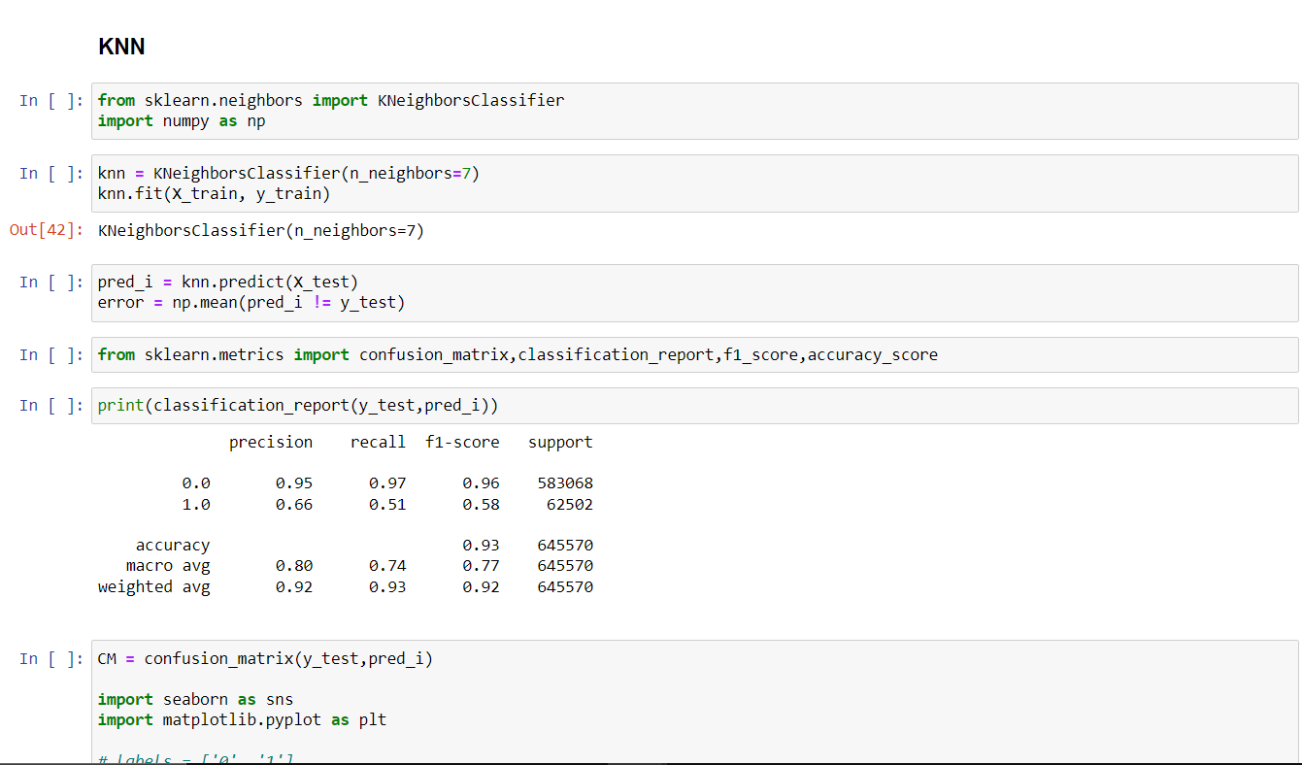
K-Nearest Neighbour is the sixth algorithm used (Accuracy: 93%)

Slide 19
Dataset Details
We’ve worked on 2 Datasets in our project.
1) The first provided dataset for the “Disease Prediction System” was collected from Kaggle.
https://www.kaggle.com/datasets/itachi9604/disease-symptom-description-dataset?select=dataset.csv
2) The second provided a dataset for the “Covid-19 Prediction” contains covid test information such as the date, gender, whether the person has had a cough, fever, sore throat, shortness of breath, headache, age, whether they were abroad or had contact with someone with covid and the test result. The dataset is obtained by a government website.
https://data.gov.il/dataset/covid-19/resource/d337959a-020a-4ed3-84f7-fca182292308

Slide 20
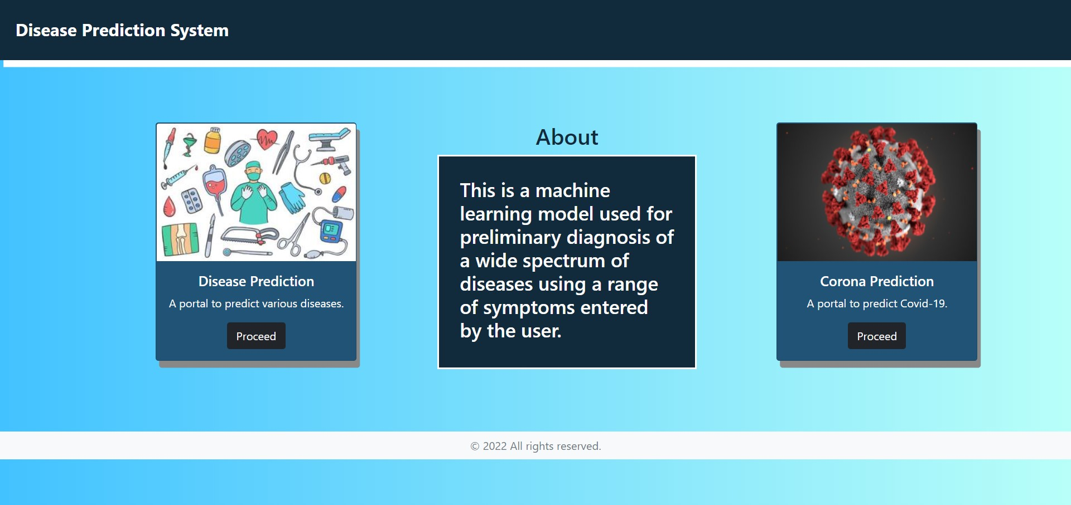
Website Images

Slide 21
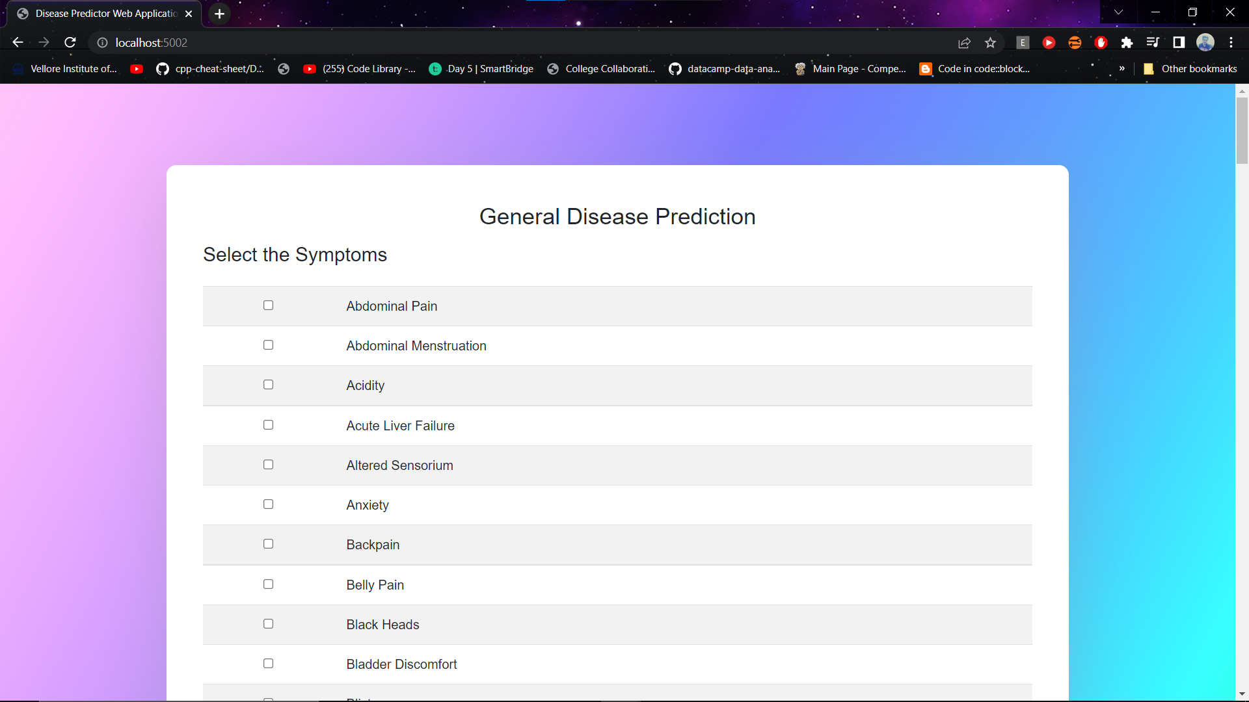
GENEAL DISEASE PREDICTION PAGE (USING FLASK)

Slide 22
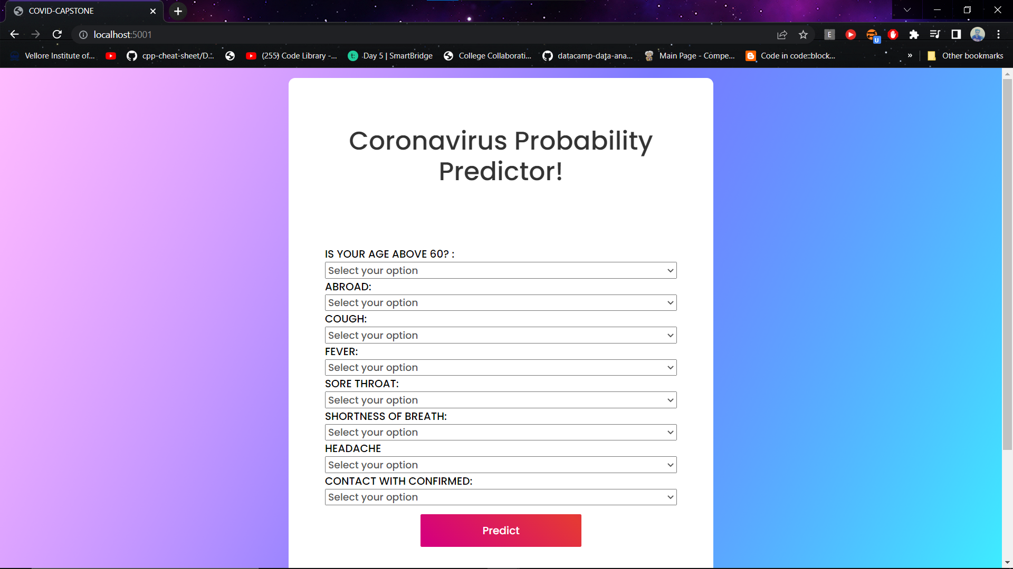
CORONAVIRUS PROBABLITY PREDICTION PAGE (USING FLASK)

Slide 23
Conclusion and Future Work
So finally, we conclude by saying that this project will help in improving future of the public health care system and help patients in getting fast and appropriate medical opinion as it provides prediction for General Disease and Covid using symptoms entered by the user at the comfort of home.
The system uses Logistic Regression for Covid Prediction as Logistic Regression is an easily interpretable classification technique that gives the probability of an event occurring, not just the predicted classification, and multiple machine learning algorithms for General Disease Prediction.
Using Algorithms, the maximum accuracy achieved is 95%. Timely prediction and diagnosis of an ailment can evade a general disease turning into a fatal disease.
FUTURE WORK
The Future Vision of the Project encompasses collecting information and data of latest diseases. we also plan to include as part of the project recommendation of the medical experts based on the predicted disease and develop a mobile application for the current based web application.

Slide 24
References
1) Rajora, H., Singh Punn, N., Sonbhadra, S. K., & Agarwal, S. (2021). Web based disease prediction and recommender system. arXiv e-prints, arXiv-2106.
2) Mohan Kumar, K. N., Sampath, S., & Imran, M. (2019). An overview on disease prediction for preventive care of health deterioration. IJEAT, 8(5S), 255-261.
3) Hossain, M. E., Khan, A., Moni, M. A., & Uddin, S. (2019). Use of electronic health data for disease prediction: A comprehensive literature review. IEEE/ACM transactions on computational biology and bioinformatics, 18(2), 745-758.
4) Ashish Kumar, Priya Ghansela, Purnima Soni , Chirag Goswami , Parasmani Sharma. (2020). Prediction of diseases using supervised learning. International journal of creative research thoughts.
5) Chen, M., Hao, Y., Hwang, K., Wang, L., & Wang, L. (2017). Disease prediction by machine learning over big data from healthcare communities. Ieee Access, 5, 8869-8879.
6) Aishwarya, C., Suvarchala, K., Aravind, B., Shashank, G., Anand, M., & Krishna Rao, N. V. (2020). Prediction of disease using machine learning and deep learning. In Energy Systems, Drives and Automations (pp. 69-79). Springer, Singapore.
7) Ferjani, M. F. Disease Prediction Using Machine Learning.
8) Dahiwade, D., Patle, G., & Meshram, E. (2019, March). Designing disease prediction model using machine learning approach. In 2019 3rd International Conference on Computing Methodologies and Communication (ICCMC) (pp. 1211-1215). IEEE.

Slide 25
Thank You

