Slide 1
Master Thesis Updates
Prakhar Mehta
11th January 2019

Slide 2
Agenda
Status
Individual v Community Solar
ABM
Hypothesis of problem
What do I wish to find?
Thesis title
Open questions
Next steps and scheduling
Discussion on the go

Slide 3
Status
CEA Tool
Sample of 1637 ‘zones’ (simply referred to as buildings hereon)
Demand data validated against literature – CEA model output data within appropriate range for residential buildings, need to check other building types against literature values
19 different building types over 1637 buildings – concern for ABM?
Different occupancies, sizes, electricity demands
Photovoltaic tool gives PV output in kWh for every hour (need a quick check to see if the numbers are ok, they should be)

Slide 4
Status Continued…
PV System ZEVs (Community Solar Regulations; EnergieSchweiz)
30kW + → qualify for rebates under new law (Energy Act 2018)
Yearly Demand 100 MWh+ (~30 households) → qualify for open electricity market
→ consider 30kW < Community PV System Size < need to define a max system size
Need to define minimum system size < Individual PV system size < 30 kW?
Making a community:
At least one building must be adjacent to the building which installs the PV
Merger cannot extend over public land (eg. roads) and private property if owner not part of ZEV
Can't use distribution network
All properties must be connected behind same grid connection point
SIMPLE: we assume to create new ZEV (legal entity) – tenants + owner – can consider some fixed administrative costs
Need to manually make communities due to so many restrictions! Need to define how I will do that!

Slide 5
Individual v Community Solar
 | Individual Solar | Community Solar
Definition | An individual household which owns their PV | A collection of households (in cooperation with the building owner)
Ownership | 100% household owned | ZEV: Owned by households + owner; as share of PV system based on how much every individual invests. (keeping agents limited, don’t want to try other ownership models like utility owned etc)
Technical criteria: System Sizing? To cover 60% of demand? (energieSchweiz heuristic) Or 2x demand (DG – for communities though) | < 30 kWp? (too large anyway) < 10 kWp might work as well | >30 kWp < max PV system size Also: < 100 MWh of yearly electricity demand
Economic criteria | Positive NPV | Positive NPV for all stakeholders
Social criteria and attitudes | Peer effects as cost reductions in NPV formula Attitudes (TPB): create initial attitudes randomly, update throughout simulation | Peer effects as cost reduction in NPV formula: radius of influence of neighbours is greater owing to more buildings in consideration for ZEV

Slide 6
ABM
Muaafa: Very simple model, can include a lot more in it (just a neighbourhood effect translated to money saved for NPV calculation)
What time scale for the simulation? 10 years, 20 years?
Yearly decision making or higher resolution?
They don’t consider the following:
Population increase – if and how to include?
Changing weather, demands, prices – how?
CEA: only 1 weather file – need to ask if we can do more here!
Agents’ attitudes
Use historical prices/bills as some input to initial attitude of agent towards solar PV?
How do these change? Use Theory of Planned behaviour ideology?
TPB: attitudes formed by an individuals beliefs ( = initial attitude) about a behaviour and an evaluation of its outcomes ( = money savings, environmental impact)

Slide 7
Hypothesis
With the new ZEV regulations in place, it makes more financial sense to install a (larger) community PV system to take advantage of the rebates.
Of course, community PV systems are more complicated:
Legal procedure to form ZEV
More coordination and communication needed; splitting shares and costs etc
Pros of community PV will outweigh individual PV
Do current ZEV regulations limit the optimal adoption of community PV systems?

Slide 8
Title
«A comparison of Individual and Community PV adoption levels under current regulations in Switzerland using Agent-based Modelling»
Deliverables:
Model of Community adoption with ABM
Comparison: Individual v Community
Total installed capacity
Geographical variability
Temporal variability in adoption
Variation in Prices
Sensitivity analyses
Prices of PV and electricity
Rebates
ZEV regulations
Attitudes?

Slide 9
Open Questions as of now
Household definition?
Building data available: demand and number of people but not households
Split demand into x households?
Incomes for these households? – Statistics Office? Random distributions?
ABM
Possible to build own model? Muaafa as blueprint?
Software: Python seems best
CEA number of buildings is 1637- will the ABM be meaningful then? Does identification of which building installed PV make sense given the limited random distribution possibilities?

Slide 10
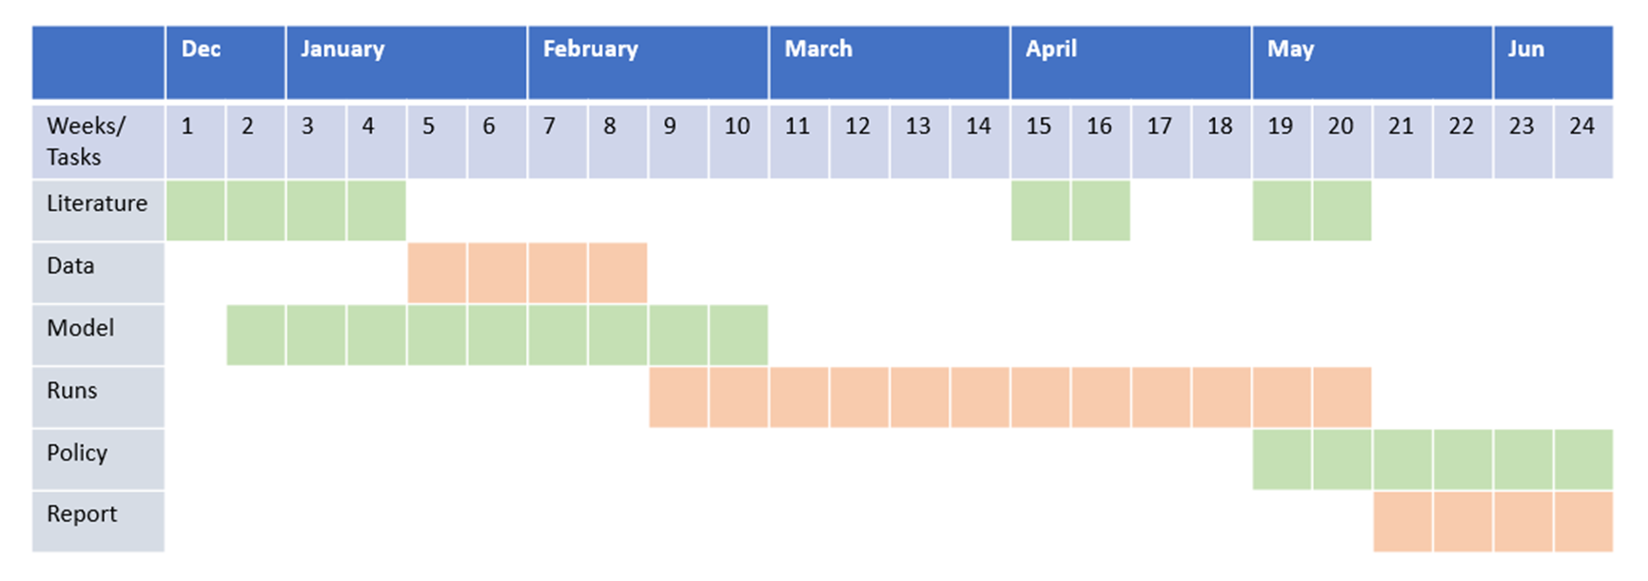
Next Weeks
W5 and W6:
ODD for ABM
Data collection from CEA runs and ensure validation of that data
Making Communities from the GIS and building data and ZEV regulations

