Slide 1

An Analysis Of Individual And Community Solar PV Adoption Levels Under Current Regulations Using Agent-based Modelling
Master Thesis Update Week 6
Prakhar Mehta
Supervisors: Danielle Griego, Alejandro Nunez-Jimenez
Professor: Dr. Arno Schlueter

Slide 2
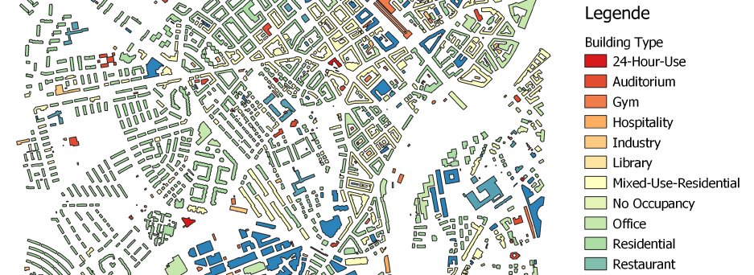
Alt-Wiedikon is beautiful.

Slide 3
Quote(s) of the month
“I think I know why no one has tried to model community adoption before.
This shit is complicated.”
~ Prakhar Mehta
“I like complicated.”

Slide 4
Agenda
Status
ZEV regulation – now 100% clear!
Adoption mechanism
Some ground rules
Agent attributes
Variables, Parameters
How it should work (partly, as of now)
Open questions
Next 2 weeks
Finalizing the modelling
Data collection and filtering
Modelling basics and outline

Slide 5
ZEV Regulation – now 100% clear!
ZEV has no size restrictions
Solar PV systems
2 kW – 50 MW → one-time remuneration = basic + performance contribution
1600 + 460/kW (< 30 kW) OR
1600 + 340/kW (< 100 kW) OR
1400 + 300/kW (> 100 kW)
2kW – 99.999 kW → No FiT
100 kW + → FiT available = 7.91 Rp./kWh in Zurich
Community solar (ZEV) has better chances of being >=100 kW system to take advantage of FiTs
In thesis: consider ZEV only for size >=100 kW, not 30 kW as I thought previously! Changes dynamics, means I need more households to be a part of the community

Slide 6
Adoption Mechanism - some ground rules
Known facts I consider
Zurich → 89% renters!
Maybe consider the remaining 11% owned households as all being single family detached houses?
Owner is important in the adoption mechanism consideration – something I only realized on Wednesday
Assumptions
Individuals who rent apartments are still allowed to install their own solar PV
Renters stay for lifetime of PV system
Chicken and egg problem of community system sizing and costs – solved by considering scenarios of different system sizes
Urge to consider that buildings install greater solar than needed so as to facilitate community systems and sharing with buildings with no solar potential
Not considering batteries – they change everything

Slide 7
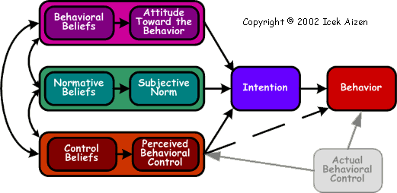
Use of Theory of Planned Behaviour for decision making – need help
Info: prices, expected savings from CEA data, calculation.
Environmental attitudes/beliefs from Swiss surveys
How to incorporate everything together?
What society thinks of solar – (community/individual differentiate?) from Swiss surveys
How to model this?
Does agent feel confident enough to do it?
Depends on how many peers have solar
Easier for community solar as simply join ZEV
Consider/neglect?

Slide 8
A discussion on agent attributes
Agent X renting a flat in a Multi-family Residential Building
Attributes
Greedy/not greedy – how much he values money
Environmental attitude
Income/education level – need either as a proxy for his perception of control (pbc element)
Motivation to comply with society? Or degree to which he cares to satisfy peers’ expectations
Agent Y owns a commercial complex
Attributes
Greedy/not greedy – how much he values money
Environmental attitude
Generally higher perception of control (greater confidence) as businessmen tend to reduce costs?
Motivation to comply with society? Or degree to which he cares to satisfy peers’ / customers’ expectations

Slide 9
Parameters and variables in the model
Parameters
ZEV defined regulations on which plots can form a ZEV
Geographical information of agent, his neighbours
Relationship with owner – good/bad? Makes agent more/less likely to work together with owner
Demographic information – is this agent attribute or parameter?
Income
Education level
Variables
Electricity prices
PV system prices
Rebate and FiT levels

Slide 10
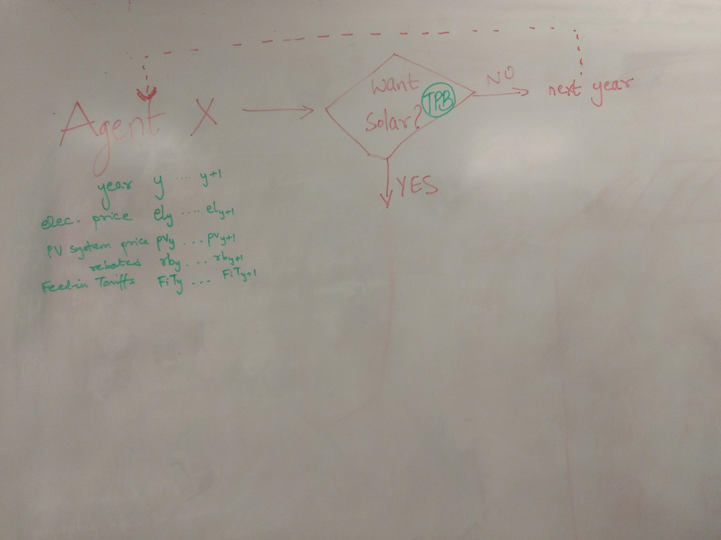
Adoption Mechanism 1: Do I want solar?
Use TPB to decide if agent wants solar or not. Maybe a simpler, smaller TPB model used here incorporating:
General environmental attitude
Level of income/education
Peer effects and subjective norm on solar PV

Slide 11
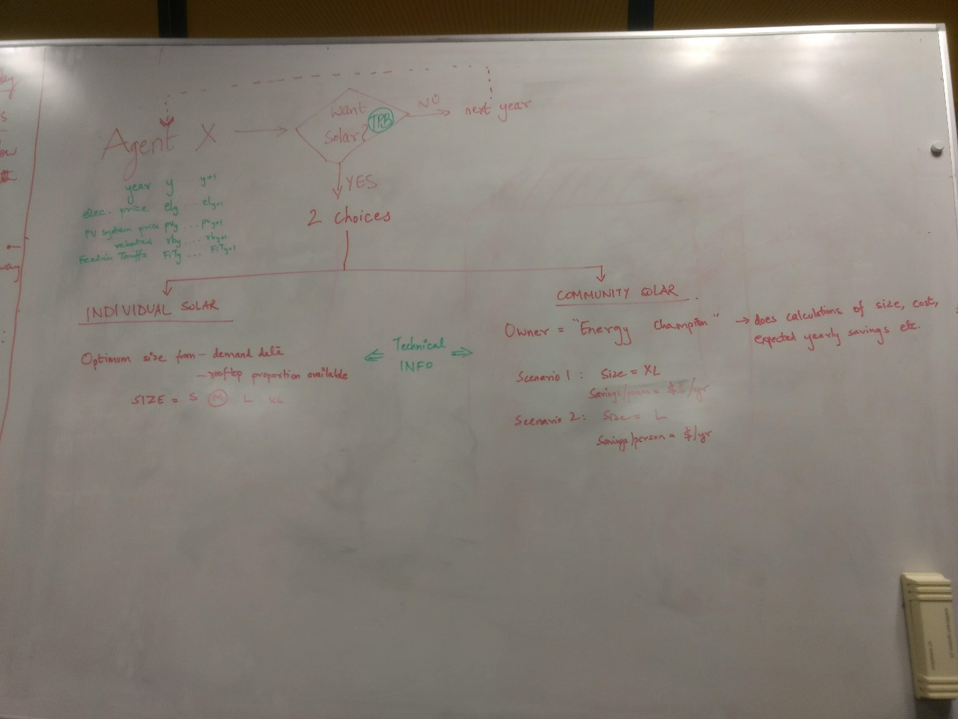
Adoption Mechanism 2: I want solar, what next?
2 choices – individual and community
Individual
Consider that agent has to do calculations and finds his optimum size and money savings
Community
Consider building owner as “Energy Champion” who takes care of admin and calculations, offers renters different scenarios

Slide 12
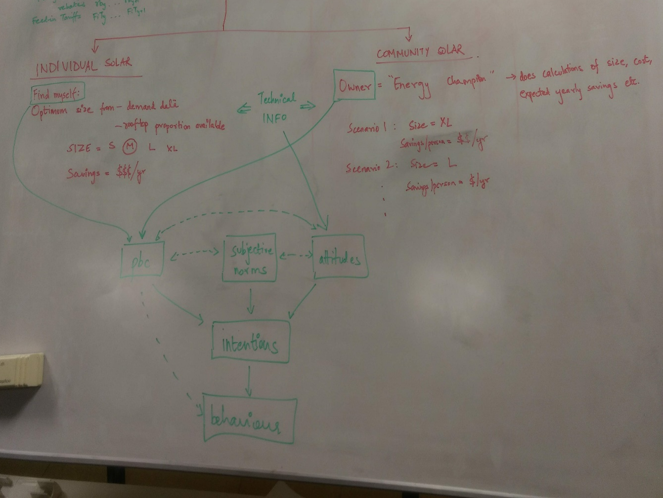
Adoption Mechanism 3: Using TPB again
Owner doing everything vs agent doing his own calculations → affects control
Information about sizing and savings → affects attitudes
Other agent attributes might be complementary, favouring one side over another
TPB is generally used to model behaviour with ONE decision as end goal – to do/not to do something. I’m not clear on using it to choose between doing TWO things. Maybe I need 2 separate TPBs?

Slide 13
Open Questions
Community definition had the chicken and egg problem – size affects cost, and cost affects decisions which affects size
If consider that building owner pays for community PV system, what size?
Hence, scenarios of different sizes, and see adoption levels in each vs individual adoption
Another problem arises – if building owner pays for community PV and agents simply consume energy at a price, then unfair to compare with individual adoption where agent must pay the capital cost of his system
Do a minimum number of people need to say YES to adopt community solar? Or is it the owner who decides to install solar, based on his own TPB?
Who starts first and why?
After a year is simulated, what happens to variables, parameters and attributes? How does TIME feature in the model?

Slide 14
Next 2 Weeks
Finalize modelling methodology – my theory of how decision making will work
Make plots out of the Wiedikon area – QGIS and OpenStreetMaps
Use SFOE GeoInformatics office data as CEA PV tool validation
Modelling basics
Data collection
Data filtering
How to model TPB

