Slide 1

An Analysis Of Individual And Community Solar PV Adoption Levels Under Current Regulations Using Agent-based Modelling
Master Thesis Update Week 8
Prakhar Mehta
Supervisors: Danielle Griego, Alejandro Nunez-Jimenez
Professor: Dr. Arno Schlueter

Slide 2
Current state of the master thesis:
The calm before the storm.

Slide 3
Agenda
Status
ZEV regulation – still only 90% clear!
Adoption mechanism
Some ground rules revised
Agent Attributes, Variables, Parameters – some decided
How it should work
Open questions
Next 2 weeks (same as at last meeting. Shit.)
Finalizing the modelling
Data collection and filtering
Modelling basics and outline

Slide 4
ZEV Regulations (haste makes waste)
There is a minimum size – 10% of connected load in the community. Assume to be 10% (or greater) of maximum demand in my case as connected load unavailable?
Electricity not self-consumed is sold to grid (=EWZ). Confusion because there is an option to choose between FiT and one-time subsidy.
EnergieSchweiz documents show a 37kW ZEV example, excess energy is sold to grid.
Logically, of course the excess energy must be sold to grid!
A call with EnergieSchweiz is scheduled, should clear my doubts
Renters have a choice to join/not join ☺
All participants in the production site must be end users on at least one of the participating properties → Does this mean that if your building is not participating in the ZEV you cannot participate?
Costs to tenants can’t be higher than grid use costs, includes:
Eligible capital costs of the investment
The costs of operation and maintenance of the facility;
Additional costs:
The cost of externally sourced electricity; and
The cost of internal measurement, data delivery, administration and billing.

Slide 5
Adoption Mechanism - some ground rules revised
Known facts I consider
Zurich → 89% renters!
Maybe consider the remaining 11% owned households as all being single family detached houses?
Our case – would like to assume that the 17.34% of single-family houses are owner occupied
Assumptions
Individuals who rent apartments are still allowed to install their own solar PV. No clarification on this yet. – UNLIKELY SO IGNORE
Renters stay for lifetime of PV system. ZEV regulations also include contract handover to new tenants so this is not really an assumption

Slide 6
4 Dimensions of variables in the ABM
Time (t)
Variables vary in time
E.g. – FiT is 7.91 Rp./kWh in 2019, becomes 8 next year, so on…
Location (l)
Agents in different locations will have restrictions on peer effects, etc.
Agent (j)
E.g. - Each agent is different in his environmental attitude
Category of agent (k)
Agents can be grouped into different categories, next slide

Slide 7
Agent Categories (dimension k)
Building Type | Owners | Broader Building Owner Type | # Decision Makers | Category k
24 hour use | Publicly owned | Service for the public ~ non profit | 1 | k1
Library | Publicly owned | Service for the public (?) ~ non profit | 1
School | Publicly owned | Service for the public ~ non profit | 1
Residential | Privately owned | Quasi-Commercial ~ for profit (can’t screw over his tenants) | 1 or >1 (tenants) | k2
Mixed-Use Residential | Privately owned | Quasi-Commercial ~ for profit (can’t screw over his tenants) | 1 or >1 (tenants)
Gym | Privately owned | Commercial ~ for profit | 1 | k3 k4 k5
Hospitality | Privately owned | Commercial ~ for profit | 1
Restaurant | Privately owned | Commercial ~ for profit | 1
Auditorium | Privately owned | Commercial ~ for profit | 1
Supermarket | Privately owned | Commercial ~ for profit | 1
No Occupancy | Privately owned | Commercial (?) ~ for profit | 1
Industry | Privately owned | Commercial ~ for profit | 1
Office | Privately owned | Commercial ~ for profit | 1

Slide 8
ABM Developments
Agent attributes to be included surely:
Environmental attitude
ea_init: Initial attitude from surveys, randomly distributed over agent population. Varies across agent categories
WTI (Willingness to Invest): Based on when was the last time the building was renovated. The longer back in the future, the higher the WTI. Adds a time varying component.
Peer Effects
Maybe use of small world networks to connect agents here?
Price Signals
Important to have – else changes in prices won’t have any effects on adoption
Need to consider some form of knowledge variable, which makes some agents aware of adoption incentives in place. Link to most environmentally aware agents.
Variable | Composed of | Constant in | Varies in
Environmental Attitude | ea_init | t,l | j, k
 | WTI | j,l | t, k
Peer effects | - | j | t, l ,k, j
Price Signals | NPV | l | j, k, t
 | Knowledge | l | t, j, k,

Slide 9
ABM discussion
On the Whiteboard
Individual PV option 250 CHF one time for 20 years 80 kWh/year credits

Slide 10
ABM developments
Want to include tenants
They have a choice to join/not join
Purely rationally, tenants should join ZEV as prices will be lower, or at the extreme case, same as utility
Including will show how many join/not join and hence show the difference in expected savings vs realized savings for the owner – a degree of how important it is for the owner that tenants join the ZEV
FiT and/or One-time subsidy?
I am unclear
Anyway, NPV or savings calculation will have 2 calculations and owners can choose the higher value
Information Campaigns
Even after information campaigns, not all people take in the information, only a few will
Which few? → those with most environmental awareness. Need scientific studies to back up this claim

Slide 11
Open Questions
Agent categorization needs to be initialized – how?
Inclusion of tenants – am I gaining a lot? (I think its interesting, but…?)
Okay to neglect the tenant proposal to owners?
Should I start working weekends already?

Slide 12

Next 2 Weeks
Shifting gears, accelerating
Finalize modelling methodology – my theory of how decision making will work
Make plots out of the Wiedikon area – QGIS and OpenStreetMaps
Use SFOE GeoInformatics office data as CEA PV tool validation
Modelling basics
Data collection – begun already
Data filtering
How to model TPB

Slide 13
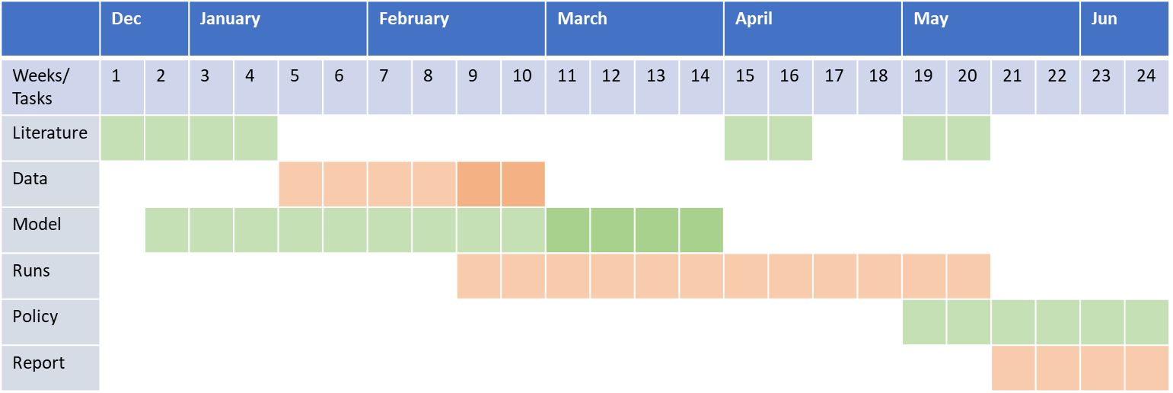
Time plan – Feel slightly behind
~ almost 2 months in
Mid-term PPT

