Slide 1

An Analysis Of Individual And Community Solar PV Adoption Levels Under Current Regulations Using Agent-based Modelling
Master Thesis Update Week 6
Prakhar Mehta
Supervisors: Danielle Griego, Alejandro Nunez-Jimenez
Professor: Dr. Arno Schlueter

Slide 2
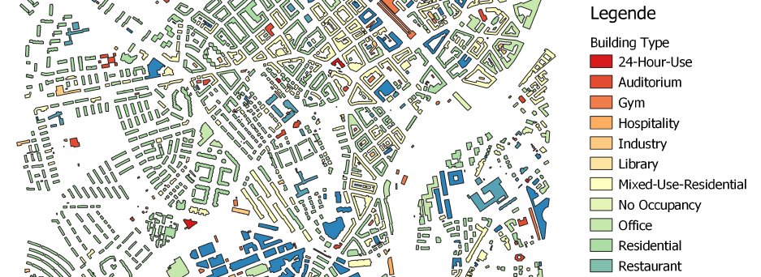
Alt-Wiedikon is beautiful.

Slide 3
Quote(s) of the month
“I think I know why no one has tried to model community adoption before.
This shit is complicated.”
~ Prakhar Mehta
“I like complicated.”

Slide 4
Agenda
Status
ZEV regulation – now 100% clear!
Adoption mechanism
Some ground rules
Agent attributes
Variables, Parameters
How it should work (partly, as of now)
Open questions
Next 2 weeks
Finalizing the modelling
Data collection and filtering
Modelling basics and outline

Slide 5
ZEV Regulation – now 100% clear!
ZEV has no size restrictions
Solar PV systems
2 kW – 50 MW → one-time remuneration = basic + performance contribution
1600 + 460/kW (< 30 kW) OR
1600 + 340/kW (< 100 kW) OR
1400 + 300/kW (> 100 kW)
2kW – 99.999 kW → No FiT
100 kW + → FiT available = 7.91 Rp./kWh in Zurich
Community solar (ZEV) has better chances of being >=100 kW system to take advantage of FiTs
In thesis: consider ZEV only for size >=100 kW, not 30 kW as I thought previously! Changes dynamics, means I need more households to be a part of the community

Slide 6
Adoption Mechanism - some ground rules
Known facts I consider
Zurich → 89% renters!
Maybe consider the remaining 11% owned households as all being single family detached houses?
Owner is important in the adoption mechanism consideration – something I only realized on Wednesday
Assumptions
Individuals who rent apartments are still allowed to install their own solar PV
Renters stay for lifetime of PV system
Chicken and egg problem of community system sizing and costs – solved by considering scenarios of different system sizes
Urge to consider that buildings install greater solar than needed so as to facilitate community systems and sharing with buildings with no solar potential
Not considering batteries – they change everything

Slide 7
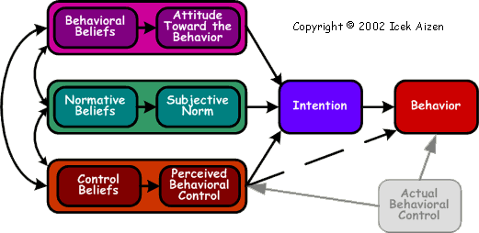
Use of Theory of Planned Behaviour for decision making – need help
Info: prices, expected savings from CEA data, calculation.
Environmental attitudes/beliefs from Swiss surveys
How to incorporate everything together?
What society thinks of solar – (community/individual differentiate?) from Swiss surveys
How to model this?
Does agent feel confident enough to do it?
Depends on how many peers have solar
Easier for community solar as simply join ZEV
Consider/neglect?

Slide 8
A discussion on agent attributes
Agent X renting a flat in a Multi-family Residential Building
Attributes
Greedy/not greedy – how much he values money
Environmental attitude
Income/education level – need either as a proxy for his perception of control (pbc element)
Motivation to comply with society? Or degree to which he cares to satisfy peers’ expectations
Agent Y owns a commercial complex
Attributes
Greedy/not greedy – how much he values money
Environmental attitude
Generally higher perception of control (greater confidence) as businessmen tend to reduce costs?
Motivation to comply with society? Or degree to which he cares to satisfy peers’ / customers’ expectations

Slide 9
Parameters and variables in the model
Parameters
ZEV defined regulations on which plots can form a ZEV
Geographical information of agent, his neighbours
Relationship with owner – good/bad? Makes agent more/less likely to work together with owner
Demographic information – is this agent attribute or parameter?
Income
Education level
Variables
Electricity prices
PV system prices
Rebate and FiT levels

Slide 10
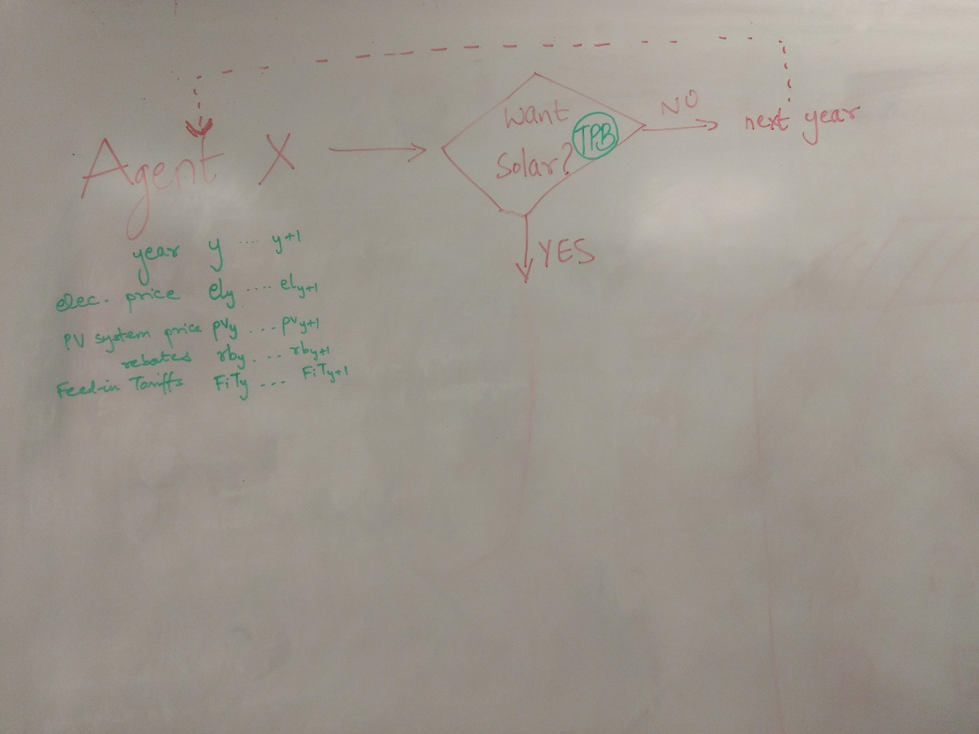
Adoption Mechanism 1: Do I want solar?
Use TPB to decide if agent wants solar or not. Maybe a simpler, smaller TPB model used here incorporating:
General environmental attitude
Level of income/education
Peer effects and subjective norm on solar PV

Slide 11
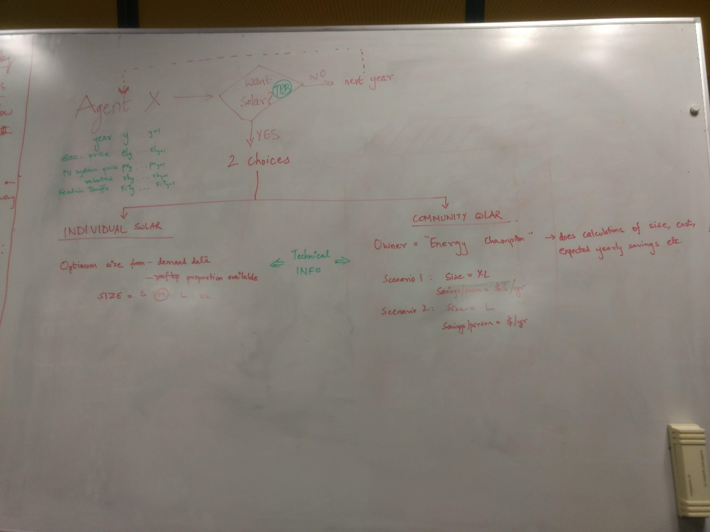
Adoption Mechanism 2: I want solar, what next?
2 choices – individual and community
Individual
Consider that agent has to do calculations and finds his optimum size and money savings
Community
Consider building owner as “Energy Champion” who takes care of admin and calculations, offers renters different scenarios

Slide 12
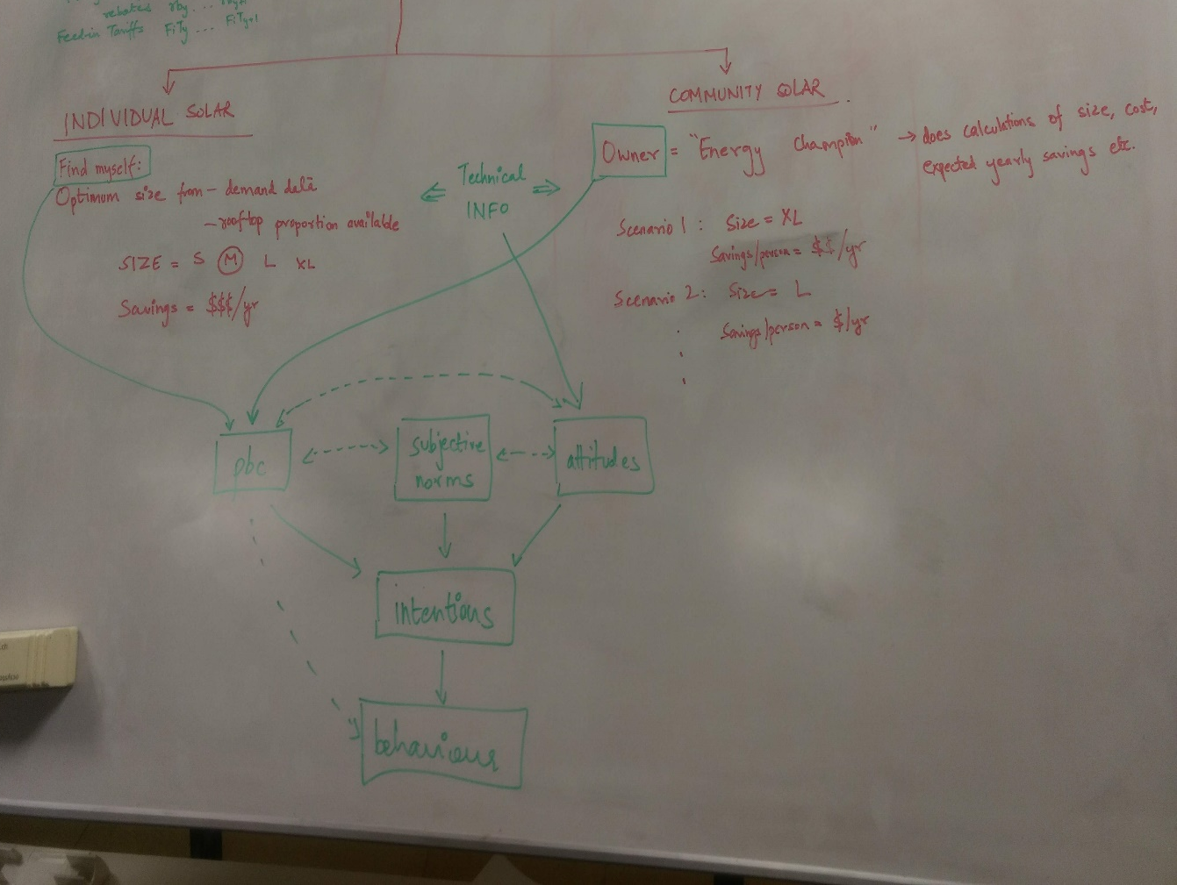
Adoption Mechanism 3: Using TPB again
Owner doing everything vs agent doing his own calculations → affects control
Information about sizing and savings → affects attitudes
Other agent attributes might be complementary, favouring one side over another
TPB is generally used to model behaviour with ONE decision as end goal – to do/not to do something. I’m not clear on using it to choose between doing TWO things. Maybe I need 2 separate TPBs?

Slide 13
Open Questions
Community definition had the chicken and egg problem – size affects cost, and cost affects decisions which affects size
If consider that building owner pays for community PV system, what size?
Hence, scenarios of different sizes, and see adoption levels in each vs individual adoption
Another problem arises – if building owner pays for community PV and agents simply consume energy at a price, then unfair to compare with individual adoption where agent must pay the capital cost of his system
Do a minimum number of people need to say YES to adopt community solar? Or is it the owner who decides to install solar, based on his own TPB?
Who starts first and why?
After a year is simulated, what happens to variables, parameters and attributes? How does TIME feature in the model?

Slide 14
Next 2 Weeks
Finalize modelling methodology – my theory of how decision making will work
Make plots out of the Wiedikon area – QGIS and OpenStreetMaps
Use SFOE GeoInformatics office data as CEA PV tool validation
Modelling basics
Data collection
Data filtering
How to model TPB

Slide 15
Meeting after-thoughts
Thanks for the lengthy discussion, since this was more brainstorming it took much more than an hour.
For the next meeting on Friday in 2 weeks’ time (Feb 8), we can already schedule 1.5-2 hours. I will try to send in my slides by 4 PM the Thursday before if the meeting is in the morning.
In the next slides I try to write down what I got from our discussion

Slide 16
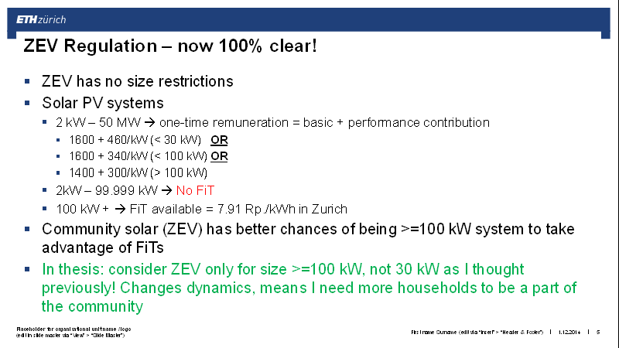
ZEV Regulations
ZEV regulations – will be interesting to see how results are affected as the limit I define for the ZEV is varied (100 kW, 50 kW,…) → probably part of sensitivity analysis
Rooftop availability can limit the PV system installation size
Side note: Since the FiT is so low, it may not even be an interesting factor in the monetary calculations.
Need to check if there is a cap on the initial investment subsidy, as used to be the case for the old KEV regulations

Slide 17
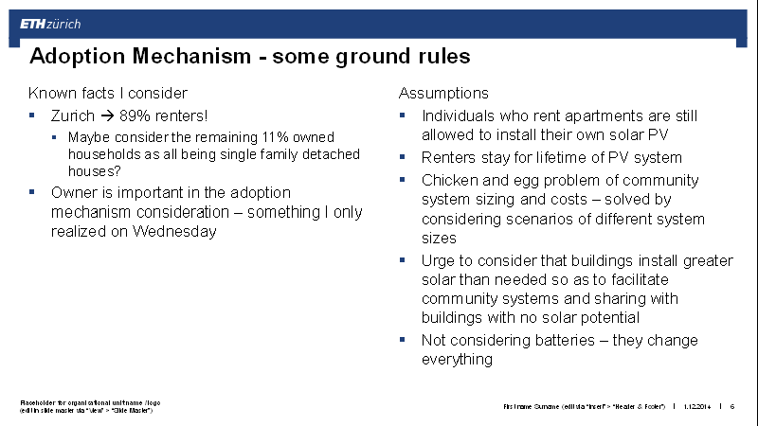
Adoption Mechanism – some ground rules
Check if single family free-standing homes are co-incidentally 11% of all the buildings I have
45.38% residential – don’t have breakdown on the ‘Zone’ level
If I look at raw building data, there are”
0.7% Einfamilienhaus friestehend = free standing single family home
16.64 % Einfamilienhaus angebaut = single family home extended (whatever that means)
Could probably assume that all single family homes = 17.34% are owner occupied
Will need to look at how Sabine grouped buildings into zones
Community system size chicken and egg problem:
Start with scenario with maximum rooftop coverage, vary it according to results OR as a sensitivity analysis
Batteries – include in thesis report as scope for future research

Slide 18
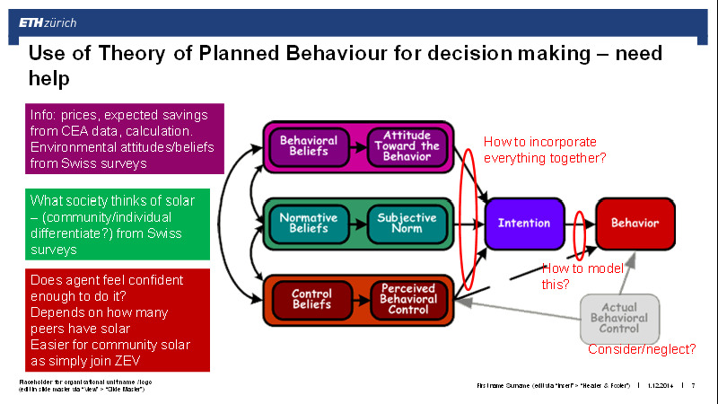
Use of TPB – summarizing discussion related to TPB here
KISS principle – keep it simple, stupido
Attitudes
New: Perceived individual/community advantage? Attractiveness of solar?
Including ease/difficulty if owner explains everything/agent does calculations himself is very subjective and difficult/questionable how to include. Hence leave this out or model as a cost? I will think more.
Information - Not sure I understand completely
The info I had thought as important would be the expected savings calculated from PV size, demand etc.
Makes sense that if this info does not change with time then no need to include it – need to think about this based on the mechanism
Maybe this is included at a later stage, as we discussed on the whiteboard. Pictures in the following slides
Then what is the point of info?

Slide 19
Use of TPB – summarizing discussion related to TPB here
Subjective Norms
Peer effects are better encapsulated here than in PBC
New: fraction of neighbours in the own plot (or maybe even own building) that say YES for adopting individual/community solar
Individual solar adoption and community solar adoption by neighbours should have different effect on subjective norms of the agent!
Distribution of community/individualistic mindsets – in subjective norms or PBC?
The Swiss have a sharing culture – can look at car sharing tendencies/other shared goods for appropriate quantification and inclusion in my model
Perceived Behavioural Control
Some sort of attribute/variable that can include relationship between owner-renter and if either makes a proposal for a PV system
Neglecting Actual Behavioural Control

Slide 20
Use of TPB – summarizing discussion related to TPB here
Incorporating everything together: ANJ’s example
Agent attributes vary between 0-1 and a weighted sum is taken as the intention.
Need to think on the how, what and why about weights to consider
From intention to behaviour
Since we have 3 potential behavioural outcomes, some sort of sub-mechanism to include this. Example from ANJ was to have an order of states (community > individual > no solar) which feed back into the intention. This can be via an economic evaluation.

Slide 21
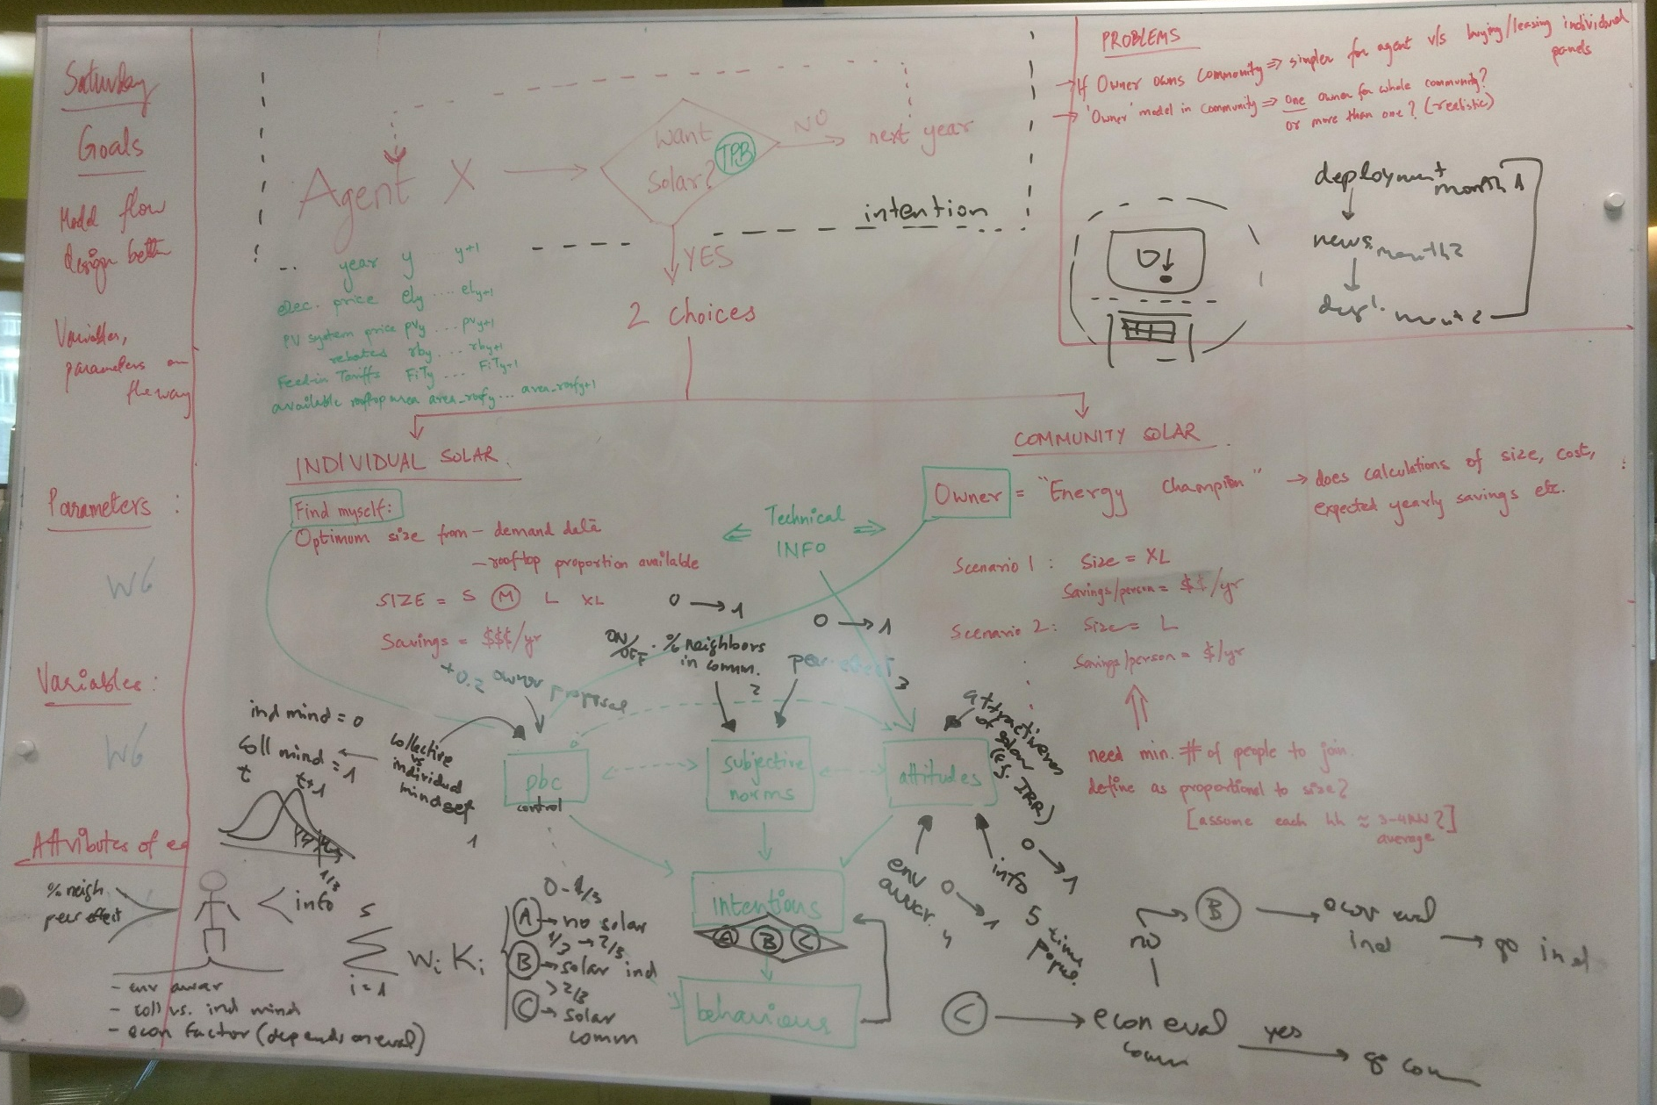
The Whiteboard

Slide 22
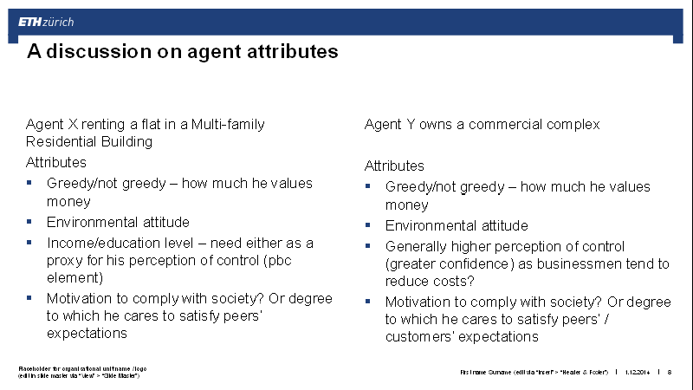
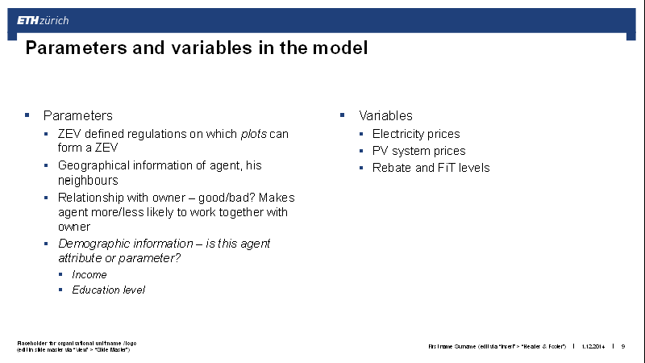
Attributes, variables and parameters
Need to fix mechanism first, then see what is important/needed, and accordingly decide on how to include them
Maybe some are binary variables
Some can be ranges
…
Must classify agents into different categories:
Agent X – building owner
Agent Y – renter in a multi-family home
…
Think about the mechanisms – same or different mechanism for different agents?

Slide 23
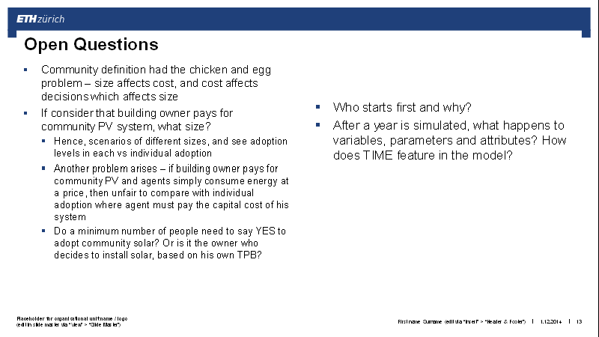
Open Answers to Open Questions
Community sizing – agree with scenarios of different sizes
Owner paying for community system
Will need to see how model results are affected and include another scenario in which even users of the solar energy pay for initial capital costs
Owner-renter relationship to be kept neutral or rather neglected
Consider first that owner just decides to install solar, that’s how adoption works today
Futuristic scenario where renters/users are part of the decision making process
Who starts first is answered by the mechanism itself – depending on attributes, thresholds for adoption are crossed
Time isn’t a worry anymore, just need to ensure that the appropriate variables and attributes are changed correctly/reasonably (need to figure that out as well)

Slide 24
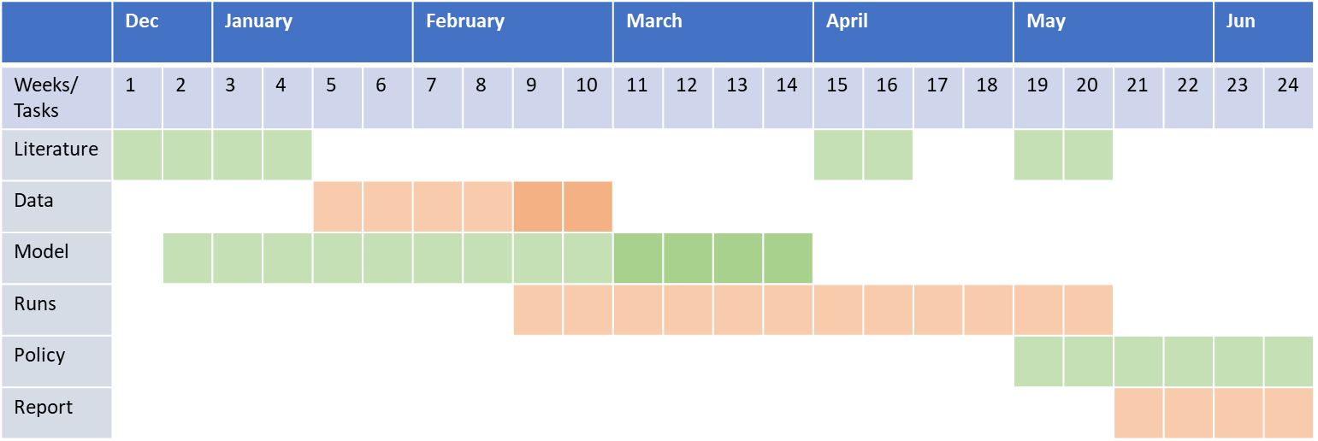
Time plan needs some adjustment to be realistic. See darker squares

