Slide 1
Dec
January
February
March
April
May
June
t4
gr
rggg
aefew

Slide 2
 | Dec |  | January |  |  |  | February |  |  |  | March |  |  |  | April |  |  |  | May |  |  |  | Jun
Weeks/ Tasks | 1 | 2 | 3 | 4 | 5 | 6 | 7 | 8 | 9 | 10 | 11 | 12 | 13 | 14 | 15 | 16 | 17 | 18 | 19 | 20 | 21 | 22 | 23 | 24
Literature
Data
Model
Runs
Policy
Report

Slide 3
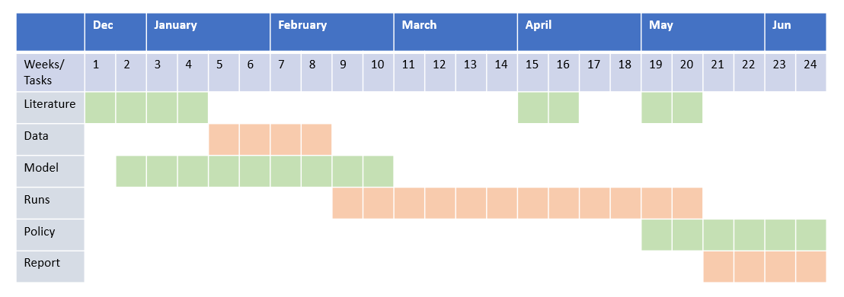

Slide 4
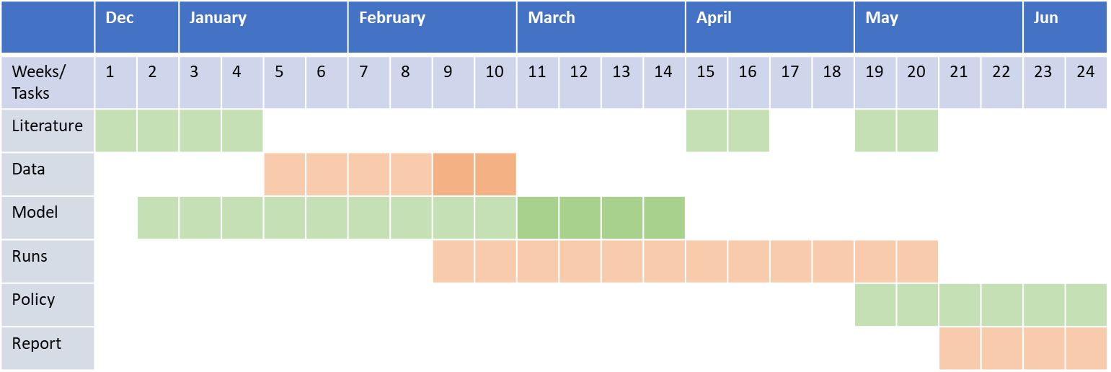
Edited on 25 Jan

Slide 5
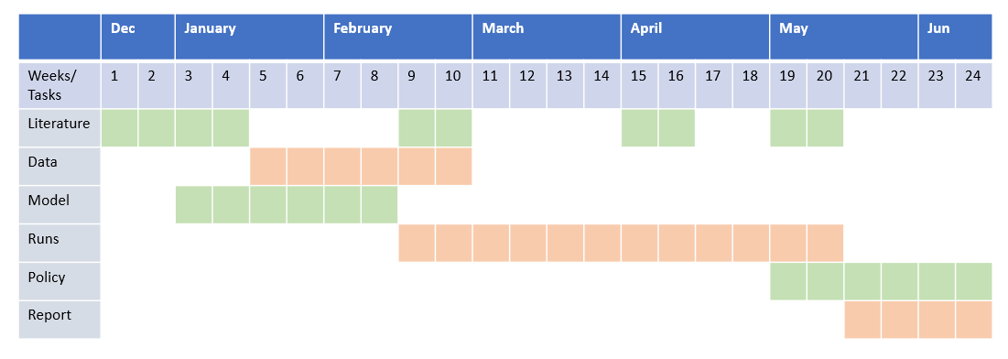
OLD

