Slide 1




MEDREACH
Medreach:
The right hospital, right now,
confirmed before you leave home
AI-powered emergency coordination for Madhya Pradesh
Understands Hindi, English, Hinglish
Hospital accepts before you travel
Live patient tracking
MPOnline Idea & Innovation Hackathon 2026 · Challenge 5, Healthcare
Live: medreach-2.onrender.com | github.com/prakharporwal518-collab/Medreach
Notes:
Medreach is a working product: everything shown on the following slides is from the prototype that is live today.

Slide 2
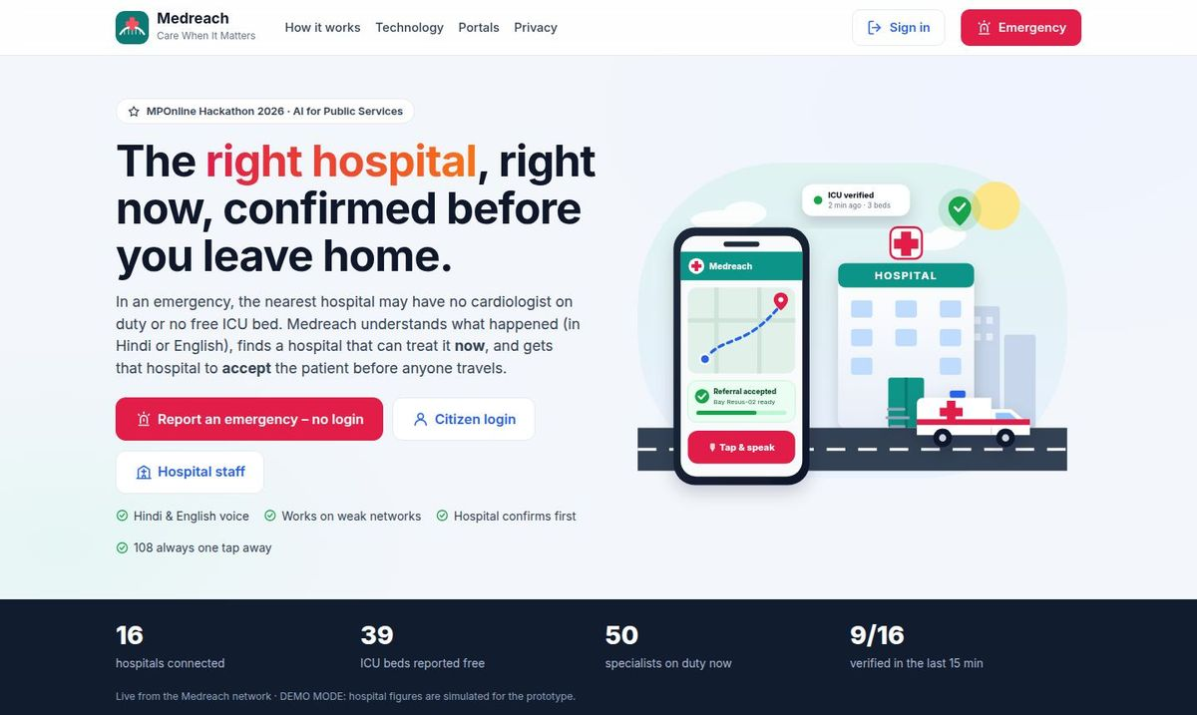


What Medreach Is
01 INTRODUCTION
AI-powered emergency coordination, not a diagnosis app. It joins the family in panic, the hospital emergency desk and the health department on one live network.
CITIZENS & FAMILIES
Speak the emergency, see only hospitals that can treat it, get a confirmed bed and a tracking link. No login. “I’m alone” mode.
HOSPITALS
Verified board of beds, ICU, ventilators and doctors on duty. Referrals arrive with an AI pre-arrival (SBAR) note; one tap to accept.
GOVERNMENT OF MP
Our live home page, with network figures (demo data labelled as simulated).
A live, audited view of emergency capacity, and data on where patients are refused or delayed.
7
2
16
51
LIVE DEPLOYMENT
suggested technologies
private portals
Bhopal-region hospitals
automated tests
medreach-2.onrender.com
Notes:
Each user sees a different, private view. Citizens never see other patients; hospitals only see referrals sent to them.

Slide 3
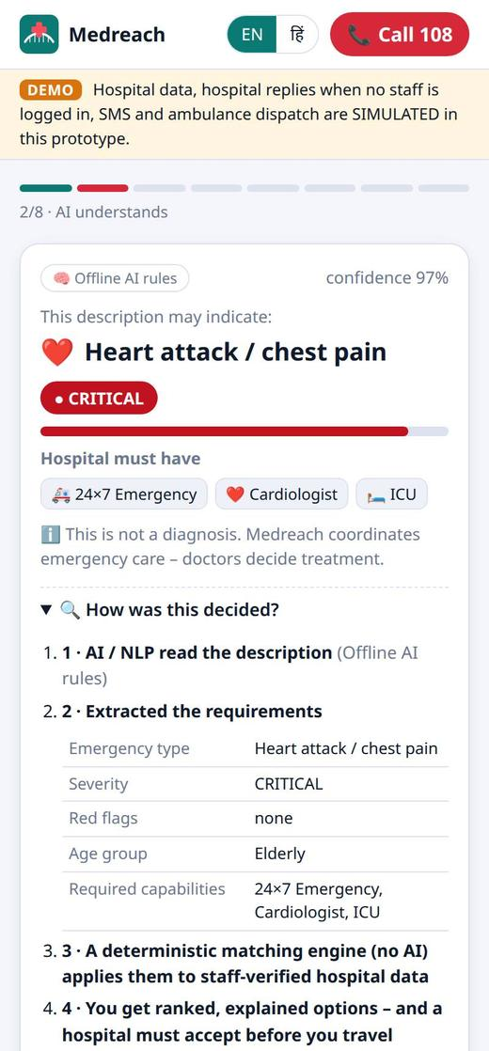
Chest Pain at 11 pm in Bhopal
02 SCENARIO
A 62-year-old man has chest pain and is sweating. His son has a phone and a car.
11:00
11:25
11:35
12:05
Today
Drives to the nearest hospital, chosen by distance
At the gate: no cardiologist, ICU full
Second trip across the city at night
Arrives; the ER was not expecting him
›
›
›
Fragmented journey
11:00
11:01
11:03
11:16
Medreach
Son says “Papa ko seene mein dard hai…”
Possible heart attack, CRITICAL; needs cardiologist + ICU
Bansal Hospital accepts, prepares bay Resus-02
Ambulance arrives (ETA 13 min); ER read the note
›
›
›
Coordinated journey
Times are illustrative; the 13-minute ETA and bay come from our prototype run.
What the son sees a minute after speaking.
Notes:
Walk through both rows. The family never has to guess, and the hospital is never surprised.

Slide 4








Why Patients Lose the Golden Hour
03 OVERVIEW
Nearest is not capable
No trusted live status
Maps show distance, not whether the specialist is on duty or the ICU has a bed tonight.
Bed figures are old, with no owner or time stamp.
1,68,491
No acceptance first
Panic and language
Families arrive unannounced; refusal happens at the gate.
People cannot fill forms in panic; many prefer to speak Hindi.
people died in road accidents in India in 2022
Source: MoRTH, “Road Accidents in India 2022”. Heart attacks, strokes, burns and childbirth emergencies face the same delays.
People living alone
Information is lost
Cannot call hospitals, arrange transport and inform family at once.
Allergies and Ayushman / ABHA details don’t reach the ER doctor.
WHO FEELS IT
Patients & families
wasted trips, delayed treatment
Rural citizens & ASHA workers
long distances, costly wrong choice
Hospital ER teams
unannounced critical arrivals
Health department
no live picture of capacity
Notes:
Verify the statistic from the MoRTH report before presenting. The six causes map one-to-one to the features on the next slides.

Slide 5




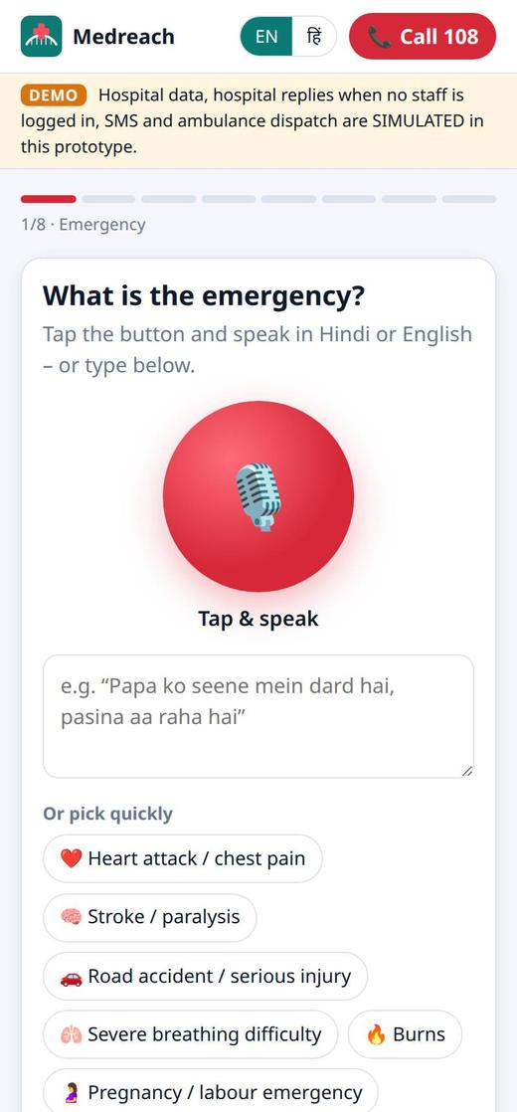
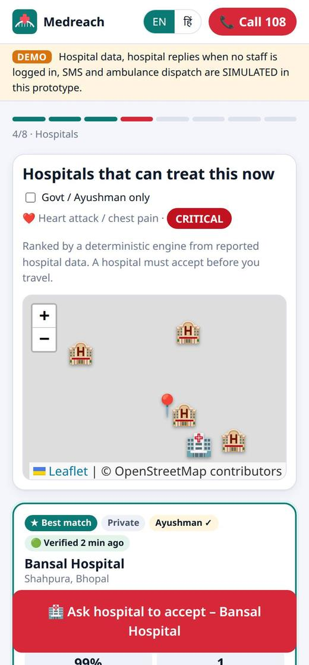
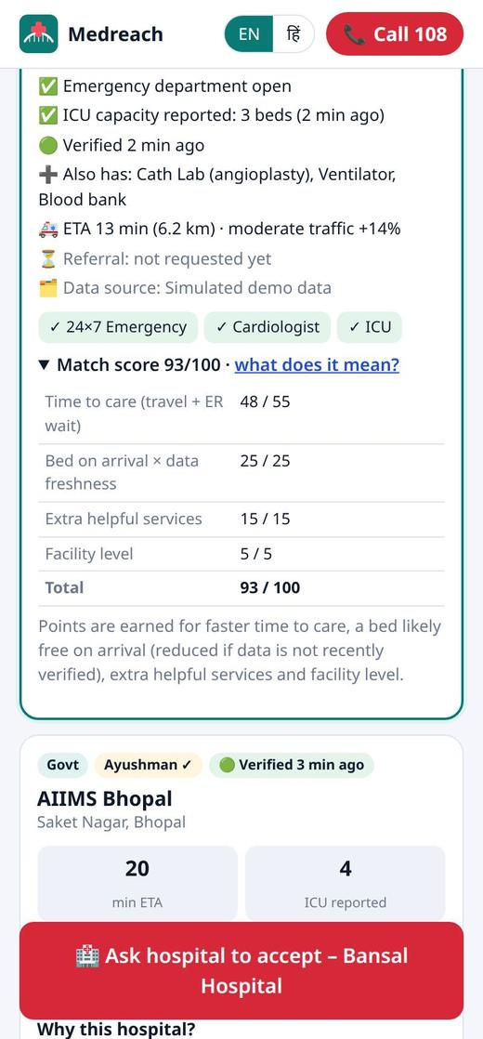
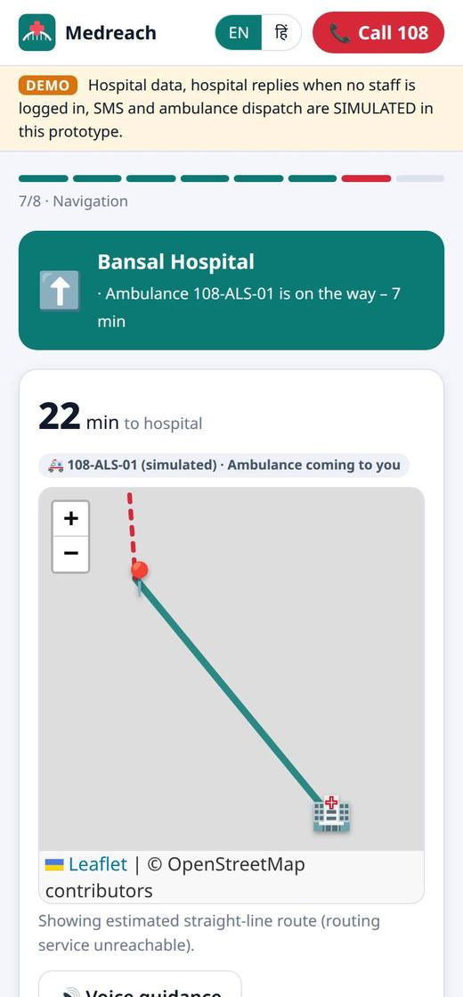




One Flow from Emergency to Confirmed Bed
04 SOLUTION
1
2
3
4
5
6
7
Emergency input
›
AI understanding
›
Match hospital
›
Verify freshness
›
Hospital accepts
›
Transport
›
Arrival
speak, type, photo or health card
severity, red flags, needs
specialist, equipment, bed
who updated, and when
named officer assigns a bay
ambulance or own vehicle
confirmed bed, family informed
RULES WE NEVER BREAK
Hospital accepts before anyone travels
Only hospitals that can treat the case
60 s without answer → next hospital
Never diagnoses: “may indicate”
Call 108 on every screen
Speak or pick a common emergency
Only hospitals that can treat it
“Why this hospital?” score parts
Ambulance status and navigation
Notes:
This is the flowchart from our idea, implemented. Every phone screen is a real screenshot.

Slide 6
Technical Approach
05 TECHNICAL APPROACH
CITIZEN PWA
FAMILY LINK
HOSPITAL DESK
Technology | What it does in Medreach
Generative AI | Turns spoken words into requirements; writes the ER note
Voice bots | Hindi / English speech in; key steps read aloud
Computer vision | Photo of an injury → visible findings
OCR | Reads Ayushman / ABHA cards on the phone, with consent
Predictive analytics | Traffic ETA, chance a bed is free on arrival, ER forecast
Conversational AI | One follow-up question at a time
Mobile app | Installable, bilingual PWA; works on weak networks
voice · photo · OCR · offline
status · hospital · ETA only
referrals · beds · live map
MEDREACH SERVER (Node.js + Express)
REST API + live updates (SSE) · OTP login with 4 roles · case store · audit log · consent · 24-hour deletion
TRIAGE ENGINE
MATCHING ENGINE
PREDICTION
understands and classifies severity
ranks hospitals that can treat it
traffic ETA, bed on arrival, ER forecast
Stack: Node.js 22 · Express 5 · PWA · Leaflet + OpenStreetMap (no API keys) · Tesseract.js · Web Speech · Claude SDK
Engines run on the server and on the phone, so triage works offline. Claude (optional) adds understanding and writes the SBAR note.
Safety: severity = max(AI, rules), so AI never lowers urgency. Ranking: time to care 55 + bed on arrival × freshness 25 + services 15 + level 5
Notes:
51 automated tests cover triage, matching, scoring, login, roles and privacy views.

Slide 7




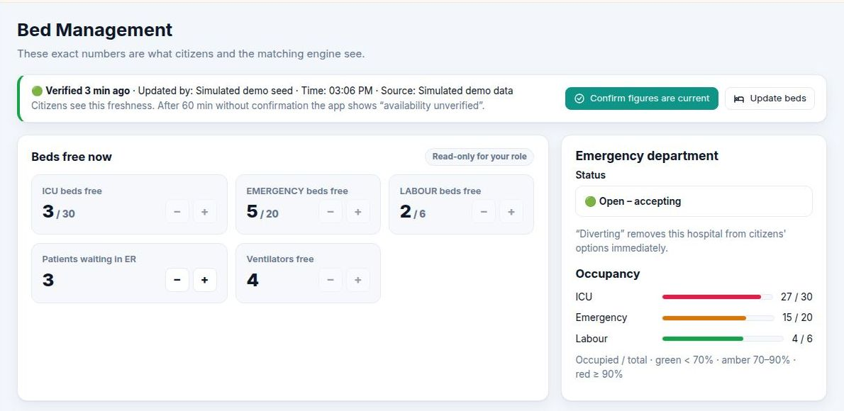
From Prototype to Statewide
06 IMPLEMENTATION
Prototype
Pilot · Bhopal
Integrate
Scale · MP
Done
~3 months
~3–6 months
~6–12 months
Portals live, AI triage, matching, acceptance, live maps, 51 tests
Hospital onboarding, nodal officers, ER training, clinical review, SMS OTP
Health Facility Registry, HMIS, 108 control room, ABDM, encrypted DB
District rollouts, state command view, IVR for feature phones
KEY RISKS & MITIGATIONS
Risk | Mitigation
Hospitals stop updating | Freshness on every figure; stale ranked lower; one-click confirm
AI misreads a case | AI only raises urgency; a deterministic engine decides
No hospital answers | After 60 s the next suitable hospital is asked
Weak network | Offline PWA runs triage and matching on the phone
What hospitals keep current. One click re-confirms the figures.
Notes:
Durations are planning estimates. Cost stays low: open-source stack, free maps, one web app for every phone, AI optional.

Slide 8
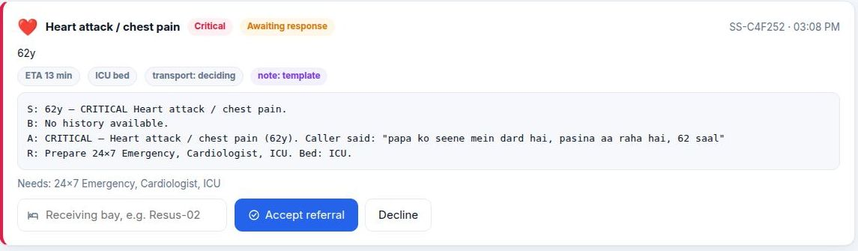
What Makes Medreach Different
07 INNOVATION
 | Maps | Bed portals | Helplines | Medreach
Understands a spoken emergency in Hindi | No | No | Operator | Yes
Matches specialist and equipment | No | Beds only | Manual | Yes
Shows who updated each figure, and when | No | Rarely | No | Every figure
Hospital accepts before travel | No | No | Sometimes | Yes + bay
Automatic fallback to next hospital | No | No | Manual | 60 s
Pre-arrival note for the ER doctor | No | No | No | SBAR note
Help for a person living alone | No | No | No | “I’m alone”
1
2
1 AI-written SBAR note from what the son said
2 Assign a bay and accept in one tap
< 1 s
status change reaches every citizen
60 s
before the next hospital is asked
Reported capacity, referral accepted and confirmed destination are always shown separately, so “2 ICU beds” is never mistaken for “admitted”.
0
API keys needed for maps
Notes:
Live proof: set a hospital’s ER to “Diverting” and it disappears from every family’s list immediately.

Slide 9
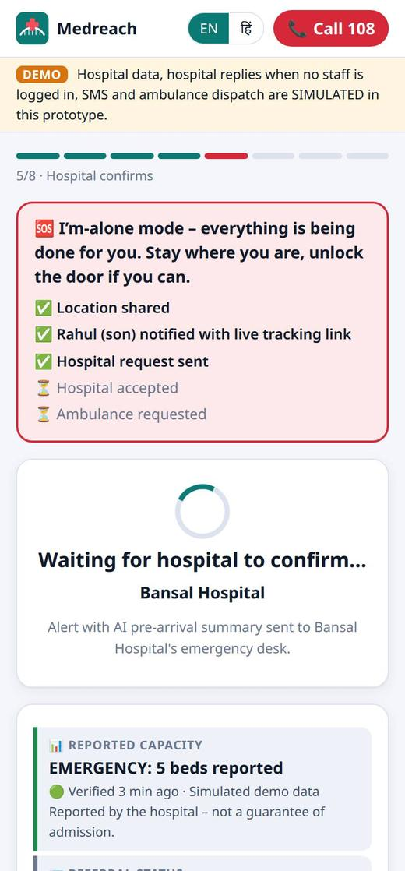
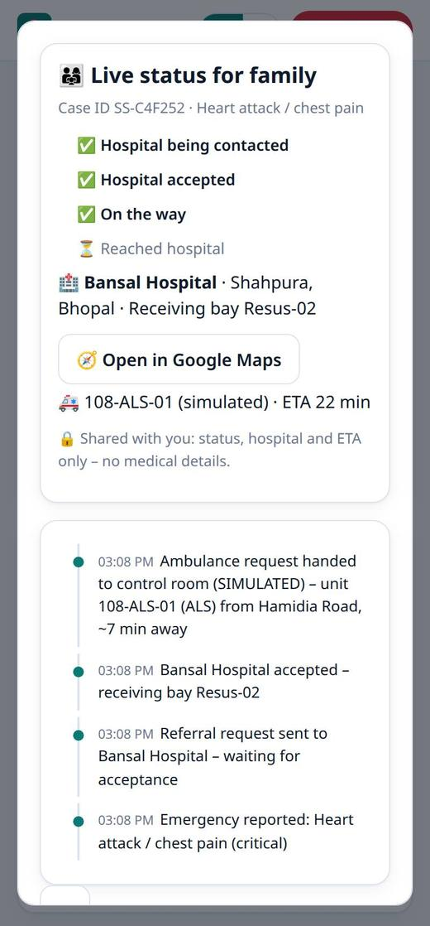



Impact and Benefits
08 IMPACT AND BENEFITS
01
02
03
Right care, first time
Equal access
Lower costs
Pre-arrival acceptance gets patients treated sooner.
Voice and Hindi for rural, elderly and first-time users.
No repeat trips; better use of ICU beds and specialists.
04
05
06
Live, audited data
Informed citizens
Stronger system
Verified capacity for planning beds and ambulances.
Safe first-aid steps; awareness of Ayushman, ABHA, 108.
Fewer surprise arrivals, less crowding, fewer transfers.
HOW THE PILOT WILL MEASURE IT
Time to definitive care
Transfers avoided
Acceptance time
Data freshness
“I’m alone”: one tap does every step.
Family link: status, hospital, ETA. No medical data.
Notes:
Impact will be measured from our own audit log and case timestamps during the pilot.

Slide 10





Why Should Medreach Be Selected?
09 WHY MEDREACH
Thank You
REAL IMPACT
WORKING NOW
BUILT IN FULL
Closes a life-or-death gap for citizens of Madhya Pradesh: a bed confirmed before travel.
Both portals are live on the web today. Try the whole flow in about 3 minutes.
All 7 suggested technologies in working code, listed file by file.
SAFE BY DESIGN
PRIVATE
READY TO SCALE
AI only raises urgency; a tested engine decides; 108 always one tap away.
Consent, masked IDs, OTP and roles, audit log, deletion 24 h after hand-over.
Low-cost open stack; clear path to HFR, HMIS, 108 and ABDM.
OUR ASK
Partner with us for a 3-month pilot with Bhopal hospitals, then statewide integration with the Health Facility Registry, hospital HMIS, the 108 control room and ABDM.
LIVE DEMO medreach-2.onrender.com CODE github.com/prakharporwal518-collab/Medreach HOSPITAL LOGIN Bansal Hospital · BANSAL-ED01
Notes:
Close with the ask, then offer to run the live demo.

