Slide 1


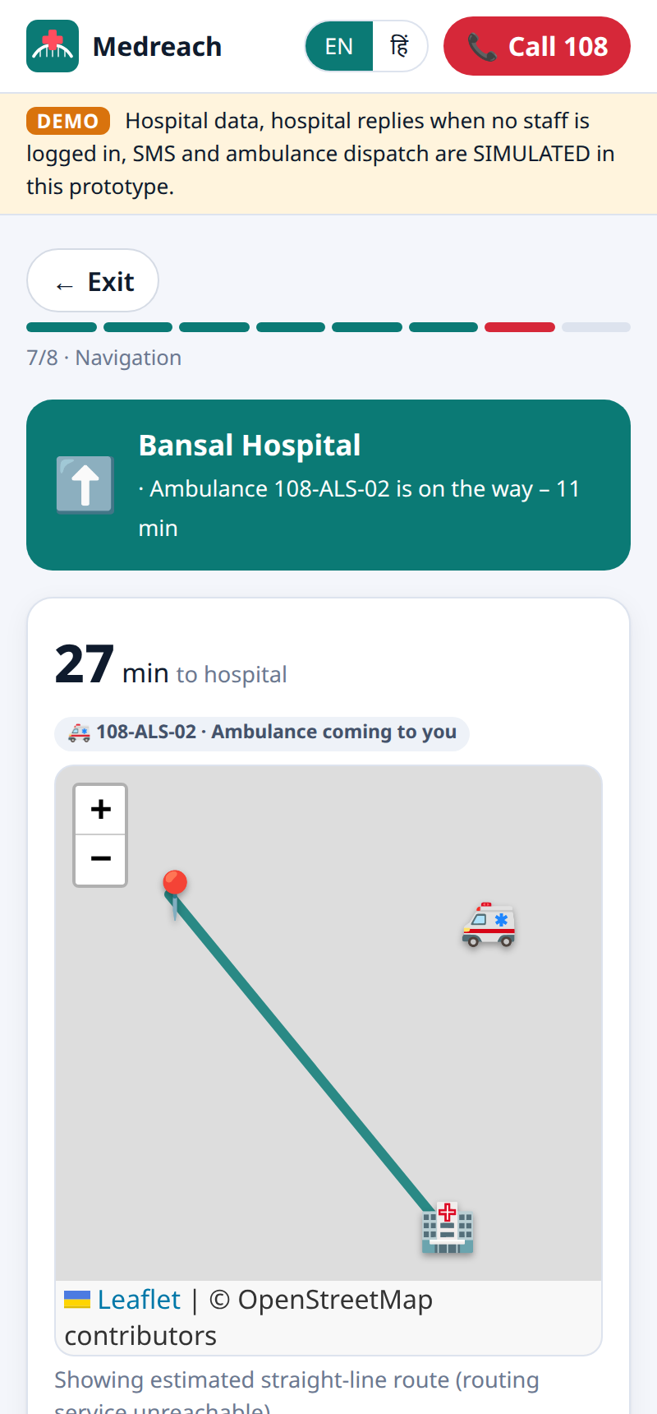




01 INTRODUCTION
MEDREACH
Medreach
The right hospital, right now –
confirmed before you leave home
AI-powered emergency coordination for Madhya Pradesh, connected to the 108 / 102 national ambulance services.
Speak in Hindi or English
AI understands the emergency
Hospital accepts first
no wasted trips, ER is ready
108 ambulance dispatched
nearest unit, tracked live
Works on 2G, SMS, offline
built for villages
MPOnline Idea & Innovation Hackathon 2026 · Challenge 5: Healthcare · Team Medreach
Live: medreach-2.onrender.com | github.com/prakharporwal518-collab/Medreach
Notes:
Medreach finds the right hospital for an emergency, gets the hospital to accept before the family travels, and hands the case to the 108 ambulance service. Everything in this deck is from the working prototype that is live at medreach-2.onrender.com.

Slide 2
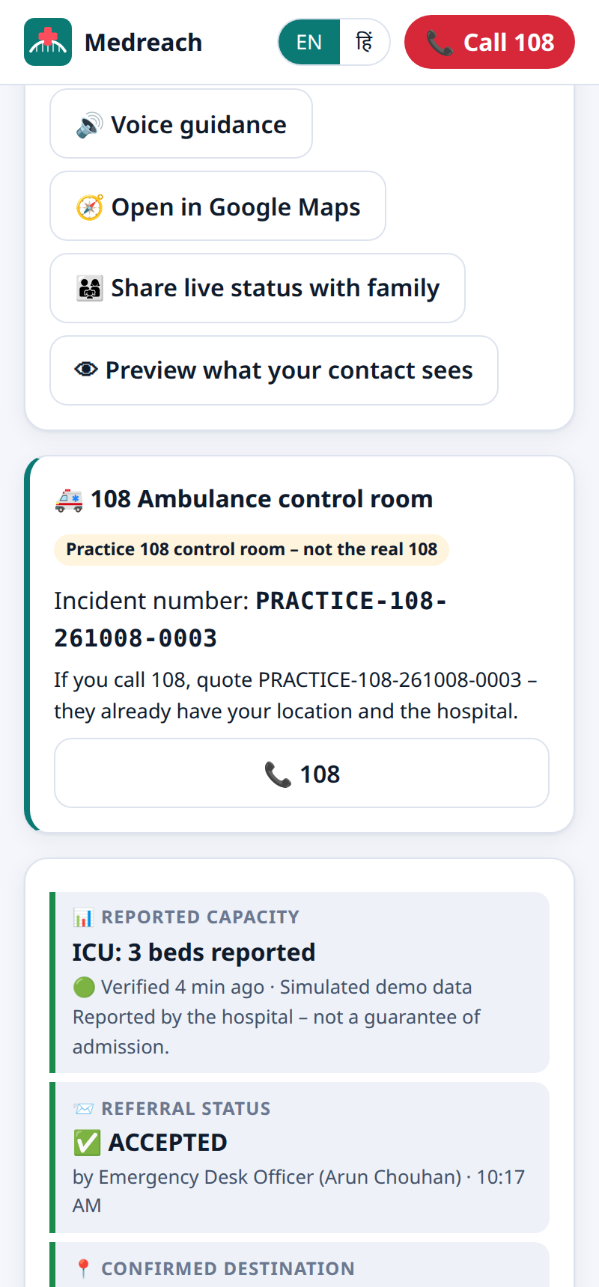


9:40 PM, a Village Near Berasia: Chest Pain
02 SCENARIO
Ramesh’s father (58) collapses with chest pain and sweating. Only 2G works. The nearest town is 25 km away. What happens next decides his life.
Today
With Medreach
0 min
Panic. Calls relatives – nobody knows which hospital has a cardiologist tonight.
0:00
Son speaks in Hindi: “papa ko seene mein dard hai…”
+20 min
Drives to the nearest hospital: no cardiologist, ICU full.
0:30
AI: possible heart attack – CRITICAL. Needs cardiologist + ICU.
1:00
Only hospitals that can treat it, ranked by match score.
+45 min
Calls 108 and repeats the address and details; the weak 2G call drops.
2:00
Bansal Hospital accepts and reserves a resus bay.
+90 min
Reaches a second hospital that was not expecting him.
2:30
108 incident created, nearest ALS ambulance sent and tracked.
The golden hour is lost on the road.
He arrives at an ER that is ready for him.
What the family sees: hospital accepted + 108 incident number.
Notes:
An illustrative story. On the left, the usual chain of delays. On the right, the same emergency through Medreach; minute marks are illustrative, the screen on the right is a real prototype screen.

Slide 3






One Platform for Citizen, Hospital and 108
03 OVERVIEW
THE PROBLEM
1,68,491
Citizen / family
Hospital
108 / 102 control room
road-accident deaths in India in 2022
Speak or type in Hindi / English
Aadhaar + OTP verified account
See beds, doctors, blood live
SMS when there is no internet
Accept referral, reserve a bay
AI pre-arrival (SBAR) note
Update every 108 minutes
Named Data Update Officer
Signed incident, no re-asking
Nearest suitable unit
Live status back to family
102 Janani for pregnancy
Source: MoRTH, Road Accidents in India 2022
Nearest ≠ capable
maps show distance, not the specialist on duty
No trusted live status
bed figures are old, nobody owns them
No acceptance first
refusal happens at the hospital gate
MEDREACH ENGINE
AI triage · Match score · Live capacity · 108 hand-off · SMS gateway · Tamper-evident audit
Weak networks
villages have 2G or no data
Running today: 16 hospitals across Bhopal, Raisen, Sehore and Vidisha · 9-ambulance practice 108 fleet · English and Hindi
Notes:
Medreach is the coordination layer between the three parties every emergency needs. It does not replace 108 or the hospital – it connects them with live, verified information. Verify the MoRTH statistic before presenting.

Slide 4





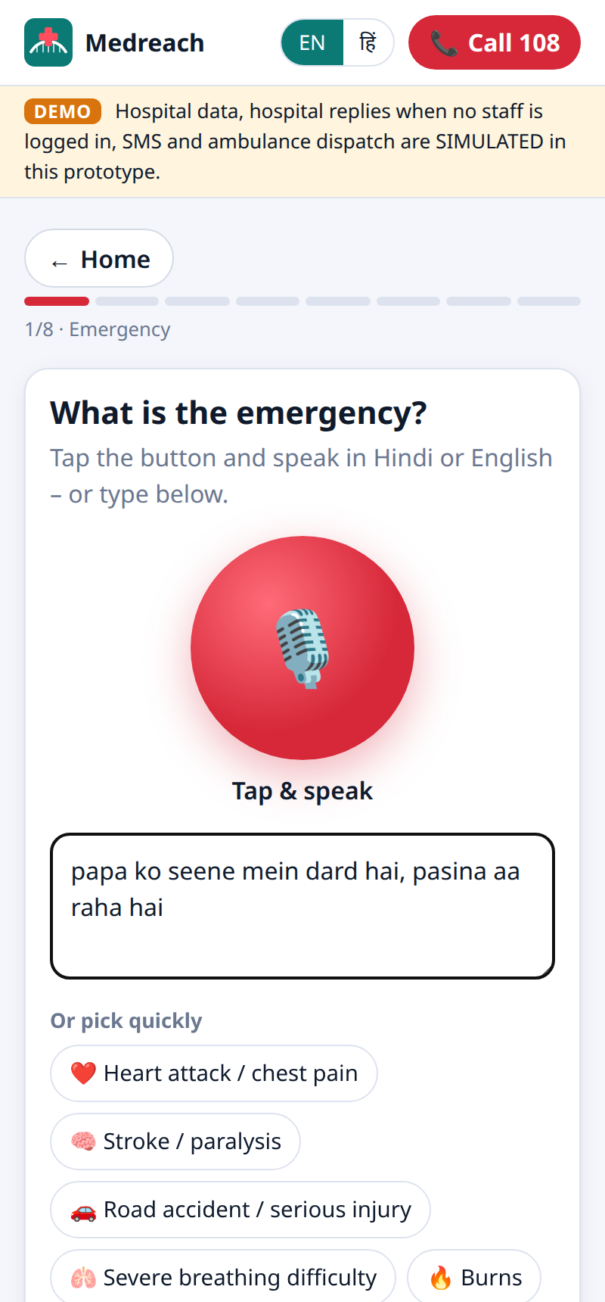
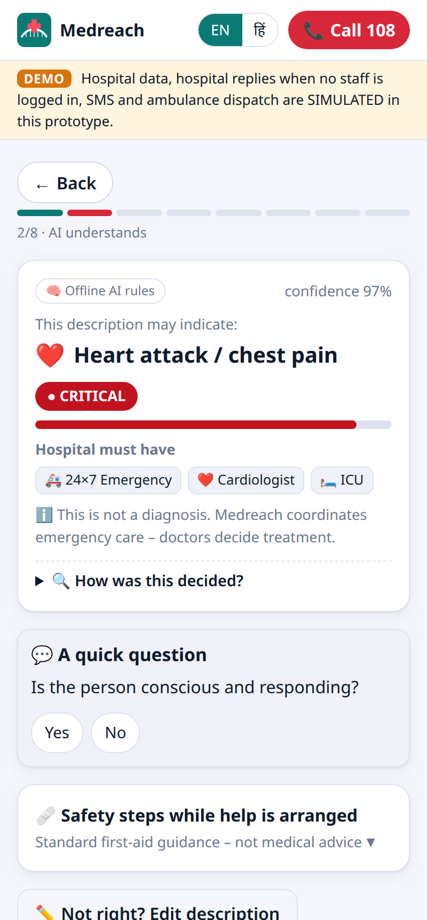
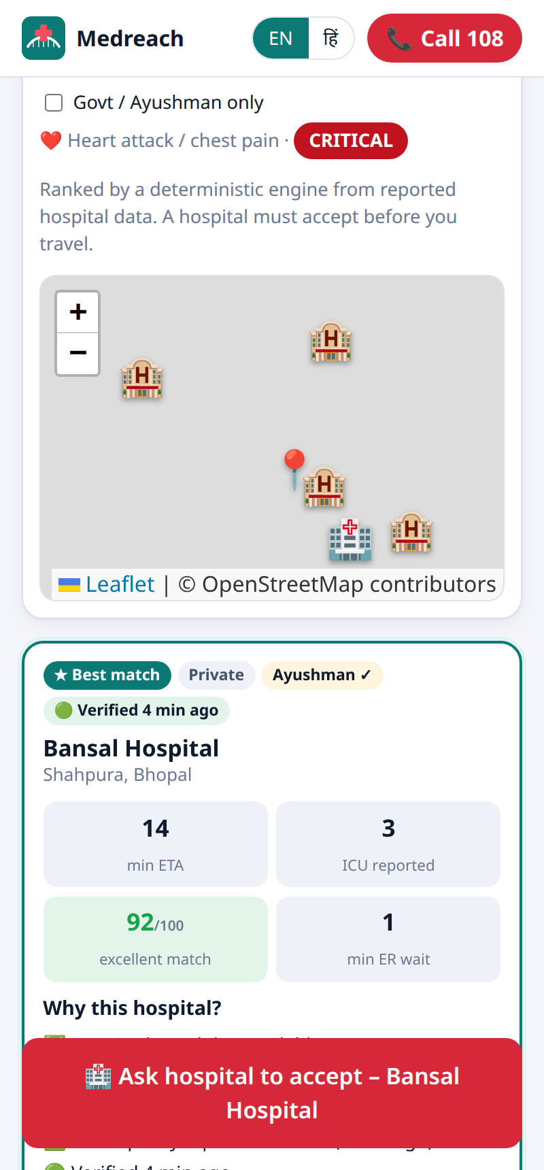
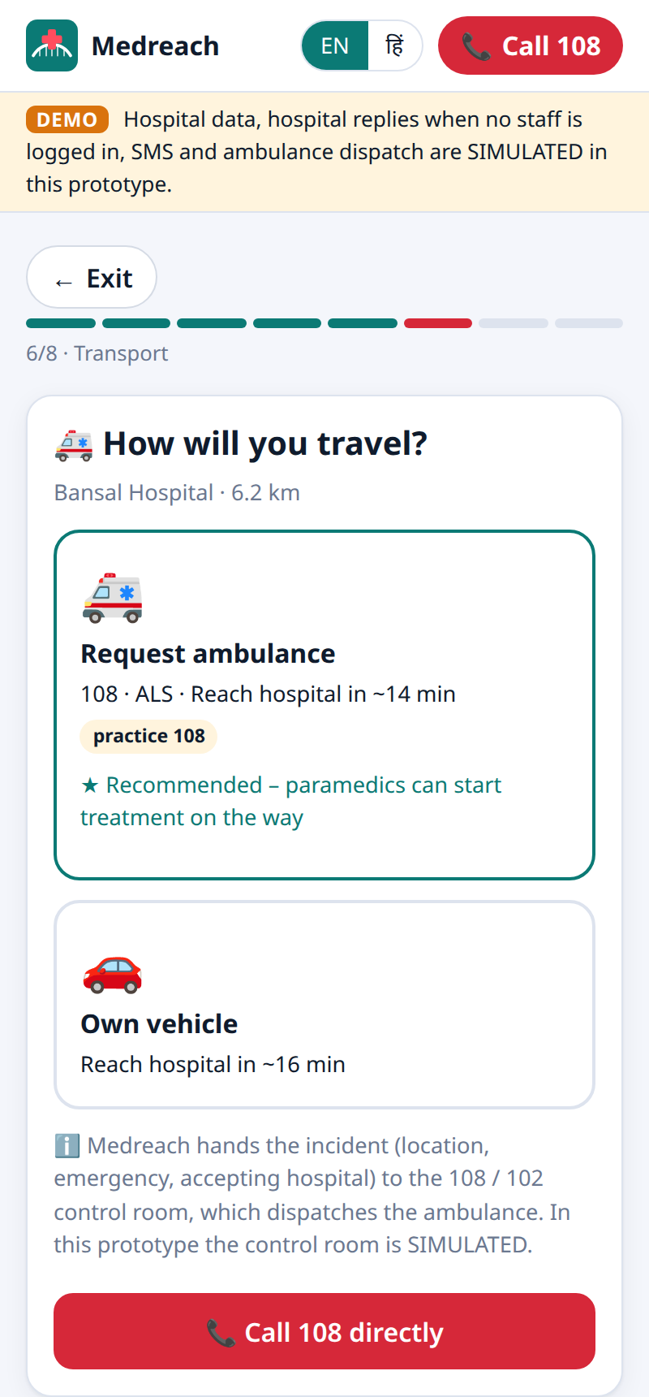





From First Words to a Confirmed Bed in 7 Steps
04 SOLUTION PROPOSED
1
2
3
4
5
6
7
Speak
›
AI triage
›
Match score
›
Hospital accepts
›
108 / 102
›
Live tracking
›
Arrival
voice, text, photo or health card
severity, red flags, needs
specialist, bed, distance, freshness
named officer reserves a bay
signed incident, nearest unit
family sees ambulance and ETA
ER ready with SBAR note
RULES WE NEVER BREAK
Hospital accepts before anyone travels
Only hospitals that can treat the case
60 s without answer → next hospital
Never diagnoses: “may indicate”
Call 108 visible on every screen
Speak or pick an emergency
AI understands – in seconds
Match score: 92/100
Accepted → choose 108
108 unit tracked live
Notes:
Walk the flow left to right; the phones below are the real screens for steps 1, 2, 3, 5 and 6. The red step is the national 108/102 hand-off.

Slide 5














Architecture: Simple, Secure, Integrable
05 TECHNICAL APPROACH
CHANNELS
MEDREACH SERVER
INTEGRATIONS
Citizen web app (PWA)
voice · offline · installable
Node.js 22 · Express 5 · Server-Sent Events (live push)
108 / 102 dispatch (CAD)
HMAC-signed JSON webhooks
AI triage
Gemini 2.5 Flash + offline rules
Match-score engine
explainable 100-point score
Hospital dashboard
accept · update · audit
Aadhaar OTP (UIDAI)
via licensed AUA / KUA
Live capacity
108-min update cycle
Routing & ETA
road distance, traffic hour
108 control-room console
fleet · incidents · dispatch
SMS gateway (DLT)
inbound + replies
Secure case store
AES-256-GCM fields
Audit chain
SHA-256 hash-chained log
SMS “#MR1” code
for no-internet villages
Maps and roads
OpenStreetMap · OSRM
SECURITY BY DESIGN
OPEN, LOW-COST STACK
Aadhaar never stored (keyed hash + last 4) · OTP limits & lockout · signed 108 messages with replay window · rate limits · strict CSP · per-field staff permissions
Web Speech API (voice) · Tesseract.js (health-card OCR on the phone) · Leaflet maps · Service Worker (offline) · runs on one small cloud server (Render)
Notes:
Every arrow on the left is a channel we have built; every box on the right is an integration with a defined contract. The 108 contract is HMAC-signed both ways and is already exercised by our practice control room. AI is optional: if the AI key is missing, rule-based triage keeps working offline.

Slide 6
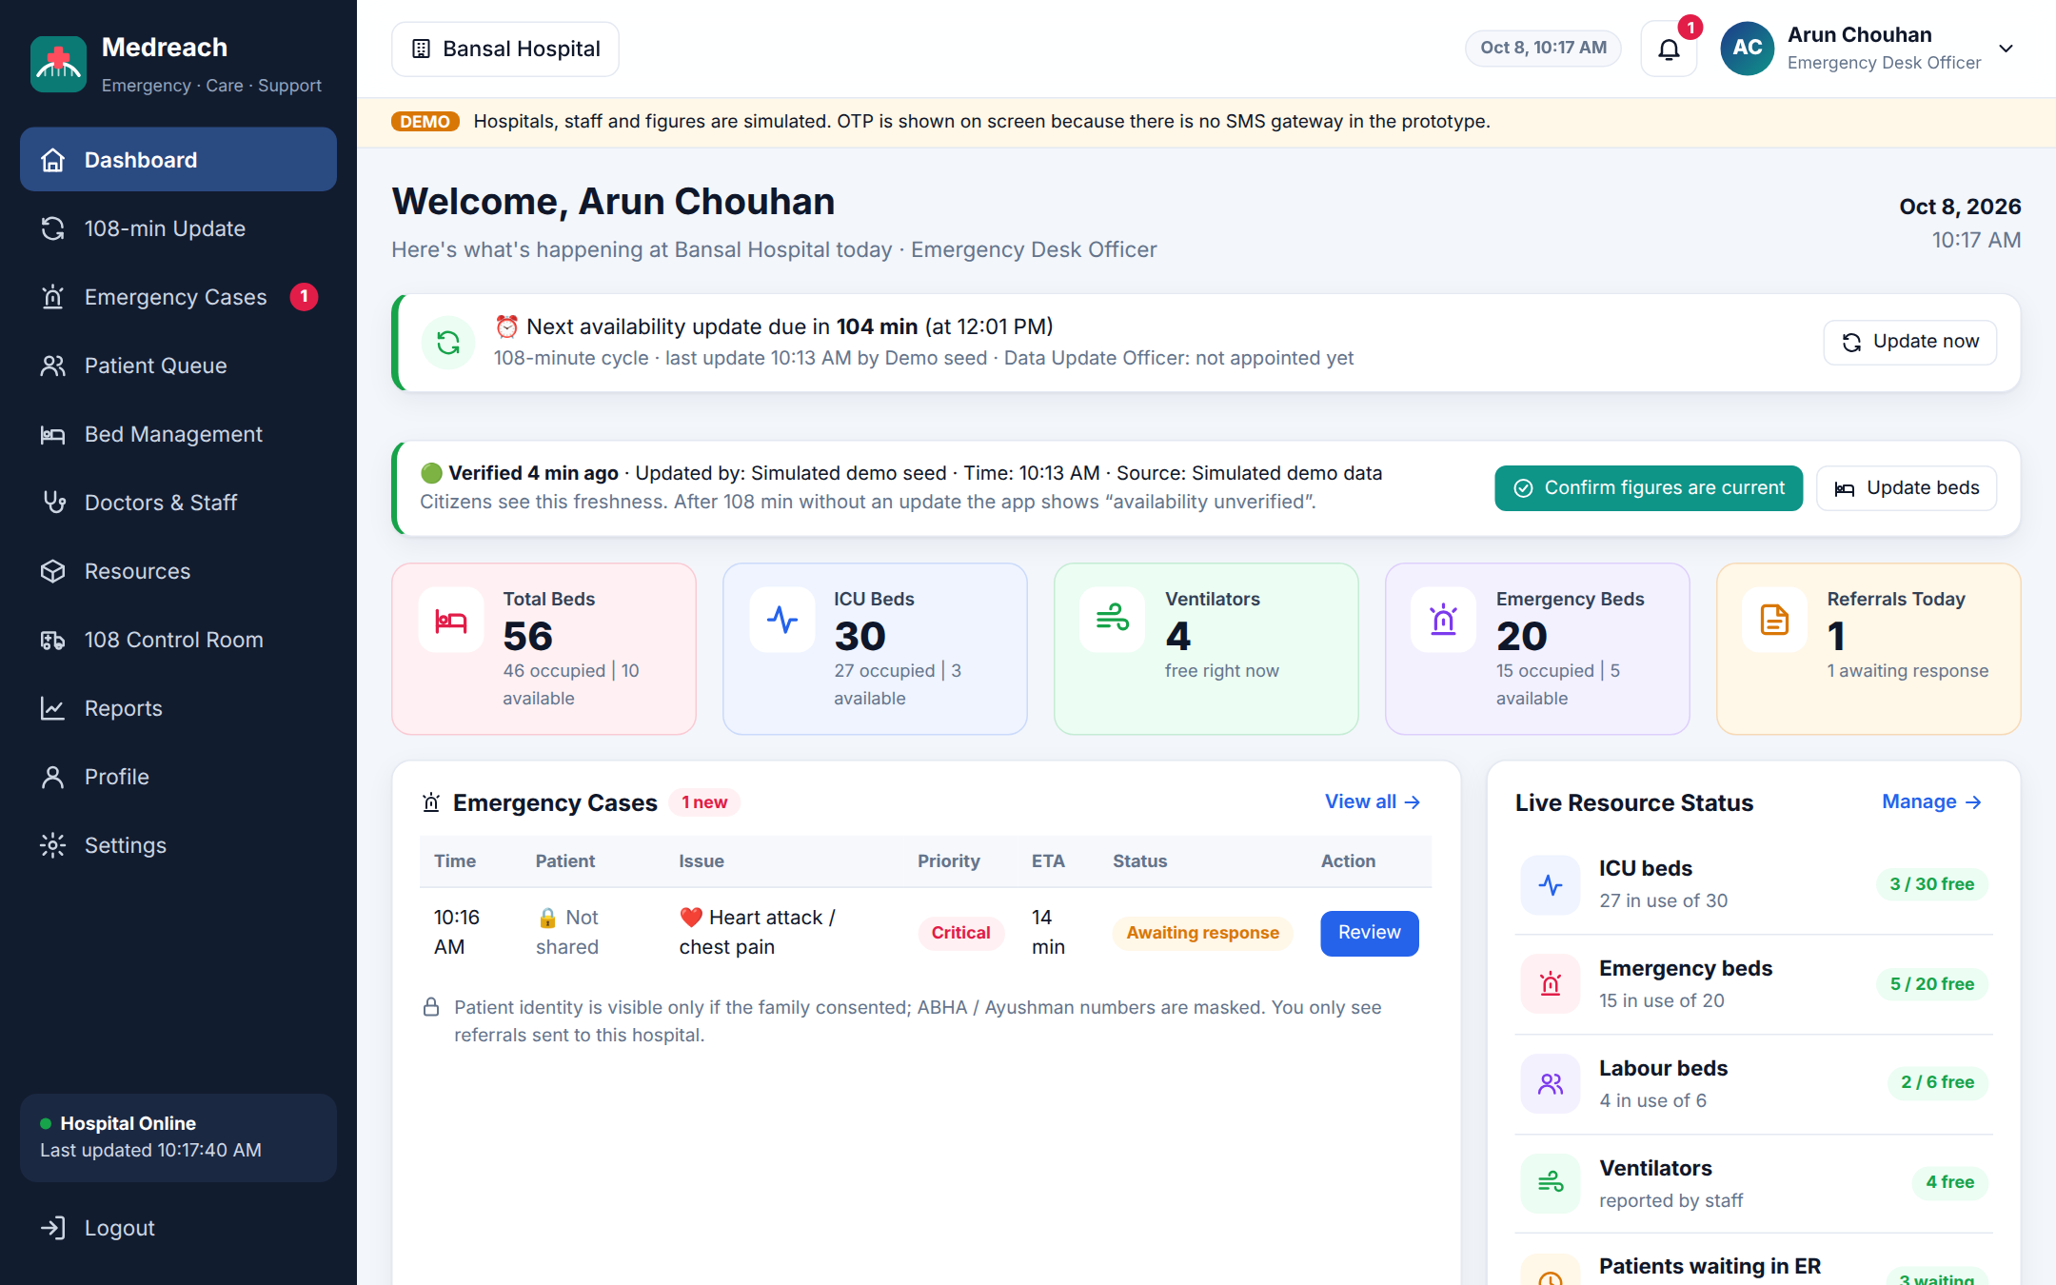
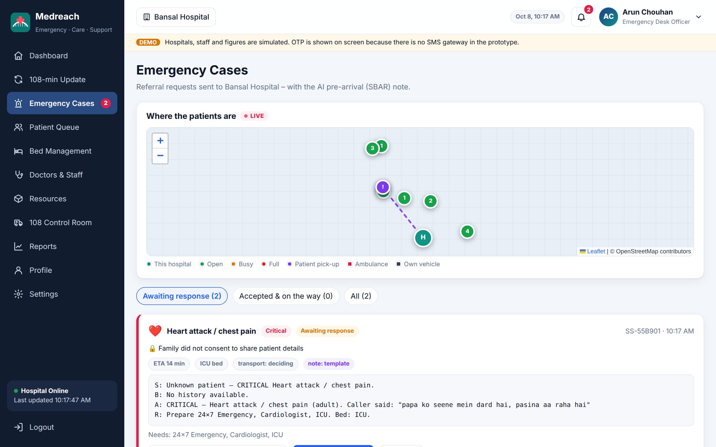
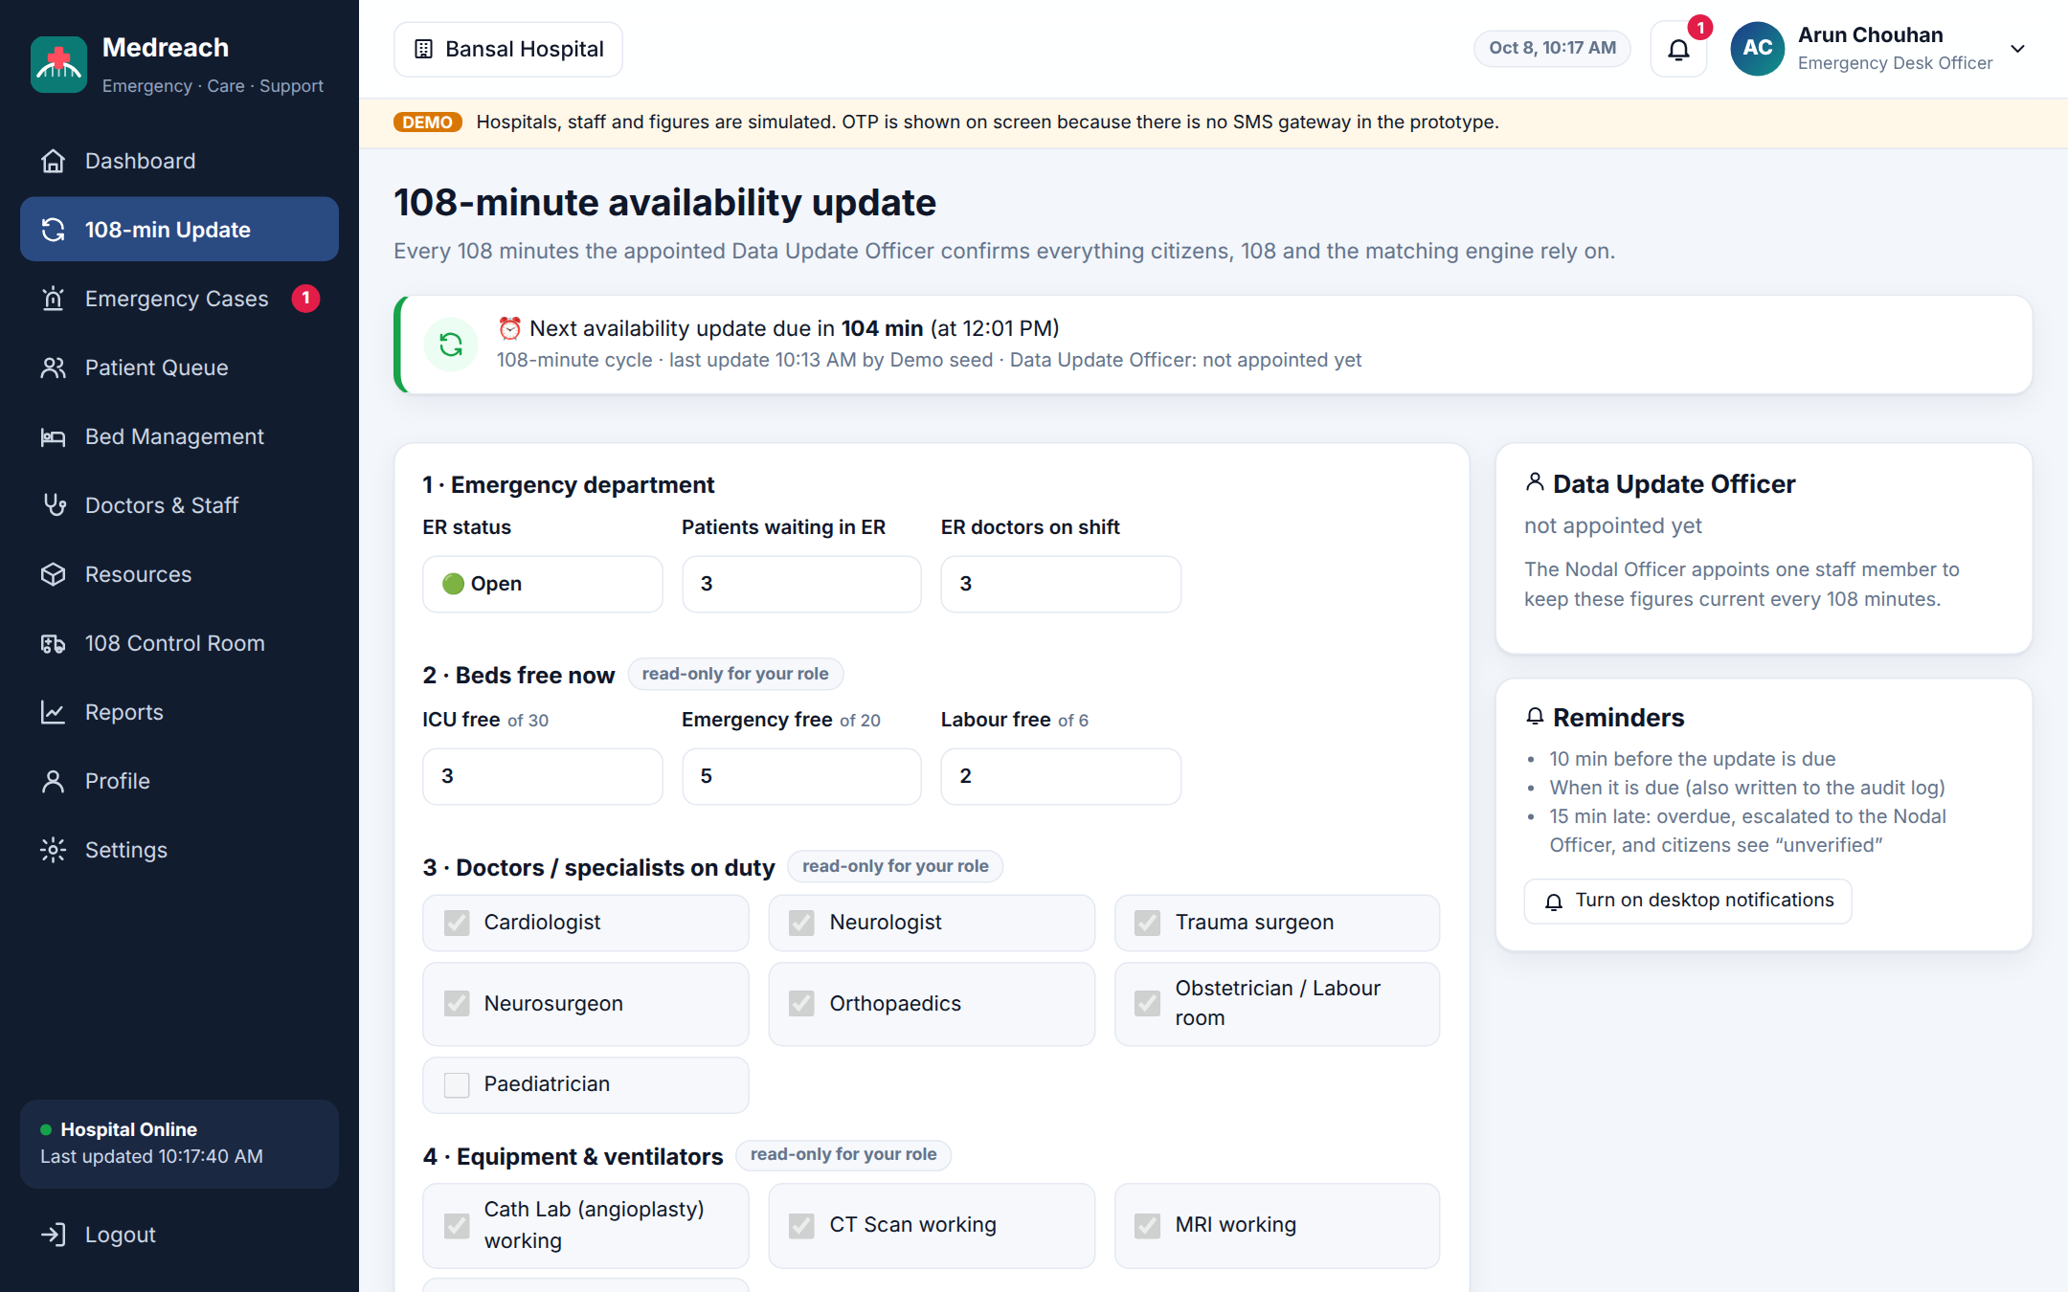
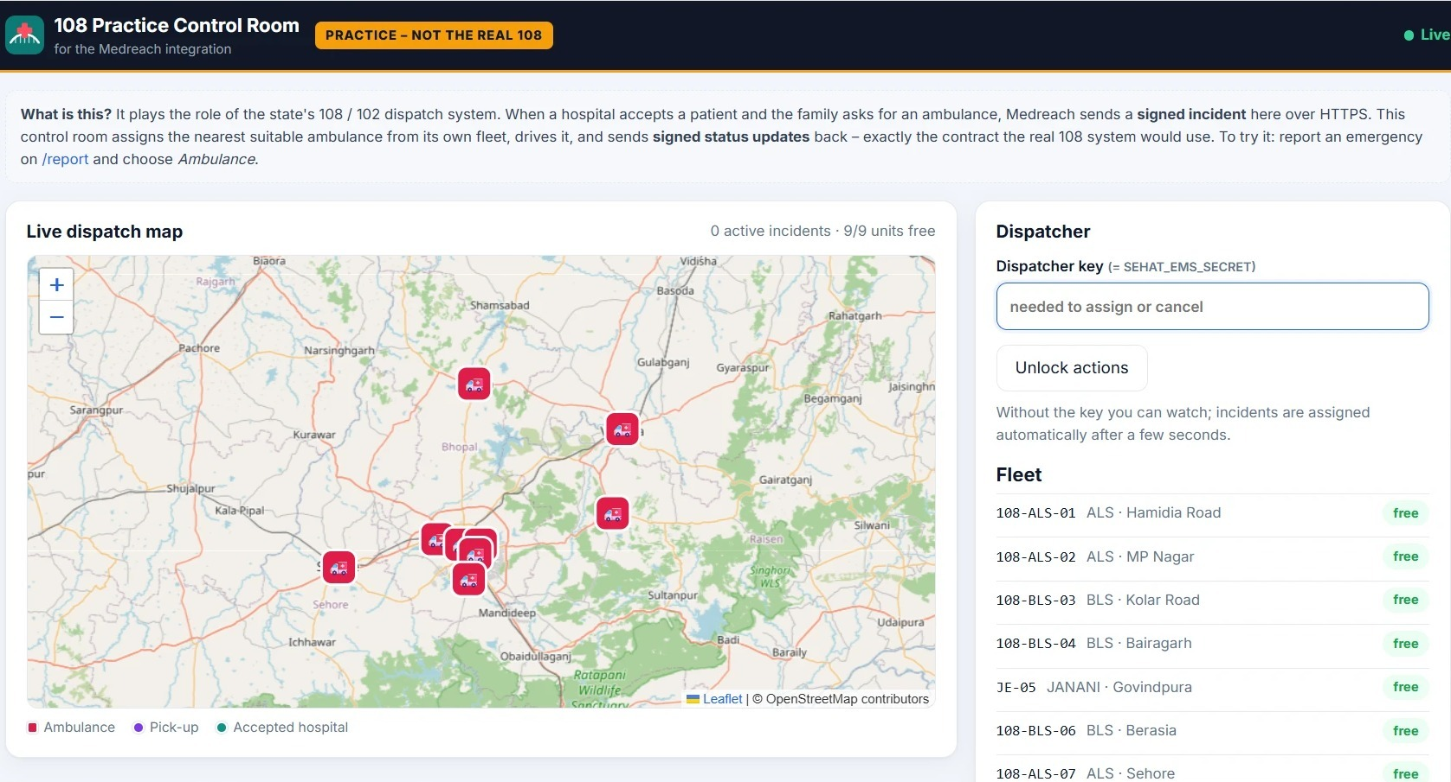
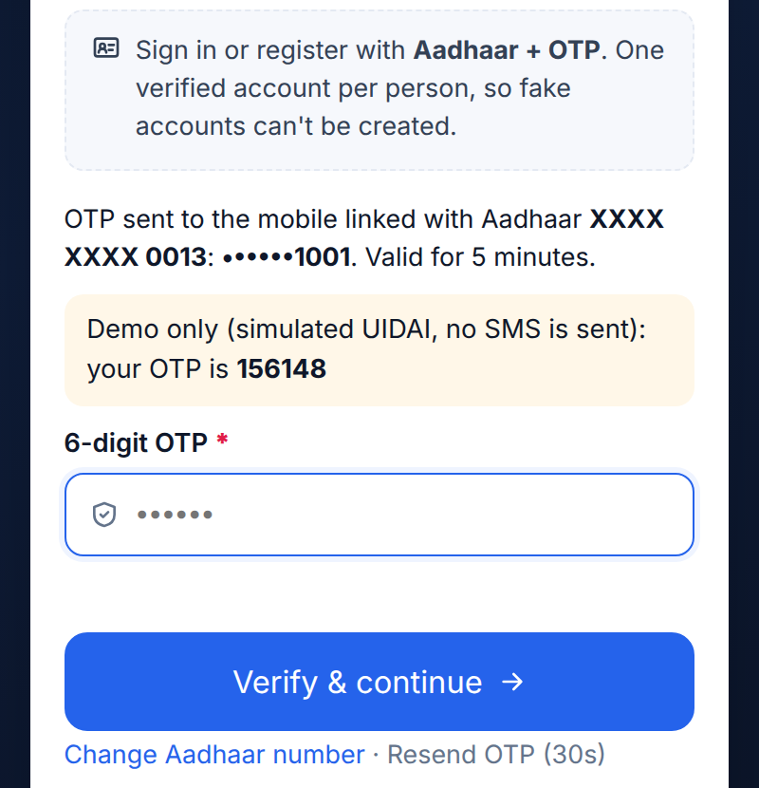
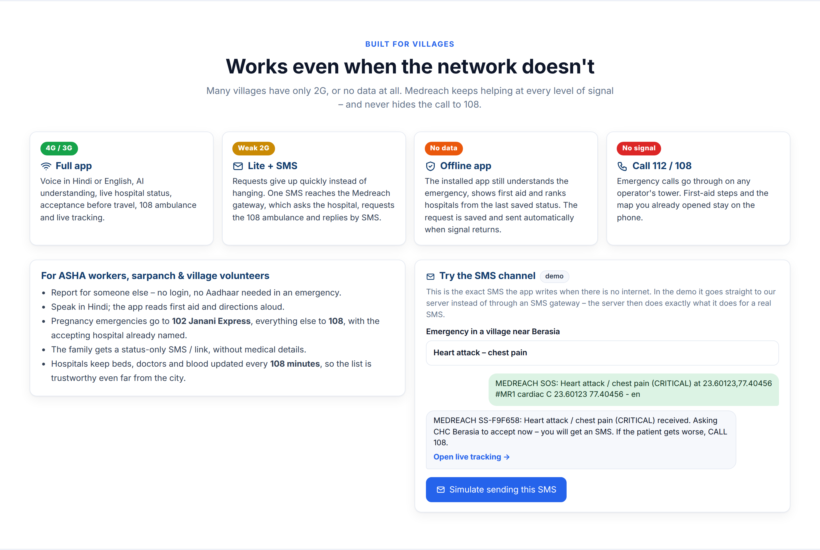
Built, Deployed and Tested – Not a Mockup
06 IMPLEMENTATION
94
automated tests passing
3
connected portals: citizen, hospital, 108
Hospital dashboard – live capacity
Incoming referral + AI SBAR note
108-minute update & Data Officer
16
hospitals · 4 districts
9
ambulances in practice 108 fleet
LIVE NOW
medreach-2.onrender.com
108 control room (live site)
Aadhaar + OTP sign-in
Villages: SMS when no internet
Notes:
Everything on this slide is a real screen. The control-room screenshot is from our deployed site; the others were captured from the same code. Demo data is clearly labelled as simulated in the product.

Slide 7




What Makes Medreach Different
07 INNOVATION / DIFFERENTIATION
Capability | Calling around | Map apps | Medreach
Knows if the specialist & ICU are free now | if someone answers | ✘ | ✔
Hospital confirms before you travel | sometimes | ✘ | ✔
Speak in Hindi / Hinglish, AI understands | ✔ | ✘ | ✔
108 gets location + accepting hospital | ✘ | ✘ | ✔
Works on 2G, SMS and offline | ✔ | ✘ | ✔
Data owner + 108-minute freshness | ✘ | ✘ | ✔
Aadhaar-verified users, tamper-evident audit | ✘ | ✘ | ✔
Explainable match score
Accept before travel
Each hospital gets a score out of 100 with its parts shown.
No family leaves without a “yes” and a bay.
108-minute update cycle
Signed 108 hand-off
Named officer, reminders, “unverified” if late.
HMAC contract any state CAD can adopt.
#MR1 SMS code
AI pre-arrival note
Whole request fits in one SMS on 2G.
SBAR summary reaches the ER first.
Medreach does not replace 108 or hospitals – it connects them.
Notes:
Today families either call around or use map apps; neither tells you whether the hospital can actually treat you now, and neither talks to 108. These six ideas are what we built that nobody else combines.

Slide 8



Impact: Minutes Saved Are Lives Saved
08 IMPACT & BENEFIT
60 s
108 min
4
0
a hospital must answer, or the next one is asked
maximum age of hospital data before it is flagged
network levels covered: 4G, 2G + SMS, offline, call
Aadhaar numbers stored – only a keyed reference
Citizens & families
Hospitals
108 / Health department
Right hospital the first time
No form-filling in panic: just speak
Family tracks the ambulance live
Villages served on 2G / SMS
Patients arrive announced, bay ready
SBAR note before arrival
Fewer unsuitable walk-ins
Audit log protects the staff
No re-asking: complete incident
Live map of capacity statewide
Data owner for every hospital
Planning from real demand
SCALE-UP
Pilot Bhopal division – 16 hospitals, 4 districts
›
Madhya Pradesh all districts, with the state 108 operator
›
India any state’s 108 / 102, same open contract
Notes:
The four numbers are design guarantees built into the product, not estimates. Benefits reach all three sides of an emergency, and the 108 contract lets any state adopt it.

Slide 9





Why Medreach Deserves to Win
09 WHY SHOULD WE SELECT YOU?
It works today
Ready for real 108
SCAN TO TRY IT LIVE
Live website: speak → hospital accepts → 108 ambulance → tracking, end to end.
Signed incident contract, proven with our practice control room.
Built for rural MP
Secure & private
Hindi voice, 2G / SMS / offline, 102 Janani Express for mothers.
Aadhaar OTP, AES-256-GCM, tamper-evident audit, no Aadhaar stored.
medreach-2.onrender.com
Code: github.com/
prakharporwal518-collab/Medreach
Low cost, scalable
Responsible AI
Thank you
धन्यवाद
Open-source stack, one web app for every phone, AI optional.
Never diagnoses; hospitals decide; Call 108 always one tap away.
Notes:
Close with the live demo: open the QR link, report an emergency in Hindi, accept it on the hospital dashboard and watch the 108 control room dispatch the ambulance.

