Slide 1

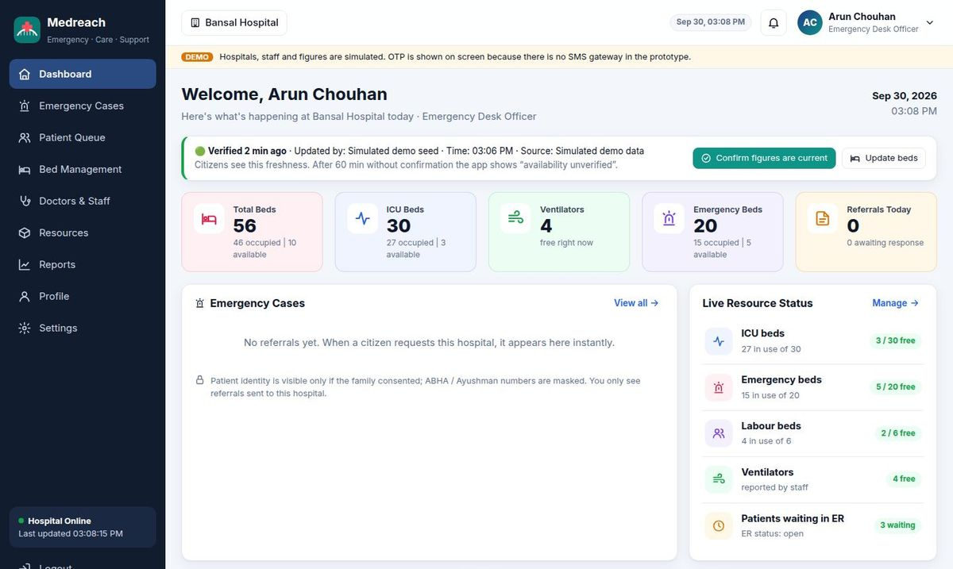
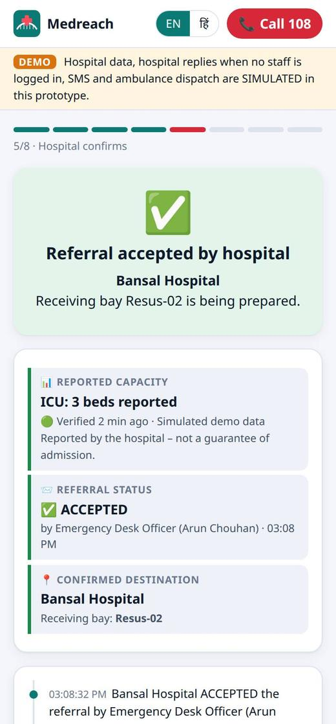
Medreach
MPOnline Idea & Innovation Hackathon 2026 · Challenge 5: AI for Public Services, Healthcare
Get the right hospital to say yes before the patient leaves home
Medreach is a working emergency-coordination system for Madhya Pradesh. A family describes the emergency in Hindi or English. We find a hospital that can treat it right now, the hospital accepts and prepares a bed, and the ambulance is tracked until arrival.
Screens from our running prototype: the hospital dashboard (back) and the citizen app after Bansal Hospital accepted a referral (front).
Live prototype medreach-wtne.onrender.com
Source code github.com/prakharporwal518-collab/Medreach
Notes:
Opening line: Medreach is not a concept. Everything on these slides is from the prototype that is live today.

Slide 2
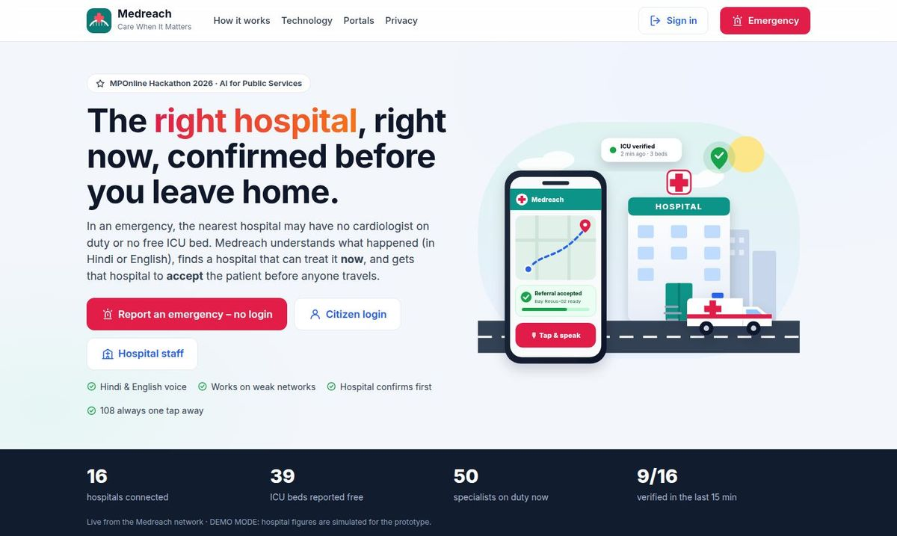
What Medreach does, and who it is for
01 INTRODUCTION
Medreach is an emergency coordination platform, not a diagnosis app. It joins three people who today work blind: the family in panic, the hospital emergency desk, and the health department.
Citizens and families
Speak the emergency, see only hospitals that can treat it, get a confirmed bed and a tracking link for relatives. No login needed. “I’m alone” mode for people living alone.
Hospital emergency desks
A verified board of beds, ICU, ventilators and doctors on duty. Referrals arrive with an AI-written pre-arrival (SBAR) note; one tap to accept and assign a bay.
Health department, Govt. of MP
Our home page, with live network figures (demo data is labelled as simulated).
A live, audited view of emergency capacity across hospitals, and data on where patients are refused or delayed.
Live
2
16
7 of 7
51
deployed and running on the web
private portals
Bhopal-region hospitals modelled
suggested technologies used
automated tests passing
Notes:
Stress that the three users see different, private views. Citizens never see other patients; hospitals only see referrals sent to them.

Slide 3
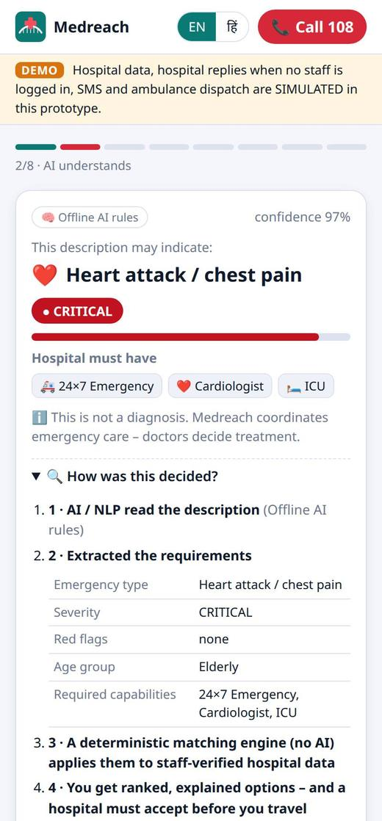
11 pm in Bhopal: one emergency, two outcomes
02 SCENARIO
A 62-year-old man has chest pain and is sweating. His son has a phone and a car.
Today
11:00
11:25
11:35
12:05
Family drives to the nearest hospital, chosen only by distance
At the gate: no cardiologist on duty, ICU full
Back in the car to a second hospital across the city
Arrives. The ER was not expecting him
With Medreach
11:00
11:01
11:03
11:16
Son says: “Papa ko seene mein dard hai, pasina aa raha hai”
App: possible heart attack, CRITICAL; needs cardiologist + ICU
Bansal Hospital accepts and prepares bay Resus-02
Ambulance arrives (ETA 13 min); ER has already read the note
One trip instead of two, and a team that is ready on arrival. Times are illustrative; the 13-minute ETA and bay come from our prototype run.
What the son sees about a minute after speaking.
Notes:
Walk through both rows left to right. The point: the family never has to guess, and the hospital is never surprised.

Slide 4
Why patients lose the golden hour
03 OVERVIEW OF THE PROBLEM
1,68,491
01
Nearest is not capable
02
No trusted live status
Maps show distance, not whether the cardiologist is on duty, the ICU has a bed or the CT scanner works tonight.
Bed figures, where they exist, are old and have no owner or time stamp, so nobody trusts them.
people died in road accidents in India in 2022
03
No acceptance before travel
04
Panic and language
Source: Ministry of Road Transport & Highways, “Road Accidents in India 2022”.
Families arrive unannounced. Refusal happens at the gate, after the journey.
In an emergency people cannot fill forms. Many would rather speak, and in Hindi.
Road crashes are only one part. Heart attacks, strokes, burns and childbirth emergencies face the same problem: the first hospital reached is often not equipped for that case at that hour, and nobody finds out until the family arrives.
05
People living alone
06
Information is lost
An elderly person alone cannot call hospitals, arrange transport and inform family at once.
Allergies, history and Ayushman / ABHA details do not reach the ER doctor before the patient.
Who feels it
Patients & families
wasted trips, refusals, delayed treatment
Rural citizens & ASHA workers
long distances make a wrong first choice costly
Hospital ER teams
unannounced critical arrivals, crowding
Health department
no live picture of emergency capacity
Notes:
Read the statistic from the source before presenting. The six causes map one-to-one to the features on the next slides.

Slide 5
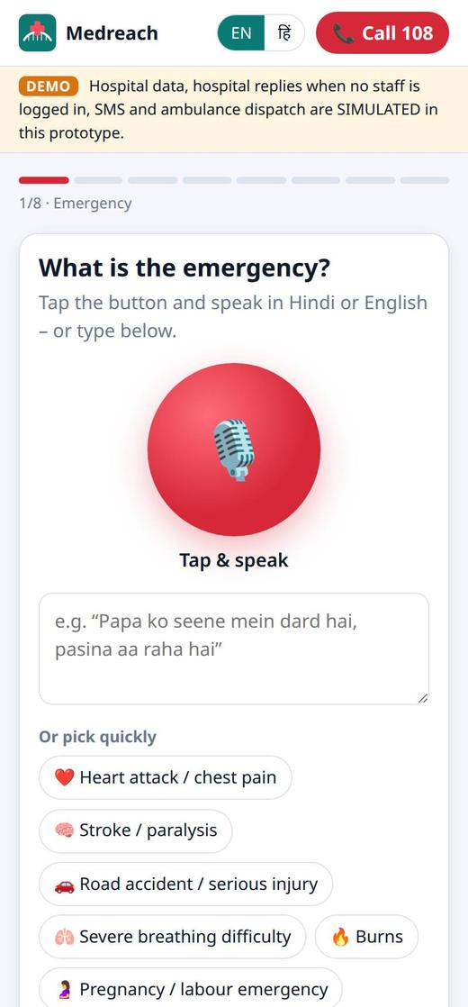
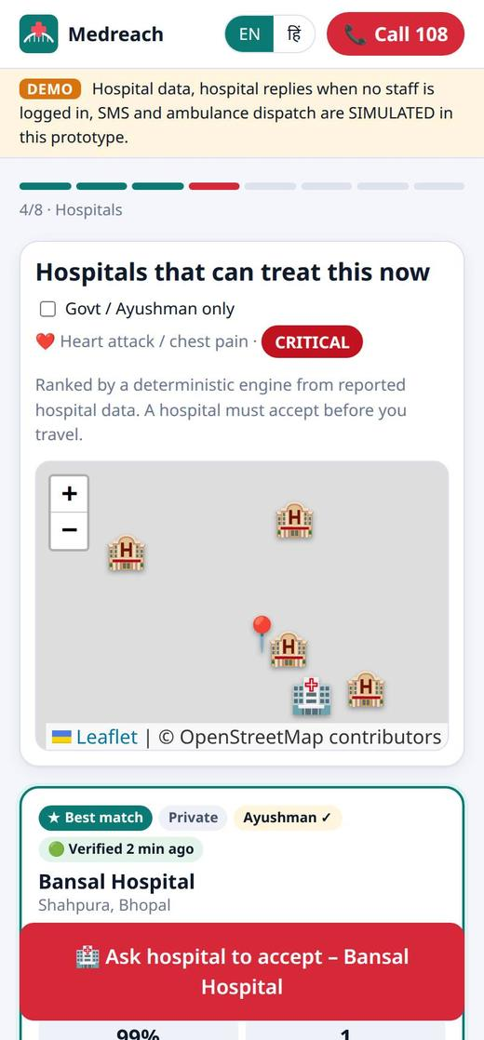
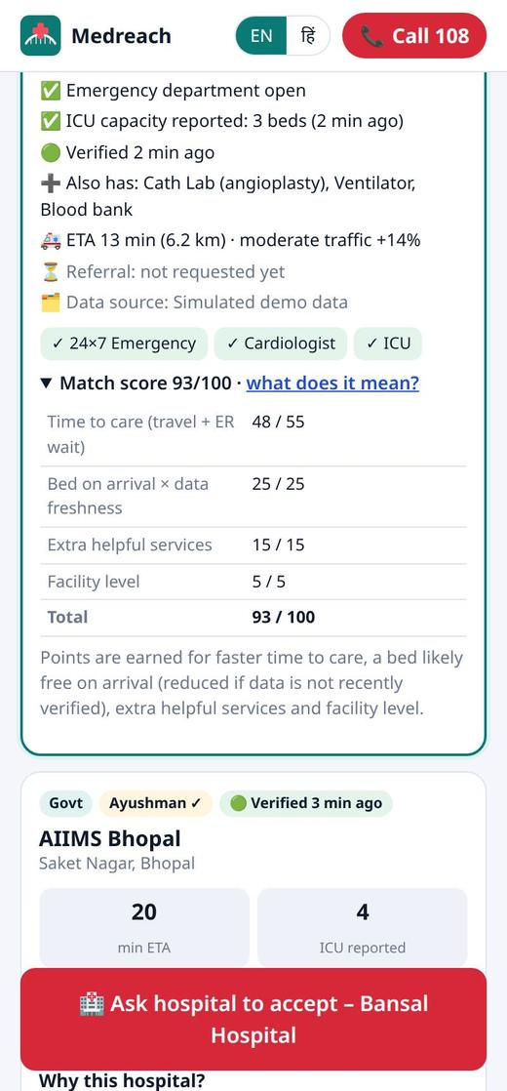
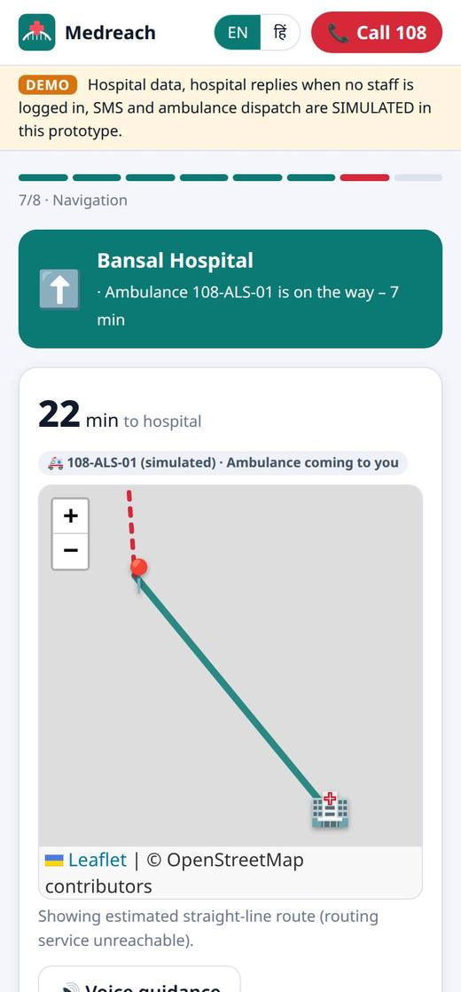
One flow, from the first words to a confirmed bed
04 SOLUTION
1
2
3
4
5
6
7
Speak or type
Understand
Match
Verify
Accept
Travel
Arrive
voice, text, photo or health card
type, severity, red flags, needs
specialist on duty, working equipment, bed
who updated each figure, and when
named officer accepts, assigns a bay
ambulance or own vehicle, live map
confirmed bed, family kept informed
Rules we never break
The hospital accepts before anyone travels.
Only hospitals that can treat the case are offered.
No answer in 60 seconds: the next hospital is asked automatically.
It never diagnoses; it says “may indicate”.
Call 108 stays on every screen.
Step 1 · Tap and speak, or pick a common emergency
Step 3 · Only hospitals that can treat this case
Step 4 · “Why this hospital?” with each score part
Step 6 · Ambulance status and navigation
Notes:
This is the flowchart from our idea, implemented. Each phone screen is a real screenshot.

Slide 6
How it is built
05 TECHNICAL APPROACH
Citizen app
Family link
Hospital desk
Technology | What it does in Medreach
Generative AI | Turns “papa ko seene mein dard…” into requirements; writes the ER note
Voice bots | Hindi / English speech in; acceptance and directions read aloud
Computer vision | Photo of an injury → visible findings that can raise urgency
OCR | Reads Ayushman / ABHA cards on the phone; shared only with consent
Predictive analytics | Traffic ETA, chance a bed is still free on arrival, 8-hour ER forecast
Conversational AI | Asks one follow-up question at a time (conscious? breathing?)
Mobile app | Installable PWA, bilingual, works on weak networks
PWA · voice · photo · OCR · offline
status, hospital, ETA only
referrals · beds · live map
Medreach server (Node.js + Express)
REST API + live updates (SSE) · Hospital ID + Staff ID + OTP login with 4 roles · case store · audit log · consent · 24-hour deletion
Shared engines
Claude (optional)
triage · matching · prediction. Same code runs on the phone, so it works offline.
reads free text and photos, writes the SBAR note. Rules engine is the fallback.
Built with: Node.js 22 · Express 5 · PWA + service worker · Leaflet with OpenStreetMap (no API keys) · Tesseract.js · Web Speech API · Claude SDK · 51 automated tests
Live-mode integrations: Health Facility Registry · hospital HMIS · 108 control room · ABDM · SMS gateway
Ranking: time to care (55 pts) + bed free on arrival × data freshness (25) + helpful services (15) + facility level (5). Safety: severity = max(AI, rules); AI never picks the hospital.
Notes:
Stack: Node.js 22, Express 5, PWA, Leaflet with free OpenStreetMap tiles (no API keys), Tesseract.js, Web Speech API, Claude SDK. 51 automated tests.

Slide 7
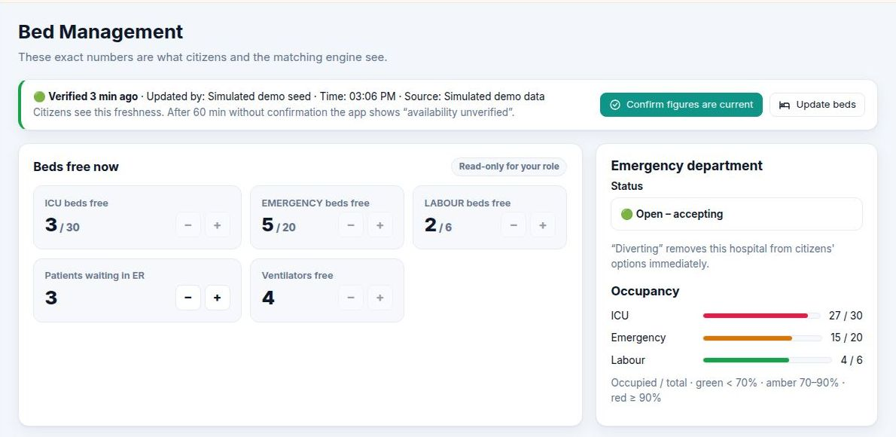
From prototype to a state-wide service
06 IMPLEMENTATION
Prototype done
Both portals live, AI triage, matching, acceptance, live maps, privacy controls, 51 tests.
Pilot in Bhopal about 3 months
Onboard a group of government and private hospitals, name a nodal officer each, train ER desks, clinical review of triage rules, SMS OTP.
Integrate about 3–6 months
Health Facility Registry, hospital HMIS feeds, 108 control room hand-off, ABDM records, encrypted database.
What a hospital keeps current: beds, ventilators, ER status. One click re-confirms the figures.
Risk | How we handle it
Hospitals stop updating | Every figure shows its age; stale data is ranked lower; one-click confirm
AI misreads a case | AI can only raise urgency; a deterministic engine decides
No hospital answers | After 60 s the next suitable hospital is asked
Weak or no network | Triage and matching run on the phone from saved data
Scale across MP about 6–12 months
District-by-district rollout, state command view, IVR / missed-call option for feature phones.
Durations are planning estimates and depend on hospital onboarding and approvals.
Notes:
Cost is low: open-source stack, free maps, one web app for every phone, AI optional. Hospitals already have emergency desks; we only ask them to keep a few numbers current.

Slide 8
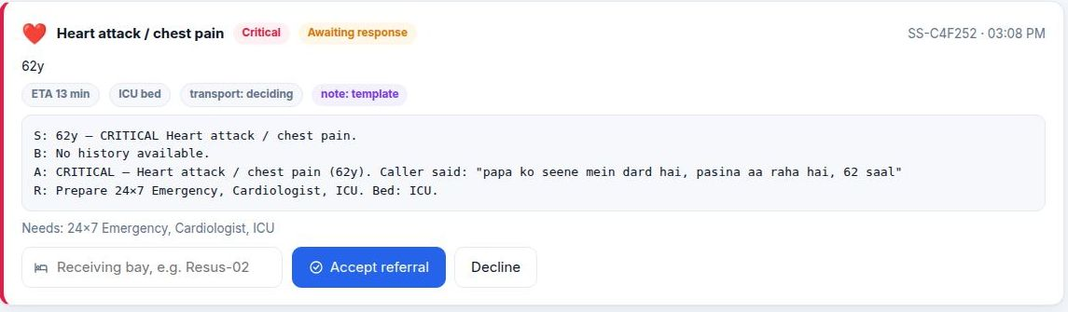
What existing tools do not do
07 INNOVATION AND DIFFERENTIATION
 | Map search | Bed portals | Helplines | Medreach
Understands a spoken emergency in Hindi | No | No | Operator | Yes
Matches specialist and equipment, not just beds | No | Beds only | Manual | Yes
Shows who updated each figure, and when | No | Rarely | No | Every figure
Hospital accepts before the family travels | No | No | Sometimes | Yes, with bay
Moves to the next hospital automatically | No | No | Manual | After 60 s
Sends a pre-arrival note to the ER doctor | No | No | No | SBAR note
Handles a person who is alone | No | No | No | “I’m alone”
1
2
1 AI-written SBAR note, built from what the son said
2 Desk officer assigns a bay and accepts in one tap
< 1 s
for a hospital’s status change to reach citizens
60 s
before the next hospital is asked
0
API keys needed for maps
We also keep three things separate on every screen: what a hospital reported, whether it accepted, and the confirmed destination. A family never mistakes “2 ICU beds” for “admitted”.
Try it: set a hospital’s ER to “Diverting” and it disappears from every family’s list immediately.
Notes:
Existing tools answer “where is the nearest hospital”. We answer “which hospital can treat this now, and has it said yes”.

Slide 9
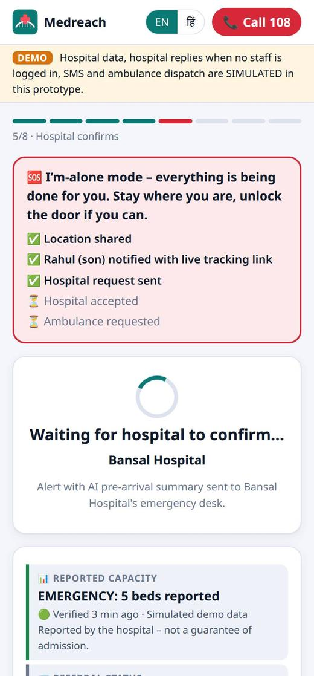
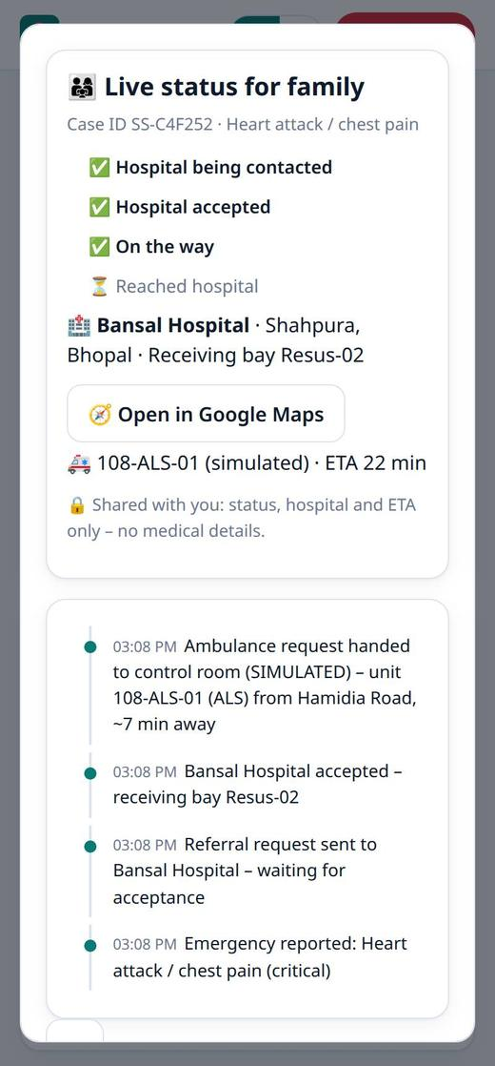
Who gains, and how we will measure it
08 IMPACT AND BENEFITS
Area | Benefit
Social | Right care the first time; equal access for rural, elderly and Hindi-speaking citizens
Economic | No repeat trips or wasted visits; better use of ICU beds and specialists
Governance | Live, audited view of emergency capacity for planning beds and ambulances
Educational | Safe first-aid steps, clear “not a diagnosis” messaging, awareness of Ayushman, ABHA, 108
User | One button, voice, two languages, clear status and a family tracking link
Health system | Fewer surprise arrivals, less ER crowding, fewer transfers between hospitals
What the pilot will measure
Measure | How we get it
Time to definitive care | From the first request to the treating hospital, from case timestamps
Transfers avoided | Patients who needed a second hospital, before vs during the pilot
Acceptance time | From referral sent to “accepted” in the audit log
“I’m alone”: one tap shares location, alerts a contact, books the hospital and an ambulance.
The family link: status, hospital and ETA. No medical details.
Notes:
Impact will be measured from our own audit log and case timestamps during the pilot, so the numbers are verifiable.

Slide 10
Why Medreach should be selected
09 WHY MEDREACH
Thank you
Reason | Evidence you can check
It solves a real, life-or-death gap | Families in MP lose the golden hour at the wrong hospital; Medreach confirms a bed before travel
It already works | Both portals are live at medreach-wtne.onrender.com; the whole flow takes about 3 minutes to try
All 7 technologies are real | Each one is in working code, listed file by file in our repository
The AI is safe and explainable | AI can only raise urgency; a tested engine decides and shows why; 108 is always on screen
Privacy is built in | Consent before sharing, masked IDs, staff OTP and roles, audit log, deletion 24 h after hand-over
It can scale cheaply | Open-source stack, free maps, one web app for all phones; clear path to HFR, HMIS, 108 and ABDM
Our ask: a 3-month pilot with a group of Bhopal hospitals, followed by integration with the Health Facility Registry, hospital HMIS, the 108 control room and ABDM for a state-wide rollout.
Live prototype: medreach-wtne.onrender.com Code: github.com/prakharporwal518-collab/Medreach Hospital demo login: Bansal Hospital · BANSAL-ED01
Notes:
Close with the ask, then offer to run the live demo.

