Slide 1

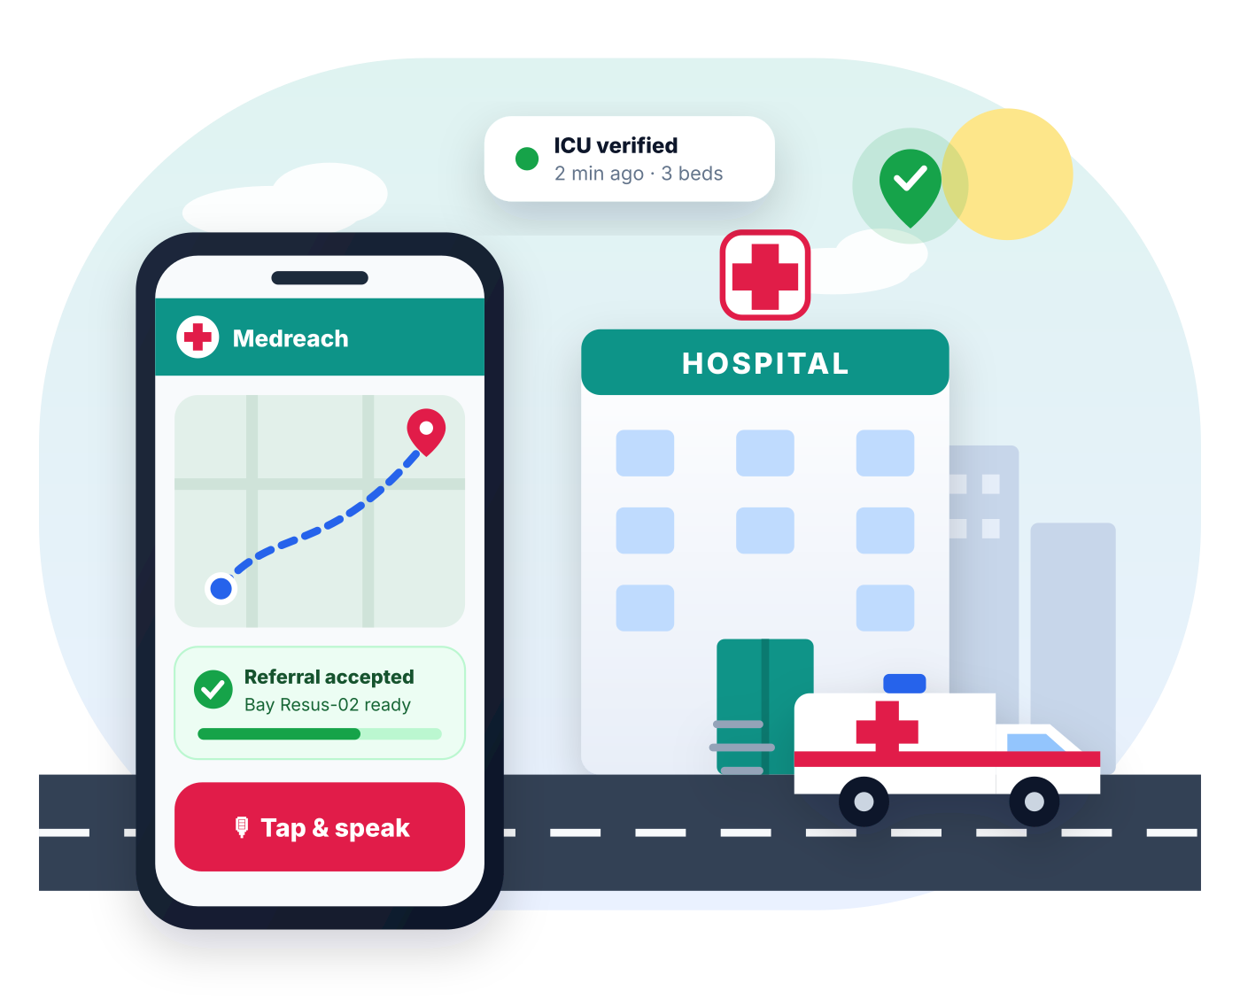
The right hospital, right now, confirmed before you leave home
Medreach
RIGHT HOSPITAL · RIGHT NOW
AI-powered emergency coordination for Madhya Pradesh: understand the emergency, find a hospital that can treat it now, get it to accept, and guide the patient there.
MPOnline Hackathon 2026
Challenge 5 · Healthcare
Team Leader: Prakhar Porwal
Live demo: medreach-wtne.onrender.com · Code: github.com/prakharporwal518-collab/Medreach
Notes:
Medreach gets an emergency patient to a hospital that can treat them right now and has already accepted them, before the family leaves home.

Slide 2




Introduction: what Medreach is
Medreach is an AI-powered emergency coordination platform for Madhya Pradesh. It understands an emergency described in Hindi, English or Hinglish, finds a hospital that can treat it right now using staff-verified data, gets that hospital to accept the patient, and guides the patient there with live tracking.
7 / 7
2
suggested technologies used
private portals: citizen & hospital
Challenge 5 · AI Innovation for Public Services & Citizen-Centric Governance · Domain: Healthcare
16
51
Citizens & families
Voice-first emergency help, no login needed, “I’m alone” mode
Bhopal-region hospitals in the demo
automated tests passing
Hospitals
Verified status board, referrals with an AI pre-arrival note
Government of MP
Live, audited view of emergency capacity across hospitals
Live and deployed: medreach-wtne.onrender.com
Notes:
Medreach is a working, deployed product, not a mock-up. It has two private portals, one for citizens and one for hospital staff, and uses all seven technologies suggested by the challenge.

Slide 3



Scenario: chest pain at 11 pm in Bhopal
A 62-year-old man has chest pain and is sweating. Here is what happens today, and what happens with Medreach.
Today
With Medreach
1
Family drives to the nearest hospital
1
Son speaks the emergency in Hindi
2
No cardiologist on duty, ICU full
2
AI: may indicate heart attack, needs cardiologist + ICU
3
Referred onward: second trip across the city
3
Bansal Hospital accepts, bay Resus-02 ready
4
ER unprepared; golden hour lost
4
Ambulance tracked live; ER read the note in advance
Result: one journey instead of two, and the hospital is ready when the patient arrives. (Illustrative scenario; time saved will be measured in the pilot.)
Notes:
The family did nothing wrong; they simply had no way to know which hospital could treat this emergency at this moment, and no hospital knew they were coming. Medreach fixes exactly that gap.

Slide 4








Overview: why patients lose the golden hour
Nearest ≠ capable
No trusted live status
Maps don’t know if the specialist is on duty, the ICU is free or the CT works now.
Availability is unpublished or outdated, with no owner and no time stamp.
1,68,491
No acceptance first
Panic & language
Families arrive unannounced; refusals happen at the gate.
Hard to type forms in panic; many prefer to speak in Hindi.
road-accident deaths in India, 2022
Source: MoRTH, “Road Accidents in India 2022”. Heart attacks, strokes, burns and obstetric emergencies add many more.
People living alone
Lost information
Cannot call hospitals, arrange transport and inform family at once.
Allergies and ABHA / Ayushman details don’t reach the ER doctor.
Who is affected
Patients & families
Rural citizens & ASHA workers
Hospital ER teams
Health department
Wasted trips, refusals, delayed care
Long distances make a wrong choice costly
Unannounced critical arrivals, crowding
No live picture of emergency capacity
Notes:
The root cause is an information gap between citizens and hospitals: capability, live status and acceptance are not available before the family travels.

Slide 5






Solution: one flow from emergency to confirmed bed
An emergency coordination platform, not a diagnosis app. Every step of our flowchart is implemented and live.
1
2
3
4
5
6
7
Emergency
AI understands
Match
Verify
Accepted
Transport
Arrival
Speak, type, photo or scan a health card
Type, severity, red flags, needed capabilities
Specialist on duty, equipment working, bed
Freshness: who updated, and when
Named officer accepts, assigns a bay
Ambulance or own vehicle, live map
Confirmed destination, family informed
Hindi · English · Hinglish
Only capable hospitals
Accepted before travel
60 s auto-fallback
Voice-first, built for panic
Deterministic, explainable matching
No refusals at the gate
No answer → next hospital asked
Notes:
Medreach implements the flowchart end to end: emergency, AI understanding, location, capability matching with current status, ETA, hospital confirmation, transport, navigation and confirmed arrival.

Slide 6
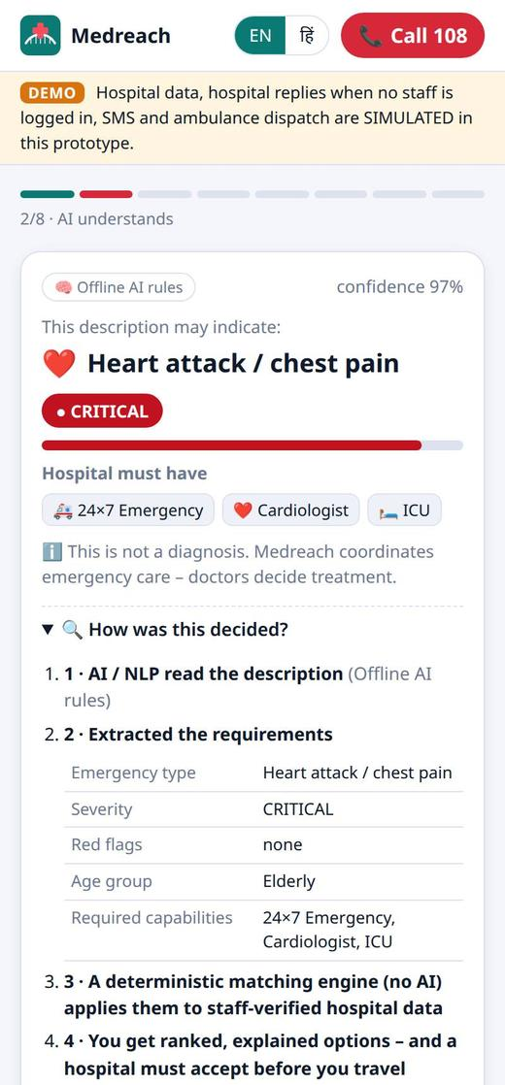
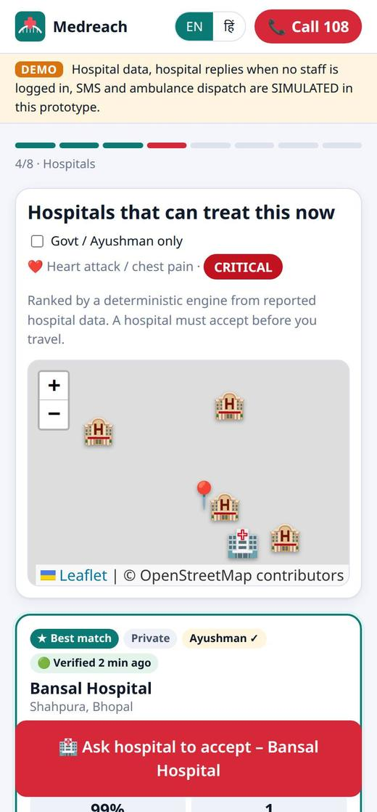
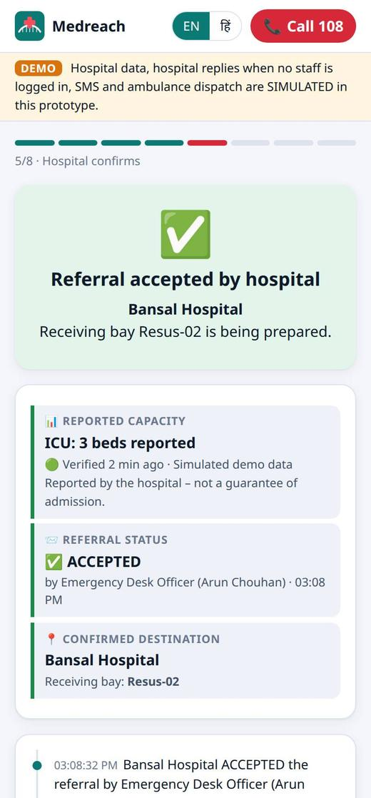
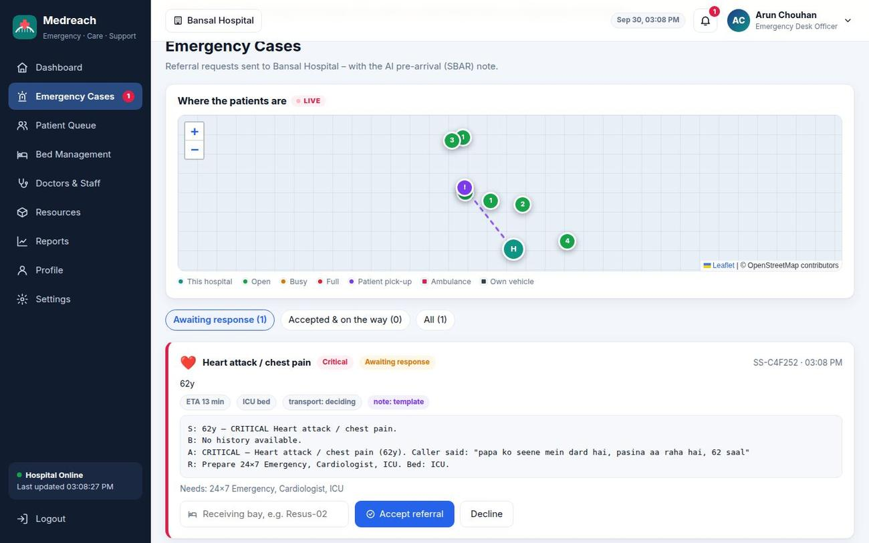
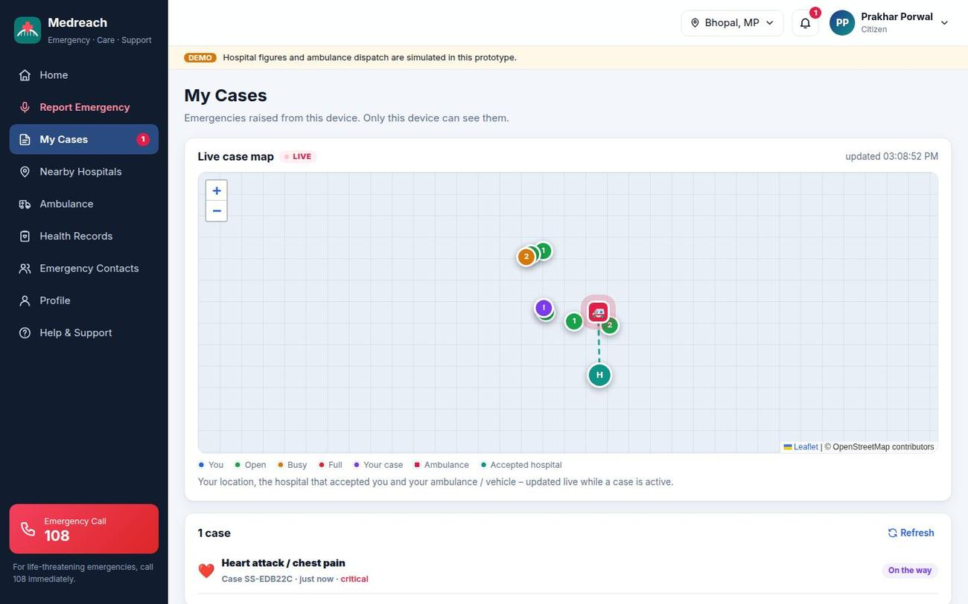
Solution in action: citizen and hospital
Hospital reviews the AI pre-arrival note and accepts with a receiving bay
AI understands
Capable hospitals
Accepted
May indicate heart attack · CRITICAL
Ranked from verified data
Named officer, bay Resus-02
Citizen dashboard: live map, ambulance on the way to the accepted hospital
Notes:
Left: what the family sees on the phone. Right: the hospital accepts with a receiving bay, and the citizen dashboard shows the ambulance moving live to that hospital.

Slide 7







Technical approach: architecture and AI
All 7 technologies in code
Citizen PWA
API layer
Generative AI
Voice · photo · OCR · offline
One set of routes & rules
Claude (optional)
Generative AI requirements + SBAR note
Voice Bots Hindi / English in and out
Family link
Auth & roles
Shared engines
Status · hospital · ETA only
Hospital ID + Staff ID + OTP
Triage · match · predict
Computer Vision photo of injury → findings
OCR Ayushman / ABHA card on phone
Hospital dashboard
Case store
Live mode
Referrals · beds · live map
Live events · audit · consent
HFR · HMIS · 108 · ABDM
Predictive Analytics ETA, bed-on-arrival, forecast
Conversational AI one follow-up at a time
REST + live updates (SSE) over HTTPS · shared engines also run on the phone, so triage works offline
Mobile App offline, bilingual PWA
AI understands; rules decide. Severity = max(AI, rules), so AI can never lower urgency. A deterministic, tested engine chooses the hospital.
Notes:
Stack: installable PWA, Node.js and Express with Server-Sent Events, Claude via the official SDK with the rules engine as floor and fallback, Leaflet with free OpenStreetMap tiles, Tesseract.js OCR on the device and the Web Speech API.

Slide 8








Implementation: from prototype to statewide
Prototype
Pilot · Bhopal
Integrate
Scale · MP
Done
~3 months
~3–6 months
~6–12 months
Both portals live, AI triage, matching, acceptance, live maps, 51 tests
Onboard hospitals, nodal officers, ER desk training, clinical review, SMS OTP
Health Facility Registry, HMIS, 108 control room, ABDM, encrypted database
District-by-district rollout, state command view, IVR for feature phones
Integrations for live mode
Risk | Mitigation
Hospitals don’t update data | Freshness on every figure, stale ranked lower, one-click confirm
Wrong AI reading | AI only raises urgency; deterministic matching; 108 always visible
No hospital answers | 60 s timeout → next suitable hospital
Weak network | Offline PWA runs triage & matching on the phone
NHA Health Facility Registry
Hospital HMIS feeds
108 control room (CAD)
ABDM / ABHA records
SMS gateway (OTP, alerts)
OpenStreetMap, no API keys
Notes:
Feasibility: open-source stack, free maps, one PWA for every phone, AI optional. Hospitals already have emergency desks; staff only confirm figures. Durations are planning estimates.

Slide 9




Innovation: what makes Medreach different
Capability | Map search | Bed portals | Helplines | Medreach
Understands the emergency (voice, Hindi) | No | No | Operator | AI + voice
Matches capability (specialist, equipment) | No | Beds only | Manual | Yes
Shows freshness & who updated data | No | Rarely | No | Every figure
Hospital accepts before travel | No | No | Sometimes | Yes + bay
Automatic fallback to next hospital | No | No | Manual | 60 s
AI pre-arrival note for ER doctor | No | No | No | SBAR note
Help for a person living alone | No | No | No | “I’m alone”
Three truths kept separate
Reported capacity ≠ referral accepted ≠ confirmed destination.
Explainable score
“Why this hospital?” checklist first; every score part shown.
Privacy by design
Consent, masked IDs, audit log, deletion 24 h after hand-over.
Live proof: when a hospital sets its ER to “Diverting”, it disappears from every citizen’s list within a second.
Offline-first
Same engines run on server and phone; works on weak networks.
Notes:
Existing tools answer “where is the nearest hospital”. Medreach answers “which hospital can treat this now, and has it said yes?”

Slide 10









Impact and benefits
Social
Economic
Governance
Benefits by stakeholder
Right care the first time; equal access for rural, elderly and Hindi-speaking citizens
No repeat trips or wasted visits; better use of ICU beds and specialists
Live, audited view of emergency capacity for planning beds and ambulances
Patient
Treated sooner, bay ready
Family
Live link, no medical data
Educational
User
Health system
ER team
Advance notice + AI note
Safe first-aid steps, “not a diagnosis” clarity, awareness of Ayushman, ABHA, 108
One button, voice, bilingual, clear status and a family tracking link
Fewer surprise arrivals, less ER crowding, fewer inter-hospital transfers
Government
Audited capacity data
108 service
Destination already accepted
Pilot KPIs: time to definitive care · secondary transfers avoided · referral acceptance time · data freshness
ASHA workers
Raise an emergency by voice
Notes:
Impact will be measured in the Bhopal pilot with these KPIs.

Slide 11



Why should Medreach be selected?
Thank you
Real, urgent problem
Working, deployed product
All 7 technologies
Solves a life-or-death gap for citizens of Madhya Pradesh: the right hospital, the first time.
Both portals live on the web today, not slides or a mock-up.
Generative AI, voice, vision, OCR, predictive and conversational AI in a mobile app.
Safe & explainable AI
Privacy by design
Ready to scale
AI can only raise urgency; a tested engine decides and explains why.
Consent, masked IDs, audit logs and 24-hour deletion; DPDP Act aligned.
Clear pilot plan and integration path to HFR, HMIS, 108 and ABDM.
Live demo: medreach-wtne.onrender.com Code: github.com/prakharporwal518-collab/Medreach Hospital login: Bansal Hospital · BANSAL-ED01
Notes:
Ask: support to pilot Medreach with a group of Bhopal hospitals for three months, then integrate the Health Facility Registry, hospital systems, the 108 control room and ABDM for state-wide rollout.

