Slide 1

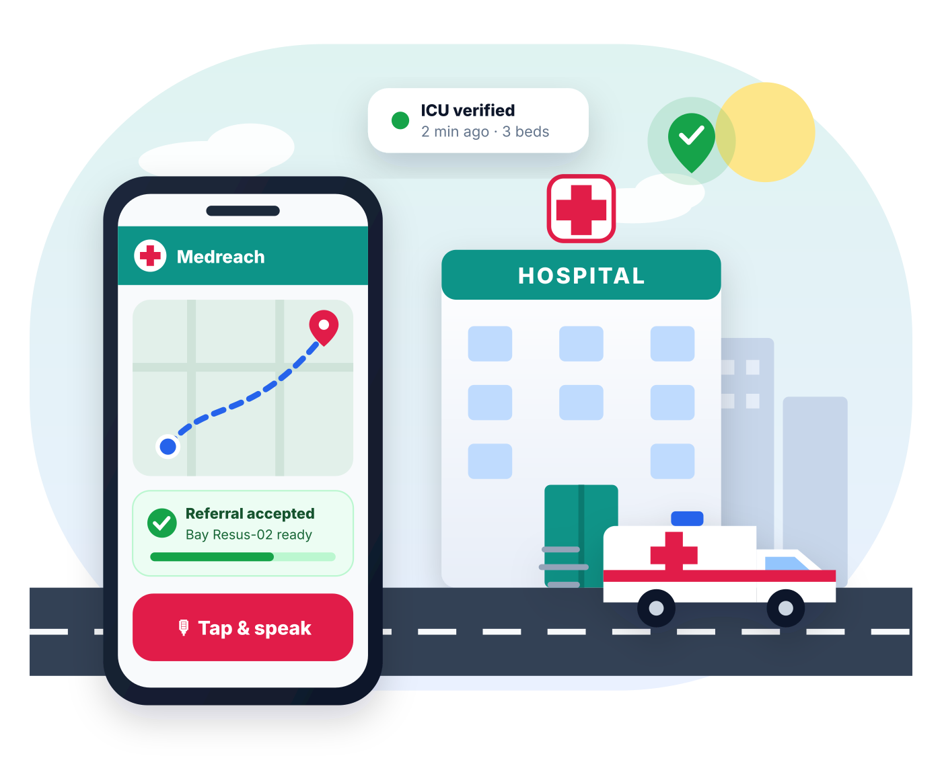
The right hospital, right now, confirmed before you leave home
Medreach
RIGHT HOSPITAL · RIGHT NOW
AI-powered emergency coordination for Madhya Pradesh: understand the emergency, find a hospital that can treat it now, get it to accept, and guide the patient there.
MPOnline Hackathon 2026
Challenge 5 · Healthcare
Team Leader: Prakhar Porwal
Live demo: medreach-2.onrender.com · Code: github.com/prakharporwal518-collab/Medreach
Notes:
Medreach gets an emergency patient to a hospital that can treat them right now and has already accepted them, before the family leaves home. It is a working, deployed product built for Challenge 5 (Healthcare).

Slide 2




The nearest hospital is not always the right one
11 pm, Bhopal. A 62-year-old man has chest pain. His family rushes to the nearest hospital, where there is no cardiologist on duty and no free ICU bed. They are sent across the city, and the golden hour is lost.
Nearest ≠ capable
No trusted live status
Maps show the closest hospital, not whether the specialist is on duty, the ICU is free or the CT scanner works now.
Bed and doctor availability is unpublished or outdated, with no owner and no time stamp.
1,68,491
road-accident deaths in India, 2022
No acceptance first
Panic & living alone
Source: MoRTH, “Road Accidents in India 2022”. Heart attacks, strokes, burns and obstetric emergencies add many more time-critical cases.
Families arrive unannounced; hospitals cannot prepare and refusals happen at the gate.
Hard to type, call hospitals, arrange transport and inform family, especially for elderly people alone.
Notes:
The problem is an information gap. Nobody tells the family in advance which hospital can treat this emergency at this moment, and no hospital knows they are coming. The 2022 MoRTH figure shows the scale for road accidents alone.

Slide 3







One flow from emergency to confirmed bed
An emergency coordination platform, not a diagnosis app. Every step of our flowchart is implemented and live.
1
2
3
4
5
6
7
Emergency
AI understands
Match
Verify
Accepted
Transport
Arrival
Speak, type, photo or scan a health card
Type, severity, red flags, needed capabilities
Specialist on duty, equipment working, bed
Freshness: who updated, and when
Named officer accepts, assigns a bay
Ambulance or own vehicle, live map
Confirmed destination, family informed
Hindi · English · Hinglish
Only capable hospitals
Accepted before travel
60 s auto-fallback
Voice-first, built for panic
Deterministic, explainable matching
No refusals at the gate
No answer → next hospital asked
Notes:
Medreach implements the flowchart end to end: emergency, AI understanding, location, capability matching with current status, distance and ETA, hospital confirmation, transport, navigation and confirmed arrival.

Slide 4
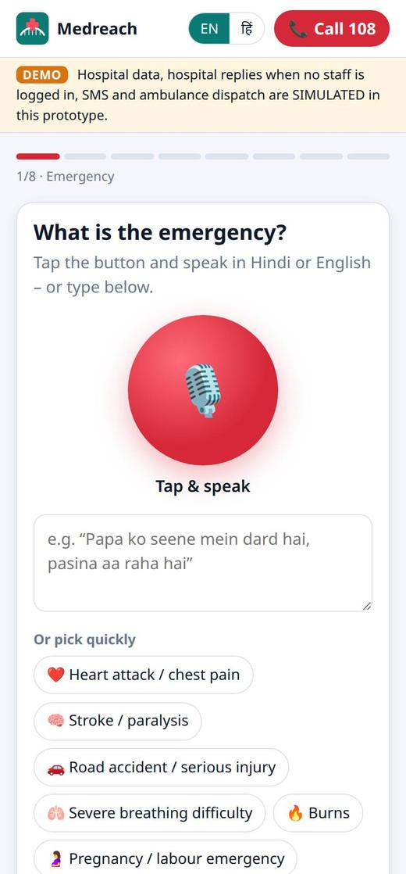
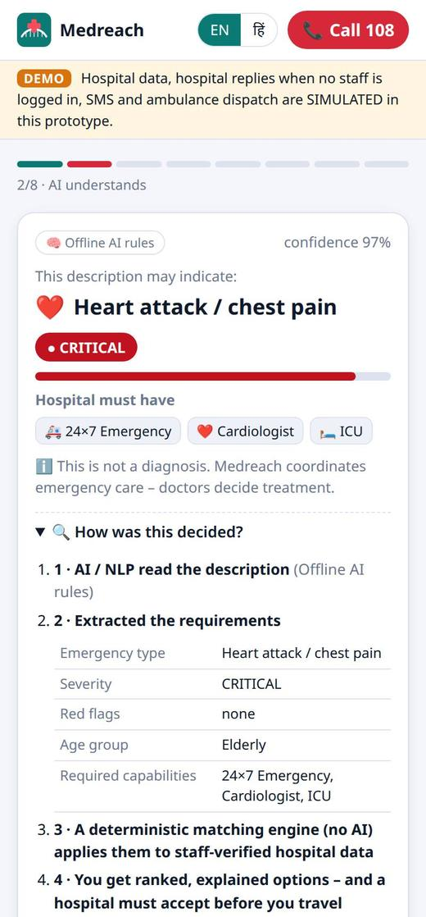
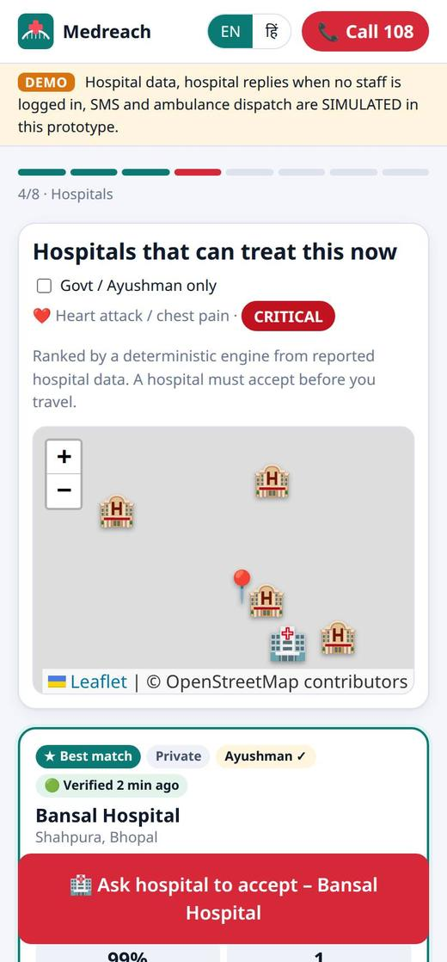
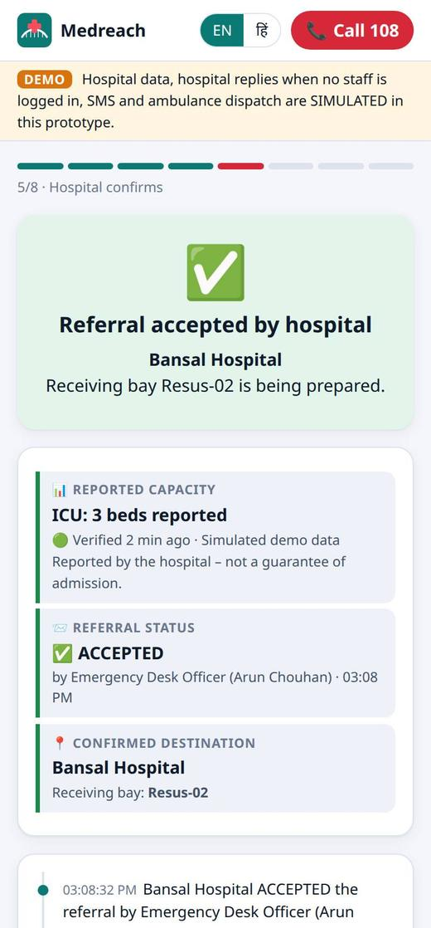




For citizens: speak, choose, get accepted
What the citizen gets
Voice in Hindi & English
“How was this decided?” explained
Call 108 always one tap away
1 · Speak or type
2 · AI understands
3 · Capable hospitals
4 · Accepted
Works offline & on weak networks
Hindi or English voice, quick picks, photo and health-card scan
“May indicate heart attack · CRITICAL · needs cardiologist + ICU”
Ranked from staff-verified data, with “Why this hospital?”
Named officer accepts, receiving bay Resus-02 ready
Notes:
Demo line: “Papa ko seene mein dard hai, pasina aa raha hai, 62 saal”. The app says “this may indicate” a heart attack, marks it critical and lists the capabilities a hospital must have. It never diagnoses.

Slide 5
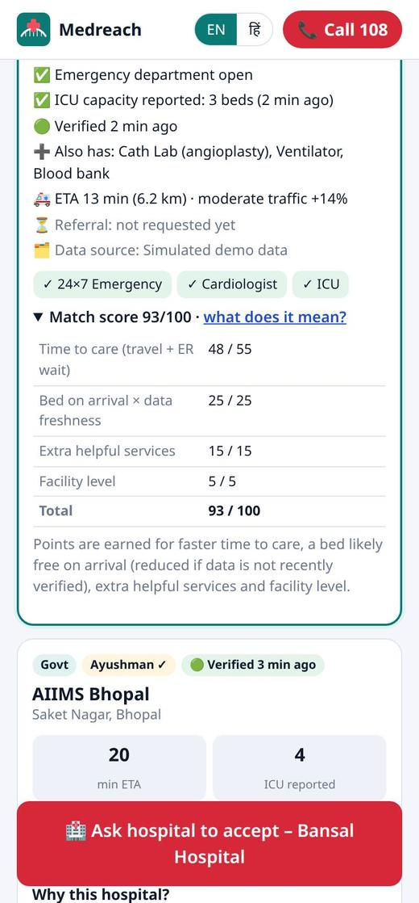



Capability-first matching you can trust
Must-have capabilities
A hospital qualifies only if the service exists, the specialist is on duty and the machine works now.
Freshness on every figure
Every number shows who updated it and when. Stale data is never shown as confirmed.
Safe, explainable AI
AI only understands; a deterministic engine decides. Severity = max(AI, rules), so AI can never lower urgency.
Verified < 15 min
15–60 min: may have changed
Score parts always add up to the total (tested). Predictive analytics: traffic-aware ETA, Poisson bed-on-arrival, ER wait.
Unverified: ranked lower
“Why this hospital?” in the app
Notes:
The AI never picks the hospital. It extracts requirements; then a deterministic, tested engine ranks hospitals on time to care, bed likely free on arrival weighted by data freshness, extra services and facility level. Live demo: set ER to Diverting and the hospital disappears from citizens’ lists within a second.

Slide 6
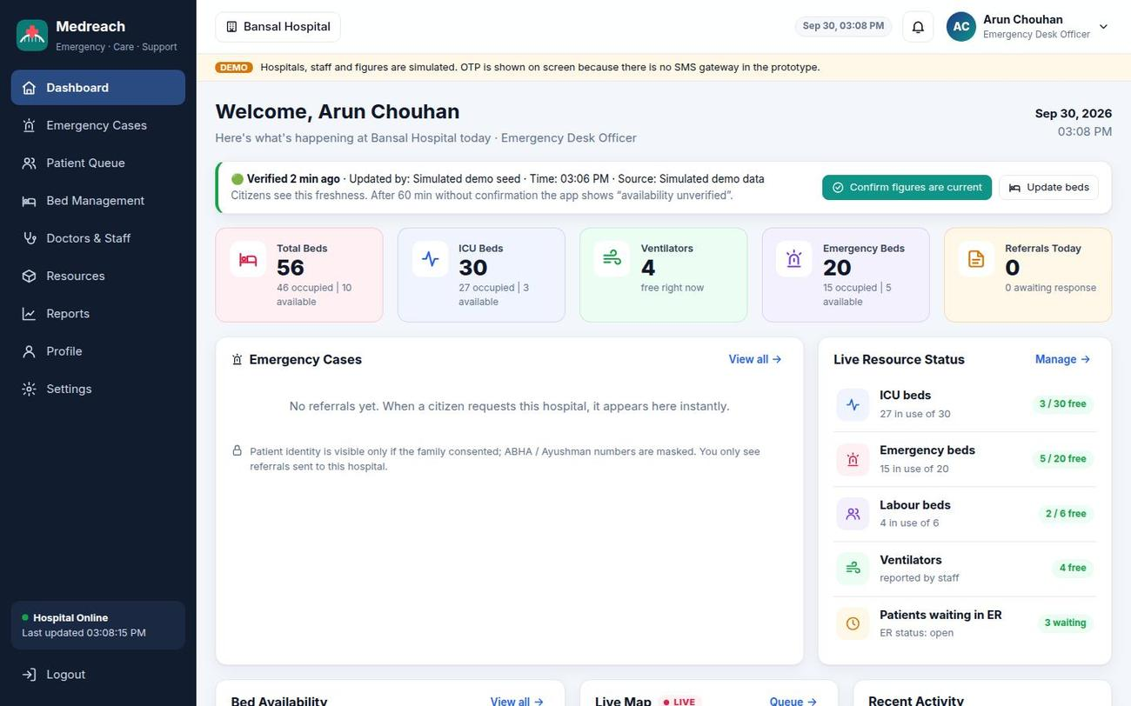




For hospitals: verified status, accept in one tap
AI pre-arrival SBAR note
Situation, Background, Assessment, Recommendation before the patient arrives.
Accept + receiving bay
Named officer accepts and assigns e.g. Resus-02; citizen sees it instantly.
60-second auto-fallback
Decline or no answer → next suitable hospital is asked automatically.
Staff-only, audited
Hospital ID + Staff ID + OTP; 4 roles; every action in the audit log.
Hospital dashboard: beds, ICU, ventilators and referrals, each with “updated by / time / source”
Notes:
Only authorised staff can change what citizens see. Roles: Nodal Officer, Emergency Desk Officer, Resource Manager and State Health Admin. One click on “Confirm figures are current” re-verifies data, which keeps freshness high with little effort.

Slide 7
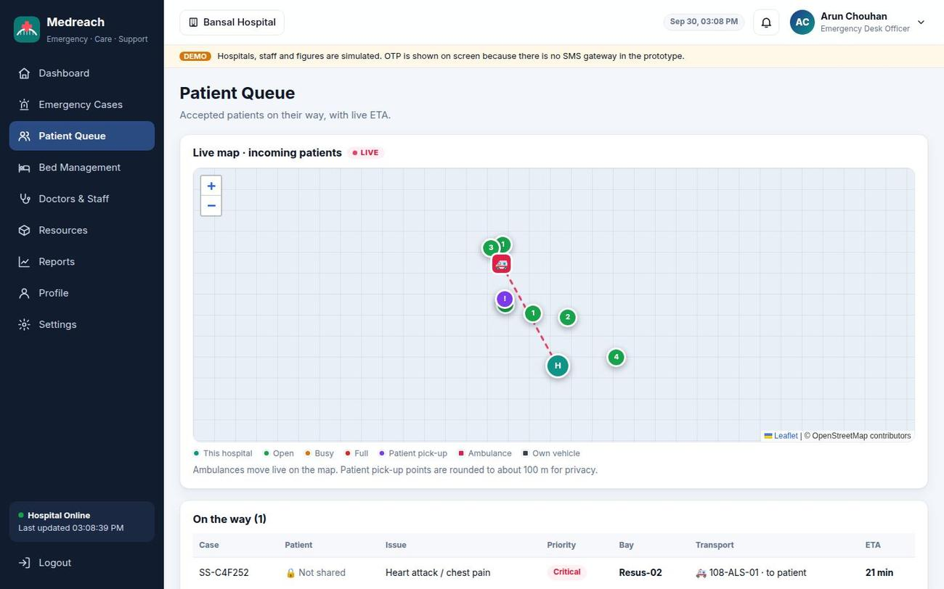
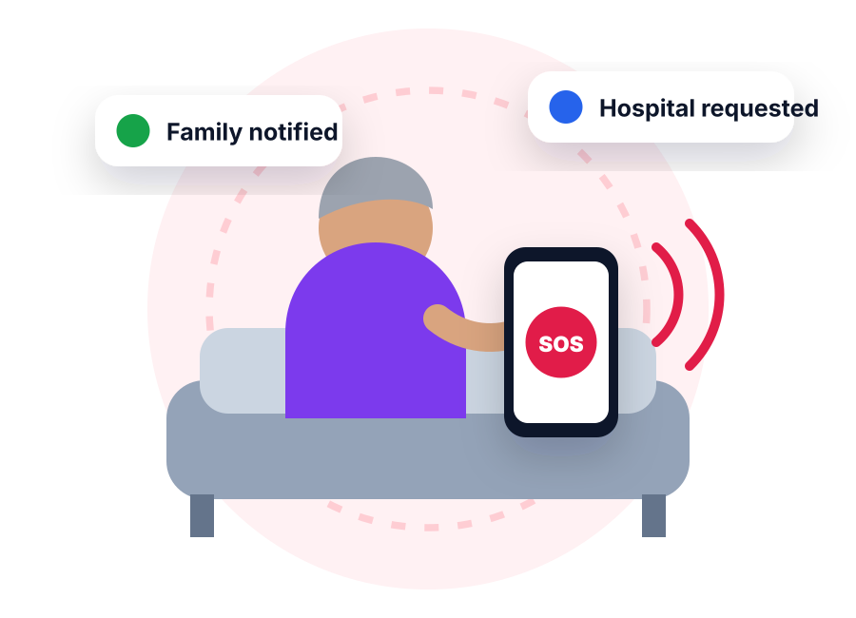


Live tracking, family link and “I’m alone” mode
“I’m alone” mode
One tap does every step for someone who cannot make calls.
1
Location shared
2
Trusted contact alerted with a tracking link
3
Hospital request sent with “patient is ALONE”
4
Hospital accepted, bay prepared
Hospital Patient Queue: incoming patient, moving ambulance and live ETA
5
Ambulance requested
Ambulance or own vehicle
Free maps, no API keys
Family link: no medical data
Notes:
Both dashboards show live maps: citizens see their ambulance moving to the accepted hospital; hospitals see incoming patients with ETA. Pick-up points are rounded to about 100 m for privacy. The family link shows status, hospital and ETA only.

Slide 8






All 7 suggested technologies, working in the product
Generative AI
Voice Bots
Computer Vision
OCR
Claude turns messy text into requirements and writes the SBAR note
Speak in Hindi / English; key steps are read aloud
Photo of injury → visible findings that can raise urgency
Ayushman / ABHA card read on the phone, shared only with consent
server/llm.js
public/js/voice.js
public/js/vision.js
public/js/ocr.js
Predictive Analytics
Conversational AI
Mobile App
Plus: live maps
Traffic ETA, bed-on-arrival odds, ER wait, 8-hour forecast
One follow-up question at a time; severity updates live
Installable PWA, bilingual, works offline
Citizen + hospital maps on free OpenStreetMap
shared/predict.js
shared/triage.js
public/sw.js
public/js/livemap.js
Design principle: AI understands the citizen; a deterministic, explainable engine chooses the hospital from staff-verified data. Offline? The rules engine and PWA keep working.
Notes:
Every suggested technology is used in working code, not just mentioned. The shared engines run on both the server and the phone, which is why the app still understands an emergency without internet.

Slide 9












Impact for people, hospitals and the state
Social
Economic
Governance
Privacy & security by design
Right care the first time; equal access for rural, elderly and Hindi-speaking citizens
No repeat trips or wasted visits; better use of ICU beds and specialists
Live, audited view of emergency capacity for planning beds and ambulances
Consent before sharing patient details
ABHA / Ayushman IDs masked
Educational
User
Health system
Staff OTP login and roles
Safe first-aid steps, “not a diagnosis” clarity, awareness of Ayushman, ABHA, 108
One button, voice, bilingual, clear status and a tracking link for family
Fewer surprise arrivals, less ER crowding, fewer inter-hospital transfers
Audit log of every action
Details deleted 24 h after hand-over
Pilot KPIs: time to definitive care · secondary transfers avoided · referral acceptance time · data freshness
Aligned with the DPDP Act 2023
Notes:
Impact is measured in the pilot with these KPIs. Trust comes from the privacy model: consent, masking, hospital-scoped access, audit logs and automatic deletion.

Slide 10




Built today, ready to pilot in Bhopal
Thank you
Prototype
Pilot · Bhopal
Integrate
Scale · MP
Done
~3 months
~3–6 months
~6–12 months
Both portals live, AI triage, matching, acceptance, live maps, 51 tests
Onboard hospitals, nodal officers, ER desk training, clinical review
Health Facility Registry, hospital HMIS, 108 control room, ABDM, SMS
District-by-district rollout, state view, IVR for feature phones
Why Medreach should be selected
Real, urgent problem
Working product
Safe & honest
Ready to scale
Life-or-death gap for MP citizens
Deployed, 7/7 technologies, 51 tests
Explainable, private, data labelled
HFR, HMIS, 108, ABDM integration
Live demo: medreach-2.onrender.com Code: github.com/prakharporwal518-collab/Medreach Hospital login: Bansal Hospital · BANSAL-ED01
Notes:
Ask: support to pilot Medreach with a group of Bhopal hospitals for three months, then integrate the Health Facility Registry, hospital systems, the 108 control room and ABDM for state-wide rollout.

