Slide 1

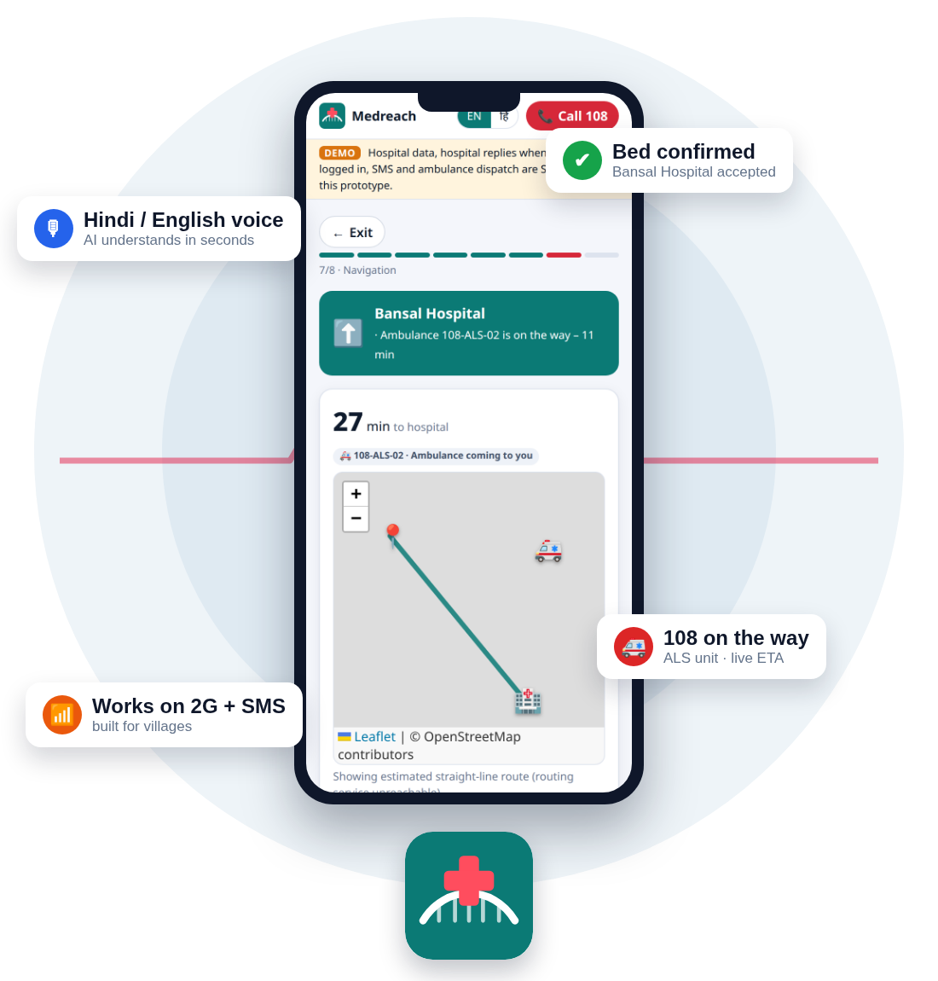




MPONLINE IDEA & INNOVATION HACKATHON 2026
MEDREACH
Emergency care
TITLE PAGE · INTRODUCTION
Challenge – 5: Healthcare
Problem Statement – Emergency patients lose the golden hour – families cannot see which hospital can treat them right now, and citizens, hospitals and 108 are not connected.
Solution Title – MEDREACH – AI-powered emergency coordination for Madhya Pradesh, integrated with the 108 / 102 national ambulance services
Theme – Healthcare · Emergency response
Category – Software (web app + integrations)
Team Name – [ TEAM MEDREACH ]
Live Prototype – medreach-2.onrender.com
Hindi voice AI
Accept before travel
108 / 102 linked
2G · SMS · offline
The right hospital, right now – confirmed before you leave home.
Team Medreach
Notes:
Title page. Medreach finds the right hospital for an emergency, gets the hospital to accept before the family travels, and hands the case to 108. Everything shown is from the live prototype.

Slide 2
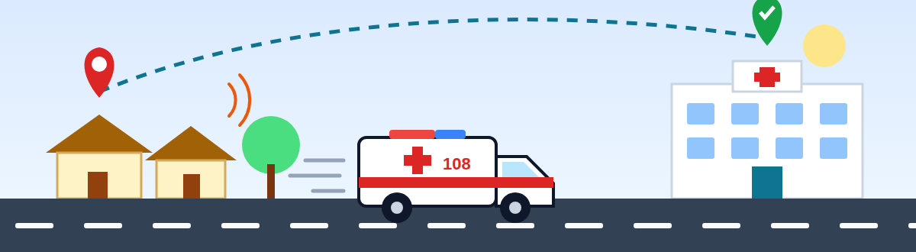
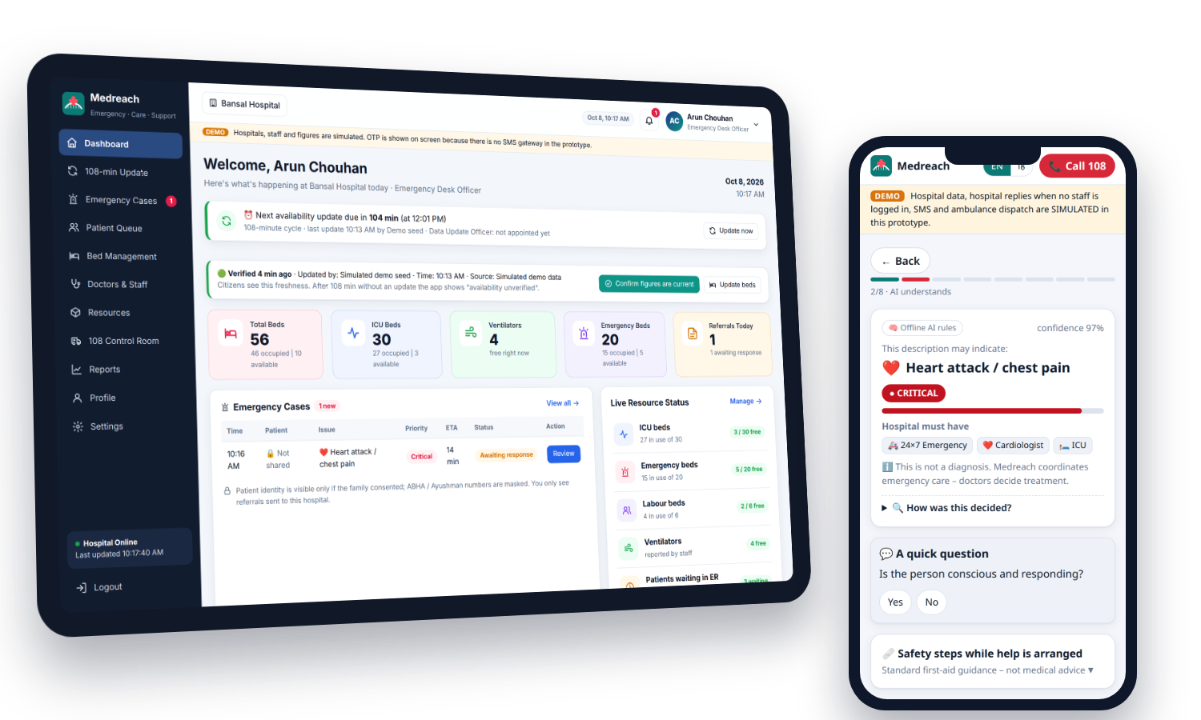


SCENARIO
TEAM
MEDREACH
MPONLINE
HACKATHON
2026
THE EMERGENCY
From Guesswork to Guaranteed Care
WHAT MEDREACH DOES
Right hospital | Confirmed bed | 108 linked
✦ 9:40 PM, a village near Berasia: Ramesh’s father (58) has chest pain and sweating.
✦ Only 2G works; the town hospital is 25 km away.
✦ Nobody knows which hospital has a cardiologist and a free ICU bed tonight.
✦ Calling 108 means repeating the address on a weak line.
✦ Understands Hindi or English voice in seconds.
✦ Shows only hospitals with the right specialist, bed and blood – live.
✦ Hospital accepts and reserves a bay before the family leaves.
✦ Hands the case to 108 / 102 and tracks the ambulance.
Today
With Medreach
1
FINDING A HOSPITAL
Drive to the nearest one
Only hospitals that can treat it
2
CONFIRMING A BED
Refused at the gate
Hospital accepts first
3
CALLING 108
Repeat address, call drops
Signed incident sent
Why Medreach?
4
INFORMING THE ER
Arrives unannounced
AI pre-arrival note
5
TRACKING
Right hospital
Accept first
108 linked
Works on 2G
Secure data
No idea where it is
Live map + ETA
The Result Guesswork → Confirmed bed
Every emergency, a confirmed bed
Notes:
Illustrative scenario. Left: what happens today. Centre: each step of the emergency, today versus with Medreach. Bottom-left: the real hospital dashboard and citizen app.

Slide 3
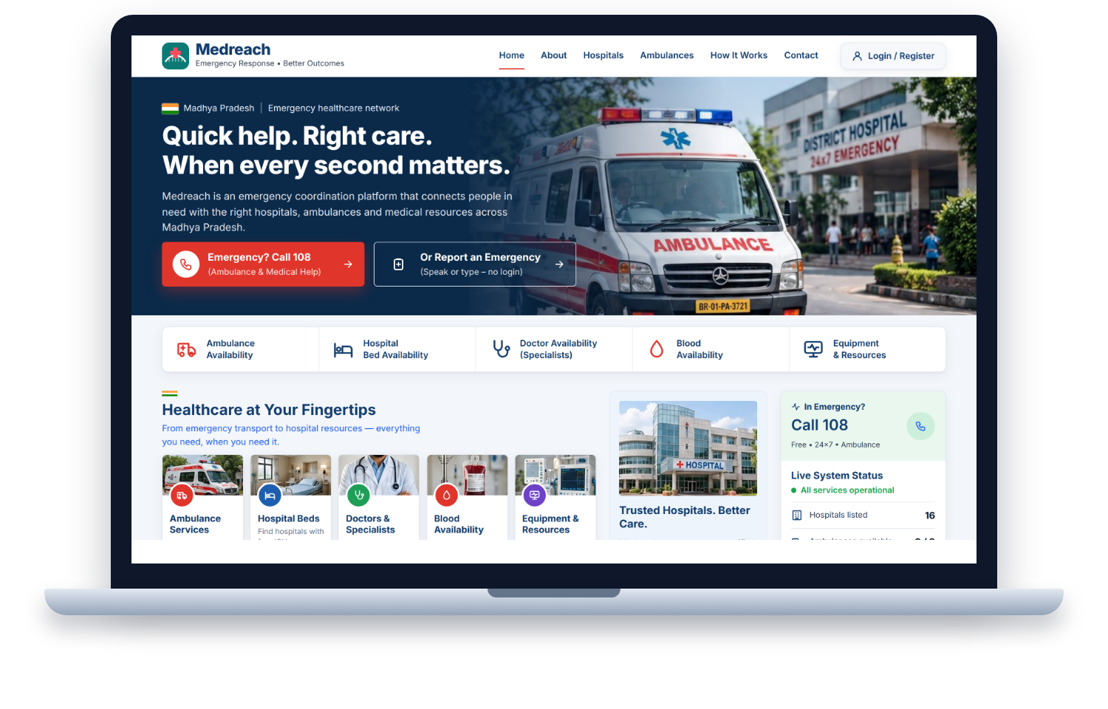



PROBLEM & OVERVIEW
TEAM
MEDREACH
MPONLINE
HACKATHON
2026
THE PROBLEM
ROOT CAUSES
WHO IS AFFECTED
1,68,491
Nearest hospital ≠ capable hospital
Bed and doctor data is old – nobody owns it
No acceptance before the patient arrives
Villages have only 2G or no data
Patients and families in panic
Rural citizens and ASHA workers
ER teams facing surprise arrivals
108 call-takers re-asking details
road-accident deaths in India in 2022
Source: MoRTH, Road Accidents in India 2022
Heart attacks, strokes, burns and childbirth emergencies face the same delays.
1 CITIZEN SPEAKS
2 MEDREACH MATCHES
3 HOSPITAL ACCEPTS
4 108 DISPATCHES
CITIZEN APP
HOSPITAL DASHBOARD
108 CONTROL ROOM
Voice in Hindi / English
Aadhaar + OTP sign-in
Live beds, doctors, blood
Accept & reserve a bay
AI pre-arrival (SBAR) note
108-minute data updates
Signed incident, no re-asking
Nearest suitable unit
Live status to the family
Live home page
MEDREACH = ONE LIVE LINK BETWEEN CITIZEN, HOSPITAL AND 108
Notes:
Top: the problem, its causes and who suffers. Middle: the four-step promise. Bottom: the three connected portals. Verify the MoRTH figure before presenting.

Slide 4






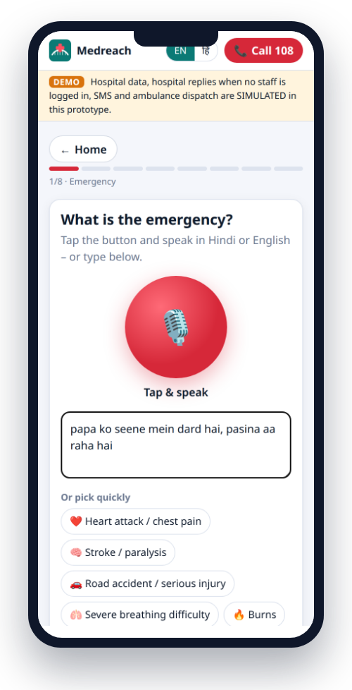
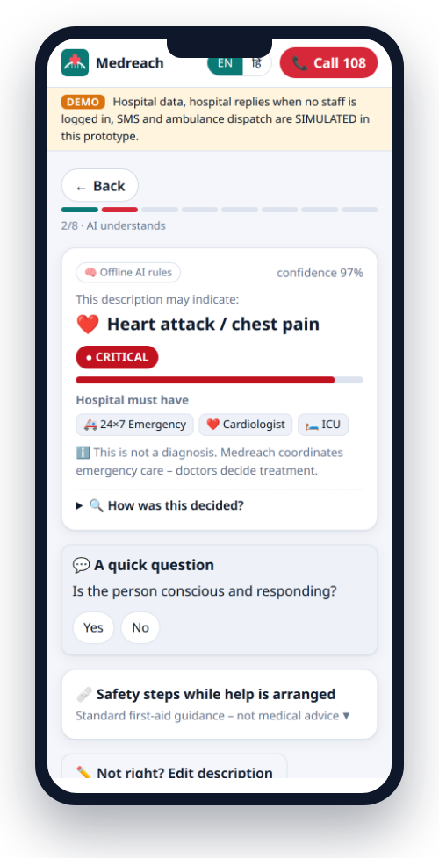
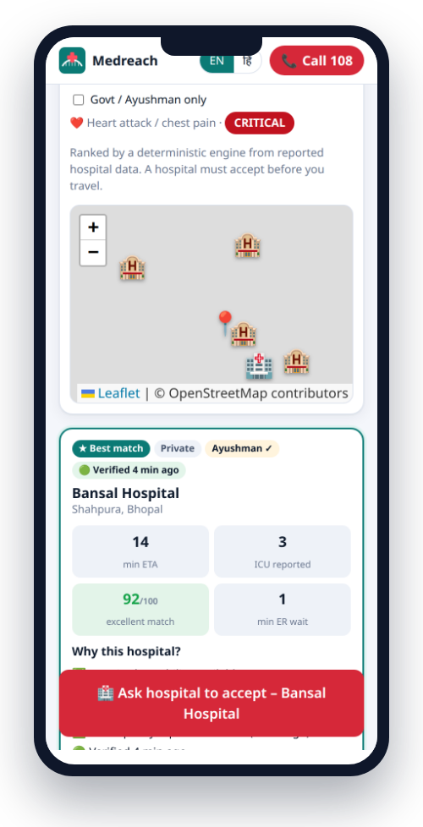
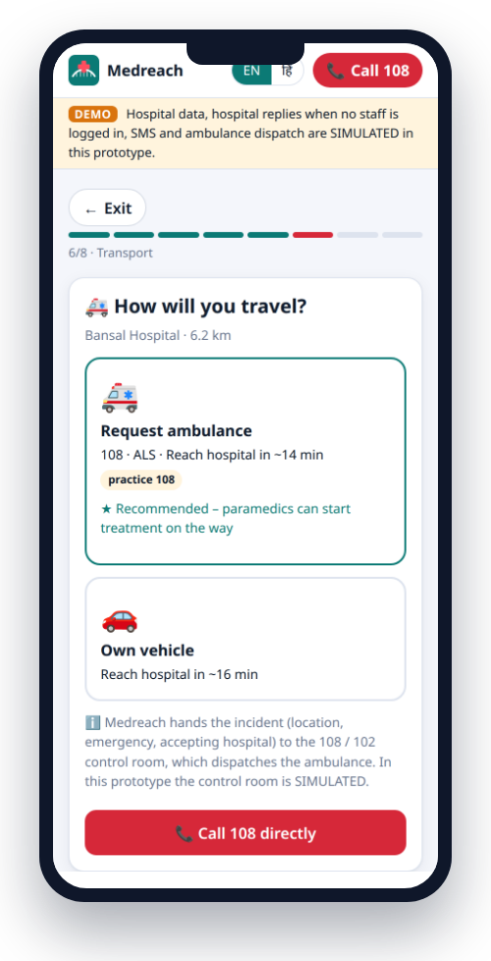
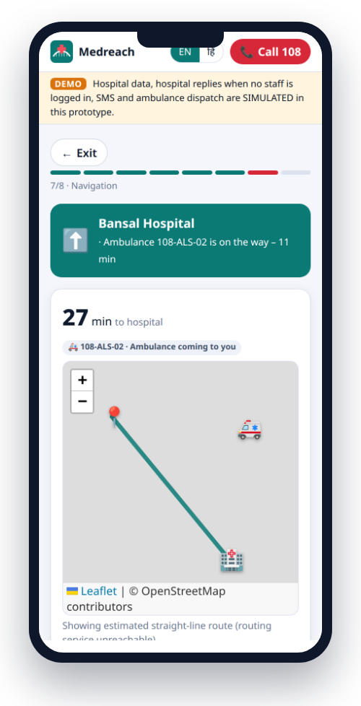




PROPOSED SOLUTION
TEAM
MEDREACH
MPONLINE
HACKATHON
2026
THE COMPLETE FLOW: From First Words to a Confirmed Bed
1
Speak
2
AI Triage
3
Match
4
Accept
5
108 / 102
6
Track & Arrive
Voice, text, photo or health card
Hindi / English understood, red flags found
Specialist, bed, distance, data freshness
Named officer reserves a bay
Signed incident to the control room
Family and ER see the live ETA
Output
Emergency details
Output
Severity + needs
Output
Ranked list /100
Output
Confirmed bed
Output
Unit + incident no.
Output
ER ready on arrival
REAL SCREENS FROM THE LIVE PROTOTYPE
RULES WE NEVER BREAK
1
2
3
5
6
Hospital accepts before anyone travels
Only hospitals that can treat the case
60 s without an answer → next hospital
Never diagnoses – says “may indicate”
Call 108 is visible on every screen
Speak
AI triage
Match 92/100
Accepted → 108
Live tracking
Notes:
The six-step flow with the output of each step. Below, the real phone screens: numbers match the steps.

Slide 5


















TECHNICAL APPROACH
TEAM
MEDREACH
MPONLINE
HACKATHON
2026
CHANNELS
MEDREACH CORE · Node.js 22 + Express 5 · live push (SSE)
INTEGRATIONS
Citizen web app (PWA)
AI triage
Gemini 2.5 Flash + rules
Match score
explainable, out of 100
Live capacity
108-minute update cycle
108 / 102 dispatch (CAD)
Hospital dashboard
Aadhaar OTP via AUA / KUA
108 control-room console
Routing & ETA
road distance (OSRM)
Case store
AES-256-GCM fields
Audit chain
SHA-256 linked log
SMS gateway (DLT)
SMS #MR1 code (no internet)
OpenStreetMap + OSRM
FRONTEND
BACKEND
AI ENGINE
INTEGRATIONS
Installable web app (PWA)
Leaflet maps + voice (Web Speech)
Tesseract.js card OCR on phone
Node.js 22 + Express 5
Server-Sent Events live updates
Encrypted store + REST APIs
Gemini 2.5 Flash triage + SBAR
Rule-based fallback, works offline
Explainable 100-point match
108 / 102 signed webhooks
SMS gateway with DLT
UIDAI OTP via licensed AUA
SECURITY LAYER
Four protections on every request
Aadhaar never stored
keyed hash + last 4 digits
Encrypted health data
AES-256-GCM per field
Signed 108 messages
HMAC-SHA256 + replay window
Tamper-evident audit
SHA-256 hash chain
Notes:
Channels on the left feed the Medreach core; integrations on the right have defined contracts. AI is optional: rule-based triage keeps working without it. The security layer applies to every request.

Slide 6
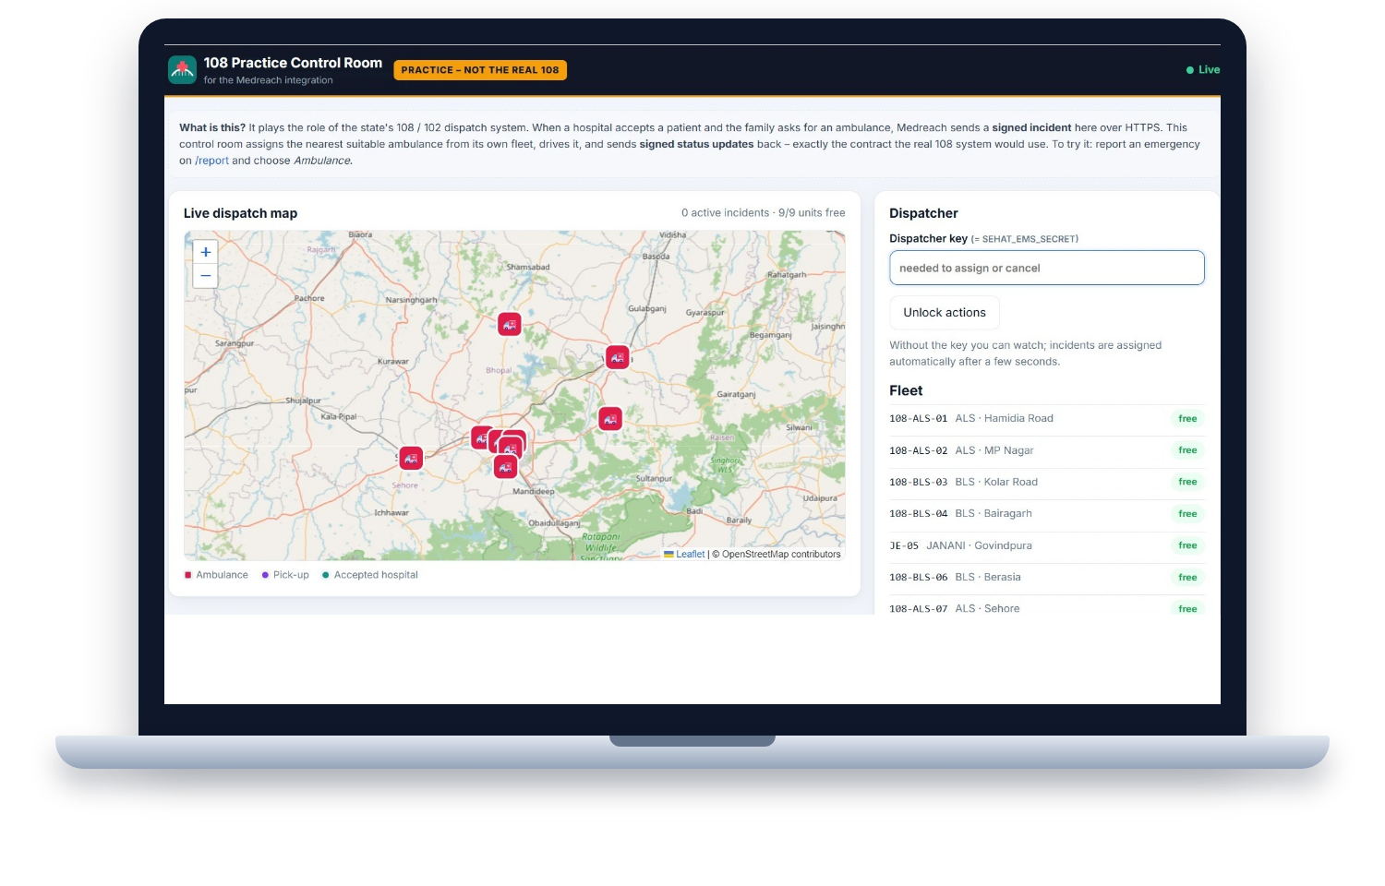
IMPLEMENTATION & FEASIBILITY
TEAM
MEDREACH
MPONLINE
HACKATHON
2026
BUILT & WORKING
KEY RISKS
MITIGATION
Live website – no app store needed
Citizen app, hospital dashboard, 108 console
94 automated tests · Hindi + English
Open-source stack – no licence cost
Hospitals may not keep data current
Weak or no network in villages
Each state’s 108 runs its own system
Health and Aadhaar data privacy
108-min cycle, named officer, “unverified” flag
SMS gateway, offline app, 108 / 112 call
Open signed contract + practice control room
AUA/KUA OTP, AES-256-GCM, consent
1 PROTOTYPE LIVE
2 DISTRICT PILOT
3 MP ROLLOUT
4 NATIONAL 108 / 102
PROTOTYPE TODAY
NEXT PILOT
SCALE
16 hospitals · 4 districts (sample data)
9-ambulance practice 108 fleet
Aadhaar OTP (simulated UIDAI)
Live: medreach-2.onrender.com
Bhopal division with CMHO + 108 operator
Real Data Update Officers
Licensed AUA/KUA + DLT SMS
Measure time to confirmed bed
All districts of Madhya Pradesh
Any state’s 108 / 102 – same contract
Capacity analytics for health dept.
ABHA health-record link
Live 108 control room (deployed site)
FEASIBLE TODAY: SOFTWARE ONLY, RUNS ON PHONES AND HOSPITAL PCs ALREADY IN USE
Notes:
What is built, the main risks and how each is handled, and the rollout from today’s prototype to a district pilot and statewide / national scale.

Slide 7
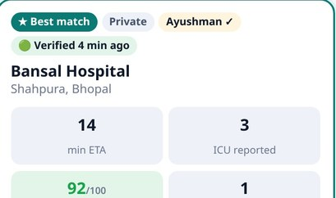
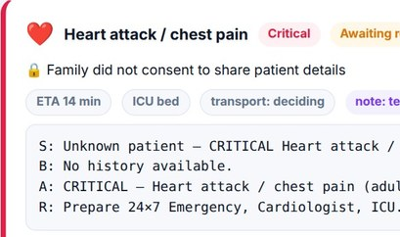
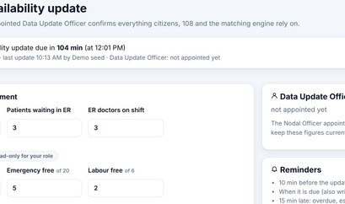
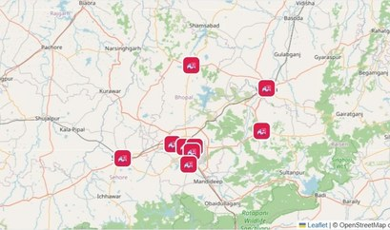
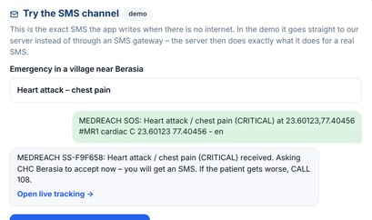
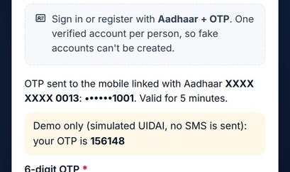
INNOVATION & DIFFERENTIATION
TEAM
MEDREACH
MPONLINE
HACKATHON
2026
TODAY vs MEDREACH
KEY INNOVATIONS
Capability | Calling around | Map apps | Medreach
Specialist & ICU free right now | maybe | ✘ | ✓
Hospital confirms before travel | sometimes | ✘ | ✓
Speak Hindi, AI understands | ✓ | ✘ | ✓
108 gets location + hospital | ✘ | ✘ | ✓
Works on 2G / SMS / offline | ✓ | ✘ | ✓
Data owner, 108-min freshness | ✘ | ✘ | ✓
Verified users, tamper-proof log | ✘ | ✘ | ✓
✦ Accept before travel: no family leaves without a hospital’s “yes”.
✦ Explainable match score out of 100 – every part shown.
✦ 108-minute update cycle with a named Data Update Officer.
✦ Signed 108 hand-off any state’s control room can adopt.
✦ A whole emergency fits in one SMS (#MR1 code) on 2G.
VOICE AI
MATCH SCORE
ACCEPT FIRST
108 LINKED
Match score 92/100
AI pre-arrival note
108-minute update
108 control room
SMS #MR1 code
Aadhaar + OTP
explainable ranking
SBAR reaches the ER first
named Data Update Officer
live dispatch map
works on 2G
one person, one account
Notes:
Left: what exists today versus Medreach. Right: the five ideas nobody else combines. Bottom: each idea as a real screen from the prototype.

Slide 8








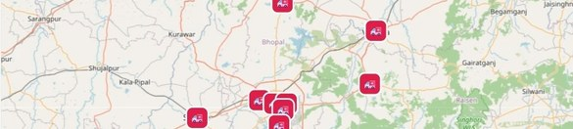
IMPACT AND BENEFITS
TEAM
MEDREACH
MPONLINE
HACKATHON
2026
CITIZENS
HOSPITALS
108 & GOVT.
RURAL MP
Right hospital the first time
Speak – no forms in panic
Track the ambulance live
Patients arrive announced
Bay ready, SBAR note first
Fewer unsuitable walk-ins
Complete incident, no re-asking
Live capacity map of MP
A data owner for every hospital
Works on 2G, SMS and offline
102 Janani Express for mothers
ASHA workers can report
✦ KEY BENEFITS OF CONNECTED EMERGENCY CARE ✦
FASTER DECISIONS
RIGHT HOSPITAL
LOW COST
SMARTER PLANNING
Guesswork
→ Confirmed
No new hardware ✘
One web app for every phone
Open-source stack, AI optional
Runs on one small cloud server
Hospital must answer in 60 s
Ranked list in seconds
Only hospitals that can treat it
Fewer second trips
Live capacity across districts
Real demand data for planning
EXPECTED OUTCOME
Every emergency in Madhya Pradesh reaches a hospital that has already said yes – with 108 on the way and the ER ready – confirmed in minutes, not after a wasted trip.
Notes:
Who benefits and how. The 60-second answer rule and the 108-minute freshness cycle are built into the product.

Slide 9





WHY SHOULD WE BE SELECTED?
TEAM
MEDREACH
MPONLINE
HACKATHON
2026
It works today
Ready for real 108
Built for rural MP
SCAN TO TRY IT LIVE
Live site: speak → hospital accepts → 108 ambulance → tracking, end to end.
Signed incident contract, proven with our practice control room.
Hindi voice, 2G / SMS / offline, 102 Janani Express for mothers.
Secure & private
Low cost, scalable
Responsible AI
medreach-2.onrender.com
Aadhaar OTP, AES-256-GCM, tamper-evident audit, no Aadhaar stored.
Open-source stack, one web app for every phone, AI optional.
Never diagnoses; hospitals decide; Call 108 is always one tap away.
Code: github.com/prakharporwal518-collab/ Medreach
✓ WORKING PROTOTYPE
✓ 108 INTEGRATED
✓ RURAL-READY
✓ SECURE BY DESIGN
THANK YOU · धन्यवाद
Medreach – the right hospital, right now, confirmed before you leave home.
Notes:
Close with the live demo: scan the QR code, report an emergency in Hindi, accept it on the hospital dashboard and watch the 108 control room dispatch the ambulance.

