Slide 1
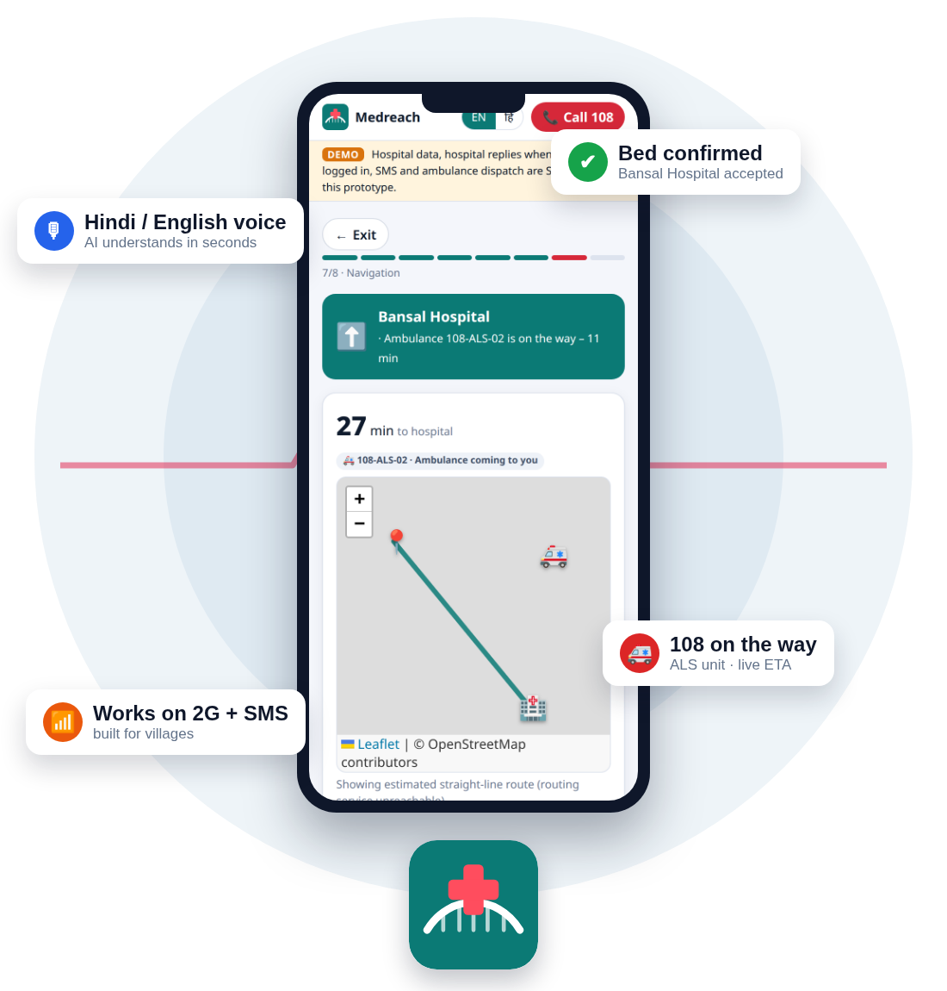
MPONLINE IDEA & INNOVATION HACKATHON 2026
MEDREACH
The right hospital, right now.
Emergency coordination that connects a citizen, a capable hospital and ambulance response before the patient arrives.
CITIZEN
HOSPITAL
108 / 102
Speak or type in Hindi / English
Accept referral + prepare ER
Dispatch + live status
Hindi voice AI
Accept before travel
108 / 102 linked
2G · SMS · offline
Working prototype: 16 hospitals · 4 districts · 9-ambulance practice 108 fleet · Hindi + English
Team MedReach | Prototype: medreach-2.onrender.com
Emergency care • capacity • ambulance • handover
MedReach · MPOnline Idea & Innovation Hackathon 2026
1

Slide 2

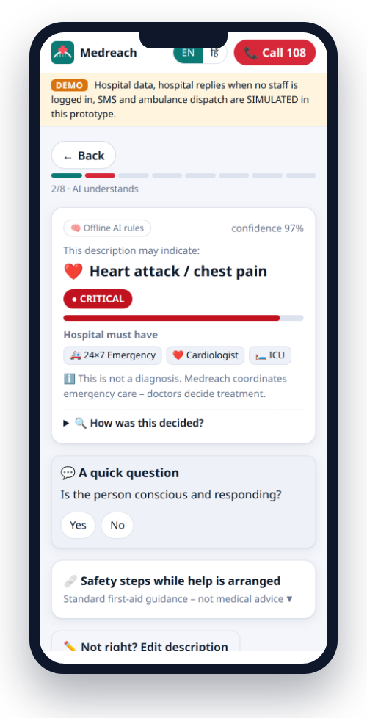
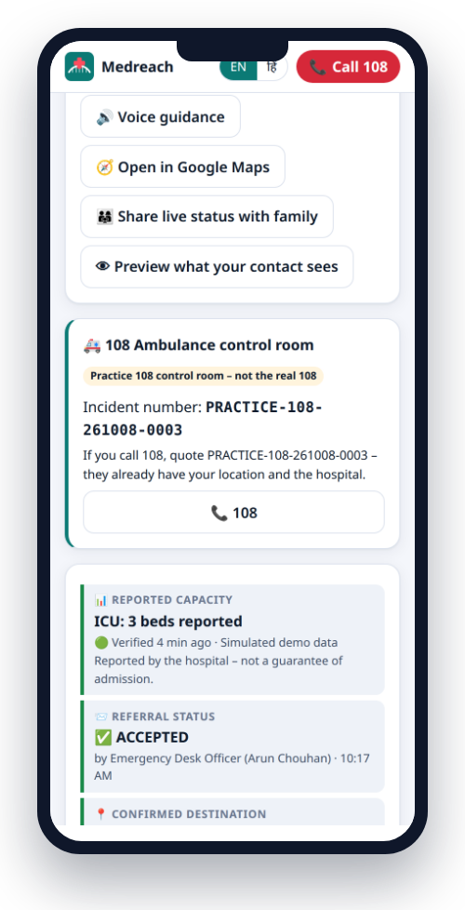
02
SCENARIO
A realistic emergency journey
9:40 PM · Village near Berasia · Chest pain
A family knows they need help, but not which hospital can actually treat the case tonight. The nearest hospital is not automatically the right hospital.
0:00
Family calls / speaks in Hindi
No clear information about specialist or ICU.
0:30
MedReach identifies urgency indicators
Possible cardiac emergency; capability requirements are surfaced.
1:00
Hospitals ranked by capability + travel
Only suitable facilities remain in the shortlist.
2:00
Hospital accepts
ER bay / receiving team is prepared before travel.
2:30
Ambulance request created
Location, accepting hospital and incident details move together.
AI flags a possible cardiac emergency
Hospital accepted + 108 incident number
Result: the family leaves only after a capable hospital has said yes – and 108 already has the details.
MedReach · MPOnline Idea & Innovation Hackathon 2026
2

Slide 3
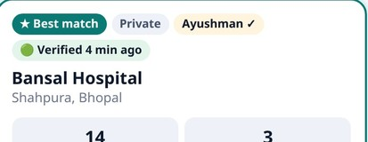
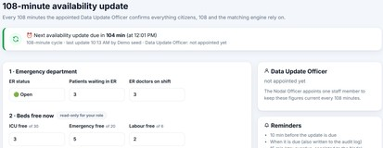
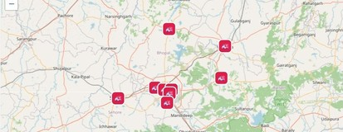
03
OVERVIEW
One platform · three operational views
THE PROBLEM
MEDREACH CONNECTS
• Nearest hospital may not have the required specialist, ICU or equipment.
• Families often discover capacity problems only after reaching the gate.
• Hospital status can become outdated without a clear data owner.
• Rural users may have weak 2G / no reliable mobile data.
CITIZEN / FAMILY
HOSPITAL
CONTROL ROOM
Voice or text emergency input
Location + basic details
See matched hospitals
Track ambulance / status
Receive pre-alert
Accept / decline referral
Reserve receiving capacity
Update beds, doctors, resources
Incident visibility
Dispatch coordination
Ambulance status
Signed handover
1,68,491 road-accident deaths in India in 2022 (MoRTH)
CORE ENGINE
AI-assisted prioritization + capability matching + live capacity + routing + audit
Match score 92/100
108-minute update
Live dispatch map
The goal is not diagnosis. The goal is to reduce avoidable delay between the emergency, the right facility and the ambulance response.
MedReach · MPOnline Idea & Innovation Hackathon 2026
3

Slide 4
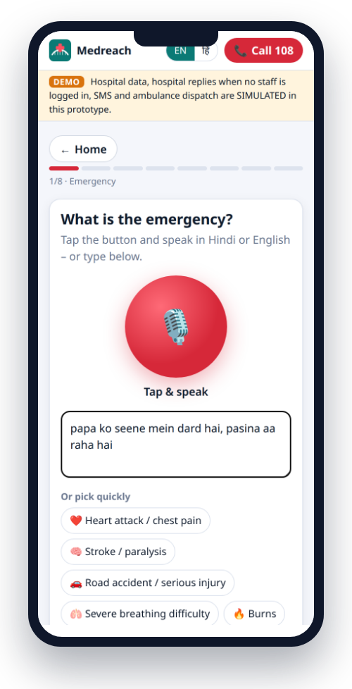
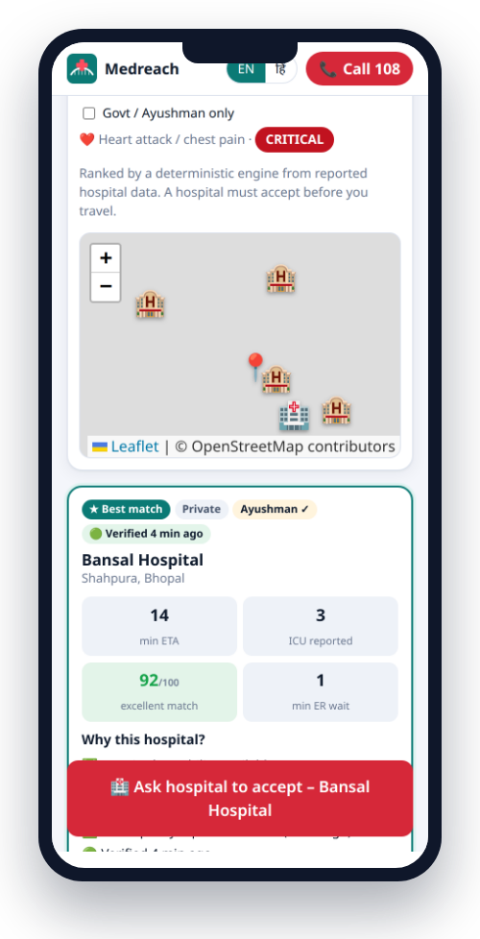
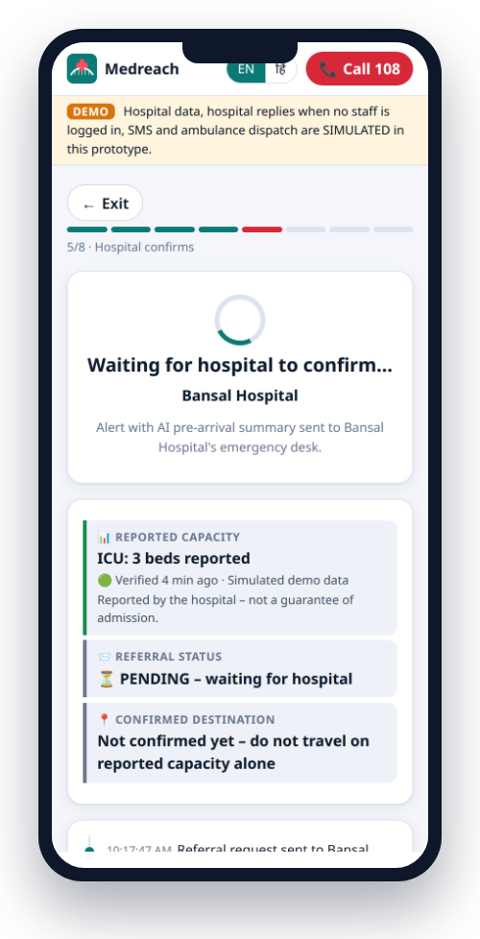
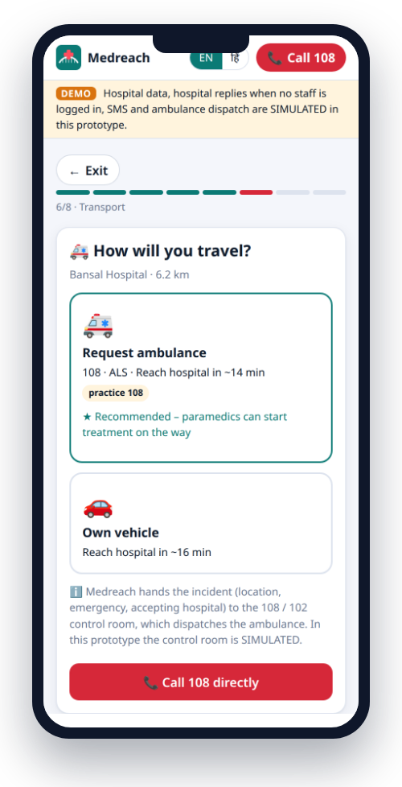
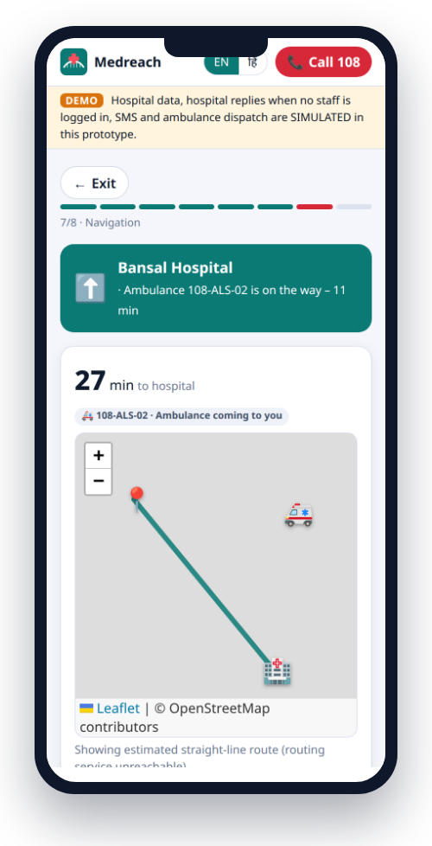
04
SOLUTION PROPOSED
From first words to a prepared emergency room
1 Speak / type
2 Prioritize
3 Match
4 Accept
5 Reserve
6 Dispatch
7 Arrive
Voice, text or basic case details
Red flags + urgency indicators
Specialist, ICU, equipment, blood, distance
Hospital confirms capability
Receiving bay / resource prepared
108 / 102 hand-off + tracking
ER receives structured pre-alert
›
›
›
›
›
›
OPERATING RULES
ACCEPT FIRST
CAPABLE ONLY
NO DIAGNOSIS
108 ALWAYS
Built into the product, not just policy.
Hospital accepts before the family travels.
Only facilities that can handle the case are ranked.
AI uses “may indicate” language; it does not diagnose.
Call 108 remains visible and available.
MedReach · MPOnline Idea & Innovation Hackathon 2026
4

Slide 5












05
TECHNICAL APPROACH
Simple architecture with integration points
INTEGRATIONS / SERVICES
CITIZEN PWA
MEDREACH SERVER
108 / 102
ROUTING
Voice · text · offline mode
Location + case details
Node.js + Express
REST APIs + Server-Sent Events
Dispatch / incident hand-off
Road distance + ETA
HOSPITAL DASHBOARD
SMS
MAPS
DECISION LAYER
Accept · update capacity
Pre-arrival information
Fallback for weak data
Leaflet / OpenStreetMap
AI-assisted triage
Explainable match score
SECURITY
AUDIT
CONTROL ROOM
OTP, rate limits, permissions
Hash-chained event log
Incidents · fleet · dispatch
Status back to family
CASE STORE
Encrypted fields + audit chain
Open, low-cost stack • deployable on a small cloud server
Gemini 2.5 Flash · Web Speech · Tesseract.js · AES-256-GCM · HMAC
MedReach · MPOnline Idea & Innovation Hackathon 2026
5

Slide 6
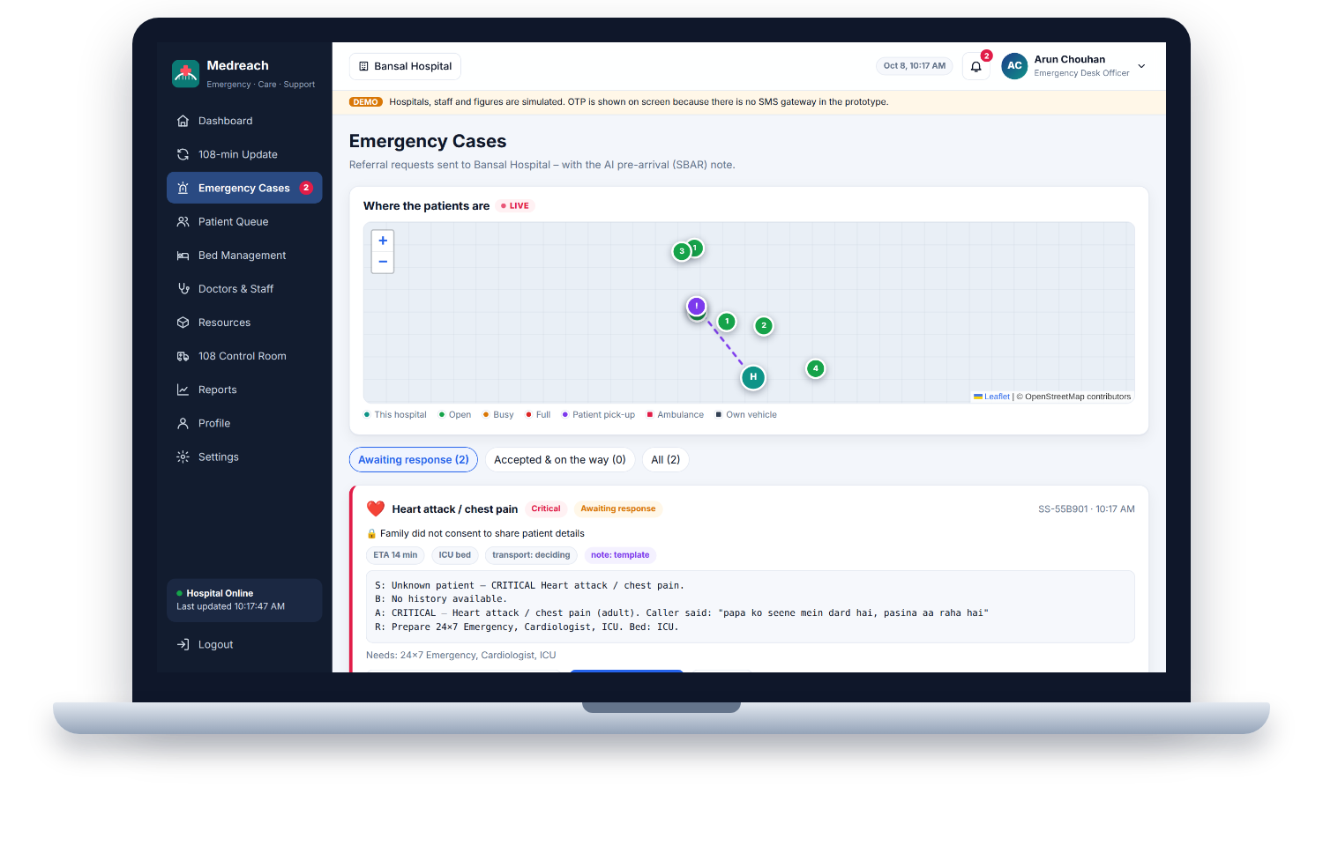
06
IMPLEMENTATION
Built around a demonstrable MVP
WHAT THE MVP DEMONSTRATES
Citizen flow
Emergency input → matched facilities → acceptance status
Hospital flow
Incoming referral → capability/capacity update → accept
Hospital dashboard – incoming referral with AI pre-arrival note
Control-room flow
Incident → ambulance assignment → status updates
16
9
hospitals · 4 districts
practice 108 ambulances
Rural fallback
SMS code / low-bandwidth path when internet is unreliable
94
4
Handover
automated tests passing
network levels supported
Structured pre-arrival information reaches the receiving team
Prototype today: 16 hospitals · 4 districts (sample data) · 9 practice ambulances · 94 automated tests
MedReach · MPOnline Idea & Innovation Hackathon 2026
6

Slide 7
07
INNOVATION / DIFFERENTIATION
Not another “nearest hospital” map
Capability
Calling around
Map apps
MedReach
Knows specialist / ICU availability
~ Usually no
✗ No
✓ Yes
Hospital confirms before travel
✗ No
✗ No
✓ Yes
Explainable match score
✗ No
✗ No
✓ Yes
Hindi / Hinglish input
~ Phone dependent
~ Limited
✓ Yes
2G / SMS / offline path
~ Variable
✗ No
✓ Yes
Pre-arrival hospital handover
✗ No
✗ No
✓ Yes
Ambulance + accepting hospital linked
~ Manual
✗ No
✓ Yes
Positioning: MedReach does not replace hospitals or 108/102. It connects the pieces and makes the hand-off explicit.
MedReach · MPOnline Idea & Innovation Hackathon 2026
7

Slide 8




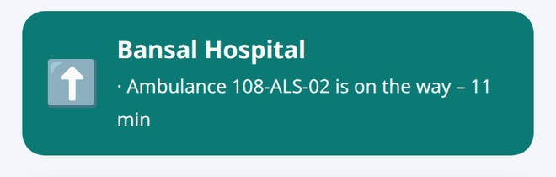
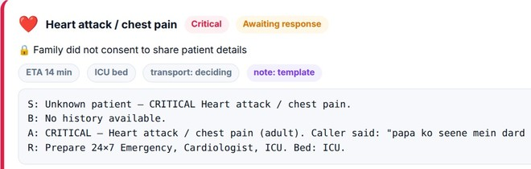
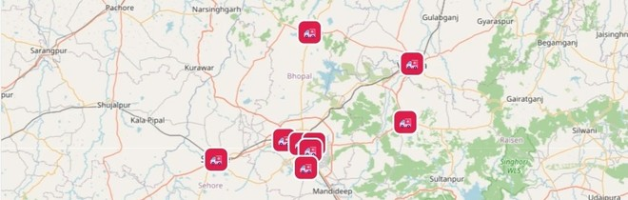
08
IMPACT & BENEFIT
Minutes saved matter at every hand-off
FIRST-TIME MATCH
PRE-ALERT
LIVE STATUS
RURAL ACCESS
Reduce unsuitable hospital visits
Hospital knows before arrival
Family sees progress
2G / SMS / offline pathway
RIGHT FACILITY
READY ER
LESS UNCERTAINTY
MORE REACH
CITIZENS & FAMILIES
HOSPITALS
HEALTH / CONTROL ROOM
• Speak instead of filling forms during panic.
• See whether a hospital has accepted.
• Track ambulance / incident status.
• Reduce avoidable travel between facilities.
• Receive a structured pre-arrival note.
• Control who updates capacity.
• Prepare receiving space before arrival.
• Maintain an auditable case trail.
• Single incident view.
• Connect location to accepting facility.
• Monitor ambulance movement.
• Use demand data for planning.
Scale path: pilot in a Bhopal-division cluster → state-wide hospital network → integration with any state 108/102 CAD.
MedReach · MPOnline Idea & Innovation Hackathon 2026
8

Slide 9
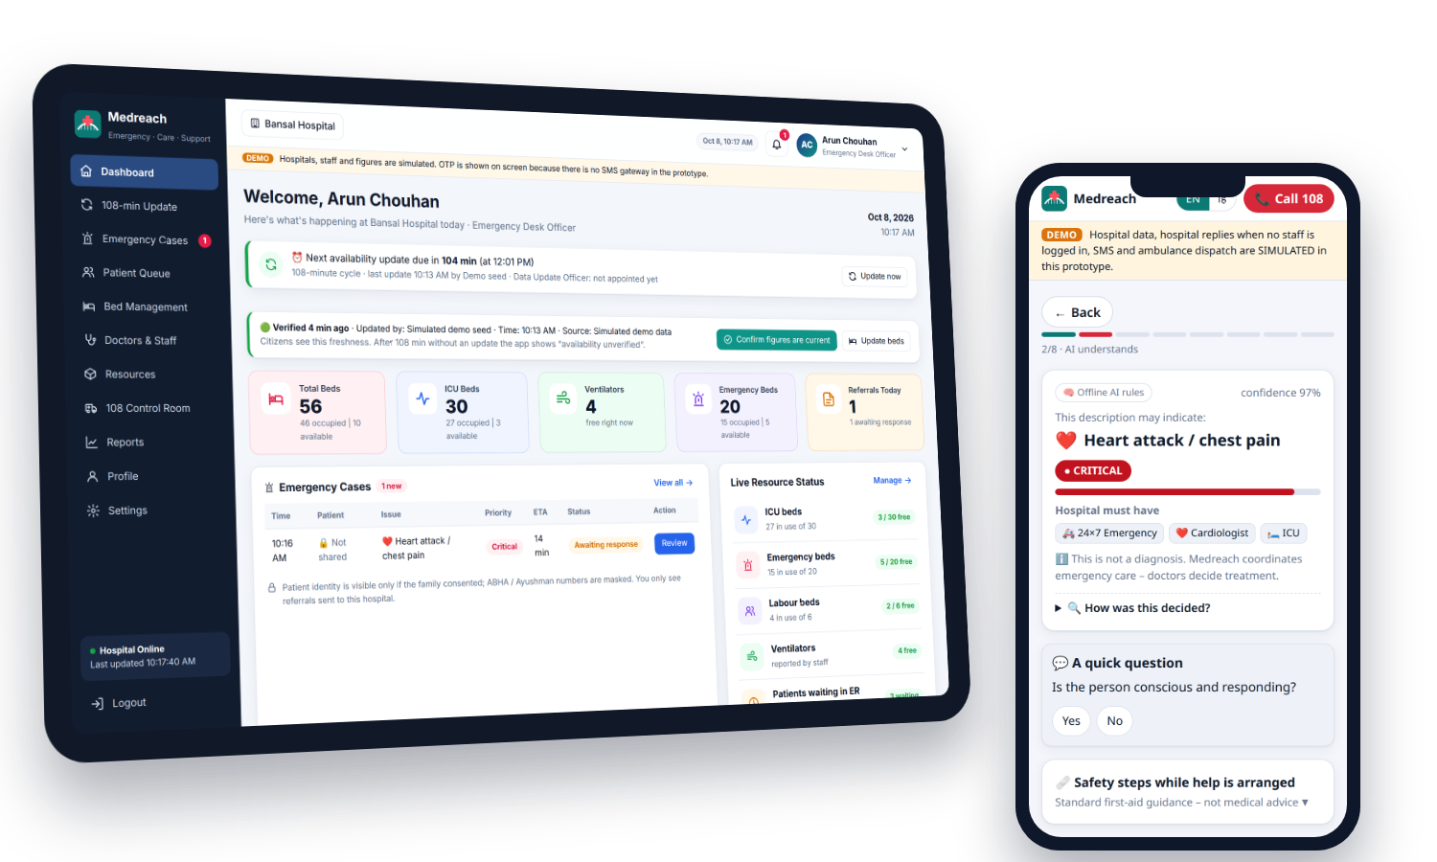

09
WHY SHOULD WE SELECT YOU?
A practical, demonstrable and scalable approach
1
Works as an end-to-end workflow
1
Citizen → capable hospital → ambulance → tracking → handover.
2
Designed for real operating constraints
2
Hindi input, low bandwidth, SMS fallback and explicit hospital acceptance.
3
Responsible use of AI
3
AI assists prioritization and matching; it does not diagnose or replace clinicians.
SCAN TO TRY IT LIVE
medreach-2.onrender.com
Report in Hindi → hospital accepts → 108 dispatch → live tracking
4
Low-cost and integrable
4
Web-first architecture, open-source components and clear integration points.
LIVE PROTOTYPE
MedReach connects the emergency journey — it does not replace emergency services.
medreach-2.onrender.com | GitHub: prakharporwal518-collab/Medreach
MedReach · MPOnline Idea & Innovation Hackathon 2026
9

