Slide 1



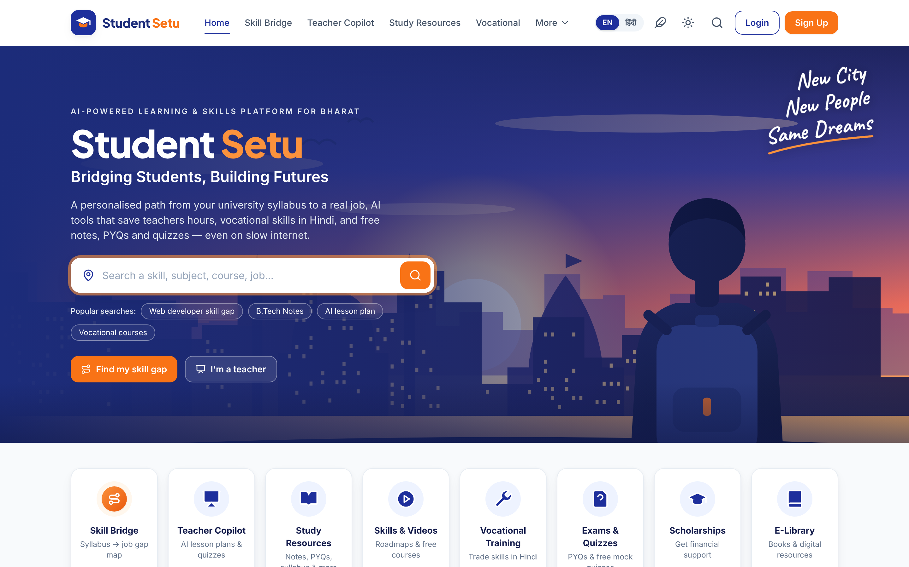





HACK FOR SOCIAL CAUSE · EDTECH
COVER PAGE
Live prototype · Built for Bharat
PROBLEM STATEMENT / CONCEPT TITLE
Student Setu
Student Setu — AI-powered Curriculum-to-Career Bridge
Personalised skilling for students, an AI copilot for teachers and vocational training in Hindi — built to work on low-bandwidth phones across Bharat.
Bridging Students, Building Futures
THEME
Quality Education & Skill Development
Remote learning · personalised education · empowering teachers · vocational training
studentsetuconnect.netlify.app
TEAM NAME (REGISTERED ON PORTAL)
‹Team Name›
TEAM ID (REGISTERED ON PORTAL)
‹Team ID›
STATE / UT
Scan for live demo
‹State / UT›
studentsetuconnect.netlify.app
@HSC submission
Notes:
Cover: Student Setu is an AI-powered curriculum-to-career bridge. Fill in Team Name, Team ID and State/UT exactly as registered on the portal.

Slide 2







Problem – Proposed Solution
‹Team Name›
THE CORE PROBLEM — EDUCATION ISN’T TURNING INTO JOBS
45%
of Indian graduates are not job-ready
~4%
of Indians aged 15–59 have formal vocational training
27:1
students per teacher — little time for prep or personal attention
26%
of Web Developer job skills covered by a B.Tech syllabus, even at graduation
India Skills Report 2025 (54.81% employable)
PLFS 2023-24, MoSPI
AISHE 2021-22, Ministry of Education
Our gap-map analysis (RGPV B.Tech)
PROPOSED SOLUTION — ONE PLATFORM, THREE PILLARS
Setu Skill Bridge
Teacher Copilot
Bharat-first Access
For students
For teachers
For every learner
Gap Map: real syllabus (Course → University → Semester) vs 13 job roles × 45 skills
Personalised week-by-week plan from free courses + AI coach tips
Verified Skill Badges: server-graded, signed, checkable by any employer
AI lesson plans & question papers from the syllabus, in English or Hindi
Auto-graded class quizzes — students join with a code, no login
Weak-topic heatmap → one-click re-teach; verified teacher accounts
7 vocational trade tracks in Hindi, linked to Skill India, Apprenticeship & ITI
Lite mode for 2G/3G, offline installable app, listen-aloud audio
WhatsApp sharing, full Hindi UI; hostel & tiffin finder as optional support
Solves: skills gap · personalised education
Solves: empowering teachers · quality education
Solves: remote learning · vocational training
INNOVATION & UNIQUENESS
Syllabus-mapped gap map, semester by semester
Tamper-proof badges: answers never reach the browser
Closed teaching loop: quiz → heatmap → re-teach
Works without AI & offline: templates + PWA
Notes:
Problem: graduates are not job-ready, few have vocational training, teachers are stretched. Solution: Skill Bridge for students, Teacher Copilot for teachers, Bharat-first access for everyone.

Slide 3





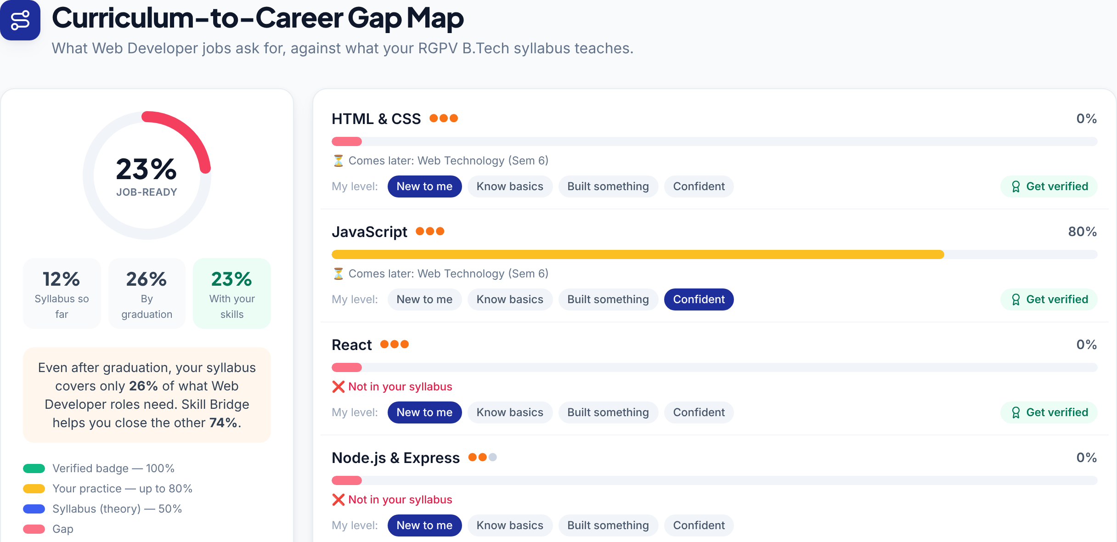



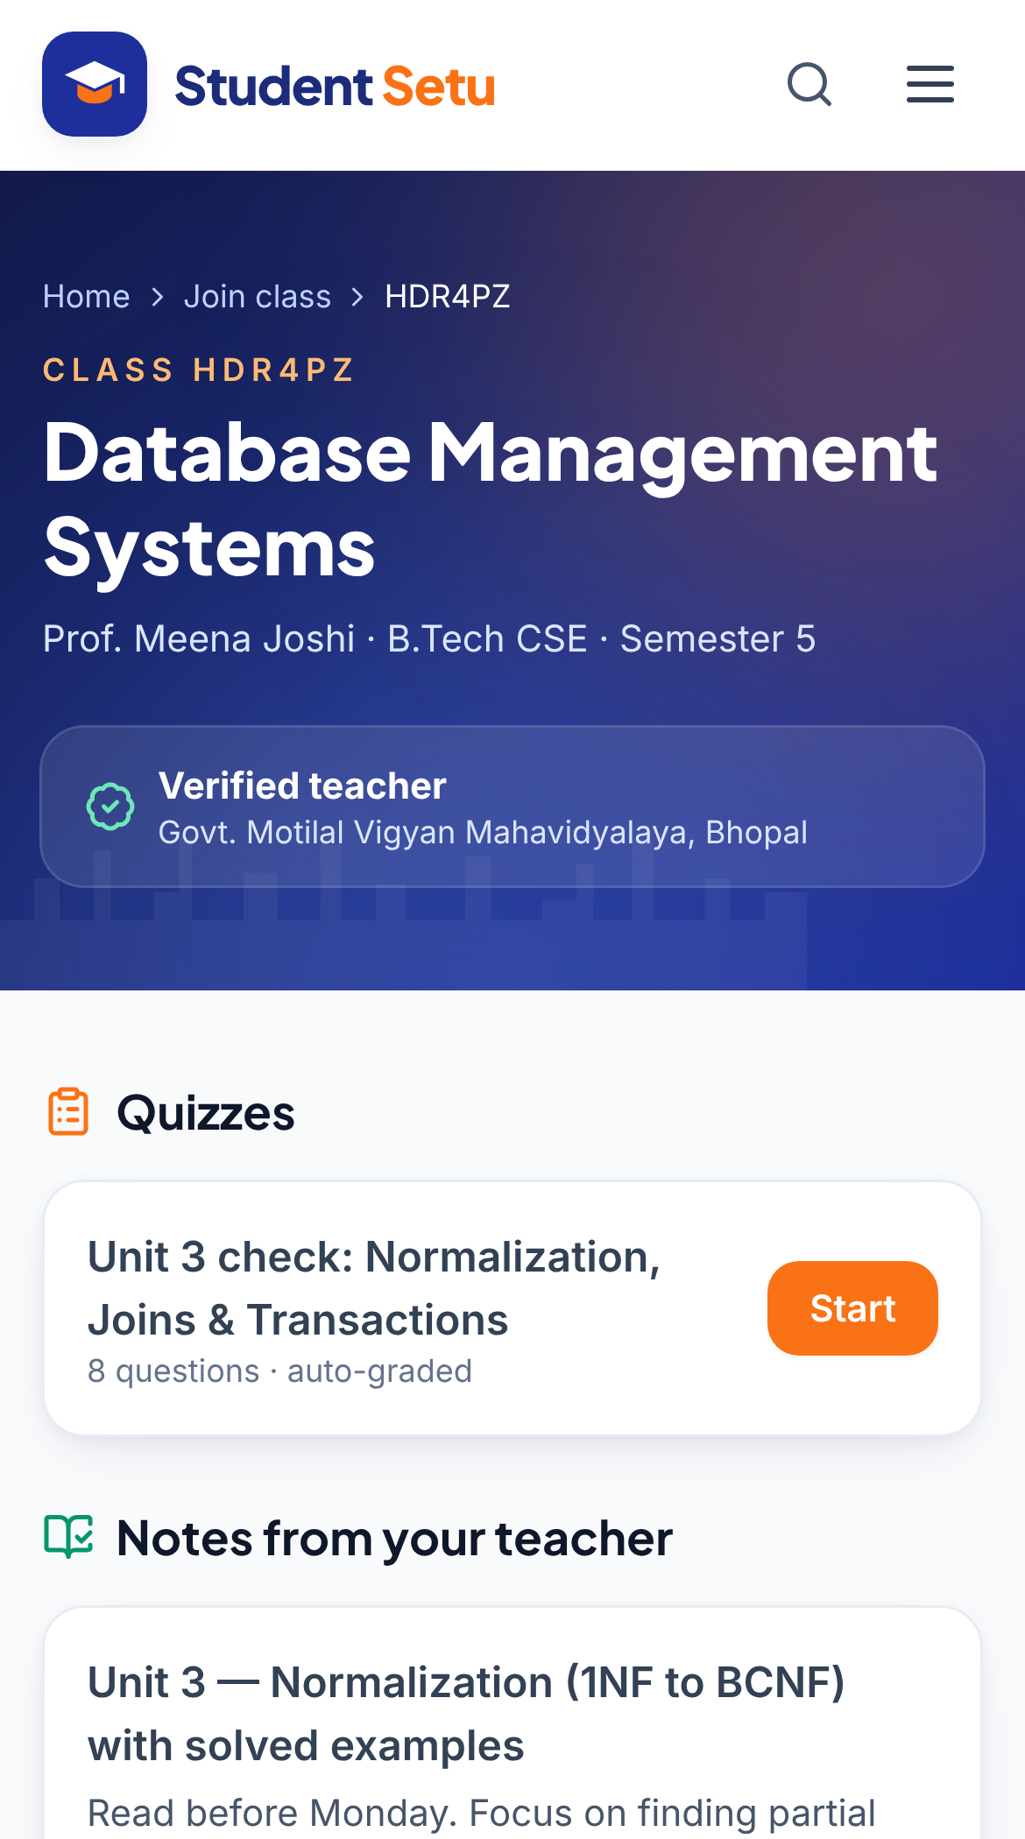

Technical Approach
‹Team Name›
TECHNOLOGIES — SERVERLESS, LOW-COST STACK
METHODOLOGY — HOW IT WORKS
Frontend (PWA)
React 18 · Vite 6 · Tailwind CSS · Framer Motion · React Router · Service Worker · Web Speech API
Student journey
Pick course · univ · sem
Gap map
Weekly plan
Server-graded test
Signed badge
Serverless API
Netlify Functions (Node 20, TypeScript): copilot · badge · classroom · chat
Teacher loop
Syllabus topic
AI lesson, paper or quiz
Share code on WhatsApp
Students submit, no login
Heatmap → re-teach
AI
Data
Security
Google Gemini 2.5 Flash (JSON mode)
Netlify Blobs (class quizzes & results)
HMAC-SHA256 badges, keys on server
Process: agile build–test sprints · Playwright end-to-end tests · GitHub → Netlify auto-deploy
WORKING PROTOTYPE — REAL SCREENS
GitHub
Live demo
Demo video
prakharporwal518-collab/
Student-Setu
studentsetuconnect.netlify.app
‹Add demo video link›
Extent of AI usage
In product: Gemini writes lesson plans, papers, quizzes, coach tips & chat replies
Guardrails: strict JSON schema, key on server, “review before use”, template fallback
No AI where trust matters: quiz grading & badge signing are deterministic
In development: Claude Code AI assistant for coding & testing, reviewed by the team
Student phone: verified-teacher class · Gap map: 23% job-ready
Notes:
Stack: React PWA on Netlify, four serverless functions, Gemini for content, Blobs for class data, HMAC-signed badges. Show the live demo and GitHub link.

Slide 4





Impact Potential
‹Team Name›
POTENTIAL IMPACT ON THE TARGET AUDIENCE
STAKEHOLDERS
Students
4.33 Cr in higher education
Students
Teachers
Colleges & universities
Know the exact job-skill gap from Semester 1 · free personalised plan · skill proof employers can verify
Student
Setu
Teachers
15.98 L faculty
Employers & recruiters
Govt: Skill India, NSDC, AICTE
Lesson plans, papers & quizzes in minutes · see what the class didn’t understand · re-teach with data
Vocational learners
~96% lack formal training
Trade skills in Hindi on a basic phone · tests & badges · links to Skill India, Apprenticeship India & ITI
Parents
Mentors, alumni & peer tutors
Hostel & tiffin providers
BENEFITS OF THE SOLUTION
Social
Economic
Educational
Institutional
Equal access for rural, Hindi-medium & first-generation learners; safe stay & food info for migrant students
₹0 for learners, free courses, verified skills → better jobs & wages; saves teachers’ prep hours
Topic-level outcome data; aligned with NEP 2020 — multilingual, vocational & competency-based
Colleges see syllabus-vs-industry gaps to update curriculum; employers hire on verified skills
Notes:
Audience: students, teachers, vocational learners. Eight stakeholder groups connect through the platform. Benefits are social, economic, educational and institutional.

Slide 5



Feasibility and Risk Analysis
‹Team Name›
FEASIBILITY — ALREADY PROVEN BY A LIVE PROTOTYPE
Technical
Economic
Operational
Scalable
Live app + 4 serverless functions; every flow tested end-to-end
~₹0 at pilot scale on free tiers (Netlify, Gemini); no app-store cost
Runs in any phone browser; students need no login; English + Hindi
Serverless auto-scaling; a new university = one new syllabus file
POTENTIAL CHALLENGES & RISKS → STRATEGIES TO OVERCOME THEM
Risk / challenge | Level | Mitigation strategy
AI gives wrong or low-quality content | High | “Review before use” label · teacher edits all output · strict JSON schema · template fallback
Poor internet & low-end phones | High | Lite mode (no images or animations) · offline installable PWA · lazy-loaded pages · audio
Fake teacher accounts | Medium | Admin verifies college + employee ID · only verified teachers can run classes
Badge cheating or forgery | Medium | Answers never sent to the browser · server grading · HMAC-SHA256 signature · public verify link
Low teacher adoption | Medium | 3 free tries without login · Hindi · WhatsApp sharing · saves prep time from day one
Keeping syllabus data current at scale | Medium | One structured file per university · next: university & teacher uploads, college partnerships
Student data privacy | Low | Students join with class code + name only · no phone or email · API keys only on the server
Notes:
Feasibility is proven by the live prototype. Seven risks, each with a concrete mitigation already built or planned.

Slide 6





Team
‹Team Name›
TEAM COMPOSITION & ROLES
CHALLENGES WE SOLVED
‹Member 1›
‹Member 2›
Keeping test answers secret in a web app
→ grading moved to the server + signed badges
Team Lead · Full-stack
Frontend & UI/UX
AI must never break a live class
→ strict JSON output + ready-made templates
Architecture, serverless functions, deployment
React screens, Hindi UI, Lite mode, accessibility
Learners on 2G/3G connections
→ Lite mode + offline installable app
‹Member 3›
‹Member 4›
Mapping syllabus to real job skills
→ 45-skill × 13-role dataset, semester-wise
AI & Backend
Research & Content
Gemini prompts, quiz grading, signed badges
Syllabus–skill mapping, vocational modules, testing
Trusting who is really a teacher
→ admin verification with college & employee ID
OUR JOURNEY
1
2
3
4
5
6
Student-life MVP
Re-read the problem
Setu Skill Bridge
Teacher Copilot
Bharat add-ons
Trust & launch
Hostels, tiffin, colleges, local connect
Pivoted to learning-first; life support kept optional
Gap map, personal plan, verified badges
Lessons, papers, quizzes, class heatmap
Hindi, Lite mode, offline app, vocational
Teacher verification, live on Netlify
Notes:
Replace member names and adjust roles. Challenges show the hard problems we solved. Journey: we started as a student-life app and pivoted to learning-first after re-reading the problem statement.

Slide 7






References
‹Team Name›
Data & research
Government platforms we link to
Technology documentation
India Skills Report 2025 (CII, Wheebox, AICTE)
Skill India Digital Hub
Google Gemini API
taggd.in/industry-reports/isr/india-skills-report-2025
skillindiadigital.gov.in
ai.google.dev
AISHE 2021-22, Ministry of Education
Apprenticeship India
Netlify Functions & Blobs
aishe.gov.in
apprenticeshipindia.gov.in
docs.netlify.com
Periodic Labour Force Survey, MoSPI
SWAYAM & NPTEL free courses
React · Vite · Tailwind CSS
mospi.gov.in
swayam.gov.in · nptel.ac.in
react.dev · vite.dev · tailwindcss.com
National Education Policy 2020
National Scholarship Portal
Web Speech API & PWAs (MDN)
education.gov.in — NEP 2020
scholarships.gov.in
developer.mozilla.org
Our project
Live demo: studentsetuconnect.netlify.app
Source code: github.com/prakharporwal518-collab/Student-Setu
Demo video: ‹Add demo video link›
Live demo
GitHub
Notes:
All statistics on slide 2 come from these sources. Scan the QR codes for the live demo and the source code.

