Slide 1
Software Architecture: Group 5
Implementation Tactic
Steven Simmons
Shimon Johnson
Prakhar Rawat

Slide 2
Technologies Used:
Python3
RabbitMQ
Pika
Make/Proc

Slide 3
Message, RabbitMQ, PIKA and Event loops
1. A Message could include any kind of information or even a simple text message.
2.RabbitMQ is a Queue manager software that stores these messages until the receiver connects to it and deques each message.
3.Pika is a pure python implementation of the AMQP 0-9-1 protocol that tries to stay fairly independent of the underlying network support library.
4. An event loop is a that can register tasks to be executed, execute then, delay or even cancel them and hendle different events related to these operations.

Slide 4
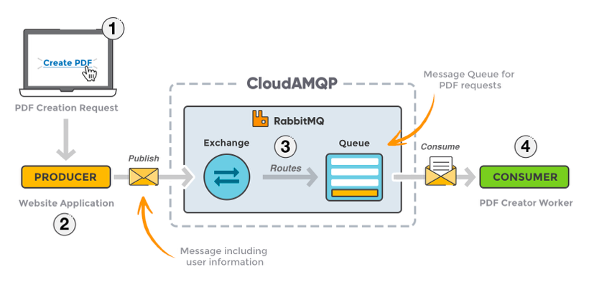
An example of Message queuing.

Slide 5
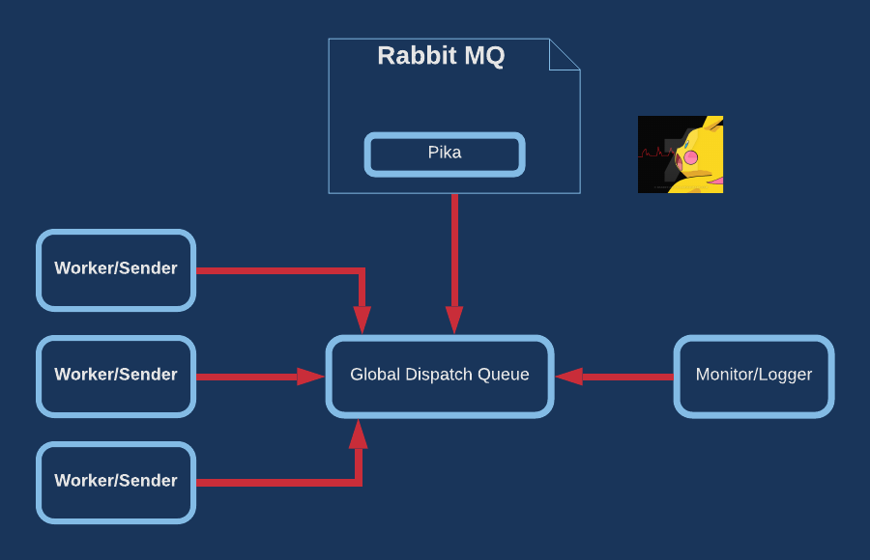
Designed Workflow for tactic implementation

Slide 6
Let’s Dive into the Demonstration now !

