Slide 1

Department of Information Science
An Algorithm Selector Framework for Automated Model Card Generation
Validating Automated Metrics for Quality Assessment
INFO 5731 – Computational Methods for Information Systems
Group 1: Prakhar Rustagi - 11783222, Varun Kumar Chennuri - 11749795, Pallavi Mannam - 11755894, Saloni Prakash Khot - 11825970, Samraggi Thapa – 11828286
Mentor: Dr. Haihua Chen
Date: 11/29/2025

Slide 2
Presentation Overview:
Introduction & Motivation
Project Goals & Evaluation Metrics
Methodology & Flowchart
Key Results: Correlation Analysis
Conclusion & Future Work
References & Contributions

Slide 3


Introduction & Motivation
The Problem: Assessing Model Card Quality
The Challenge: Automatically generating model cards requires robust, objective quality assurance.
Limitation: Manual human review is slow, expensive, and non-scalable.
Our Solution: We must validate an automated metric (BERTScore & Roberta BERT) that can reliably proxy human judgment, enabling efficient evaluation and algorithm selection.

Slide 4
Project Goals and Evaluation Metrics
Core Goal: Validate BERTScore F1 as an automated metric by measuring its alignment with human quality scores.
Human Judgments (Rubric) Scores (1-5) on five critical dimensions: Faithfulness, Relevance, Appropriateness, Consistency, and Usefulness.
Automated Metric BERTScore (F1): A semantic similarity metric based on pre-trained language models.
Validation Method Pearson Correlation Coefficient (ρ) :Measuring the linear relationship between the automated F1 score and each human dimension.

Slide 5
Human Annotation: Rubric and Granularity
Dimension | Abbreviation | Definition (What We Measure)
Faithfulness | F | Is the content factually correct and derived accurately from the source data/model?
Relevance | R | Is the content logically connected to the specific section's topic and model context?
Appropriateness | A | Is the tone, style, and terminology suitable for the target audience of the model card?
Consistency | C | Is the information presented logically consistent across different sections of the model card?
Usefulness | U | Does the content provide valuable, actionable information about the model's performance and limitations?

Slide 6
Annotation Granularity: Analysis by 8 Key Sections
Model Card Section | Key Content Focus
model_details | Fundamental information about the model, version, developers, and licensing.
intended_use | The specific use cases and environments the model was designed for, and explicitly, what it should not be used for.
training_data | Description of the data used to train the model, including sources, collection methods, and any pre-processing steps.
safety_considerations | Analysis of potential risks, harms, mitigations, and safety metrics relevant to the model's deployment.
generative_capabilities | The specific functions, outputs, and performance modes that the model is able to exhibit.
limitations | Known boundaries, out-of-scope scenarios, performance drop-offs, and failure modes of the model.
ethical_considerations | Discussion of fairness, bias, privacy, and societal impact related to the model's usage.
evaluation_data | Details on the datasets and metrics used to test and evaluate the model's final performance.

Slide 7
Methodology & Flowchart
  The Validation Process (4-Step Flowchart)Data Collection: Gather Model Card sections and granular Human Annotations (F, R, A, C, U) across 8 key sections (See Slide 5 for Rubric details).
  Automated Evaluation: Calculate BERTScore (F1, P, R) using two distinct language model backbones (bert-base-uncased and roberta-large).
  Correlation Analysis: Compute the Pearson Correlation Coefficient (ρ) between the Automated BERTScore F1 and the Human Score for each of the five dimensions.
  Algorithm Selection: Use the validated, high-correlation metrics (ρ > = 0.70) to select the best Model Card generation algorithms objectively.

Slide 8
Key Result: BERT-Base Correlation (ρ)
  Metric Validation: Correlation with bert-base-uncased.
  The baseline model demonstrates strong alignment (ρ > 0.70) with three critical human dimensions, validating its use as an automated proxy.
Human Dimension | Abbr. | ρ Value | Interpretation
Appropriateness | A | 0.80 | Strongest: Highly effective at measuring textual suitability and fit.
Faithfulness | F | 0.78 | Strong: Reliable proxy for factual correctness and source adherence.
Usefulness | U | 0.71 | Strong: Effective measure of informational value.
Relevance | R | 0.34 | Weak: Struggles with broader, contextual relevance.
Consistency | C | 0.21 | Weakest: Poorly suited for measuring internal logic.

Slide 9
Key Result: RoBERTa-Large Correlation (ρ)
  Metric Validation: Correlation with roberta-large
  We tested the more complex roberta-large model, expecting higher correlations, but found its performance was generally lower than the baseline.
Human Dimension | Abbr. | ρ Value | Interpretation
Appropriateness | A | 0.77 | Slightly lower than BERT-base.
Faithfulness | F | 0.75 | Slightly lower than BERT-base.
Usefulness | U | 0.69 | Falls just below the $0.70$ threshold for strong reliability.
Relevance | R | 0.32 | Marginally lower.
Consistency | C | 0.20 | Marginally lower.

Slide 10
Model Comparison & Final Selection
BERT-Base vs. RoBERTa-Large
Dimension | bert-base-uncased (ρ) | roberta-large (ρ) | Result
Appropriateness | 0.80 | 0.77 | BERT-Base Wins
Faithfulness | 0.78 | 0.75 | BERT-Base Wins
Usefulness | 0.71 | 0.69 | BERT-Base Wins
Relevance | 0.34 | 0.32 | Draw (Both Weak)
Consistency | 0.21 | 0.20 | Draw (Both Weak)
Final Selection: bert-base-uncased
Strongest Proxy: Consistently showed higher correlation across all strongly-validated dimensions (F, A, U).
Efficiency: It is a smaller model, resulting in faster computation and lower resource consumption, making it ideal for a scalable automated framework.
Note: For choosing the algorithm, we will use the base BERT . But in project, we have used both
Figure: Existing machine learning models organized by timeline (Li at al., 2020).

Slide 11
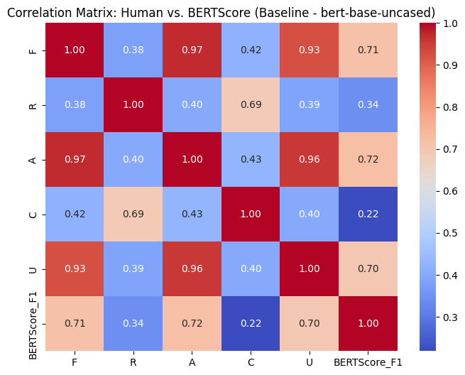
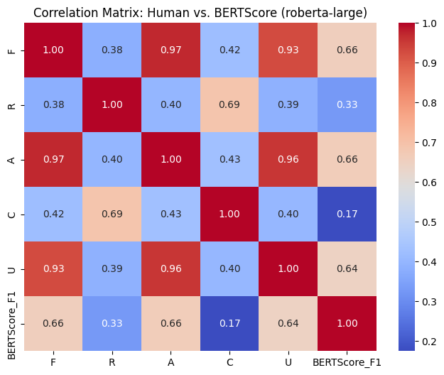
Heatmaps for Correlation(Both Models)

Slide 12
Algorithm Performance Ranking
Average Performance Scores by Generation Algorithm
We aggregated the average human scores and the average BERTScore F1 (using the validated bert-base-uncased metric) to rank the generation algorithms.
Algorithm | Avg. BERTScore F1 | Avg. Faithfulness (F) | Avg. Appropriateness (A) | Avg. Usefulness (U)
human (Baseline) | 0.151 | 3.72 | 3.69 | 3.57
naacl | 0.137 | 3.40 | 3.39 | 3.30
poolenriched | 0.132 | 3.48 | 3.46 | 3.37
onlypaper | Lowest | Lowest | Lowest | Lowest

Slide 13
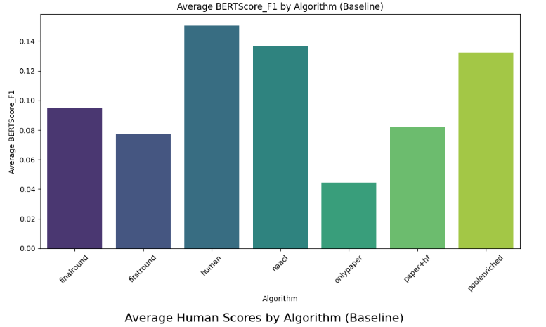
Algorithm Performance: Bar Chart Results
Comparing Algorithm Quality (F, A, U)
The decision framework uses both automated and human scores. While naacl achieved a higher automated BERTScore F1, the human scores show a different picture.
Visualization:

Slide 14
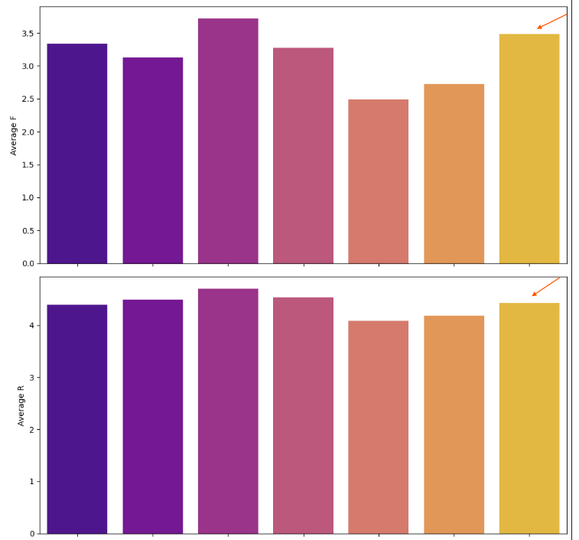
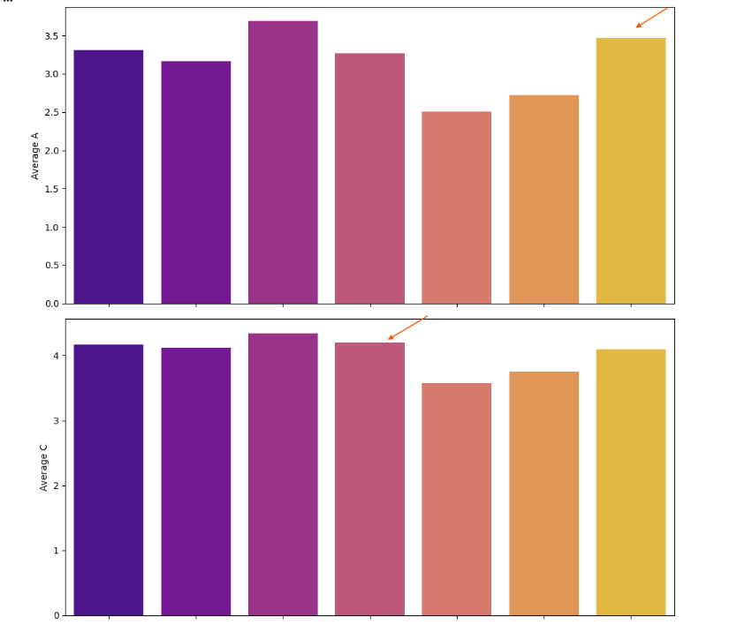
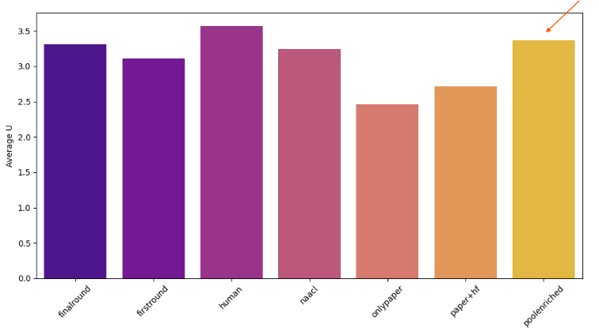
Algorithm Performance: Bar Chart Results
Key Finding: The poolenriched algorithm consistently aligned most closely with human judgments across the critical metrics of Faithfulness, Appropriateness, and Usefulness, achieving the second-highest human scores.
Discrepancy: The naacl algorithm achieved a higher average BERTScore F1 (0.137 vs 0.132), but its lower human scores (F, A, U) suggest a mild discrepancy between the automated metric and perceived quality for that specific algorithm.

Slide 15
GitHub Link and Author Contributions (Mandatory)
Final Selection and Framework Takeaways Validated Metric: BERTScore F1 using the bert-base-uncased backbone. Chosen Algorithm: The pool-enriched generation method, due to its superior alignment with human judgment (F, A, U) despite a marginally lower automated score than naacl.
Framework Success: We successfully validated a metric and used it to objectively select the best-performing Model Card generation algorithm, confirming the necessity of integrating diverse data sources (pool-enriched logic) for robust documentation.
Impact: This framework allows us to minimize human QA effort, accelerate development cycles, and ensure responsible AI documentation quality at scale.

Slide 16
Final Algorithm Selection & Conclusion
Project Repository
GitHub Link: Prakhar_INFO5731_Fall2025/Group_1_Project at main · prakharrustagi42/Prakhar_INFO5731_Fall2025
Team Member | Key Responsibilities & Phases Led
Prakhar Rustagi | Project Lead/Technical Core: Proposal Finalization, Integration of Partner's Data, BERTScore Calculation (Base vs. Large), Statistical Analysis (Correlation/Wilcoxon), Results & Discussion Write-up, Final LaTeX Review.
Pallavi Mannam | Annotation & Analysis: Literature Review Write-up, Manual Annotation, Annotation Review/Cleaning, Algorithm Ranking & Visualization.
Saloni P. Khot | Documentation & Synthesis: Literature Review Write-up, Manual Annotation, Conclusion and Abstract Finalization.
Varun K. Chennuri | Annotation & Documentation: Manual Annotation, Annotation Review/Cleaning, Methodology Write-up, Conclusion and Abstract Finalization.
Samraggi Thapa | Analysis & Formatting: Manual Annotation, Algorithm Ranking & Visualization, Final LaTeX Formatting & Integration.

Slide 17
Thank you!
Question?

