Slide 1





CostRouter
PROJECT PRESENTATION
Cheap model
Send every LLM call to the cheapest model that can handle it — without losing track of the budget
Agent step
CostRouter
Cost-aware model routing for LangGraph agents
Expensive model
github.com/prakharsahup/Cost-Router
Notes:
Hi everyone. This is CostRouter, a project about spending less on AI models without getting worse answers. Modern AI agents call a language model at every step. CostRouter sits in front of those calls and decides, step by step, whether a cheap model is good enough or the expensive one is needed — while keeping track of a budget in dollars. I'll explain the idea, how it works, how we tested it on real models, what we found, and then show it live.

Slide 2
Agents pay premium prices for every step — even easy ones
Look up a capital city
2×
price per token of the bigger model in our test (gpt-oss-120b vs gpt-oss-20b)
Format a date
Summarize an email
84%
of our test questions the small model already got right (big model: 89%)
One big model for everything
Compare two job offers
Answer a quick fact
Can each step go to the cheapest model that can handle it — without ever overspending?
Prove a math result
● easy ● medium ● hard
Notes:
An agent breaks a task into many small steps, and most teams send every step to their best, most expensive model. But many steps are easy: looking something up, formatting text. In our test the bigger model costs twice as much per token, and the small model already answered 84% of questions correctly versus 89% for the big one. So the question for this project is: can we pick the right model per step automatically, and guarantee we never blow the budget?

Slide 3




One LangGraph node picks the model for every step
Cheap model
openai/gpt-oss-20b
Agent step
RouterNode
Next step
score → budget check → route → validate → log
Expensive model
openai/gpt-oss-120b
Difficulty estimator
Budget tracker
Decision logger
Scores each step 0–1 from prompt length, reasoning words and past failures. Under 1 ms, no API call.
A USD ledger priced from real token usage, with 50% / 10% warnings and SOFT or HARD_STOP limits.
Every decision goes to SQLite: score, model, cost, budget before and after. Prompts kept as hashes only.
Notes:
Here's the architecture. LangGraph is a popular framework for building agents as a graph of steps. CostRouter is a single node you drop into that graph. Each step comes in, the RouterNode decides, and the step goes to either the cheap model or the expensive model, then on to the next step. Underneath are three parts: a difficulty estimator that scores the step, a budget tracker that keeps a ledger in real dollars, and a decision logger that records every choice in a SQLite database so you can audit it later.

Slide 4



Every step goes through the same five checks
1
2
3
4
5
Score difficulty
Check the budget
Route
Validate
Charge & log
Length, reasoning words and failure history become one score from 0 to 1
Can the ledger cover the expensive model, even in the worst case?
Score above the threshold and affordable → expensive; otherwise cheap
Empty or malformed cheap answer → retry once on the expensive model
Real token cost goes to the ledger; the decision goes to SQLite
Example from the live demo — “What's the cheapest way to buy 22 pens?”
score 0.54
> threshold 0.30
budget OK
EXPENSIVE · gpt-oss-120b
valid: $56
cost $0.00066
Notes:
Every single step goes through the same five checks. One: score how difficult it looks. Two: check the budget can cover the expensive model in the worst case. Three: route — if the score is above a threshold and we can afford it, use the expensive model, otherwise the cheap one. Four: validate the answer — if the cheap model returns something empty or broken, retry once on the expensive model. Five: charge the real cost to the ledger and log the decision. At the bottom is a real example from the live demo: the pens question scored 0.54, above the 0.30 threshold, so it went to the expensive model, which answered $56 for well under a tenth of a cent.

Slide 5



Difficulty: three cheap signals, scored in under 1 ms
Score breakdown for four demo questions
Prompt length
× 0.3
Longer prompts are assumed harder (full marks at 2,000 characters)
threshold 0.30
Reasoning words
× 0.3
“step by step”, “prove”, “compare”, “justify”… (full marks at 2 different words)
Failure history
× 0.4
How often this kind of step failed validation before (starts at a 0.5 prior)
score = 0.3·length + 0.3·words + 0.4·history
score above the threshold → expensive model
A fresh session: every kind of step starts at the 0.5 history prior, which adds 0.20.
Notes:
How do we judge difficulty without asking an AI? Three cheap signals. Prompt length, because longer questions tend to be harder. Reasoning words like 'step by step', 'prove' or 'compare'. And history: how often this kind of step has failed before. They're combined with fixed weights into one score. The chart shows four real demo questions: the capital-of-Australia question scores 0.21 and the plain math problem 0.25, so both go to the cheap model, while the pens and train questions are full of reasoning words and score 0.54, above the 0.30 threshold, so they go to the expensive model. All of this takes under a millisecond and costs nothing.

Slide 6



A dollar budget that degrades visibly — or holds a hard cap
Charged in real dollars from each call's token usage
Warnings when 50% and 10% of the budget is left
Can't afford the expensive model? The step is downgraded and flagged
SOFT mode
HARD_STOP mode
$0.0113
$0.0064
spent vs a $0.0067 cap (168%)
never over the $0.0067 cap
50 steps downgraded · finishes the job · 84% accuracy
53 steps refused · stops early · 40% accuracy
Notes:
The budget tracker is a ledger in real dollars: every call is charged from its actual token usage. It warns at 50% and 10% left, and when the expensive model is no longer affordable, the step is downgraded to the cheap model and flagged. There are two modes. In this test the budget was capped at half of what the expensive model alone would spend. SOFT mode keeps answering with the cheap model after the money runs out, so it finished every question but ended at 168% of the cap — the blue line goes below zero. HARD_STOP refuses any call it can't afford: it stayed under the cap, but stopped answering after 47 questions. So: SOFT when finishing matters, HARD_STOP when the budget is a hard limit.

Slide 7



Cheap model failed? Escalate — and log every decision
“Judith Keppel was the first winner of the top prize on which UK programme?”
The audit record (SQLite)
step_id triviaqa-16
difficulty_score 0.058
model_chosen expensive
retried true
budget_forced false
actual_cost_usd 0.000427
budget_before 9.992341
budget_after 9.991914
prompt_hash b764d66dcf871fbc
error MalformedOutputError
Cheap model
Empty reply: spent all 1,024 tokens thinking
validator: no “Final answer:” line → retry on the expensive model
Expensive model
“Who Wants to Be a Millionaire?” — correct
7 of 100 cheap replies in the benchmark were empty. Whenever the router sent one of those to the cheap model, the validator caught it and — budget permitting — escalated.
A real row from the t = 0.065 benchmark run. Prompts are stored as length + hash, never as text.
Notes:
Cheap models sometimes fail in obvious ways. Here's a real case from the benchmark: on this trivia question, the small model spent its entire 1,024-token allowance thinking and returned nothing. CostRouter's validator noticed there was no final answer and retried once on the expensive model, which got it right. That happened to 7 of the 100 cheap answers; the validator caught every one the router sent to the cheap model, and escalated it whenever the budget allowed. On the right is the actual database row for that decision: the score, the model, that it was retried, the exact cost and the budget before and after. We store a hash of the prompt instead of the text, for privacy.

Slide 8






We tested it on 100 real questions with two real models
100
2
2×
real questions
real models on Groq
price gap
50 TriviaQA (knowledge) + 50 GSM8K (math word problems), seeded sample, shuffled together
openai/gpt-oss-20b (cheap) vs openai/gpt-oss-120b (expensive)
$0.075 / $0.30 vs $0.15 / $0.60 per million input / output tokens
9
$0.023
139
runs
total API cost
automated tests
2 baselines, a 5-threshold sweep, and 2 budget caps (SOFT and HARD_STOP)
every answer cached at temperature 0, so all runs see identical responses
plus hand-checked grading of every answer marked wrong
Notes:
To find out whether it actually works, we ran a real experiment. 100 questions from two well-known benchmarks: TriviaQA for general knowledge and GSM8K for math word problems. Two real models from OpenAI's open-weight gpt-oss family, served by Groq; the big one costs twice as much per token. We ran nine configurations: always cheap, always expensive, five router thresholds and two budget caps. Every answer was recorded once, so all nine runs see exactly the same responses — the only difference is the routing. The whole experiment cost about two cents. The code has 139 automated tests, and I checked the grading by hand.

Slide 9
Results: v1 ≈ a random mix; task-type routing could save 27%
84%
Always cheap
$0.0094 · 70% of the cost
89%
Always expensive
$0.0134 · the baseline
88%
Best router setting
96% of the cost — about a random mix
89%
Route by task type
73% of the cost — same accuracy
Notes:
Here are the results. The x-axis is cost, the y-axis is accuracy, so up and to the left is better. Always cheap got 84% for under a cent; always expensive got 89%. Our router settings, in blue, land between them — the best one gets 88% at 96% of the cost. Honestly, that's about what you'd get by randomly mixing the two models. But look at the purple point: if we had routed by task type — trivia to the big model, math to the small one — we'd keep the full 89% at 73% of the cost. So the infrastructure works, and there's real money on the table; the next slide shows why v1 misses it.

Slide 10
Why: the models differ only on trivia, not on math
Long math looks “hard” to the heuristic, but both models score 96% there. The money is wasted on GSM8K, while trivia — the one place the big model helps — is where it's needed.
Notes:
Why does v1 miss it? On the left: on math, both models score 96% — the small model is a reasoning model and handles GSM8K fine. The whole accuracy gap is on trivia: 72% versus 82%. On the right: but our heuristic thinks long math problems are hard, so at most thresholds it sends almost all of the math to the expensive model, where nothing is gained. The lesson is that prompt length is a poor proxy for difficulty when the cheap model can reason. That's exactly what version 2 should learn.

Slide 11
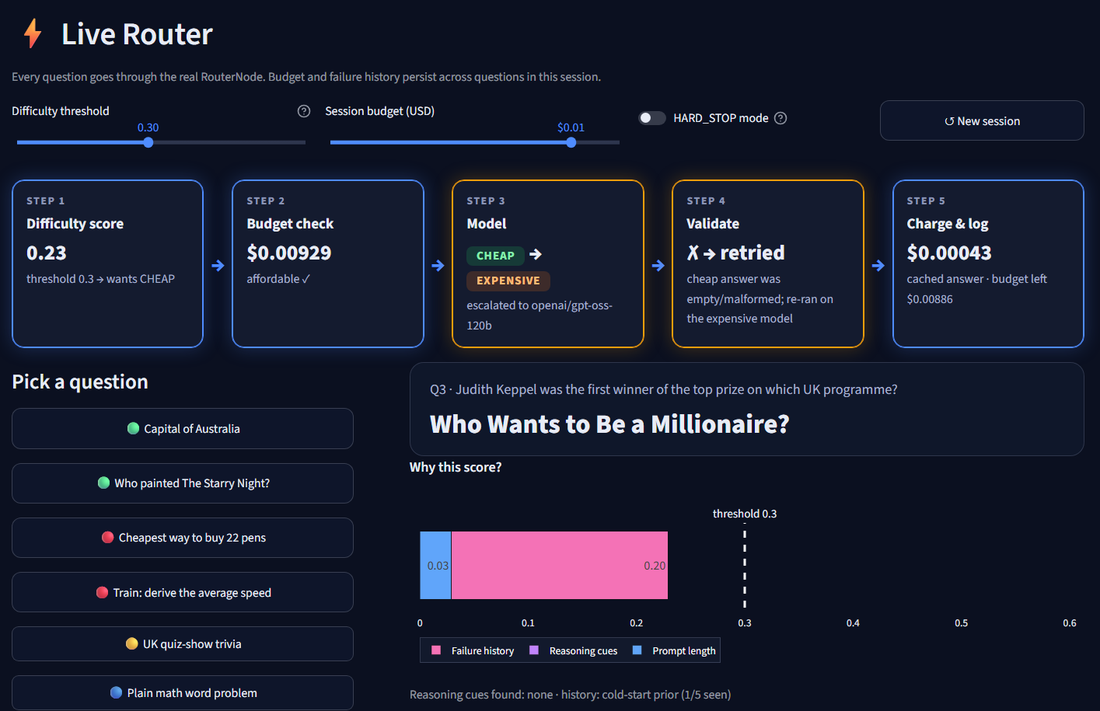

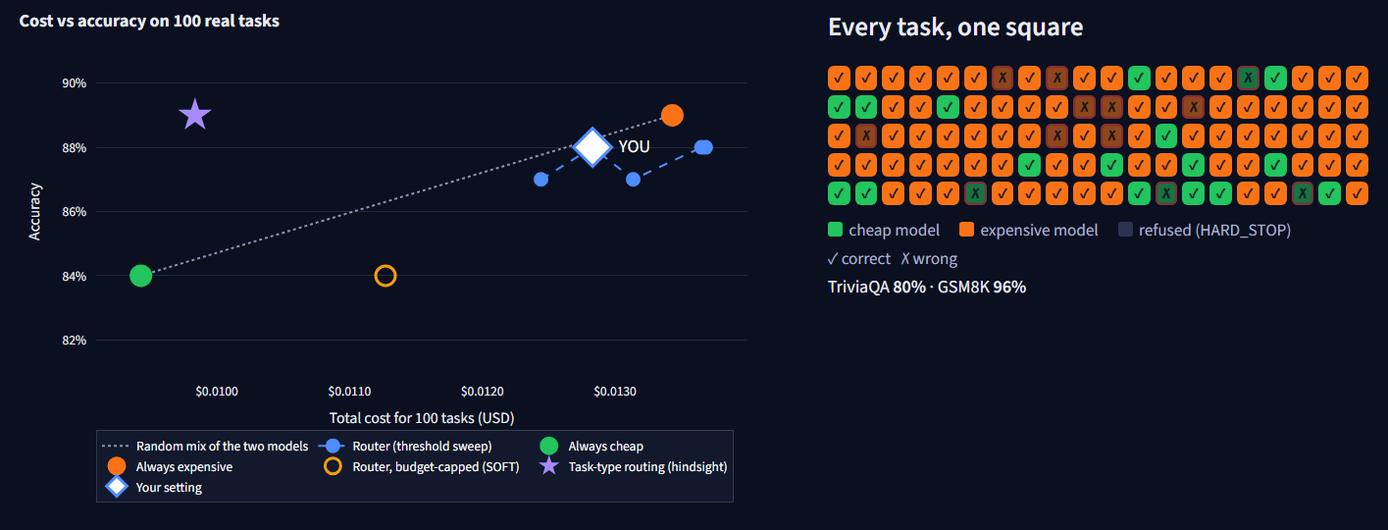
Live demo: watch every routing decision
Easy question → cheap model
Hard question → expensive; tricky trivia → retry
Shrink the budget → budget-forced downgrades
Playground: drag the threshold, watch cost and accuracy move
streamlit run dashboard/app.py
Notes:
Now let me show it live. [Switch to the dashboard.] On the Live Router page I'll ask an easy question — it goes to the cheap model. Then a hard one with lots of reasoning words — expensive. Then the tricky trivia question: watch step 4 turn amber as the cheap answer comes back empty and gets retried on the expensive model. Then I'll shrink the budget so hard questions get downgraded. Finally the Playground replays all 100 benchmark questions instantly as I drag the threshold. If anything goes wrong with the live demo, these screenshots show the same screens.

Slide 12






What we learned and what comes next
LESSONS
NEXT VERSION
The plumbing works
Cheap first, escalate on failure
Budgets, escalation and the audit trail behave as specified on real models
Learn difficulty per kind of step
Length is a weak signal
When the cheap model can reason, “long” doesn't mean “hard”
More than two model tiers, async agents
Measure honestly
Fixed seeds, cached answers and hand-checked grading made the result trustworthy
CI, a PyPI package, live provider prices
Questions?
github.com/prakharsahup/Cost-Router
Notes:
To wrap up. Three lessons: the plumbing works — budgets, escalation and logging behave exactly as designed on real models. Prompt length turned out to be a weak difficulty signal once the cheap model can reason. And measuring honestly — fixed seeds, recorded answers, hand-checked grading — is what let us trust a result that wasn't the one we hoped for. Next version: try the cheap model first and escalate only on failure, learn difficulty per kind of step, support more models and async agents, and package it properly. The code is on GitHub. Thank you — happy to take questions.

