Slide 1
Regulatory Reporting Case Study
Analysis for R1 and R2
Prakhar Srivastava
Date: [23-Sep-2024]

Slide 2

Introduction
Overview of the case study
Objectives:
- Provide aggregate data for R1 and R2
- Analyze cross-currency and same-currency volumes in GBP
Data sources: customer_data and transactions_data

Slide 3
Data Exploration
Key Observations:
The currency_route format is structured as "GBP --> AUD" and similar.
Customer data contains country codes (GBR for UK, USA for US) to classify entities.

Slide 4
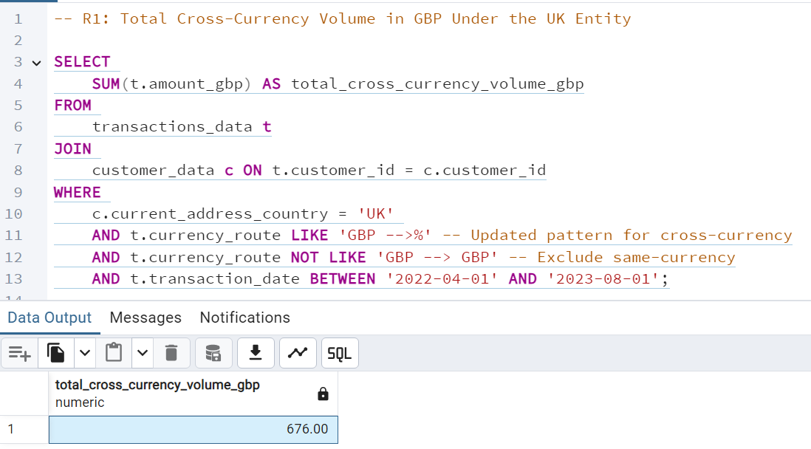
Query 1 - R1 (UK Entity Cross-Currency Volume)
SQL Query used
Result: 676 GBP
Query Logic:
Join Tables: Linked transactions_data with customer_data on customer_id.
Cross-Currency Check: Used currency_route LIKE 'GBP -->%' and excluded GBP --> GBP.
Date Range: Filtered transactions between '2022-04-01' and '2023-08-01'.
Filter UK Entity: Selected transactions with current_address_country = 'UK'.
Summation: Summed amount_gbp for total volume.

Slide 5
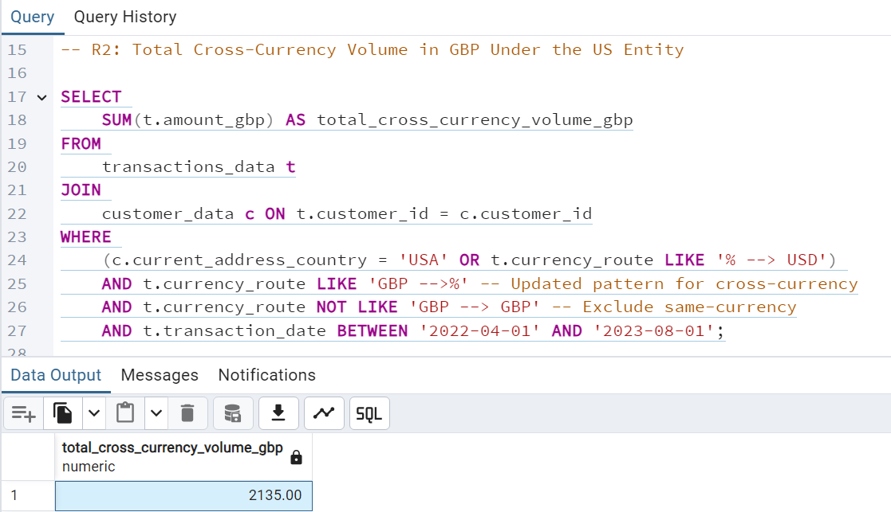
Query 2 - R2 (US Entity Cross-Currency Volume)
SQL Query used
Result: 2135 GBP
Query Logic:
Join Tables: Linked transactions_data with customer_data on customer_id.
Cross-Currency Check: Used currency_route LIKE 'GBP -->%' and excluded GBP --> GBP.
Date Range: Filtered transactions between '2022-04-01' and '2023-08-01'.
Summation: Summed amount_gbp for total cross-currency volume.
Filter US Entity: Selected transactions with current_address_country = 'USA' or route involving USD.

Slide 6
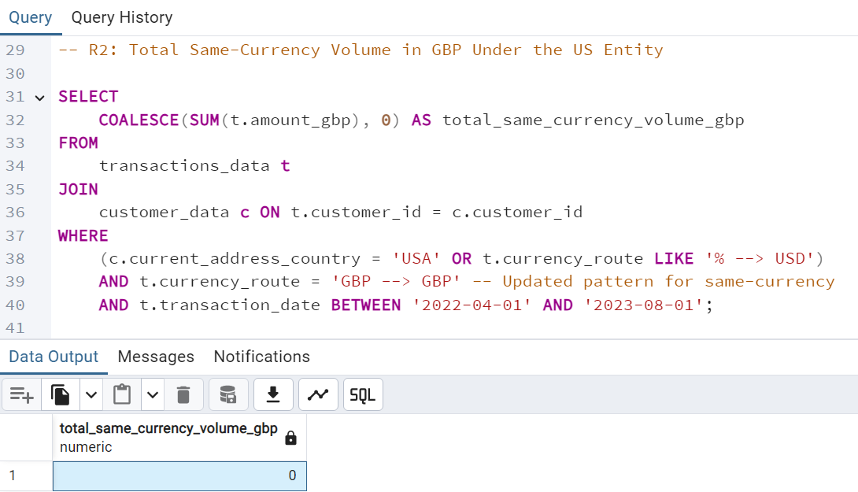
Query 3 - R2 (US Entity Same-Currency Volume)
SQL Query used
Result: 0 (No transactions found)
Query Logic:
Join Tables: Linked transactions_data with customer_data on customer_id.
Filter US Entity: Selected transactions with current_address_country = 'USA' or route involving USD.
Same-Currency Check: Used currency_route = 'GBP --> GBP' to find same-currency transactions.
Date Range: Filtered transactions between '2022-04-01' and '2023-08-01'.
Summation: Attempted to sum amount_gbp; resulted in 0 as no matching transactions were found.

Slide 7


Key Findings and Insights
Summary of Results:
- UK Entity Cross-Currency Volume: 676 GBP
- US Entity Cross-Currency Volume: 2135 GBP
- US Entity Same-Currency Volume: 0 GBP
Interpretation of Results:
The US entity has significantly more cross-currency activity compared to the UK entity.
No same-currency transactions were identified for the US entity.

Slide 8

Caveats and Considerations
Data Format Inconsistencies: The format of the currency routes may vary, leading to potential misidentification of cross-currency transactions.
Customer Data Accuracy: The Current_Address_Country field may not always reflect the latest customer location.
Transaction Date Range: Transactions outside of the analyzed range (01/04/2022 - 01/08/2023) were not included.

Slide 9
Recommendations and Next Steps
Data Validation: Implement a validation step to ensure all currency routes follow the same standard format.
Customer Data Updates: Ensure that customer information, especially their residence, is updated regularly to avoid misclassification of transactions.
Automation: Automate the reporting process using tools like Airflow or DBT to ensure consistency in weekly and annual submissions.

Slide 10
Conclusion
Final remarks on the analysis and findings
Acknowledgment of the scope and importance of the regulatory reports

