Slide 1


WELCOME
Intro
STARTUP GUIDANCE
Features
Faculty
The End
services
DESIGNED BY : PRAKHAR SHUKLA
ABHISHEK KUMAR SINGH
AYUSH SAHU
ANURAG SINGH

Slide 2
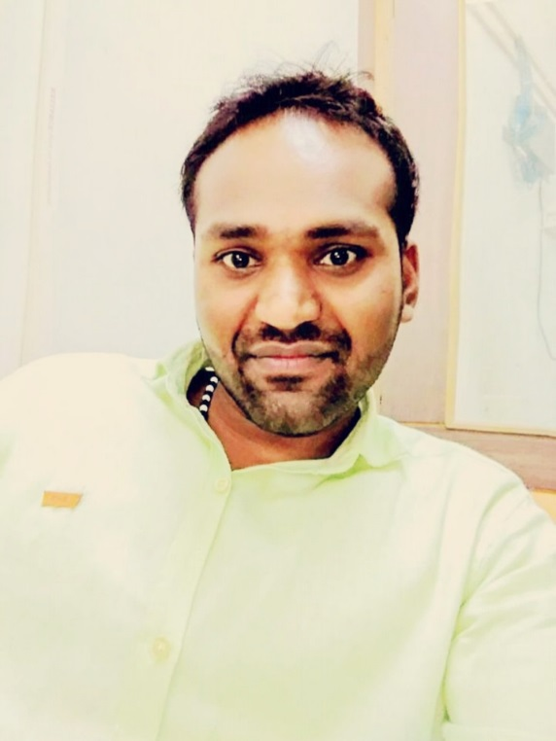
The End
Intro
services
Features
Faculty
UNDER THE GUIDANCE OF
Mr. RAKESH YADAV
FACULTY@SRMIST

Slide 3
INTRODUCTION
Startup is the need of the hour in developing countries like India, instead of taking jobs as a engineer we should try and generate jobs. So as a budding engineer , in our project we have tried to simplify the work of a young entrepreneur.
The End
Features
Intro
services
Faculty

Slide 4
BACKGROUND
In India though lot of startups get started but most of them get failed as the potential entrepreneur doesn’t have the proper guidance of how the investment sector works and if their idea is unique or not.
The End
services
Features
Faculty
Background

Slide 5



The End
Intro
services
teas
Features
Faculty
PREDICTION
UNIQUENESS
FORUM
WHAT IS YOUR SUCCESS PROBABILITY!!
HOW UNIQUE IS YOUR IDEA!!!
DISCUSS YOUR IDEA WITH THE INVESTORS

Slide 6
PREDICTION
Our web app uses machine learning implemented through python to predict the outcomes in any scenario. The user can give information such as the idea of his startup, the investment he is putting himself, the industry field, location of his startup, the machine will predict the probability of getting the required funding from an investor.
The End
services
Into
Features
Faculty

Slide 7
UNIQUENESS
The uniqueness depends upon how much one’s idea differs from any other idea. This is principle used by our machine to tell us the uniqueness of any idea. The machine recognizes the keywords from the input data and compares it with its database and tells us the how unique the idea is.
The End
services
Intro
Features
Faculty

Slide 8
nb
FORUM
There will be separate portal for the interested investors which can connect with the potential candidates through our forum which will be a discussion platform for both candidates and investors. If an investor is interested in any startup, he can communicate with the startup candidate through private messenger.
The End
services
Intro
Features
Faculty

Slide 9
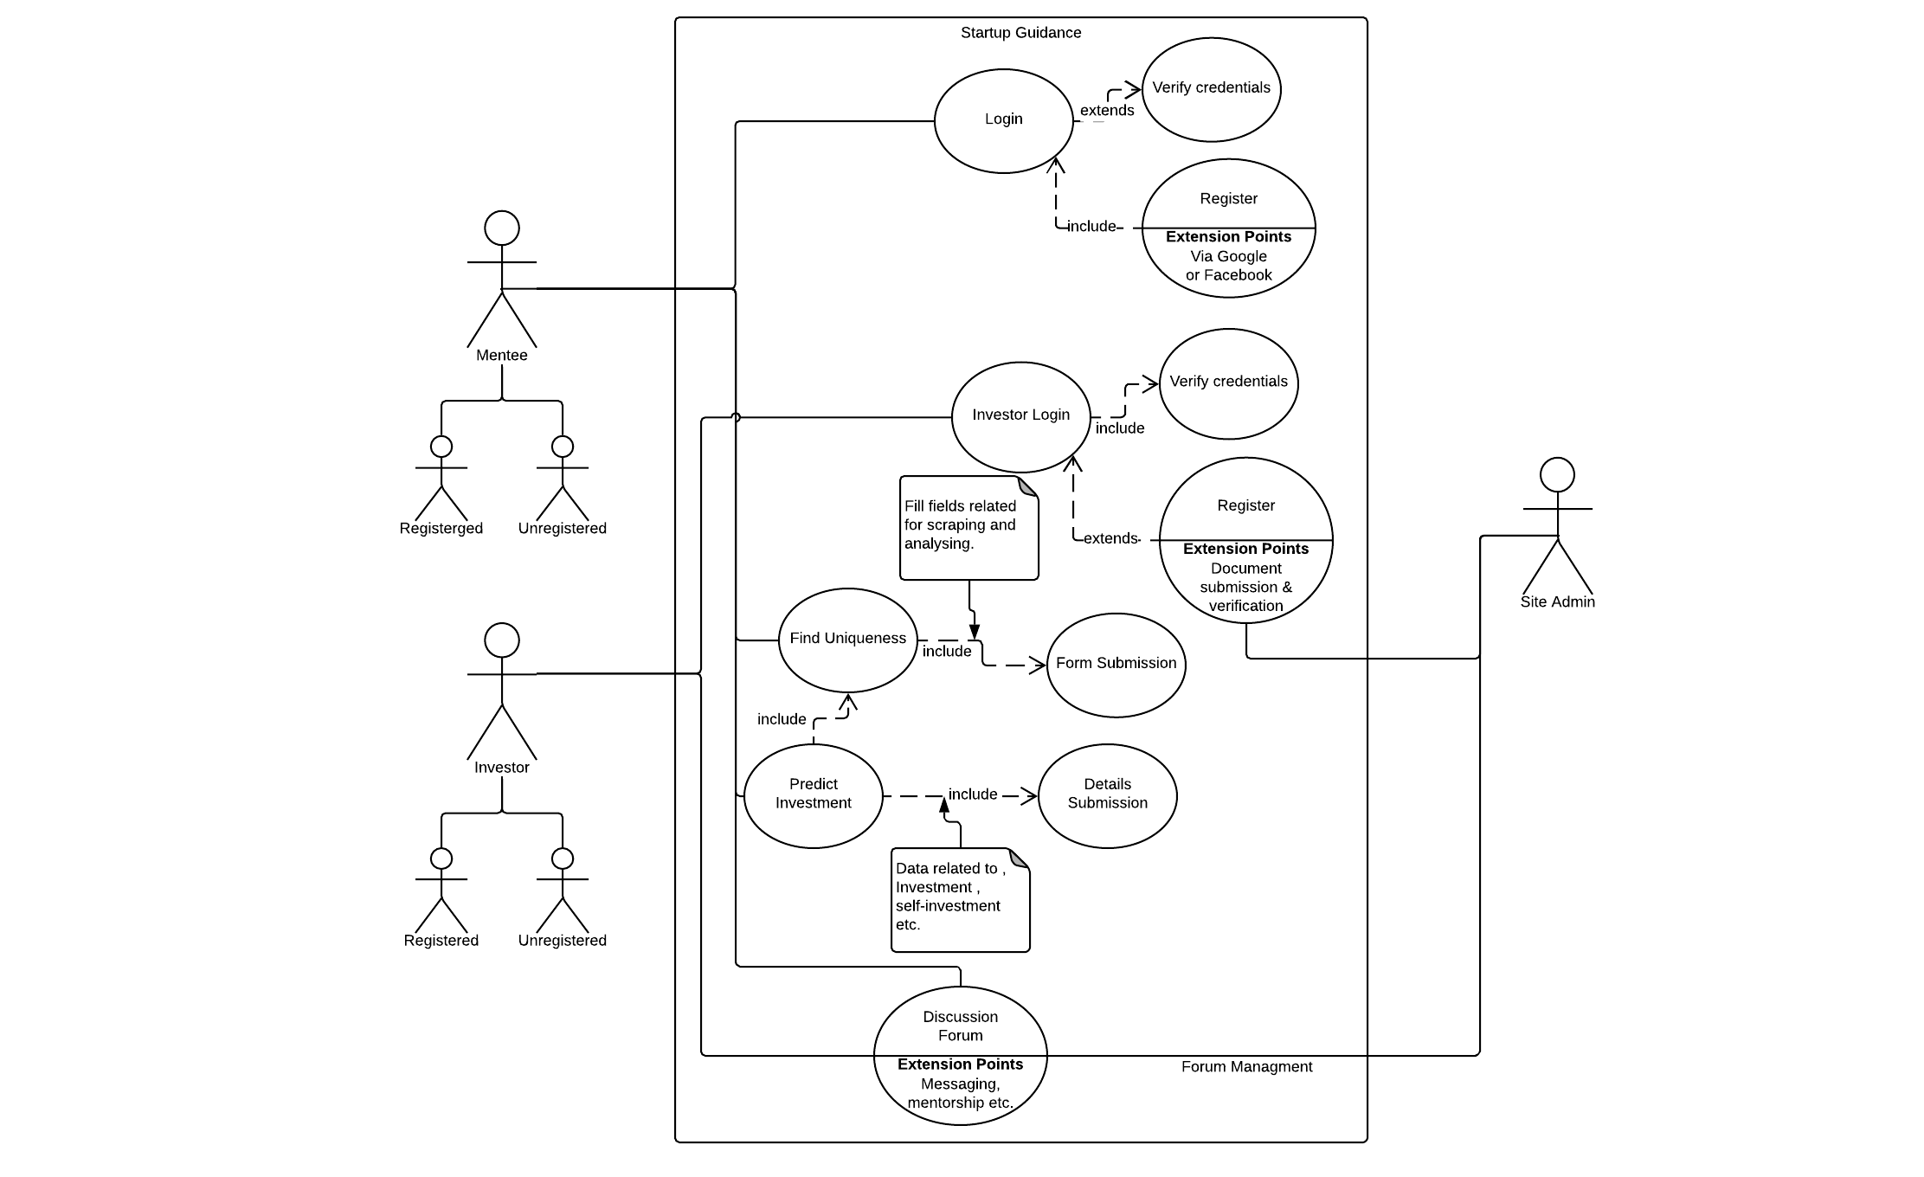
The End
services
Features
Faculty
Background

Slide 10
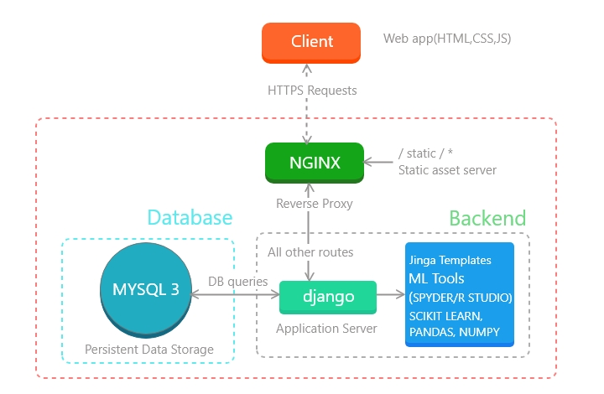
TECHNOLOGY STACK
The End
Technology
services
Faculty
Features

Slide 11
THANK YOU
The End
Intro
services
Features
Faculty

