Slide 1
CompGAN
Prakhar Srivastava
MS Computer Engineering- ECE
Stony Brook University, NY, USA

Slide 2
GAN
GANs is a Generative Adversarial Network model.
It uses an adversarial minimax game between a generator and a discriminator.

Slide 3
Why, Where, Problem
Recommender systems (RS)
GANs successful
Problem in recommender system
Generative model–
generate “new and better solutions”
Computer Vision industry
Recommendation Systems
Fewer user or insufficient information makes recommendation task difficult

Slide 4
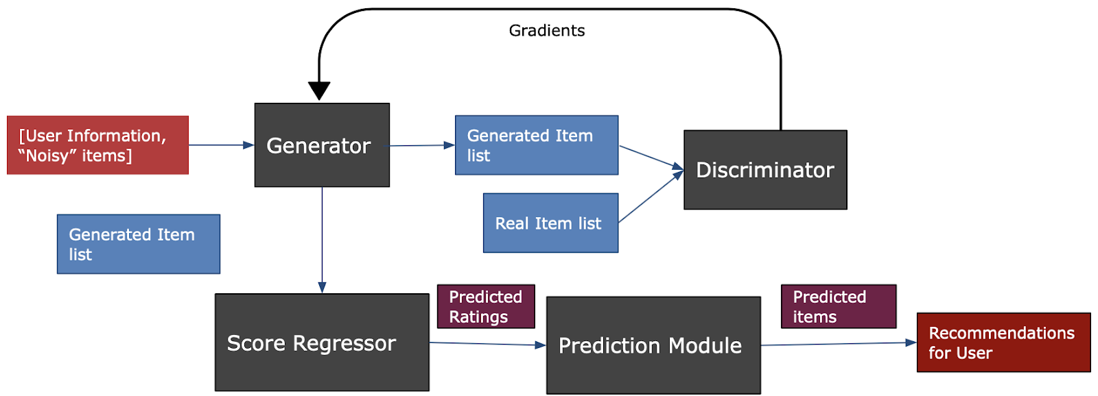
GAN Architecture

Slide 5
Terms used
Users = Applications
Items = laptops

Slide 6
GAN (CFGAN)
The Generator is trained on the implicit user - item feedback matrix R{mn}, where m is the number of users and n is the number of items.
The Discriminator is trained to differentiate between a generated item vector and a real item vector

Slide 7

Losses
Binary cross entropy loss to be minimize.
Loss function:
where xj, xj are the original and ground truth items

Slide 8
Losses
Minimize Generator loss: Objective function of G + Reconstruction loss
Minimize Discriminator loss: Binary cross entropy
Reconstruction Loss:
Don’t want generator to generate all the items for recommendation.
Sample some negative items and add to user’s list

Slide 9
Score Regressor
Score Regressor is trained after training the GAN using the items generated by the Generator.
We need to impute the ratings for items in:
Train on user/item information
Backpropagation

Slide 10
Switch to Google colab

