Slide 1
TCube (train the teacher) – an effective education initiative
It is a Faculty Development Program (FDP) which targets to train teachers of technical institutes in India to improve the teaching skills.
It’s a bootstrap model based on learning management system.
Technology Used : Django Web Framework, Python, JavaScript

Slide 2
Modules Involved
1) Attendance Module Registration Module
2) Certificate Generation Module
3) Email Content
4) Faculty Pooling
5) FDP Manager (Principle Course Delivery Manager)
6) Library Knowledge Management System
7) Manage RC Capacity
8) Role Management
9) Status Management

Slide 3
Remote Center Capacity Management
Prakhar Singh Sengar
NIT Patna

Slide 4
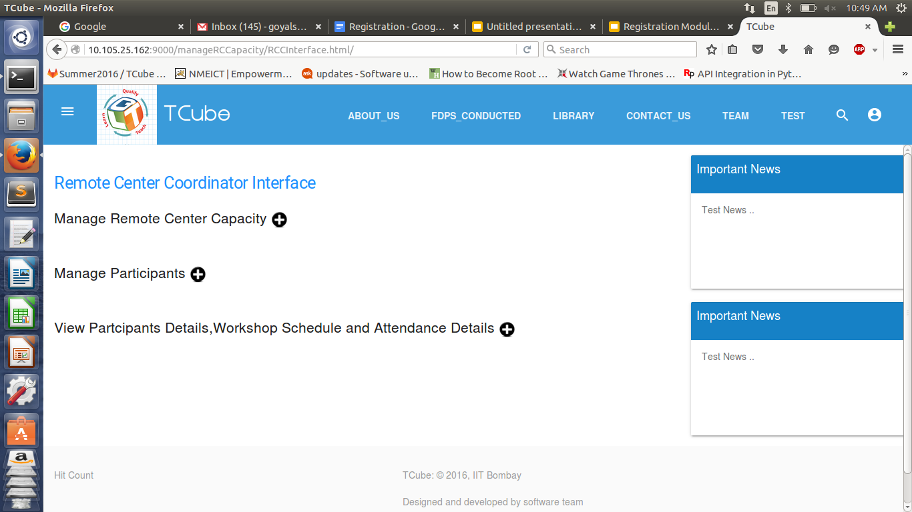
RCC Interface

Slide 5
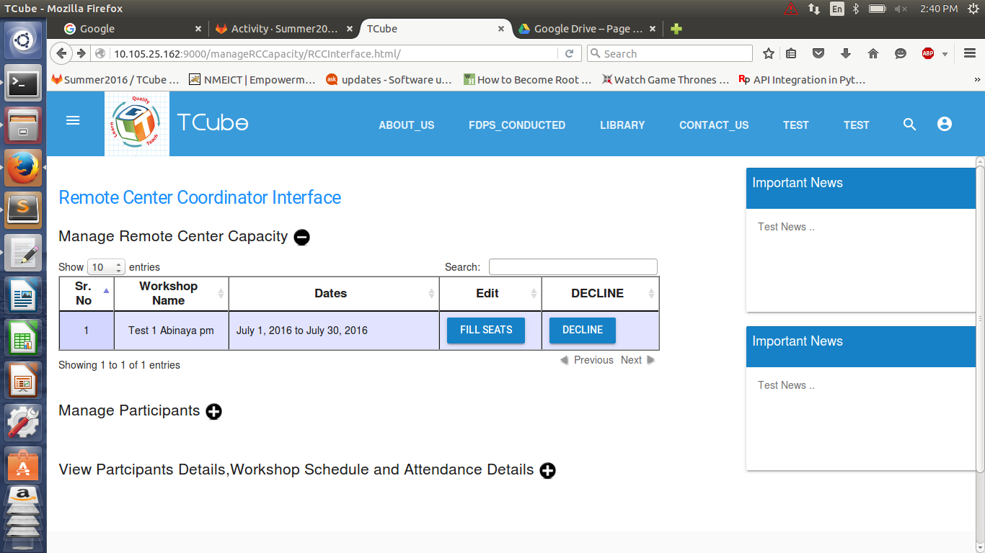
Fill/Decline Workshop
RCC can fill the capacity or decline the workshop if there are no participants.

Slide 6
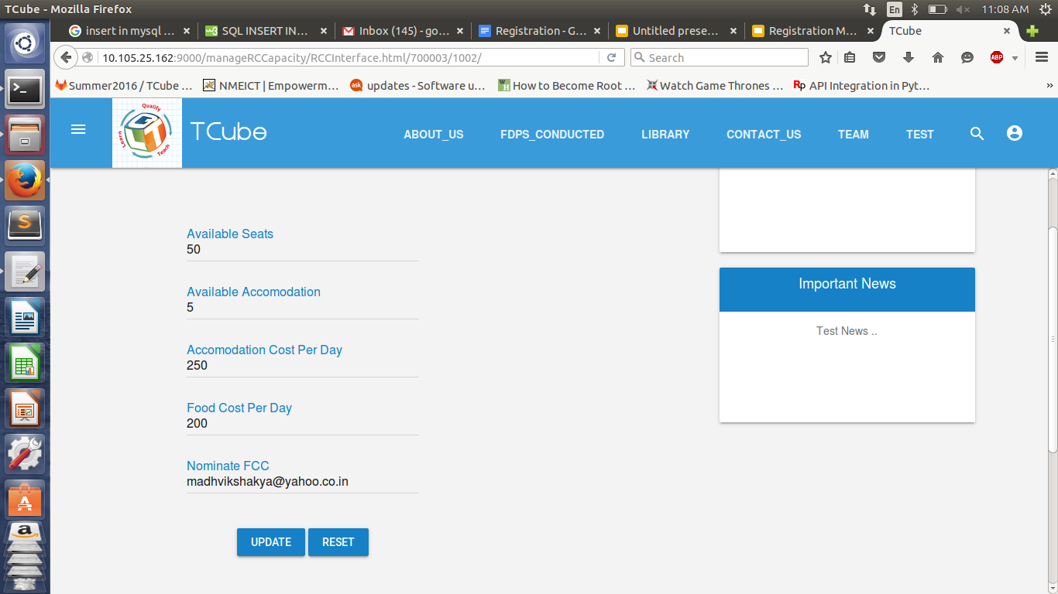
Fill Capacity
Once the RCC has filled the capacity, he can also update it.

Slide 7
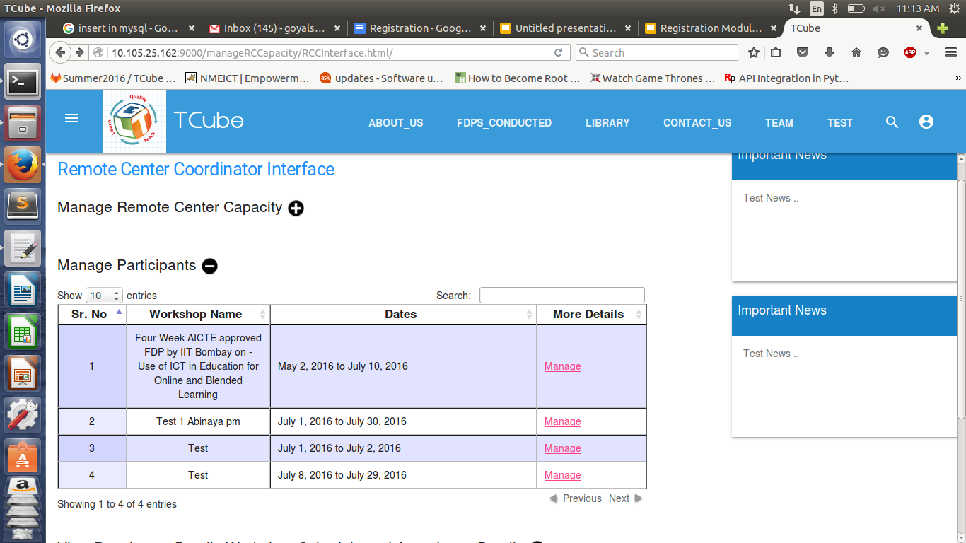
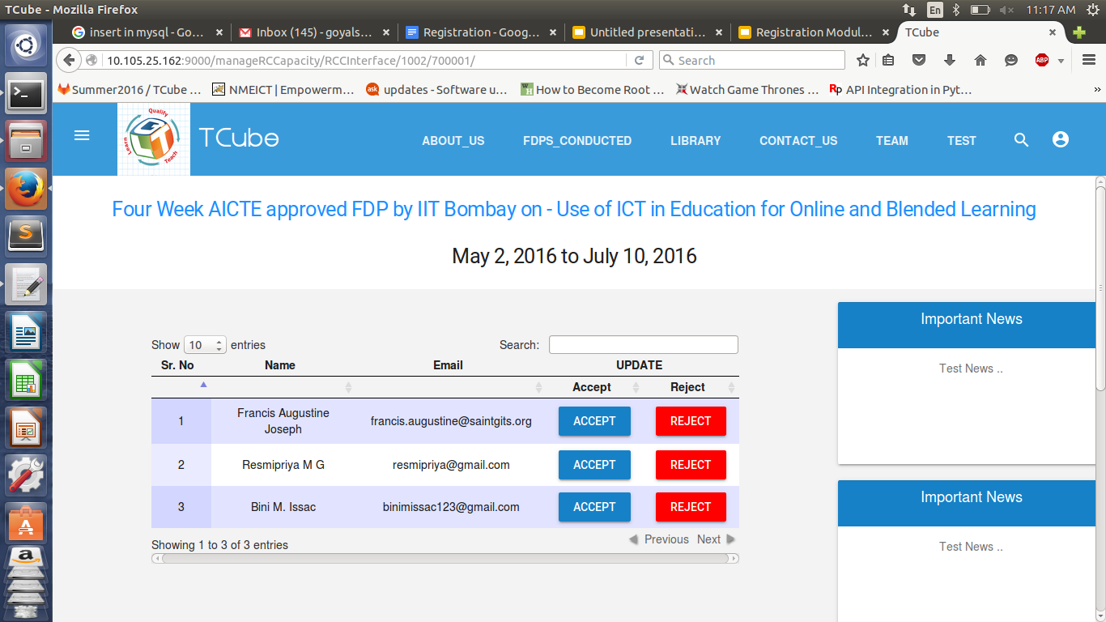
Manage Participants
The RCC accept/reject participants based on whether they have made the payment to Remote Center.

Slide 8
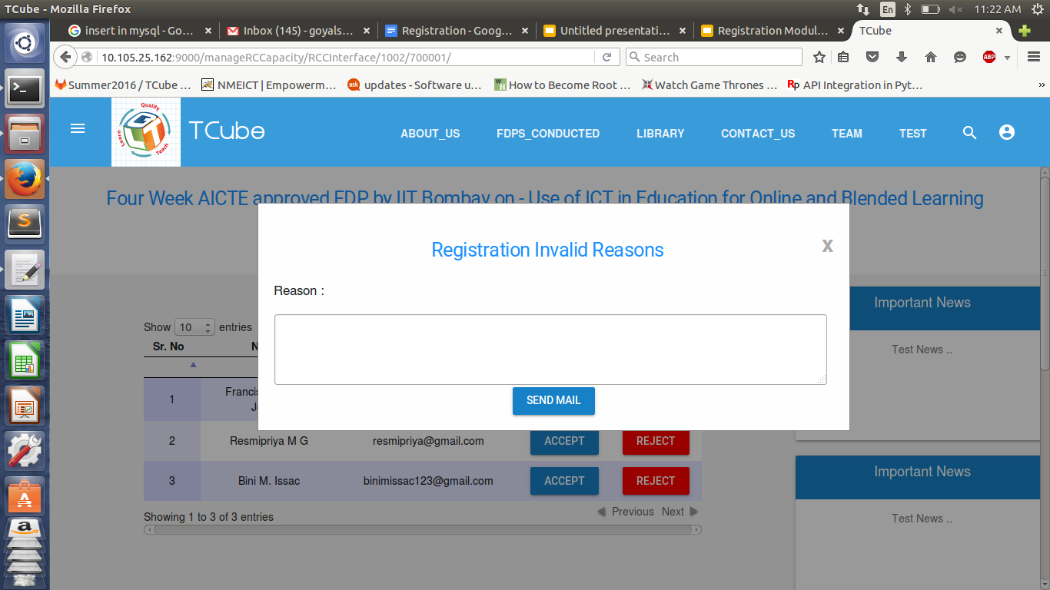
On reject, the RCC enters the reason and an email is sent to participant.

Slide 9
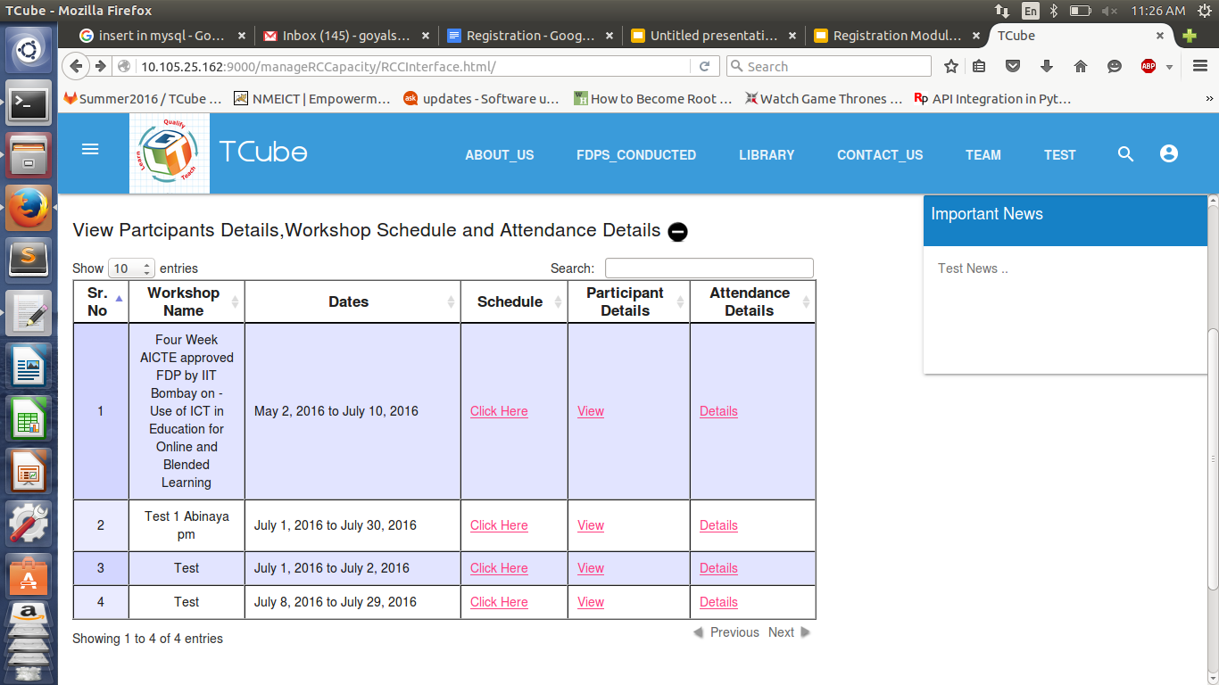
View Other Details
The RCC can also view participant’s, attendance details and workshop schedule

Slide 10
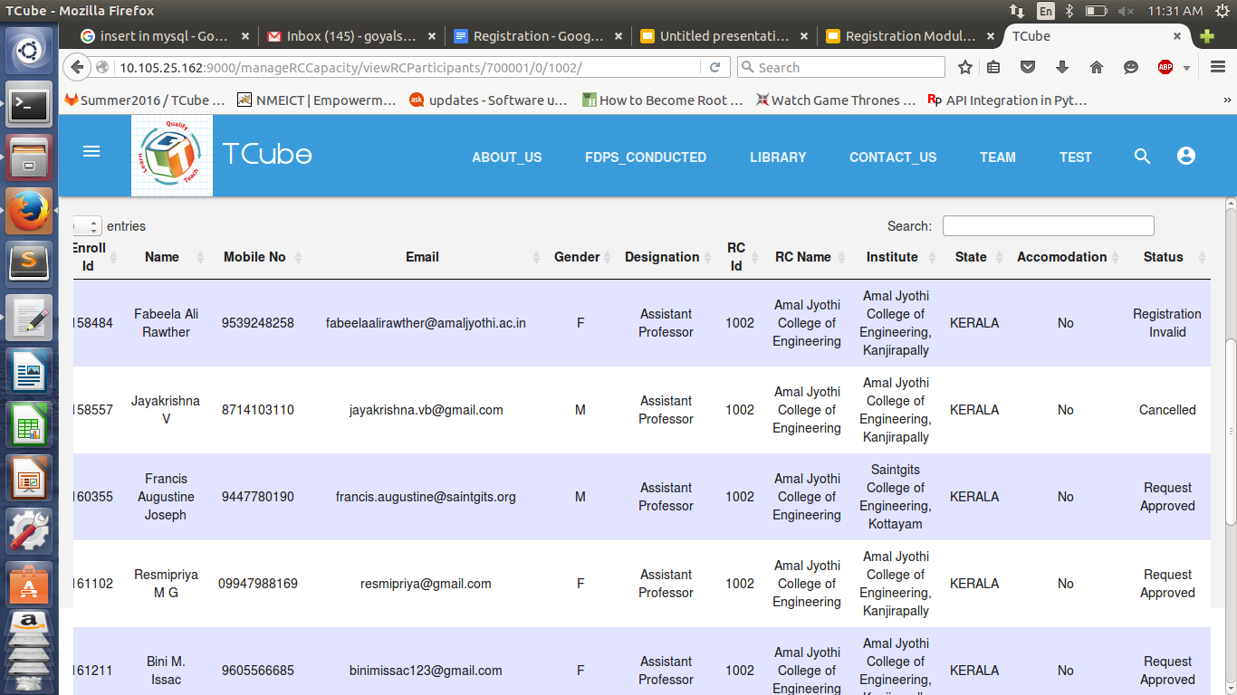
View Participants

Slide 11
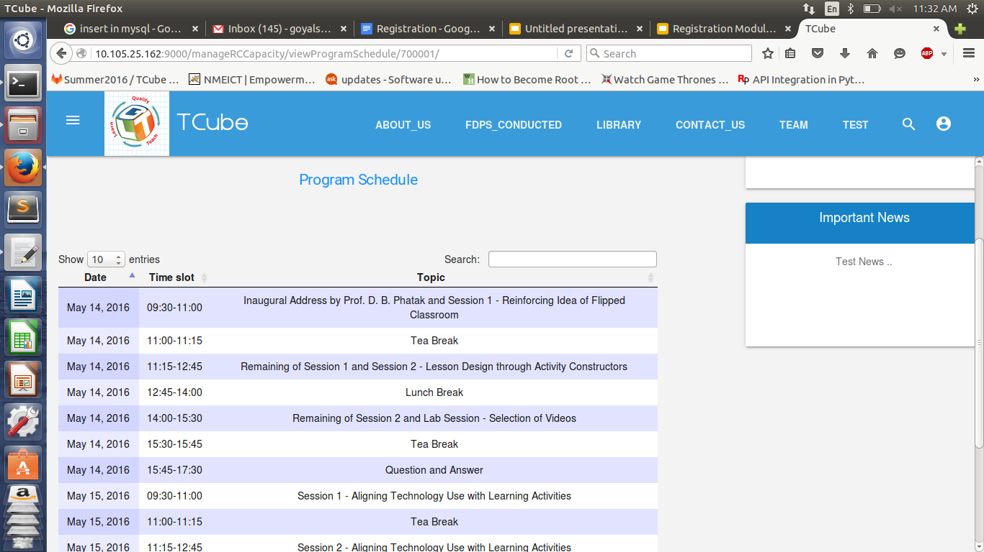
View Workshop Schedule

Slide 12
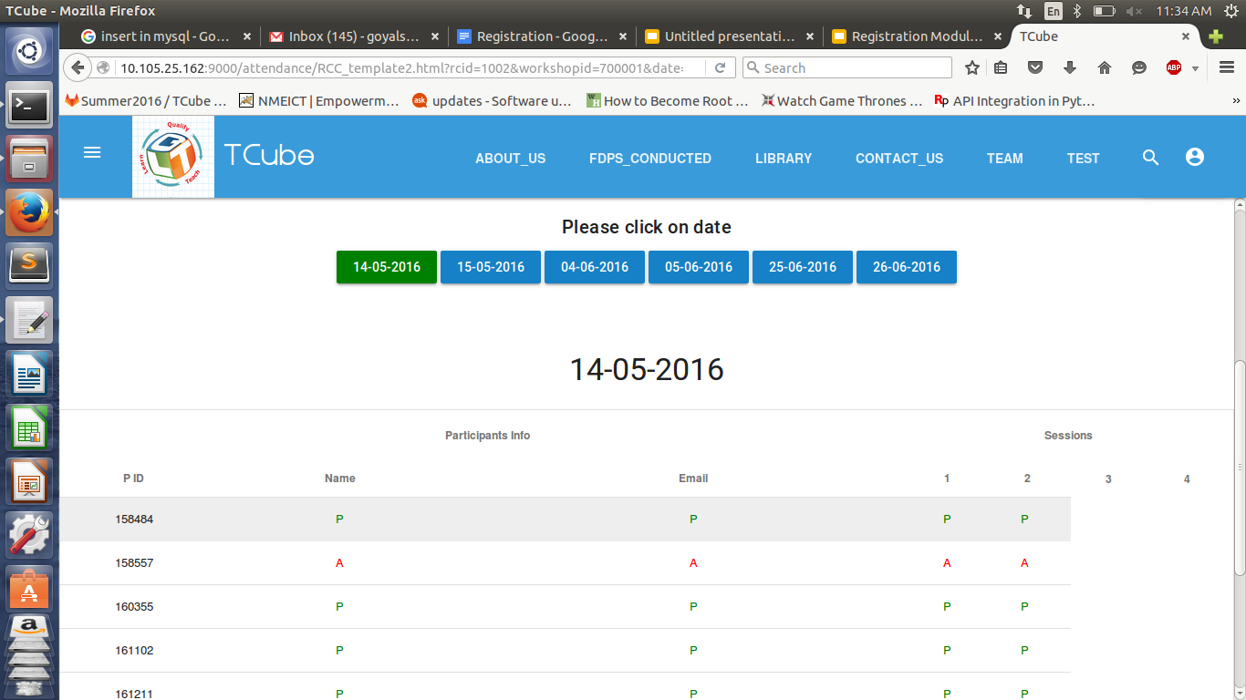
View Attendance Details

Slide 13
Status Management
Prakhar Singh Sengar
NIT Patna

Slide 14
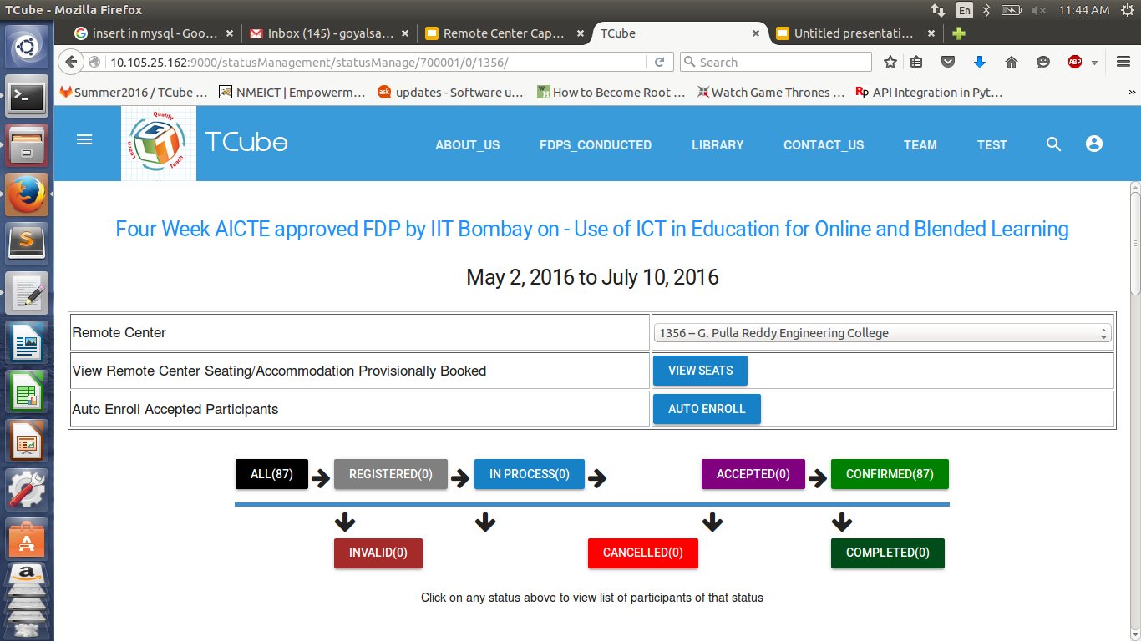
Participants shown Remote Center Wise

Slide 15
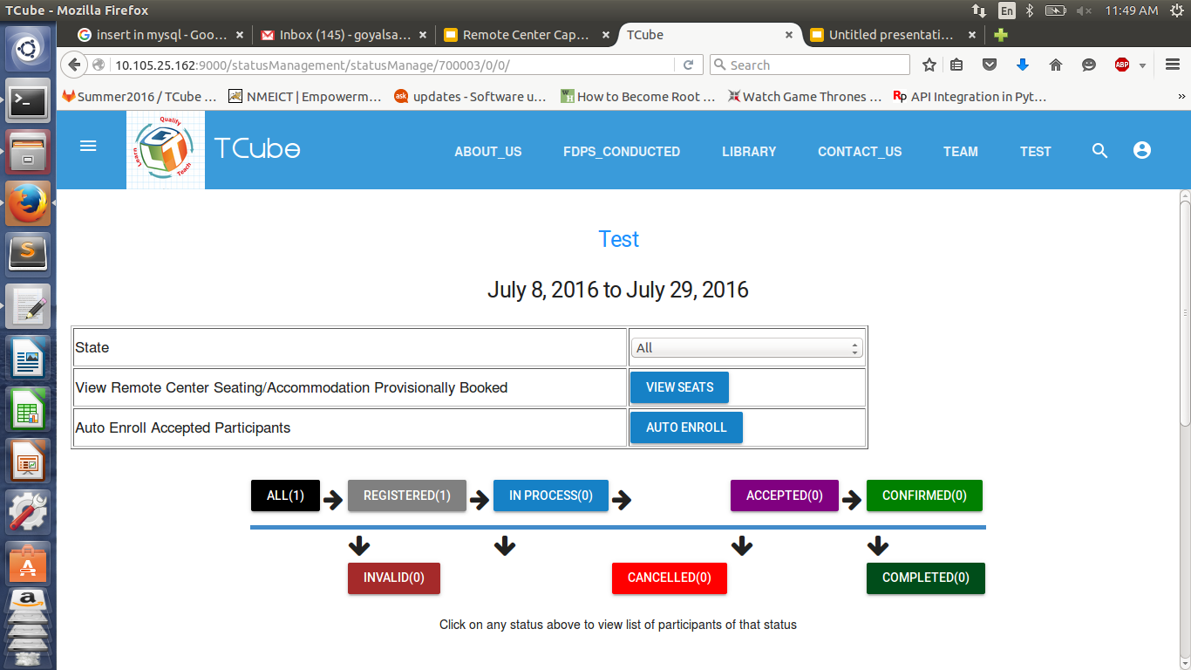
Participants shown State Wise

Slide 16
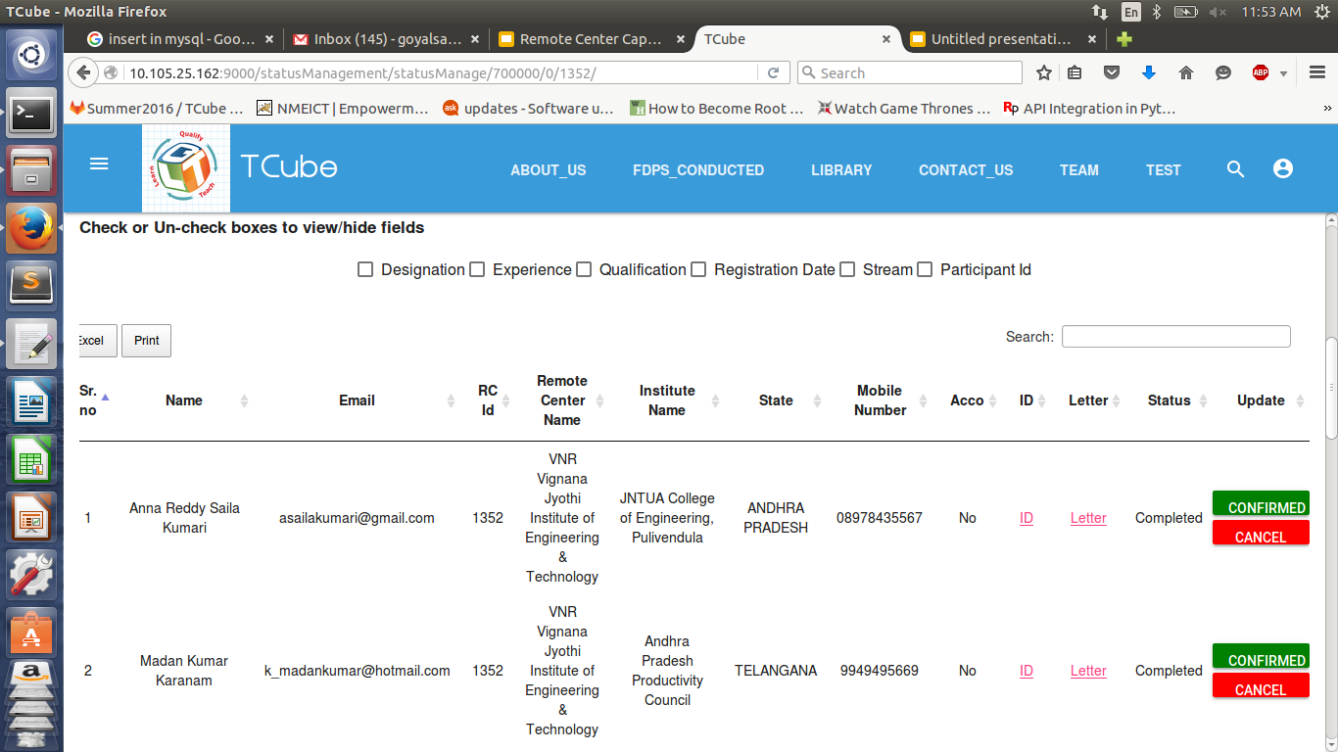
Status of participants will change according to the button clicked.

Slide 17
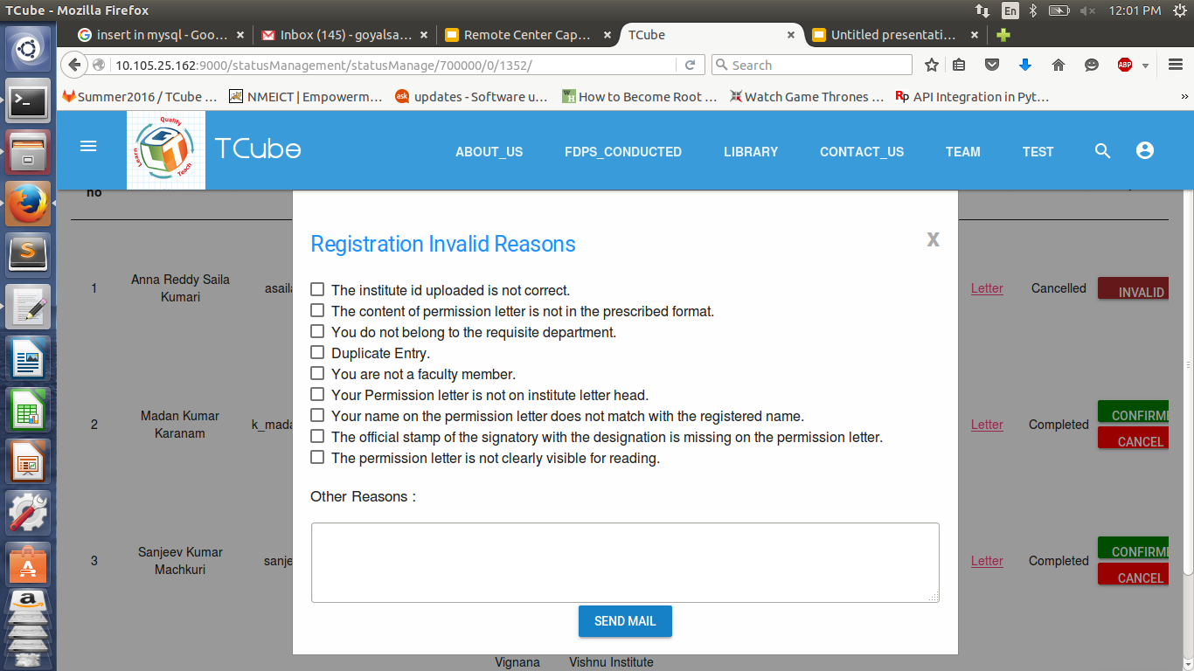
On clicking invalid, the PDM will enter the reason for invalidating the participant and an-email is sent to him/her informing him about the reason.

Slide 18
TCube software communicates with the IITBombayX (Learning Management System) for data migration and analysis.
The participant, when approved in status management is enrolled in IITBombayX for the course he/she has enrolled.
For this we have used the edx enrollment API to enroll the participant automatically in the LMS system of IIT Bombay.

Slide 19
Thank You

