Slide 1

Eco - Loop Building Agent
Autonomous Closed-Loop HVAC Optimization via EnergyPlus + Local LLM
Problem Statement Title:
Eco - Loop Building Agent
Theme:
Smart Automation / Sustainable Energy
PS Category:
Software
Candidate Name:
Prakhar Mishra
Candidate ID:
20518043

Slide 2
Proposed Solution
What Eco - Loop Does:
Links EnergyPlus (physics sim) with a local LLM (Gemma-4-E2B)
Continuous loop: Sense → Reason → Act → Repeat, every hour
Autonomously adjusts HVAC setpoints — zero human intervention
Innovation & Uniqueness:
Fully local System – local LLM running on Nvidia rtx 2050 4gb vram
Real physics co-simulation (not a rule engine)
LLM output safety-wrapped by deterministic ASHRAE 55 guardrails
4× efficiency: 168 hourly decisions over 7 days in < 4 minutes
Traditional BMS vs EcoLoop AI
✗ Static schedules, no adaptation
✓ Dynamic setpoints, hourly AI decisions
✗ Ignores weather / occupancy
✓ Reads 6-hr weather forecast + live PMV
✗ Wastes energy on overcooling
✓ 23.34% cooling energy reduction
✗ No comfort feedback loop
✓ ASHRAE 55 PMV compliance: 98.2%

Slide 3
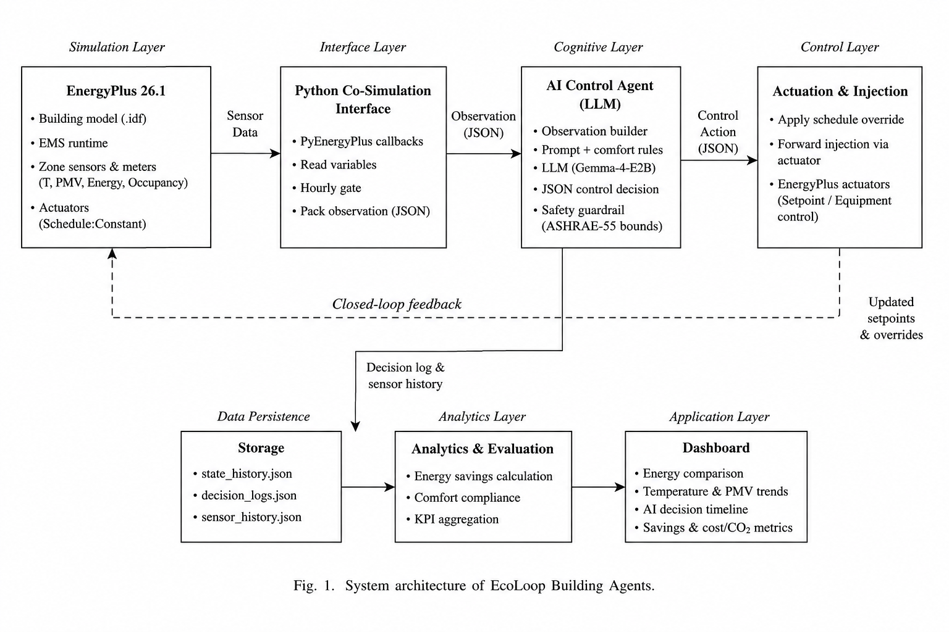
Technical Approach
Technologies Used:
Simulation: EnergyPlus 26.1.0 + pyenergyplus PythonPlugin API
Cognitive: Gemma-4-E2B — local LLM via llama.cpp (OpenAI REST)
Language: Python 3.11 (src/ecoloop package)
Data: EPW weather files, SQLite (eplusout.sql), JSONL log
Dashboard: HTML + Chart.js (BMS Control Console)
Key Design Decisions:
Hourly gating → 4× fewer LLM calls (672 → 168 over 7 days)
max_tokens=128 → ~1.5s inference per call
Fallback to last_good setpoints on timeout — never crashes EnergyPlus
Skip actuation during design-day sizing (env_num < 3 guard)

Slide 4
Feasibility, Challenges & Mitigations
Feasibility:
Fully implemented & tested — 7-day Chicago summer simulation (July 1–7)
Runs end-to-end in < 4 minutes on consumer hardware
No internet or cloud required — 100% locally deployable without external api support
Challenge
Risk
Mitigation Strategy
LLM outputs malformed JSON
Simulation crash
Regex fallback + last_good setpoint reuse
LLM too slow for 672 timesteps
Unusable runtime (>50 min)
Hourly gating — 168 calls, < 4 min total
Setpoints outside safe HVAC range
Equipment damage / instability
Deterministic ASHRAE 55 clamp layer
LLM over-corrects (hunting)
Oscillating setpoints
3-step rolling decision memory in prompt
Design-day sizing interference
Corrupted HVAC sizing
env_num < 3 guard skips actuation

Slide 5
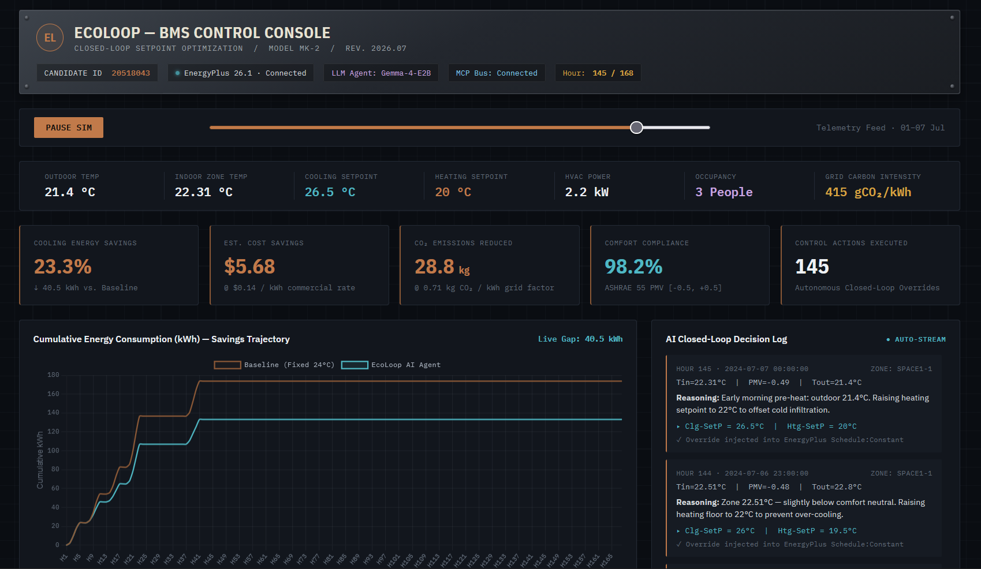
Artifacts — Results, Code & Dashboard
Quantitative Results (July 1–7, Chicago Summer)
Metric | Baseline | EcoLoop AI | Change
Cooling Energy | 173.70 kWh | 133.16 kWh | -23.34%
Avg PMV Index | -0.66 | -0.55 | +16% toward comfort
Avg Zone Temp | 22.96 °C | 23.35 °C | Less overcooling
AI Decisions Made | 0 | 168 | Hourly
Total Runtime | – | < 4 min | 7 days simulated

Slide 6
References
1. EnergyPlus Documentation
U.S. Department of Energy — energyplus.net/documentation
2. ASHRAE Standard 55-2020
Thermal Environmental Conditions for Human Occupancy — ashrae.org
3. Fanger, P.O. (1970)
Thermal Comfort: Analysis and Applications in Environmental Engineering
4. Gemma (Google DeepMind, 2024)
Open-weight LLM — ai.google.dev/gemma
5. llama.cpp
Local LLM inference, OpenAI-compatible API — github.com/ggerganov/llama.cpp
6. pyenergyplus
EnergyPlus Python API — github.com/NREL/EnergyPlus
7. Model Context Protocol (MCP)
Anthropic open standard for agentic tool calling — modelcontextprotocol.io
8. Project Repository
https://github.com/prakhxr0/agentic-bms

