Slide 1


MERN STACK PROJECT
WeMeet Video Call

Slide 2
Tech Stack
ReactJs
Simple Peer
NodeJS
Socket.io
Material UI

Slide 3

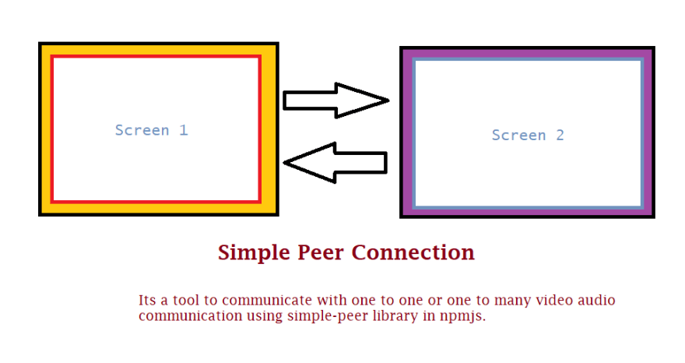

Slide 4
Camfrog provided Free Online Video Chat Rooms where you can find girls and boys on live webcam for chatting easily. These rooms are very popular because there are many open minded men and women who like Video calling around the world. These free online Webcam chat rooms are very useful because many people can watch each other live while chatting. They play a great role in bringing people closer to each other. If you are interested in watching your friends on Webcam then you are welcome here. We provide you a great venue where you can hang around with your friends to watch them by the internet calling without any kind of charges.

