Slide 1
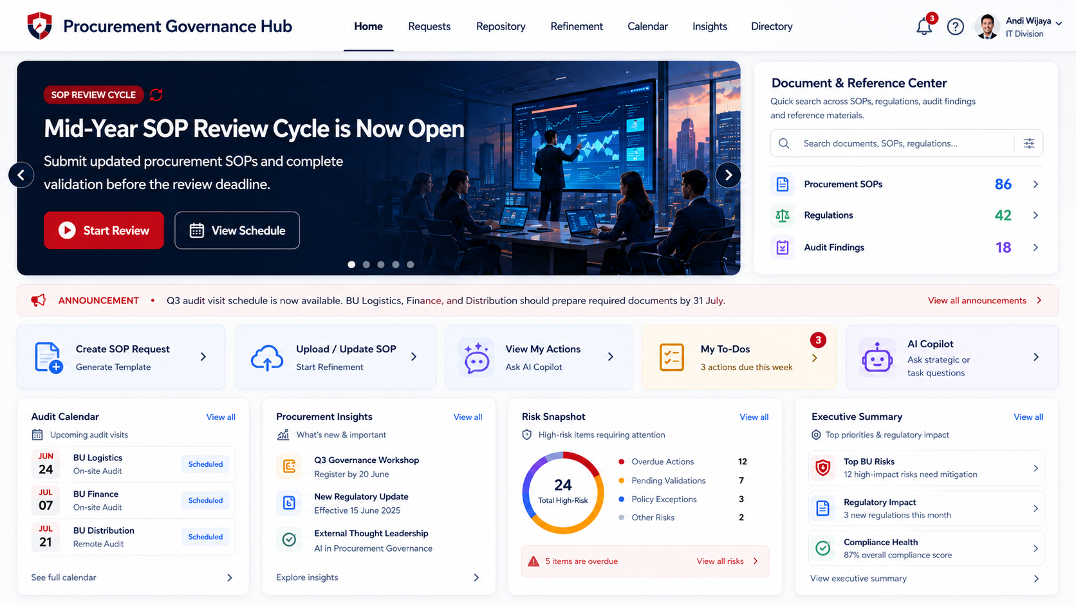
Board-ready master plan
AI-Assisted Procurement SOP
Governance Platform
A governance platform for managing procurement SOP requests, AI-assisted refinement, validation, publishing, monitoring, and executive visibility across business units.
From document portal to lifecycle governance platform
Revised board deck
Executive view
Live risk summary
Procurement
Governance
Hub
Request → Refine → Validate → Publish → Monitor
AI copilot
Audit schedule
01

Slide 2
AI-Assisted Procurement SOP Governance Platform
02
The Big Idea
This is the message that should anchor the whole discussion.
We are building a governance platform,
not just a document portal.
Portal
is the interface.
Governance platform
It helps ensure procurement SOPs across business units are properly documented, reviewed, validated, aligned with regulations, and followed up with clear ownership and measurable timelines.
is the function.
Positioning shift
from storage and access into lifecycle governance.
This wording avoids the confusion of “operating system” while keeping the strategic ambition clear.
02

Slide 3
AI-Assisted Procurement SOP Governance Platform
03
As-Is: The Current Reality
The issue is not only document storage. The bigger issue is fragmented SOP governance.
1
SOPs are scattered
4
Review takes time
Different BUs, formats, owners, and storage habits.
Compliance teams read, compare, and consolidate manually.
2
Ownership is unclear
5
Updates are not linked
PIC, active version, and approval status are not always visible.
Regulations, audit findings, and business needs may not directly trigger SOP changes.
3
Requests are manual
6
Follow-up is hard to monitor
New SOP/template requests can live in email, chat, or meetings.
Owners, due dates, and progress are not always visible to management.
Pain pattern: fragmented inputs, manual review, unclear ownership, and delayed visibility.
03

Slide 4
AI-Assisted Procurement SOP Governance Platform
04
To-Be: How the Platform Solves It
Each target capability directly answers a current pain point.
As-Is Pain
To-Be Solution
SOPs are scattered
Centralized SOP repository with version history
Ownership is unclear
Every SOP has BU, PIC, status, language, and approval trail
Requests are manual
BU can submit SOP requests and use AI-assisted template drafting
Review takes time
SOP Refinement compares draft/current SOP against preferred references
Updates are not linked
Regulation, audit findings, business needs, fraud signals, and analysis become triggers
Follow-up is hard to monitor
Action tracking, notification, and integration to ClickUp/Jira when needed
The To-Be model is designed to close the exact governance gaps seen in the As-Is condition.
04

Slide 5
AI-Assisted Procurement SOP Governance Platform
05
Platform Definition
A simple definition management can repeat.
AI-Assisted Procurement SOP Governance Platform
A centralized governance platform for managing the procurement SOP lifecycle across business units, from new SOP request and AI-assisted template drafting to SOP Refinement, human validation, repository publishing, monitoring, and executive intelligence.
Multilingual
Scalable
Controlled
Designed for Indonesian and English communication across countries.
Ready to support more BUs, entities, and future regional expansion.
Corporate Compliance remains the final validator and approver.
05

Slide 6
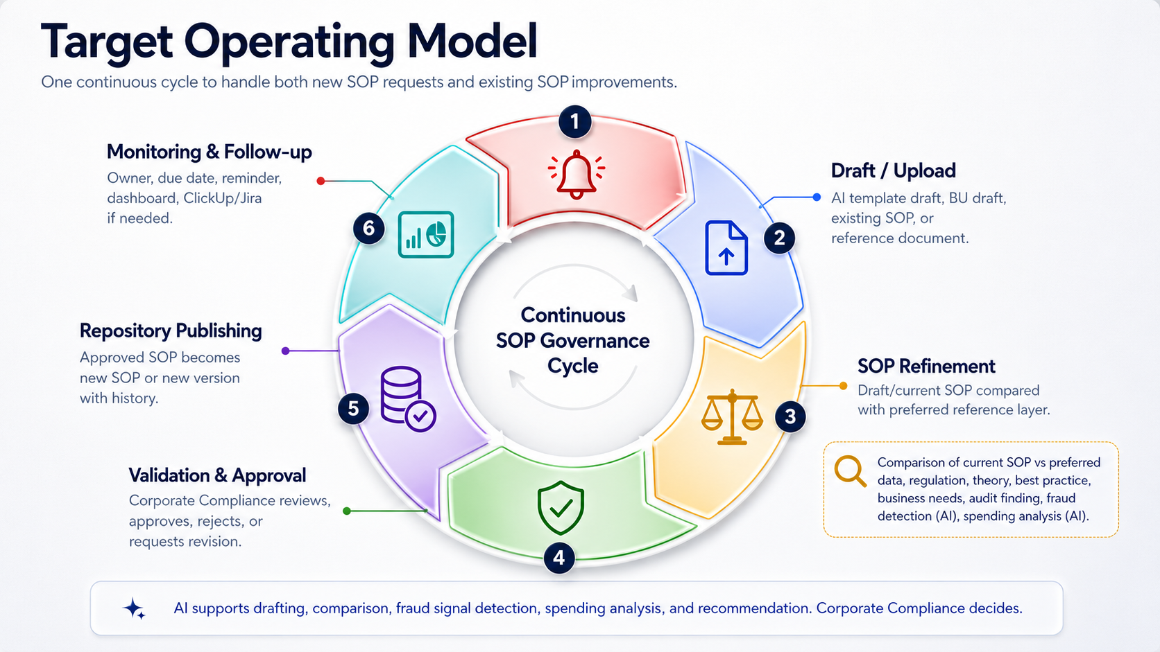
06

Slide 7
AI-Assisted Procurement SOP Governance Platform
07
SOP Refinement
The key analysis step: draft/current SOP versus preferred reference layer.
Draft / Current SOP
Preferred Reference Layer
BU draft, AI-generated template, or existing SOP version from repository.
vs
comparison of current SOP vs preferred data, regulation, theory, best practice, business needs, audit finding, fraud detection (AI), spending analysis (AI)
Preferred data
Business needs
Regulation
Audit finding
Theory
Fraud detection (AI)
Best practice
Spending analysis (AI)
AI-assisted output
Human control
Repository result
Candidate gap, recommendation, evidence, fraud indicator, analytical note
Corporate Compliance validates before it becomes official
Approved SOP is published as new SOP or new version
07

Slide 8
AI-Assisted Procurement SOP Governance Platform
08
User Experience Vision
08

Slide 9
AI-Assisted Procurement SOP Governance Platform
09
Who Uses It
Same platform, different lens. Operational users need detail; executives need clarity.
Business Unit Compliance / PIC
Corporate Compliance
Director / Executive
Request new SOP/template
Review SOP requests
See risk overview
Generate AI draft
Run SOP Refinement
Ask strategic questions
Upload or update SOP
Validate AI findings
Track high-risk issues
Respond to finding
Approve/reject recommendations
Review executive summaries
Update action status
Monitor actions and owners
Monitor lifecycle health
09

Slide 10
AI-Assisted Procurement SOP Governance Platform
10
Core Capabilities
The platform focuses on SOP lifecycle governance, not replacing existing execution tools.
1. SOP Repository & Version Control
2. SOP Request & AI Template Drafting
Approved SOPs, ownership, language, status, and history.
BUs can request new SOPs and generate initial templates.
3. SOP Refinement
4. Human Validation & Approval
Draft/current SOP compared with preferred references and AI analysis.
Corporate Compliance validates, approves, rejects, or requests revision.
5. Action Tracking & Notification
6. Executive Intelligence & Copilot
Owner, due date, reminder, escalation, and PM tool integration.
Dashboard, summary, risk view, and strategic Q&A.
ClickUp/Jira remains an execution layer. The platform provides governance context, validated actions, and executive visibility.
10

Slide 11
AI-Assisted Procurement SOP Governance Platform
11
First 3 Months: Launch Fast, But Safely
A limited production launch for pilot BUs, not the full enterprise dream in one heroic sprint.
Included in Release 1
Not in Release 1
Homepage / Procurement Governance Hub
Full auto-scraping all regulators
SOP repository v1
AI final approval
SOP request form
Predictive analytics
AI-assisted template draft
Full multi-country localization
Manual reference upload
Complex two-way ClickUp/Jira sync
SOP Refinement v1
Human validation workflow
Enterprise-wide rollout
Basic action tracking
Advanced fraud analytics
Basic dashboard
ID/EN support
Promise: usable in 3 months, then matured through staged releases.
11

Slide 12
AI-Assisted Procurement SOP Governance Platform
12
12-Month Roadmap
Clear deliverables, not vague consultant fog. A rare kindness.
0-3 months
4-6 months
7-9 months
10-12 months
MVP Launch for Pilot BU
Workflow Stabilization & Integration
AI-Assisted Monitoring & Executive Visibility
Enterprise Rollout & Control Improvement
Repository v1, SOP request, AI template draft, manual references, SOP Refinement v1, validation, basic dashboard, ID/EN.
More BUs, email notification, ClickUp/Jira task creation, stronger approval flow, reviewer assignment, audit trail v1.
Controlled regulatory monitoring, periodic SOP review schedule, AI impact analysis, fraud/anomaly signal, SLA and overdue tracking.
Multi-country readiness, advanced multilingual output, cross-BU SOP maturity comparison, stronger audit log, access control review, operational readiness.
“Cross-BU SOP maturity comparison” means comparing coverage, status, overdue actions, findings, and readiness across BUs.
12

Slide 13
AI-Assisted Procurement SOP Governance Platform
13
AI Guardrails
The AI must be useful, not creatively dangerous. Humanity already has enough of that.
Context-bound
Evidence-based
Human-approved
Answer only from approved portal data.
Show sources or say the data is not available.
No AI finding becomes official without review.
No silent automation
Logged decisions
AI cannot approve, close, or change official status by itself.
Prompts, outputs, validations, and overrides are tracked.
AI recommends, compares, detects patterns, and drafts. Corporate Compliance validates, approves, and decides.
13

Slide 14
AI-Assisted Procurement SOP Governance Platform
14
Multilingual by Design
Because the group operates across countries, ID/EN is not decoration. It is scale readiness.
Portal UI
Documents
AI Output
Executive View
Menus, labels, status, dashboard
SOPs and regulations in Indonesian or English
Summary, recommendations, email drafts
ID/EN summaries and strategic Q&A
Start with Indonesian + English.
Design the architecture so more languages can be added later without rebuilding the portal.
14

Slide 15
AI-Assisted Procurement SOP Governance Platform
15
Executive Intelligence Layer
Directors need the helicopter view, not the engine room.
Typical questions executives can ask
What the platform returns
Which BU has the highest compliance risk?
Risk summary by BU
What are the top procurement issues this month?
Open and overdue action items
Which high-risk findings are overdue?
High-risk issue highlights
What changed after the latest regulation update?
Regulatory impact summary
Which SOPs are waiting for validation?
Executive-ready monthly summary
What should be escalated this week?
Recommended priorities for escalation
15

Slide 16
AI-Assisted Procurement SOP Governance Platform
16
Budget: Cost Categories Only
No fixed numbers yet until technology choices are locked.
Application platform
Database
Document storage
AI usage
Document processing
Knowledge base / search
Integration
Security & governance
Monitoring & operations
Change management
ClickUp/Jira note
No need to position it as a new agenda. It can remain the existing execution tool and integrate with the platform when validated actions need to become tasks.
16

Slide 17
AI-Assisted Procurement SOP Governance Platform
17
How We Measure Success
Useful metrics, not pretty numbers with no decision attached.
Coverage
Request speed
Review speed
Target SOPs onboarded and tagged
New SOP request-to-publication cycle time
SOP Refinement review cycle time
Quality
Execution
Visibility
Validated findings vs false positives
Action SLA and overdue items
Executive dashboard and copilot usage
Decision needed
1. Confirm positioning and scope 2. Pick pilot business units 3. Confirm Corporate Compliance validation owner 4. Confirm initial references and languages 5. Approve the 3-month limited production launch
17

