Slide 1

MITIGATING EDUCATIONAL UNCERTAINITY WITH MACHINE INTELLIGENCE IN STUDENT ADVISING
ORIENTAL INSTITUTE OF SCIENCE & TECHNOLOGY
Team Name: Tech Infantry
Department: Computer Science Engineering
Guide Name: Prof. Anamika Joshi
Team Leader Name: Prakrati Mishra (0105CS231152)
Team Members: Saksham Kumar (0105CS231191)
Sakshi Pawar (0105CS231192)
Shubham Mallick (0105CS231222)

Slide 2
Introduction
Brief Background of the Problem Domain:
Declining enrollment in government colleges.
Students and parents lack awareness about career opportunities from different courses.
Critical indecision persists in selecting streams and programs post-Class 10/12.
Importance of the Topic:
Enhances accessibility and attractiveness of government educational institutions.
Reduces dropouts and migration to private institutions.
Motivation for Choosing this Project:
Supports students in rural/semi-urban areas with limited counseling access.
Leverages technology for equitable access to opportunities.

Slide 3
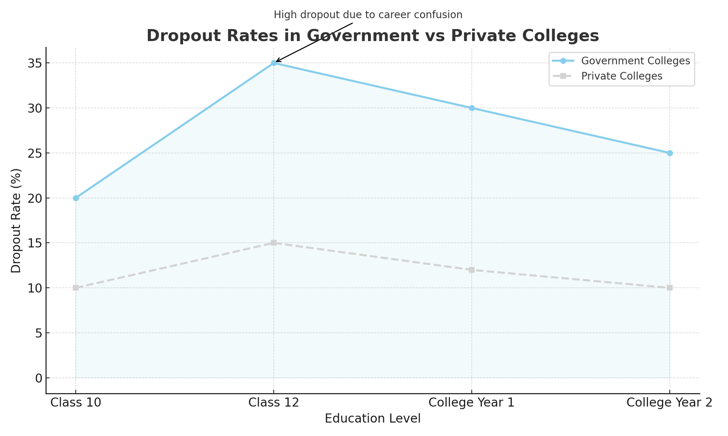
Problem Statement
Clear Statement of the Issue:
Students make uninformed academic choices.
Poor alignment between aptitude and courses.
Lack of timely alerts for admissions and scholarships.
Rural students face digital and informational barriers.
Why it Needs a Solution:
Enhances credibility of government colleges.
Supports personalized, data-driven planning.
Prepares students for future careers.

Slide 4
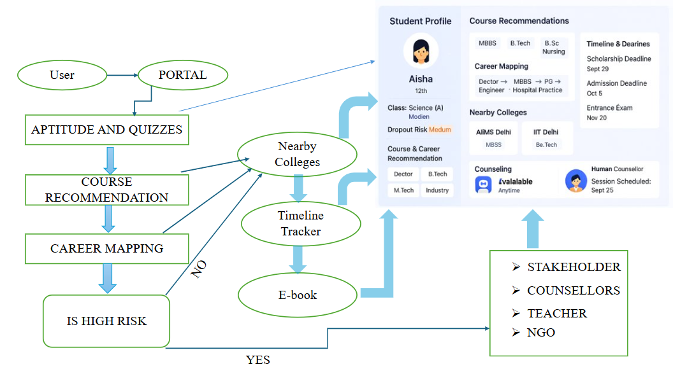
SOLUTION
Proposed Solution:
UML Diagram
AI-powered career guidance, works online + offline
Real-time job market insights
Clear academic-to-career pathways
AI + Human mentorship
E-Book Directory
Innovation & Uniqueness of the Solution:
First AI + Human hybrid model
Predictive analytics for early intervention
Offline-first, low-bandwidth design
Timeline notifications & reminders
Scholarship & financial aid recommendation engine
Multilingual & culturally adaptive
Career path visualization & guidance

Slide 5
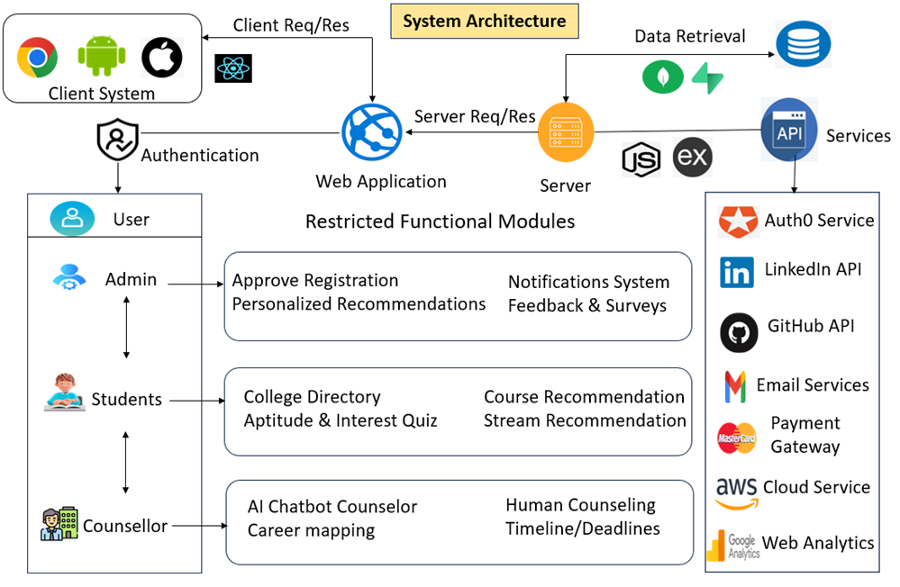

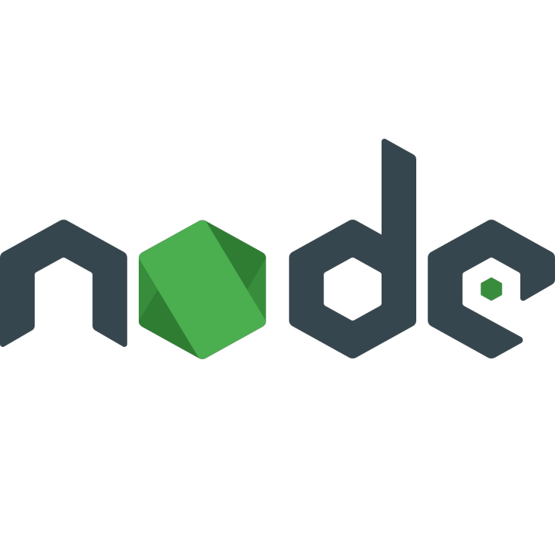
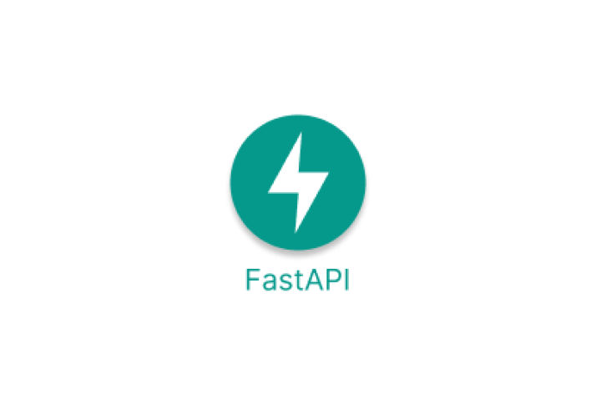







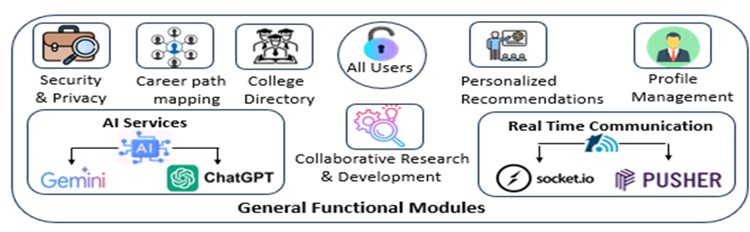
TECHNICAL APPROACH
Technology Stack:
Frontend: HTML5, CSS3, JavaScript,
React.js, tailwindcss, Streamlit
Backend: Fastapi, Flask, Nodejs
AI/ML: Scikit-learn, Tensorflow/Keras, nltk,
mistral AI + Langchain
Data-preprocessing: Numpy, pandas
Database: MongoDB, Pickle, Json
Data visualization: Matplotlib, D3.js
APIs: Authentication, JWT
Version Control: GitHub
Dropout risk factors Prediction:
Academic Performance, Behavioral Indicators
Personal, Institutional, Social, & External Factors
Historical Data, Early Warning Indicators

Slide 6
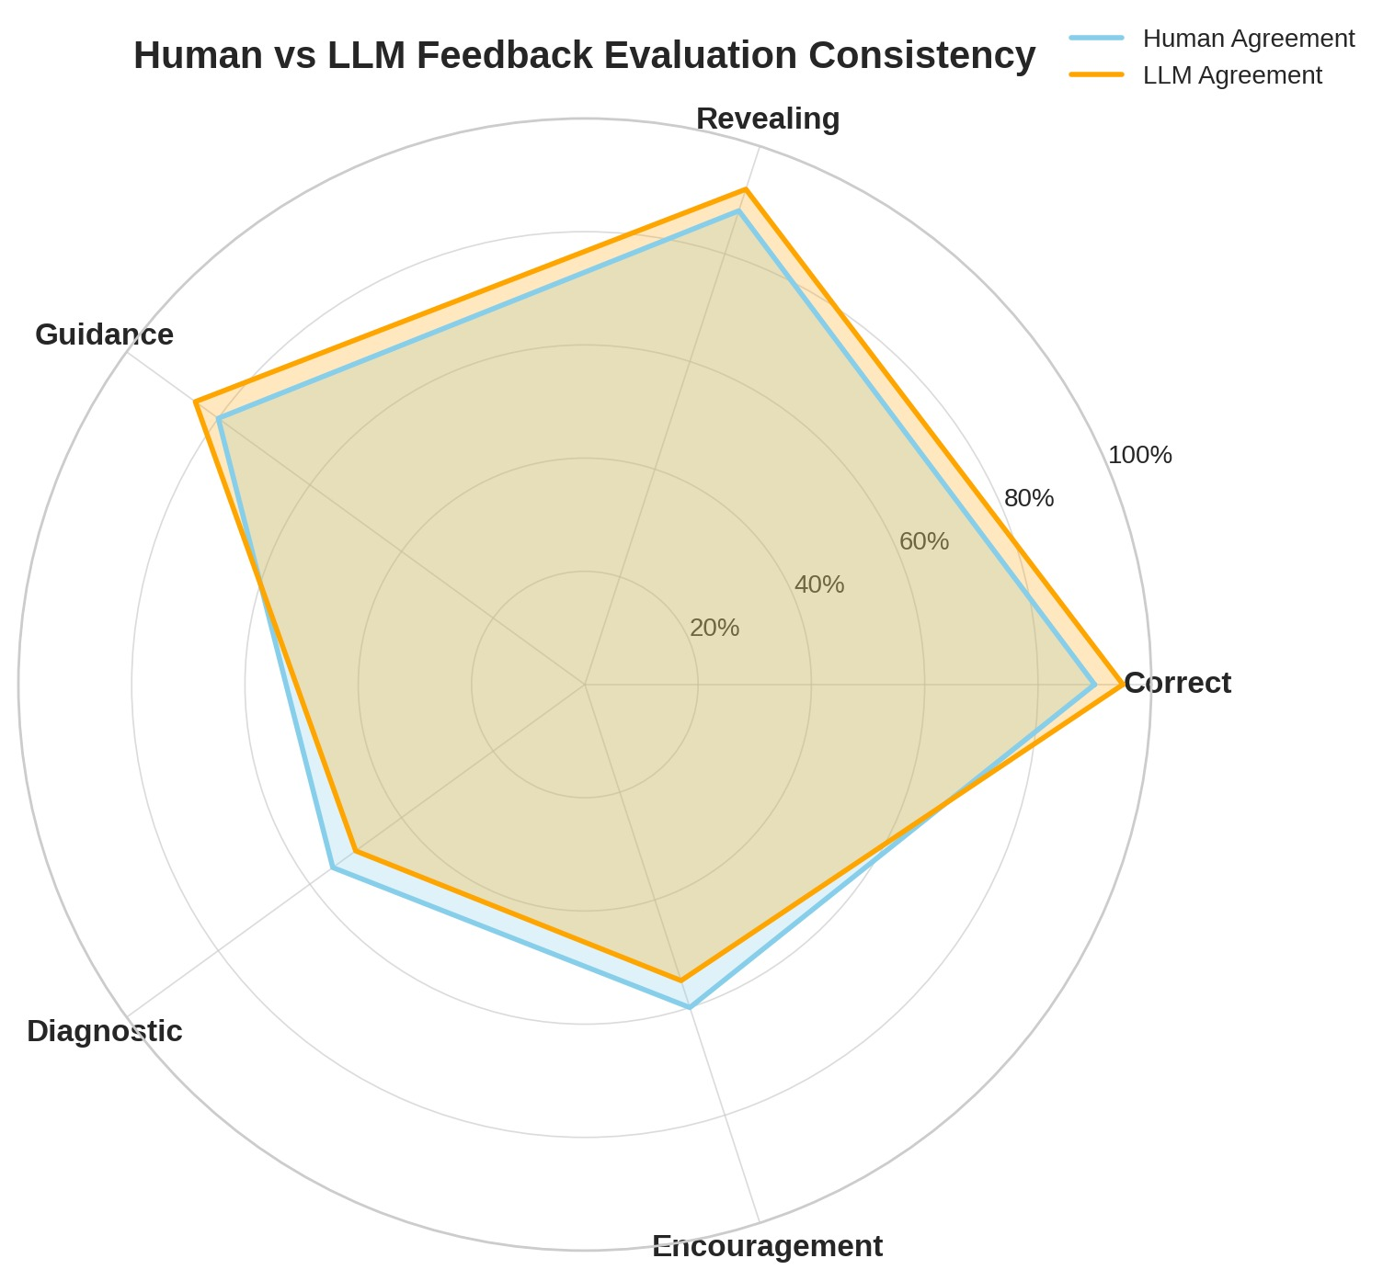
Comparison with Existing Models
Feature | Proposed AI-Powered Career Guidance System | Existing Career Guidance Models | Traditional Counseling Methods
Accuracy | High & Data-Driven (AI + Human Hybrid) | Moderate (Algorithm-based) | Variable (Depends on counselor)
Speed of Evaluation | Real-Time Recommendations | Medium | Slow (Manual Evaluation)
Dropout Risk Prediction | Yes | No | Medium
Scalability | High (Handles large student base) | Medium | Low (Limited counselors)
Offline Capability | Yes | Mostly No | Yes (Manual)
Localization | Region-specific career & college data | Often Global/Generic | Regional but limited data insight
Decision Support | Predictive Analytics & Dashboards | Static Results | Manual interpretation
Language Support | Multilingual & Culturally Adaptive | Limited | Depends on counselor
Integration | Seamless with Govt. Educational Systems | Limited | No
Learning Capability | Yes (AI improves with feedback) | No | No
User Accessibility | High (Mobile-first, 2G-compatible) | Moderate | Low in rural areas

Slide 7

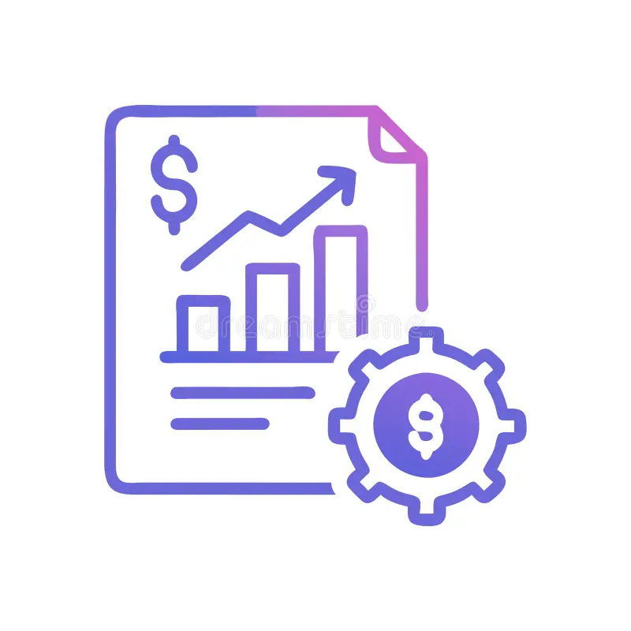


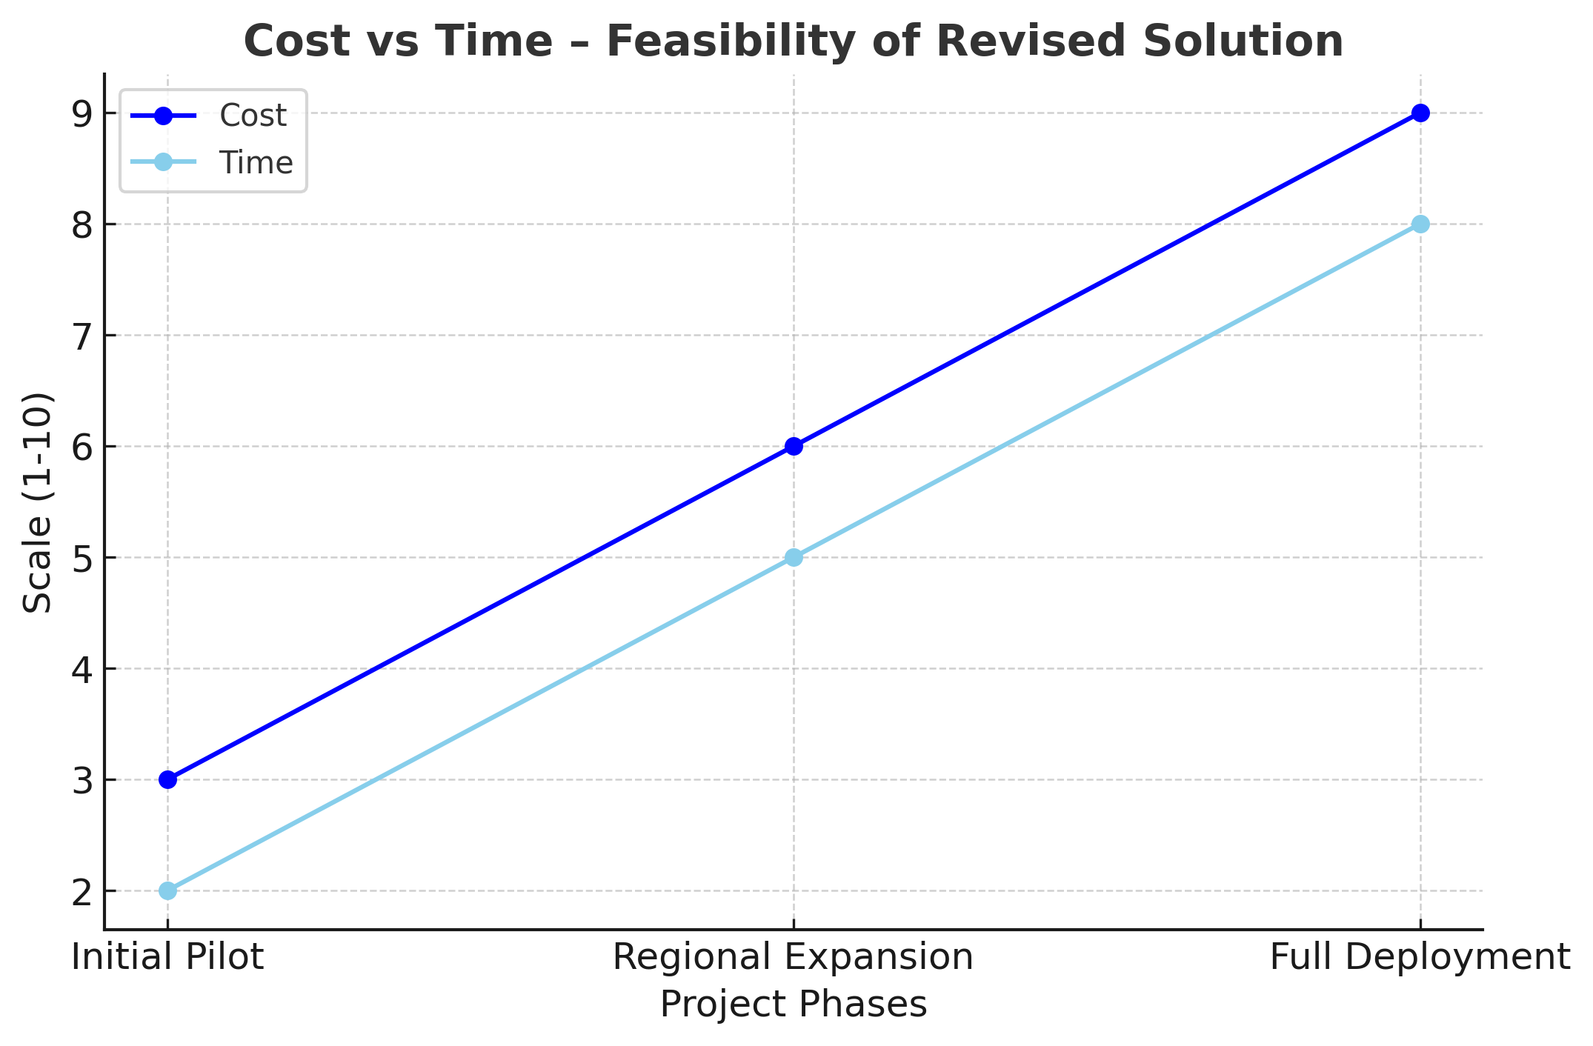
FEASIBILITY AND VIABILITY
Technical Feasibility
Scalable: rural + urban
Cloud + offline support
Easy system integration
01
Ongoing technical support
Economic Feasibility
Simple, user-friendly interface
02
Overcoming
Challenges
02
Scalable & adaptive
Low cost
02
03
Feedback loops for improvement
04
Adaptive content for literacy levels
Operational Feasibility
Project
Analysis
Works on 2G & power cuts
Easy adoption & use
Multi-language support
05
Offline access with online sync
Potential Risks:
High cost
& maintenance
Cultural
language
barriers
Remote
connectivity
gaps
Digital
illiteracy &
resistance
Resistance
to
change

Slide 8







IMPACT AND BENEFITS
Benefits:
Potential Impact on the Targeted Audience:
24/7 Availiabilty
Candidates / Students:
Personalized career paths
Higher job readiness
Access in rural areas
Better employment outcomes
Effective Data Analysis
Reduced Manual Workload
Experts / Counselors:
Data-driven insights
Wider student reach
Reduced manual effort
Stronger mentoring role
Cost-Effective Project Evaluation
Actionable Data & Insights
Policymakers / Institutions:
Real-time skill gap insights
Data-based policy making
Improved education outcomes
User-Friendly
Scalable

Slide 9
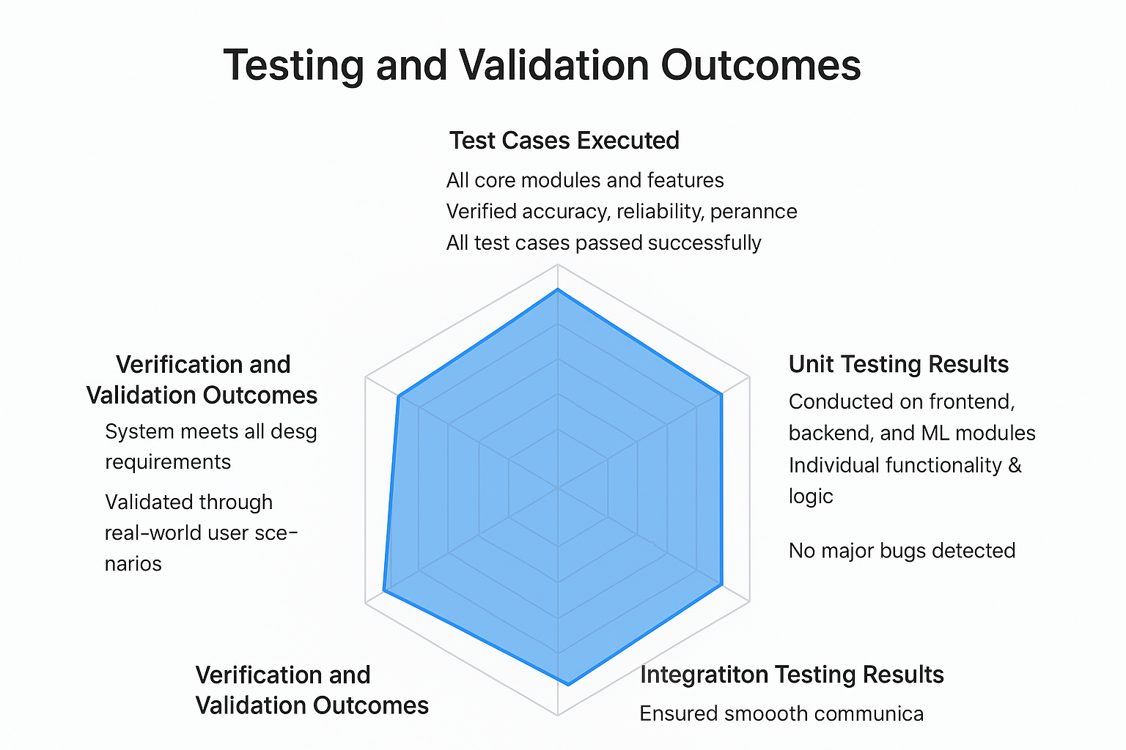
Testing
Test Cases Executed
Tested all core modules and features.
Verified accuracy, reliability, and performance.
Verification and Validation Outcomes
Verified system meets all design requirements.
Validated through real-world user scenarios.
System proved accurate, scalable, and user-friendly.
Unit Testing Results
Conducted on frontend, backend, and ML modules.
Verified individual functionality and logic.
Integration Testing Results
Checked data flow between all modules.
Ensured smooth communication and stability.

Slide 10
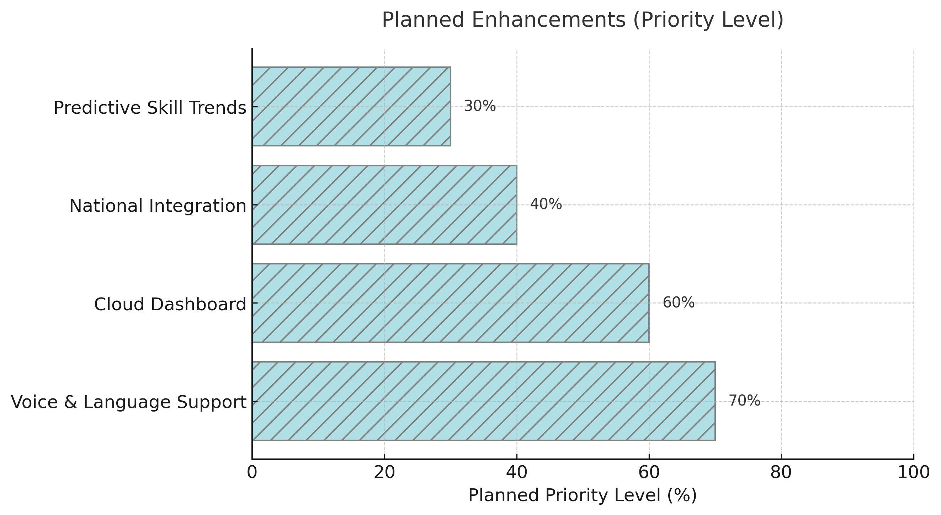
Future Enhancements
Scope for Improvement
Improve model accuracy with larger datasets.
Enhance user interface for better accessibility.
Ideas for Further Development
Introduce personalized career growth tracking.
Implement AI-driven internship and job matching.
Develop mobile app with gamified learning and mentorship features.
Next Phase Plans
Launch beta version for testing in select colleges.
Collect user feedback for refinement.
Deploy cloud-based dashboards for institutions & counselors.
Long-Term Applications
Nationwide career guidance and scholarship tracking platform.
Integration with government education portals.
Predictive analytics for future skill demand trends.

Slide 11
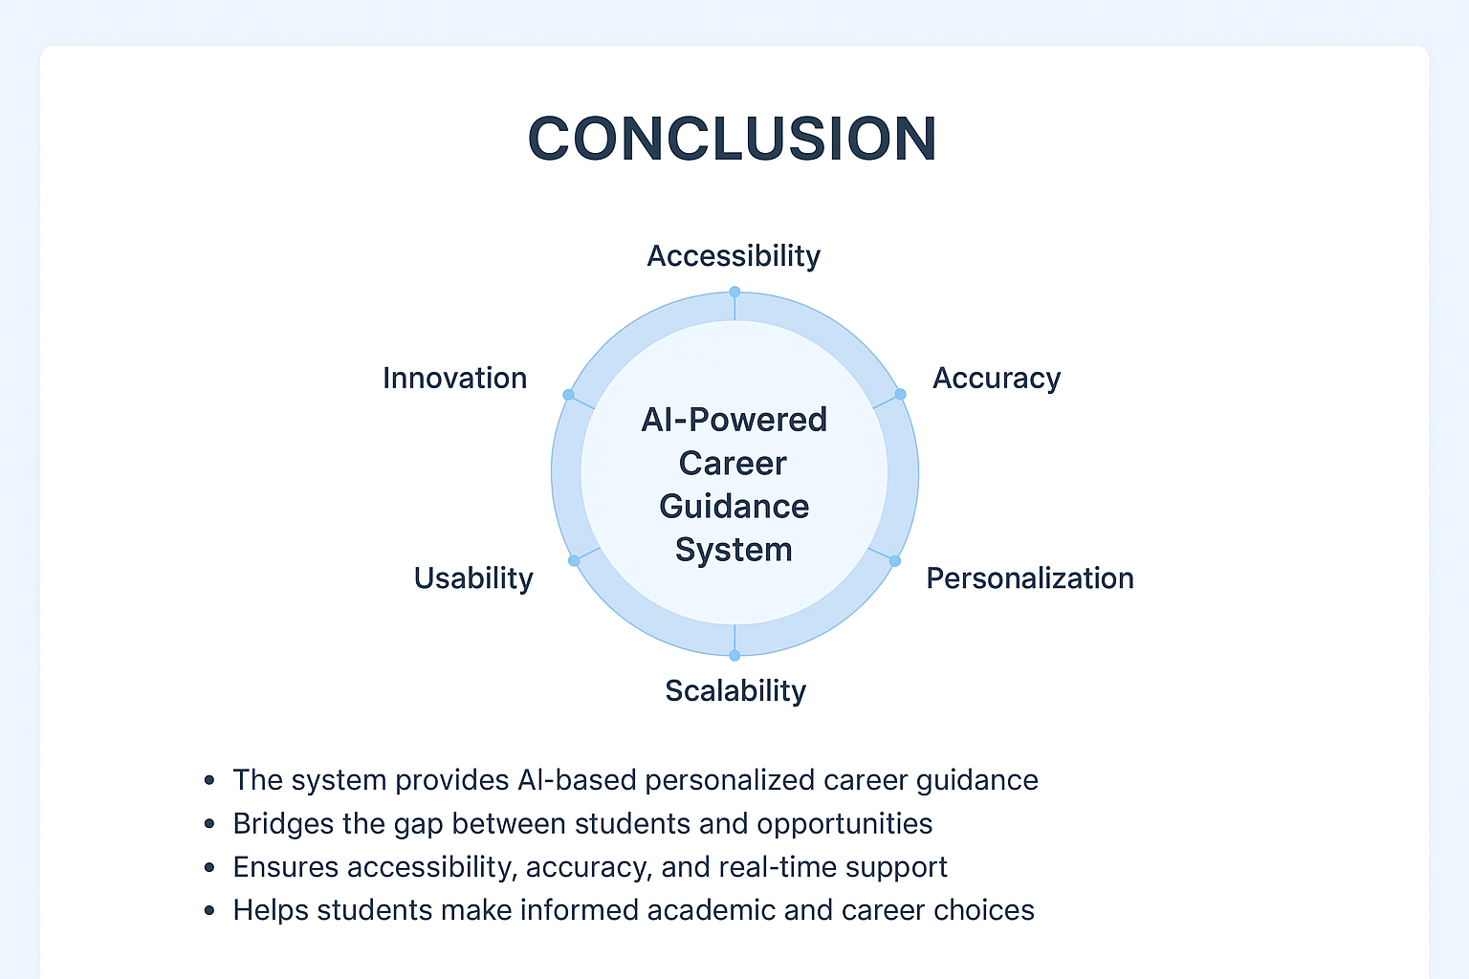
Conclusion
The system provides AI-based personalized career guidance.
Bridges the gap between students and opportunities.
Ensures accessibility, accuracy, and real-time support.

Slide 12

RESEARCH AND REFERENCES
Research & Best Practices:
Career guidance using decision trees
The role of Technology in Career Counseling in India
Economic Benefits of Career Guidance
AI-Powered Career Counseling
Machine Learning in Education
Supporting Facts for Feasibility and Viability
As per NITI Aayog 2022 survey, 82% rural students lack guidance
As per Deloitte 2022, 67% of students prefer hybrid learning models, supporting AI + human mentorship.
Feasibility Facts:
TRAI 2023 report
Deloitte 2022
Problem Statement
Requirement Analysis
Research Workflow
Study Existing System
System Deployed
Design Proposed System

Slide 13
THANK YOU

