Slide 1

data engineering Assignment- week 2
Submitted by: Prakriti Dahal
Submitted to: christy pearson

Slide 2
Dataset Overview: In-Vehicle Coupon Recommendation
Purpose: Analyze factors influencing drivers' decisions to accept promotional coupons during various driving scenarios.
Source: https://archive.ics.uci.edu/dataset/603/in+vehicle+coupon+recommendation
Dataset Summary:
Records: 12,684 | Features: 26
Categories:
Contextual Factors: Destination, time, weather, temperature, passenger.
Coupon Details: Type, expiration time.
Demographics: Gender, age, marital status, income, education.
Behavioral Patterns: Visit frequency to bars, coffee houses, restaurants, etc.
Proximity: Coupon location relative to destination (same/opposite direction, time to reach)
Target Variable (Y): Coupon acceptance (1 = Accepted, 0 = Rejected).

Slide 3
Dataset Overview: In-Vehicle Coupon Recommendation
Applications:
Understand consumer behavior.
Build predictive models for coupon acceptance.
Optimize marketing strategies and improve engagement rates.
Dataset Description: Given below on a table

Slide 4
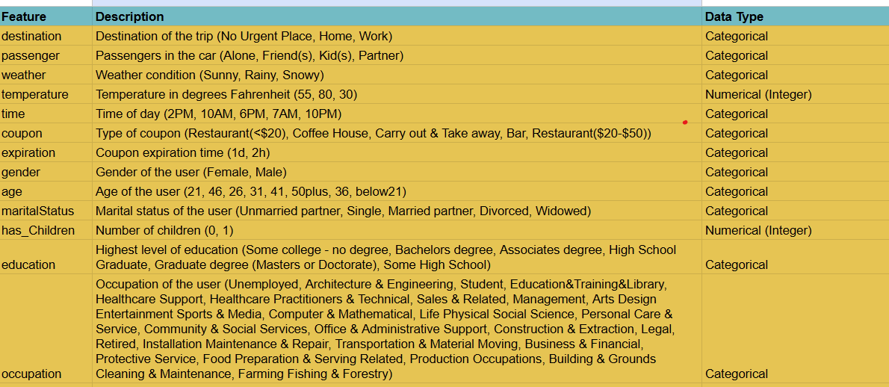

Slide 5
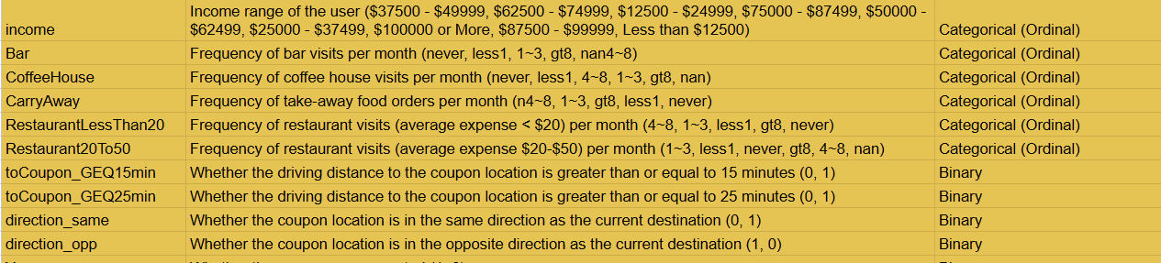

Slide 6
Problem statement
Objective:
The goal is to understand and predict drivers' decisions to accept or reject promotional coupons while driving. This involves exploring the interplay of contextual, demographic, and behavioral factors to identify key influences on consumer behavior. Insights from this analysis can help businesses optimize coupon delivery strategies and improve redemption rates.
Key Questions:
What are the most significant factors influencing coupon acceptance (e.g., weather, passenger, income)
How do contextual conditions such as time of day, destination, and travel companions affect decisions?

Slide 7
Problem statement
Expected Outcomes:
Consumer Insights: A comprehensive understanding of consumer decision-making during driving scenarios.
Key Factors Identification: Identification of the most critical variables driving coupon acceptance.
Predictive Modeling: Development of an accurate predictive model to forecast acceptance likelihood.
Marketing Optimization: Data-driven strategies for delivering personalized and contextually relevant coupons to increase engagement and conversion rates.
Practical Applications: Recommendations for businesses to enhance targeted marketing and improve customer retention.

Slide 8
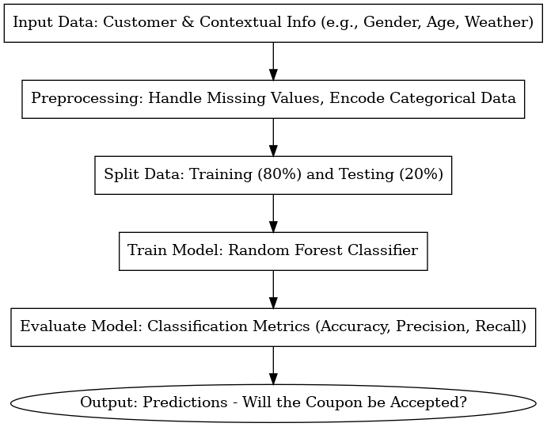
MLS system

Slide 9
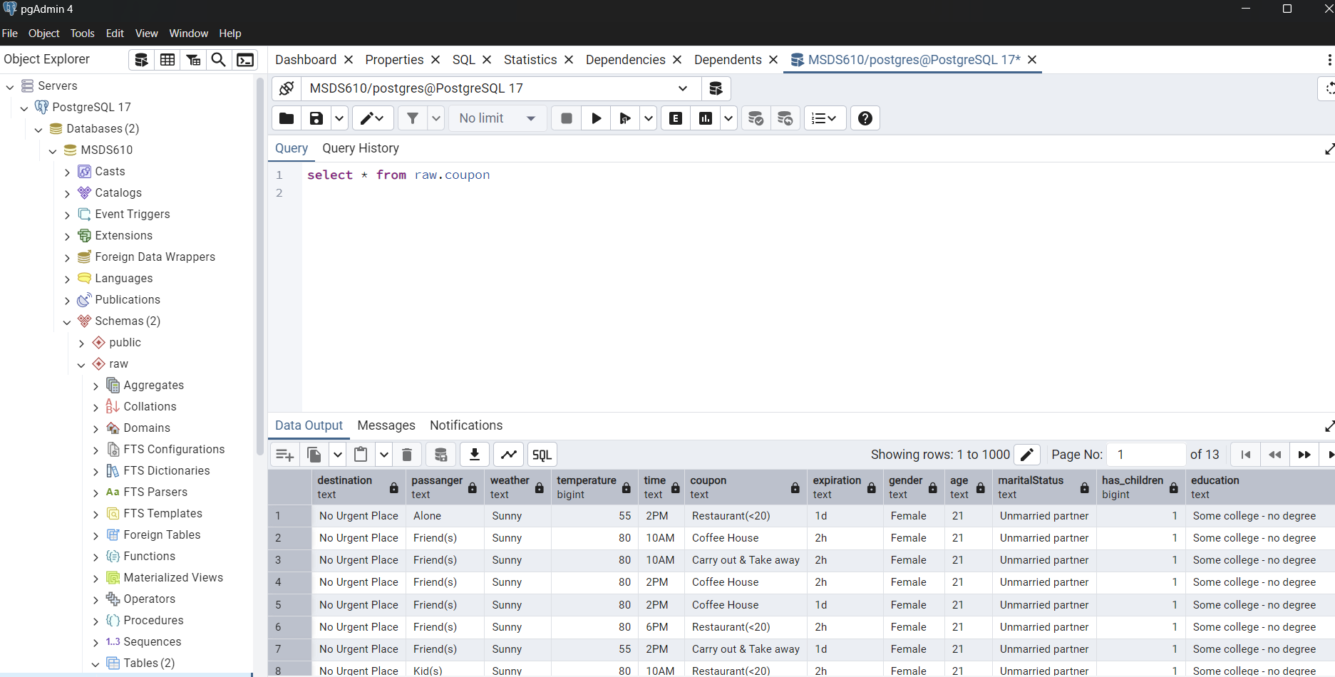

Slide 10
The EnD

