Slide 1
Data Pipeline Design & Data Quality
A structured approach to data processing and validation
Notes:
Welcome to this presentation on Data Pipeline Design and Data Quality. We’ll go through how data moves through a pipeline, the transformations it undergoes, and how we ensure data integrity and accuracy. Let’s begin!

Slide 2
Pipeline Design - Overview
1. Extract Data from Relational Database
2. Transform: Cleaning, Normalization, Feature Engineering
3. Store in Another Database Table for easy querying and integration
Notes:
This slide outlines our data pipeline.
First, we extract raw data from a relational database.
Next, we transform the data by cleaning, normalizing, and applying feature engineering techniques.
Finally, we store the processed data in another relational database table for further use.

Slide 3
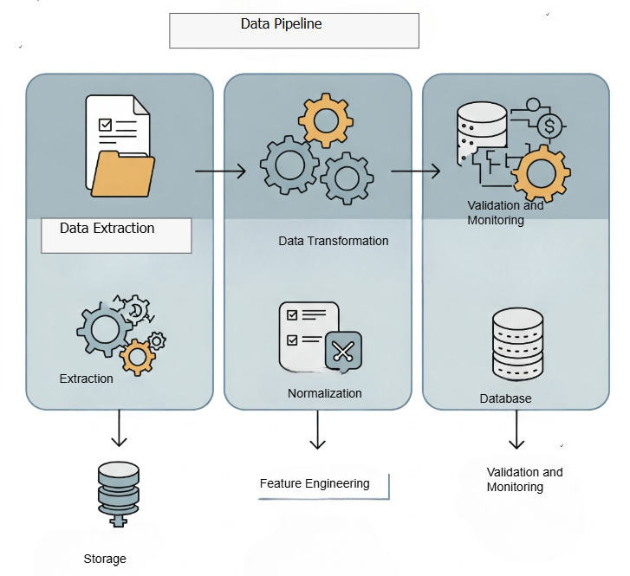

Slide 4
Pipeline Type: Batch Processing
Batch processing is chosen for structured, periodic updates.
Suitable for this dataset as real-time processing isn't required.
Ensures efficient data validation and transformation.
Notes:
We have chosen batch processing for this pipeline.
Batch processing is best for structured, periodic updates.
Since this dataset doesn’t require real-time analysis, batch processing ensures efficient data transformation and validation.
It also simplifies quality monitoring and debugging.

Slide 5
Data Format Choice: Relational Database Table
Data will be stored in another relational database table.
Benefits include:
Seamless integration with existing systems
ACID compliance for consistency
Efficient indexing and querying support
Notes:
We are storing the processed data in another relational database table instead of a file format like Parquet.
This format allows seamless integration with other systems.
Indexing and querying capabilities improve efficiency.
ACID compliance ensures data consistency and reliability.

Slide 6
Data Quality Issues
**Missing Values:** Columns like 'car' and 'CoffeeHouse' have null values.
**Duplicates:** Potential duplicate records need to be checked.
**Categorical Inconsistencies:** Non-uniform values in categorical fields.
Notes:
Now, let's discuss potential data quality issues in our dataset.
Missing values: Some columns, like 'car' and 'CoffeeHouse,' have missing values.
Duplicates: There may be duplicate records that need to be removed.
Categorical inconsistencies: Some categories have inconsistent formatting, such as variations in text capitalization.

Slide 7
Validation & Monitoring
**Missing Values:** Impute missing values using median/mode or remove rows if necessary.
**Duplicate Detection:** Use unique identifiers and deduplication techniques.
**Categorical Cleaning:** Standardize text categories (e.g., 'never' vs. 'Never').
Notes:
To address these data quality issues, we implement validation and monitoring strategies:
Missing Values: We either impute missing values using statistical methods or remove affected records if necessary.
Duplicates: We identify and remove redundant records using unique identifiers.
Categorical Cleaning: We standardize categorical values to maintain consistency.

Slide 8
Detecting Data Drift & Schema Changes
Implement automated checks for distribution shifts in key features.
Monitor schema changes by tracking column additions or type changes.
Use logging and alerts to detect unexpected variations.
Notes:
Over time, data may change. To maintain quality, we need to monitor for data drift and schema changes:
Data Drift: Track changes in feature distributions using statistical tests.
Schema Monitoring: Detect column changes, missing values, or unexpected data types.
Automated Alerts: Set up alerts to flag anomalies and take corrective action.

Slide 9
