Slide 1

Sales Data Visualization Analysis Week 8 Final Project
Submitted By: Prakriti Dahal
Submitted To: John Koenig
Date: 3/6/2026

Slide 2

Problem / Situation
Retail stores collect a lot of transaction data.
However, raw numbers alone do not explain what is happening in the business.
By analyzing and visualizing the data, we can better understand sales patterns, product performance, and profitability.

Slide 3

Research Questions
What patterns can we find in retail sales data that help us understand which products customers buy the most?
Are the products that generate high sales also the ones that bring the most profit to the business?
How do discounts affect profitability, and do higher discounts reduce overall profit?
Do sales change over time or differ across regions, and what might explain those differences?

Slide 4

Data
The dataset used is the Sample Superstore retail dataset.
It contains around 10,000 sales transactions.
Important fields include:
- Order Date
- Sales
- Profit
- Discount
- Category and Sub‑Category
- Region

Slide 5
Methodology
Python was used for the analysis.
Steps followed:
1. Load the dataset using Pandas
2. Clean and prepare the data
3. Group and summarize sales information
4. Create charts using Matplotlib to visualize patterns.

Slide 6
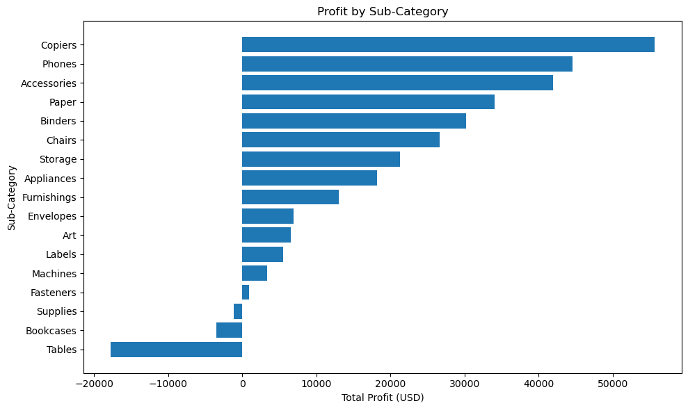
Profit by Sub-Category
Copiers are the most profitable sub-category, generating significantly more profit than any other item.
Tables are the primary source of financial loss, with a negative profit exceeding -$15,000, followed by smaller losses in Bookcases and Supplies.
High-tech and high-volume office essentials (Phones, Accessories, and Paper) drive the bulk of the positive margins, while smaller hardware like Fasteners and Labels contribute the least to the bottom line.

Slide 7
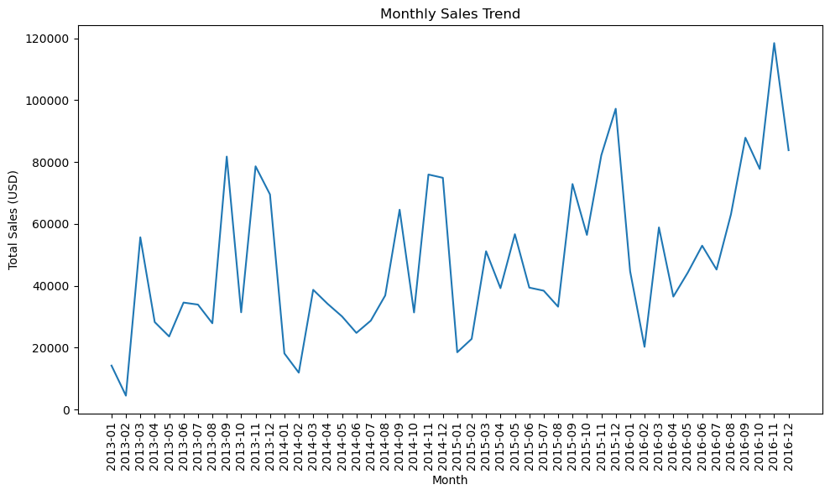
Monthly Sales Trend
The business shows a strong long-term expansion, with the baseline for sales moving from roughly $15,000 in early 2013 to over $80,000 by late 2016.
There is a clear seasonal pattern where sales spike drastically in the final quarter of every year, specifically November and December, likely due to holiday demand or year-end budget spending.
Almost every growth peak is followed by a significant "reset" or dip in January and February, indicating a cyclical "cooling off" period before the next growth phase begins.

Slide 8
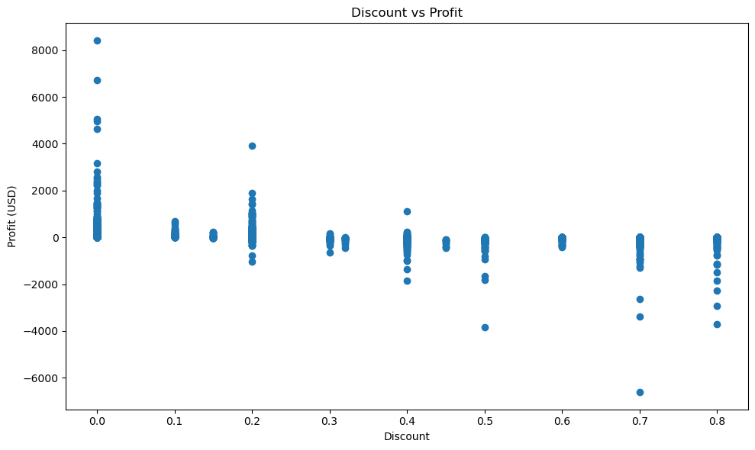
Discount vs Profit
There is a clear downward trend where increasing discounts lead to lower profits, with the highest profit margins occurring at 0.0 discount.
Profits consistently drop below zero once discounts exceed 0.2, indicating that high discounts frequently result in net losses for the business.
Discounts of 0.5 or higher show the most extreme negative outliers, with losses reaching as low as -$6,000 to -$8,000.

Slide 9
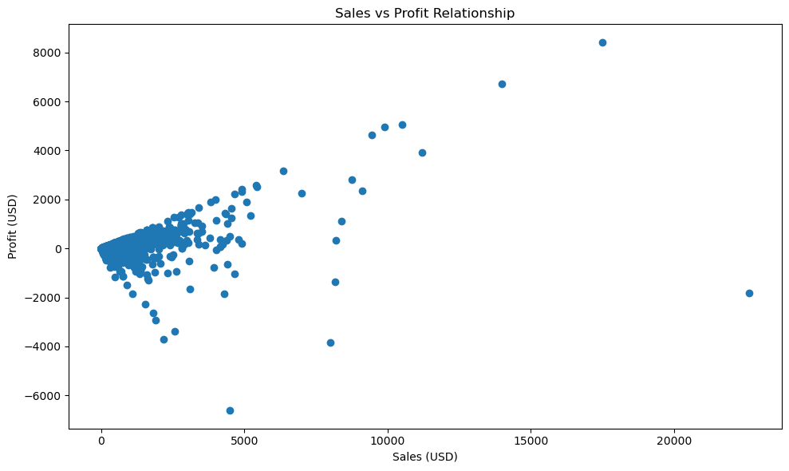
Sales vs Profit
Most data points cluster in a way that suggests as sales increase, profit tends to increase as well, with the highest profit exceeding $8,000 at a high sales volume.
While higher sales can lead to higher profits, the "spread" of the data widens as sales increase; larger transactions carry a higher risk of significant losses, as seen by the extreme negative outlier near the $5,000 sales mark.
Extremely high sales (e.g., above $20,000) do not guarantee high profit, as evidenced by the point on the far right which resulted in a net loss of approximately $2,000.

Slide 10
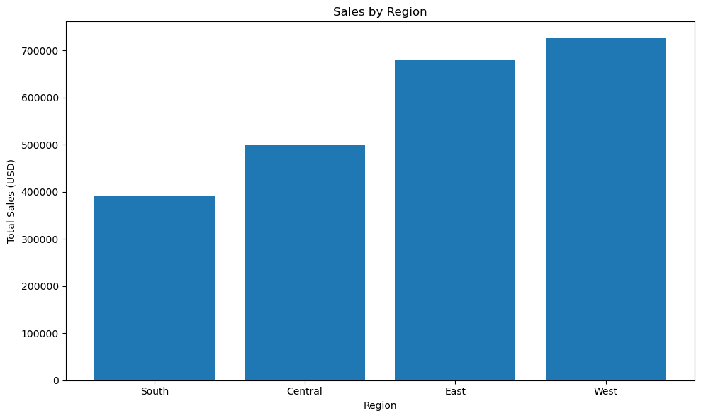
Sales by Region
The West region is the top performer with over $700,000 in total sales, followed by the East, Central, and South regions respectively.
There is a substantial difference in revenue across territories, as sales in the West are nearly double those of the South region.
The East and West regions combined account for the vast majority of total revenue, indicating these are the primary growth drivers for the business.

Slide 11
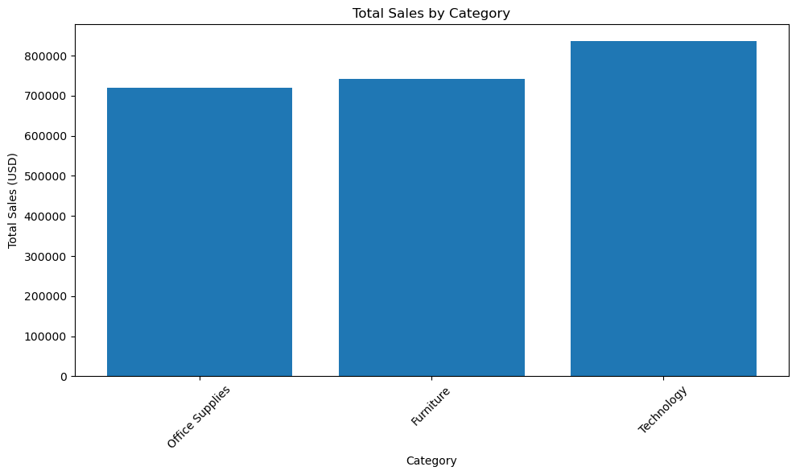
Total Sales by Category
The Technology category is the clear leader in revenue, generating over $800,000 in total sales.
Furniture and Office Supplies are closely matched, with both categories contributing between $700,000 and $750,000 each.
While Technology leads, the relatively small gap between the three categories suggests a well-diversified product mix rather than reliance on a single niche.

Slide 12

Conclusion
Some product categories generate higher sales, but high sales do not always lead to high profit.
Higher discounts often reduce profitability even if they increase sales.
Sales patterns vary over time and across regions, showing differences in customer demand and market performance.

Slide 13
THANK YOU!

