Slide 1
PSCS_481_ Online chatbot based museum ticketing system
CSE7101- Capstone Project
Review-1
Batch Number: CSE_30
Under the Supervision of,
Mr. ChandraSekhar M
Professor
School of Computer Science and Engineering
Presidency University
Roll Number | Student Name
20221CSE0474 | PRAKRUTHI K
20221CSE0375 | NEHA G
20221CSE0410 | R SANJAY
Name of the Program: Computer Science and Engineering
Name of the HoD: Dr.Asif Mohammed
Name of the Program Project Coordinator: Sumita Guddin
Name of the School Project Coordinators: Dr. Sampath A K , Dr. Geetha A

Slide 2
Content
Abstract
Literature Survey
Objectives
Existing Methods and Drawbacks
Proposed Method & Feasibility Study
Architecture Diagram
Modules
Hardware and Software Details
Timeline (Gantt Chart)
References

Slide 3
Abstract
Concise overview:
Problem introduction: booking tickets for museums is often time-consuming, confusing, and not multilingual.
Objective: build an efficient, multilingual AI chatbot for museum ticket booking that supports gate entry, shows, and time slots.
Approach: chatbot interface (web/mobile), natural language processing for multiple languages, secure online payment integration, and QR-code generation for tickets.

Slide 4
Literature Survey
Dr. R. Indhumathi, Y. Punith Chowdary, V. Akhilesh, “Multilingual Museum Ticketing System using Chatbot,” (Scribd publication).—Details a multilingual AI-powered chatbot built on HTML/CSS/JavaScript, supporting English, Hindi, Tamil, enabling ticket booking, reservations, secure payments via UPI QR codes, booking history, session management—enhancing inclusivity and usability.
Authors (anonymous), “Chatbot-Driven Museum Ticketing System using NLP and ML,” Computer Science Journal of Science and Technology, (dates unspecified).—Develops a museum ticketing chatbot integrating NLP for contextual understanding and Machine Learning, streamlining ticketing workflows.
Authors (anonymous), “MuseAme: AI-Powered Smart Museum Ticketing System,” IRJMETS, Mar 2025.—Showcases MuseAme, which leverages AI with integrated QR-code–based payments to fast-track secure transactions and modernize museum visitor experiences.
Huan Wang, “Enhancing Art Museum Experience With a Chatbot Tour Guide,” Master’s Thesis (KTH, Sweden), June 2024.—Presents a ChatGPT-powered chatbot tour guide that introduces artworks, uses image recognition to detect paintings, provides text/audio descriptions and navigation—demonstrating enhanced visitor engagement and usability.
Filip J. Kucia, Bartosz Grabek, Szymon D. Trochimiak, Anna Wróblewska, “How to Make Museums More Interactive? Case Study of Artistic Chatbot,” arXiv Preprint, Aug 30, 2025.—Describes an LLM-powered, voice-to-voice RAG chatbot (Artistic Chatbot) deployed at an art exhibition in Poland, responding in Polish using a specialized knowledge base, enhancing interactivity and informal learning in cultural heritage site.

Slide 5
Literature Survey
P. S. N., N. H. M., and K. K. Samhith, “Online Chatbot Based Ticketing System,” International Journal of Innovative Research in Technology (IJIRT), vol. 11, no. 12, pp. 4510–4516, May 2025.—Proposes a MERN-stack chatbot for museum ticketing featuring multilingual support, real-time availability checks, a payment gateway, and user analytics.
Anonymous, “Online Chatbot Based Ticketing System,” International Journal for Research in Applied Science and Engineering Technology (IJRASET), vol. 13, no. 5, pp. 2467–2474, May 2025.—Describes a Flask-based AI chatbot with secure payment integration and QR-code digital ticketing powered by a state-based conversational flow.
Sachin Pandey et al., “Museum Chatbot Ticketing System: An AI-Driven Approach to Enhance Visitor Experience and Operational Efficiency,” International Journal of Creative Research Thoughts (IJCRT), vol. 13, no. 5, May 2025.—Presents an AI-powered web/mobile chatbot offering QR-code e-ticketing, 24/7 booking, post-visit feedback, cloud infrastructure (AWS Lex, SageMaker, RDS), and secure payment integration.
Jacob Augustine (Anonymous), “Online Chatbot Based Ticketing System,” International Journal of Scientific Research in Engineering and Management, Jan 2024.—Introduces “MyMuseum,” a Flask-based AI ticket booking system with conversational AI for museum bookings, multiple payment options, automated QR-code ticket generation, and a responsive web interface.
Authors (anonymous), “Chatbot Integration in Ticketing Systems: Transforming Museum Ticketing,” International Journal of Scientific Research in Engineering and Management, (published recently).—Describes an AI-driven chatbot that simplifies museum ticket reservations, integrating secure payment, QR-code generation, and conversational interface.

Slide 6
Objectives
Develop a fully software-driven AI chatbot for ticket booking.
Enable real-time automated customer support with instant ticket generation.
Integrate secure online payment gateways within the chatbot.
Design a simple conversational UI accessible to all age groups.
Reduce manpower costs while improving user satisfaction.
Minimize operational costs by reducing dependency on human agents.

Slide 7
Existing Methods and Drawbacks
Traditional methods: manual ticket counters (time-consuming, limited language support).
Websites/apps: limited personalization, poor multilingual integration, navigation issues.
Existing chatbots: often single-language, limited transaction handling.
Drawbacks: inefficiency, poor accessibility, lack of real-time updates, security concerns.

Slide 8
Proposed Method & Feasibility Study
Proposed Method:
Build a web-based chatbot system.
Use NLP (Dialogflow/Rasa) for multilingual understanding.
Integrate with payment APIs (Razorpay/Stripe/UPI).
QR code generation for bookings.
Cloud deployment for scalability.
Feasibility:
Technology: uses existing frameworks (low development cost).
Cost: mostly open-source tools; payments via existing APIs.
Resources: student-level feasible with available computing resources.

Slide 9
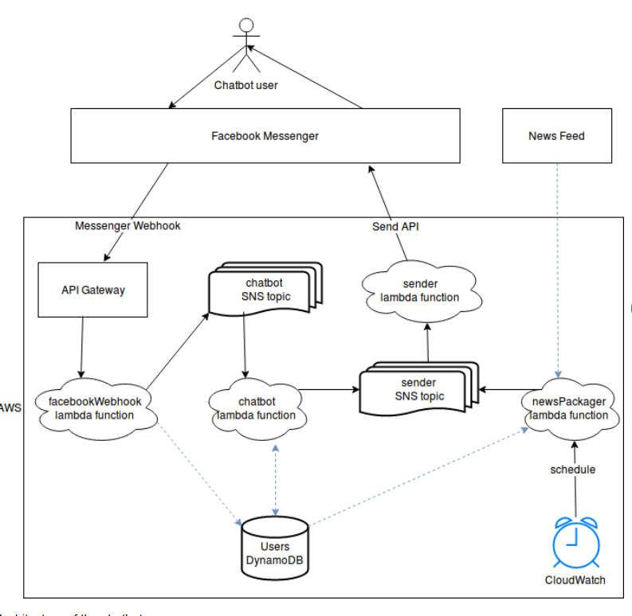
Architecture Diagram
Chatbot messenger

Slide 10
Modules
User Interaction Module: multilingual chatbot UI.
NLP & Intent Recognition Module.
Museum Database Module: shows, slots, tickets.
Payment Gateway Module.
QR Code Generation Module.
Admin Module: manage museums, schedules, users.

Slide 11
Hardware and Software Details
Hardware:
Laptop/server,
Internet.
Software:
Python/JavaScript,
Flask/Django (backend),
React (frontend),
Rasa/Dialogflow (chatbot),
MySQL/MongoDB (database),
Stripe/Razorpay (payment),
QR code library.

Slide 12
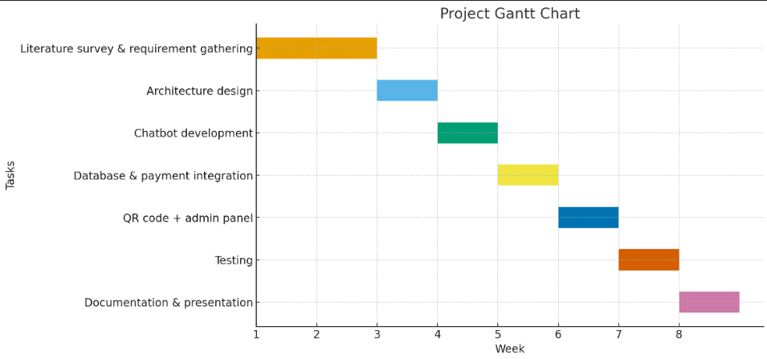
Timeline (Gantt Chart)

Slide 13
References
[1] P. S. N., N. H. M., and K. K. Samhith, “Online Chatbot Based Ticketing System,” International Journal of Innovative Research in Technology (IJIRT), vol. 11, no. 12, pp. 4510–4516, May 2025.—presents a MERN-stack chatbot for museum ticketing with multilingual support, real-time availability, payment gateway, and analytics.
[2] “Online Chatbot Based Ticketing System,” International Journal for Research in Applied Science and Engineering Technology (IJRASET), vol. 13, no. 5, pp. 2467–2474, May 2025.—describes a Flask-based AI chatbot with secure payment and QR-code digital ticketing using a state-based chatbot flow.
[3] “Museum Chatbot Ticketing System: An AI-Driven Approach to Enhance...,” International Journal of Creative Research Thoughts (IJCRT), vol. 13, no. 5, May 2025.—outlines an AI-powered web/mobile chatbot offering QR-code e-ticketing, 24/7 booking, and post-visit feedback features

Slide 14
github link
https://github.com/prakruthi-kiran/AI-chatbot

Slide 15


