Slide 1





X
X
Argonyx'26
PPT Submission Guidelines
1. Enter Team Details Carefully
Ensure correct team name, member info, and
contacts (used for communication & shortlisting).
2. Use the Given Template
Stick to 6 slides (Slides 1–6). No extra slides like
“Thank You.”
3. Focus on Problem + Idea + Feasibility
Judges look for clear problem definition, meaningful idea,and realistic 15-hour execution.
4. Add Visuals
At least one diagram/flow/mockup. Simple
sketches are fine and make the idea clear.
5. Pitch, Don’t Dump
Max 6 slides. Keep text minimal, use visuals,
highlight only key points.
6. Submission
Submit as PDF. Rename as
TeamName_TeamLeadFirstName.pdf before
upload.
7. Think Like a Founder
Show why it matters, who it helps, and the
impact. Combine creativity, feasibility, and
vision.
*Delete this slide before submission; it is only for reference.

Slide 2
Argonyx'26
X
X
team & Tittle
Title of the project:
Team Name:
Team Lead:
One‑line Tagline / Mission: “[We solve X for Y using Z]”
In a table – All Team Member’s Name, USN, Email, Contact no
EMAIL | Name | USN

Slide 3
X
X
Abstract
Write one short paragraph (max 250 words) covering:
  Problem Statement – challenge your project addresses​
  Objective – main goal of your project​
  Proposed Solution/Approach – your idea or method​
  Expected Outcome – what you aim to achieve (prototype, results, demo)​
#Instruction: Must be written as a single paragraph, not bullets.​

Slide 4
X
X
The Solution
  What is your idea, and how does it solve the problem?
  Key features (top 2–3 only).​
Argonyx'26

Slide 5
X
X
LEAN CANVAS
Problem :​
  Customer Segments: Who needs this?​
  Unique Value Proposition (USP): What makes your solution stand out?​
  Revenue Streams (if applicable): How will this sustain itself?​
  Cost Structure: Major resources required, e.g., cloud, hardware​

Slide 6
Argonyx'26
X
X
Execution Plan(MVP in 15 Hrs)
  What will you build in 15 hours?​
  How does it work? (Add a simple diagram/flow/sketch if possible)​
  Tech stack / tools you’ll use.​

Slide 7
X
X
Impact & Future Potential​
  Who benefits from your solution?​
  What positive impact will it create?​
  What’s the next step after MVP? (scaling, improvements, vision).​

Slide 8

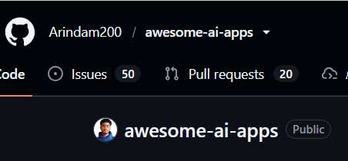

X
X
Open Source Engagement
Earn 10 Brownie Points!
Explore innovative open-source AI applications and become part of the open-source community.
Step 1: Visit the Awesome AI Apps repository
Step 2: Star the repository on GitHub
Step 3: Submit your proof to earn 10 Brownie Points
Proof Required:
  Your GitHub Username
  A screenshot showing that you have starred the repository
  Your Argonyz Team Name
Repository:
https://dub.sh/repo-argonyx
*Delete this slide before submission; it is only for reference. ​

Slide 9
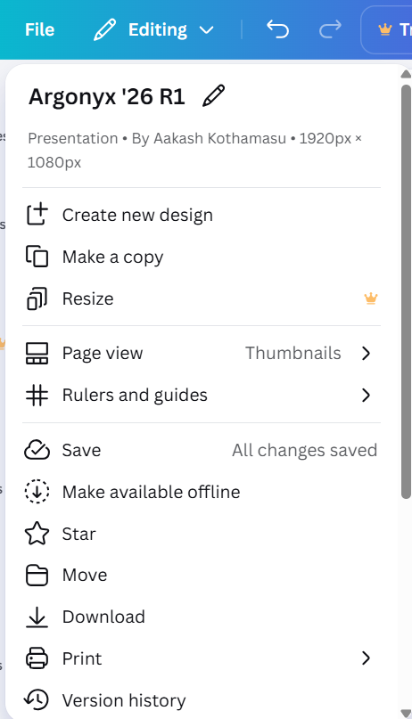
Argonyx'26
X
X
Good to go!
Make a copy of this template on Canva, edit it with your creativity, and submit it as a PDF renamed with your TeamName_TeamLeadFirstName.pdf
This isn’t just a formality, think of it as your first pitch deck. Keep it sharp, simple, and meaningful. Judges are not looking for perfection, but for clarity, creativity, and the spark of an idea that can be built into something real.
All the best!
We can’t wait to see your ideas take shape!
Team Argonyx
*Delete this slide before submission; it is only for reference. ​

