Slide 1


DEPARTMENT OF ELECTRICAL AND ELECTRONICS ENGINEERING
Seminar(18EES84)
on
FAULTS OCCUR IN SOLAR PV POWER GENERATION SYSTEM
BY
PRAKRUTHI K N
4GW19EE026
Under the Guidance of
Smt.Shilpashri V N
Assistant professor
Dept. of EEE

Slide 2
CONTENTS
INTRODUCTION
METHODOLOGY
GROUND FAULTS IN A PV ARRAY UNDER STC
LINE TO LINE FAULTS IN A PV ARRAY UNDER STC
MISMATCH FAULTS IN A PV ARRAY
CONCLUSION
REFERENCE

Slide 3
INTRODUCTION
A PV array normally contains many parallel PV strings and there are many modules in series in each string.
Each module, string as well as whole array have its I-V characteristics as well as unique MPP : “ maximum power point ” whether in normal or a fault state.
Their total I-V curve is controlled by the interactions between the PV modules. Therefore, PV modules function together as a chain, which is just a powerful as the weakest link.
PV array faults destroy PV modules and wires and cause electrical shock threats along with fire danger.
The only source for fault current is considered the PV array. In other terms, it is expected that any inverter, battery, lightning strike, or external source does not cause an overcurrent or overvoltage.

Slide 4
METHODOLOGY
Faults impact on PV Arrays Performance.
Approaches of fault analysis.

Slide 5
Faults impact on PV Array Performance
PV array faults affect the power output and result in critical and maybe dangerous circumstances.
The PV array is considered the only cause of fault current in this work.
The protective devices can handle faults and insulate fault circuits only when they have a high faulty current.
The following considerations could make fault analysis in PV more challenging:
Faults forms may vary according to there fault locations, PV array configurations and number of solar PV modules.
Environmental factors, including different irradiance levels as well as PV array temperature.
PV technology is distinct to the aging, the hot spot along with other PV mismatch faults. These causes might lead to a decrease in fault current than predicted.

Slide 6
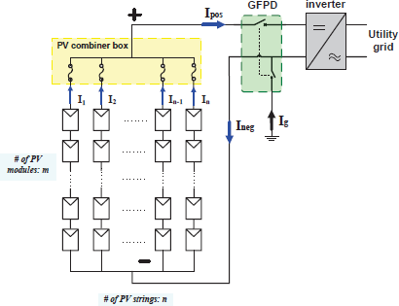
Approaches of fault analysis
There are three basic fault analysis for a PV array.
The PV scheme has n parallel PV strings linked in a distinct positive or negative bus via the PV string cables.
The PV array works in standard conditions and generates a current of I₁,I₂… I_{n} in each string. If the strings of PV are all electrically equivalent and operate in the same working environment then I₁=I₂=… =I_{n}=I.
The overall current through the inverter is I_{pos}=n×I. Two GFPD switches are closed under standard work conditions, and the Ig(“ground-fault current”) in GFPD is nil. As a consequence, the current following out of the inverter I_{neg} must be equivalent to I_{pos}(I_{pos}=I_{neg}).

Slide 7
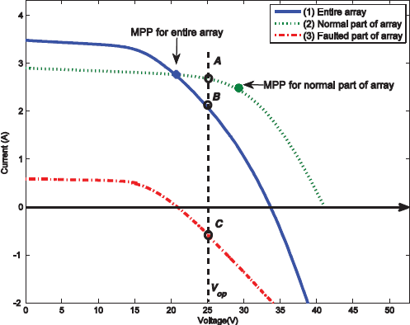
The fault analysis include :
I-V characteristics analysis
Kirchhoff's Current Law Analysis
Power conservation analysis
1. I-V Characteristics Analysis:
In general, PV array faults may induce fluctuations in the voltage along with unequal currents between PV strings.
Figure illustrates that the I-V curves vary significantly across the entire array, the normal part, and the fault parts of the array. The normal part &faulted part of the array should work at a similar voltage and parallel to one another.
It is noted that even under fault, the normal part still has a positive current, but the array faulted part has a back-fed current, which might harm cable and PV modules.

Slide 8
2. KCL Analysis:
KCL demands the total of currents that flow into the each node (or junction) on electrical circuits, equivalent to the sum of current that flows out of the node where a node is any location with 2 or more wires are attached to that node.
From this perspective , a negative/positive bus bar, a ground-fault point , or the inverter might be considered a node for PV systems.
3. Conservation of power Analysis:
The power production in PV arrays must be the sum of the power losses as well as load power.
PG=Pload + Ploss + Pfault
Here , PG indicates the power produced by using PV array
Pload represents the power supplying to the inverter
Ploss signifies the losses power in PV array, that is due to wiring cables resistance
Pfault denotes a specific load that is the power dissipated during fault working conditions in the faulted part of the array.

Slide 9
GROUND FAULTS IN A PV ARRAY UNDER STC
It is an electric short circuit that is accidental and involves ground and some usually referred current-carrying conductors. The magnitude of the ground-fault current is based on geographical factors, fault impedance, and fault location.
When a ground fault is not correctly protected, the fault connection may start generating a DC arc that may turn into a fire danger and maintain it.
The following are the typical causes for ground faults.
Ground faults with PV modules, that is the short-circuiting of solar cells to the grounded module frames by degrading PV module encapsulation, damage to impact or water corrosion, etc.
Incidental short circuit in the ground and normal conductor, such as a cable in the junction box of a module that contacted a grounded conductor.
A cable insulation fault, such as an animal eating by cable insulation, causes a ground fault.

Slide 10
LINE TO LINE FAULTS IN A PV ARRAY UNDER STC
This fault is a low-resistance link made in an electrical system or network between two different points of potential.
The line-to-line fault is generally described in PV systems as a “short-circuit” fault for array cables or PV modules of various potential.
A line-to-line fault can be caused mainly by the following:
DC junction box line to line faults such as water ingress, corrosion as well as mechanical damage.
Cables Insulation failure for example an animal eating by cable insulation causes a line fault.
Incidental short circuit among current conductors, that is a nail driven by exposed wires.

Slide 11
MISMATCH FAULTS IN A PV ARRAY
In the PV modules, mismatches arise if one module's electrical characteristics are substantially modified compared with the other modules.
The modules or solar cells interconnection that has varied conditions in their environment, is the cause of mismatch faults.
Mismatch fault is the most prominent form of defect in PV arrays compared to ground faults as well as line-to-line faults.
Mismatch faults can result in permanent PV module damage and substantial power losses.
Mismatch faults can cause major difficulties in arrays, as well as PV modules due to the entire PV module's worst-case operating condition.

Slide 12
CONCLUSION
For fault protection and detection in PV arrays, traditional methods commonly incorporate OCPD(circuit fuses or breakers) in PV components series . These protective devices can only clear faults as well as isolate faulty circuits when it contains the large faulty current.
PV faults can be more complex due to mismatches between PV modules, different fault locations varying environmental conditions. as well as the . This needs specific attention in PV arrays for fault analysis.

Slide 13
REFERENCES
S. K. Firth, K. J. Lomas, and S. J. Rees, "A simple model of PV system performance and its use in fault detection," Elsevier - solar energy, 2009.
J. Wiles. (2008) To Fuse or Not to Fuse? Home Power #125, code corner. 106-108.
S. E. Forman, "Performance of Experimental Terrestrial Photovoltaic Modules," Reliability, IEEE Transactions on, vol. R-31, pp. 235-245, 1982.
D. Stell bogen , "Use of PV circuit simulation for fault detection in PV array fields," in Photovoltaic Specialists Conference, Conference Record of the Twenty Third IEEE, pp. 1302-1307,1993.
K.-H. Chao, S.-H. Ho, and M.-H. Wang, Modeling and fault diagnosis of a photovoltaic system ,Electric Power Systems Research, 2008.
K.-H. Chao, C.-J. Li, and S.-H. Ho, "Modeling and fault simulation of photovoltaic generation systems using circuit-based model," in Sustainable Energy Technologies, 2008. ICSET 2008. IEEE International Conference on, pp. 290-294, 2008.

Slide 14


