Slide 1


DEPARTMENT OF ELECTRICAL AND ELECTRONICS ENGINEERING
Seminar(18EES84)
on
“PERFORMANCE ANALYSIS OF SOLAR HEAT GENERATION SYSTEM FOR MULTI – PURPOSE APPLICATIONS”
BY
RAKSHITHA G
4GW19EE030
Under the Guidance of
Smt. Shilpashri V N
Assistant professor
Dept. of EEE

Slide 2
CONTENTS
INTRODUCTION
METHODOLOGY
SYSTEMS MODELLING
CONCLUSION
RESULT
REFERENCE

Slide 3
INTRODUCTION
A theoretical model is developed using TRNSYS software
Residential sector is responsible for over 40% of the total global primary energy consumption and 30% of the greenhouse gas emission.
By the end of 2016 over 113 million solar thermal systems was in operation, around 63% of which are small systems installed in a single-family house.
Many strategies have been considered in order to increase energy efficiency in buildings , they are Building Added (BA) or Building Integrated Solar (BIS) to exploit solar energy in buildings and to reduce capital cost.
The performance of the solar system and the building performance are measured experimentally and calculated by TRNSYS.

Slide 4
METHODOLOGY
SOLAR FIELD
BUILDING DESCRIPTION
MSF DESALINATION UNIT

Slide 5
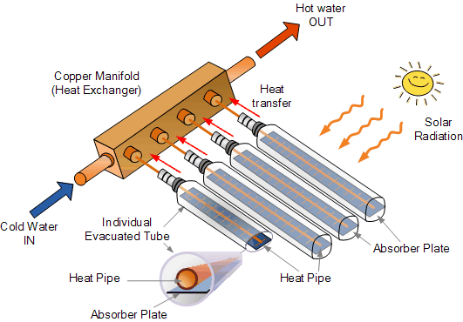
SOLAR FIELD
Solar field is designed using TRNSYS software.
It is consisting of 80 evacuated tubes, solar collectors arranged in 2 columns and 18 rows.
Two 4000 litres of thermal energy storage tanks is integrated to the field to achieve the regular supply of thermal energy to the applications.
The optimum layout of central solar field is found to operate space heating system of the administration building at CSERS and MSF water desalination unit.
Fig.1

Slide 6

BUILDING DESCRIPTION
The targeted administrative building is a ground floor building and the total area considered for space heating , and the height is 2.6 m. The building's main façade is oriented to the west.
The building is consisting of 30 offices and the building envelope adopts 200 mm concrete slabs with 60 mm thickness EPS (expanded polystyrene) insulation.
The general view of the building is shown in Fig. 2.
Fig.2
The southern part of the building is attached to the solar field using cast iron radiators.

Slide 7
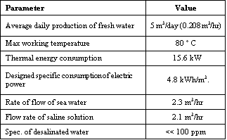
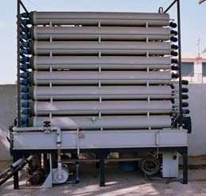
MSF DESALINATION UNIT
The desalination unit targeted in this study is small scale low temperature MSF desalination unit.
The capacity of the unit is 5 m³/day and it works at 70-80 °C. The technical specification of the unit is given in Table1.
The general view of the unit is shown in Fig. 4.
Fig .4
Table 1: Technical specification of MSF unit

Slide 8
SYSTEM MODELING
1.WEATHER DATA
The prevailing weather condition in the city is the Mediterranean climate. According to the weather data reported in Meteonorom provided in TRNSYS 18, the average ambient temperature is 20.1 °C.

Slide 9
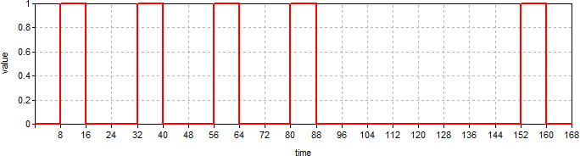
2.OPERATING DATA
Fig. 5. Operating hours during the week for space heating system
The space heating is required during the working hours of week at the administration building.
The working time is from8:00 am morning to 4:00 pm from Sunday to Thursday.
The system is off during weekend (Friday and Saturday) as shown in Fig. 5. The operation scenario of the MSF desalination is running 12 hours per day during the year.

Slide 10
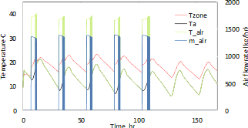
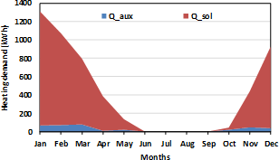
RESULT
The simulation of the proposed system is conducted for one year based on the operating, design and weather conditions given in previous sections. The results of the solar space heating and the desalination unit are presented in this section.
A. Space heating
The annual heating demand for the administration building is shown in Fig 8. It can be observed that solar field can provide the space heating system by over 93% of the entire energy required which is equivalent to about 5.1 MWh annually.
Fig.d. Annual heating demand for the building fig.e.
Fig.e - Represents the first week of January results of building solar

Slide 11
B. MSF Desalination
The performance of the thermal energy required by the MSF desalination unit is demonstrated in Fig. 10. The results show that the energy required for running the unit for 12 hours per day for the whole year is 155 MWh annually. It is proved that over 69.5% of this energy can be obtained from the solar field.

Slide 12
CONCLUSION
The suggested system is based on 80 evacuated tube solar collectors and 1200 liters thermal storage tank capacity.
The system was simulated using TRNSYS environment.
The results of the simulation for one year have shown that the system can provide up to 93% of heating load for space heating demand and 69.5% of the energy requirement for the desalination from solar energy.

Slide 13


